Slide 1


感恩遇见，相互成就，本课件资料仅供您个人参考、教学使用，严禁自行在网络传播，违者依知识产权法追究法律责任。
更多教学资源请关注
公众号：溯恩高中英语
知识产权声明

Slide 2
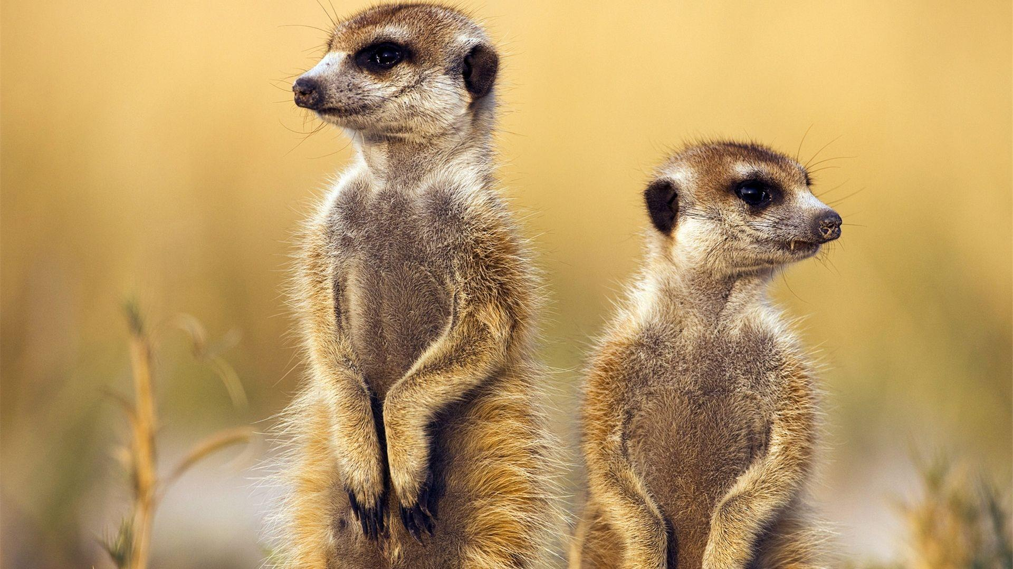
M2U2 WILDLIFE PROTECTION
reading for writing

Slide 3

illegal hunting
An increasing number of wild animals are dying out.
habitat loss
The mass extinction is caused.
habitat
pollution
We should take measures to protect wild animals!
lack of food

Slide 4
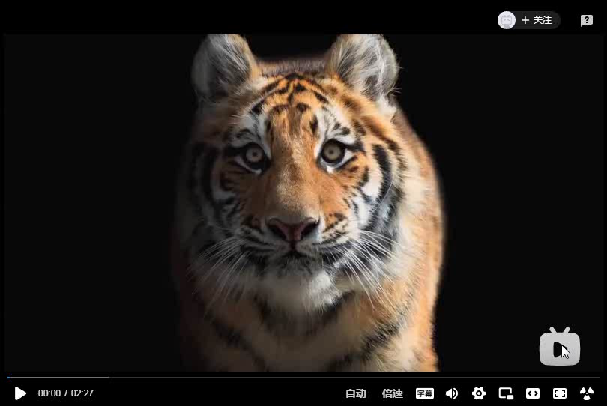

Slide 5
We established the “Wildlife Conservation Society”.
We stand for wildlife!

Slide 6
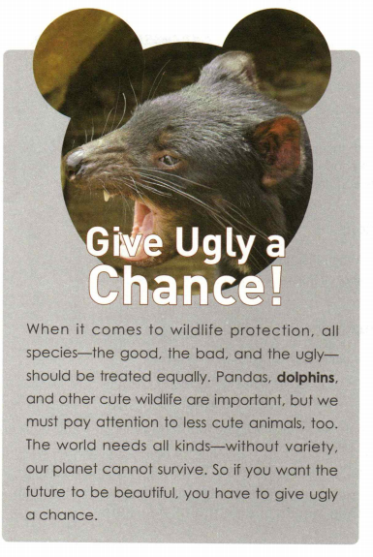
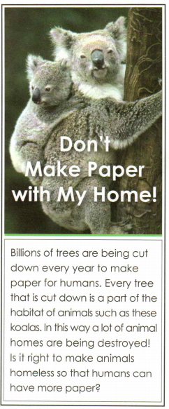

Which emotions do the photos communicate?
I think it’s….
funny
surprising
frightening
sad
…

Slide 7
Poster:
images
titles
contents

Slide 8


characteristic
image
eye-catching
attractive
theme-related
powerful
simple
interesting
attractive
title
easy-understanding
unusual
exclamatory sentence
感叹句
personification
contents

Slide 9

Poster:
Analyze the contents!
When it comes to wildlife protection, all species-the good, the bad, and the ugly-should be treated equally. Pandas, dolphins and other cute wildlife are important, but we must pay attention to less cute animals, too The world needs all kinds-without variety our planet cannot survive. So if you want the future to be beautiful, you have to give ugly a chance.
topic sentence
conclusion

Slide 10

Give Ugly a Chance！
language characteristics
When it comes to wildlife protection, all species-the good, the bad, and the ugly-should be treated equally. Pandas, dolphins and other cute wildlife are important, but we must pay attention to less cute animals, too The world needs all kinds-without variety our planet cannot survive. So if you want the future to be beautiful, you have to give ugly a chance.
When it comes to
wildlife protection
brief
clear
be treated equally
easy-understanding
exclamatory sentence
感叹句
pay attention to
less cute animals
powerful
variety
indicative
mood
陈述语气
convincing
give ugly a
chance

Slide 11

Poster:
Give Ugly a Chance!
What is your inspiration?
When it comes to wildlife protection, all species-the good, the bad, and the ugly-should be treated equally. Pandas, dolphins and other cute wildlife are important, but we must pay attention to less cute animals, too The world needs all kinds-without variety our planet cannot survive. So if you want the future to be beautiful, you have to give ugly a chance.
When it comes to
wildlife protection
“Ugly” animals are just as important as cute animals because nature needs variety
to function properly.
be treated equally
pay attention to
less cute animals
variety
give ugly a
chance

Slide 12
Analyze the contents!
Billions of trees are being cut down every year to make paper for humans. Every tree that is cut down is a part of the habitat of animals such as these koalas. In this way a lot of animal homes are being destroyed! Is it right to make animals homeless so that humans can have more paper?
topic sentence

Slide 13
Don’t Make Paper with My Home!
language characteristics
Billions of trees are being cut down every year to make paper for humans. Every tree that is cut down is a part of the habitat of animals such as these koalas. In this way a lot of animal homes are being destroyed! Is it right to make animals homeless so that humans can have more paper?
brief
clear
are being cut down
make paper
easy-understanding
现在进行时的被动语态
exclamatory sentence
感叹句
In this way
powerful
are being destroyed
make animals homeless
convincing
rhetorical question
反问
thought-provoking
发人深省的

Slide 14
Poster:
Don’t Make Paper with My Home!
What is your inspiration?
Billions of trees are being cut down every year to make paper for humans. Every tree that is cut down is a part of the habitat of animals such as these koalas. In this way a lot of animal homes are being destroyed! Is it right to make animals homeless so that humans can have more paper?
Cutting down trees to make paper destroys the natural
habitats of many animals.

Slide 15
Summary:
Let’s try to write a poster!
How do posters stir up emotions?
image
eye-catching
attractive
theme- related
powerful
simple
unusual
exclamatory sentence
title
attractive
interesting
personification
easy-understanding
language
rhetorical question
brief
clear
easy-understanding
powerful
convincing
thought-provoking

Slide 16
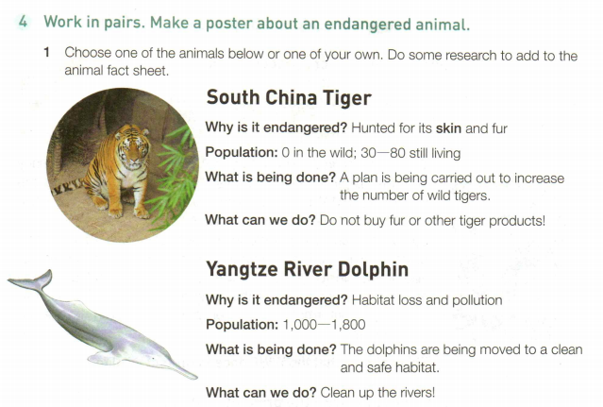
Lets try to write a poster!
How?

Slide 17
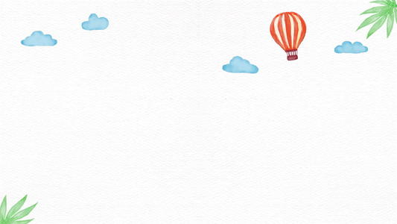
Let’s try to write a poster!
Write a title that is simple, interesting, powerful and easy-understanding, and then collect the information you need.
1
2
Write the name of the species and why it is endangered.
Use a powerful image to attract the readers’ attention to the facts and problems
3
4
Tell the readers what you want to think and do.

Slide 18
Write a title that is simple, interesting, powerful and easy-understanding, and then collect the information you need.
1
Stop buying fur, start protecting tigers!

Slide 19
2
Write the name of the species and why it is endangered.
When it comes to tigers, people regard it as “the King of forest”. But now they are in danger! Particularly, the South China Tiger was often hunted for its skin and fur. There is no South China Tiger in the wild. There are 30-80 living on the earth.

Slide 20
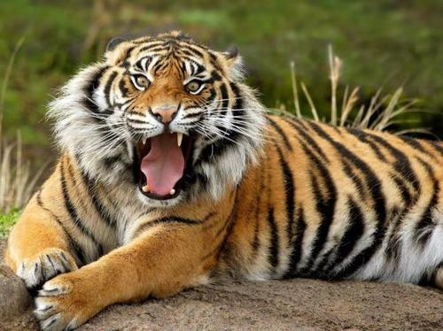
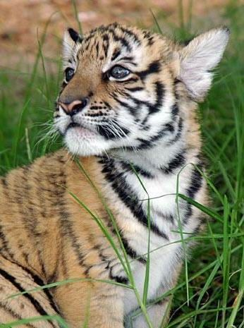
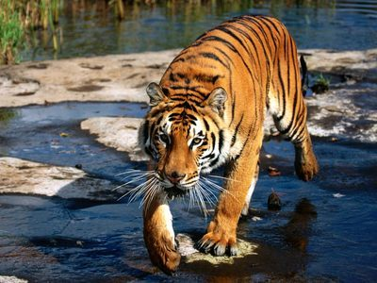
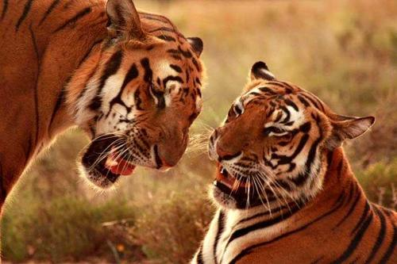
Use a powerful image to attract the readers’ attention to the facts and problems
3

Slide 21
4
Tell the readers what you want to think and do.
Luckily, a plan is being carried out to increase the number of wild tigers. As for individuals, everyone can make contributions to protecting it! Please do not buy fur or other products!

Slide 22
Stop buying fur, start protecting tigers!
When it comes to tigers, people regard it as “the King of forest”. But now they are in danger! Particularly, the South China Tiger was often hunted for its skin and fur. There is no South China Tiger in the wild. There are 30-80 living on the earth.
Luckily, a plan is being carried out to increase the number of wild tigers. As for individuals, everyone can make contributions to protecting it! please do not buy fur or other products!

Slide 23
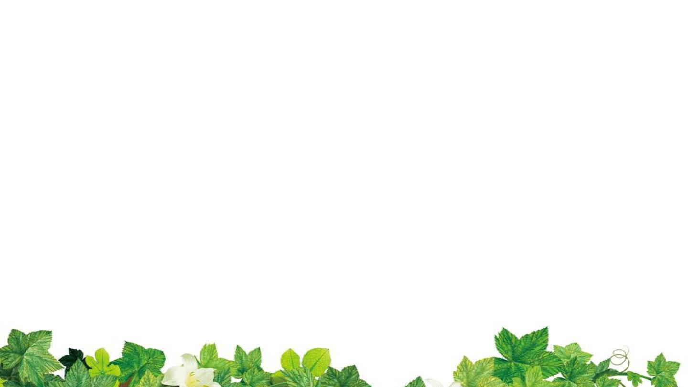
Let’s try to write a poster!
Please try to write a poster about Yangtze River Dolphin by yourself!

Slide 24
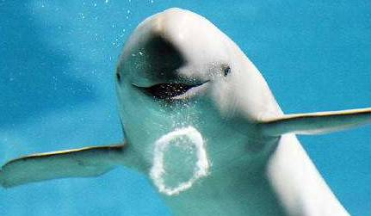
Give Back My Home
I'm one of the Yangtze River Dolphins. There are only 1,000 to 1,800 of us left. We lost our habitat because humans capture so many fishes and shrimps from our home that we have a severe lack of food. Besides, the pollution is so serious that we can no longer live there.
Some human friends move the remaining of us to a clean and safe habitat. As the common planet residents, is it right to take away our home for your own sake? Do clean up the rivers!

Slide 25

Writing task!
学校学生会将于下周五举行一场关于野生动植物保护的英文讲座，假设你是学生会主席李华，请你根据以下信息写一份英文通知。
1). 讲座时间：下周五晚上7:00-9:00； 讲座地点：学校报告厅school lecture hall
讲座内容：学校将邀请Professor David讲解野生动植物保护的知识、方法及重要性。
2). 要求：请想要参加的学生于讲座开始前半小时到报告厅签到；
讲座期间请关闭手机，保持安静。
注意：可适当增加细节；词数80左右，注意格式；多用本学期的用词用句。
body part
How?
structure
requirements
polite language

Slide 26
Writing task!
Notice
body part
In order to raise students’ awareness of wildlife protection, an English lecture will be at 7:00 pm next Friday at the school lecture hall. Professor David will be invited to give a lecture about knowledge, methods and importance of wildlife protection. Many wonderful and impressive pictures will be shown. There is no doubt that the lecture will be a feast for eyes, ears and knowledge.
The students who would like to attend it should sign in half an hour in advance at the school lecture hall. During the lecture, please turn off your cell phone and keep quiet.
Everyone will be warmly welcomed!
The Students’ Union
require-ments
polite language

Slide 27
Writing task!
学校学生会将于下周一举行一场野生动植物保护的知识竞赛，假设你是学生会主席李华，请你根据以下信息，写一则英文通知：
1). 比赛时间：下周一下午3点 比赛地点：学校报告厅
比赛人员：每个班级选出5名学生参加
比赛内容：诗歌朗诵poetry reading, 角色扮演role-play
知识问答knowledge question and answer,
比赛结果：评出前三名的班级
2). 要求：参加的学生提前半小时到报告厅签到;
观赛学生请关闭手机，保持安静。
注意：可适当增加细节；词数80左右，注意格式；多用本学期的用词用句。
assignment!

Slide 28
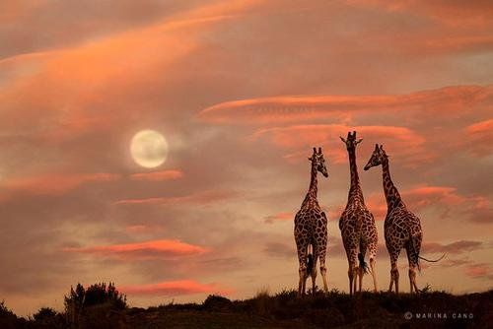
Thank
you!

