Slide 1


感恩遇见，相互成就，本课件资料仅供您个人参考、教学使用，严禁自行在网络传播，违者依知识产权法追究法律责任。
更多教学资源请关注
公众号：溯恩高中英语
知识产权声明

Slide 2

Natural Disasters
嵊州市高级中学 尹 娟

Slide 3
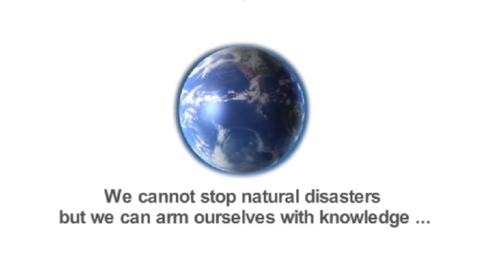

Slide 4
T
Tsunami
E
Earthquake
V
Volcano
Natural
Disasters
Drought
D
F
Flood
Wildfire
W
H
Hurricane
S
Sandstorm

Slide 5

The Story of an Eyewitness (Adapted)
Jack London
Q1. Who is the eyewitness?
Q2. What event is the eyewitness describing?
Q3. Which do you think is the proper meaning of “The story”?

Slide 6
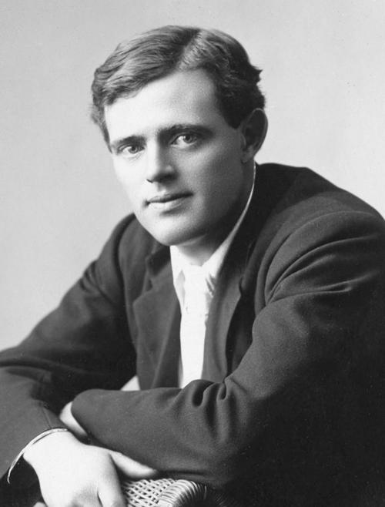
The background information
The western American city of San Francisco, California suffered a huge earthquake on April 18th, 1906.
Just a few hours after the terrible earthquake, a magazine named Collier's sent a telegraph message to the famous American writer Jack London. They asked Mister London to go to San Francisco and report about what he saw.
He arrived in the city only a few hours after the earthquake.The report he wrote is called, "THE STORY OF AN EYEWITNESS." In more than two weeks , it was published.
Jack London (1876-1916)
A famous American novelist and journalist. One of his most famous works is "The Call of The Wild”.

Slide 7

Para 1
Destructive
The earthquake
（San Francisco, April 18,1906）
Damage
shook down
hundreds of thousands of dollars’ worth of walls and chimneys
The fire that followed
Greater damage
burned up
hundreds of millions of dollars' worth of buildings and homes
Inversion
Never before in history has a city been so completely destroyed.
San Francisco is gone.
Complete destruction
Para 2
Para 3
Para 4
On Wednesday morning
By Wednesday afternoon
On Wednesday night
April 18

Slide 8
Para 2
On Wednesday morning
Unpredictable
at a quarter past five
The earthquake
a moment later
The fire
Unavoidable
The sun was red in the dark sky.
within an hour of the first quake
The smoke
Unstoppable
There was no stopping the fires.
=The fires can not be stopped.
The firefighters
did their best.
Brave , Selfless & responsible
All of the ways...
Destructive
were gone.

Slide 9
Para 3-4
San Francisco is gone. (Para1)
All of the ways man had made to keep the city safe were gone.(Para2)
On Wednesday morning
Repetition
By Wednesday afternoon
Half the heart of the city was gone.
I
on a ship on the bay/ out at sea
It was calm. No wind came up.
Contrast
Strong winds blew upon from every direction
in the unlucky city
Terrible Cruel
On Wednesday night
The very heart of the city
was gone.
Wednesday night saw the destruction of the very heart of the city.
Personification

Slide 10
The earthquake
The people
How did the people of San Francisco behave during the disaster?
Destructive
Brave & Selfless
Unpredictable
The firefighters did their best
Responsible
Unavoidable
Man himself had to make ruins...
Considerate
Tens of thousands left the city ...
Helpful & Kind
Unstoppable
Some were dressed ...and carried...
Hopeful
Terrible
There were no fights and no pushing or shoving.
Well-mannered
Cruel
The worst of disasters
brought out
the best in the survivors.

Slide 11
The worst of disasters
brought out
the best in the survivors.
Never before in history has a city been so completely destroyed.
The earthquake
Contrast
The people
Echo
Never in all of San Francisco's history were her people so kind as on this night of terror.

Slide 12
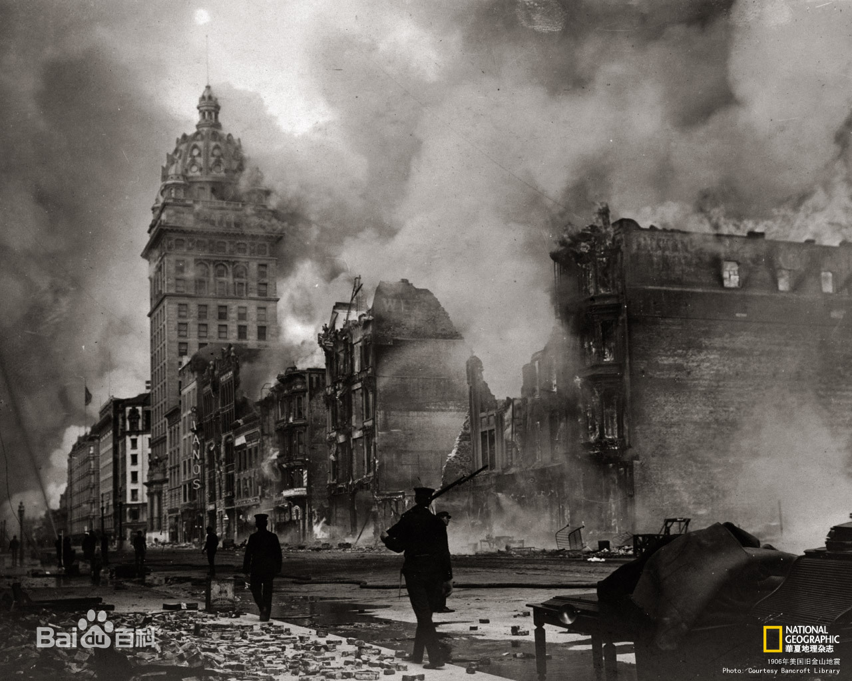
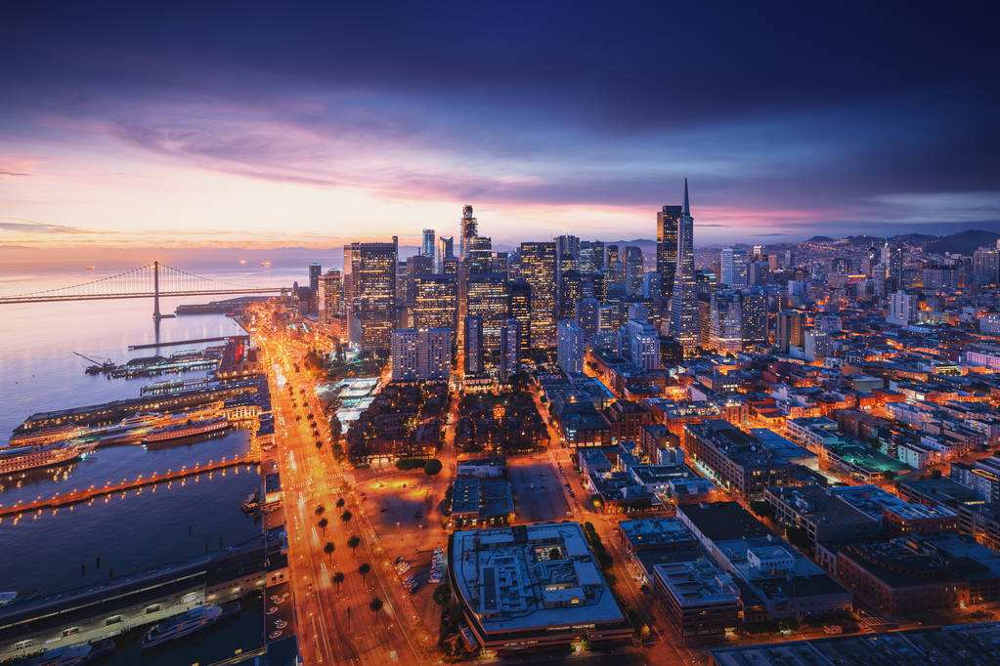
San Francisco in 1906
San Francisco now
What makes the change and difference?
Where there is love and hope, there is a way.

Slide 13
Further thinking: What can you get from the story?
1. Where there is love and hope, there is a way.
_____________________________________________________________________________________________
_____________________________________________________________________________________________
_____________________________________________________________________________________________
_____________________________________________________________________________________________
___________________________________________________________________________________________
_____________________________________________________________________________________________
_____________________________________________________________________________________________
_____________________________________________________________________________________________
_____________________________________________________________________________________________
____________________________________________________________________________________________
2. We cannot stop natural disasters, but we can arm ourselves
with knowledge and bravery.
3. Live to tell: raising awareness, reducing mortality.
4. Many hands make light work.
5. ...

Slide 14
Assignment:
Read the passage again and write a summary of the text.
These questions may be helpful for you to organise the summary:
1. What was the first disaster?
2. When and where did it happen?
3. What was the second disaster?
4. What damage did it cause?
5. How did people behave?
6. Who described the event?

Slide 15
Reference Version
The first disaster was the earthquake that struck San Francisco on Wednesday, April 18, 1906 at 5:15 in the morning. The second disaster was the fires caused by the earthquake. These fires destroyed half of the city centre in a day. But people behaved well and there was no fighting or pushing. Jack London described the event from a ship in the harbour.

Slide 16
Thank you!

