Slide 1


感恩遇见，相互成就，本课件资料仅供您个人参考、教学使用，严禁自行在网络传播，违者依知识产权法追究法律责任。
更多教学资源请关注
公众号：溯恩高中英语
知识产权声明

Slide 2

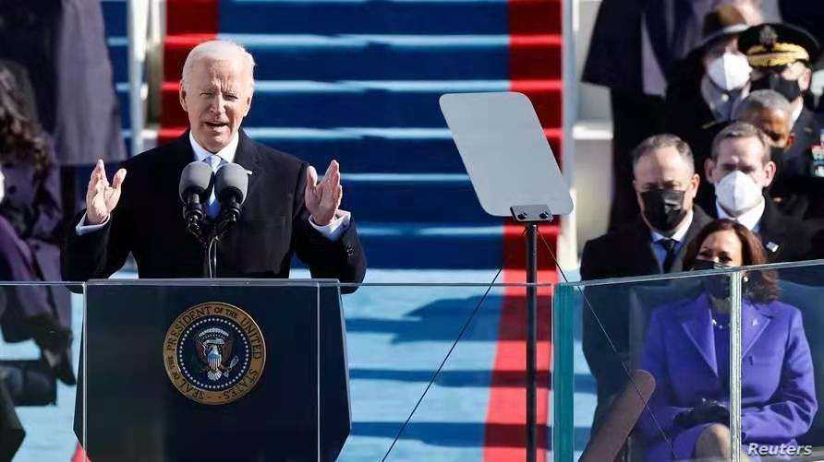

拜登宣誓就任美国第46任总统，
就职演说全文( part 1 )
温州市平阳县佳诚高中
焦海滨

Slide 3

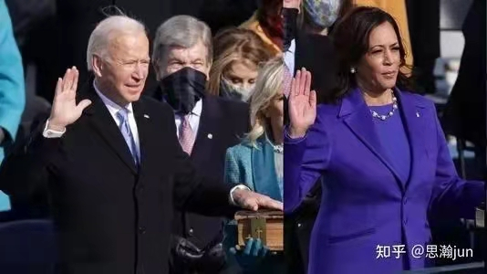
Listen and fill in the blanks:
______ _______Roberts, Vice President Harris, Speaker Pelosi,
Leader Schumer, Leader McConnell, Vice President Pence, my
—____________________, [and] my fellow Americans.
1 Speaker .n . 议长
2 Vice President .n.副总统
3 Leader .n. 领袖

Slide 4
Please check your answers :
Chief Justice Roberts, Vice President Harris, Speaker Pelosi, Leader Schumer, Leader McConnell, Vice President Pence, my distinguished guests, [and] my fellow Americans.
首席大法官罗伯茨，哈里斯副总统，佩洛西议长，舒默（参议院少数党）领袖，麦康奈尔（参议院多数党）领袖，彭斯副总统。
我尊敬的嘉宾们，我的美国同胞们。

Slide 5
Listen and fill in the blanks:
This is America's day. This is democracy's day. A day of _______and hope of renewal and resolve through a crucible for the ages. America has been tested anew and America has risen to the_________. Today, we celebrate the triumph not of a candidate, but of a cause, the cause of democracy. The people, the _____of the people, has been heard and the ______of the people has been heeded.
1 democracy.n 民主 2 renewal.n.复苏 3 resolve.v.决心
4 crucible.n.考验 5 triumph.n .胜利 6heed.v.关注

Slide 6
Please check your answers :
This is America's day. This is democracy's day. A day of history and hope of renewal and resolve through a crucible for the ages. America has been tested anew and America has risen to the challenge. Today, we celebrate the triumph not of a candidate, but of a cause, the cause of democracy. The people, the will of the people, has been heard and the will of the people has been heeded.
这是属于美国的日子。这是属于民主的日子。这是历史和希望的日子，复苏和决心的日子。美国经过长久以来严酷的考验，已经成为一个崭新的国家，能够直面挑战。今天，我们庆祝的不是一位候选人的胜利，而是一项事业的胜利，这是民主的事业。人民以及人民的意愿得到倾听和关注。

Slide 7
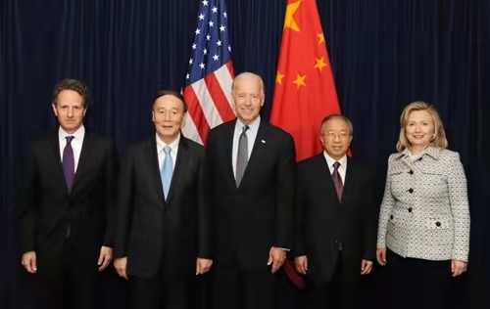
Listen and fill in the blanks:
We've learned again that democracy is_______, democracy is fragile and, at this hour my friends, democracy has prevailed. So now on this hallowed ground where just a few days ago violence sought to ______the Capitol's very foundations, we __________
as one nation under God - indivisible - to carry out the peaceful transfer of power as we have for more than two centuries.
1 prevail .v.获胜 2 hallowed adj神圣的 3 foundation基础
4 indivisible .adj不可分裂的 5 transfer .n.权力交接

Slide 8
Please check your answers :
We've learned again that democracy is precious, democracy is fragile and, at this hour my friends, democracy has prevailed. So now on this hallowed ground where just a few days ago violence sought to shake the Capitol's very foundations, we come together as one nation under God - indivisible - to carry out the peaceful transfer of power as we have for more than two centuries.
我们再次意识到，民主的可贵和脆弱。朋友们，民主在此刻获胜。几天前，在这片神圣的土地上，暴力震动了国会大厦的基础。我们在上帝的佑护下全国团结，不可分裂，让这个两百多年历史的国家和平地完成权力交接。

Slide 9
Listen and fill in the blanks:
As we _________in our uniquely American way,________, bold, optimistic, and set our sights on a nation we know we can be and must be, I thank my predecessors of both parties for their presence here today. I thank them______________________. And I know the resilience of our Constitution and the strength, the strength of our nation, as does President Carter, who I spoke with last night who cannot be with us today, but who we salute for his lifetime of service.
1 predecessors .n.前任总统们 2 resilience .n.适应力
3 salute .n.致敬

Slide 10
Please check your answers :
As we look ahead in our uniquely American way, restless, bold, optimistic, and set our sights on a nation we know we can be and must be, I thank my predecessors of both parties for their presence here today. I thank them from the bottom of my heart. And I know the resilience of our Constitution and the strength, the strength of our nation, as does President Carter, who I spoke with last night who cannot be with us today, but who we salute for his lifetime of service.
当我们瞭望独特的美国之路：不安分、大胆、乐观，我们放眼成为一个应该成为的国家。我感谢所有两党的前任总统们。我对他们表示发自内心的感谢。正如前总统卡特一样，我深知我们宪法的适应力和国家的力量。他今天无法在场，我昨晚与他通话，我们向他一辈子对国家的鞠躬尽瘁致敬。

Slide 11
Listen and fill in the blanks:
I've just taken a sacred oath each of those patriots have taken. The oath first sworn by George Washington. But the American story _____ not on any one of us, not on some of us, but on all of us. On we the people who _____a more perfect_______. This is a great nation, we are good people. And over the centuries through _______and strife in peace and in war we've come so far. But we still have far to go.
1 taken a sacred oath 神圣地宣誓 2 patriot .n. 前辈
3 strife v.冲突

Slide 12
Please check your answers :
I've just taken a sacred oath each of those patriots have taken. The oath first sworn by George Washington. But the American story depends not on any one of us, not on some of us, but on all of us. On we the people who seek a more perfect union. This is a great nation, we are good people. And over the centuries through storm and strife in peace and in war we've come so far. But we still have far to go.
我刚刚如诸位前辈那样神圣地宣誓。国父乔治·华盛顿是第一个说出这番誓言的人。然而美国的故事不依赖我们任何一个或一些人，而是我们所有人。它依赖于那些探索一个更完美的联邦政府的人。这是一个伟大的国家，我们是善良的人民。经过几百年的洗礼，经过风暴与冲突，和平与战争，我们走了这么远。但是我们还有很长的路要走。

Slide 13
Listen and fill in the blanks:
We'll press forward with speed and _______for we have much to do in this winter of peril and significant possibility. Much to do, much to_____, much to______, much to build and much to _____. Few people in our nation's history have been more challenged or found a time more challenging or difficult than the time we're in now. A once in a century _______that silently stalks the country has taken as many lives in one year as in all of World War Two.
1peril .n. 危险 2 stalk.v.潜入 3 A once in a century百年一遇的

Slide 14
Please check your answers :
We‘ll press forward with speed and urgency for we have much to do （speed and urgency 三个单词连读 spee da nur gency ,字母d没有发音）
in this winter of peril and significant possibility. Much to repair, much to restore, much to heal, much to build and much to gain. Few people in our nation's history have been more challenged or found a time more challenging or difficult than the time we're in now. A once in a century virus that silently stalks the country has taken as many lives in one year as America lost in all of World War Two.
我们将快速而有紧迫感地前进，因为我们在这个危险而充满巨大可能性的冬天有很多事情要做。我们有太多要完成，太多要治愈，太多要恢复，太多要建设，还有太多要收获。在我们国家的历史中，很少有人遇到过更大的挑战，也很少有人遇到过像如今一样如此充满挑战和困难的时代。
百年一遇的病毒潜入我们的国家，在一年中夺走的生命比整个二战还要多。

Slide 15
Listen and fill in the blanks:
Millions of jobs have been lost. Hundreds of thousands of businesses closed. A cry for__________, some 400 years in the making, moves us. The dream of justice for all will be deferred no longer. A cry for ________comes from the planet itself, a cry that can't be any more __________or any more clear now. The rise of political extremism, white supremacy, domestic terrorism, that we must confront and we will defeat.
1defer .n.推迟 2 extremism .n.极端主义
3 white supremacy白人至上主义
4 domestic terrorism境内恐怖主义

Slide 16
Please check your answers :
Millions of jobs have been lost. Hundreds of thousands of businesses closed. A cry for racial justice, some 400 years in the making, moves us. The dream of justice for all will be deferred no longer. A cry for survival comes from the planet itself, a cry that can't be any more desperate or any more clear now. The rise of political extremism, white supremacy, domestic terrorism, that we must confront and we will defeat.
百万人失业，成千上万的生意关门。几百年来对种族平等的呼声推动了我们前进。公正的梦想不再推迟。地球发出了生存的呼喊，它的呐喊无比迫切清晰。我们要对抗政治极端主义、白人至上主义和境内恐怖主义，我们将面对并战胜它们。

Slide 17
Listen and fill in the blanks:
To overcome these challenges, to restore the soul and ____the future of America, ________so much more than words. It requires the most elusive of all things in a democracy - unity. Unity. In another January on New Year's Day in 1863 Abraham Lincoln ______the Emancipation Proclamation. When he put pen to paper the president said, and I quote, 'if my name ever ___________in history, it'll be for this act, and my __________is in it’.
1 elusive难以获得的

Slide 18
Please check your answers :
To overcome these challenges, to restore the soul and secure the future of America, requires so much more than words. It requires the most elusive of all things in a democracy - unity. Unity. In another January on New Year's Day in 1863 Abraham Lincoln signed the Emancipation Proclamation. When he put pen to paper the president said, and I quote, 'if my name ever goes down in
（ 把and I 连读成ani ，中间的之母d没发音）
history, it'll be for this act, and my whole soul is in it’.
解决这些挑战，恢复人们的信念和确保美国的未来，需要的不仅仅是言语。这需要民主中最难以获得的团结。1863年的元月，林肯总统签署了《解放黑人奴隶宣言》。签字结束后，他说“如果我可以留名历史，将是因为这项法案，我所有的灵魂都在其中”。

Slide 19
Listen and fill in the blanks:
My whole soul is in it today, on this January day. My whole soul is in this. Bringing America together, ______our people, uniting our nation. And I ask every American to join me in this________. Uniting to fight the foes we face - anger, resentment and hatred. Extremism, lawlessness, violence, disease, joblessness, and hopelessness.
1 foe .n.敌人 2 resentment and hatred怨恨

Slide 20
Please check your answers :
My whole soul is in it. today, on this January day. My whole soul is in this. Bringing America together, uniting our people, uniting our nation. And I ask every American to join me in this cause. Uniting to fight the foes we face - anger, resentment and hatred. Extremism, lawlessness, violence, disease, joblessness, and hopelessness.
我整个灵魂都在今日，在一月的今日。我整个灵魂都在这项事业中：把美国团结起来，让人民团结，让国家团结。我呼吁每个美国人都加入这项事业。团结起来与敌人战斗——愤怒怨恨、极端主义、无视法律、暴力、疾病、失业和无望。

Slide 21
Listen and fill in the blanks:
With unity we can do great things, important things. We can _____wrongs, we can put people to work in good jobs, we can teach our children in safe schools. We can overcome the __________we can rebuild work, we can rebuild the middle class and make work secure, we can secure racial justice and we can make America once again the ______force for good in the world.

Slide 22
Please check your answers :
With unity we can do great things, important things. We can right wrongs, we can put people to work in good jobs, we can teach our children in safe schools. We can overcome the deadly virus, we can reward…reward work, we can rebuild the middle class and make health care secure for all , we can deliver racial justice and we can make America once again …the leading force for good in the world.
团结让我们成就伟大的事情。我们能纠正错误，让人民有好工作，我们能在安全的学校教学生。我们能战胜致命的病毒，奖励工作，重建中产阶级和让所有人的健康有保障，我们能实现种族公正，能让美国再次成为世界积极的领导力量。

Slide 23
Listen and fill in the blanks:
I know speaking of unity can sound to some like a foolish _______these days. I know the forces that divide us are deep and they are real. But I also know they are not new. Our history has been a ______________between the American ideal, that we are all created equal, and the ______ugly reality that racism, nativism and fear have____________. The battle is perennial and victory is never assured .
1 perennial.adj .长期的

Slide 24
Please check your answers :
I know speaking of unity can sound to some like a foolish fantasy these days. I know the forces that divide us are deep and they are real. But I also know they are not new. Our history has been a constant struggle between the American ideal, that we are all created equal, and the harsh ugly reality that racism, nativism ， fear ，demonization have long torn us apart. The battle is perennial and victory is never assured .
我明白，在当下谈论团结像是愚蠢的幻想。我明白分裂我们的力量深远真实。但是我也知道这种挣扎绝非新事物。我们的历史是美国理想不断斗争的过程。我们生来平等，种族主义、本土保护主义和恐惧这些丑陋残酷的现实将我们撕裂。这场战斗是长期的，而且胜负难料。

Slide 25
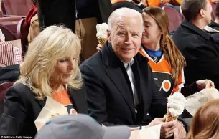
Listen and fill in the blanks:
Through civil war, the Great Depression, World War, 9/11, through struggle, sacrifice, and________, our better angels have always prevailed. In each of our moments enough of us have come together ____________________and we can do that now. History, ______and reason show the way. The way of unity.

Slide 26
Please check your answers :
Through civil war, the Great Depression, World War, 9/11, through struggle, sacrifice, and setback, our better angels have always prevailed. In each of these moments enough of us…enough of us have come together to carry all of us forward and we can do that now. History, faith and reason show the way. The way of unity.
经过南北战争、大萧条、世界大战、911，经过挣扎、牺牲和挫折，我们正义的天使一直获胜。在所有的时刻，有足够的我们团结一心向前走，我们现在也能做到。历史、信念和理性为我们指路，团结之路。

Slide 27
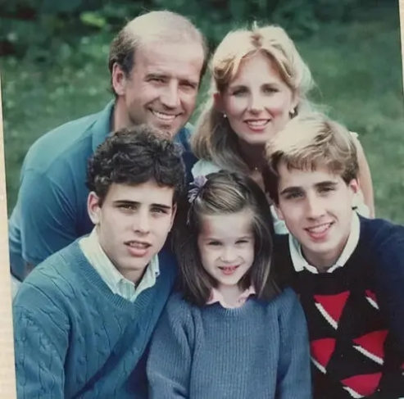
Listen and fill in the blanks:
We can see each other not as adversaries but as neighbours. We can treat each other with _____and respect. We can join forces, stop the shouting and_______________. For without unity there is no peace, only ______and fury, no progress, only exhausting outrage. No nation, only__________. This is our historic moment of crisis and challenge. And unity is the path forward. And we must meet this moment as the United States of America.
1 adversary n.对手
2. outrage 暴行

Slide 28
Please check your answers :
We can see each other not as adversaries but as neighbors. We can treat each other with dignity and respect. We can join forces, stop the shouting and lower the temperature. For without unity there is no peace, only bitterness and fury, no progress, only exhausting outrage. No nation, only a state of chaos. This is our historic moment of crisis and challenge. And unity is the path forward. And we must meet this moment as the United States of America.
我们可以把彼此当做邻居而不是对手。我们能用尊严和尊敬对待彼此。我们能同心协力，停止喊叫，降低紧张气氛。没有团结就没有和平，没有团结就只剩苦涩和愤怒，没有进步，只有精疲力尽的暴行。那不是国家，只是混乱的状态。这是我们历史危机和挑战的时刻。团结是向前的路。我们必须以美国的身份团结。

Slide 29
Listen and fill in the blanks:
If we do that, I we will not failed. We have never, ever, ever, ever failed in America when we've acted together. And so today at this time in this place, let's start afresh, all of us. Let's begin to listen to one another again, hear one another, see one another. Show respect to one another. Politics doesn't have to be a raging fire everything in its path. Every doesn't have to be a cause for total war and we must the culture in which facts themselves are manipulated and even manufactured.
1 a raging fire一团怒火 2 manipulate 控制

Slide 30
Please check your answers :
If we do that, I guarantee we will not failed. We have never, ever, ever, ever failed in America when we've acted together. And so today at this time in this place, let's start afresh, all of us. Let's begin to listen to one another again, hear one another, see one another. Show respect to one another. Politics doesn't have to be a raging fire destroying everything in its path. Every disagreement doesn't have to be a cause for total war and we must reject the culture in which facts themselves are manipulated and even manufactured.
如果我们能做到，我保证我们不会失败。只要我们团结，美国就永远永远不会失败。今天此刻此地，让我们所有人重新开始。让我们开始倾听彼此，看见彼此，尊重彼此。政治不需要是摧毁一切的怒火。意见不同不需要成为战争的引火索。我们必须抵制控制和伪造的文化。

Slide 31
Listen and fill in the blanks:
My fellow Americans, we have to be different than this. We have to be better than this and I believe America is so much better than this. Just look around. Here we stand _______________the Capitol dome._________________, completed in the shadow of the Civil War. When the union itself was literally __________in the balance. We endure, we prevail. Here we stand, looking out on the great Mall, where Dr King spoke of his dream.
1 endure坚韧不屈 2 literally确实的

Slide 32
Please check your answers
My fellow Americans, we have to be different than this. We have to be better than this and I believe America is so much better than this. Just look around. Here we stand in the shadow of the Capitol dome. As mentioned earlier, completed in the shadow of the Civil War. When the union itself was literally hanging in the balance. We endure, we prevail. Here we stand, looking out on the great Mall, where Dr King spoke of his dream.
我的美国同胞们，我们必须有所不同。我们必须做得更好，而且我相信美国比这要好得多。看看周围。现在我们站在国会大厦穹顶的阴影下。如前所述，（国会大厦的穹顶）是在内战的阴影下建成的。当时联邦确实的岌岌可危。我们坚韧不屈,我们取得胜利。我们站在这里，眺望着马丁·路德·金谈论他的梦想的大广场。

Slide 33
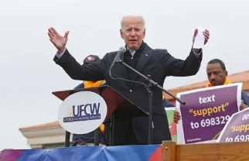
Listen and fill in the blanks:
Here we stand, where 108 years ago at another inaugural, thousands of protesters tried to ______brave women _______for the right to vote. And today we mark the swearing in of the first woman in American history elected to national office, Vice President Kamala Harris. Don't tell me things can change. Here we stand across the Potomac from Arlington Cemetery, where heroes who gave the last full measure of _______rest in eternal peace.
1 inaugural n. 就职演说
2 eternal adj .永恒的

Slide 34
Please check your answers :
Here we stand, where 108 years ago at another inaugural, thousands of protesters tried to block brave women marching for the right to vote. And today we mark the swearing in of the first woman in American history elected to national office, Vice President Kamala Harris. Don't tell me things can change. Here we stand across the Potomac from Arlington Cemetery, where heroes who gave the last full measure of devotion rest in eternal peace.
108年前，我们所站之处，在另一场就职演说上，几千名抗议者试图阻止勇敢的女性为获得投票权而游行。今天我们见证了第一位女性副总统贺卡玛拉·哈里斯。不要告诉我事情会改变。我们所站立我们站在阿灵顿公墓对面的波托马克河上，这里是英雄们奉献出全部，在永恒和平中安息的地方。

Slide 35
Listen and fill in the blanks:
And here we stand just days after a riotous mob thought they could use violence to silence the will of the people, to stop the work of our democracy, to drive us from this _________ground. It did not happen, it will never happen, not today, not tomorrow, not ever. Not ever. To all those who supported our__________, ___________the faith you placed in us. To all those who did not support us, let me say this. Hear us out as we move forward. _________________me and my heart.
1.一群暴徒 a riotous mob
2 熄灭 silence
3.关注我们 hear us out

Slide 36
Please check your answers :
And here we stand just days after a riotous mob thought they could use violence to silence the will of the people, to stop the work of our democracy, to drive us from this sacred ground. It did not happen, it will never happen, not today, not tomorrow, not ever. Not ever. To all those who supported our campaign, I'm humbled by the faith you placed in us. To all those who did not support us, let me say this. Hear me out as we move forward. Take a measure of me and my heart.
我们所站之处，几天前一群暴徒妄图用暴力熄灭人民的意愿，阻止民主的进程，试图将我们从这神圣之地赶走。暴徒的愿望没有实现，今天和明天不会实现，永远不会实现。对支持我们竞选的人们，我们感激你们对我们的信念。对没有支持我们的人，请关注我们前进的步伐，监督我和我的心。

Slide 37
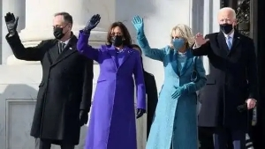
THANKS
谢谢聆听

