Slide 1


感恩遇见，相互成就，本课件资料仅供您个人参考、教学使用，严禁自行在网络传播，违者依知识产权法追究法律责任。
更多教学资源请关注
公众号：溯恩高中英语
知识产权声明

Slide 2
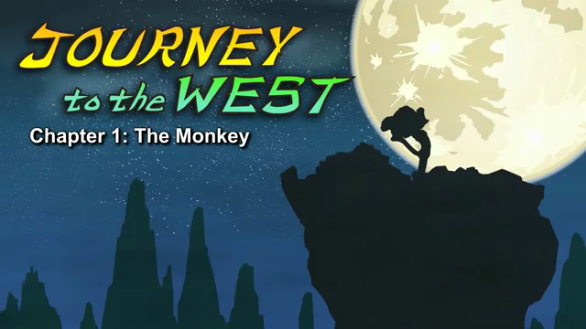
Episode 1 The Monkey

Slide 3
Part 1 quiz
1. What did Monkey come out of?
A. a rock B. a tree C. a river
2. What did the captain have?
A. magical hair B. magical hearing C.magical sight
3. Who did Monkey become friends with?
A. other monkeys and apes
B. wolves and tigers
C. the captain in Heaven
4. What did the monkeys and apes want to find?
A. the ocean B. the river's source C. a new river
5. What will happen if Monkey can jump through the waterfall?
A. He will be king.
B. He will win money.
C. He will leave the mountain.
Keys: ACABA

Slide 4
Part 2 vocabulary
1.journey 旅⾏(⼀般指陆路上的长距离旅⾏)
2.west 1. 西⽅，(2. 向西⽅)
3.split 劈开，裂开 One day the rock split open.
4.powerful 强⼤的，强⽽有力⼒的
Suddenly powerful light shot from his eyes.
5.shot 1. (枪等)射击，射出 (shoot-shot)，(2. (⽤话)反击，3. 飞驰， 飞快地移动)
Suddenly powerful light shot from his eyes.
6.emperor皇帝，帝王 The Jade Emperor, ruler of Heaven, sat up.
7.Jade Emperor ⽟皇⼤帝 The Jade Emperor, ruler of Heaven, sat up.
8.captain 1. (军队的)指挥官，(2. 船长，舰长，(飞机的)机长，3. (团体的)首领
He turned to one of his captains, who was standing nearby.
9.nearby 在附近 He turned to one of his captains, who was standing nearby.
10.southern 南⽅的
He looked out the southern gate of Heaven and saw the monkey on Earth below.
11.magical 魔术的，魔法的 But the captain had magical sight.
12.sight 景⾊，景象 But the captain had magical sight.

Slide 5
13. interesting 有趣的 " Interesting ," said the captain.
14. cause 导致，使发⽣，引起 Find out what caused that light.
15. shone 发光，闪烁 (shine-shone)The light shone from the monkey's eyes.
16. amazing 惊⼈的，令⼈吃惊的
Amazing things happen when Heaven and Earth work together.
17. drank 喝 (drink-drank) He drank from streams and ate grasses and leaves.
18. explore 探险，调查 He gathered fruit and explored caves and mountaintops.
19. mountaintop ⼭山顶 He gathered fruit and explored caves and mountaintops.
20. ape ⼈猿，类⼈猿He became friends with all the other monkeys and apes.
21. slept 睡觉 (sleep-slept)At night he slept under a cliff.
22. cliff 悬崖，绝壁At night he slept under a cliff.
23. shade 1. 荫，(2. (⾊彩的)浓淡，⾊度，3. 遮蔽，蔽荫)
One very hot morning, all the monkeys and apes were playing in the shade.
24. bounce 1. (球等)弹开，反弹, (2. 蹦蹦跳跳)
The water rolled and bounced over the rocks.
25. splash 溅，泼，激起⽔花Everyone splashed and played.
26. scratch 抓，搔After a few minutes, one monkey scratched her head.
27. source 源头，出处，根源Why don't we follow the stream to find its source?

Slide 6
Part 3 sentences
1.One day the rock split open
2. The monkey stood up and stretched
3. Suddenly powerful light shot from his eyes.
4.The Jade Emperor, ruler of Heaven, sat up.
5.He gathered fruit and explored caves and mountaintops.
6.One very hot morning, all the monkeys and apes were playing in the shade.
7.The water rolled and bounced over the rocks.
河水翻滚过石头，奔向远方。
8.Mist filled the air. The water crashed down, roaring like thunder.
9. A voice called out, “ I’ll do it.”
10. The speaker stepped forward.

