Slide 1


感恩遇见，相互成就，本课件资料仅供您个人参考、教学使用，严禁自行在网络传播，违者依知识产权法追究法律责任。
更多教学资源请关注
公众号：溯恩高中英语
知识产权声明

Slide 2

Walk and Run
行走与奔跑
铁杵磨针
Use accurate particles(小品词) to bring cohesion
Use vivid verbs to show than tell

Slide 3


Definition of particles(小品词)
He dashed out of the building to catch the bus.
We loaded suitcases, camping equipment and a tent into the car.
Then Mac heard quick and loud breathing behind him.
My dad and I got on our horses, heading slowly towards the mountains.
When I stepped off the plane, Luke was there, waiting for me.
A particle is________________:
an adverb or preposition that can combine with a verb to make a phrasal verb.与动词构成短语动词的副词或介词。

Slide 4
Function of particles
A.
Mac was pedaling hard now. He waved and yelled at passing cars but was careful not to slow down. He saw a steep uphill climb before him. He knew that once he hit the hill, he'd be easily caught up and the wolf's teeth would be tearing into his flesh.
A.
Mac was pedaling hard now. He waved and yelled at passing cars but was careful not to slow down. He saw a steep uphill climb before him. He knew that once he hit the hill, he'd be easily caught up and the wolf's teeth would be tearing into his flesh.
B.
Mac was pedaling hard now. He waved and yelled but was careful. He saw a steep uphill climb. He knew that once he hit the hill, he'd be easily bitten by the wolf.
obscure
cohesive
小品词对整体意义起修饰作用，使原本无目的性的动词具有了目的性，语义更明确，上下文连接更紧密。

Slide 5
Types of particles
in
over
out
down
away
on
off
from
up
...

Slide 6
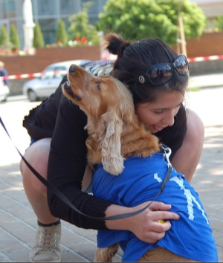
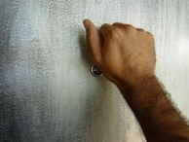
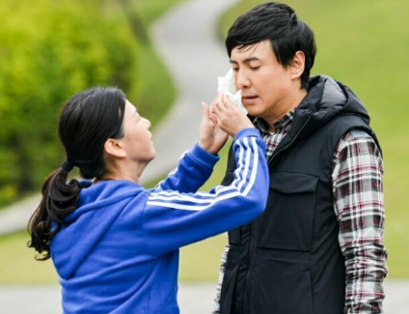
Application of particles
Describe the following pictures by using particles.
up; in; out; on; off; down; away; over; from...
vivid verb+accurate particle
She walked ___, took ____
a tissue and wiped _____ tears____ his cheeks .
up
out
He banged _______the door trying to wake up Makcik but in vain.
She bent _____ to hug her dog.
on
down
away
off

Slide 7
vivid verbs--“walk”+particles
with a quick pace (快走)
with a purpose
(有目的地走)
with sound
(出声地走)
with difficulty
(艰难地走)
walk
with mood
(带感情地走)
with care
(小心翼翼地走)

Slide 8

walk with difficulty
show
tell
The injured man staggered to his feet. (to walk with weak unsteady steps蹒跚)
Jane stumbled in the dark, looking for a shelter.
(to walk in an unsteady way蹒跚)
stagger
Wading down to the school, I met Joe. (to walk with an effort, especially water or mud.涉水/泥费力前进)
She plodded her way through the rain. (-dd-: to walk slowly with heavy steps艰难地走)
stumble
wade
plod
trudge
He trudged back to school.
(to walk slowly with heavy
steps 因疲劳或负重缓慢地走)
She dragged herself out of the bed . (-gg-: to move yourself slowly and with effort缓慢而费力地移动)
)
drag
waddle
walk
The stout old man waddled across the road.(to walk with short steps, swinging from side to side.蹒跚行走)
plough
They ploughed their way
through deep snow.
(plough one's way through sth:to force a way through sth费力向前)
grope
We groped our way along the dark corridor. (grope one's way: to reach a place by feeling with your hands摸索前行

Slide 9
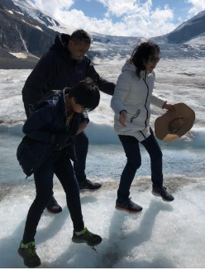
walk with care
show
tell
The burglars sneaked into the zoo.
(to go somewhere secretly, trying to avoid being seen. 偷偷溜进)
Mum glided into the room.
(to move smoothly and quietly
悄悄溜/走进)
sneak
My mother eases into the room with a smile.(to move slowly and carefully小心缓缓地移动)
ease
glide
She tiptoed to the bedside of the sleeping child.
(to walk using the front parts of your feet, so that other people can't hear you.
踮着脚走)
creep
I crept up the stairs, trying not to wake my parents.
(creep crept crept: to move slowly, quietly and carefully蹑手蹑脚地移动)
tiptoe
walk
edge
slide
He edged closer to them with great care.
(to move slowly and carefully in a particular direction慢慢移动)
The thief slid into the house.
(slide slid slid: to move quickly and quietly.快而悄声地移动）

Slide 10
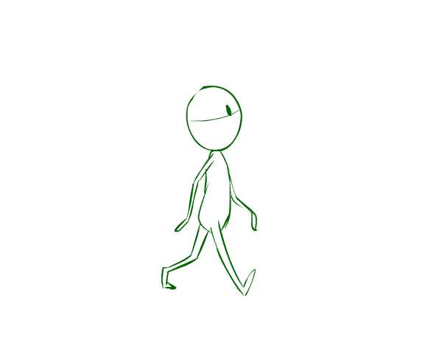
walk with a quick pace
show
tell
He smiled and bustled off towards the door.
(to move somewhere in a hurried
way匆忙地走)
She called out his lap time as he whizzed by.
(-zz-: to move fast嗖嗖地快速移动)
bustle
He swept across the hall to the staircase. (sweep swept swept: to move quickly or smoothly快走)
whiz
sweep
She strode forward to greet me.
(stride strode stridden: to walk with long steps in a particular direction大步走)
dash
stride
He dashed into the house.
(dash: to go somewhere quickly猛冲)
rush
walk
He rushed to the hospital.
(rush: to move or to do sth with great speed, often too fast迅速移动)
hurry
They hurried on.

Slide 11

show
walk with a purpose
tell
When I approached, they grew silent. 走近
She ducked behind her mum as we came in.
(duck: to move somewhere quickly, especially in order to avoid being seen 飞快行走(以免被看见)
approach
She bounced up and down excitedly on the bed.
(to jump up and down on sth.跳
动；蹦)
bounce
duck
He burst into the room without knocking.
(burst burst burst猛冲进...)
My dad and I got on our horses, and headed slowly towards the mountains.
朝某方面移动
head
burst into
walk
make one's way to
We slowly made our way to the edge of the crater向...走去

Slide 12
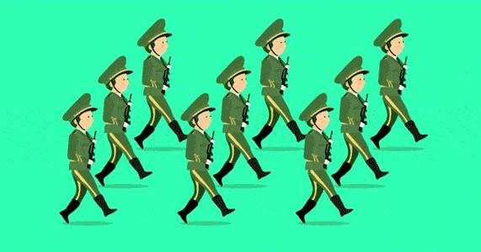
show
walk with sound
tell
She stomped angrily out of the office.咚咚咚地走出
(to walk or move with heavy steps迈着重重的步子走)
stomp
clomp/
clump
pound
She pounded along the corridor after him.
(to move with noisy steps
咚咚地走)
walk
Only this time, I'm not really running. I'm clomping.
(to put your feet down noisily and heavily as you walk. 脚步沉重地行走)

Slide 13

walk with mood
tell
show
She burst into tears and stormed off.(to go somewhere quickly and in an angry, noisy way.气呼呼地疾走)
storm
She flung out of the room.
(fling flung flung: to move somewhere suddenly with a lot of force.突然移动)
Ms.Rucker strolls towards us down the aisle.(to walk somewhere in a slow relaxed way 散步,闲逛)
fling
stroll
bounce
He bounced across the room to greet them.(to jump up and down兴奋地走)
linger
Lingering at the front gate, I hesitate about walking inside.徘徊
dance
walk
wander
He danced around the room.
(to move in a lively way轻快地移动)
She wandered in the forest aimlessly.漫游

Slide 14

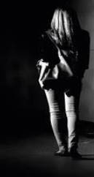
用形象的“走”加准确的小品词来展现人物情感
情境：The darkness was gathering as she wobbled in high heels along the side of the highway. The car had come to an unexpected stop, and like a normal teenager she did the only thing she could think of...get out and walk.
It was cold and late, and home was far away. This could be a long night. If only someone would stop and offer her a ride. She prayed for help and dragged herself forward.
Mini-writing(use vivid verbs of walk to translate the passage.)
语境：The darkness was gathering as she _____________
她穿着高跟鞋在公路边摇摇晃晃地走着。她的车意外地停了，像 每个正常的青少年都会做的，她唯一能想到的就是从车里出来然后步行。天很冷，夜已深，家很远。这可能是很漫长的夜晚。要是有人能停下来送她一程就好啦。她一边祈祷一边拖着腿继续往前走。

Slide 15

用形象的“走”加准确的小品词来推动情节发展
Mini-writing(use vivid verbs of walk to continue the story.)
Setting:
It was a rainy November morning. Overcome with anger I knew if I didn't leave the house soon I would lose my temper with my husband, Joe. As rain came down in sheets, Joe offered to take me to work. I struggled into my jacket, seized my bag and teaching plans and ignored him.______________________________________________
(What would I do next?)
In great anger, I stormed out，not giving him a chance to explain.
I flung out of the room, diving into the rain without kissing him good-bye.

Slide 16
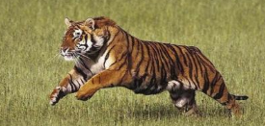
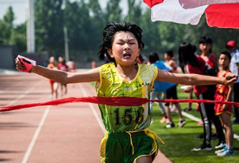
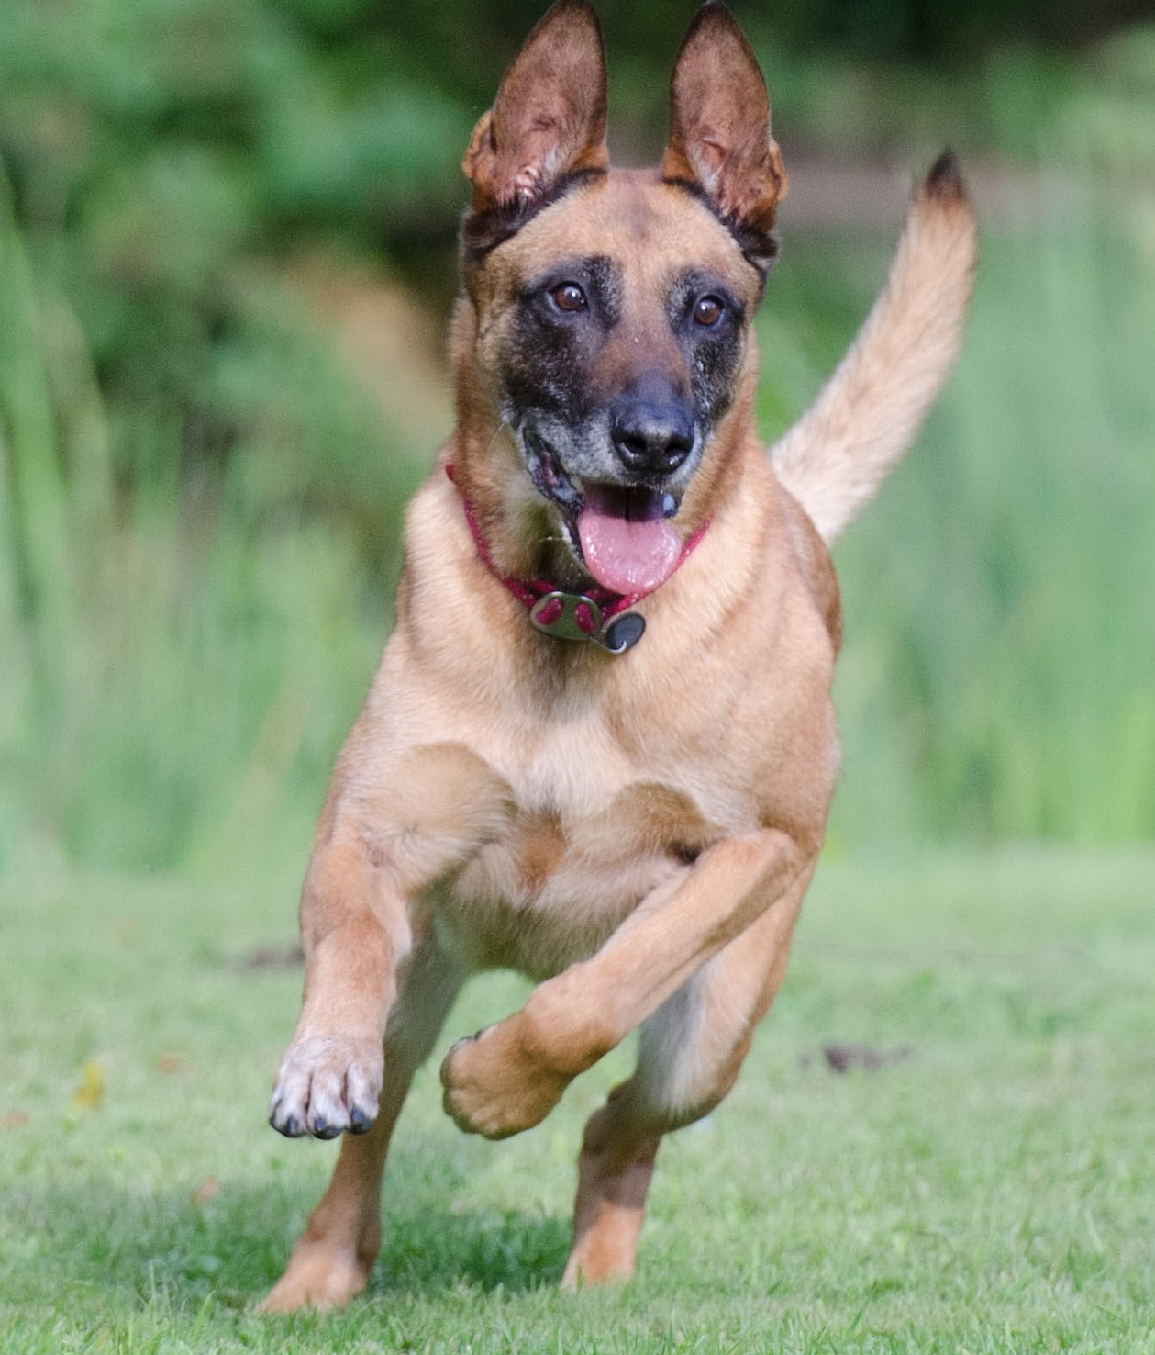
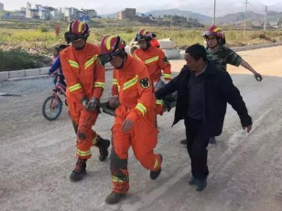
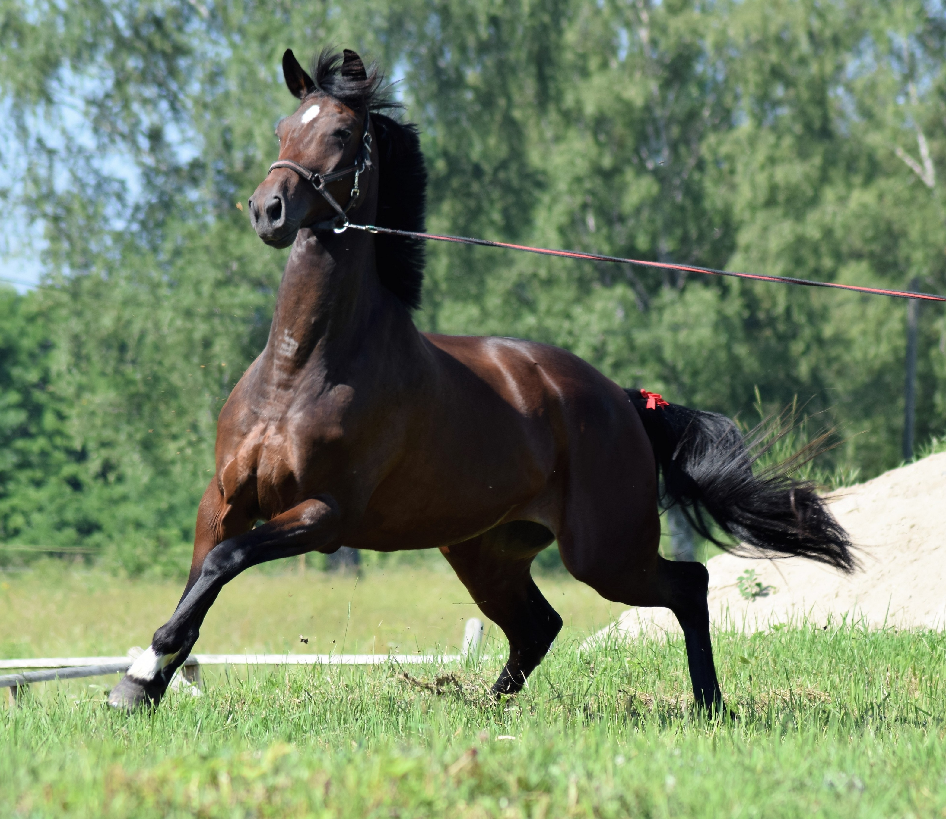
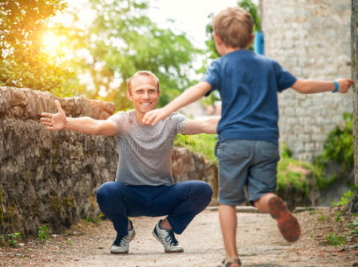
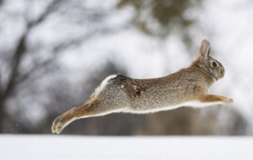
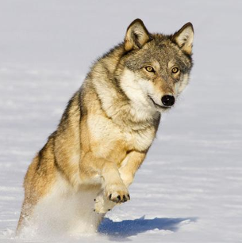

human
Run
animal
...
...
...

Slide 17
vivid verbs--“run” (human)+particles
tell
show
Jack zoomed round and he didn't feel out of breath.快速移动
zoom
She called out his lap time as he whizzed by.嗖嗖地快速移动
They dashed over to school. 跑
dash
whiz
Beadle charged off. 猛冲
Paul rushed out the door. 迅速移动
charge
rush
Kevin zipped across the road.呼啸而过
zip
He darted blindly into the gloom.飞奔
He sprinted for the finishing line. 冲刺
dart
sprint
She raced outside.
快速移动
race
run
shoot
He flung the door open and shot down the stairs.冲
He trotted/scuttled into the room. (碎步)小跑
trot/scuttle
bolt
Upon seeing the police, he bolted down an alley. 逃跑
jog
bound
He jogged down the road, panting and puffing. 慢跑
The dog bounded ahead.
跳跃着跑

Slide 18
vivid verbs--“run” (animal)+particles
eg. The horse galloped and tossed its rider.马飞奔
eg. Jo galloped across the field. 骑马飞奔
gallop
to move very fast and with a loud deep noise.轰隆隆地快速移动
eg. They thundered across our field.
thunder
a horse suddenly runs away because it's frightened.(尤指马突然或受惊)狂奔
eg. The horse reared up and bolted forward.
bolt
dart
eg.The pony darted back into the stable.

Slide 19
vivid verbs--“run” (animal)+particles
The boy pulled the door and out rushed Poppy, followed by a puppy. 冲
rush
Poppy trotted to him and got up on his back legs, trying to lick her old friend.小跑
trot
shoot
The little dog shot downstairs to welcome Daisy.冲
charge
The dog charged towards me.

Slide 20
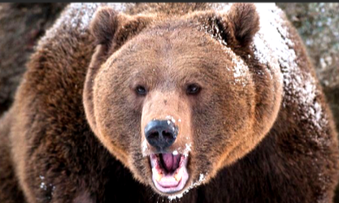
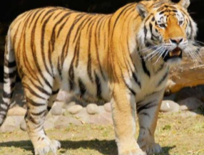
vivid verbs--“run” (animal)+particles
The tiger crashed through the jungle.(声音很响地)冲
The lion suddenly charged at me.冲
The tiger dashed through the bush.冲
The bull rushed at me.冲
The bear trotted forward a few steps.小跑

Slide 21
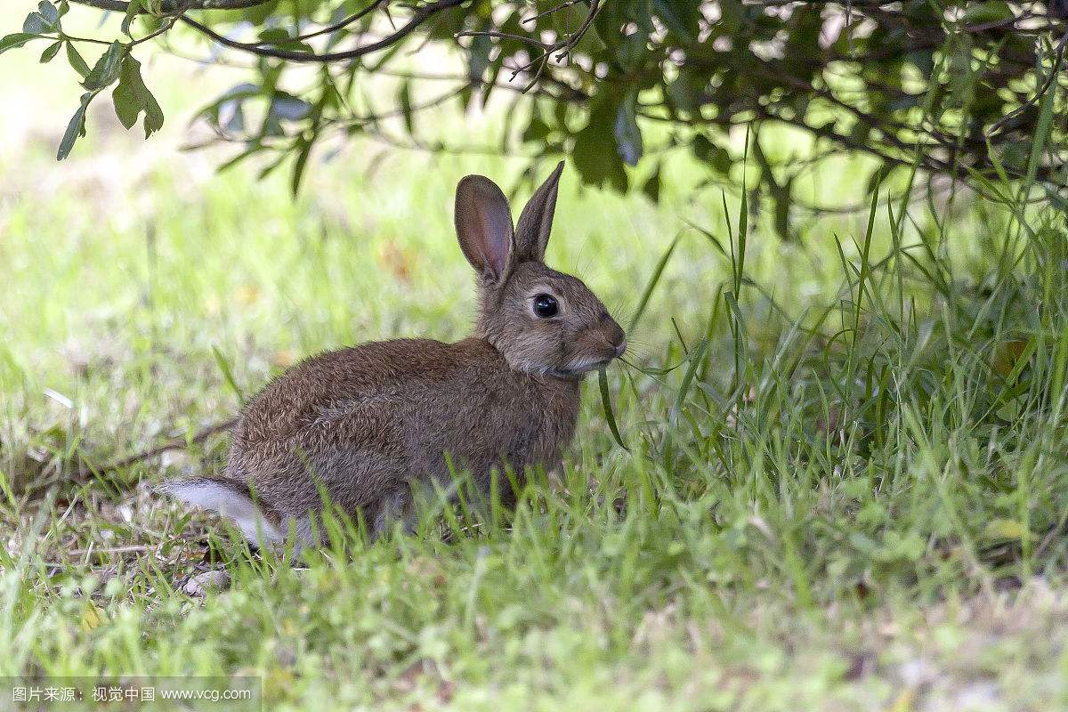
vivid verbs--“run” (animal)+particles
dash
A frightened hare dashed past.猛冲
The rabbit scampered off when it saw us.(惊惶)奔跑(to move quickly with short light steps)
scamper
dart
The hare darted away when it saw us.

Slide 22
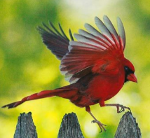
vivid verbs--“run” (animal)+particles
hop
There she saw Ben Weatherstaff digging and talking to his robin, which was hopping near him.
（hop hopped hopped: to move by jumping on one foot. 单脚跳行）

Slide 23
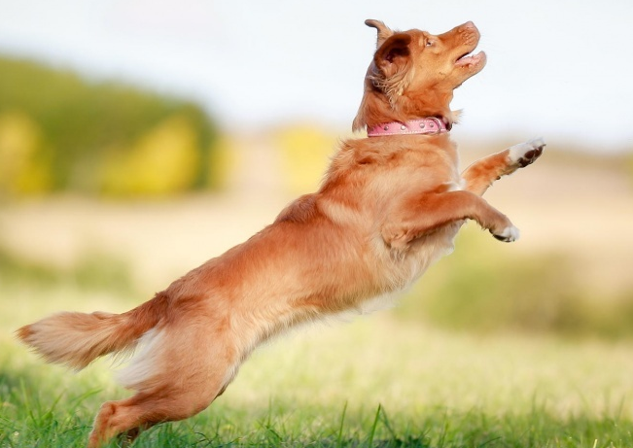
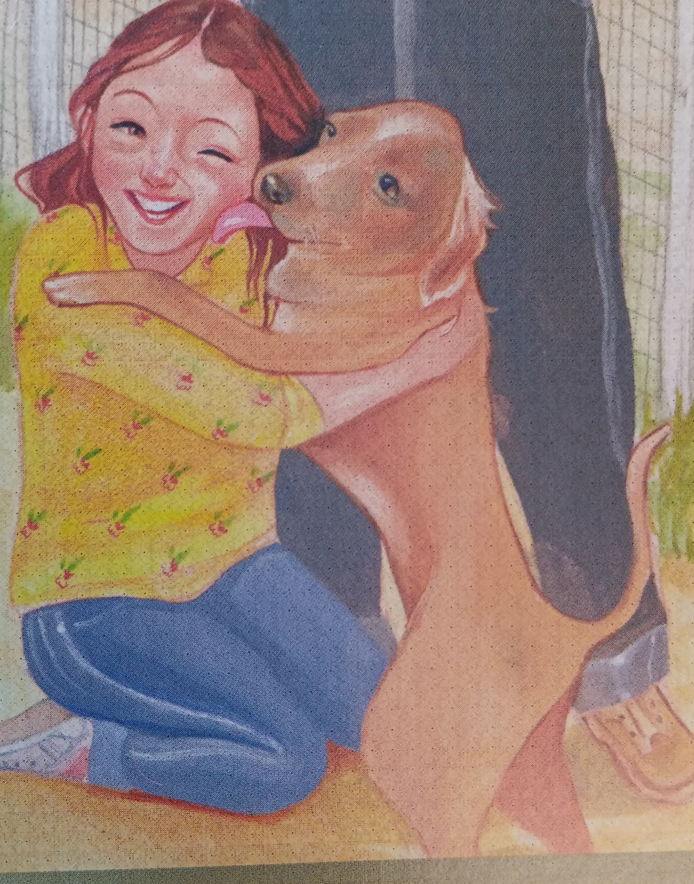
用具体的“跑”加小品词叙事传情
Describe the following pictures by using vivid verbs(run) and accurate particles (2 sentences).
Suddenly, a furry figure charged toward Jane, flinging himself into her arms. Standing on his back legs, his front paws on her shoulders, he licked her face with plentiful kisses.

Slide 24
particles
Exercise
verbs-“walk”
verbs-“run”

Slide 25
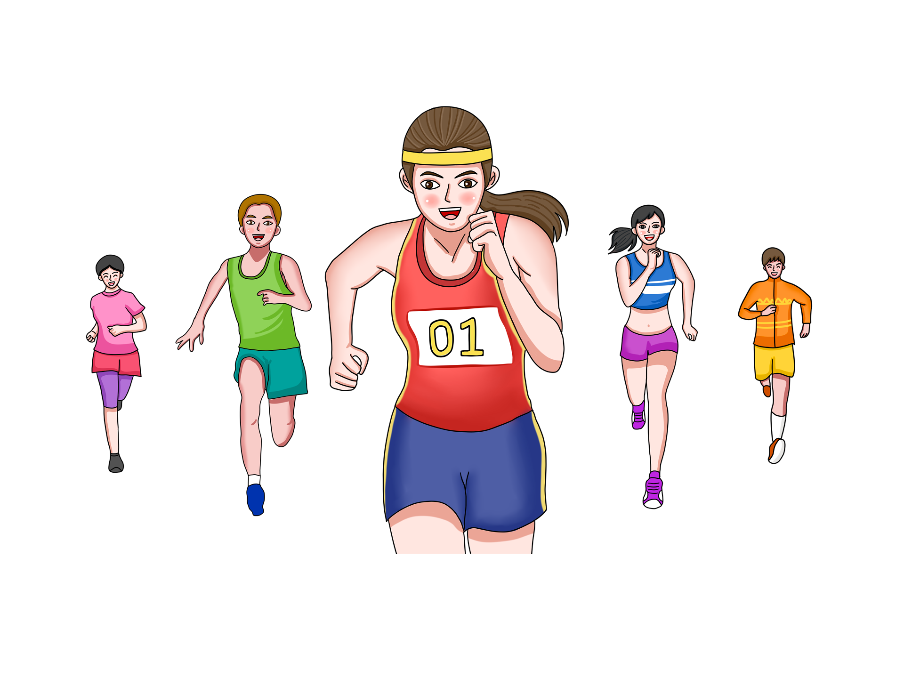
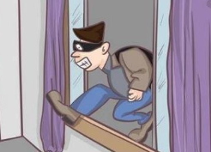
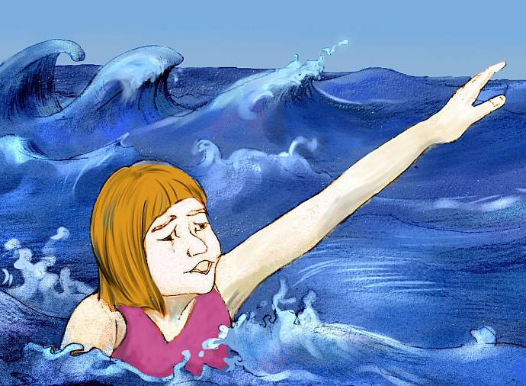
vivid verbs+accurate particles
Exercise 1: Describe the following pictures by using one sentence including a vivid verb(run/walk) and accurate particle.
With all her might, she charged towards the finishing line in lightening speed.
The burglar sneaked into the house, scanning the room with great caution for valuable items.
Hearing the cries, Tom darted down to the sea, dived into the water and pulled her back to the beach.

Slide 26

vivid verbs+accurate particles
Exercise2: Using vivid verbs of “walk” & “run” plus accurate particles to describe the actions and emotions of the characters below. (3-5sentences)
Characters: Colin, Mr. Craven
A few days later Archibald Craven returned to Misselthwaite Manor and he went straight to the garden. ____

Slide 27
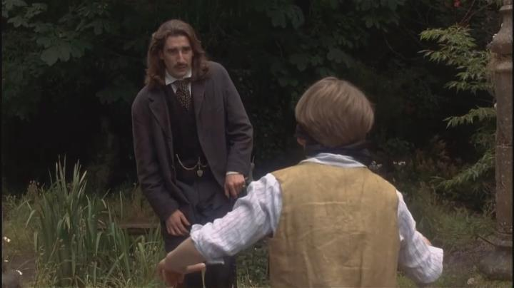
Possible answer:
A few days later Archibald Craven returned to Misselthwaite Manor and he went straight to the garden.Tracing the giggles, he reached where the secret garden was. He parted the ivy hanging on the wall, pushed back the door and crept inside. A figure of a tall, handsome boy walked into his view. As he edged closer, his heart beat fast, his soul shook in amazement. It was Colin! A sense of unbelieving joy rushed through him. “Colin. Colin.” his lips framed the words, tears springing into his eyes. Deeply moved, he released one of his hands and stroked the face of his dear son affectionately. There was a moment of silence. Then Colin's face lit up.With great eagerness to show his father the magic of the secret garden, Colin bustled off, together with his father, hand in hand.

Slide 28
vivid verbs+accurate particles
Exercise 3：Continue the story by using vivid verbs accurate particles.
Lying in bed, the boy faintly heard the doctor talking to his mother that he would surely die, --for the terrible fire had destroyed so much flesh in the lower part of his body. But the brave boy didn't want to die. He made up his mind that he would survive. To the doctor's surprise, he made it. When the danger was past, he again heard the doctor whispering to his mother that he would be a lifetime cripple(跛子) because the severe injury made the lower part of his body stop functioning. Once more the brave boy made up his mind: he would not be a cripple. He would walk. Unwilling to be confined to a wheelchair, the little boy______________________________________________
(write about 3-5 sentences)

Slide 29
Possible answer:
Unwilling to be confined(受困于) to a wheelchair, the little boy pleaded his mother to massage(按摩) his weak legs and wheel him out into the yard to get a lot more practice. He threw himself from the wheelchair, pulled himself across the grass, dragging his legs behind him. Panicked and fatigued as he was, the little boy stubbornly repeated every movement day by day. With great effort, he managed to make his way to the fence, shuffling along it. After what seemed a century, the boy finally edged step by step around the yard beside the fence. Tears stung his eyes. He was able to walk again!

Slide 30
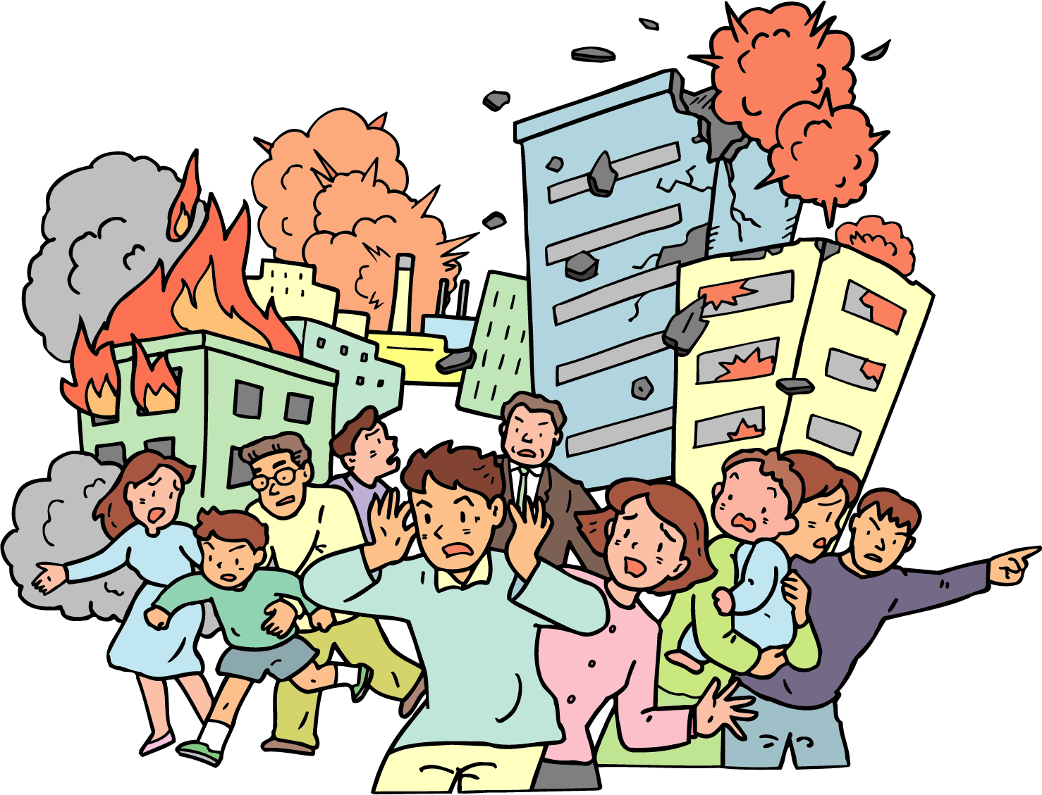
vivid verbs+accurate particles
Exercise 4：Weave the story based on the given plot by using vivid verbs accurate particles.(3-5 sentences)
Plot: 火灾发生，乔伊折回，勇救邻居小孩。
Looking at the smoke billowing from the burning houses, Joe took a deep breath and dived in for the boy._____________________
____________________________________________________________________________________________________________________________________________________

Slide 31
Possible answer:
  Looking at the smoke billowing from the burning houses, Joe took a deep breath and dived in for the boy. Stung by the thick smoke, he ploughed on, crying the little boy's name aloud. Nearly suffocated, he groped his way along the dark corridor, and finally made it to the second floor, where he heard faint cries in the distance. Without hesitation, he hurried toward him and reached the room. Thankfully, he found the trembling figure in the corner of the room. He pulled him toward him and rushed out.

Slide 32
高考读后续写
考察项目 |  | 考情分析
 |  | 2017.6 | 2017.11 | 2018.6 | 2020.1 | 2020.6 | 2021.1
话题 |  | 狼口脱险 | 跟妈妈去旅行 | 跟爸爸骑行, 森林迷路 | 人犬深情 | 熊口脱险 | 万圣节囧事
划线词 | 名词(词组) | 7 | 6 | 7 | 6 | 7 | 6
 | 动词(词组) | 3 | 1 | 2 | 2 | 2 | 4
 | 形容词/副词 |  | 3 | 1 | 2 | 1

Slide 33
高考真题(2017.6)
On a bright, warm July afternoon, Mac Hollan, a primary school teacher, was cycling from his home to Alaska with his friends. One of his friends had stopped to make a bicycle repair, but they had encouraged Mac to carry on, and they would catch up with him soon. As Mac pedaled (骑行) along alone, he thought fondly of his wife and two young daughters at home. He hoped to show them this beautiful place someday.
Then Mac heard quick and loud breathing behind him. “Man, that's a big dog!” he thought. But when he looked to the side, he saw instantly that it wasn’t a dog at all, but a wolf, quickly catching up with him.
Mac’s heart jumped. He found out his can of bear spray. With one hand on the bars, he fired the spray at the wolf. A bright red cloud enveloped the animal, and to Mac's relief, it fell back, shaking its head. But a minute later, it was by his side again. Then it attacked the back of Mac's bike, tearing open his tent bag. He fired at the wolf a second time, and again, it fell back only to quickly restart the chase.
Mac was pedaling hard now. He waved and yelled at passing cars but was careful not to slow down. He saw a steep uphill climb before him. He knew that once he hit the hill, he’d be easy caught up and the wolf’s teeth would be tearing into his flesh.
At this moment, Paul and Beeky were driving their car on their way to Alaska. They didn’t think much of it when they saw two cyclists repairing their bike on the side of the road. A bit later, they spotted what they, too, assumed was a dog running alongside a man on a bike. As they got closer, they realized that the dog was a wolf. Mac heard a large vehicle behind him. He pulled in front of it as the wolf was catching up fast, just a dozen yards away now.

Slide 34

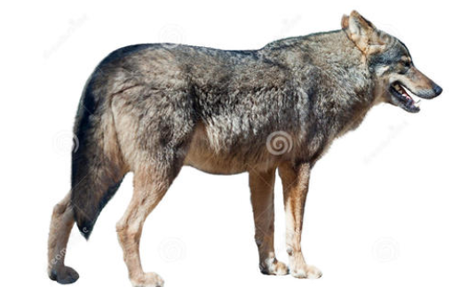
Para1:
The car abruptly stopped in front of him._______________________________
Para2:
A few minutes later, the other two cyclists arrived.________________________

Slide 35
climax
driving;pulled
hopeful
waved;yelled
hopeless
turning point:
1. the car abruptly stopped
2. cyclists arrived
more hopeful
rising action
attacked;tearing
falling action
catching up with
frightened
pedaled alone
rescued?
thankful
unforgettable
delighted
stopped
cycling from...to...
plot
ending
emotions
beginning

Slide 36
Paul & Beckey/two cyclists:
rushed/darted/shot/dashed
/raced/dashed instantly to give help...
Para.1: The car abruptly stopped in front of him. Paul and Becky got out of the car, rushing to offer help. But with the bare hands, they didn’t dare to fight with the wolf. However, they still approached to the wolf bravely. At the same time, the wolf also noticed them and turned its head back, shouting loudly at Paul and Becky. Mac then jumped off the bicycle and was ready to fight against the wolf. They reached a complete deadlock (僵局).
Para.2: A few minutes later, the other two cyclists arrived. They found the dangerous situation, where three men circled the wolf. Mac’s friends also jumped off their bicycles and joined the fight with the wolf. More and more cars stopped. Some drivers took out the sticks from the cars, and some took out the knives, even the guns towards the wolf. In the meanwhile, the wolf might feel the threats from the people, starting to withdraw. Soon, it ran away off the road and disappeared in the distance.
Mac:
jumped to the car promptly
stumbled his way to the car
sprinted crazily for the car...
The wolf:
hovering around the car
wandering for a while
charged towards Mac
caught up with the car, making fierce attacks
chased the car tightly...

Slide 37
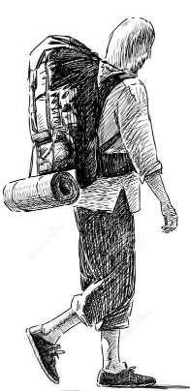
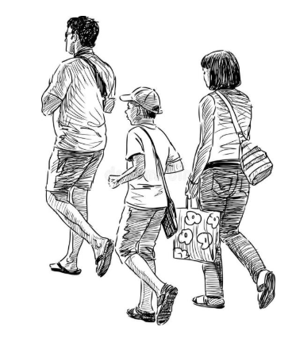
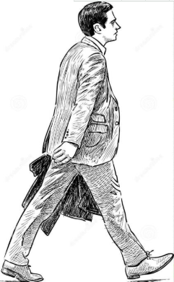
The End

Slide 38
用形象的“走”加准确的小品词来展现人物情感
语境：The darkness was gathering as she _____________
她穿着高跟鞋在公路边摇摇晃晃地走着。她的车意外地停了，像 每个正常的青少年都会做的，她唯一能想到的就是从车里出来然后步行。天很冷，夜已深，家很远。这可能是很漫长的夜晚。要是有人能停下来送她一程就好啦。她一边祈祷一边拖着腿继续往前走。

