Slide 1


感恩遇见，相互成就，本课件资料仅供您个人参考、教学使用，严禁自行在网络传播，违者依知识产权法追究法律责任。
更多教学资源请关注
公众号：溯恩高中英语
知识产权声明

Slide 2
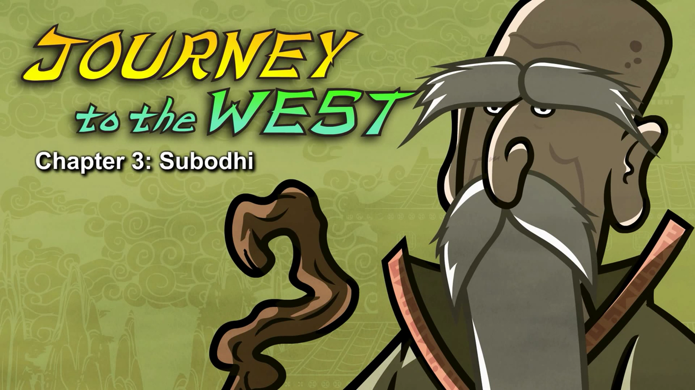
Episode 3 Subodhi

Slide 3
Part 1 quiz
Which is NOT true?
A. Monkey learned from the woodcutter.
B. Monkey wanted to learn how to live forever.
C. Monkey found Subodhi's temple.
2. What was Monkey looking for in the mountains?
A. a rock B. a woodcutter C. a sage
3. What did Monkey want to be?
A. a student B. a sage C.a woodcutter
4. Why did Wukong start to dance?
A. He knew how to live forever.
B. He loved learning from Subodhi.
C. He received a secret message.
5. How did Subodhi give Wukong a secret message?
A. He knocked Wukong on the head.
B. He whispered it to Wukong.
C. He delivered a letter.
Keys: ACABA

Slide 4
Part 2 vocabulary
1.eventually 最终Eventually he came to mountains covered in thick forest.
2.thick 厚的Eventually he came to mountains covered in thick forest.
3.steep 陡峭的，险峻的He headed up a steep mountain trail and soon heard chopping.
4.trail 径，(踩出的)⼩路He headed up a steep mountain trail and soon heard chopping.
5.chop 1. 砍，劈，(2. 切细，剁碎)
He headed up a steep mountain trail and soon heard chopping.
6.woodcutter 伐⽊者，樵夫A woodcutter was chopping firewood.
7.firewood⽊柴，柴⽕A woodcutter was chopping firewood.
8.wise 聪明的，明智的He is very wise.
9.side 旁边，侧⾯Soon he saw a temple built into the side of the mountain.
10.temple 神殿，庙宇，寺院Soon he saw a temple built into the side of the mountain.
11.confused 混乱的，困惑的The student looked confused.
12.master 1. ⼤师，师傅，(2. (狗、仆⼈等的)主⼈)Okay, Master.
13.just 仅仅，只是But you're just a monkey.
14.almost⼏乎，差不多I traveled almost 13 years to get here.
15.stare凝视，盯着看Subodhi stared at Monkey for a moment.
16.parent 亲或母亲 (parents：⽗母)Who are your parents?
17.born出⽣ bear-bore-born I was born from a rock.

Slide 5
18.probably概，或许You were probably created by Heaven and Earth.
19.create创造，创作You were probably created by Heaven and Earth.
20.meditate冥想，沉思
The monkey spent his days meditating, listening to his teacher's lessons, and doing chores.
21.chore家庭杂务
The monkey spent his days meditating, listening to his teacher's lessons, and doing chores.
22.calm down镇定下来
23.future未来I can teach you how to tell the future.
24.forget忘记Then forget it.
25.breathing 呼吸How about some magic breathing exercises?
26.exercise运动How about some magic breathing exercises?
27.rude粗鲁的，无礼的You were very rude to Master!
28.none个也没，没有任何人或物
None of the other students knew it, but Subodhi had given him a secret message.
29.given给 give-gave-given
None of the other students knew it, but Subodhi had given him a secret message.
30.secret1. 秘密的，(2. 秘密)
None of the other students knew it, but Subodhi had given him a secret message.
31.message消息，信None of the other students knew it, but Subodhi had given him a secret message.

Slide 6
Part 3 sentences
1.Eventually he came to mountains covered in thick forest.
2. He headed up a steep mountain trail and soon heard chopping.
3. The monkey spent his days meditating, listening to his teacher's lessons, and doing chores.
4.Monkey scratched his head.
5. Wu Kong shrugged.
6.He stood up and knocked WuKong on the head three times.

