Slide 1
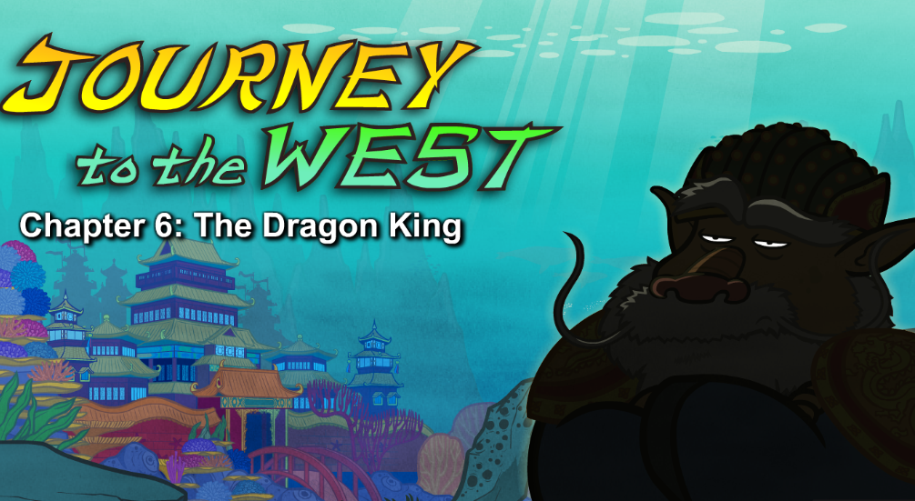
Episode 6. The Dragon King

Slide 2
Part 1 quiz
1.Who needed a powerful weapon?
A.Wukong B.the Dragon King C.the Dragon Queen
2.Where did the Dragon King live?
A.the bottom of the Eastern Sea B.the Fruit and Flower Mountain C.the Cloud Palace in Heaven
3.Why were the sword and spear not good for Wukong?
A.They were too light. B.They were too heavy. C.They were made of wood.
4.What did the queen want?
A.She wanted a heavy weapon. B.She wanted Wukong out of the palace.
C.She wanted to measure the oceans.
5.What did the king NOT say about the pillar?
A.It would be Wukong's if he could lift it. B.It was used to measure the oceans and rivers.
C.It was small and easy to handle.
Keys: AAABC

Slide 3
Part2 vocabulary
1.spear /spɪə/ ⽭ What's wrong with our swords and spears?
2.drag 拉(重的东西)，吃⼒地拉
He soon came back, slowly dragging a huge sword.
3.out of breath 喘不过⽓来
He dropped the sword/sɔːd/ and then fell down, out of breath.
4.trouble 困难，困难局⾯
Wukong picked up the sword with no trouble at all.
5.pretend /prɪ'tend/ 假装,伪装
He waved the sword through the air, pretending to fight.
6.enormous /ɪ'nɔːməs/ 巨⼤的，庞⼤的
A few minutes later, several turtles and octopuses章鱼 dragged an enormous spear into the room.

Slide 4
7.snort /snɔːt/ 1. 轻蔑(或愤怒)地哼，嘲讽地笑.2. (⽤⿐⼦等)发出⿐息声)
The Dragon King snorted.
8.stomp /stɒmp/重踩，重踏
Wukong stomped his foot.
9.outrage /'aʊtreɪdʒ/严重违法的⾏为，暴⾏
This is an outrage!
10.treasury/'treʒ(ə)rɪ/宝库，宝藏室
What about the magical iron bar in the treasury?
11.beam/biːm/ 1. 光线，光束，2. 堆满笑容，眉开眼笑
Beams of golden light shone from it.
12.fold one's arms双臂交叉
The Dragon King folded his arms.

Slide 5
Part 3 sentences
1.He soon came back, slowly dragging a huge sword.
2.He dropped the sword and then fell down, out of breath.
3.Wukong picked up the sword with no trouble at all.
4.The dragon king snorted.
5.Wukong stomped his foot,“I am not leaving until I get what I want.”
6. Beams of golden light shone from it.
7.The dragon king folded his arms.

Slide 6
Part4 Showing-time
请用以下重点词汇（至少5个）来编写故事。
drag; out of breath;stomp ones foot;fold ones arms;snort;with no trouble at all;pretend to;enormous;outrage; treasury

Slide 7
Example
There, several monkeys were competing against each other. Anyone who can lift the huge sword successfully would be awarded the first prize. One monkey came up, dragging the sword to his side and trying to hold it up. However, the moment he lifted the sword, he fell down, out of breath. The other monkeys also made an attempt. But all end up stomping their feet, hanging their heads in frustration. Seeing this, Wukong folded his arms, snorting with laughter,“ it’s just a piece of cake.” He jumped out of the way and picked up the sword with no trouble at all. At that time, thunderous applause burst out, haunting in the Flowers and Fruit Mountain.

