Slide 1
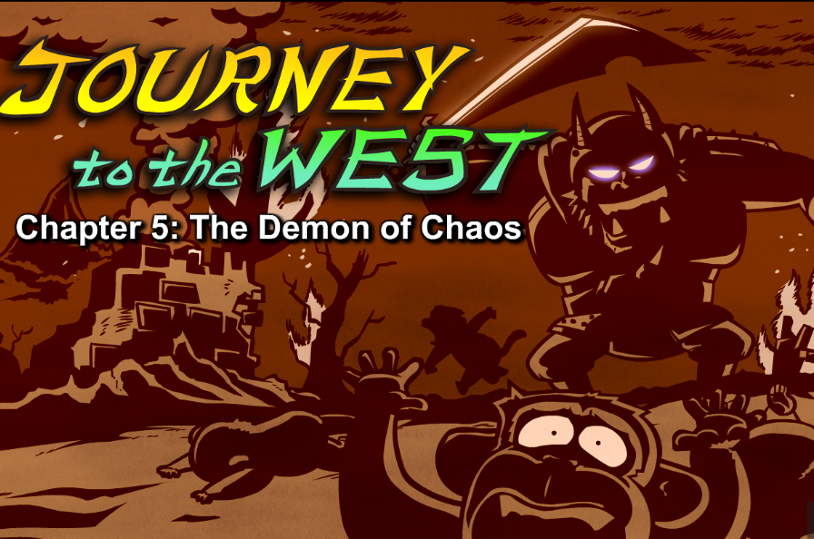
Episode 5 The Demon of Chaos

Slide 2
Part 1 quiz 1. Why did Wukong go after the demon?
A. to rescue the kidnapped monkey
B. to show how powerful he is
C. to be friends with the demon
2. Where did the demon live?
A. the Fruit and Flower mountain B. a cave on a gloomy mountain C. the Cloud Palace
3. What did the demon ask his guards to bring?
A. a sword and armor B. a meal C. a fake monkey
4. What did Wukong use to destroy the demon?
A. a sword B. a spear C. a magic spell
5. What did Wukong teach his subjects? A. how to fly on clouds B. how to use magic spells C. how to fight with swords and spears
Keys:ABACC

Slide 3
Part2 vocabulary
1.demon /'diːmən/魔⿁，恶魔
A demon attacked us.
2.kidnap/'kɪdnæp/绑架，诱拐
He stole most of our things and kidnapped many of us.
3.furious /'fjʊərɪəs/ ⾮常愤怒的 Wukong was furious.
4.handle处理，对待 I will handle the demon.
5.subject /'sʌbdʒekt/1. ⾂服者，国民，(2. (故事等的)主题，3. 科⽬)
His subjects stared in amazement.
6.gloomy /'gluːmɪ/ 忧郁的，阴郁的 Wukong soon spotted a gloomy mountain.
7.entrance /'entr(ə)ns/ 入口
Two guards stood at the entrance, practicing sword fighting.
8.revenge /rɪ'ven(d)ʒ/ 报仇，报复 I want revenge!
9.shriek /ʃriːk/(尖声)说话，尖叫
"Ahh!" the guards shrieked, and ran into the cave.

Slide 4
10.sage /seɪdʒ/圣⼈，圣贤 I learned many things from a sage.
11.handful⼀撮，⼀把
Wukong pulled out a handful of his own hair and blew on it.
12.strand/strænd/(绳、线等的)⼀股，⼀缕
Each strand of hair turned into a fake monkey—exactly like Wukong.
13.all at once突然
All at once the fake monkeys attacked the demon, punching and kicking（拳打脚踢） him.
14.chase away赶⾛，驱逐
15.fierce/fɪəs/凶猛的，残酷的
Before long, the monkeys and apes were a fierce army.

Slide 5
Part3 Showing-time
Please make a story according to the key words you have learned in this episode.
听说恶魔绑架了他的臣民，国王气得满脸通红。他怒吼道：“我来对付这个恶魔，我要报仇！” 很快，他就发现了恶魔住的那个阴沉昏暗的山洞。找到恶魔后，他冲上前，对着恶魔一阵拳打脚踢，终于赶走了恶魔，救出了所有的臣民。
Hearing that many of his subjects were kidnapped by a Demon, the King blushed furiously. He shrieked, “ I will handle the demon. I want revenge. ” Soon, he spotted the gloomy cave where the Demon lived. He jumped out of the way and attacked the Demon, punching and kicking. Finally, the King chased away the Damon and saved all his subjects.

