Slide 1


感恩遇见，相互成就，本课件资料仅供您个人参考、教学使用，严禁自行在网络传播，违者依知识产权法追究法律责任。
更多教学资源请关注
公众号：溯恩高中英语
知识产权声明

Slide 2
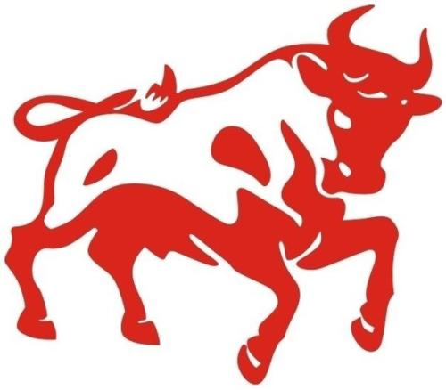
Orientation
Stacey Yu

Slide 3
How to express this animal in English?
Activity 1 Ways to express “niu”
ox
cattle
bull
calf
cow
buffalo

Slide 4

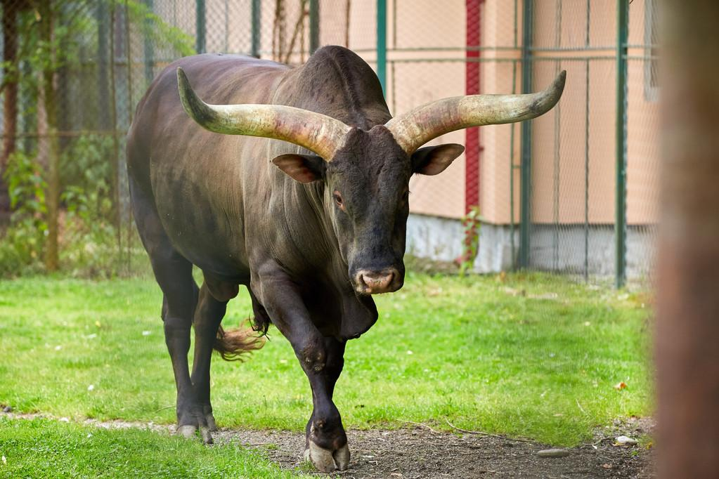
英 [bʊl] 美 [bʊl]
n. 公牛；看好股市者；粗壮如牛的人；胡说八道
a bull market 牛市
He was gored by a bull.
他被公牛顶伤。
That's a load of bull!
那是胡说八道！

Slide 5

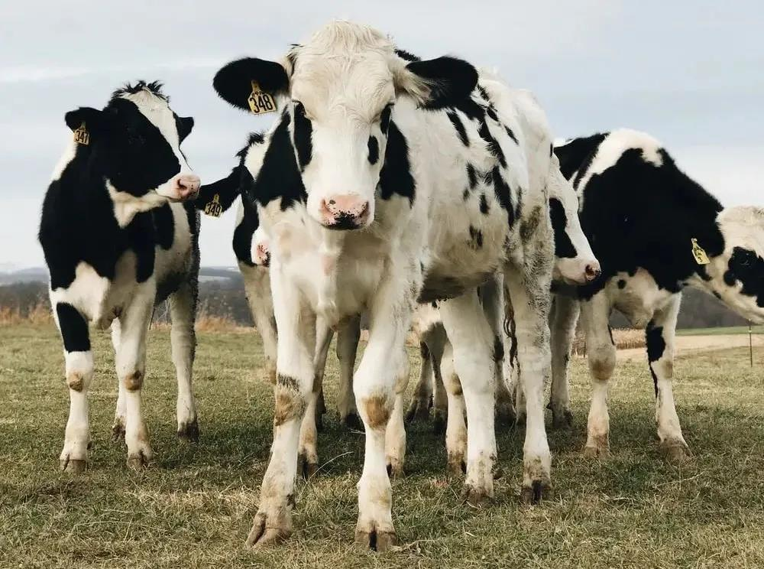
英 [kaʊ] 美 [kaʊ]
n. 奶牛，母牛；母兽
vt. 威胁，吓唬，恐吓
a herd of diary cows
a cash cow 摇钱树
Hearing the rumbling noise, the kids were cowed into silence. 听到隆隆声，孩子们吓得默不作声。

Slide 6

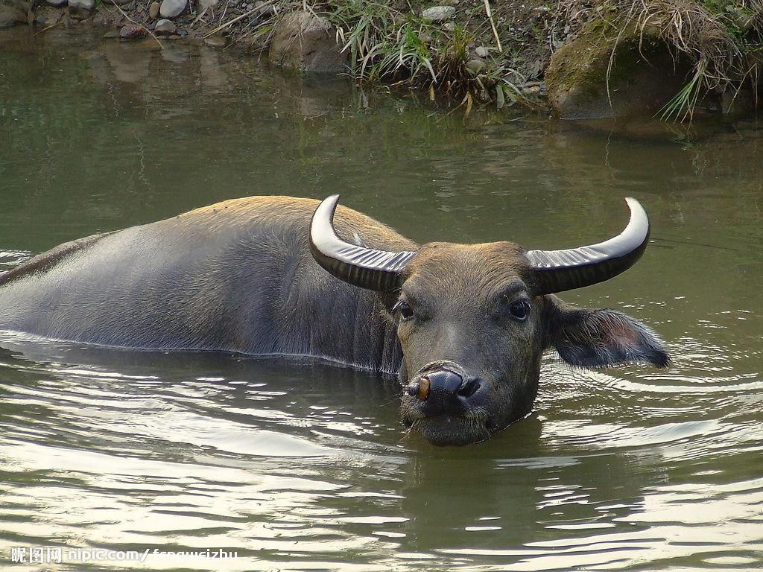
英 [ˈbʌfələʊ] 美 [ˈbʌfəloʊ]
n.水牛
Once there were 70 million buffalo on the plains.
The water buffalo squelched up and down the paddy fields, pulling the plough.
水牛拉着犁，在稻田里咕唧咕唧地走着。

Slide 7

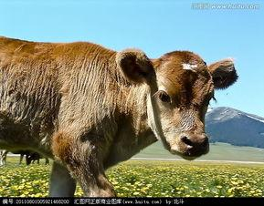
英 [kɑːf] 美 [kæf]
n.小牛；小牛犊；小腿
The calf lapped up the bucket of milk.
牛犊把那桶牛奶津津有味地喝光了。
I've torn a calf muscle.
我拉伤了小腿肌肉。

Slide 8
2021 is the year of the...
ox
cattle
bull
calf
cow
buffalo

Slide 9
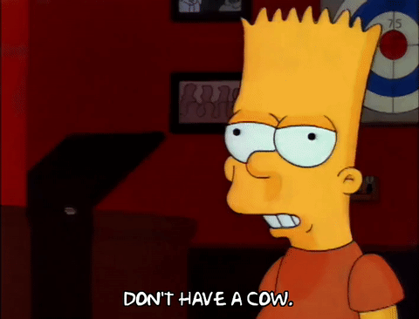
Can you guess the meaning of the following expression?
Activity 2 Idioms related to “niu”
Don't have a cow! It's no big deal.
Don't have a cow! It's just a small bug.
Don't have a cow! I'll pay for your damage.
暴跳如雷，焦虑不安

Slide 10
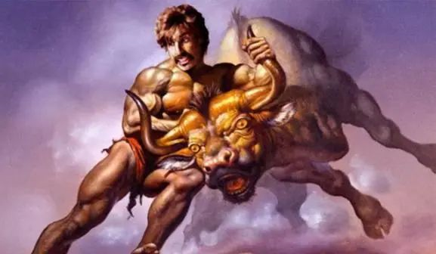
Can you guess the meaning of the following expression?
I know it's difficult to fire someone, but you just have to take the bull by the horns and tell her.
If you want to make this program a success, you will have to take the bull by the horns and do it yourself.
勇敢面对困境（或险境）

Slide 11
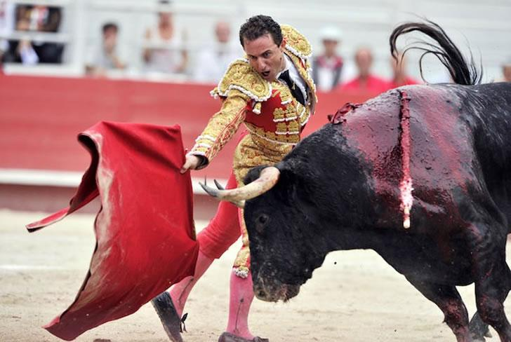
Can you guess the meaning of the following expression?
My neighbour's loud music after midnight really is like a red rag to a bull.
Don't talk to my dad about the smoking ban. It's like a red rag to a bull.
激起人怒火的事物

Slide 12
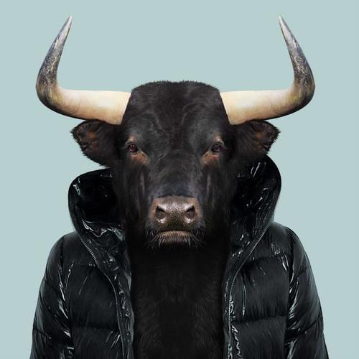
Can you guess the meaning of the following expression?
I don't know why you bother arguing with him. You're just milking the bull if you think you're going to change his mind.
Everyone told us we were milking the bull when we set up our online store on the Internet.
白费力气，徒劳无功

Slide 13
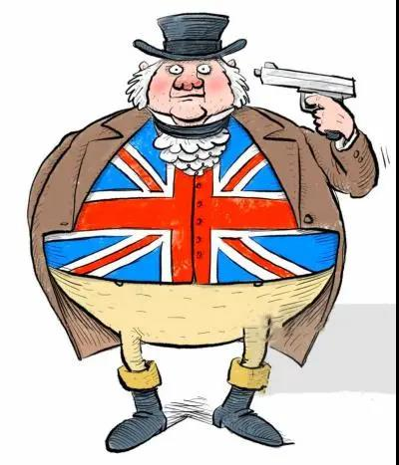
Can you guess the meaning of the following expression?
His ruddy countenance and stout figure made himlook a genuine John Bull.
他面色红润，身材胖硕，看起来就是个典型的英国人。
典型的英国人

Slide 14
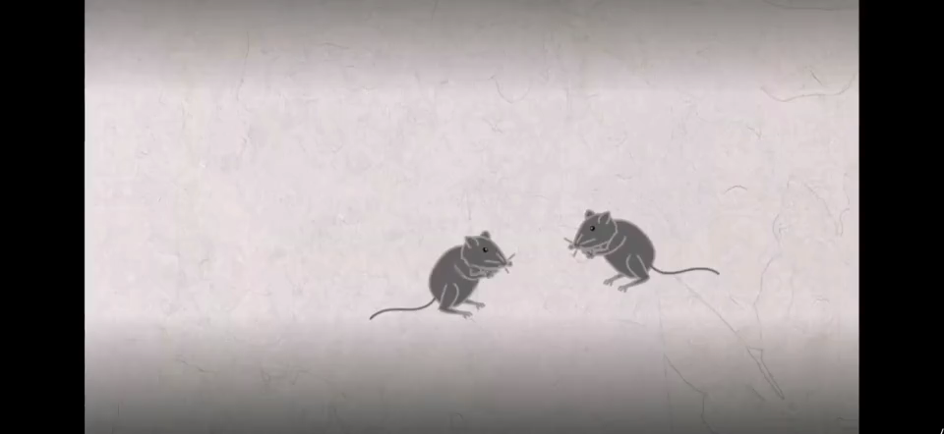
What spirit does an ox possess?
Activity 3 The spirit of “niu”

Slide 15
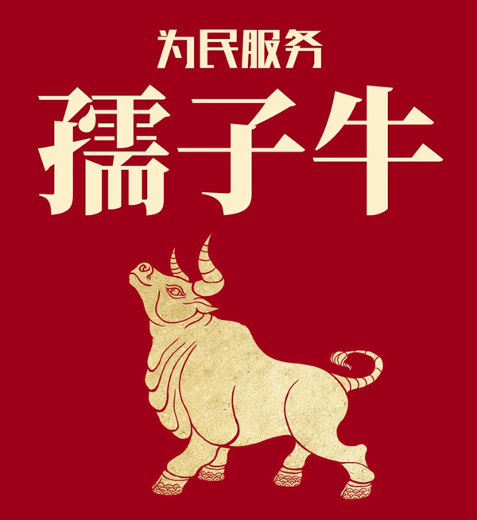
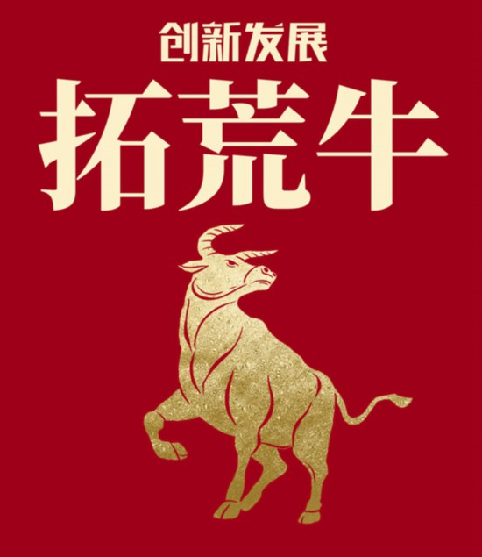
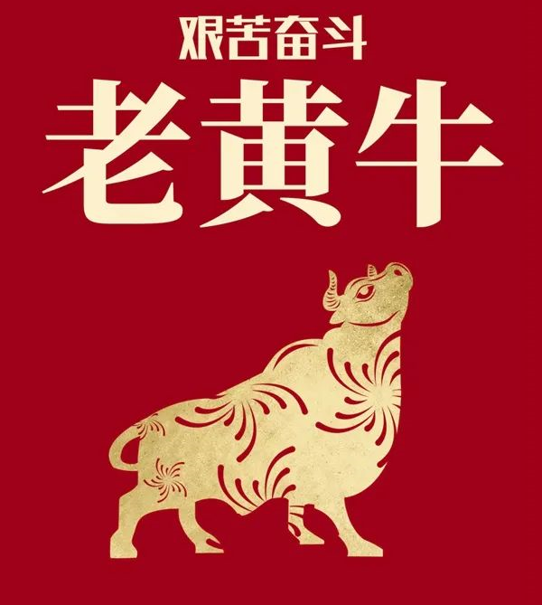
Going forward, we must exert ourselves to strive bullishly without being cowed by any problems with the
“three ox spirit”:
The serving-the-people ox:
The selfless commitment to the good of the people
The pioneering ox:
To seek innovation and development
The persisting ox:
Hardwork and the willingness to endure hardships

Slide 16

You rull!

