Slide 1


感恩遇见，相互成就，本课件资料仅供您个人参考、教学使用，严禁自行在网络传播，违者依知识产权法追究法律责任。
更多教学资源请关注
公众号：溯恩高中英语
知识产权声明

Slide 2

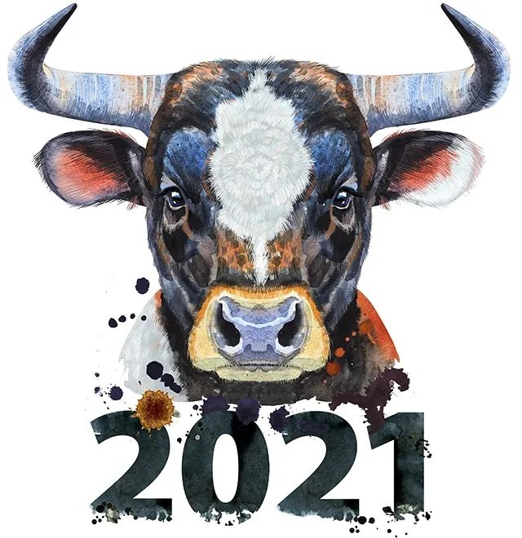

你好，中国牛！
Hello,Chinese Ox!
—— 2021年春季开学第一课
浙江省常山一中 吴俊峰
浙江省桐乡市高级中学 俞莺婕
Notes:
本PPT模板部分元素使用了幻灯片母版制作。如果需要修改，点击-视图-幻灯片母版-修改；完成后关闭编辑母版即可。

Slide 3
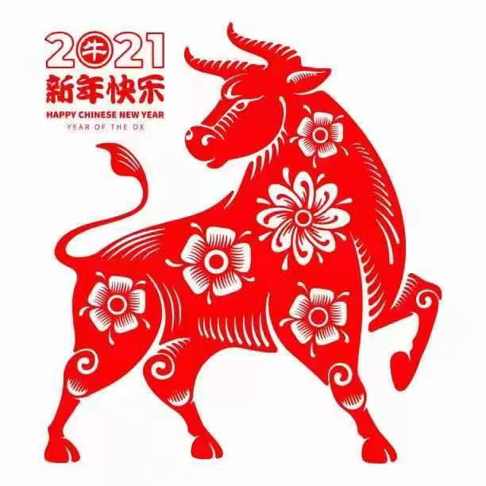
目录
Contents
1
Explore —— The richness and accuracy of expression 表达的丰富性和准确性
Warming up
2
Enhance —— The core of Chinese traditional culture 中国传统文化的内核
The spirit of the Chinese Ox
3
Embrace —— Cultural inheritance, diversity and inclusiveness
文化的传承性、多元性和包容性
A brief introduction to the Year of the Ox
4
Enjoy —— Literary beauty of culture 文学美
Describe the cattle in literature

Slide 4
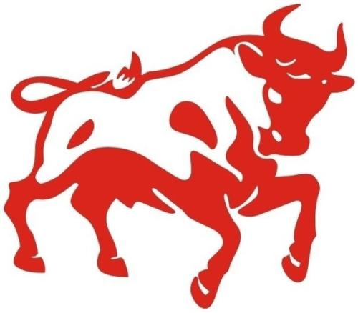
Warming up
01
Explore
The richness and accuracy of expression
表达的丰富性和准确性

Slide 5



1
How to express this animal in English?
01
ox
02
calf
03
bull
04
cow
05
buffalo

Slide 6
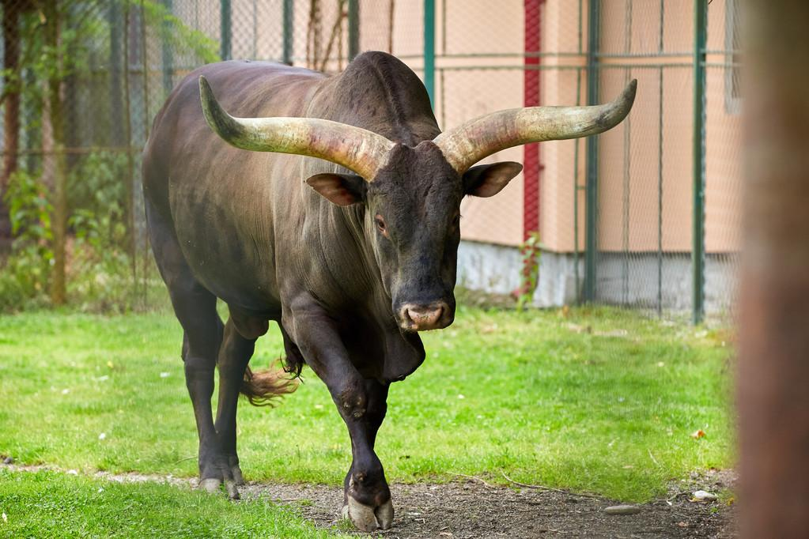
1
Learn more expressions
bull [bʊl]
n. 公牛；看好股市者；粗壮如牛的人；胡说八道
Translate these expressions into Chinese
a bull market
牛市
He was gored by a bull.
他被公牛顶伤。
That's a load of bull!
那是胡说八道！

Slide 7
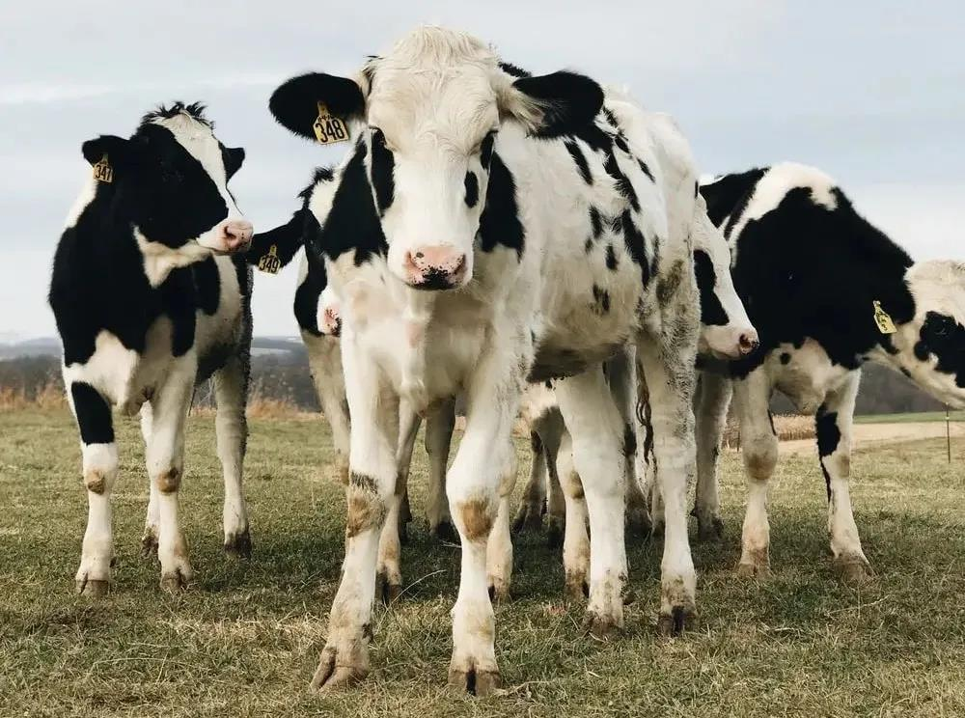
1
Learn more expressions
cow [kaʊ]
n. 奶牛，母牛；母兽 vt. 威胁，吓唬
cattle 也是牛，是成牛的泛指，公母均含，地位相当于cow。不过cattle是复数名词，或可大致理解为cattle = cows。
Translate these expressions into Chinese
a herd of dairy cows
一群奶牛
a cash cow
摇钱树
Hearing the rumbling noise, the kids were cowed into silence.
听到隆隆声，孩子们吓得默不作声。

Slide 8
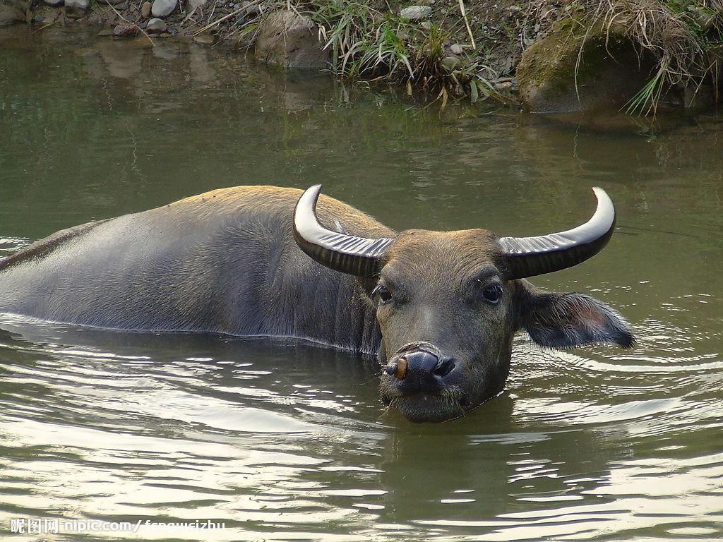
1
Learn more expressions
buffalo [ˈbʌfələʊ]
n.水牛
Translate these expressions into Chinese
Once there were 70 million buffalo on the plains.
平原上曾经有七千万头野牛。
The water buffalo squelched up and down the paddy fields, pulling the plough.
水牛拉着犁，在稻田里咕唧咕唧地走着。

Slide 9
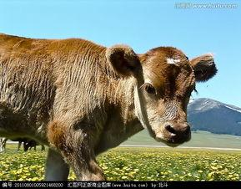
1
Learn more expressions
calf [kɑːf]
n.小牛；小牛犊；小腿
Translate these expressions into Chinese
The calf lapped up the bucket of milk.
牛犊把那桶牛奶津津有味地喝光了。
I've torn a calf muscle.
我拉伤了小腿肌肉。

Slide 10
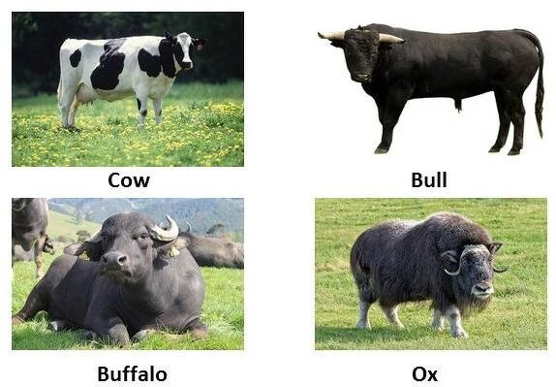
1
Learn more expressions
ox [ɒks]
n. 牛；公牛 (复数是oxen /ˈɒksn/)
泛指野生或驯养的牛类。一般情况，ox在经过训练后可在田间工作或用项圈拉东西，体积会比较大且强壮。
Translate these expressions into Chinese
as strong as an ox
体健如牛
We must lead an ox by the halter.
牵牛要牵牛鼻子。
Man, I can eat an ox!
兄弟，我可以吃下一头牛！

Slide 11
The spirit of the Chinese Ox
02
Enhance
The core of Chinese traditional culture
中国传统文化的内核

Slide 12
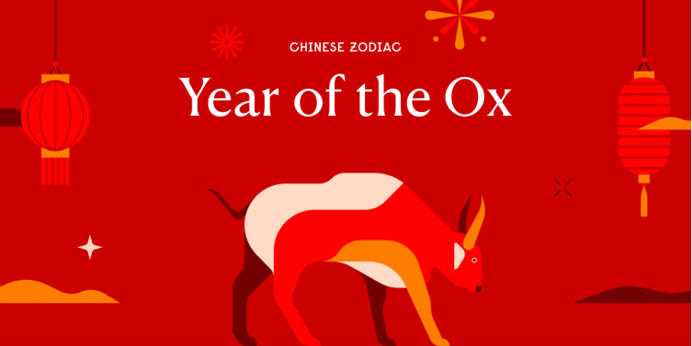
2
2021 is the year of the...

Slide 13
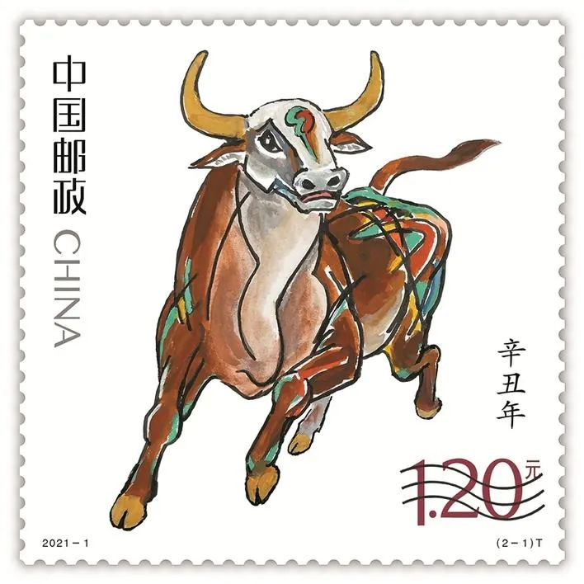
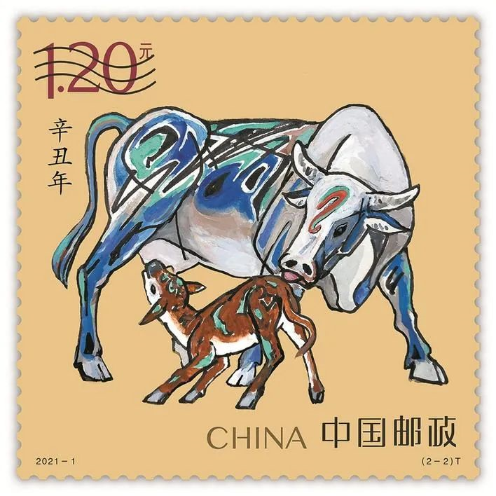
2
2021 is the year of the Ox
An issuing ceremony of Year of the Ox stamps was held at Shenzhen Stock Exchange in Futian District on Tuesday. Beginning in 1980, China Post has been issuing specially designed Chinese zodiac year stamps featuring each of the 12 zodiac animals to celebrate the Chinese New Year.

Slide 14
2
2021 is the year of the Ox
Drawn by Yao Zhonghua — an artist specializing in oil painting, classical Chinese painting — the set of two Year of the Ox stamps worth 2.4 yuan reflect the cultural characteristics of the ox, such as hardworking, persistent, practical and devoted.

Slide 15
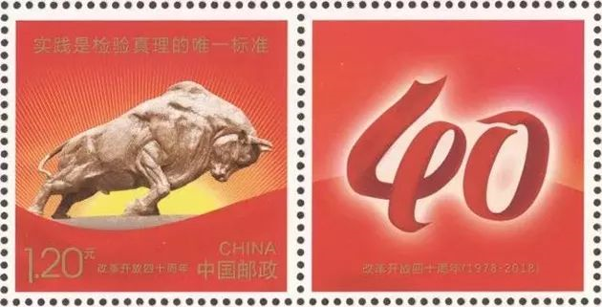
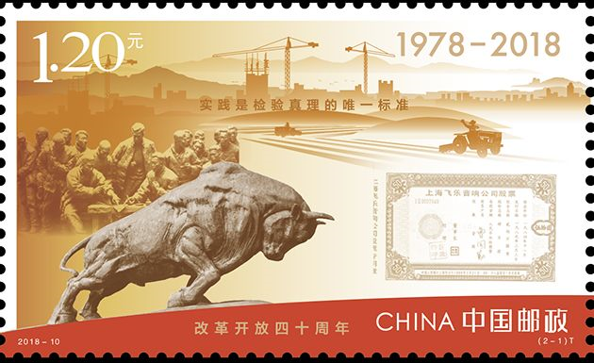
2
2021 is the year of the Ox
To launch Year of the Ox stamps in Shenzhen is a salute to the city’s spirit of daring to make attempts and innovations.
Do you know the name of Shenzhen Ox?
—— The Pioneering Ox. Why?

Slide 16
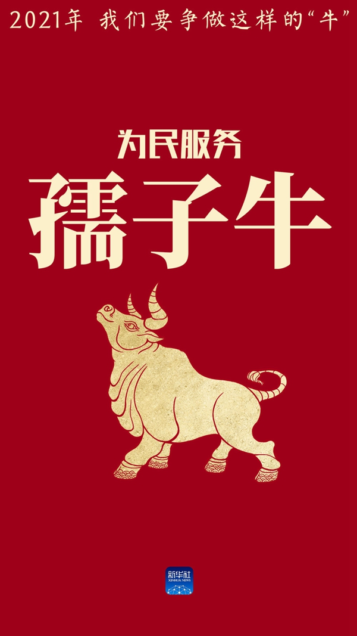
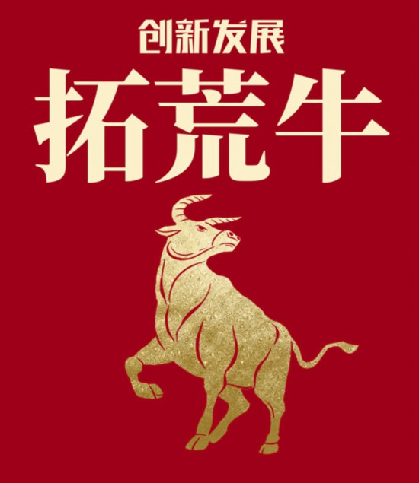
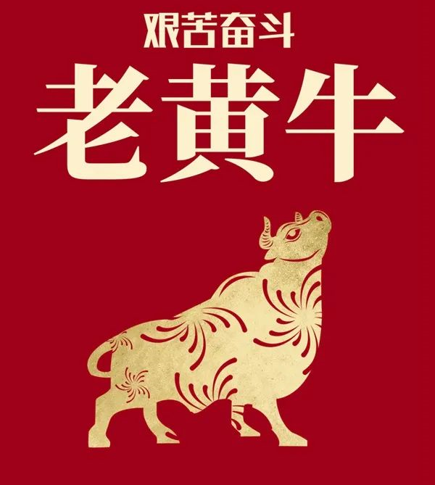
2
The spirit of the ox“三牛”精神
The serving-the-people ox
The pioneering ox
The persisting ox
The selfless commitment to the good of the people
To seek innovation and development
Hardwork and the willingness to endure hardships

Slide 17
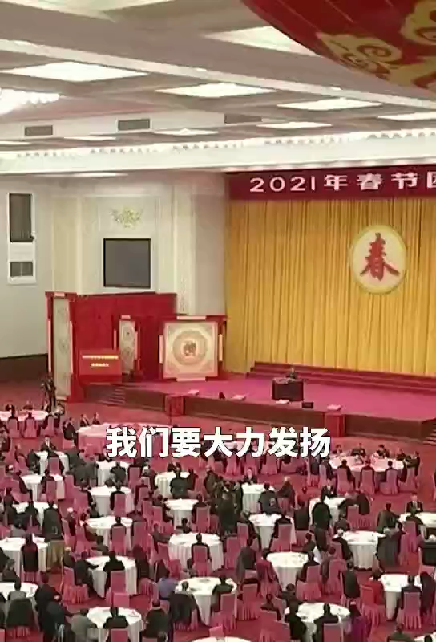
2
Chinese President Xi Jinping promoted “The spirit of the ox”
Chinese President Xi Jinping, on behalf of the Communist Party of China (CPC) Central Committee and the State Council, extended Spring Festival greetings to all Chinese Wednesday at a reception in Beijing, urging promoting "the spirit of the ox" in pursuit of fully building a modern socialist China.

Slide 18
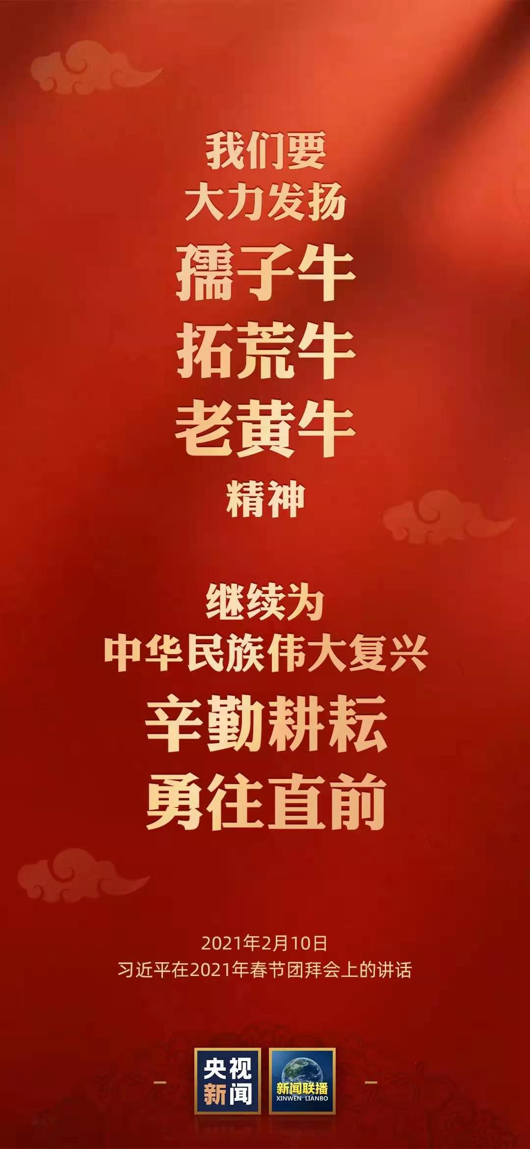
2
Chinese President Xi Jinping promoted “The spirit of the ox”
In Chinese culture, the ox is a symbol of diligence, dedication and strength.
在中华文化里，牛是勤劳、奉献、奋进、力量的象征。
Forging ahead, we should carry forward the spirit of the ox of serving the people diligently, opening up new grounds bravely and working tirelessly.
前进的道路上，我们要大力发扬孺子牛、拓荒牛、老黄牛精神。

Slide 19
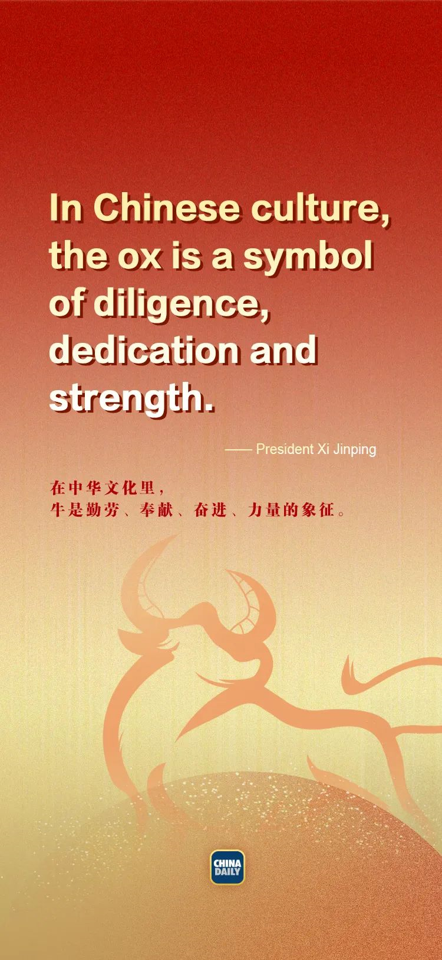
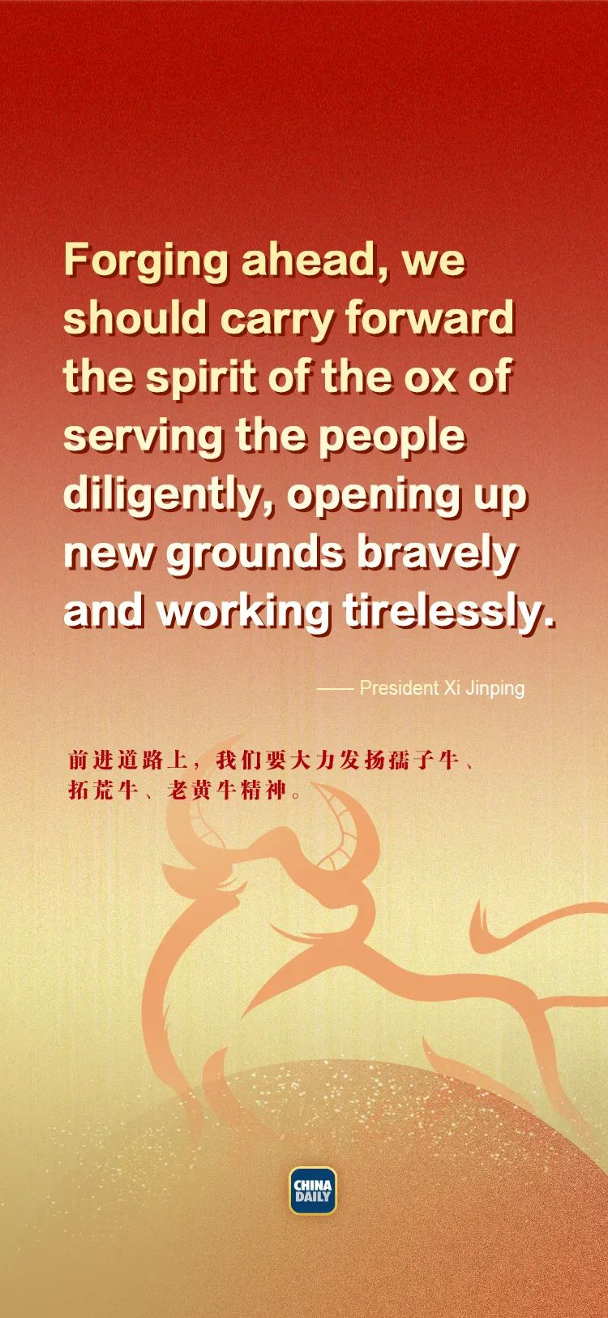
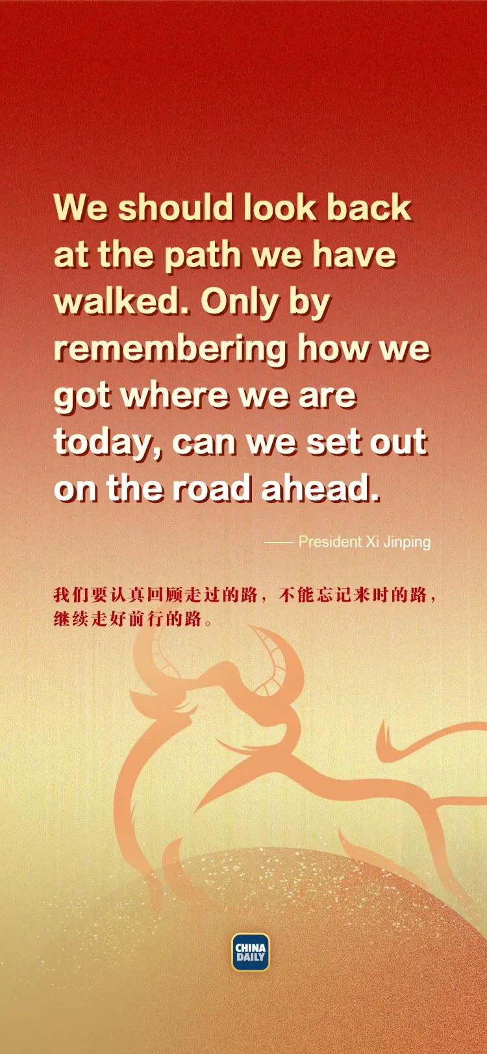
2
Chinese President Xi Jinping promoted “The spirit of the ox”
We should look back at the path we have walked. Only by remembering how we got where we are today, can we set out on the road ahead.
我们要认真回顾走过的路，不能忘记来时的路，继续走好前行的路。

Slide 20
A brief introduction to the Year of the Ox
03
Embrace
Cultural inheritance, diversity and inclusiveness
文化的传承性、多元性和包容性

Slide 21
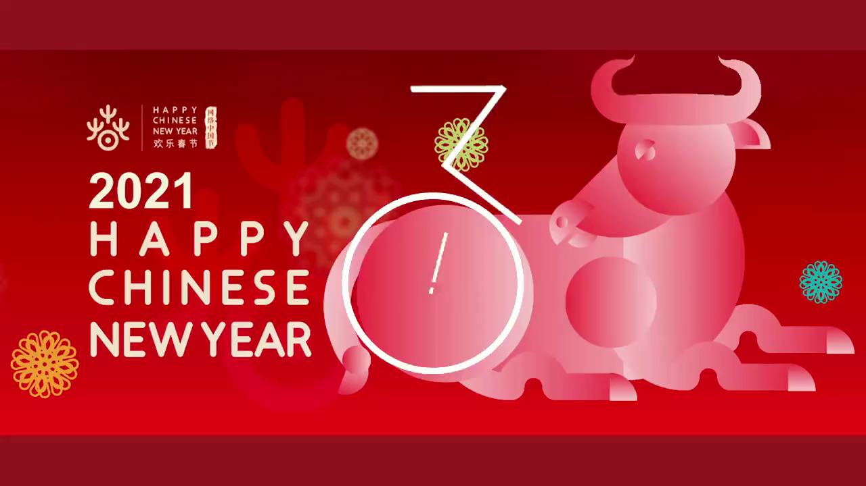
3
A brief introduction to the Year of the Ox

Slide 22
3
Cultural inheritance (文化的传承性）
2021 is , the 38th year in the traditional Chinese lunar calendar, also called the "Year of Xinchou".
The ox in the 12 Chinese . China is an agrarian society and the ox culture in China for a long time. The ancient text Sanzajing (Three Character Classic) writes “The horse,the ox, the sheep, the fowl, the dog, the pig. These six animals are those .” The six types of animals, the “head of domestic animals”,
. by the Chinese people for centuries.
2021年是牛年，是中国传统农历（干支） 纪年中的第38年，即 “辛丑年”。
牛是十二生肖之一， 排名第二 。中国是一个农耕社会，中国的牛文化也源远流长。《三字经》中记载：“马牛羊，鸡犬豕，此六畜， 人所饲。” 这六种动物被合称为 “六畜之首”, 自古以来是中国百姓最看重的家畜。
☞ domestic /dəˈmestɪk/ adj. 国内的；家庭的；驯养的
the Year of the Ox
ranks second
zodiac animals
dates back
which men keep
collectively known as
have been cherished

Slide 23
3
Cultural inheritance (文化的传承性）
China raising cattle and cattle have been
to the lives of working people. According to legend, Emperor Yan worshipped the cattle totem and invented agriculture, and was henceforth
Shennong (God of Agriculture). The ferocious Chiyou, a subordinate in the tribe of Emperor Yan, also worshipped the cattle totem and became a God of War in Chinese legends.
我国养牛历史悠久，牛与劳动人民的生活息息相关。传说中的炎帝崇拜牛图腾，发明了农业，又称作神农氏。炎帝部落的蚩尤，好战，也崇拜牛图腾，成为了中国传说中的战神。
☞ worship /ˈwɜːʃɪp/ n. 崇拜；礼拜；尊敬 v. 崇拜；尊敬；爱慕
☞ totem /ˈtəʊtəm/ n. 图腾；崇拜物
☞ henceforth /ˌhensˈfɔːθ/ adv. 从此以后
☞ ferocious /fəˈrəʊʃəs/ adj. 残忍的；惊人的
☞ subordinate /səˈbɔːdɪnət/ n. 部属，下属，下级
has a long history of
closely related
referred to as

Slide 24
3
Cultural inheritance (文化的传承性）
In the folk legend The Cowherd and the Weaver Girl often hailed as China's Romeo and Juliet, the weaver girl, a deity from heaven, the cowherd, a diligent, down-to-earth and faithful mortal. After , the cowherd continued to love the weaver girl, even though they could meet only
on a magpie bridge. The honest and loyal personality of the cowherd was accentuated in the story, and the star-crossed lovers' affection toward one another elucidated the yearning for a better life by the Chinese working people.
堪称中国版 《罗密欧与朱丽叶》的《牛郎织女》中，仙女织女爱上了勤劳朴实、 忠贞不二的牛郎。即便被迫分离后，牛郎依旧深爱着织女，哪怕只有一年一度才在鹊桥上相见。故事中，忠厚、 忠诚的牛郎人格得到了延伸和升华，两人浓厚的感情也阐释了中国劳动人民对美好生活的向往之情。
☞ hail /heɪl/ 赞扬（或称颂） ☞ deity /ˈdeɪəti/ n. 神；神性
☞ mortal /ˈmɔːtl/ n. 人类，凡人 ☞ accentuate /əkˈsentʃueɪt/ vt. 强调；重读
☞ elucidate /ɪˈluːsɪdeɪt/ vt. 阐明；说明 ☞ yearn /jɜːn/ i. 渴望，向往；思念，想念；怀念
fell in love with
forced separation
once a year

Slide 25
3
Cultural diversity & inclusiveness （文化的多元性 & 包容性）
The bull's masculine qualities have made it in many ancient cultures. Since prehistoric times, the symbolism of the bull .
power and male fertility, and the bull itself has been the object of many religious rituals. Hindus do not eat beef, because the hardworking bull once assisted men in farming along the sacred Ganges River. Egyptian pharaohs regarded the bull as a deity, and often portrayed it as a sun god in their .
牛的阳刚之气使它一直是许多古代文化的重要象征之一。自史前时代以来，公牛的象征意义就与战斗力和男性生育能力联系在一起，牛本身也是许多古老宗教祭祀的对象。印度教徒不吃牛肉，因为勤劳的牛曾经在神圣的恒河旁协助人类耕种。埃及的法老视牛为神祇，在他们的绘画和雕塑中常常把牛塑造成太阳神。
☞ masculine /ˈmæskjəlɪn/ adj. 男性的；阳性的；男子气概的
☞ fertility /fəˈtɪləti/ n. 多产；肥沃; 能生育性；可繁殖性；想象力丰富
☞ ritual /ˈrɪtʃʊəl/ n. 典礼；宗教仪式；固定程序
☞ deity /ˈdeɪəti/ n. 神；神性
☞ portray /pɔːˈtreɪ/ vt. 描绘；扮演
a key symbol
has been associated with
paintings and sculptures

Slide 26
3
Cultural diversity & inclusiveness （文化的多元性 & 包容性）
using the character for
There are many Chinese expressions the bull, such as “strength of nine oxen and two tigers”, a metaphor for great strength; “tall as an ox and large as a horse”, used to describe someone's physical size; “playing the harp to a bull”, an analogy for wasting one's breath; and “to take the bull by the horns”, an expression for stubbornness. However, there is . than using the character “bull(niou)” .
汉语中有许多关于牛的词语，如比喻极大力量的“九牛二虎”，形容长得高大强壮的“牛高马大”，比喻白费口舌的“对牛弹琴”，和形容固执的 “钻牛角尖”。不过，最简单的莫过于用一个“牛”字来赞赏一个人的能力了。
☞ metaphor /ˈmetəfə/ n. 暗喻，隐喻；比喻说法
☞ analogy /əˈnælədʒi/ n. 类比；类推；类似
nothing simpler
to praise a person's competence

Slide 27
3
Cultural diversity & inclusiveness （文化的多元性 & 包容性）
regarding
There are many words and expressions the bull in English too. A continual rise in stock market prices is called a “bull market” since bulls symbolize . The word "cow" is also often used to describe “stubbornness” and “headstrong”, such as “have a cow”, a slang term for throwing a fit; “a bull in a china shop”, which describes a careless person; or“bull-taming”, which means one can even . primordial forces.
英语里也有很多关于牛的词语。股票价格持续上升被称为“牛市”, 因为牛象征着生产和增值。英文中也经常用“牛” 来形容“倔强”和“固执”，如比喻愤怒的“have a cow”, 形容粗心鲁莽的 “a bull in a china shop”，“bull-taming” 则表达只要有决心就能战胜原始的力量。
☞ slang /slæŋ/ n. 俚语；行话 adj. 俚语的
☞ throw a fit 大发脾气；大为烦恼
☞ primordial /praɪˈmɔːdiəl/ adj. 原始的；根本的；原生的
production and profit
with determination
overpower

Slide 28
3
Cultural confidence （文化自信）
The bull is also the token for sturdiness. The Iron Bulls of the Yellow River, built in 725 AD during the Tang Dynasty (AD 618-907), used their weights and footings underground the Pujindu Floating Bridge, an artery for logistics at the time. The infrastructure cost 1,100 tons of iron, equivalent to of China's iron production that year. It is . appropriate to describe the iron statues, which are great in size and even greater
with the Chinese term “like a bull with a heavy load”
牛也可以是力量的象征。黄河铁牛，是中国古代唐朝公元725年时搭建的铁质桥桩，这几尊铁牛用自身的力量支撑着唐朝的运输命脉：蒲津渡浮桥。基建耗费了1100吨铁，相当于当年国家铁产量的五分之四。用“如牛负重”来形容这体积庞，
责任又重大的桥庄是再合适不过的了。
☞ token/ˈtəʊkən/ n. 标志；（用于表达感情的）记号 ☞ sturdiness/ˈstɜːrdinəs/ n. 坚固；强健，雄壮
☞ artery /ˈɑːtəri/ n. 动脉；干道；主流 ☞ logistics /ləˈdʒɪstɪks/ n. 后勤；物流；组织工作
☞ infrastructure /ˈɪnfrəstrʌktʃə(r)/ n. 基础设施；公共建设 ☞ equivalent /ɪˈkwɪvələnt/ adj. （在价值、数量等方面）相等的
to anchor and support
four-fifths
more than
in responsibility

Slide 29
3
Cultural confidence （文化自信）
The ox, a animal, has deeply influenced the lives of the Chinese people .
2020 was a difficult year. As the Year of the Ox ,we hope everyone can many “moo”-re new opportunities. Happy Year of the Ox!
老牛， 中国人眼里踏实、憨厚又勤劳的动物一直深深地影响着历代中国人的生活。
2020年“鼠” 实不易，农历牛年即将到来，希望大家在新的一年里 “牛” 转新机。牛年大吉！
grounded, humble and hardworking
for generations
approaches
be blessed with

Slide 30
Describe the cattle in literature
04
Enjoy
Literary beauty of culture
文学美

Slide 31
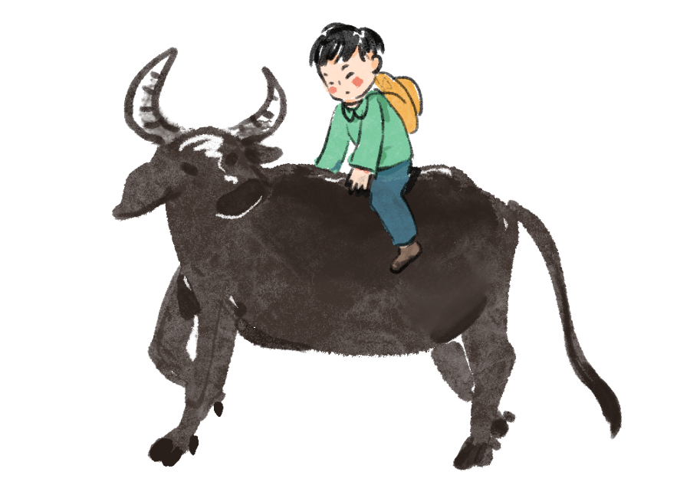
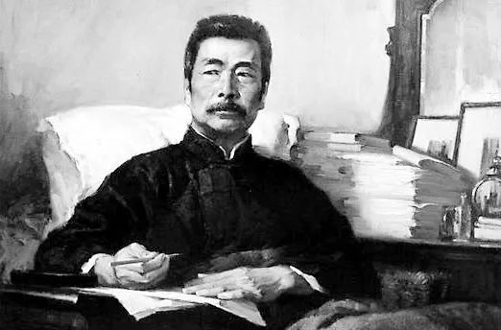
4
An ox in literature
What poem comes to your mind in this picture?
Lu Xun (1881－1936), “Fierce-browed, I coolly defy a thousand pointing fingers; Head bowed, like a willing ox I serve the children”
defy /dɪˈfaɪ/ vt. 藐视；公然反抗

Slide 32
4
How to vividly describe the cattle in literature
01. Suddenly a dozen long-horned cattle burst out of the prairie, not far from the stable. Their tails stood up and their fierce horns tossed and their feet pounded the ground.
prairie /ˈpreəri/ n. 大草原；牧场
stable /ˈsteɪbl/ adj. 稳定的；n. 马厩；养马场
toss /tɒs/ v. 抛，投； 甩（头，以表示恼怒或不耐烦）；颠簸
pound /paʊnd/ n. 英镑；重击，重击声 v. 捣烂；敲打；猛击
01
突然，在离马厩不远处的草原上，一下冒出了十几头长角牛。它们翘着尾巴摇晃着凶悍的长角，蹄子一个劲地在地上飞扬着。
02. The cow bawled and the little calf squalled, bleating thinner bawls.
All night the calf and the cow were stamping and swishing their tails in the stable.
bawl /bɔːl/ v. 放声痛哭；大喊；怒吼
squall /skwɔːl/ v. 尖叫；（尤指婴儿）大声啼哭，号哭
bleat /bliːt/ v. （羊）咩咩叫，牛（哞哞叫）；低声说话；抱怨
stamp /stæmp/ n. 邮票；跺脚 v.用脚踩踏；跺脚
swish /swɪʃ/ vt. 鞭打；使作沙沙声
02
母牛哞哞大叫，小牛犊也会奶声奶气地小声叫着。
整个晚上，母牛和小牛犊都在马厩里跺着脚、摇着尾巴驱赶蚊子。

Slide 33
4
How to vividly describe the cattle in literature
03
03. The gentle cow went meekly away with the rope around her long horns, and the calf frisked and jumped behind.
meekly /ˈmiːkli/ adv. 温顺地；逆来顺受地；忠厚地
frisk /frɪsk/ v. （动物）蹦跳，欢跃，活蹦乱跳
温驯的奶牛角上绑着一根绳子，顺从地让史科特先生牵走了。小牛犊活蹦乱跳地跟在后面。
04. A piebald cow also lazily nibbled the grass there, occasionally casting its tail over its scrawny back.
piebald /ˈpaɪbɔːld/ adj. （马、牛）花斑的；黑白两色的
nibble /ˈnɪbl/ v. 细咬；小口咬，一点点地咬（食物）；(动物) 啃啄
scrawny /ˈskrɔːni/ adj. 骨瘦如柴的
04
一头花斑母牛在那里懒洋洋地嚼着青草，偶尔甩起尾巴拍打那瘦骨嶙峋的脊背。

Slide 34
4
How to vividly describe the cattle in literature
05
05. A cow came up to the door and breathed loudly once or twice and the dog gave it a dignified growl.
dignified /ˈdɪɡnɪfaɪd/ adj. 庄严的；有尊严的；高贵的
growl /ɡraʊl/ v./n. （动物，尤指狗）发出低吠声；（人发出的）低声咆哮着说；（机器或引擎发出的）发隆隆声
一头母牛走到门前大声喷了两口气，狗凛然不可侵犯似的向它狂吠起来。
06. Near the cart was a half-dozing cow, chewing her cud, and standing patiently to be rained on, with wreaths of vapour rising from her reeking hide.
cart /kɑːt/ n. 二轮运货马车；手推车；手拉车
dozing /ˈdoʊzɪŋ/ v. 假寐（doze的现在分词）；上课打瞌睡；打盹
cud /kʌd/ n. （牛等动物）反刍的食物，倒嚼的食物
wreath /riːθ/ n. 花冠；圈状物；（烟、云等的）圈，缭绕
vapour /ˈveɪpə(r)/n. 蒸汽，烟雾
reek /riːk/ v. 散发臭味；散发蒸汽（或浓烟）
hide /haɪd/ n. 躲藏；兽皮
06
马车不远处有一头睡跟惺忪的奶牛，嘴里嚼着反刍的食物，默默地站在那里，任凭雨水打在身上，湿淋琳的背上日出缭绕的水气。

Slide 35
4
How to vividly describe the cattle in literature
07. The bull had its head down and was munching the grass, snorting peacefully. It was an ugly bull—reddish-looking eyes, a white face; matted, curly hair round its head. Its horns curved outwards to sharp points and the ring in its nose was worn from years of dragging on the grass.
munch /mʌntʃ/ v. 用力咀嚼；大声咀嚼
snort /snɔːt/ v. 轻蔑或愤怒地发出哼声；（气愤或被逗乐）喷鼻息
matt /mæt/ adj. 不光亮的，无光泽的，哑光的
curve /kɜːv/ n. 曲线；弯曲 v. 弯；使弯曲
07
公牛低着头，大口嚼着草，悠闲
地打着响鼻儿。那是一头丑陋的
公牛，红眼睛，白脸庞。头上蓬乱卷曲的毛。尖尖的角向外弯曲着，而鼻子上的环由于多年在草地上的拖拉而磨损了。
08
08. The bull backed again, bowed his horns … suddenly rushed to one side and ran away, waggling his head from side to side.
waggle /ˈwæɡl/ v. 摇摆；不停地来回摇动
公牛再次退后，垂下了角……突然冲到一侧，左右摇着头逃跑了。

Slide 36
4
How to vividly describe the cattle in literature
09.The bull stamped and whimpered, like an impetuous spoiled child, snuffing the ground, and throwing up a bushel of dust.
whimper /ˈwɪmpə(r)/ v. 呜咽，啜泣 n. 呜咽声，啜泣声；牢骚
impetuous /ɪmˈpetʃuəs/ adj. 冲动的；鲁莽的；猛烈的
snuff /snʌf/ v. 出声地嗅；熄灭（小火苗）
bushel /ˈbʊʃl/ n. 蒲式耳（相当于35.2公升）；大量；很多
09
公牛用蹄子刨着地面，咆哮着，像一个鲁莽的、宠坏了的孩子。鼻息拂过地面，扬起一片灰尘。
10
10. The bull landed sideways in the dirt with a throaty grunt. The impact would have killed most creatures, but the bull just flailed its legs, righted itself and shook its horns.
throaty /ˈθrəʊti/ adj. 喉音的；嘶哑的；低沉洪亮的
grunt /ɡrʌnt/ v. （动物，尤指猪 ) 发出呼噜声；咕哝着说
flail /fleɪl/ v. 用力地胡乱摆动；（用棍棒）猛击；
公牛侧身降落在泥土中，喉咙里发出呼噜声。这个冲击力会杀死大多数动物，但是公牛只是甩了甩，使自己恢复平衡，并抖了抖双角。

Slide 37
4
How to vividly describe the cattle in literature
11.The bull roared, shaking its head to dislodge the tarp, only to get it more tangled up in the fabric.
dislodge /dɪsˈlɒdʒ/ v. 逐出，驱逐；用力移动
tarp /tɑːp/ n. 油布；防水布
tangle /ˈtæŋɡl/ v. （线、毛发等的）缠结的一团，处于混乱状态；纠纷；打架
fabric /ˈfæbrɪk/ n. 织物；布
11
公牛咆哮着，摇着头试图把篷布甩掉，然而却越缠越多。
12
12.The bull glared at me, its blue eyes as bright and hot as butane flames in the gloom of the cavern. Then it charged.
butane /ˈbjuːteɪn/ n. [有化] 丁烷
gloom /ɡluːm/ n. 昏暗；阴暗
cavern /ˈkævən/ n. 洞穴；凹处
公牛瞪着我，它的蓝眼睛像幽暗洞穴中的丁烷火焰一样明亮和热。然后它猛冲过来。

Slide 38
4
How to vividly describe the cattle in literature
13.The bull lurched away, shaking his head in dismay.
lurch /lɜːtʃ/ v. 突然倾斜；（因震惊或惊恐等）心猛地一跳，胃猛地翻腾；蹒跚
dismay /dɪsˈmeɪ/ n. 沮丧；惊慌vt. 使沮丧；使惊慌
13
公牛蹒跚着走开了，沮丧地摇摇头。
14.When the bull stretched himself on the ground, she climbed on to his back and placed the beautiful wreath round his horns. But he instantly sprang up, and ran away with her so fast that she did not venture to jump off, but could only hold on to his horns and scream with all her might.
stretch /stretʃ/ v. 伸展；拉紧；（使）过分延长
sprang /spræŋ/ v. 跳跃；弹起（spring 的过去式）
venture /ˈventʃə(r)/ v. 敢于冒险；小心地说（或做）
might /maɪt/ aux. 可能，也许 n. 强大力量，威力
14
当公牛趴在地上时，她爬到它的背上，把美丽的花环绕在牛角上。但牛立刻跳了起来，跑得太快，她没有冒险跳下去，但只能抓住牛角，高声尖叫着。

Slide 39
Homework
假定你是李华，2021年春节期间，你的美国朋友Alex 询问中国春节的传统文化和习俗。请用英语给Alex回一封邮件，内容包括:
1. 新年祝福;
2. 活动内容；
3. 牛年“精神”。
注意:1.词数80左右;
2.可以适当增加细节, 以使行文连贯。

Slide 40
Possible version
Dear Alex,
As the lunar Chinese new year is drawing near, I’d like to cordially send you the best wishes for the approaching new year and share some related details.
As is often the case, most Chinese would celebrate the Spring Festival with their families, sitting together to have a New Year’s Eve feast, watching the Spring Festival Gala and hand out lucky money to the young in red envelopes. Since 2021 is the year of the ox in Chinese zodiac, we would also exert ourselves to strive bullishly with the spirit of the ox, that is, to be devoted, innovative and persisting.
Hopefully, my sharing would be constructive. Wish you a happy, healthy and prosperous new year!
Yours,
Li Hua

Slide 41
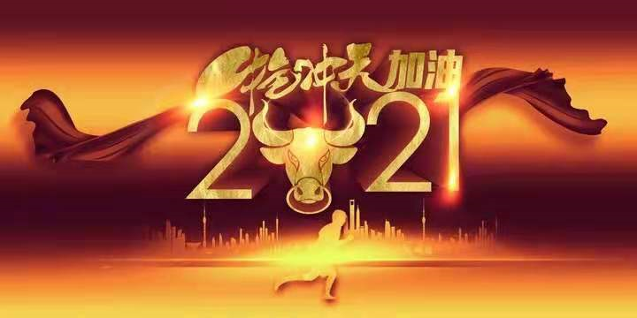

You rull！
Notes:
本PPT模板部分元素使用了幻灯片母版制作。如果需要修改，点击-视图-幻灯片母版-修改；完成后关闭编辑母版即可。

