Slide 1


感恩遇见，相互成就，本课件资料仅供您个人参考、教学使用，严禁自行在网络传播，违者依知识产权法追究法律责任。
更多教学资源请关注
公众号：溯恩高中英语
知识产权声明

Slide 2
Identities and Responsibilities
Celebrating Women's Day

Slide 3
How does our society define us as a woman/a man?
sacrifice
mother
hard work
Women’s Day
family chores
…
gifts

Slide 4
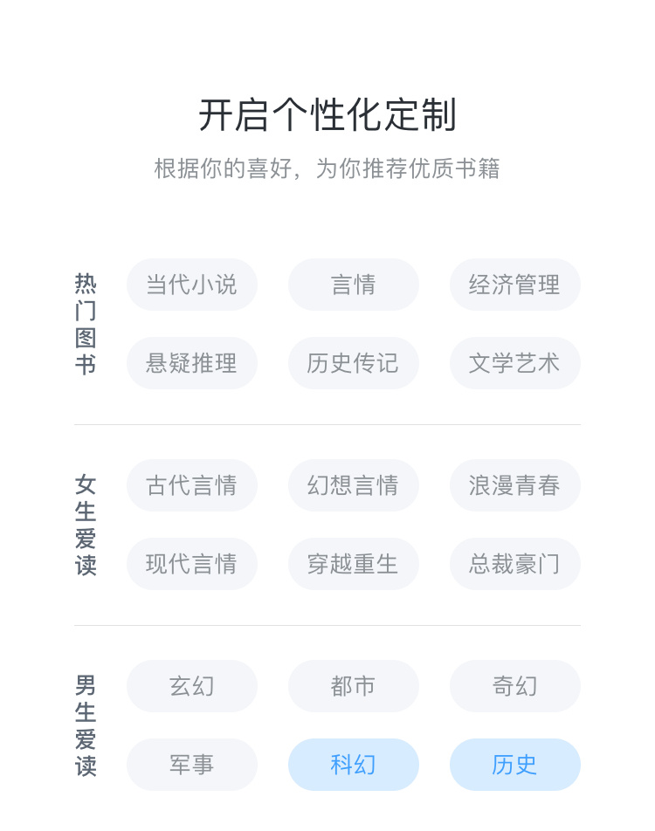
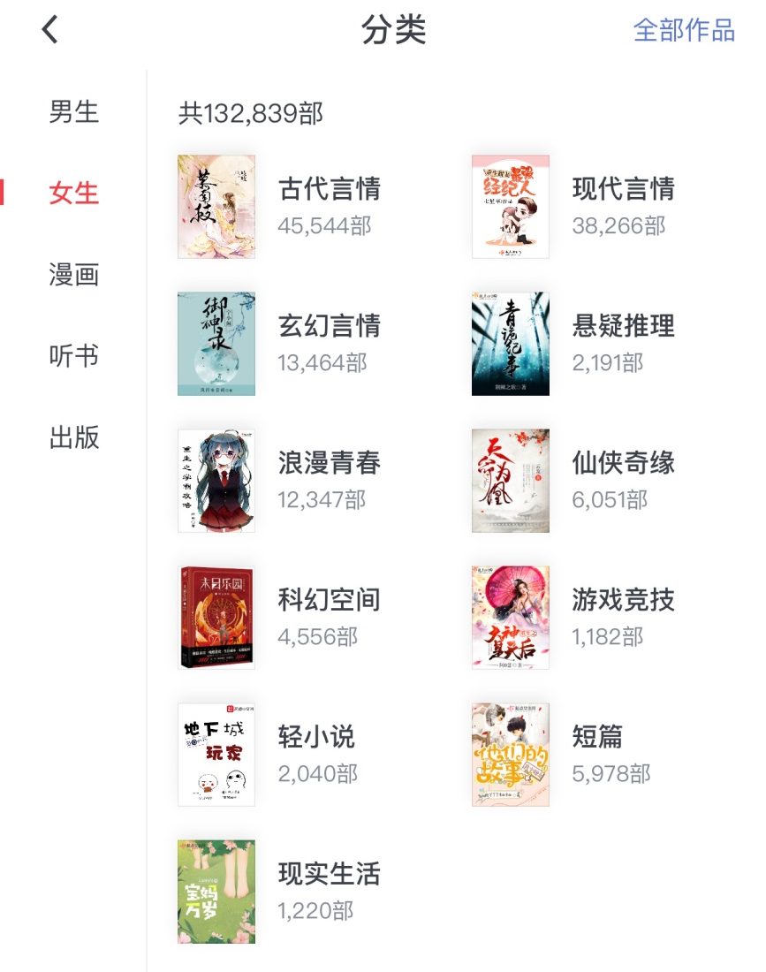
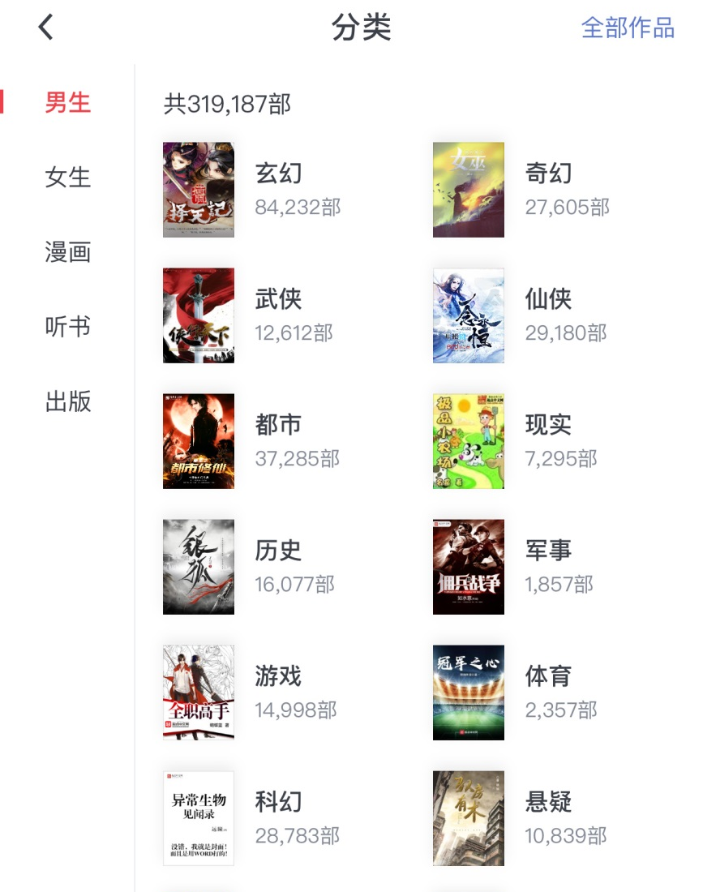
How does our society define us as a woman/a man?

Slide 5
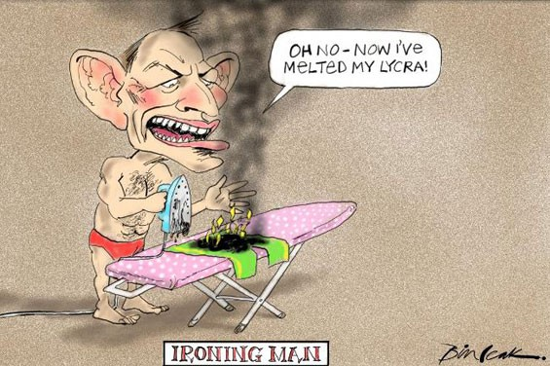
Match the jobs to a gender – Male/Female?
Pilot
Babysitter
Engineer
Doctor
Beautician(美容师)
Politician

Slide 6
identities and responsibilities
We judge people on the basis of stereotypes

Slide 7
identities and responsibilities
1
For women
2
For men
3
He for she & She for he

Slide 8
identities and responsibilities
1
For women
2
For men
3
He for she & She for he

Slide 9
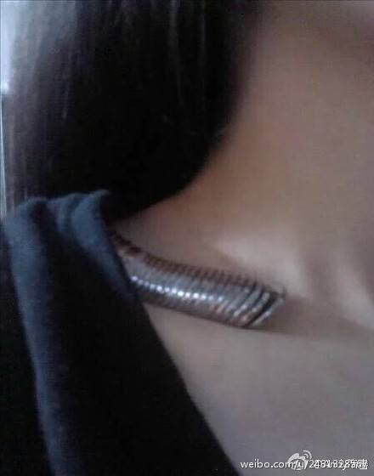
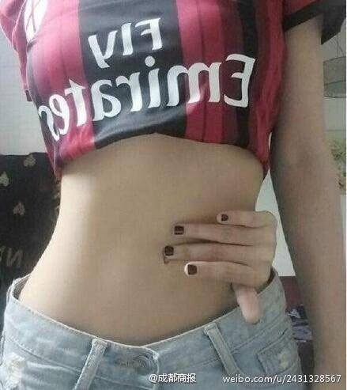
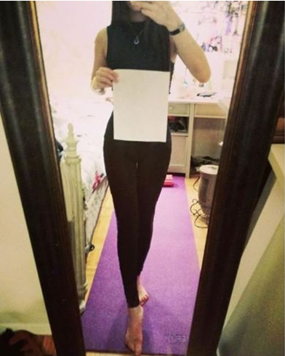
A4 Waist Challenge: YES or NO?

Slide 10
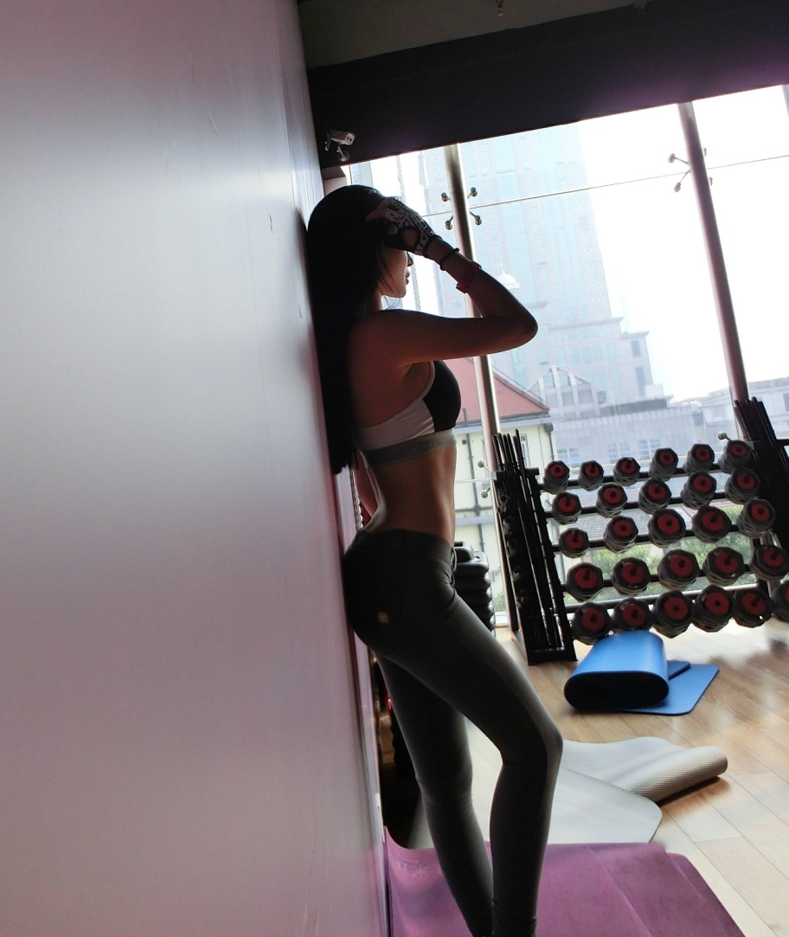
Say YES to the challenge
Azura Ge:
Show off the progress she had made in the gym
Another Chinese student:
Show off her recent weight loss

Slide 11
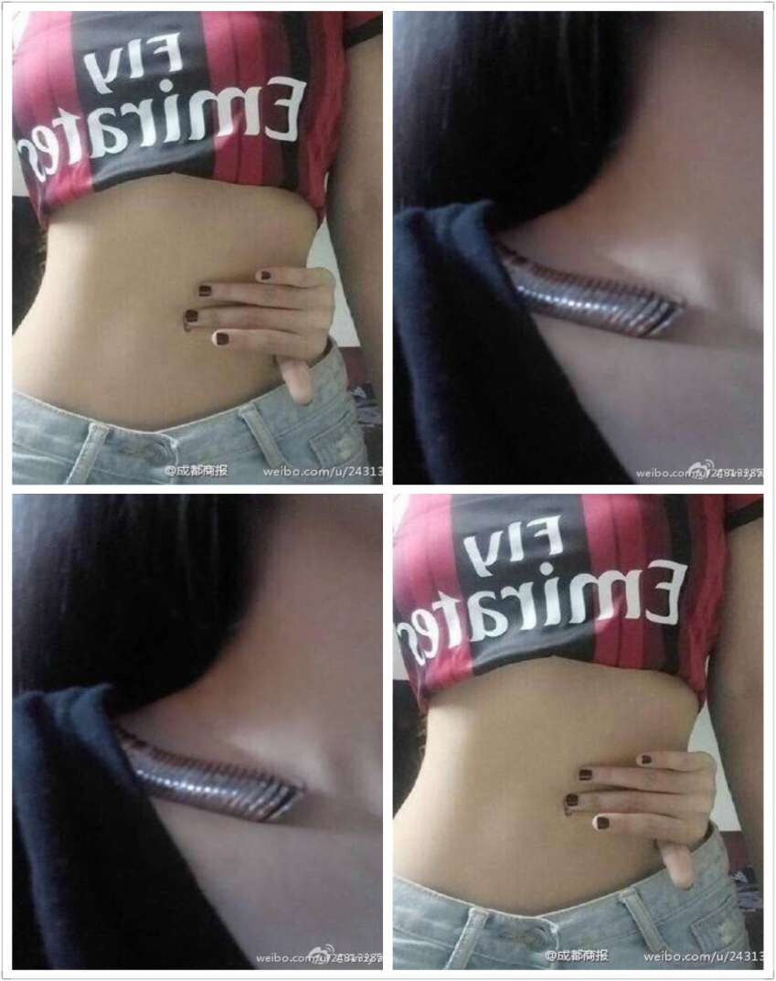
Say NO to the challenge
irresponsible
be criticized as ______________ and _______________ unhealthy.
could ______________eating disorders and body shaming.
Angela Hui:
have a _______________ body image
potentially
promote
prejudiced
Notes:
What is your response? Yes or NO?
Do a quick survey

Slide 12
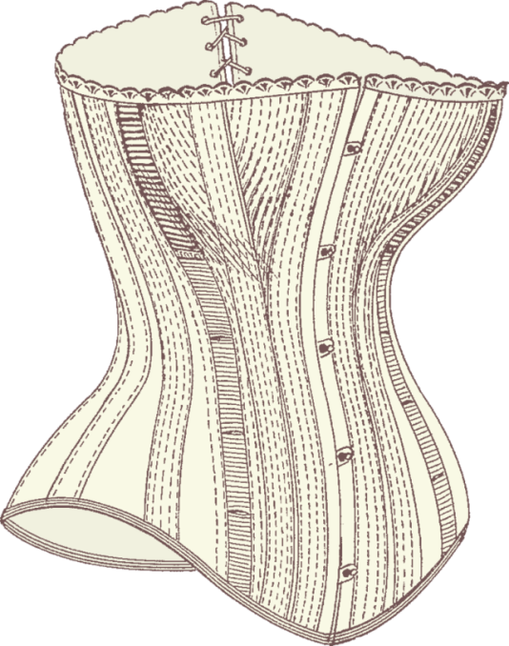
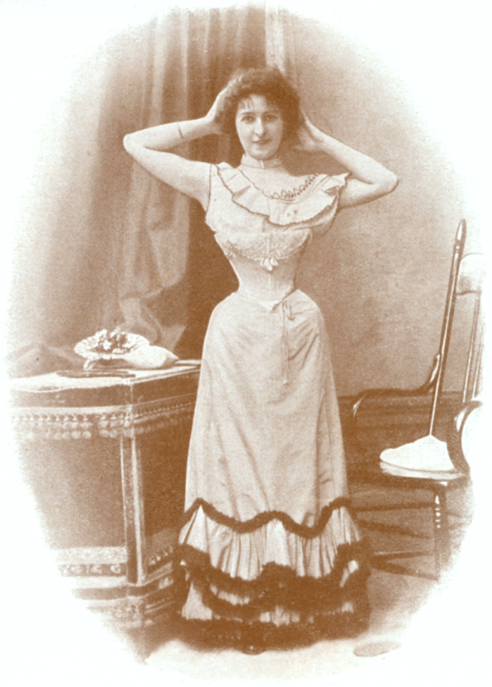
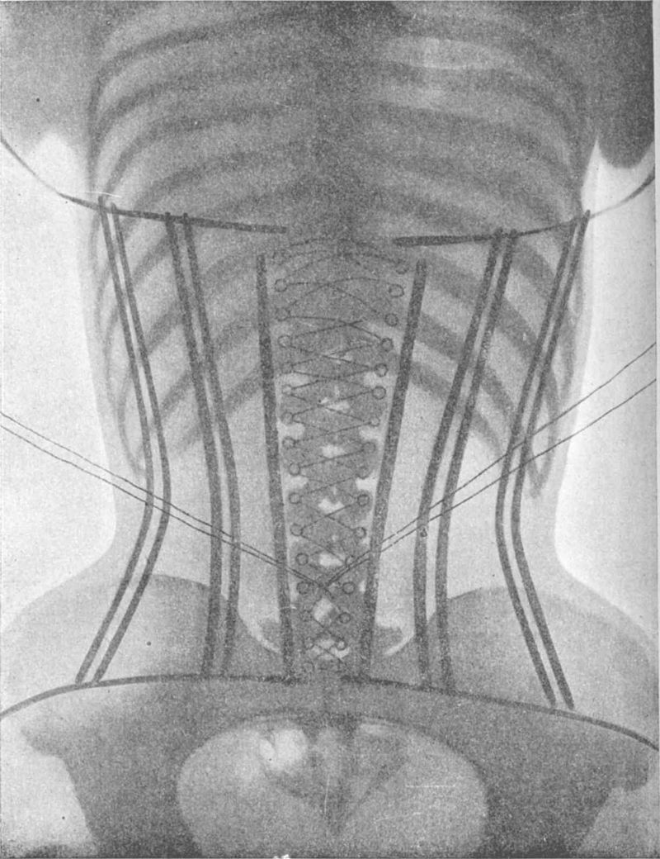
rib (肋骨) broken
corset(束腰内衣)

Slide 13
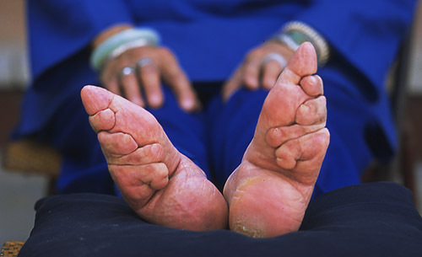
corset(束腰内衣)
foot-binding

Slide 14

the standards for ________ to submit to(顺从)
Gender ______________________________________________
Prejudice/Discrimination/Inequality
women
Notes:
From …to…

Slide 15

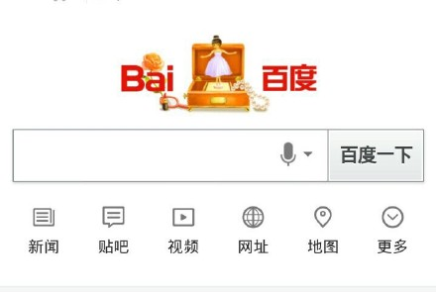
Celebrating Women’s Day

Slide 16


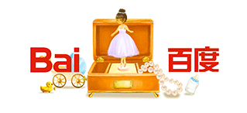
Description
a lipstick, a mirror and a necklace
a red rose, rings, a wedding dress
a baby carriage, a milk bottle, toys

Slide 17
Description
As is vividly shown in the picture, a little girl is dancing in a music box, surrounded by __________.
As she dances, she has grown into a young lady in _________, with _____________________ around.
She whirled in this _______________. Things that surrounded her have, eventually, changed into _________________________________.

Slide 18
Interpretation 解读
The picture seems to be reflecting a woman’s role as ____________and ___________, suggesting that Baidu would like to shows its appreciation towards women for their ____________
a lipstick, a mirror and a necklace
a red rose, rings, a wedding dress
a baby carriage, a milk bottle, toys

Slide 19

How does Baidu define us as a woman?
A doll in the box?

Slide 20
How does Baidu define us as a woman?
A doll in the box?
Women’s identities are severely materialized and fixed.
A wife and a mother? (a babysitter?)

Slide 21
How does the society define us as a woman?
Not just in China
NO equal pay
NO equal rights
changing for the better

Slide 22
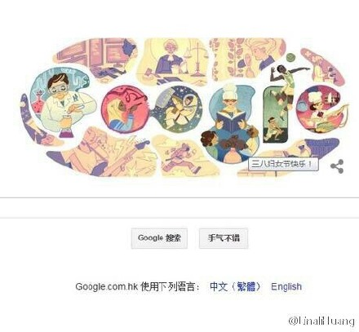
How does google define us as a woman?
International Working Women’s Day

Slide 23
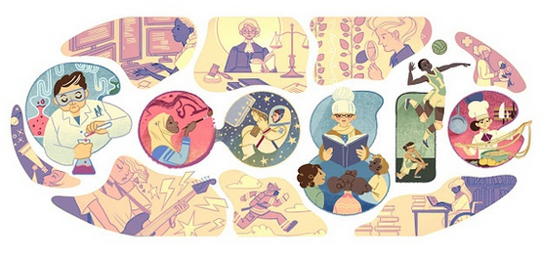
Description: As can be seen in the picture, …
become…; take up; devote …to…, …
Notes:
Music box

Slide 24
Interpretation: Based on the above description, we can see that Google tries to observe this day by …
show respect to women from all walks of life
show appreciation and love towards women for their economic, political and social achievements.
all-round development/achievements
Notes:
Music box

Slide 25
Advice for young women
Do not live someone else’s life and someone else’s idea of what womanhood is. Womanhood is you. Womanhood is everything that’s inside of you.
Be absolutely who you are, and stick to your instinct and your guts and don’t try and be like other people.
I think we have to do things to keep a balance in our lives and not let any institution such as Hollywood define who we are. You have gotta know who you are and present that.
Yes, it’s gonna be a struggle and yes you are gonna hear a lot of “no”s before you hear a “yes”. But learn to enjoy the process and embrace it and have fun with it.
Work hard, be so good that they can’t ignore you. Keep to your moral, keep to your integrity, and don’t stop fighting because ultimately for any dream, for any goal, it takes a lifetime. And why wouldn’t you wanna give it that? It’s not a race, it’s a journey and enjoy the journey.

Slide 26
identities and responsibilities
1
For women
2
For men
3
He for she & She for he

Slide 27
Is it OK for guys to wear makeup?
In 2017 barely concealed sniggers greeted the reveal that French president Macron spent €26,000 (¥20,0000) on makeup in his first three months in office.
And in December, the Washington Post hinted that Donald Trump used Bronx Colors concealer, which was gleefully reported elsewhere.

Slide 28
How does the society define us as a man?
Man up
Get on with it
Be strong and silent

Slide 29
Gender Inequality for Men
A man is valued less important by society as ___________________________.
A man is not supposed to ________________ for fear it looks less “man”.
A man is stereotyped(被模式化)
to be _________________________________________ and not to be____________________________________________
a father/a parent
ask for help
aggressive, dominant, strong, …
fragile, sensitive, vulnerable,…

Slide 30
Advice for young men
Is it OK for guys to wear makeup?
The answer is really quite simple: Male, female, gay, straight, anyone can wear makeup.
We often hear those famous phrases found around such as manning up, getting on with it, and being strong and silent.
For a long time, words like this left very little space for men to reposition or _______________ themselves in society. But ultimately, we are all humans. We all get anxiety, and believe it or not, men do have body image ___________ too. For me, Makeup enables me to walk down the street with my head held high feeling like the very best possible __________ of myself.

Slide 31
Advice for young men
But this is just my story. I’ve never said all men should wear makeup in the same way that I don’t agree all women should have to wear makeup.
This is about giving people a _____________. Allowing people to be who they ______________ want to be whether they choose to wear a little, a lot or no makeup at all. Be brave, lead by example(以身作则), be you, and most importantly always be happy because regardless of age, race, sexual preference and gender, everybody deserves to feel confident.

Slide 32
Advice for young men
Is it OK for guys to wear makeup?
The answer is really quite simple: Male, female, gay, straight, anyone can wear makeup.
We often hear those famous phrases found around such as manning up, getting on with it, and being strong and silent.
For a long time, words like this left very little space for men to reposition or _______________ themselves in society. But ultimately, we are all humans. We all get anxiety, and believe it or not, men do have body image ___________ too. For me, Makeup enables me to walk down the street with my head held high feeling like the very best possible __________ of myself.
redefine
issues
version

Slide 33
Advice for young men
But this is just my story. I’ve never said all men should wear makeup in the same way that I don’t agree all women should have to wear makeup.
This is about giving people a _____________. Allowing people to be who they ______________ want to be whether they choose to wear a little, a lot or no makeup at all. Be brave, lead by example(以身作则), be you, and most importantly always be happy because regardless of age, race, sexual preference and gender, everybody deserves to feel confident.
choice
personally

Slide 34
identities and responsibilities
1
For women
2
For men
3
He for she & She for he
Notes:
More often than not, we judge people on the basis of stereotypes(刻板印象).
What kind of respo// should we load ourselves with

Slide 35
How do you define others as a woman/a man?

Slide 36
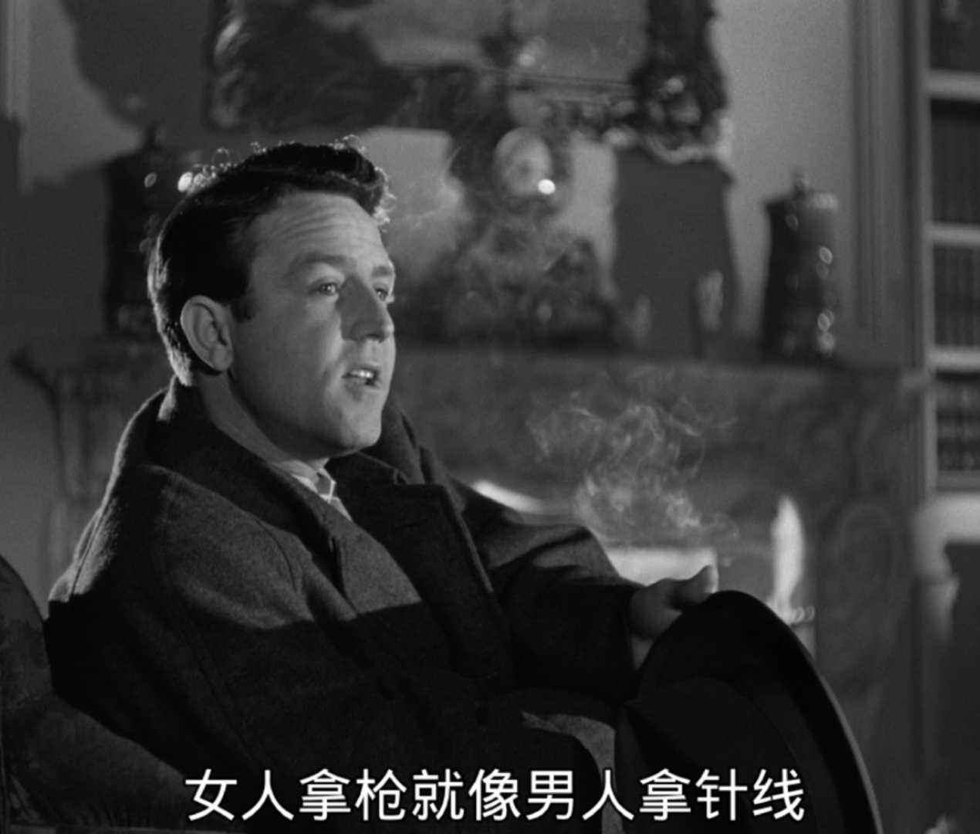
How do you normally judge others?
He/she is a boy/a girl.
a son/a daughter.
a brother/ a sister.
So he/she must…
can’t…
is supposed to…

Slide 37
She for he & He for she
1
show your respect

Slide 38
1
show your respect
Instead of judging boys as girly, respect yourself and others.
If women don’t mind their boyfriends or husbands wearing makeup, men will be more encouraged to experiment with these types of products.

Slide 39
She for he & He for she
1
show your respect
2
become a KOL(key opinion leader)

Slide 40
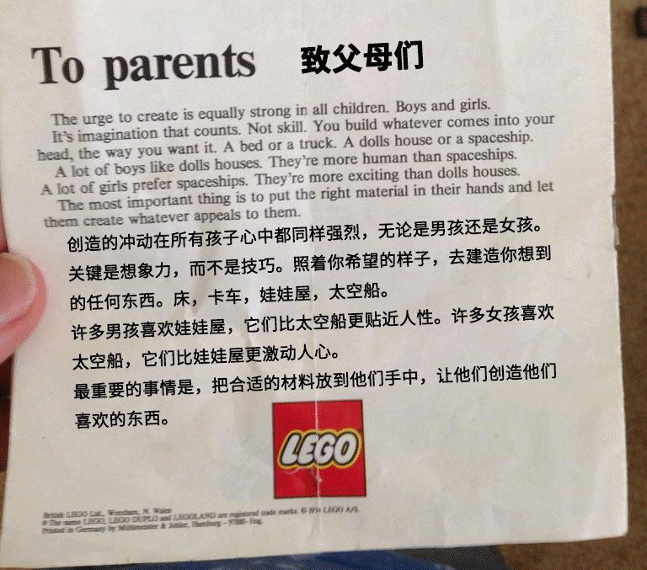
2
become a KOL(key opinion leader)

Slide 41
2
become a KOL(key opinion leader)

Slide 42
From Emma Watson
If we stop defining each other by what we are not and start defining ourselves by who we are – we can all be freer.
如果我们停止用我们所非定义他人，而开始以我们所是定义自己——我们都会更加自由。

Slide 43
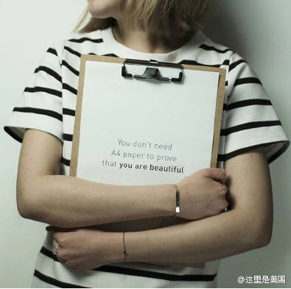
If not you, who?
If not now, when?
You don’t need A4 paper to prove that you are beautiful.

