Slide 1
十校联盟
2021届
高三寒假
返校联考
阅读理解题分析
海宁市高级中学 戚燕飞

Slide 2
Passage A
1
出处：https://www.coventry.ac.uk/news/coventry-graduate-receives-young-achievement-award/

Slide 3
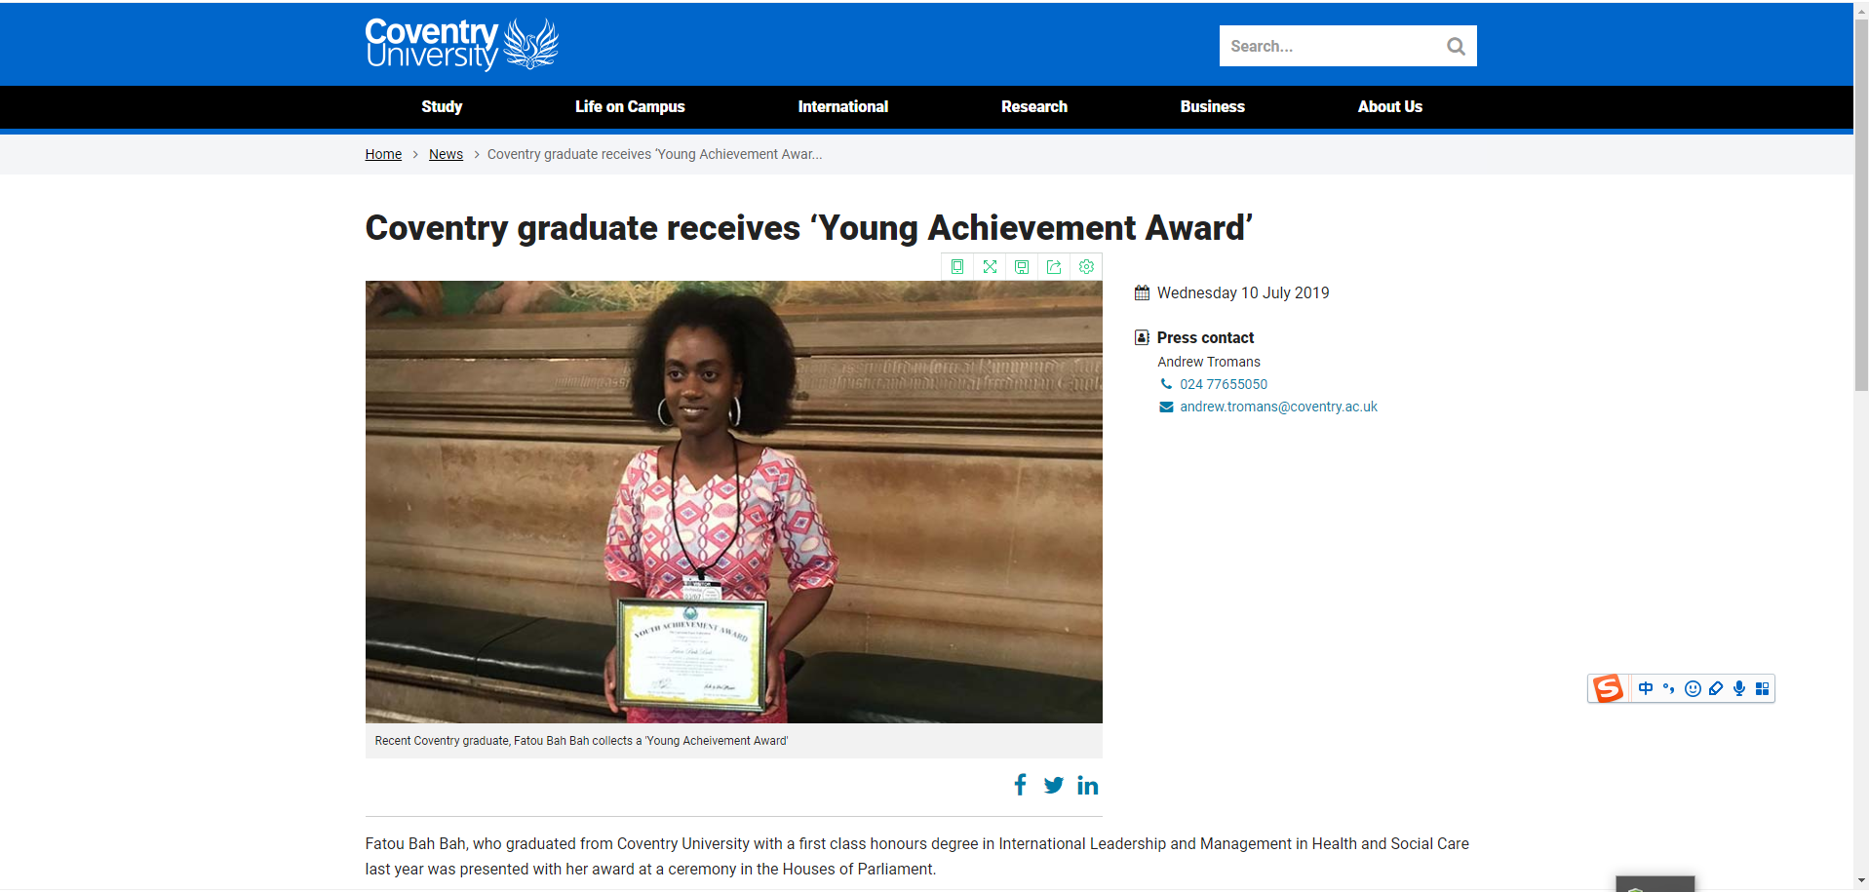
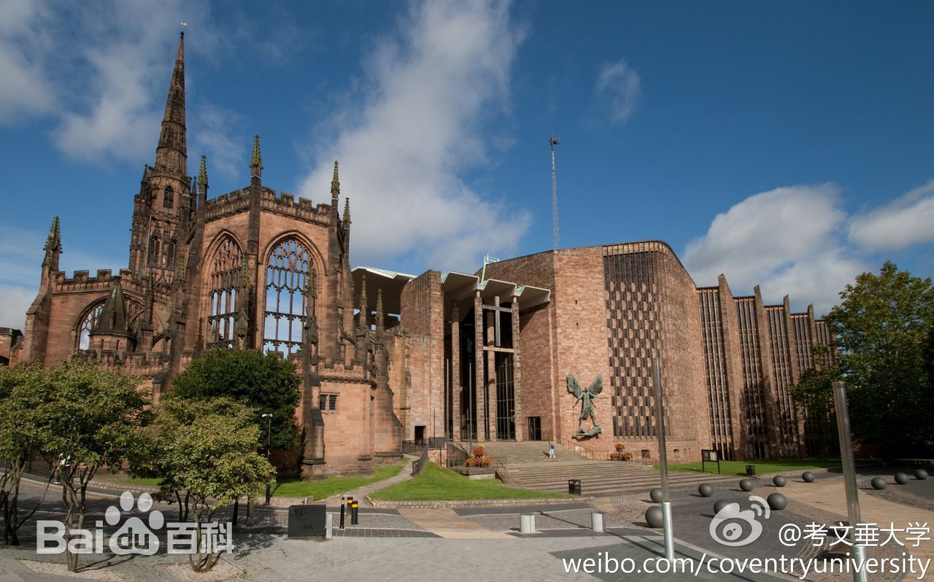
Writing style：News report

Slide 4
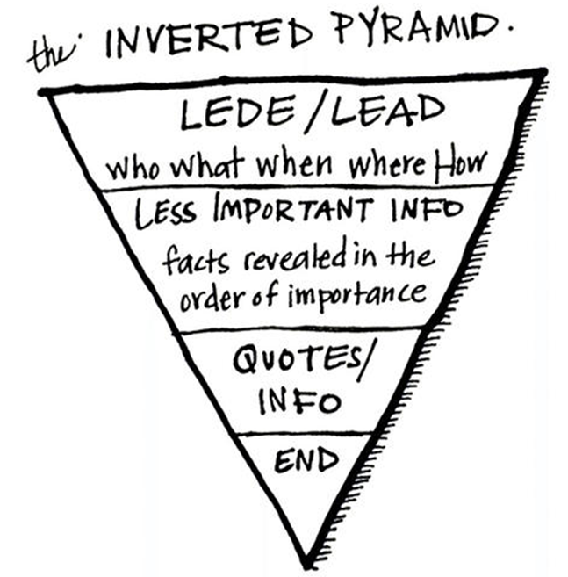
lead
Fatou Bah Bah,who graduated from Coventry University with a first class honors degree last year,was presented with her award at a ceremony in the Houses of Parliament.
Fatou was recognized by the Universal Peace Federation,an interfaith(跨信仰的）peace-building organization, not only for her academic accomplishments but also her commitment to global justice.In 2017, while still studying for her first degree,Fatou co-founded Ebou Mala Children's Charitable Foundation (EMCCF). EMCCF helps deprived children in underdeveloped countries like The Gambia by providing them with support to get a better education and access to better healthcare.
Commenting on receiving the Young Achievement Award, Fatou said:“Receiving the Young Achievement Award shows that hard work and determination pay off.I am grateful to staff at Coventry University who gave me support and resources I needed,especially with English not being my first language,and without that I would not have achieved what I have. Coventry University has made a big impact on what I am today. It has helped me grow in confidence,develop team work and leadership skills."
Fatou plans to return to Coventry University to start the next stage of her academic career.Fatou will be in the first group of students on the new Global Social Development Management (with Professional Experience) MSC course.The course is designed to develop future managers for social development organizations such as Non-Government Organizations (NGOs) to promote and develop key management skills using technology fostered through experiential learning.
Reasons
for being rewarded
Fatou's comments
on being rewarded
Fatou's plan
structure？

Slide 5
Fatou Bah Bah,who graduated from Coventry University with a first class honors degree last year,was presented with her award at a ceremony in the Houses of Parliament.
Fatou was recognized by the Universal Peace Federation,an interfaith(跨信仰的）peace-building organization, not only for her academic accomplishments but also her commitment to global justice.In 2017, while still studying for her first degree,Fatou co-founded Ebou Mala Children's Charitable Foundation (EMCCF). EMCCF helps deprived children in underdeveloped countries like The Gambia by providing them with support to get a better education and access to better healthcare.
Commenting on receiving the Young Achievement Award, Fatou said:“Receiving the Young Achievement Award shows that hard work and determination pay off.I am grateful to staff at Coventry University who gave me support and resources I needed,especially with English not being my first language,and without that I would not have achieved what I have. Coventry University has made a big impact on what I am today. It has helped me grow in confidence,develop team work and leadership skills."
Fatou plans to return to Coventry University to start the next stage of her academic career.Fatou will be in the first group of students on the new Global Social Development Management (with Professional Experience) MSC course.The course is designed to develop future managers for social development organizations such as Non-Government Organizations (NGOs) to promote and develop key management skills using technology fostered through experiential learning.
lead
Reasons
for being rewarded
Fatou's comments
on being rewarded
Fatou's plan
main idea？

Slide 6
23. What’s the passage mainly about?
A. Coventry University awards Fatou for her achievements.
B. Coventry graduate receives "Young Achievement Award".
C. Fatou Bah Bah is awarded for devotion to social justice.
D. Fatou Bah Bah expresses appreciation to Coventry University.
Lead：Para.1
Fatou Bah Bah, who graduated from Coventry University with a first class honors degree last year, was presented with her award at a ceremony in the Houses of Parliament.
定语从句
mainly about
Fatou Bah Bah，去年在考文垂大学获得一等荣誉学士学位的毕业生，在议会大厦的举行的颁奖典礼上被授奖。
Para.2
Fatou was recognized by the Universal Peace Federation,an interfaith(跨信仰的）peace-building organization, not only for her academic accomplishments but also her commitment to global justice.
同位语
Fatou 获得了世界和平联盟（一个跨信仰和平建设组织）的认可，不仅仅是因为他的学术成就，也是因为她对全球正义的贡献。

Slide 7
22.What can we learn from Fatou's comments on her Award?
A. Hard work and determination will doubtlessly pay off.
B. Fatou owes her achievements mainly to Coventry University.
C. Coventry University has made a limited impact on Fatou.
D. Fatou is awarded for her academic accomplishments.
Para. 3
Receiving the Young Achievement Award shows that hard work and determination pay off. I am grateful to staff at Coventry University who gave me support and resources I needed, especially with English not being my first language, and without that I would not have achieved what I have. Coventry University has made a big impact on what I am today. It has helped me grow in confidence, develop team work and leadership skills.
comments
doubt+less+ly
With 结构
owes
虚拟语气
to
获得青年成就奖表明努力工作和决心是有回报的。我非常感谢考文垂大学的工作人员, 特别是在英语不是我的母语情况下，给予我的支持和我所需要的资源，如果不是这样，我就不会有今天的成就。考文垂大学对我今天的成就产生了巨大的影响。它帮我增强了自信，培养了团队合作精神和领导能力。
名词性从句
details

Slide 8
仿写(应用文写作)
我们十分感谢Ashville College的老师们，尤其是英语不是我们的母语的情况下，给了我们无私的帮助和指导，如果没有这些，我们就不可能取得如此大的进步。
We are grateful to the teachers who gave us unreserved help and guidance we need, especially with English not being our first language, and without that we would not have made such great progress.

Slide 9
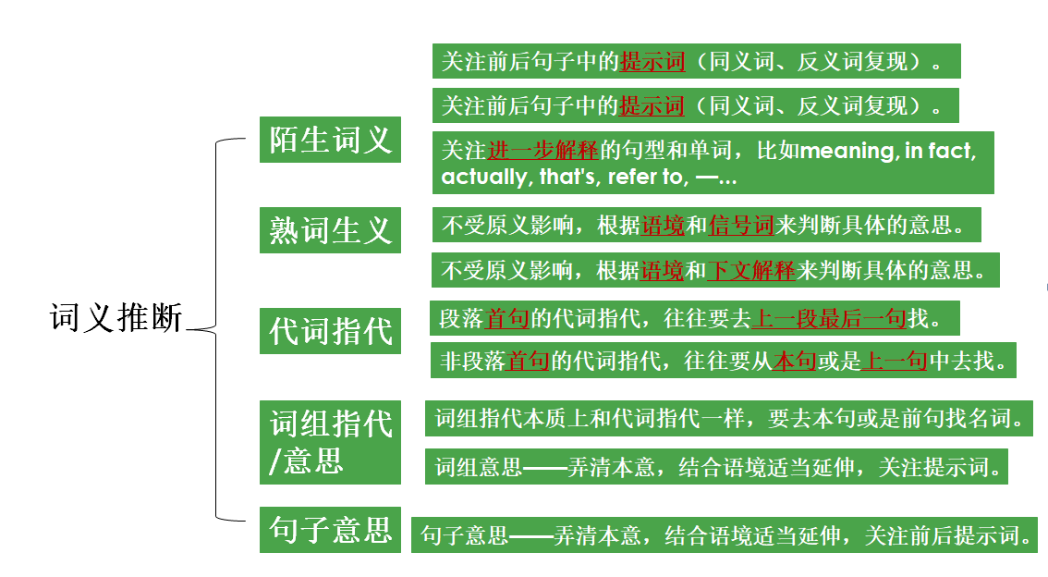
21.Which of the following is the closest in meaning to “deprived” in paragraph 2?
A. Sensitive.
B. Clumsy.
C. Delighted.
D. Disadvantaged.
(of a person/area) in unfavourable circumstances, especially with regard to finacial or social
context
Para.2
Fatou was recognized by the Universal Peace Federation,an interfaith(跨信仰的）peace-building organization, not only for her academic accomplishments but also her commitment to global justice.In 2017, while still studying for her first degree,Fatou co-founded Ebou Mala Children's Charitable Foundation (EMCCF). EMCCF helps deprived children in underdeveloped countries like The Gambia by providing them with support to get a better education and access to better healthcare.

Slide 10
Passage B
2
出处：2020年9月大学英语四级阅读理解

Slide 11
When is cleaning walls a crime? When you're doing it to create art, obviously. A number of street artists around the world have started expressing themselves through a practice known as reverse graffiti(反向涂鸦）.They find dirty surfaces and paint them with images or messages using cleaning brushes or pressure hoses(高压水管）. Either way, it's the same principle:the image is made by cleaning away the dirt. Each artist has their own individual style but all artists share a common aim: to draw attention to the pollution in our cities. The UK's Paul Curtis, better known as Moose, operates around Lees and London and has been asked by a number of companies to make reverse graffiti advertisements.
Brazilian artist,Alexandre Orion,turned one of Sao Paulo's transport tunnels into an amazing wall painting in 2006 by getting rid of the dirt. Made up of a series of white skulls(颅骨），the painting reminds drivers of the effect their pollution is having on the planet. “Every motorist sits in the comfort of their car, but they don't give any consideration to the price their comfort has for the environment and consequently for themselves," says Orion.
The anti-pollution message of the reverse graffiti artists confuses city authorities since the main argument against graffiti is that it spoils the appearance of both types of property: public and private. This was what Leeds City Council said about Moose's work: “Leeds residents want to live in clean and attractive neighborhoods. We view this kind of advertising as environmental damage and will take strong action against it." Moose was ordered to “clean up his act.” How was he supposed to do this: by making all property he had cleaned dirty again?
As for the Brazilian artist's work, the authorities were annoyed but could find nothing to charge him with. They had no other option but to clean the tunnel-but only the parts Alexandre had already cleaned. The artist merely continued his campaign on the other side. The city official then decided to take further action. They not only cleaned the whole tunnel but every tunnel in Sao Paulo.
the definition of reverse graffiti
One example of reverse garaffiti
city authotities's attitudes towards reverse garaffiti

Slide 12
26. What does the author imply about Leeds City Council's decision?
A. It is simply ridiculous.
B. It is well-informed.
C. It is rather unexpected.
D. It is quite reasonable.
Para. 3
How was he supposed to do this: by making all property he had cleaned dirty again?
他（Moose）要怎么做这个事情（clean up his act）呢：是通过把他清理干净的重新弄脏吗？
Para.1
Find dirty surfaces
Paint them with images or messages using cleaning brushes or pressure hoses
The image is made by cleaning away the dirt.
To draw attention to the pollution in our cities.
24.What can we learn from the passage about reverse graffiti? A. It uses paint to create anti-pollution images.
B. It creates a lot of trouble for local residents. C. It causes lots of distraction to drivers.
D. It turns dirty walls into artistic works.

Slide 13
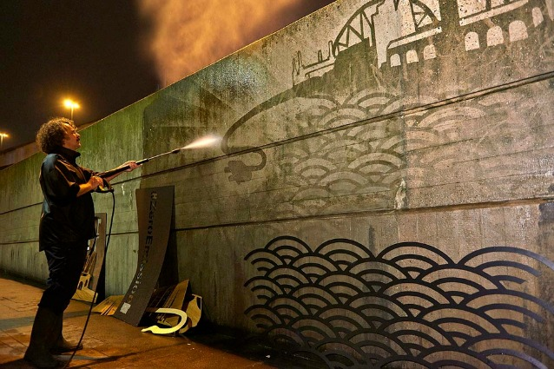
Reverse Graffiti is an artistic practice where an image is created not by adding color to a surface, but by subtracting(减去) color. It’s also known as “dust tagging”, “clean tagging” or “green graffiti” because it’s usually performed by removing dirt from a surface, and not using any chemical product (such as spray bottles, which are used for regular graffiti).

Slide 14
Exercise
_______ (make) up of a series of white skulls(颅骨），the painting reminds drivers of the effect their pollution ________(have) on the planet.
这幅画由一堆颅骨组成，提醒着司机们，他们正制造着的污染对地球造成的影响。
Every motorist sits in the comfort of their car, ________ they don't give any consideration to the price their comfort has for the environment and _________(consequence) for themselves.
每个司机都舒适地坐在车里，但是他们却没有任何考虑因他们的舒适，环境要付出的代价，当然也就不会考虑到他们自己因此要付出的代价。
25.Why does Alexandre Orion create a series of white skulls on one of Sao Paulo's tunnels? A. He has a talent for painting white skulls. B. He is enthusiastic about doing creative artworks. C. He wants to raise public awareness of environmental protection. D. He intends to express his dissatisfaction with local governments.

Slide 15
Exercise
As for the Brizilian artist's work, the authorities were annoyed but could find nothing ________(charge) him with.
至于这位英国艺术家的作品，政府很恼怒但没法控告他。
They had no other option but ________(clean) the tunnel....They not only cleaned the whole tunnel but every tunnel in Sao Paulo.
他们别无选择只能去清理那个隧道。....他们不仅清理了整个隧道，还清理了Sao Paulo的所有隧道。
27.How did Sao Paulo city officials handle Alexandre Orion's reverse graffiti?
A. They made him clean all the tunnels in Sao Paulo.
B. They took action to ban all reverse graffiti.
C. They charged him with polluting tunnels in the city.
D. They made it impossible for him to practice his art.

Slide 16
Passage C
3
出处：https://www.scientificamerican.com/article/a-solution-for-loneliness/

Slide 17
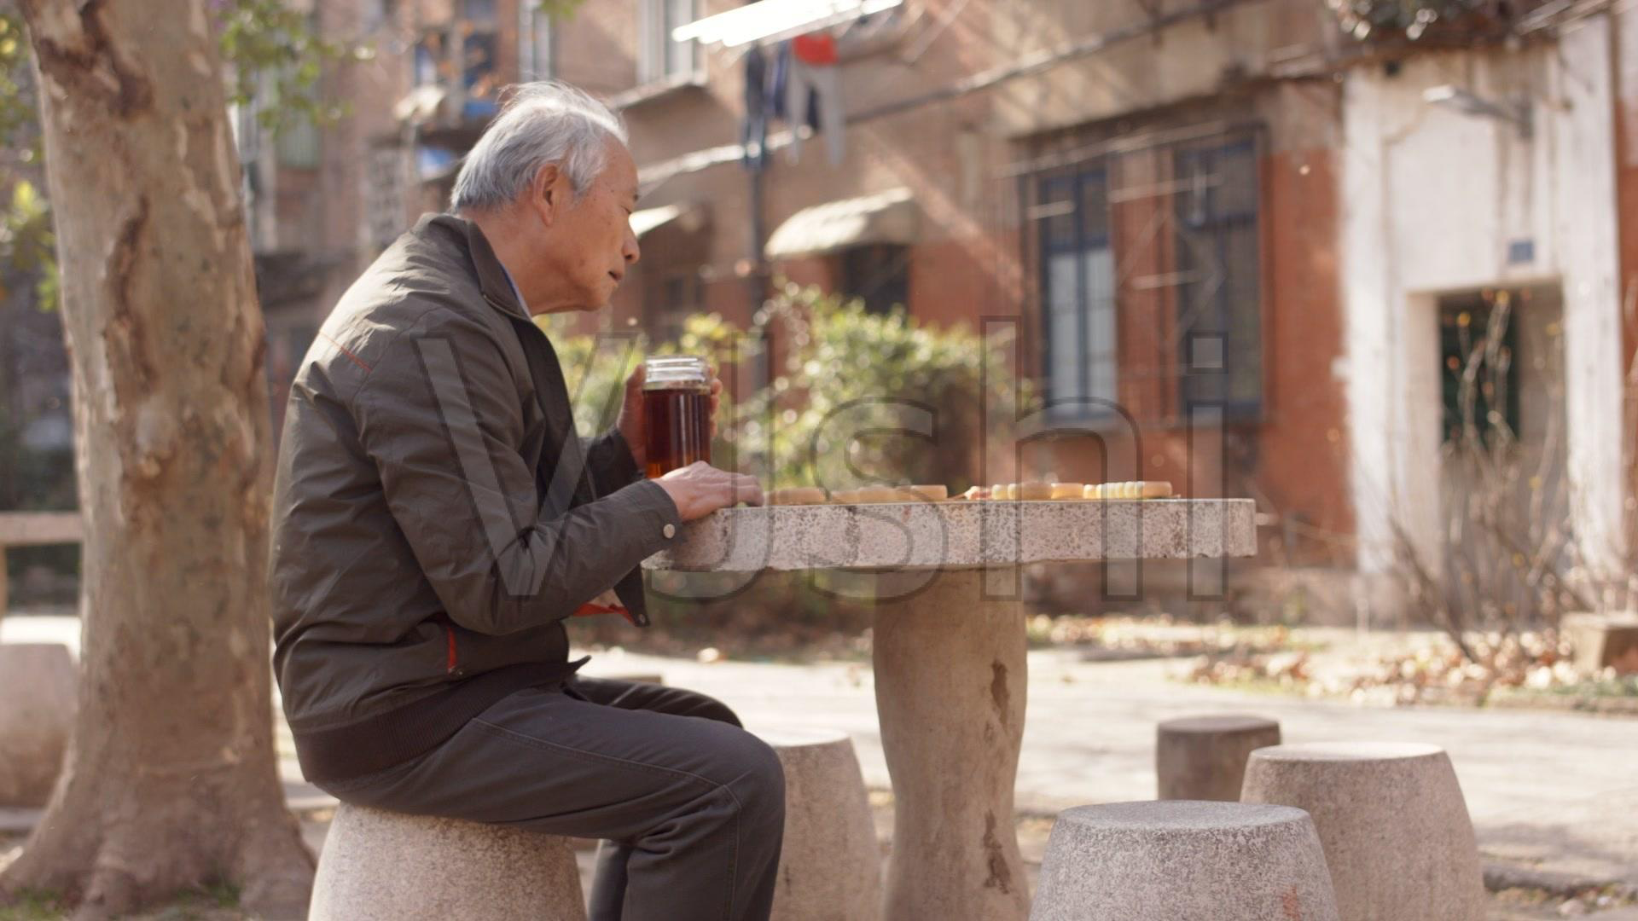
Describe the picture
He had set up a chessboard on the table in front of him, and he watched as people passed by, mostly focusing on their phones. His eyes kept jumping from person to person, searching for someone to join him for a game of chess.
longliness
28. Why does the author mention the older man in paragraph one? A. To tell the story of the lonely man. B. To summarize the whole passage. C. To introduce the theme of the passage. D. To arouse readers' sympathy.
他摆好了棋盘，看着人来人往，而大部分人都关注着自己的手机。他的眼睛不断地在人群中移动，想要寻找某个人来和他下上一盘棋。

Slide 18
I was riding a bus recently and noticed an older man sitting outside a coffee shop on a busy sidewalk. He had set up a chessboard on the table in front of him, and he watched as people passed by, mostly focusing on their phones. His eyes kept jumping from person to person, searching for someone to join him for a game of chess.
Loneliness is killing us. Almost half of the Americans feel lonely a lot of the time,which puts them at risk of developing physical and mental illnesses, including heart disease, cancer and depression. This is a public health problem that needs to be addressed on a wide scale.
But at the individual level, there is much we can do to get rid of loneliness.One effective strategy is to volunteer. Participating in volunteer opportunities may help decrease loneliness and its related health impact for several reasons. The first and most obvious is that it's a meaningful way to connect with others and make new friends. Second, volunteering can make up for the loss of meaning that commonly occurs with loneliness. Third, people who regularly engage in mentally stimulating activities are less likely to suffer from cognitive decline. These insights may be especially relevant for the growing senior population due to increased physical limitations and loved ones' passing away. By 2030, one in five residents in the US will be of retirement age. They may no longer have to work to provide purpose and connection, and will be likely to suffer from isolation.
I wish I could have stopped my bus that day to play chess with the older man. He struck me as a symbol of our times: people wanting desperately to connect-not through a screen, but face to face, with others from their community. Now more than ever, we have a real need and opportunity to build a culture of social interaction. Volunteering is a great way to start.

Slide 19
I was riding a bus recently and noticed an older man sitting outside a coffee shop on a busy sidewalk. He had set up a chessboard on the table in front of him, and he watched as people passed by, mostly focusing on their phones. His eyes kept jumping from person to person, searching for someone to join him for a game of chess.
Loneliness is killing us. Almost half of the Americans feel lonely a lot of the time,which puts them at risk of developing physical and mental illnesses, including heart disease, cancer and depression. This is a public health problem that needs to be addressed on a wide scale.
But at the individual level, there is much we can do to get rid of loneliness.One effective strategy is to volunteer. Participating in volunteer opportunities may help decrease loneliness and its related health impact for several reasons. The first and most obvious is that it's a meaningful way to connect with others and make new friends. Second, volunteering can make up for the loss of meaning that commonly occurs with loneliness. Third, people who regularly engage in mentally stimulating activities are less likely to suffer from cognitive decline. These insights may be especially relevant for the growing senior population due to increased physical limitations and loved ones' passing away. By 2030, one in five residents in the US will be of retirement age. They may no longer have to work to provide purpose and connection, and will be likely to suffer from isolation.
I wish I could have stopped my bus that day to play chess with the older man. He struck me as a symbol of our times: people wanting desperately to connect-not through a screen, but face to face, with others from their community. Now more than ever, we have a real need and opportunity to build a culture of social interaction. Volunteering is a great way to start.
introduce the theme--loneliness
The harmful effects of loneliness
An effective way to get rid of loneliness -- volunteering
An echo and appealing for volunteering to get rid of loneliness

Slide 20
30.Which of the following is the best title for the text?
A. A Solution to Loneliness
B. The Best Way to Stay Healthy
C. Volunteering for the Elderly
D. Benefits of Volunteering

Slide 21

29. What do we know about volunteering according to the passage?
A. It is getting increasingly popular worldwide. B. It makes up for the loss of the loved ones.
C. It enables the seniors to find a job. D. It helps people avoid mental problem.
Para.3
But at the individual level, there is much we can do to get rid of loneliness.One effective strategy is to volunteer. Participating in volunteer opportunities may help decrease loneliness and its related health impact for several reasons. The first and most obvious is that it's a meaningful way to connect with others and make new friends. Second, volunteering can make up for the loss of meaning that commonly occurs with loneliness. Third, people who regularly engage in mentally stimulating activities are less likely to suffer from cognitive decline. These insights may be especially relevant for the growing senior population due to increased physical limitations and loved ones' passing away. By 2030, one in five residents in the US will be of retirement age. They may no longer have to work to provide purpose and connection, and will be likely to suffer from isolation.
由于老年人身体每况愈下，加之爱人去世，使得以上所言对他们来说特别重要。

Slide 22
29. What do we know about volunteering according to the passage?
A. It is getting increasingly popular worldwide. B. It makes up for the loss of the loved ones.
C. It enables the seniors to find a job. D. It helps people avoid mental problem.
Topic & Stucture
Para.3
But at the individual level, there is much we can do to get rid of loneliness.One effective strategy is to volunteer. Participating in volunteer opportunities may help decrease loneliness and its related health impact for several reasons. The first and most obvious is that it's a meaningful way to connect with others and make new friends. Second, volunteering can make up for the loss of meaning that commonly occurs with loneliness. Third, people who regularly engage in mentally stimulating activities are less likely to suffer from cognitive decline. These insights may be especially relevant for the growing senior population due to increased physical limitations and loved ones' passing away. By 2030, one in five residents in the US will be of retirement age. They may no longer have to work to provide purpose and connection, and will be likely to suffer from isolation.
由于老年人身体每况愈下，加之爱人去世，使得以上所提的原因对他们来说特别重要。

Slide 23
29. What do we know about volunteering according to the passage?
A. It is getting increasingly popular worldwide. B. It makes up for the loss of the loved ones.
C. It enables the seniors to find a job. D. It helps people avoid mental problem.
Topic & Stucture
提出观点：志愿服务是一个有效消除孤独的方法
Para.3
But at the individual level, there is much we can do to get rid of loneliness.One effective strategy is to volunteer. Participating in volunteer opportunities may help decrease loneliness and its related health impact for several reasons. The first and most obvious is that it's a meaningful way to connect with others and make new friends. Second, volunteering can make up for the loss of meaning that commonly occurs with loneliness. Third, people who regularly engage in mentally stimulating activities are less likely to suffer from cognitive decline. These insights may be especially relevant for the growing senior population due to increased physical limitations and loved ones' passing away. By 2030, one in five residents in the US will be of retirement age. They may no longer have to work to provide purpose and connection, and will be likely to suffer from isolation.

Slide 24
29. What do we know about volunteering according to the passage?
A. It is getting increasingly popular worldwide. B. It makes up for the loss of the loved ones.
C. It enables the seniors to find a job. D. It helps people avoid mental problem.
Topic & Stucture
提出观点：志愿服务是一个有效消除孤独的方法
Para.3
But at the individual level, there is much we can do to get rid of loneliness.One effective strategy is to volunteer. Participating in volunteer opportunities may help decrease loneliness and its related health impact for several reasons. The first and most obvious is that it's a meaningful way to connect with others and make new friends. Second, volunteering can make up for the loss of meaning that commonly occurs with loneliness. Third, people who regularly engage in mentally stimulating activities are less likely to suffer from cognitive decline. These insights may be especially relevant for the growing senior population due to increased physical limitations and loved ones' passing away. By 2030, one in five residents in the US will be of retirement age. They may no longer have to work to provide purpose and connection, and will be likely to suffer from isolation.
论证观点的重要性：说明志愿活动的意义

Slide 25
29. What do we know about volunteering according to the passage?
A. It is getting increasingly popular worldwide. B. It makes up for the loss of the loved ones.
C. It enables the seniors to find a job. D. It helps people avoid mental problem.
Topic & Stucture
提出观点：志愿服务是一个有效消除孤独的方法
Para.3
But at the individual level, there is much we can do to get rid of loneliness.One effective strategy is to volunteer. Participating in volunteer opportunities may help decrease loneliness and its related health impact for several reasons. The first and most obvious is that it's a meaningful way to connect with others and make new friends. Second, volunteering can make up for the loss of meaning that commonly occurs with loneliness. Third, people who regularly engage in mentally stimulating activities are less likely to suffer from cognitive decline. These insights may be especially relevant for the growing senior population due to increased physical limitations and loved ones' passing away. By 2030, one in five residents in the US will be of retirement age. They may no longer have to work to provide purpose and connection, and will be likely to suffer from isolation.
论证观点的重要性：说明志愿活动的意义
论证观点的可行性：解释为什么志愿活动能有效消除孤独

Slide 26
29. What do we know about volunteering according to the passage?
A. It is getting increasingly popular worldwide. B. It makes up for the loss of the loved ones.
C. It enables the seniors to find a job. D. It helps people avoid mental problem.
Topic & Stucture
Prevent sth. from happening
提出观点：志愿服务是一个有效消除孤独的方法。
Para.3
But at the individual level, there is much we can do to get rid of loneliness.One effective strategy is to volunteer. Participating in volunteer opportunities may help decrease loneliness and its related health impact for several reasons. The first and most obvious is that it's a meaningful way to connect with others and make new friends. Second, volunteering can make up for the loss of meaning that commonly occurs with loneliness. Third, people who regularly engage in mentally stimulating activities are less likely to suffer from cognitive decline. These insights may be especially relevant for the growing senior population due to increased physical limitations and loved ones' passing away. By 2030, one in five residents in the US will be of retirement age. They may no longer have to work to provide purpose and connection, and will be likely to suffer from isolation.
论证观点的重要性：说明志愿活动的意义。
论证观点的可行性：解释为什么志愿活动能有效消除孤独。
论证观点的必要性：很多老人会面临孤独问题。

Slide 27
Important factors in reading comprehension
writing style
思维
内容
语言
structure
topic／topic sentence
context
details

Slide 28
Thank you！

