Slide 1


感恩遇见，相互成就，本课件资料仅供您个人参考、教学使用，严禁自行在网络传播，违者依知识产权法追究法律责任。
更多教学资源请关注
公众号：溯恩高中英语
知识产权声明

Slide 2


THE UNITED KINDOM
What's in a Name

Slide 3
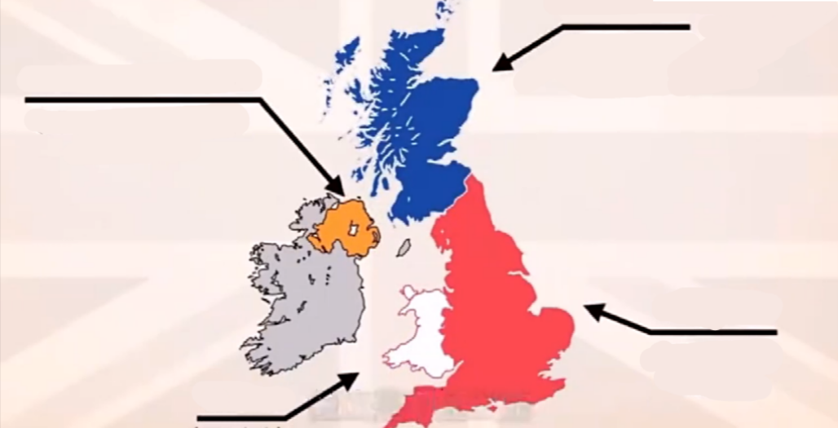
Watch the video and name the four parts on the map
*1
延迟符号

Slide 4
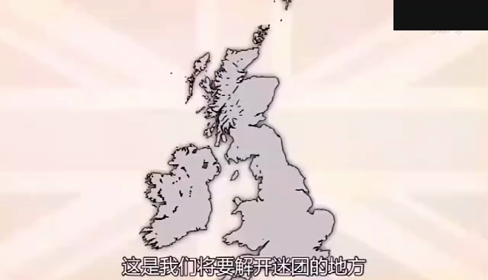
溯恩英语

Slide 5
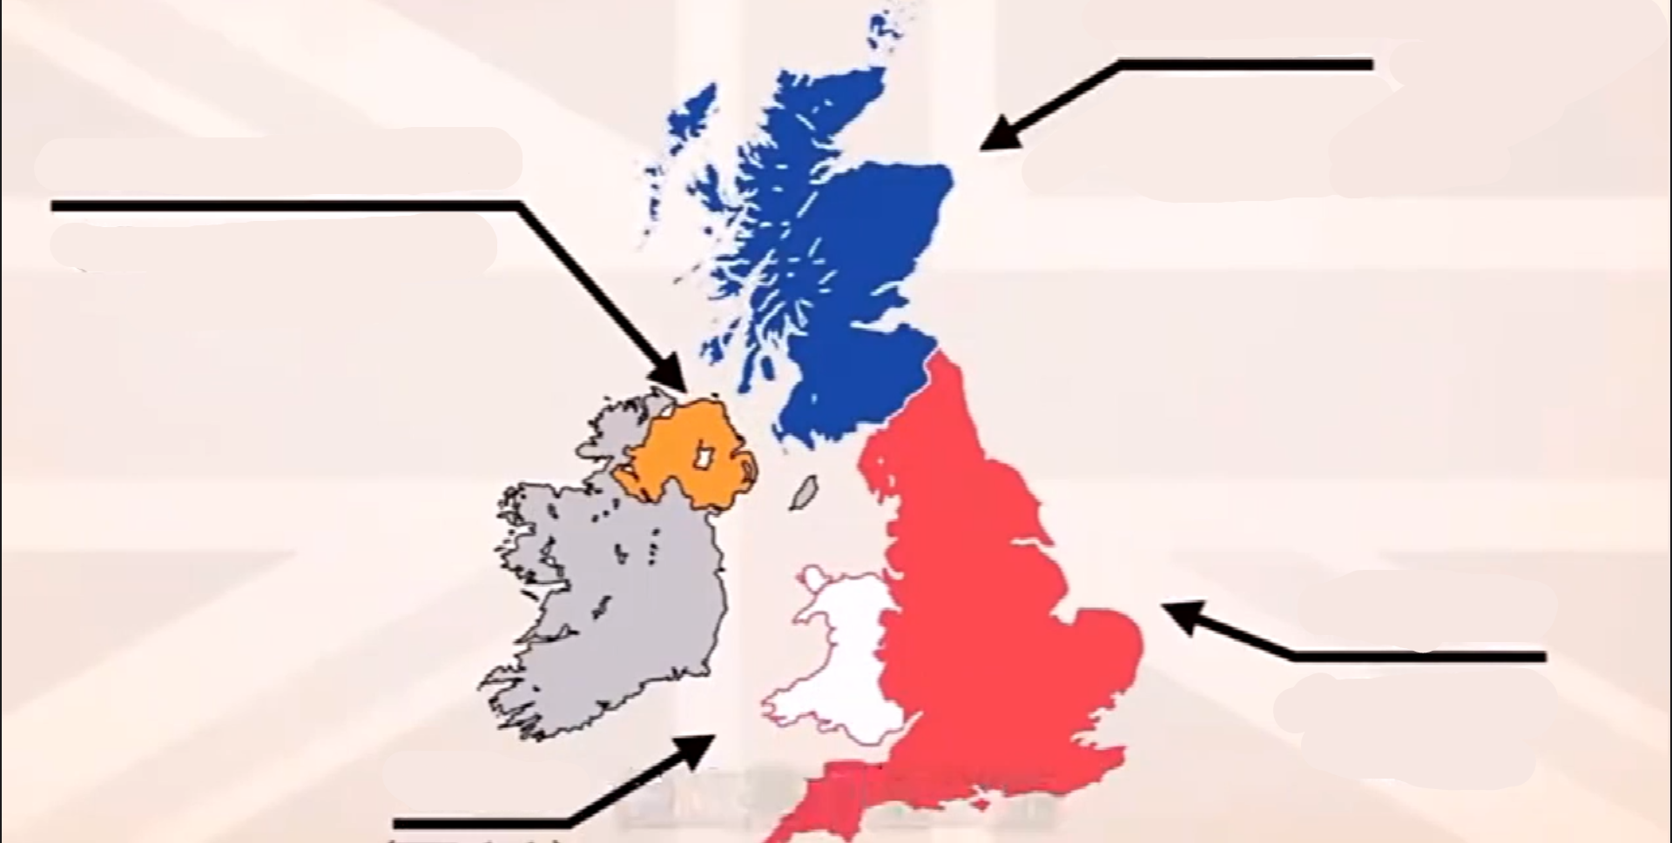
Scotland
Northern Ireland
England
Wales

Slide 6
Read the passage and think about the following questions
*2
1
What do the UK's four countries have in common?
Which group of people was the first to set foot on the UK?
2
3
What happened to England in the 11th century ?
4
What does the last paragraph mainly talk about?

Slide 7
Read the passage and think about the following questions
*2
1
What do the UK's four countries have in common?
A. They share the same national day.
B. They share the same military defence.
B. They share the same military defence.
C. They have a common legal system.
D.They have a common sports team.
They use the same flag, known as the Union Jack, as well as share the same currency and military defence.

Slide 8
Read the passage and think about the following questions
*2
2
Which group of people was the first to set foot on the UK?
A. The Normans.
B. The Romans.
B. The Romans.
C. The Vikings
D. The Anglo-Saxons
The first group, the Romans, came in the first century.

Slide 9
Read the passage and think about the following questions
*2
3
What happened to England in the 11th century ?
A. The Romans built towns and roads in England.
B. The Anglo-Saxons brought in the English language.
C. The Normans became the conqueror of England.
C. The Normans became the conqueror of England.
D. The Vikings introduced many new words into English.
The last group were the Normans. They conquered England after the well-known Battle of Hastings in the 11th century.

Slide 10
Read the passage and think about the following questions
*2
4
What does the last paragraph mainly talk about?
A. The attractions of the UK.
A. The attractions of the UK.
B. The long and interesting history of the UK.
C. The historic sites of the UK.
D. The past and the present of the UK.

Slide 11
Analyze the structure of the passage in the following five parts.
*3
systems
formation
people
What's in a name?
name
tourism

Slide 12
the United kindom of Great Britain and Northern Ireland
*3
Name
Great Britain
标题
标题
标题
标题
the UK
标题
标题
标题
the United Kingdom
England
Britain

Slide 13
*3
Formation
In the 16th century
Before the 16th century
England
Wales
Wales was joined to the Kingdom of England.
the Kingdom of England
In the 18th century
In the 19th century
The Kingdom of Ireland was added to create the United Kingdom of Great Britain and Ireland.
Scotland was joined to create the Kingdom of Great Britain.
Northern Ireland
Scotland
In the 20th century
The southern part of Ireland broke away from the UK.

Slide 14
*3
systems
flag
currency
education and legal
systems
延迟符号
military defence
Similarities
differences
traditions
football teams

Slide 15
*3
People
The Romans, came________________, whose achievements included _______________________.
in the first century
building towns and roads
in the fifth century
The Anglo-Saxons, arrived _______________,who started __________________, and changed the way
_________________.
the English language
people built houses
in the eighth century
The Vikings, came _________________, leaving behind lots of______________.
new vocabulory
in the 11th century
The Normans, conquered England_______________. They built______all around England, and made changes to ______________, and since then ___________ slowly got into the English language.
castles
the legal system
Frech words
Notes:
此段的阅读设计简单了一些，考虑结合后面的视频资料，完成what did they do and how did they influence the country and its traditions? 此段刚好体现learn about a country through its history

Slide 16
*3
a fascinating mix of history and modern culture
Tourism
London
the capital city:
an ancient port city
the whole country
historic sites
and museums

Slide 17
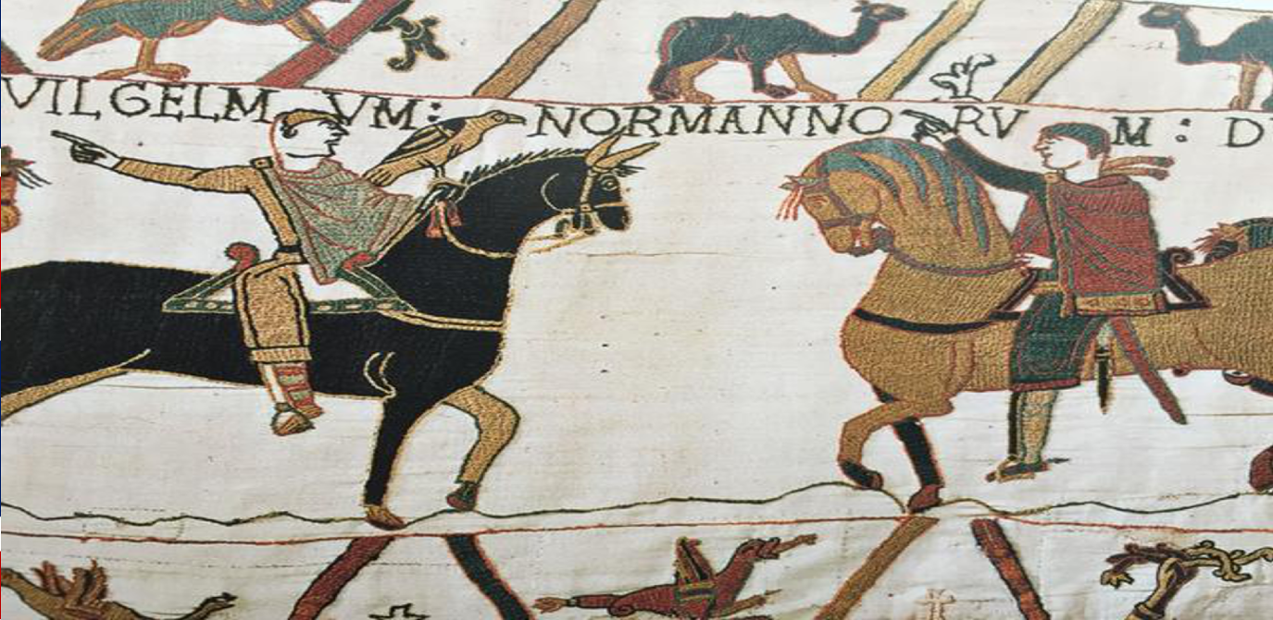
*4
Watch the video and discuss: What changes did these historic events bring to English language?

Slide 18


bye~bye
溯
恩
英
语
新
线
开
启

