Slide 1


感恩遇见，相互成就，本课件资料仅供您个人参考、教学使用，严禁自行在网络传播，违者依知识产权法追究法律责任。
更多教学资源请关注
公众号：溯恩高中英语
知识产权声明

Slide 2

Unit5 Music
Listening & Speaking

Slide 3
Learning Objectives
At the end of the class, you will be able to
1. master following new words and phrases: stringed, classical, perform, performer, touch my soul, give me energy, remind me of home, run food stand, set up equipment.
2. be familiar with some types of music and stringed instrument
3. master the listening tip of listening for the explanation.
4. express their preference for music and their willing to take part in the school music festival fluently

Slide 4
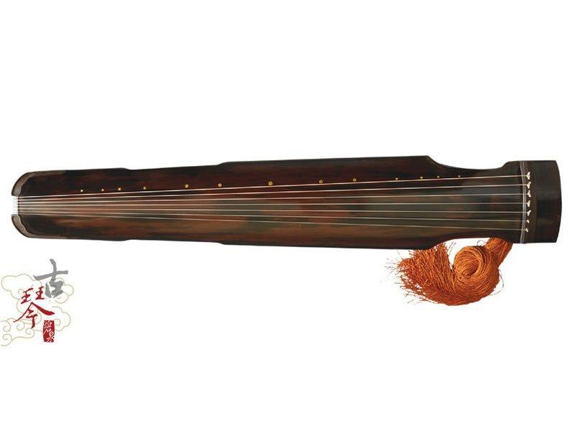
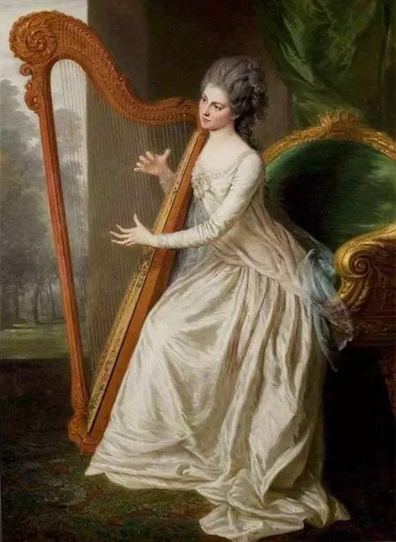
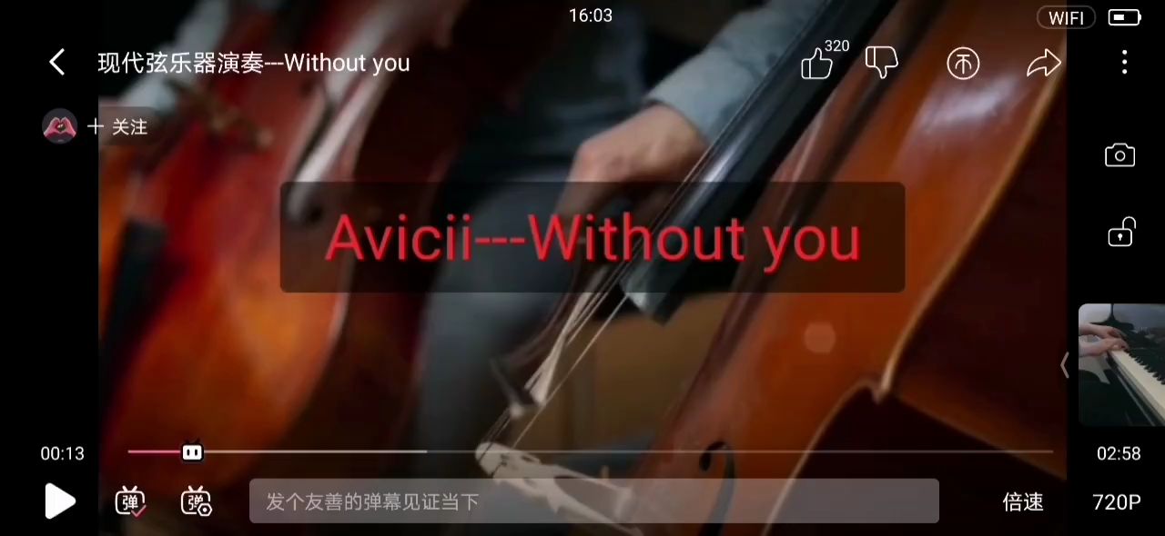

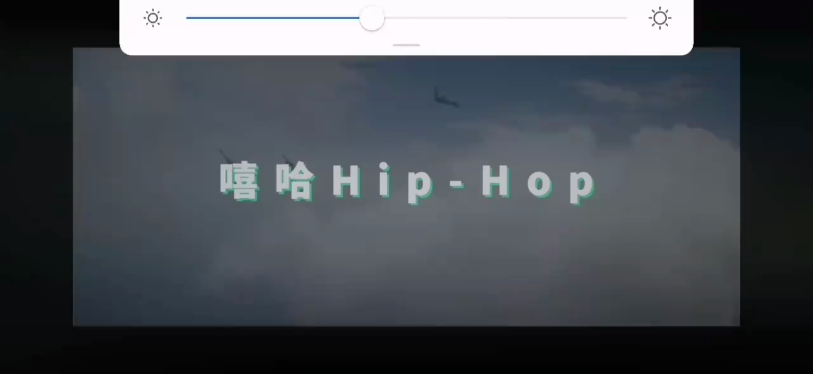
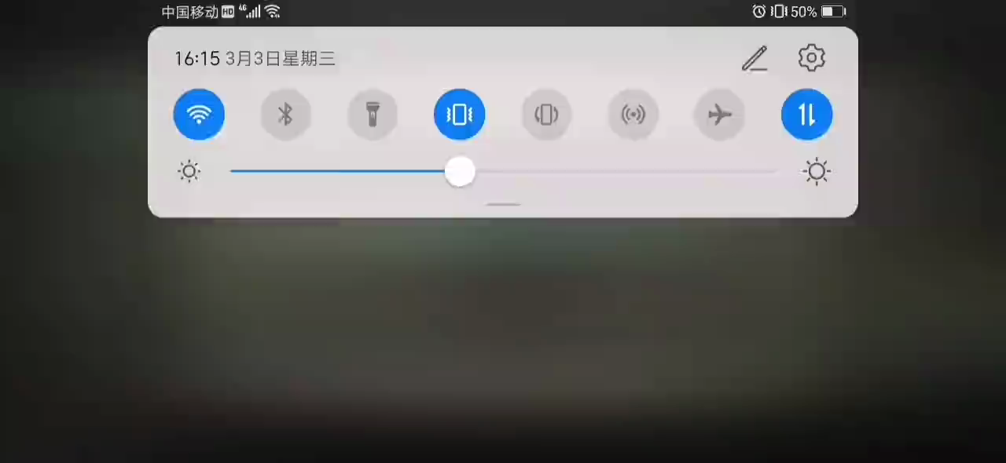
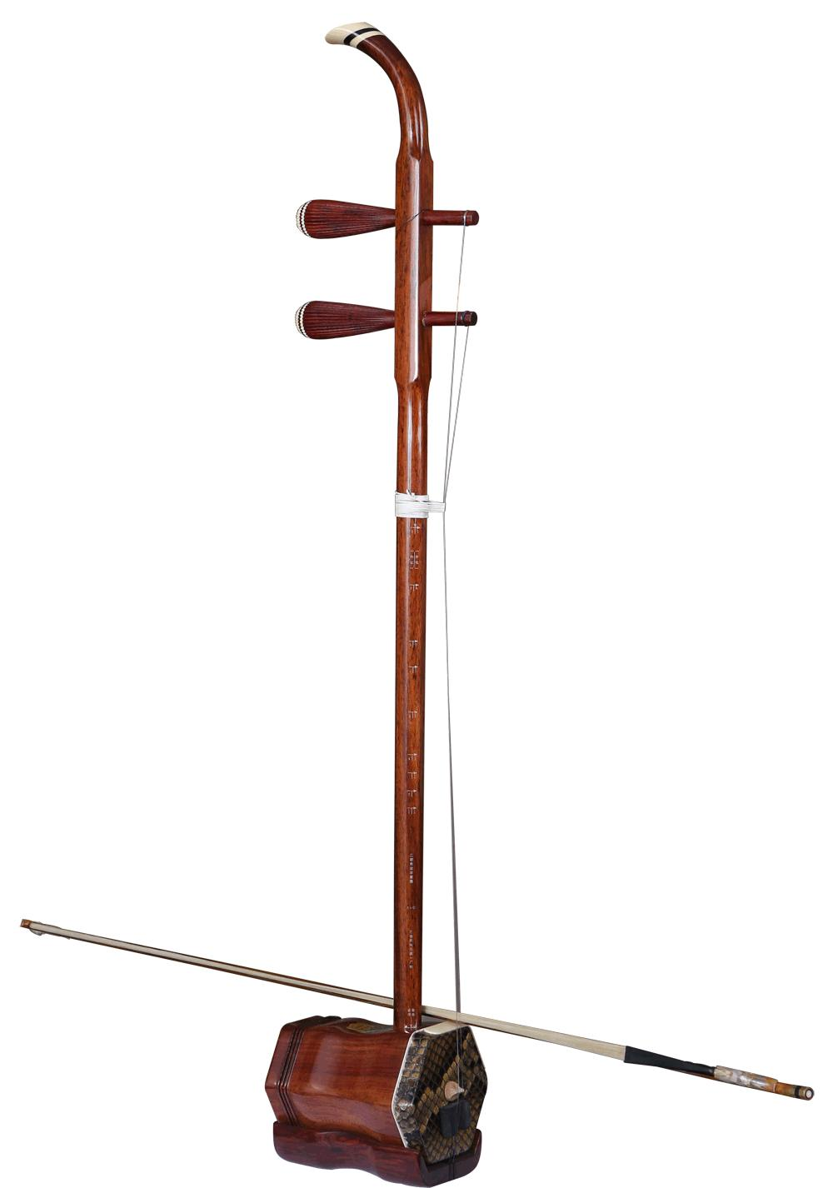
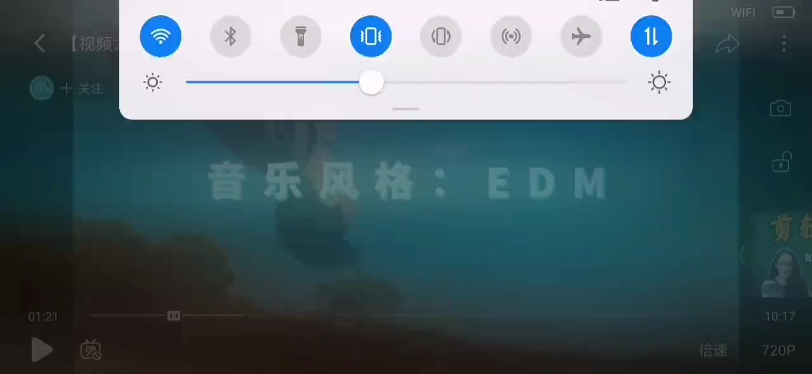
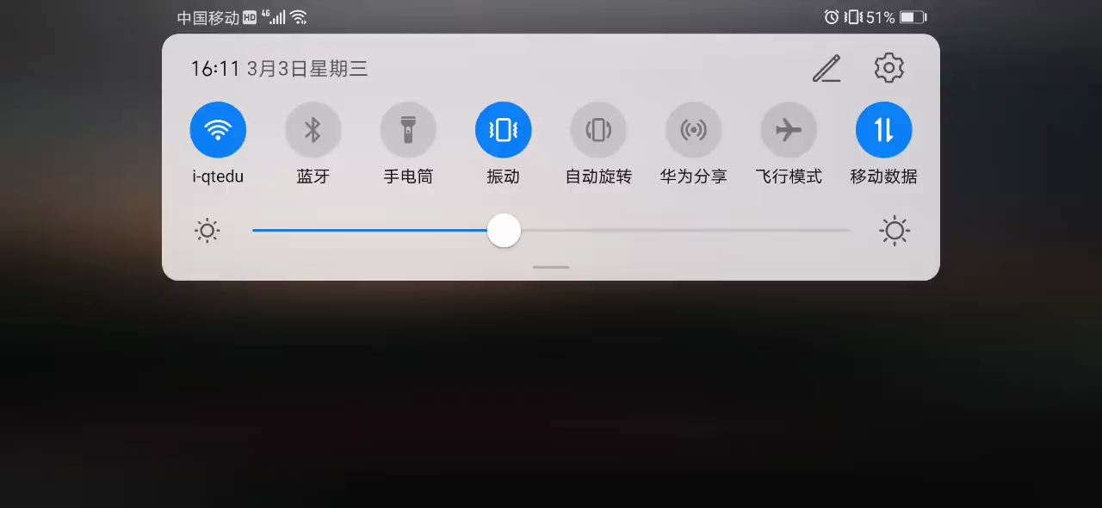
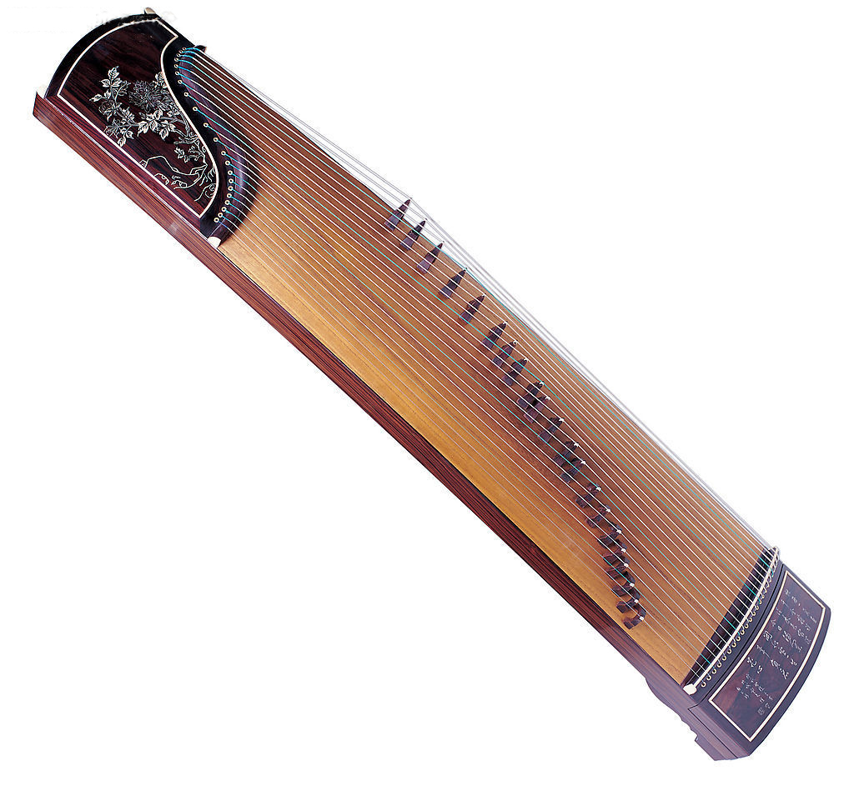

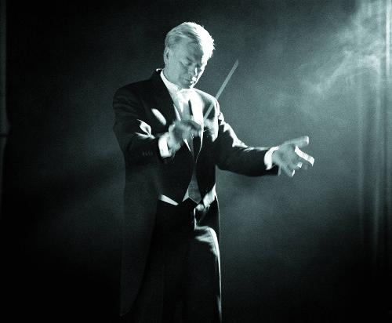
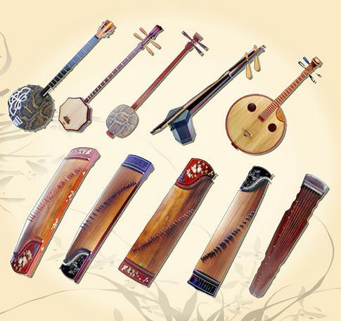
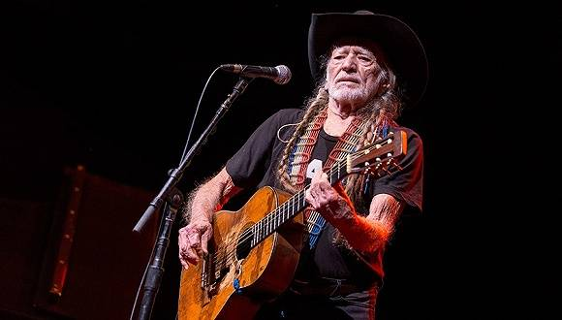
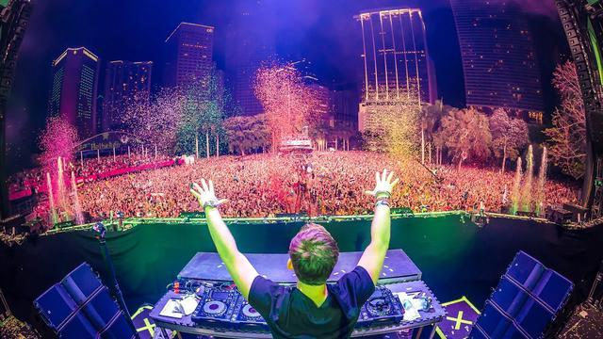

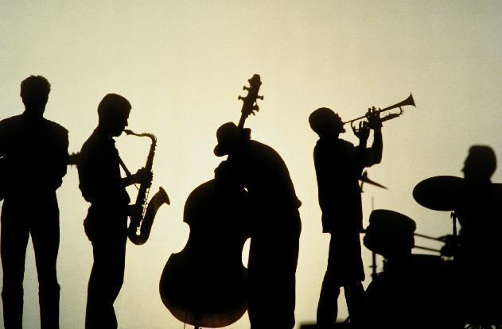
Lead-in
What kind of music do you know?
What does the following symbol stand for?
types
harp
Beth
Hip-pop
classical
guitar
violin
Music
Among above music，which one do you prefer?
Western
Eastern
stringed
instruments
EDM
country music
jazz
rock
Chinese traditional

Slide 5
Lead-in
I have a preference for _________, that's because _________________.
country music
country music can always touch my soul
1. touch my soul
2. make me happy/want to dance
3. give me energy/hope
4. remind me of home/love/friends
...
The reasons for one's preference vary from person to person.

Slide 6

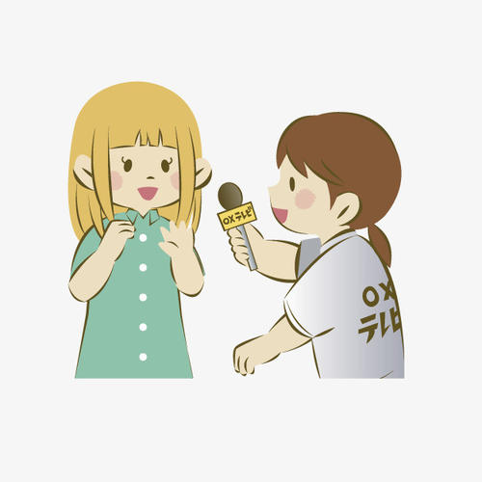
Listening
Let's listen and choose the right answers
A reporter from the school newspaper is interviewing students about music.
1. What kind of music does the first student like?
A. Hip-pop B. Chinese traditional C. country music
2. Why does the second student like classical music?
A. It touches his heart.
B. It can make him move.
C. It makes him feel like sitting beside a quiet stream...
3. Which one is not mentioned in the interview?
A. Hip-pop B. Chinese traditional C. Country music
the first student
the third student

Slide 7

Listening
Let's listen and finish the explanation
Country music touches my heart.
So you like music that’s ________ of __________?
full feeling
When I listen to hip-hop, I just have to move!
So it makes you want to ___________?
dance
Listening Tip:
When you hear some words or phrases that are difficult, you can pay attention to the following sentences, because there may be an explanation which use easier words with the same meaning. This will help you to understand more easily.
peaceful
There is no wonder that everyone will like music.
Classical music makes me feel like I’m sitting beside a quiet stream and enjoying nature.
So to you, it’s _______ and __________?
beautiful

Slide 8
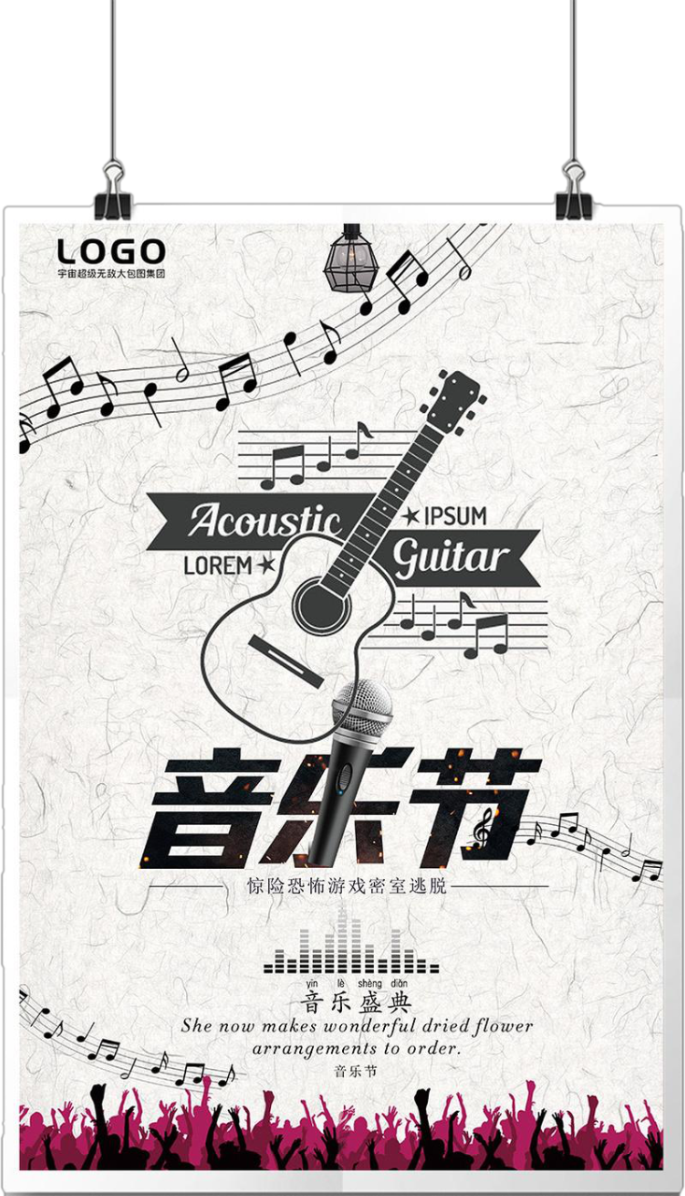
Listening
Listen and tick the kinds of volunteers the festival needs
announcement
of school music festival
 people to give music lessons
 choir members
 people to run food stands
 people to sell festival tickets
 people to sell music CDs
 people to set up equipment
 musical performers
Will you join?
√
What can you do?
√
wokers
√
audience
run food stand
performer
sell ticket
give a performance
set up equipment
√
perform on the stage

Slide 9
Listening
Listen and finish the mind map
hold a music festival
_____ ______
raise money
content
Time
next month
purpose
_____ ______
structure of an announcement
announcement
contact
way
place
on the sports field
_______________
participant
just __ __ ____ with your _______
get in touch
anyone with_____ ______ can try out;
___________ of all kinds
teacher
music talent
volunteers

Slide 10
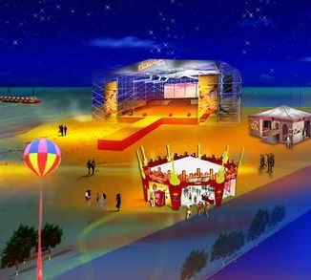
Sample
A: You know there will be a music festival in our hometown, will you take part in it?
B: Music Festival?
A: Yes. It's going to be next week on the center square. I know that you can sing some hip-pop.
B: I would prefer to sing ... ,because... How about you?
A: You know I'm not talented in music, so I would rather help out with crowds. Can you give me any advice?
B: Well, I think you can...
A:...
B:...
There will be a music festival in your hometown，and now they need lots of performers and volunteers.
Performers
hip-pop
classical
country music
Chinese traditional
Help out with crowds
run food stands
sell festival tickets
sell music CDs
set up equipment
Discussion

Slide 11
Practice
Translation
working
1. Lydia doesn’t feel like ___________(work) abroad.After all, her parents are old.
2. The manager praised him for his _________(energetic) and enthusiasm
3. He felt it was teacher's duty to touch student's heart and ______
4. you are talented in music, why don't you try _____ for the school music festival? 5. Australians have a ____________(prefer) for sweet foods.
6. _________(string) instruments became popular in China during Song Dynasty.
7. The company has decided to buy some modern _____________(equip)
8. The ____________ giving a ______________ on the stage is my favorite singer, as well as an actor. (perform)
1. 触碰一个人的灵魂
2. 给我能量
3. 使某人想起
4. 感觉像/想要做...
5. 经营食品摊
6. 安装好设备
8. 表演
9. 参加选拔
10. 偏爱
touch one's soul
energy
give me energy
soul
remind sb of...
out
feel like (doing)
preference
run food stands
Stringed
set up equipment
equipment
give a performance
performer
performance
try out for
have a preference for

