Slide 1


感恩遇见，相互成就，本课件资料仅供您个人参考、教学使用，严禁自行在网络传播，违者依知识产权法追究法律责任。
更多教学资源请关注
公众号：溯恩高中英语
知识产权声明

Slide 2
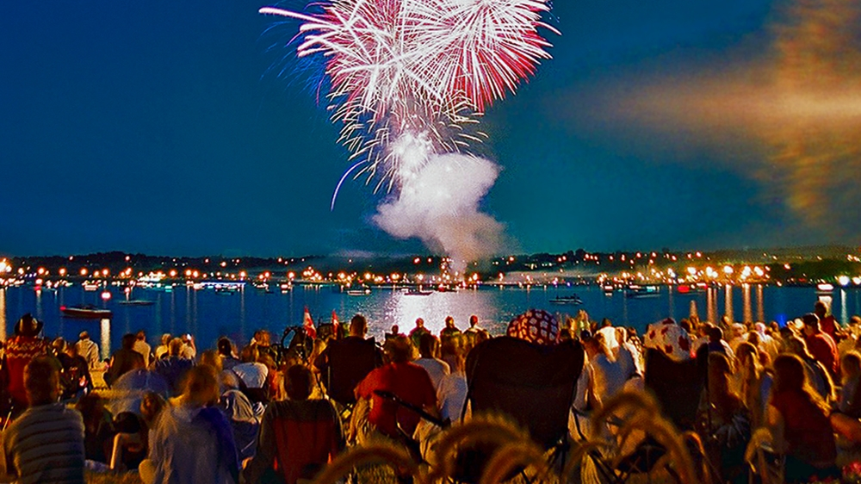
WHY DO WE CELEBRATE FESTIVALS?
Reading and Thinking
Period 1
杭州第四中学

Slide 3
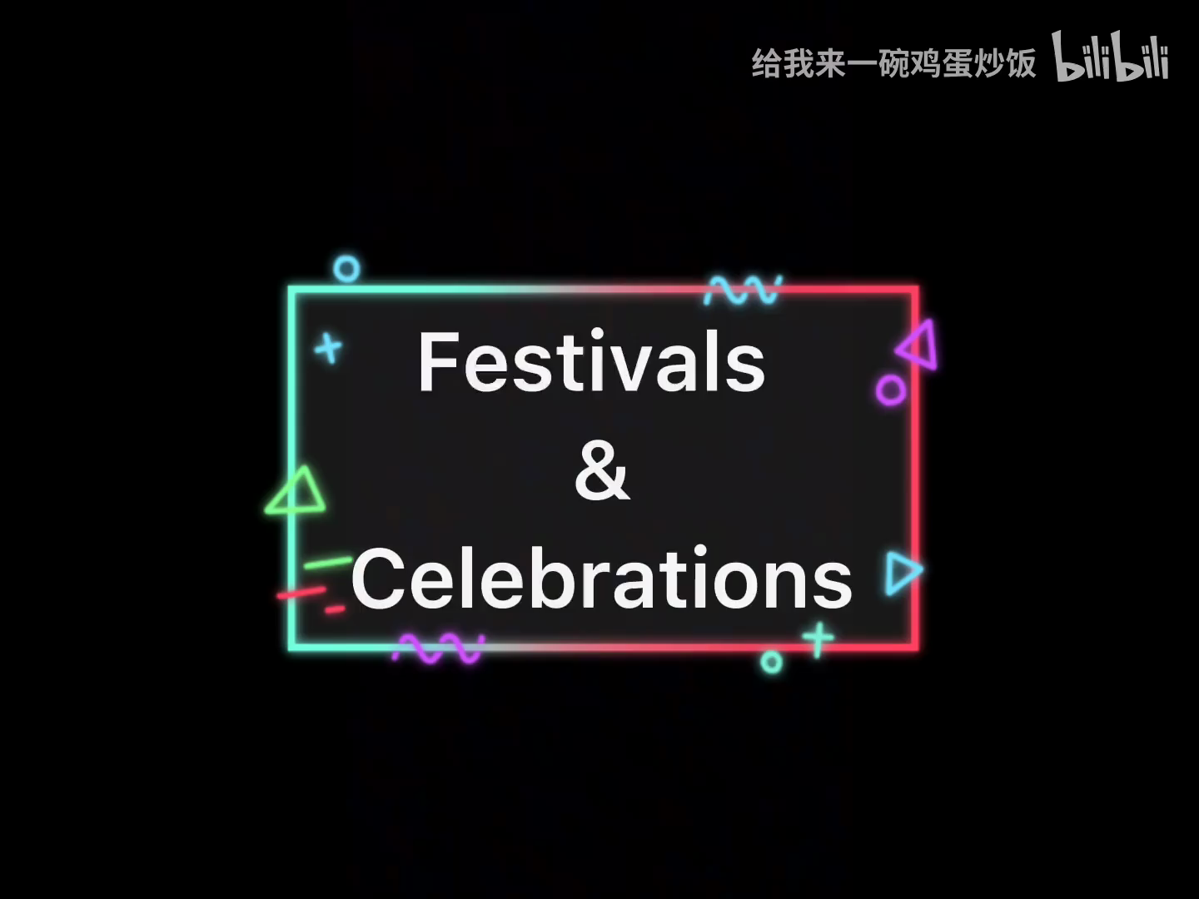
Lead-in
Watch a video about festivals around the world.

Slide 4
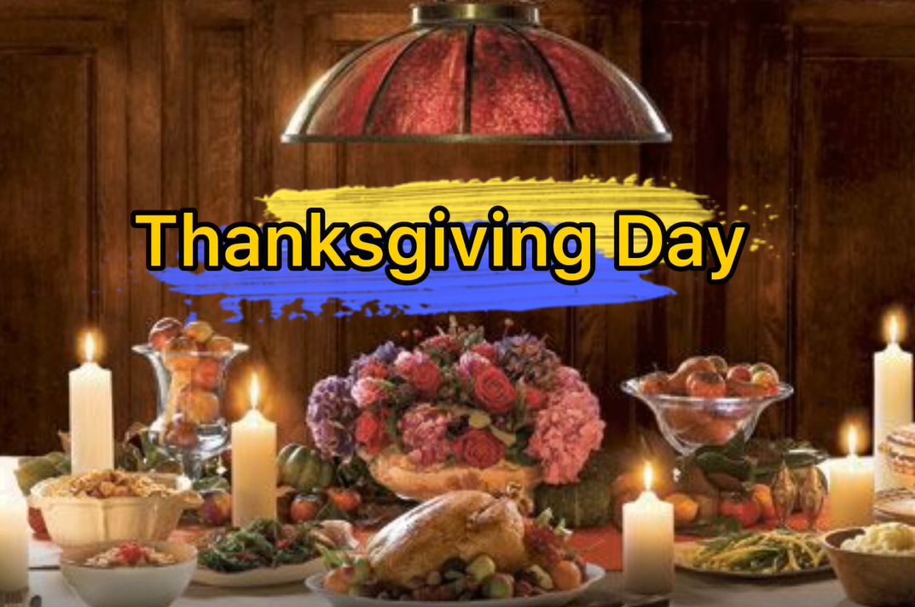
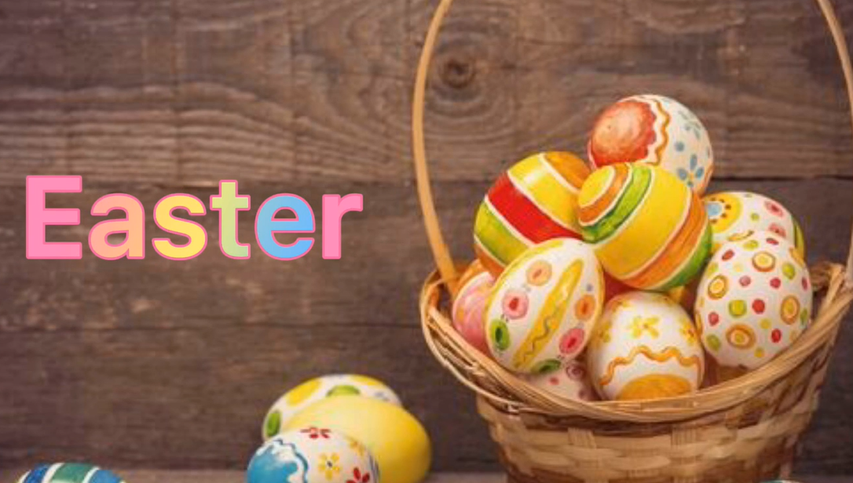
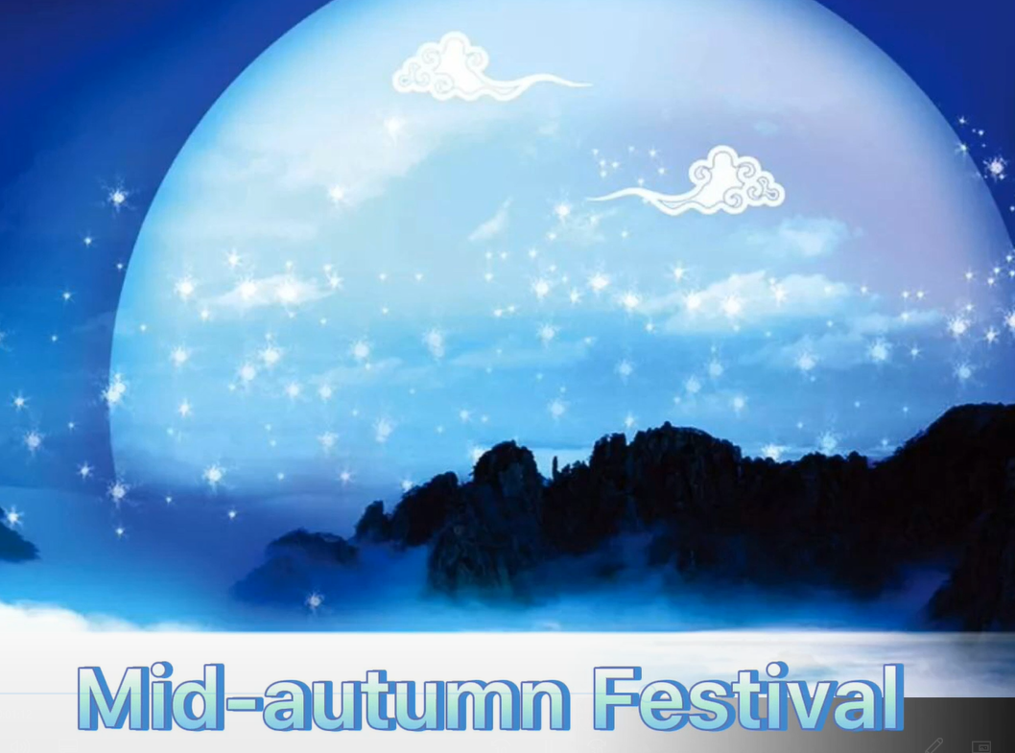
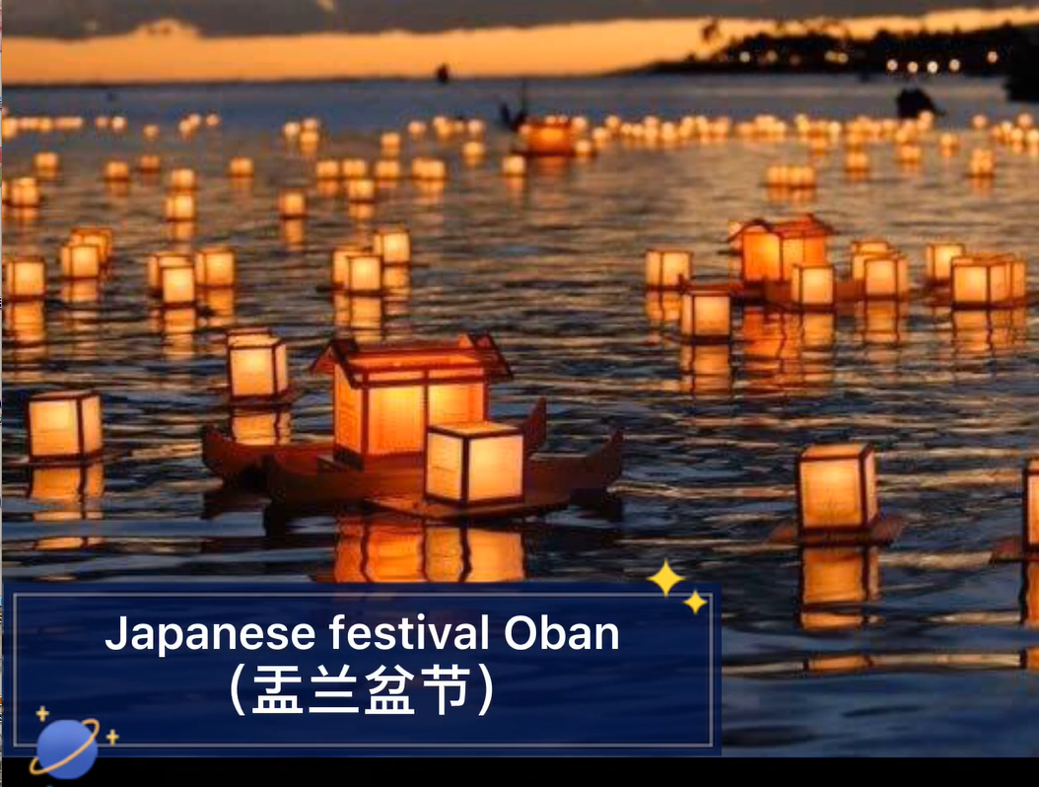
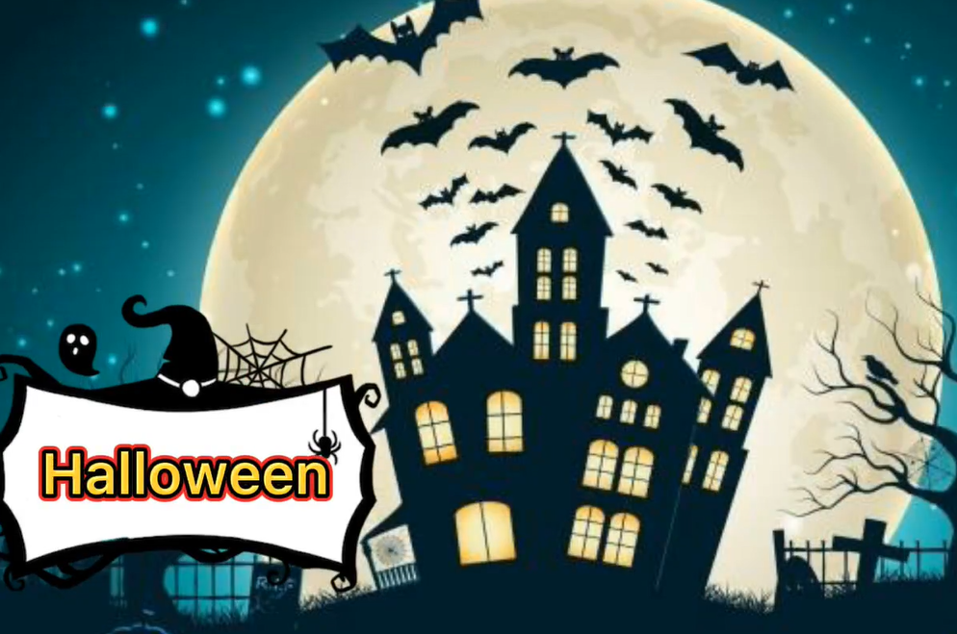
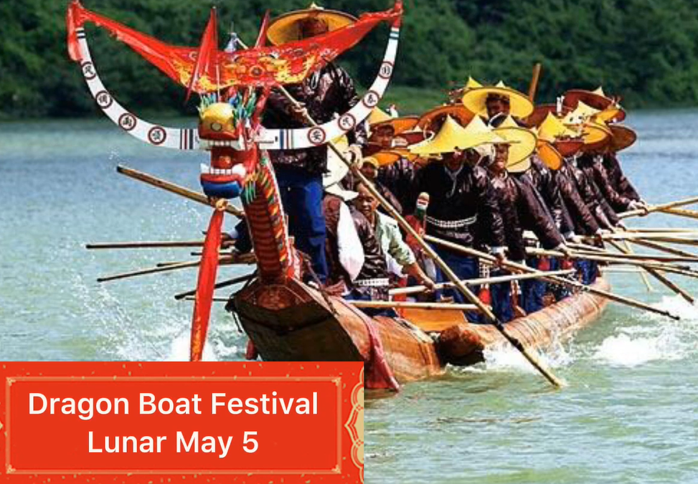
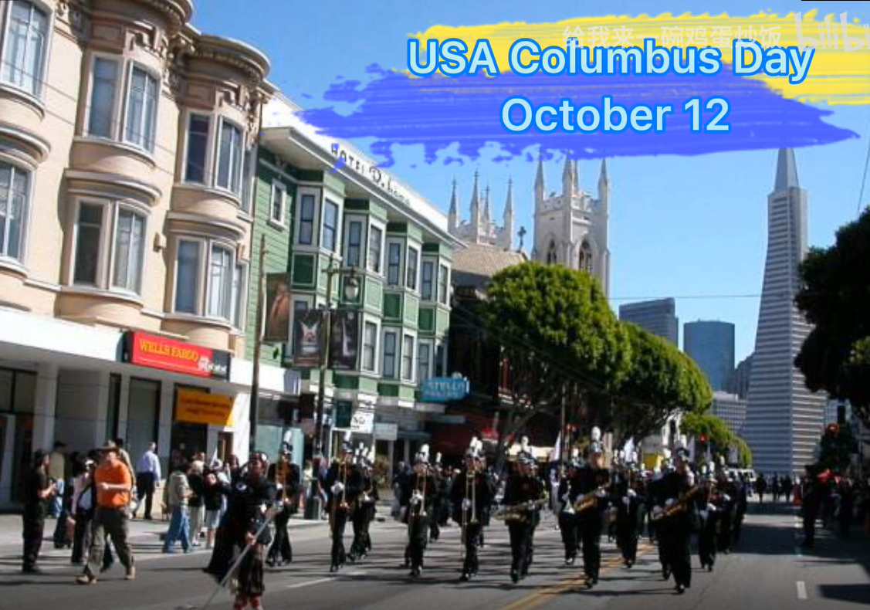

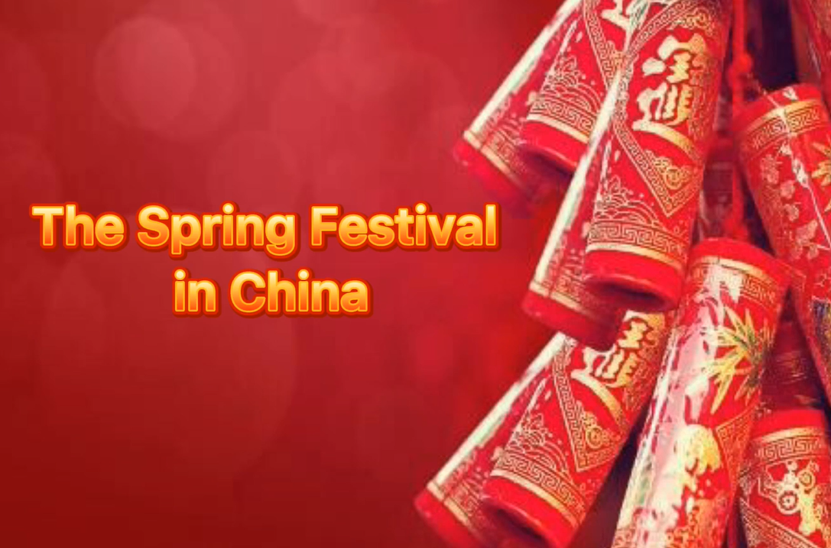
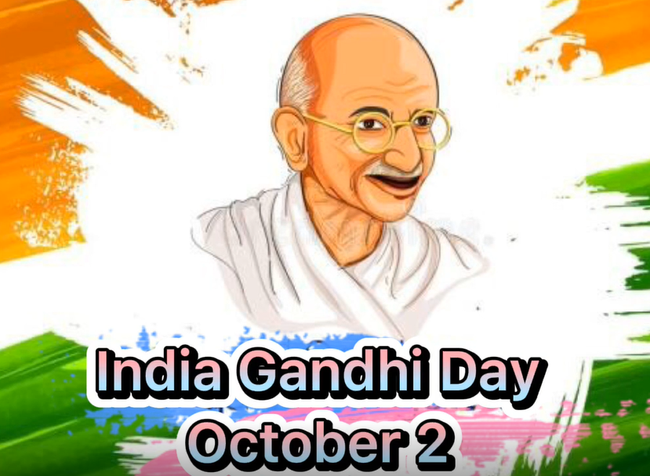
Lead-in
Watch a video about festivals around the world.
What festivals can you find in this video?
For the dead
To honour people
For the harvest
For the spring
Think:
Why do we celebrate festivals?

Slide 5
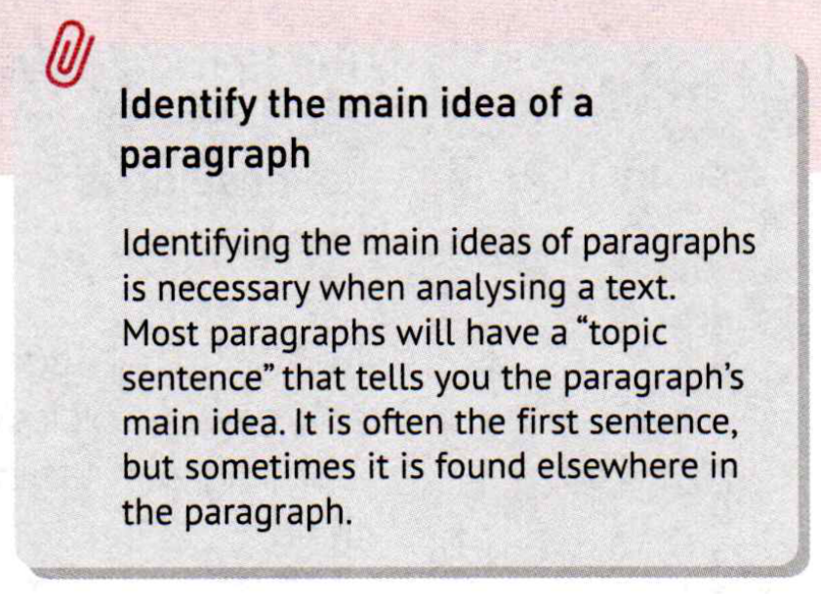
Skimming
Identify the topic sentence of each para.
Basic para-structure
1.Topic sentence (Main idea)
2.Supporting details/ Examples
(Specific information)
Function
Position
It may be in the middle of a paragraph or in the end of a paragraph

Slide 6
Skimming Para 1
Tell the topic sentence and its function.
Festivals are celebrated all around the world. They have a wide range of origins, such as the seasons of the year, religions, famous figures, and important events. Every festival has its different customs and unique charms. However, no matter how different they may seem, all over the world, the spirit of sharing joy, gratitude, love, or peace is common in all festivals.
However as transition to introduce the deeper information. Topic sentence as conclusion.

Slide 7
Read for Details—Para. 1
Which two sentences can help you summarize the main idea?
Festivals are celebrated all around the world. They have a wide range of origins, such as the seasons of the year, religions, famous figures, and important events. Every festival has its different customs and unique charms. However, no matter how different they may seem, all over the world, the spirit of sharing joy, gratitude, love, or peace is common in all festivals.
different
common
different
common
Notes:
2 words，并且此处可提供寻找主题句的技巧。以下各段类似，提供不同技巧。

Slide 8
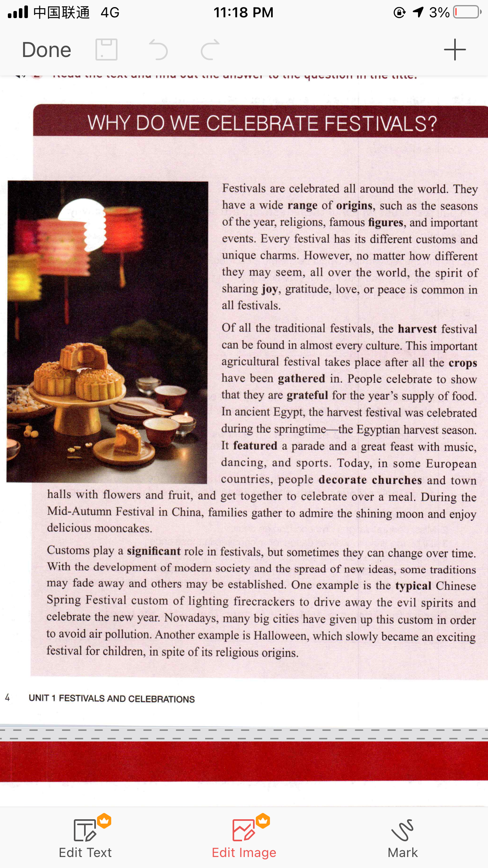
Skimming Para. 2
Tell the topic sentence and its function.
Topic sentence as a general idea to lead in.

Slide 9
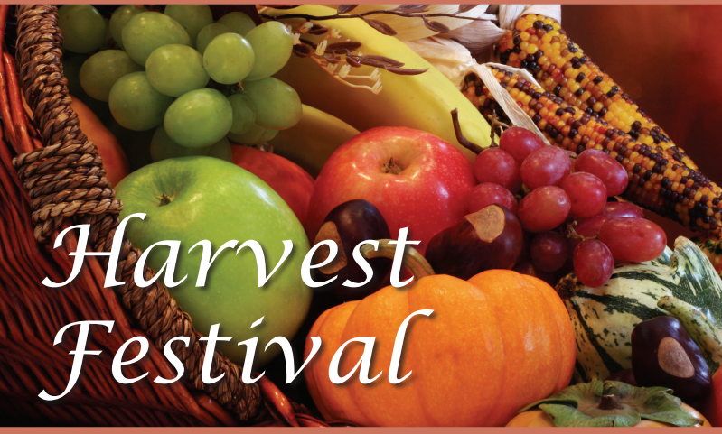
Harvest festival-Para. 2
Topic sentence
Of all the traditional festivals, the harvest festival can be found in almost every culture.
Purpose the harvest festival：People celebrate to _________________________________________________________
Location | Time | The people always do
Egypt
European countries | /
China
show that they are grateful for the year's supply of food
during the springtime
featured a parade and a great feast with music, dancing, and sports
Three
examples
decorate churches and town halls with flowers and fruit
get together to celebrate over a meal
custom
families gather to admire the shining moon and enjoy delicious mooncakes
Mid-Autumn

Slide 10
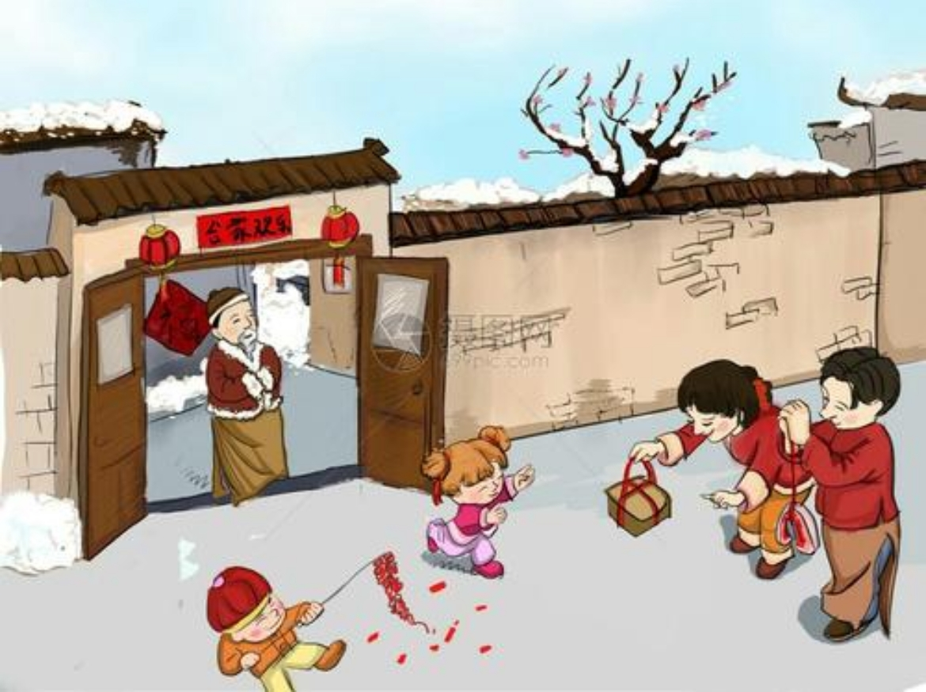
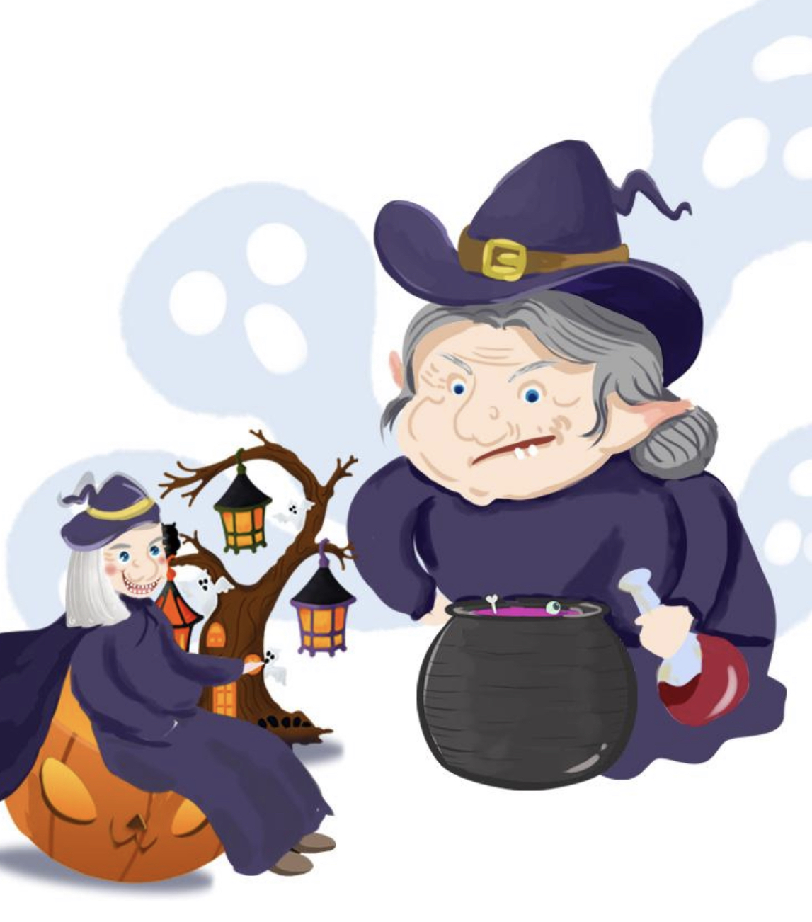
Skimming Para. 3
Tell the topic sentence and its function.
Topic sentence as a general idea to start the discussion.

Slide 11
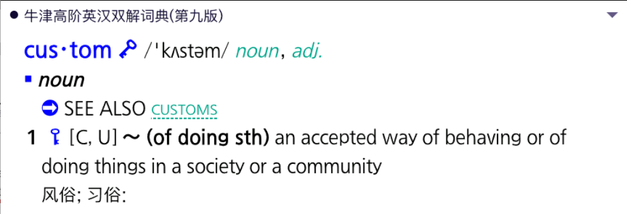
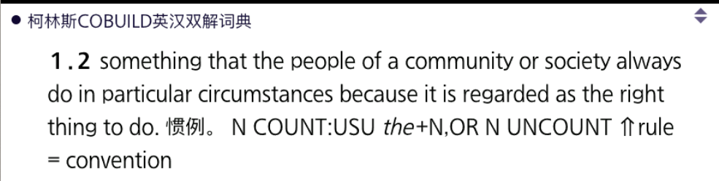
check the meaning of “custom”. Is custom something never change？
Custom-Para. 3
always do ≠ permanent
Customs play a significant role in festivals, but sometimes they can change over time.

Slide 12
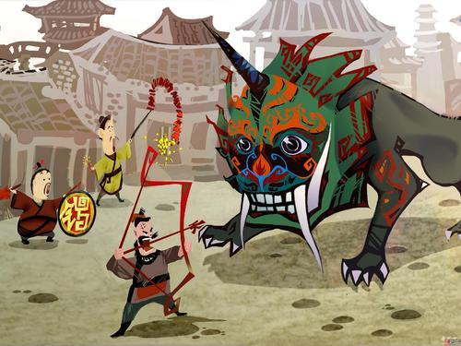
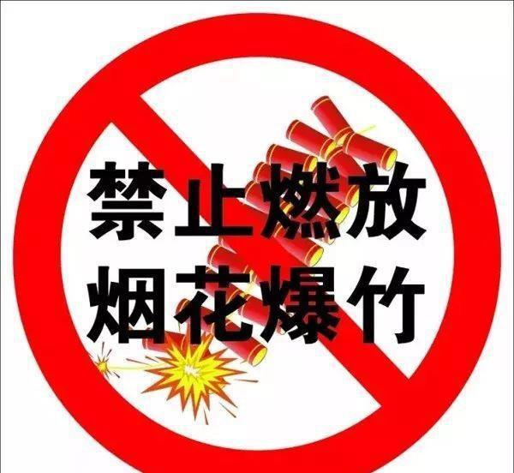
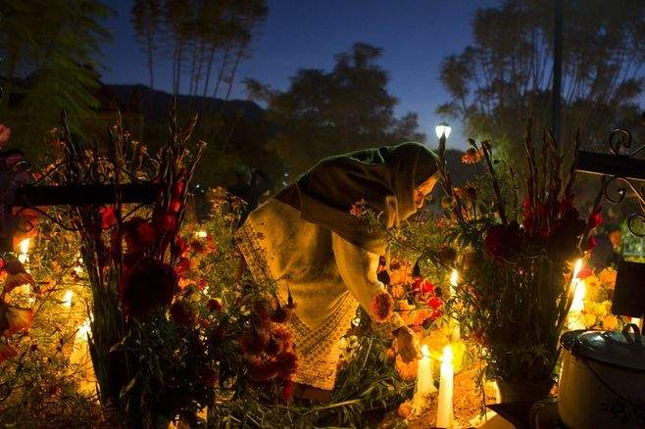
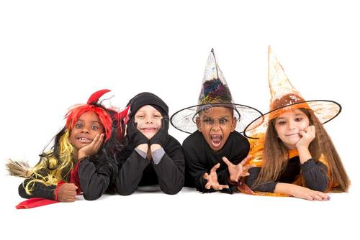
Custom-Para. 3
Customs play a significant role in festivals, but sometimes they can change over time.
In the past
nowadays
lighting firecrackers to drive away the evil spirits and celebrate the new year
many big cities have given up this custom in order to avoid air pollution
Spring
festival
Halloween
an exciting festival for children
its religious origins

Slide 13
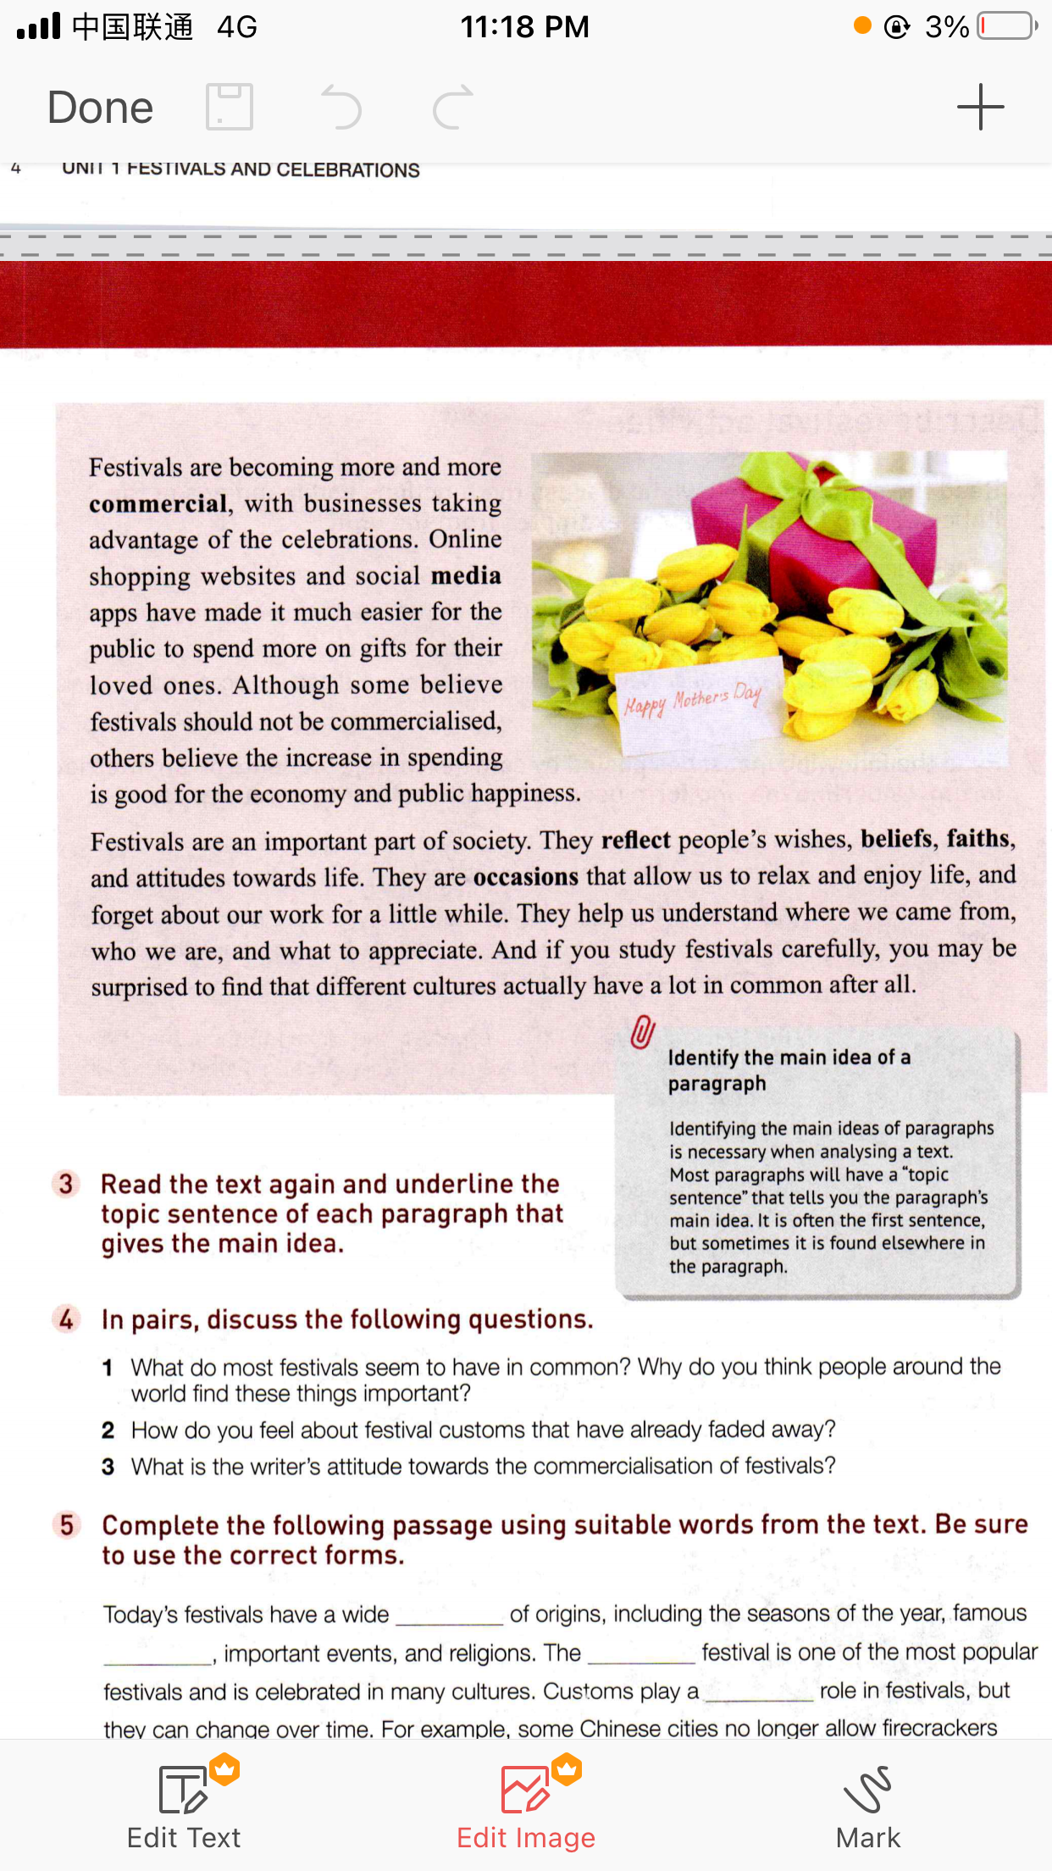
Skimming Para. 4
Tell the topic sentence and its function.
Topic sentence states a general idea.

Slide 14

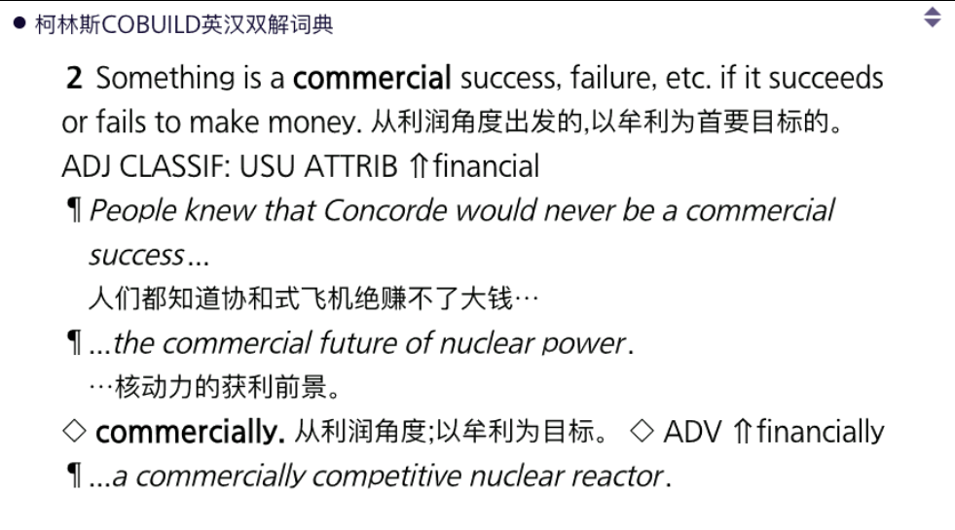

Custom-Para. 4
what do we mean by commercial?
How about people’s opinion?

Slide 15
Skimming Para. 5
Tell the topic sentence and its function.
Topic sentence tells the main idea of this paragraph.

Slide 16
Read for Details—Para. 5
Why festivals are important? Find some supporting details.
what do most festival seem to have in common?
Topic sentence
Supporting details
Festivals are an important part of society. They reflect people's wishes, beliefs, faiths, and attitudes towards life. They are occasions that allow us to relax and enjoy life, and forget about our work for a little while. They help us understand where we came from, who we are, and what to appreciate. And if you study festivals carefully, you may be surprised to find that different cultures actually have a lot in common after all.
They reflect
They are occasions that allow
They help
in common
WHY DO WE CELEBRATE FESTIVALS?

Slide 17

Task
Since festivals could be different, but also should have the positive qualities in common.
Please create a new festival. Show us the name, time, customs, and purpose of this new festival.
Name: Food-sharing Day.
Time: This festival takes place in 16th Oct, which is the World Food Day.
Customs: a pot-luck activity in class. Each student brings a dish cooked by himself/herself and shares with classmates.
Purpose: People celebrate to show their ability of cooking. It helps us understand why we need to cherish food and keep away from waste.
Useful sentence structure：
This festival takes place……
the harvest festival was celebrated during……
People celebrate to show that……
They reflect …….
They are occasions that allow us….
They help us understand……
Notes:
请提供最少一个写作样本。

Slide 18
Sharing time- sample version
Today we want to introduce a No-homework Festival(name).
This festival should be found in every culture. This important No-homework Festival takes place around November after the mid-term exam(time).
Students celebrate to show their wish to have a rest. On that day, teachers cannot give assignments but only let students enjoy the class and take a rest after the class. In the meantime, it features a great feast with music, dancing on campus(custom).
We think this festival reflects student's wishes to adjust themselves after a tense exam. This is an occasion that allows us to relax and enjoy school life, and forget about our busy schoolwork for a little while (purpose).

Slide 19
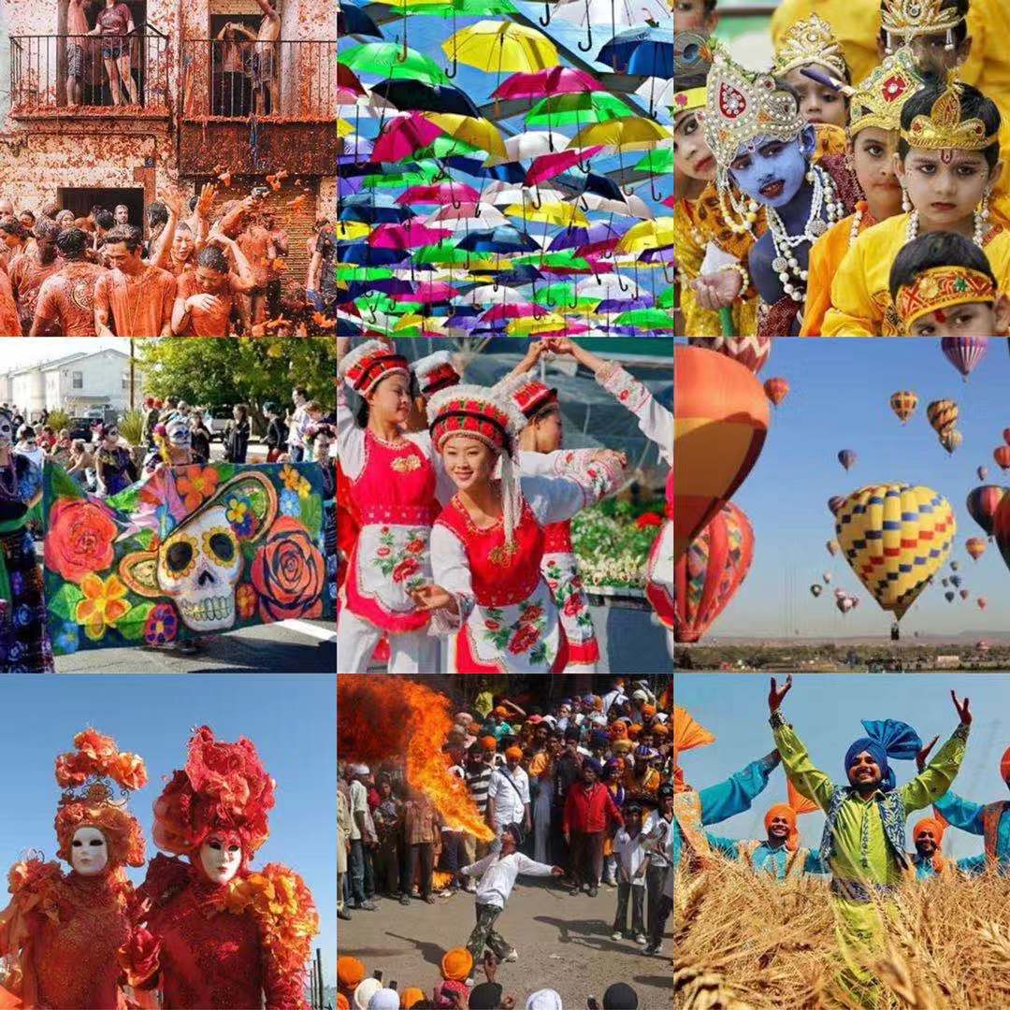
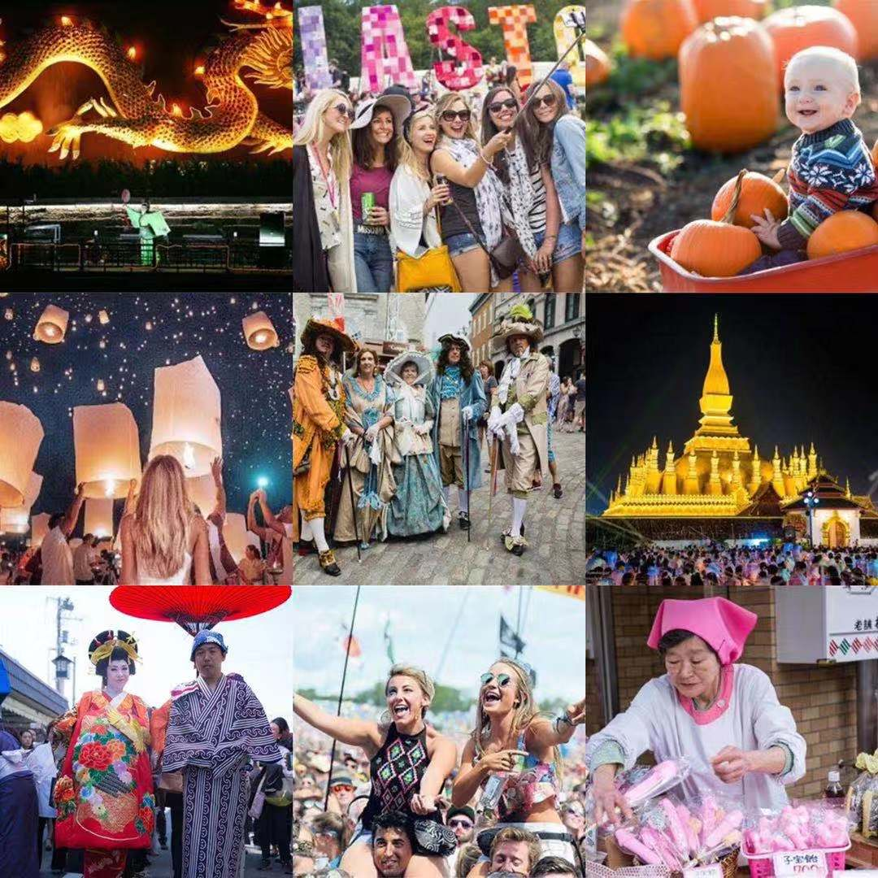
“And if you study festivals carefully, you may be surprised to find that different cultures actually have a lot in common after all！”

