Slide 1


感恩遇见，相互成就，本课件资料仅供您个人参考、教学使用，严禁自行在网络传播，违者依知识产权法追究法律责任。
更多教学资源请关注
公众号：溯恩高中英语
知识产权声明

Slide 2


续写微写作：
如何让语言丰满且生动
（以2021.1 浙江读后续写真题为例）
余杭区杭州二中树兰高级中学 郭合英

Slide 3

【学生在读后续写中失分原因】
1.审题不够仔细，缺乏合理的想象，导致出现张冠李戴的现象；
续写内容不符合逻辑，与上文不连贯，不考虑文章的基调和
各情节之间的逻辑关系。
2.大部分学生认为只要有合理的故事情节就可以了，而忽视
了语法和词汇的丰富性、准确性、贴切性、鲜活性等方面，
导致续写得分不高。
3.续写部分与原文风格不相符。
4.续写忽视结尾部分，没有立意或立意不高；有的同学虽有立
意，但立意跑偏脱离原文情节；情节未能传递正能量。
5.忽视衔接。

Slide 4

第5档作文评分原则
很多学生在这里翻车！那么如何表达你的语言，让它丰满、生动、地道呢？这是我们今天学习的主题：如何使语言丰满且生动。
本题总分为25分，分5个档次给分
第五档 (21-25) | 与所给短文融洽度高，与所提供各段落开头语衔接合理。 内容丰富，应用了5个以上短文中标出的关键词语。 所使用语法结构和词汇丰富、准确， 可能有些错误，但完全不影响意义表达。 有效地使用了语句间的连接成分，使所续写短文结构紧凑。

Slide 5
读后续写（满分25）
阅读下面短文，根据所给情节进行续写，使之构成一个完整的故事。
Pumpkin (南瓜) carving at Halloween is a family tradition. We visit a local farm every October. In the pumpkin field, I compete with my three brothers and sister to seek out the biggest pumpkin. My dad has a rule that we have to carry our pumpkins back home, and as the eldest child I have an advantage - I carried an 85-pounder back last year.
This year, it was hard to tell whether my prize or the one chosen by my 14-year-old brother, Jason, was the winner. Unfortunately we forgot to weigh them before taking out their insides, but I was determined to prove my point. All of us were hard at work at the kitchen table, with my mom filming the annual event. I'm unsure now why I thought forcing my head inside the pumpkin would settle the matter, but it seemed to make perfect sense at the time.
With the pumpkin resting on the table, hole uppermost, I bent over and pressed my head against the opening. At first I got jammed just above my eyes and then, as I went on with my task，unwilling to quit，my nose briefly prevented entry. Finally I managed to put my whole head into it，like a cork (软木塞） forced into a bottle. I was able to straighten up with the huge pumpkin resting on my shoulders.

Slide 6
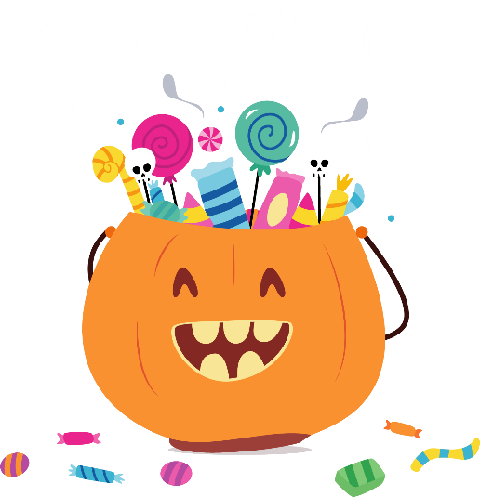
My excitement was short-lived. The pumpkin was heavy. “I‘m going to set it down, now,” I said, and with Jason helping to support its weight, I bent back over the table to give it somewhere to rest. It was only when I tried to remove my head that I realized getting out was going to be less straightforward than getting in. When I pulled hard. my nose got in the way. I got into a panic as I pressed firmly against the table and moved my head around trying to find the right angle. but it was no use. “I can’t get it out! ” I shouted，my voice sounding unnaturally loud in the enclosed space.
Para.1
I was stuck for five or six minutes though it felt much longer. ___________________
________________________________________________________________________________________________________________________________________________
Para.2
That video was posted online the Monday before Halloween. ____________________
________________________________________________________________________________________________________________________________________________

Slide 7

1. 丰富性
6.鲜活性
语
言
的构成和
提升
2. 多样性
7.时文性
3.准确性
8.感情线
4.地道性
9.运用描写
5.贴切性
10.主题升华

Slide 8
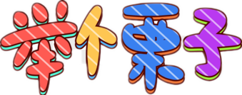
1. 丰富性：指词汇和语法表达的丰富性。主要指词汇的使用、不同语法的表达和长难句的运用。词汇和语言的积累是提高读后续写能力的基础。学生只有脑中储备足够数量的词汇，才能保证在运用时随意支取，使续写语言准确、地道、生动。
(以2021.1高考真题为例)

Slide 9
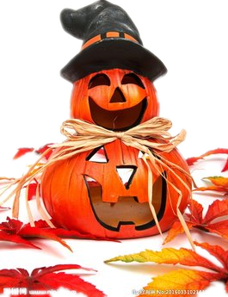
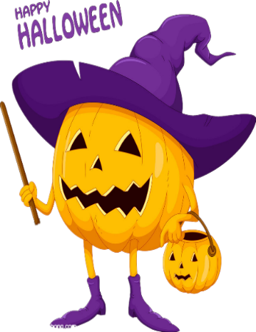
词汇的运用
Para.1
I was stuck for five or six minutes though it felt much longer. Inch by inch, I worked my fingers to the bone to pull
the pumpkin up, but in vain. My brain didn’t work at that time.
I rued the day if only I hadn’t forced my head into the pumpkin. I had no choice but to turn to my family for help. My brother , John, seized the pumpkin and pulled it over and over again, like a farmer pulling a carrot form his garden, but still in vain. I was thrown into a world of darkness and sank into despair. Just at that time, my dad went downstairs, seeing my embarrassment, grinning from ear to ear. He swooped a knife and pierced the pumpkin with care. The pumpkin was dissected in two. I was full of the joys of spring instantly my father took the pumpkin away form my head. I felt the air much fresher than ever before. During the time, my mom was constantly filming the whole moment.
用seize替换常用的catch
用grin替换常用的laugh
用swoop替换常用的catch/grap等
用pierce替换常见的stab
用dissect替换了常见的divide
用instantly替换了常见的as soon as

Slide 10
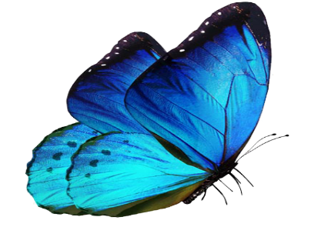

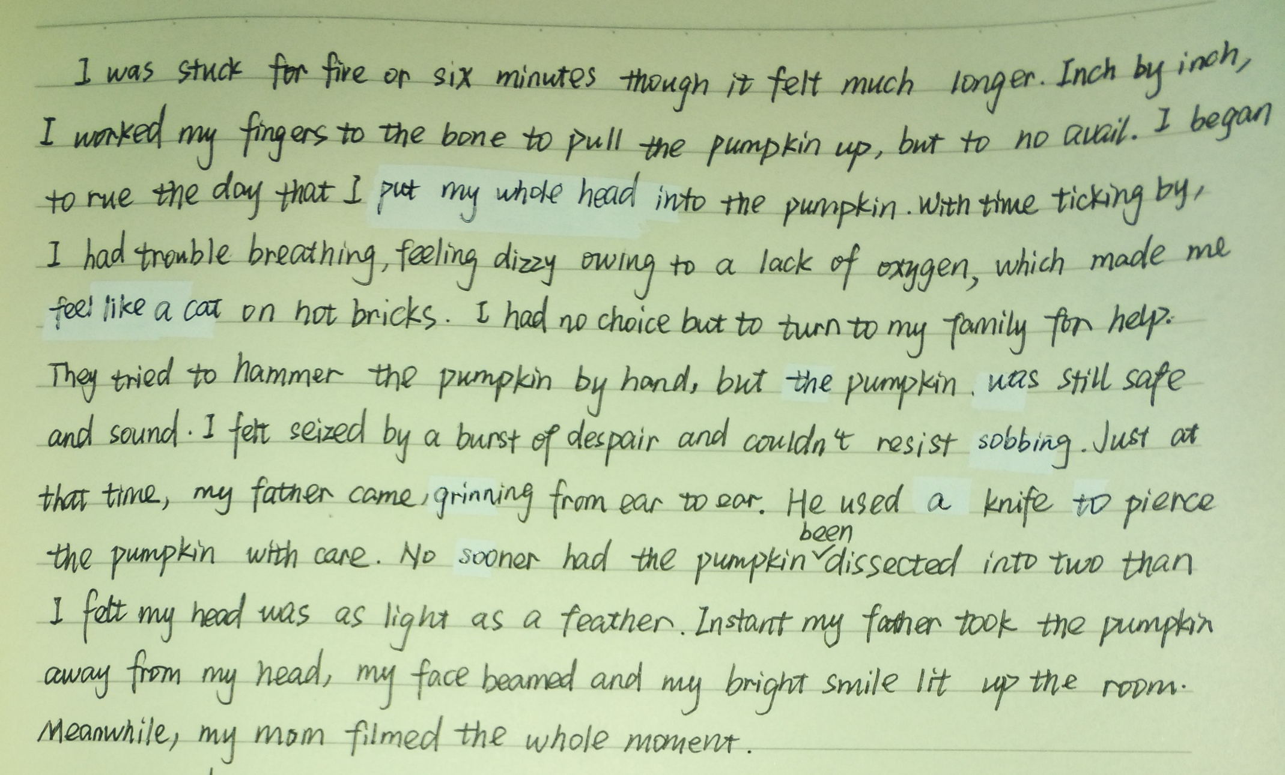

词的运用方面----再举个例子
用tick替换常用的go
用turn to sb替换常用的ask sb. for help
用cannot resist doing 替换常用的cannot help doing
用pierce替换常用的stab
用dissect替换常用的burst/divide
用beam替换常用的smile/laugh/look cheerful

Slide 11
句式的运用
Para.1
I was stuck for five or six minutes though it felt much longer. Inch by inch, I worked my fingers to the bone to pull
the pumpkin up, but in vain. My brain didn’t work at that time.
I rued the day if only I hadn’t forced my head into the pumpkin. I had no choice but to turn to my family for help. My brother , John, seized the pumpkin and pulled it over and over again, like a famer pulling a carrot form his garden, but still in vain. I was thrown into a world of darkness and sank into despair. Just at that time, my dad went downstairs, seeing my embarrassment, grinning from ear to ear. He swooped a knife and pierced the pumpkin with care. The pumpkin was dissected in two. I was full of the joys of spring instantly my father took the pumpkin away form my head. I felt the air much fresher than ever before. During the time, my mom was constantly filming the whole moment.
have no choice but to do sth. 的句型
if only 引导的虚拟语气
非谓语
非谓语

Slide 12
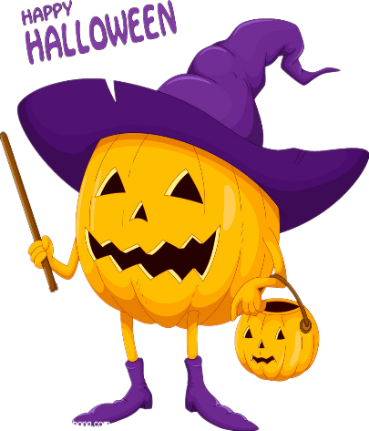
Para.2
That video was posted online the Monday before Halloween. At the outset, I had an egg on my face due to an awkward dilemma. However, my mom told me with pride that the video filmed by her was so popular that it attracted millions of followers and received a thousand and one likes. Hearing the news, I almost laughed my head off. Never in my wildest dreams was it the video that made me become a web celebrity, which made my jaw drop. Everywhere I went, there were millions of followers, asking for my signature and taking photos with them, which made me float on air. What an unforgettable Halloween for me!
宾语从句
非谓语
部分倒装
强调句型
非谓语
定语从句
感叹句

Slide 13
2.多样性：语言是文化的载体，语言的多样性保证了文化的多样性。英国大文豪塞缪尔·约翰逊说:“语言是思想的外衣。” 诚然，为了表达思想、抒发情感、交流意见，人们离不开语言。
在读后续写中语言的多样性主要是指：
1. 同一词意的用词不同表达。
2. 同义句的多样化表达。
3. 同一成分的不同表达形式。

Slide 14
词汇的多样性
Para.1
I was stuck for five or six minutes though it felt much longer. Inch by inch, I worked my fingers to the bone to pull
the pumpkin up, but in vain. My brain didn’t work at that time.
I rued the day if only I hadn’t forced my head into the pumpkin. I had no choice but to turn to my family for help. My brother , John, seized the pumpkin and pulled it over and over again, like a farmer pulling a carrot form his garden, but still in vain. I was thrown into a world of darkness and sank into despair. Just at that time, my dad went downstairs, seeing my embarrassment, grinning from ear to ear. He swooped a knife and pierced the pumpkin with care. The pumpkin was dissected in two. I was full of the joys of spring instantly my father took the pumpkin away form my head. I felt the air much fresher than ever before. During the time, my mom was constantly filming the whole moment.
用seize替换常用的catch
同一词意的用词不同表达方式
用swoop替换常用的catch/grap等

Slide 15
同义句的多样化表达
Para.1
I was stuck for five or six minutes though it felt much longer. Inch by inch, I worked my fingers to the bone to pull the pumpkin up, but in vain. My brain didn’t
work at that time. I rued the day if only I hadn’t forced my head into the pumpkin. I had no choice but to turn to my family for help. My brother , John, seized the pumpkin and pulled it over and over again, like a farmer pulling a carrot form his garden, but still in vain. I was thrown into a world of darkness and sank into despair. Just at that time, my dad went downstairs, seeing my embarrassment, grinning from ear to ear. He swooped a knife and pierced the pumpkin with care. The pumpkin was dissected in two. I was full of the joys of spring instantly my father took the pumpkin away form my head. I felt the air much fresher than ever before. During the time, my mom was constantly filming the whole moment.
Para.2
That video was posted online the Monday before Halloween. At the outset, I had an egg on my face due to an awkward dilemma. However, my mom told me with pride that the video filmed by her was so popular that it attracted millions of followers and received a thousand and one likes. Hearing the news, I almost laughed my head off. Never in my wildest dreams was it the video that made me become a web celebrity, which made my jaw drop. Everywhere I went, there were millions of followers, asking for my signature and taking photos with them, which made me float on air. What an unforgettable Halloween for me!
异常开心
开心大笑
异常开心
异常开心

Slide 16


同一成分的多样性
（以主语为例：看主语的不同表达形式）
It作形式主语
人称代词作主语
当然，主语的表达还有很多种方式，比如动名词作主语，不定式作主语等，这里就不一一列举了。
名词作主语
强调句中的it
物作
主语
无灵
主语
无灵
主语
改为“I”

Slide 17

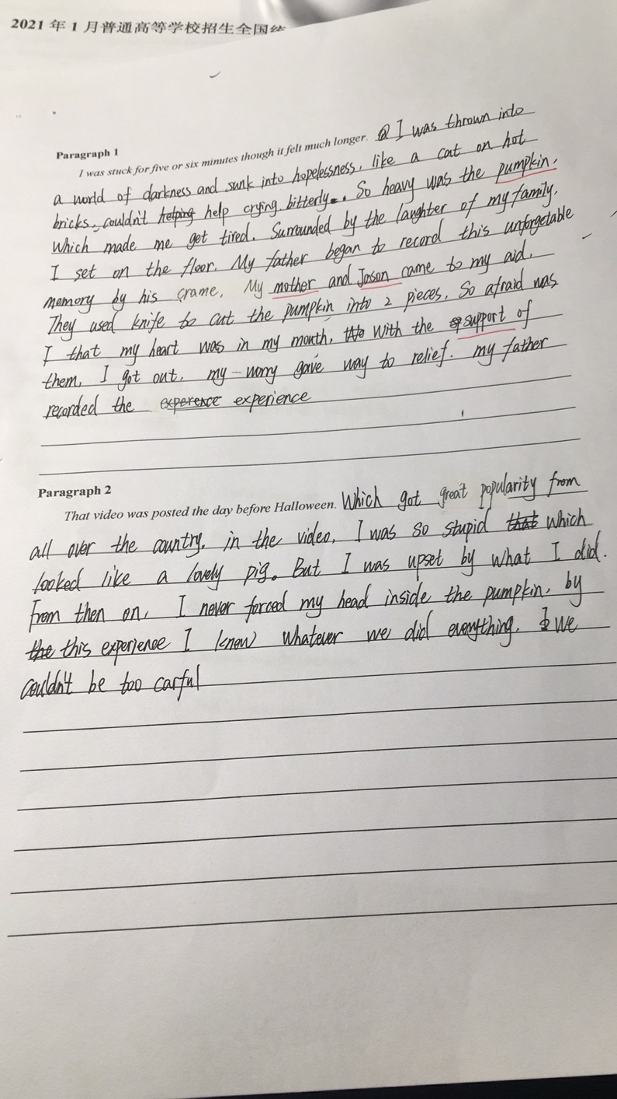
3.准确性：主要指原文信息的准确性和语言表达的准确性。
张冠李戴：原文中有一句话：All of us were hard at work at the kitchen table, with my mom filming the annual event.可知拍视频的是妈妈而不是爸爸。
so┄that 引起倒装，此句只有so,没有that 不能倒装
注意：
如果没有准确的信息和正确的句子表达，即使故事情节合理，那么得分也不高，所以希望同学们平时注重基础，多做句子翻译，为读后续写作铺垫。
缺少连词and
前面是句号，不能用which.
是so┄that结构，不是so ┄which结构.
正确：I was so stupid that I looked like a foolish pig.
sit的过去式为sat

Slide 18
4.地道性：所谓“地道的英语”，是指行文造句应该符合目的语的表达习惯且不留“译痕”，而不是生搬硬套译为中式英语。中国学生语言不地道的原因主要有二个，其一英语学习习惯的影响，学生大都把注意力放在了背单词、学语法，习惯性地养成了用汉语来思考英语，这势必造成英语地道性的缺失；其二是汉语的锚定作用、母语负迁移及中西思维的差异使地道性语言属于稀有者的“专属高配”。
短期内学生可以用无灵主语和俚语来提高读后续写语言的地道性。
如何获取地道语言：
提高学生的英语地道性表达不是一朝一夕就能成功的，平时要做好积累。
1. 积累英文的习惯表达，不能按照字
面意思去翻译。
2. 摘抄英文原版文章，可以从知名网
站和BBC等原版报纸或期刊中摘录
英语句式的地道表达。

Slide 19
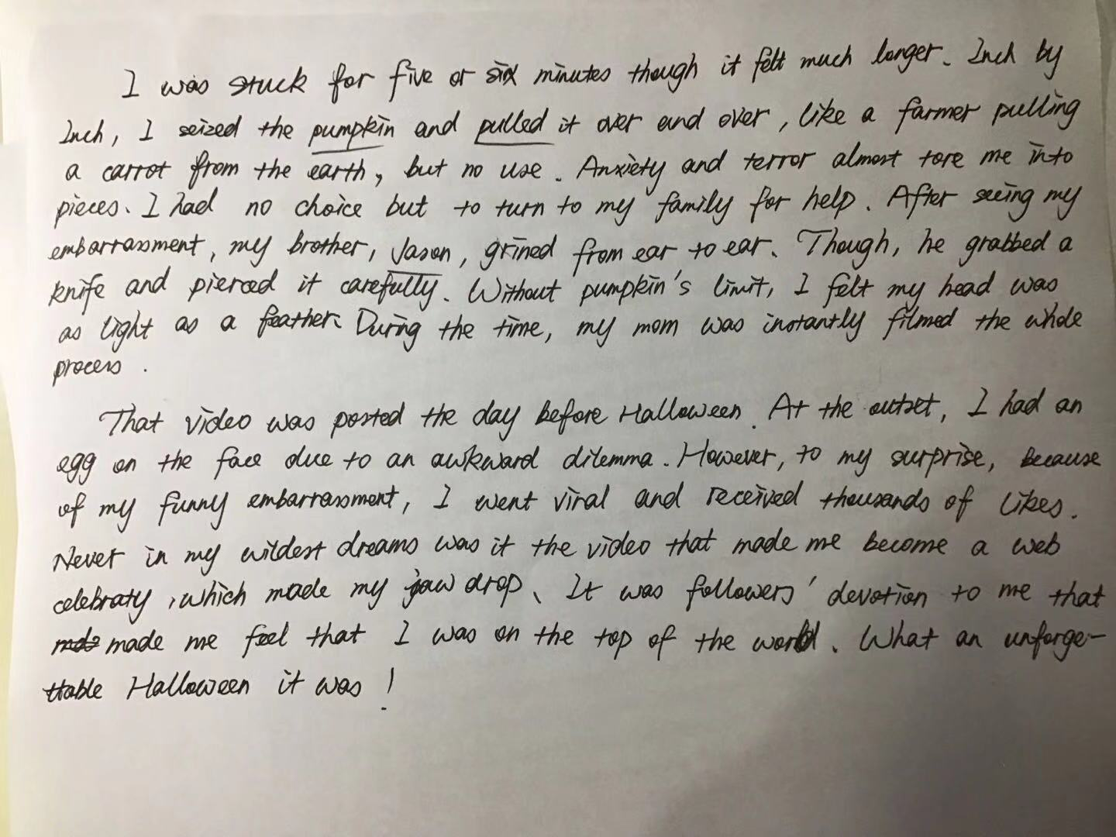
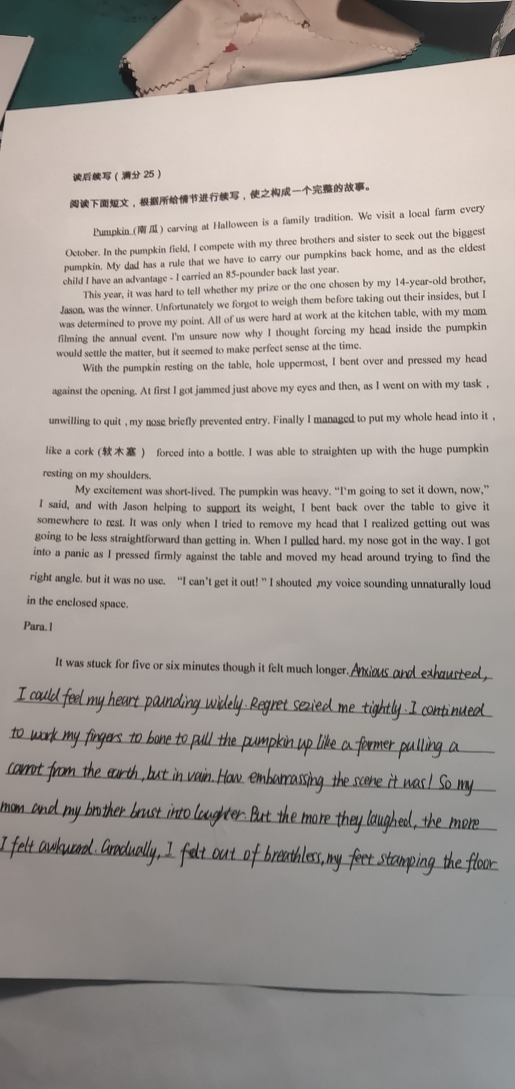
地道语的表达
无灵表达使语言灵动地道
无灵表达使语言灵动地道

Slide 20
地道语的表达
地道表达：努力作某事
无灵表达：头脑一片空白
Para.1
I was stuck for five or six minutes though it felt much longer. Inch by inch, I worked my fingers to the bone to pull the pumpkin up, but in vain. My brain didn’t
work at that time. I rued the day if only I hadn’t forced my head into the pumpkin. I had no choice but to turn to my family for help. My brother , John, seized the pumpkin and pulled it over and over again, like a farmer pulling a carrot form his garden, but still in vain. I was thrown into a world of darkness and sank into despair. Just at that time, my dad went downstairs, seeing my embarrassment, grinning from ear to ear. He swooped a knife and pierced the pumpkin with care. The pumpkin was dissected in two. I was full of the joys of spring instantly my father took the pumpkin away form my head. I felt the air much fresher than ever before. During the time, my mom was constantly filming the whole moment.
地道表达：后悔
地道表达：尴尬
Para.2
That video was posted online the Monday before Halloween. At the outset, I had an egg on my face due to an awkward dilemma. However, my mom told me with pride that the video filmed by her was so popular that it attracted millions of followers and received a thousand and one likes. Hearing the news, I almost laughed my head off. Never in my wildest dreams was it the video that made me become a web celebrity, which made my jaw drop. Everywhere I went, there were millions of followers, asking for my signature and taking photos with them, which made me float on air. What an unforgettable Halloween for me!
地道表达：
笑死了/太搞笑了
地道表达：开心
地道表达：惊呆了
地道表达：异常开心
地道表达：
非常开心

Slide 21
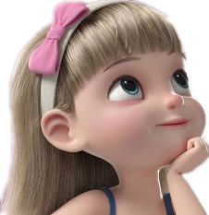
5. 贴切性：用词贴切就是根据语境条件使用语言，即符合外部语境的各种要求。语境有“外部语境”和“内部语境”。“内部语境”指上下文，“外部语境”指言语交际的各种情境条件， 包括交际的场合，对象，目的，表达方式等。读后续写的遣词造句须从内部语境考虑，表达才得体。也就是说在几个可用的词中选出最恰当、最得体的那个，把所要表达的意思恰如恰如其分地表达出来。具体用哪个最恰当，要根据具体的情况，仔细斟酌，反复推敲。
到底用哪个词更好呢？

Slide 22
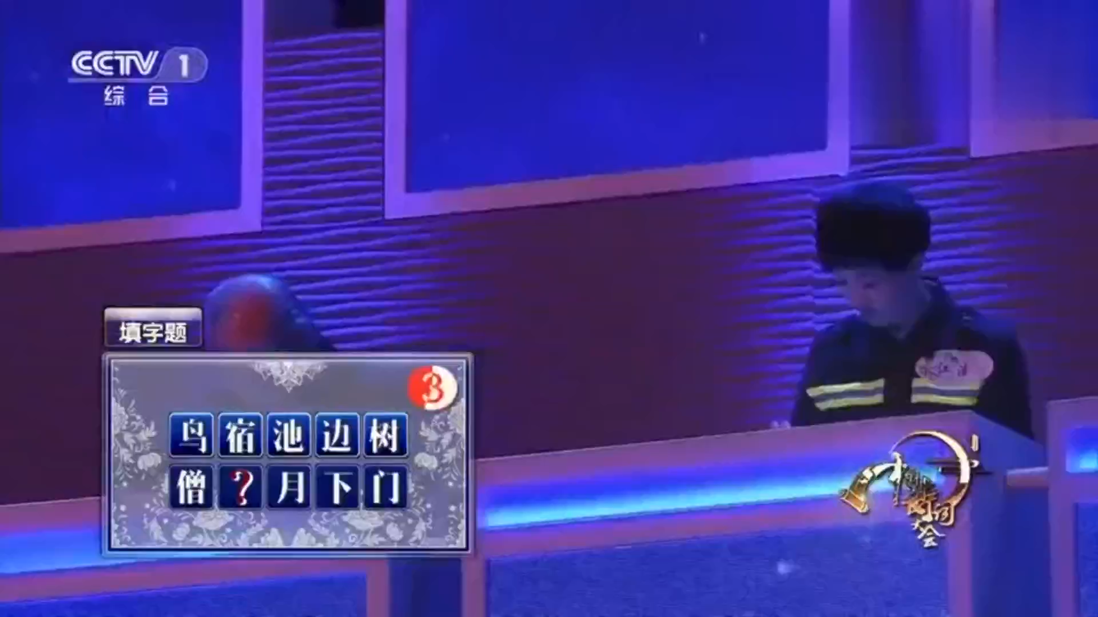


Slide 23
force: to use physical strength to move sb/sth into a particular position 汉语意为“强行把┄移动”，显而易见，这个词比put 用的贴切。说明塞不下而强行塞进去，结果拔不出来了。
Para.1
I was stuck for five or six minutes though it felt much longer. Inch by inch, I worked my fingers to the bone to pull the pumpkin up, but in vain. My brain didn’t
work at that time. I rued the day if only I hadn’t forced my head into the pumpkin. I had no choice but to turn to my family for help. My brother , John, seized the pumpkin and pulled it over and over again, like a farmer pulling a carrot form his garden, but still in vain. I was thrown into a world of darkness and sank into despair. Just at that time, my dad went downstairs, seeing my embarrassment, grinning from ear to ear. He swooped a knife and pierced the pumpkin with care. The pumpkin was dissected in two. I was full of the joys of spring instantly my father took the pumpkin away form my head. I felt the air much fresher than ever before. During the time, my mom was constantly filming the whole moment.
grin: to smile widely.
Laugh: to make sounds with your voice, usually while you are smiling.很显然，此处用laugh更贴切，把孩子的天真活泼写了出来。
grin: to smile widely.
laugh: to make sounds with your voice, usually while you are smiling.很显然，此处用grin更贴切，把大人的成熟稳重写了出来。
Para.2
That video was posted online the Monday before Halloween. At the outset, I had an egg on my face due to an awkward dilemma. However, my mom told me with pride that the video filmed by her was so popular that it attracted millions of followers and received a thousand and one likes. Hearing the news, I almost laughed my head off. Never in my wildest dreams was it the video that made me become a web celebrity, which made my jaw drop. Everywhere I went, there were millions of followers, asking for my signature and taking photos with them, which made me float on air. What an unforgettable Halloween for me!

Slide 24

再举个用词不贴切的例子（学生其他的语法错误暂时忽略）
put: to move sth into a particular place or position
squeeze: to press sth firmly, especially with your finger
用“put” 说明南瓜有足够大的空间，容易进容易出，那么就不会出现后面“头拔不出来”的情况。
“squeeze”说明南瓜口窄小，头被作者强行塞了进去，为后面的“ 头拔不出来”很好地做了铺垫 。
很显然，这里用“squeeze”比用“put”更贴切，更符合当时的场景。建议此句改为：I began to rue the day that I had squeezed my whole head into the pumpkin.

Slide 25


1. 补充说
2. 重复地说
3. 聊天
4. 通知某事
5. 宣布某事
6. 告诉某人
7. 小声地说
8. 安慰某人
9. 解释说
10. 抱怨说
11. 叹息说
12. 回应说
13. 恳求说
14. 插话
15. 脱口而出
add
repeat
chat with sb.
inform sb. of sth.
announce/declare
tell sb. sth.
whisper/murmur
comfort sb.
explain
complain sb.
sigh
respond to
plead
put in
blurt out
同学们平时要多留意，做好语言的积累！譬如“说”，有哪几种？如何用？只有充足的积累，才能应用自如。

Slide 26
Have a try
选择正确的“说法”
tell, announce, speak, blurt out, add, explain, chat, murmur, whisper, let out.
blurted out
1. She the bad news before I could stop her.
2. He expressed his satisfaction of my answers, that he would
visit me the next day.
3. The poor was pinned down totally by the walls in the earthquake for one
week, so he in a weak voice for help.
4. The teacher it to me over and over again until I understood it.
5. Our monitor a notice yesterday.
6. Within mintunes, they become familiar and ___________ like old friends,
7. In order not to disturb others, they to each other.
8. In the live program, she _______a surprising voice, “Oh, my God!
adding
murmured
explained
announced
chatted
whispered
let out

Slide 27
6. 鲜活性：想让读后续写的语言鲜活起来，就要恰当使用一些修辞手法。修辞的使用可以使文章语言生动活泼，增加语言的美感，提高语言的说服力和感染力，而且画面感十足。
Para.1
I was stuck for five or six minutes though it felt much longer. Inch by inch, I worked my fingers to the bone to pull the pumpkin up, but in vain. My brain didn’t
work at that time. I rued the day if only I hadn’t forced my head into the pumpkin. I had no choice but to turn to my family for help. My brother , John, seized the pumpkin and pulled it over and over again, like a farmer pulling a carrot form his garden, but still in vain. I was thrown into a world of darkness and sank into despair. Just at that time, my dad went downstairs, seeing my embarrassment, grinning from ear to ear. He swooped a knife and pierced the pumpkin with care. The pumpkin was dissected in two. I was full of the joys of spring instantly my father took the pumpkin away form my head. I felt the air much fresher than ever before. During the time, my mom was constantly filming the whole moment.
比喻：把拔南瓜的动作比喻为拔萝卜，生动形象而且有很强的画面感
Para.2
That video was posted online the Monday before Halloween. At the outset, I had an egg on my face due to an awkward dilemma. However, my mom told me with pride that the video filmed by her was so popular that it attracted millions of followers and received a thousand and one likes. Hearing the news, I almost laughed my head off. Never in my wildest dreams was it the video that made me become a web celebrity, which made my jaw drop. Everywhere I went, there were millions of followers, asking for my signature and taking photos with them, which made me float on air. What an unforgettable Halloween for me!
夸张
比喻：写出了绝望
夸张
夸张

Slide 28

比喻：写出了焦灼的心情
比喻：写出了南瓜被拿下来之后的轻松愉悦

Slide 29
7.时文性：在英语教学阶段有一项关键的教学任务就是将时文内容渗透到课堂，去发展学生的语言能力和深层次地了解语言的内涵以及拓展课程的外部延伸知识，让学生能够进一步认识社会、认识生活，从而培养学生的自信心，发展学生的优势与个性，提升学生的人文素养。
2021.01浙江高考续写需要用到网络词汇
发朋友圈：post sth. on the Moments
发到YouTube上：post sth. on the YouTube account
分享朋友圈：share sth. with
聊天记录：chat history
点赞： likes/ thumbs-up
撤回消息： recall a message
有人@你： You were mentioned.
转发：repost
扫二维码： Scan QR Code
屏蔽：block
(取消)关注： (un)follow sb.
删除好友：unfriend
拉黑;黑名单：blacklist
迅速走红：go viral
评论：make comments on
网红：internet celebrity

Slide 30

Para.2
That video was posted online the Monday before Halloween. At the outset, I had an egg on my face due to an awkward dilemma. However, my mom told me with pride that the video filmed by her was so popular that it attracted millions of followers and received a thousand and one likes. Hearing the news, I almost laughed my head off. Never in my wildest dreams was it the video that made me become a web celebrity, which made my jaw drop. Everywhere I went, there were millions of followers, asking for my signature and taking photos with them, which made me float on air. What an unforgettable Halloween for me!
粉丝
点赞
网红
粉丝
签名

Slide 31


走红
Para.2
That video was posted online the Monday before Halloween. It was unexpected that it should go viral, attracted millions of followers and got a thousand and one likes. What’s even more humiliating for me was that some naughty children carved my embarrassing moment on their pumpkins. With the carved pumpkin on the head and the ghost coat on the body, they knocked at the door on Halloween night and shouting, “ Trick or treat! ” They sang and danced in front of my house. The thought of the scene that they were delighted filled me with awkwardness. However, my mom told me it was I that brought happiness to them. Hearing this, my awkwardness gave way to my delight. I reckoned it deserved it if I could bring pleasure to others on the special festival. What an unforgettable Halloween!
粉丝
点赞

Slide 32


8.感情线：读后续写蕴含了两条线，一条是动作线，另一条是感情线。动作的变化推动着情感的变化。读后续写是让我们做一个有情有义的人，通过读文章走进作者的情感世界，与之产生共鸣，才能真正懂得续写的内容和情感的发展。
喜
怒
哀
乐

Slide 33
感情线贯穿全文
写出了被南瓜套住的“后悔”心理
被传到网上之后的“尴尬”
Para.1
I was stuck for five or six minutes though it felt much longer. Inch by inch, I worked my fingers to the bone to pull the pumpkin up, but in vain. My brain didn’t
work at that time. I rued the day if only I hadn’t forced my head into the pumpkin. I had no choice but to turn to my family for help. My brother , John, seized the pumpkin and pulled it over and over again, like a famrer pulling a carrot form his garden, but still in vain. I was thrown into a world of darkness and sank into despair. Just at that time, my dad went downstairs, seeing my embarrassment, grinning from ear to ear. He swooped a knife and pierced the pumpkin with care. The pumpkin was dissected in two. I was full of the joys of spring instantly my father took the pumpkin away form my head. I felt the air much fresher than ever before. During the time, my mom was constantly filming the whole moment.
感情曲线变化
感情曲线变化
Para.2
That video was posted online the Monday before Halloween. At the outset, I had an egg on my face due to an awkward dilemma. However, my mom told me with pride that the video filmed by her was so popular that it attracted millions of followers and received a thousand and one likes. Hearing the news, I almost laughed my head off. Never in my wildest dreams was it the video that made me become a web celebrity, which made my jaw drop. Everywhere I went, there were millions of followers, asking for my signature and taking photos with them, which made me float on air. What an unforgettable Halloween for me!
尴尬
后悔
想拔又拔不出来的“绝望”心情
收到无数点赞之后的“开心”
高兴
意外成为网红之后的“吃惊”
南瓜被拿下来之后的“喜悦”
绝望
粉丝要求签名和拍照之后的“异常开心”
吃惊
开心
异常开心

Slide 34
9.巧用描写: 读后续写主要涉及动作描写、环境描写、情感描写和对话描写。在续写中描写的运用不仅可以衬托人物的内心世界，而且可以让你的语言充满满满的画面感。
Para.1
It was stuck for five or six minutes though it felt much longer. Inch by inch, I worked my fingers to the bone to pull the pumpkin up, but in vain. My brain didn’t work at that time. I rued the day if only I hadn’t forced my head into the pumpkin. I had no choice but to turn to my family for help. My brother , Jason, seized the pumpkin and pulled it over and over again, like a farmer pulling a carrot form his garden, but still in vain. I was thrown into a world of darkness and sank into despair. Just at that time, my dad went downstairs, seeing my embarrassment, grinning from ear to ear. He grabbed a knife and pierced the pumpkin with care. The pumpkin was dissected in two. I was full of the joys of spring instantly my father took the pumpkin away from my head. I felt the air much fresher than ever before. During the time, my mom was constantly filming the whole moment.
心里活动描写
动作描写
心里活动描写
动作描写
环境描写
动作描写

Slide 35

9.巧用描写: 读后续写主要涉及动作描写、环境描写、情感描写和对话描写。在续写中描写的运用不仅可以衬托人物的内心世界，而且可以让你的语言充满满满的画面感。
Para.1
I was stuck for five or six minutes though it felt much longer. All possible means have been tried to pull my head from the pumpkin, but to no avail(徒劳无功). I was seized with remorse, anxiously stamping my foot .With time ticking by, I had trouble breathing, feeling dizzy owing to a lack of oxygen. I had no choice but to turn to my family. Seeing my awkwardness, my brother, John, managed to crack my pumpkin open with his pumpkin. In a flash, I felt my head was as light as a feather. I was on the top of the world. My mom grinned from ear to ear, filming the whole embarrassing moment. My dad uttered with humor, “You get the biggest pumpkin, and your brother get the hardest one. You are both winners.” Everyone in the room laughed his head off.
动作描写
动作描写
动作描写
对话描写
动作描写

Slide 36

10.主题升华：主题升华是十分重要的一部分。一般要写在结尾句，句式无需很复杂，但需要体现真善美。读后续写能否拿高分某种意义上说全在于立意，而立意又在于能否给出一个好的结尾。升华句可以是格言警句、歌词，也可以是自己组织的有立意升华的句子，只要和续写的主题保持一致就可。
Para.2
That video was posted online the Monday before Halloween. It was unexpected that it should go viral, attracted millions of followers and got a thousand and one likes. What’s even more humiliating for me was that some naughty children carved my embarrassing moment on their pumpkins. With the carved pumpkin on the head and the ghost coat on the body, they knocked at the door on Halloween night and shouting, “ Trick or treat! ” They sang and danced in front of my house. The thought of the scene that they were delighted filled me with awkwardness. However, my mom told me it was I that brought happiness to them. Hearing this, my awkwardness gave way to my delight. I reckoned it deserved it if I could bring pleasure to others on the special festival. What an unforgettable Halloween!
主题升华句：在这个特殊的节日，只要能给别人带来快乐，我认为这是值得的。

Slide 37
Para.2
That video was posted online the Monday before Halloween. At the outset, I had an egg on my face due to an awkward dilemma. However, my mom told me with pride that the video filmed by her was so popular that it attracted millions of followers and received a thousand and one likes. Hearing the news, I almost laughed my head off. Never in my wildest dreams was it the video that made me become a web celebrity, which made my jaw drop. Everywhere I went, there were millions of followers, asking for my signature and taking photos with them, which made me float on air. It occurred to me that “helping others” by accident at times will be happy, even if a trivial matter.
主题升华句：有时无意间的帮助他人也是一种快乐，即使是一件微不足道的小事。

Slide 38
结语
续写部分是故事发展的高潮，是需要学生发挥想象力充分地去创新和自我思想深度的挖掘，既要有独特的内容还要有思想上的升华。续写想要拿高分仅有故事情节是不够的，一定要在语言上多下功夫。要从语言的丰富性，多样性，地道性，贴切性、时文性等多方面去考虑。建议同学们平时做好语言的积累让自己的续写语言鲜活、生动而且画面感十足；结尾要有立意，读后续写能否拿高分在某种程度上来说全在于立意，而立意又在于是否有个好结尾；还要注意感情线的贯穿。
读后续写最好的攻克方法就是把1篇读后续写反复打磨100遍，那么你就化简成蝶了。

Slide 39


愿所有的美好总会不期而遇

