Slide 1


感恩遇见，相互成就，本课件资料仅供您个人参考、教学使用，严禁自行在网络传播，违者依知识产权法追究法律责任。
更多教学资源请关注
公众号：溯恩高中英语
知识产权声明

Slide 2


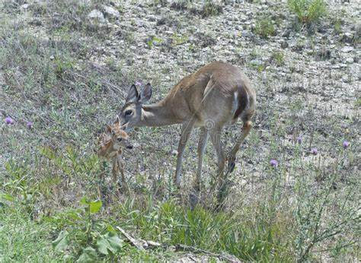

宁波十校2021届高三3月联考
读后续写讲评
TheWater of Life

Slide 3
The water of life
It was one of the hottest days of the dry season. We had not seen rain in almost a month. The crops were dying. Cows had stopped giving milk. The creeks and streams were long gone back into the earth. It was a dry season that would bankrupt several farmers before it was through. Every day, my husband and his brothers would go about the tiring process of trying to get water to the farm. If we didn't see some rain soon, we would lose everything.
It was on this day that I learned the true lesson of sharing and witnessed the only miracle I have seen with my own eyes. I was in the kitchen making lunch for my husband and his brothers when I saw my six-year old son, Billy, walking toward the woods. He wasn’t walking with the usual carefree abandon of a youth but with a serious purpose. I could only see his back. He was obviously walking with a great effort trying to be as still as possible. Minutes after he disappeared into the woods, he came running out again toward the house. I went back to make sandwiches, thinking that whatever task he had been doing was completed
Moments later, however, he was once again walking in that slow purposeful

Slide 4
stride toward the woods. This activity went on for over an hour: walking carefully to the woods, and then running back to the house. Finally, my curiosity got the best
of me. I crept out of the house and followed him on his journey.
He was cupping both hands in front of him as he walked, very careful not to spill the water he held. Maybe two or three tablespoons were held in his tiny hands. I sneaked closer as he went into the wood. Branches and thorns slapped his little face but he did not try to avoid them. He had a much greater purpose. As I leaned in to spy on him, I saw an amazing sight. A mother deer with a huge pair of deer horns appeared in front of him, with a baby fawn(幼鹿) lying on the dry ground. I almost screamed to get him away.
Paragraph1：
However, Billy walked right up to them. _____________________________
paragraph 2:
I witnessed the most beautiful heart working hard to save a life. ___________

Slide 5
Summary of the story:
The dry season had lasted quite a while without any _____ of rain. The farmers suffered a lot, _________ (struggle) to find water for their farms, but without luck. Everything seemed likely to be lost ______ any miracle came.
But a miracle did happen to my son Billy. While I was preparing dinner, I coincidentally found that he was going to and _____ the woods with great efforts. Out of _________ (curious), I followed him, trying to work out what he was realy up to. Billy held some water in his _____ (cup) hands and came to the woods, _______the baby fawn was lying on the ground with her mother for company. The fawn was badly in need of water, obviously too thirsty and too weak to rise to his ______ (foot).
sign
struggling
unless
from
curiosity
cupped
where
feet
Water mattered!

Slide 6
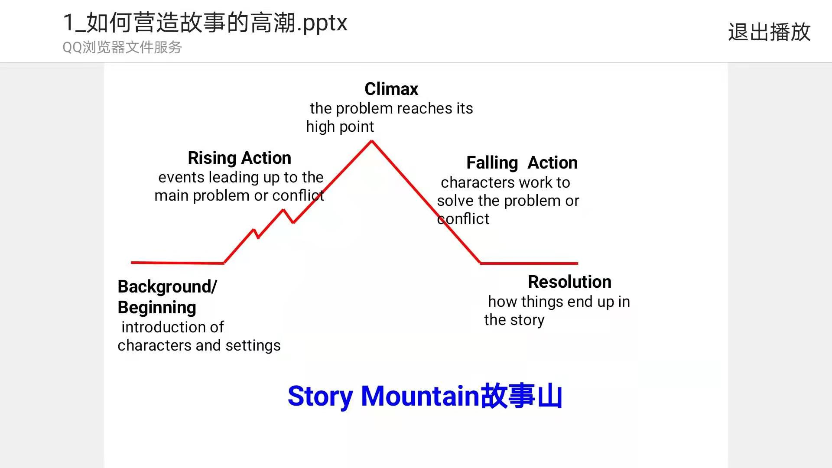
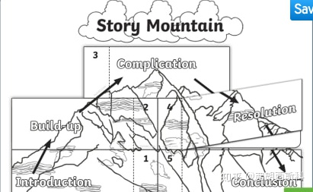
Undertsand the passage-- story mountain:
故事山能够帮助迅速厘清故事结构，预测故事的发展方向，锻炼思维能力。

Slide 7
Undertsand the passage-- story mountain:
Climax
Curiously, I followed Billy and found a weak fawn in desperate need of water.
Rising Action
I found my son Billy go to and from the woods repeatedly.
curious
Falling Action
Para1: Billy walked right up to them...
a little curious
?
Background/Beginning
The hottest days of hot season came without any sign of rain, which worried the farmers.
Resolution
Parag2: I witnessed the most beautiful heart working hard to save a life...
?
worried, desperate
Story Mountain故事山

Slide 8
Design the plot-- underlined words:
rain
farm
miracle
Billy
woods
fawn
cup
spill
dry
carefully
1.Billy carefully knelt by the fawn’s side and carefully placed his cupped hands close to its mouth.
2. Cautiously, Billy approached the poor fawn abd reached out his cupped hands, signalling the fawn to drink the water.
3. Miraculously, out of nowhere came a constant shower of rain, as if in answer to Billy’s act of kindness.
1.Carefully, Billy placed his tiny cupped hands close to the fawn’s mouth.
2. Though the mother deer’s throat was burning dry, her heart and eyes watered.
Tip1: Underlined words help you design the plot without going off the main story line.

Slide 9

Design the plot-- underlined words- abstract noun(s):
rain
farm
miracle
Billy
woods
fawn
cup
spill
dry
carefully
The rain that came that day was a miracle, saving our farm, just like my boy saved a life.
And what a miracle! The tears on my cheeks turned into the long-expected rain from the sky!
Then I felt something wet on my face. What a miracle! --- It was the tears out of my eyes, but rain drops from the sky!
And at that time, the miracle we had been praying for showered us -- the long- expected life of water fiannly fell on this dry land！
Tip2: If you want to convey some message at the end of the story, the underlined abstract noun can be a good hint.

Slide 10
Design the plot-- first sentence:
Paragraph1: However, Billy walked right up to them.
Paragraph2:I witnessed the most beautiful heart working hard to save a life.
How did Billy feed the fawn?
How did the fawn react to Billy’s kindness and what did he do?
What did the mother deer do?
What did I do after witnessing the whole thing?
How did Billy react to my sudden appearance?
What miracle happened? (--rain)

Slide 11
Design the plot-- first sentence:
Paragraph1: However, Billy walked right up to them.
How did Billy feed the fawn?
How did the fawn react to Billy’s kindness and what did he do?
1.Billy carefully knelt by the fawn’s side and carefully placed his cupped hands close to its mouth.
2.Cautiously, Billy approached the poor fawn and reached out his cupped hands, signalling the fawn to drink the water.
1.Instinctively, the fawn approached, stuck out his tongue and eagerly sucked every drop of water. Thirst satisfied, the fawn looked up at little Billy, licking his moistured lips, as if a sign of gratitude.
2.The fawn, suffering from dehydration and heat exhaustion lifted its head up with great efforts and eagerly lapped up the water cupped in my beautiful boy’s hands.

Slide 12
Design the plot-- first sentence:
Paragraph1: However, Billy walked right up to them.
What did the mother deer do?
1.The mother deer stood by as if in guard.
2.The mother deer, who had all the time been around, breathed a sigh of relief though she herself was so thirsty that her throat was burning dry.
Paragraph2:I witnessed the most beautiful heart working hard to save a life.
What did I do after witnessing the whole thing?
1.Before he tried to explain, I strode to him and held him tight.
2.Deeply touched by his act of kindness, I strode over and gathered my young into my arms tightly, tears of pride rolling down my cheeks and his back.
3. Never could I have imagined that my young should be blessed with such a generous heart.

Slide 13
Design the plot-- first sentence:
Paragraph2:I witnessed the most beautiful heart working hard to save a life.
How did Billy react to my sudden appearance?
What miracle happened? (--rain)
1.A little embarrassed but still proud, he shared the whole story with me, saying that if he didn’t offer the helping hand, the fawn would end up being thirsty to death.
2.Somewhat surprised at my suddent appearance, he appeared a little embarrassed and ran into my arms.
3.He couldn’twait to share the whole thing with me.
1.I looked up at the sky. It was as if God, Himself, was weeping with pride. The rain that came that day was a miracle, saving our farm, like my boy saved a life.
2.And miraculously, the tears on my cheeks turned into the long-expected rain from the sky!
3.It must be God’s answer to people’s call for the rain, and also a reward for Billy’s act of kindness!

Slide 14
Language accumulation--口渴:
1.His tongue was hanging out of his mouth, as if licking for water.
2.Saliva felt thick in her mouth.
3.He was so thirsty that the only thing in his thought was water.
4.He felt his throat was burning dry.

Slide 15
Language accumulation--肚子饿:
1. He felt the stomach twisting and turning in agony.
2. He was as hungry as a wolf.
3.He was so hungry that he wolfed down his food.
4.He was hungry enough to eat up an elephant.
5.His stomach was begging for food.
6.His stomach was rumbling /started to rumble.
7.My stomach is making noises from hunger.

Slide 16
参考范文：
However, Billy walked right up to them. Cautiously, he knelt down by the weak baby fawn, seemingly familiar with the two creatures. The fawn, suffering from dehydration and heat exhaustion lifted its head up with great efforts and eagerly lapped up the water cupped in my beautiful boy’s hands. The mother deer stood by as if in guard. Not until the fawn licked the last drip of water did Billy move a little bit. I contained myself not to make a slightest sound, for fear of scaring them. (81)
I witnessed the most beautiful heart working hard to save a life. With the water gone, Billy jumped to his feet and met my smiling eyes. Before he tried to explain, I strode to him and held him tight. As the tears that rolled down my face began to hit the ground, they were suddenly joined by other drops and more drops and more. I looked up at the sky. It was as if God, Himself, was weeping with pride. The rain that came that day was a miracle, saving our farm, just like my boy saved a life. (87)

Slide 17
下水作文：
However, Billy walked right up to them. Carefully, he reached out his tiny cupped hands, his shining eyes expectantly looking at the fawn. Instinctively, the fawn approached, stuck out his tongue and eagerly sucked every drop of water. Thirst satisfied, the fawn looked up at little Billy, licking his moistured lips, as if a sign of gratitude. The mother deer, who had all the time been around, breathed a sigh of relief though she herself was so thirsty that her throat was burning dry. Seeing the fawn back on his feet, Billy, my baby, was more than delighted, as if he had saved the world.
（97）
作文亮点点评：
1.carefully, instinctively等句子性副词置于句首，凸显动作神态。
2.looking, licking, seeing等非谓语动词的运用，使文章方式变得多样化。
3.动作链和独立主格的运用，使句子变得紧凑，动作之间的紧密联系得到加强。
4.动作和心理活动的穿插运用，使文章有了生命色彩。
5.高级词块stick out, thirst satisfied, burn dry, back on one; feet.

Slide 18
下水作文：
I witnessed the most beautiful heart working hard to save a life. Deeply touched by his act of kindness, I strode over and gathered my young into my arms tightly, tears of pride rolling down my cheeks and his back. A little embarrassed but still proud, he shared the whole story with me, saying that if he didn’t offer the helping hand, the fawn would end up being thirsty to death. And miraculously, the tears on my cheeks turned into the long-expected rain from the sky! It must be God’s answer to people’s call for the rain, and also a reward for Billy’s act of kindness!(97)
作文亮点点评：
1.a little embarrassed but still proud形容词主语句首，miraculously等句子性副词置于句首，凸显动作神态。
2.多处分词和独立主格的运用，使文章表达方式变得多样化。
3.结尾两句的点题，精彩地诠释了文中miracle的意义，高明！语言也有韵律感。
4.高级词块tears of pride, end up doing, long-expected.

Slide 19
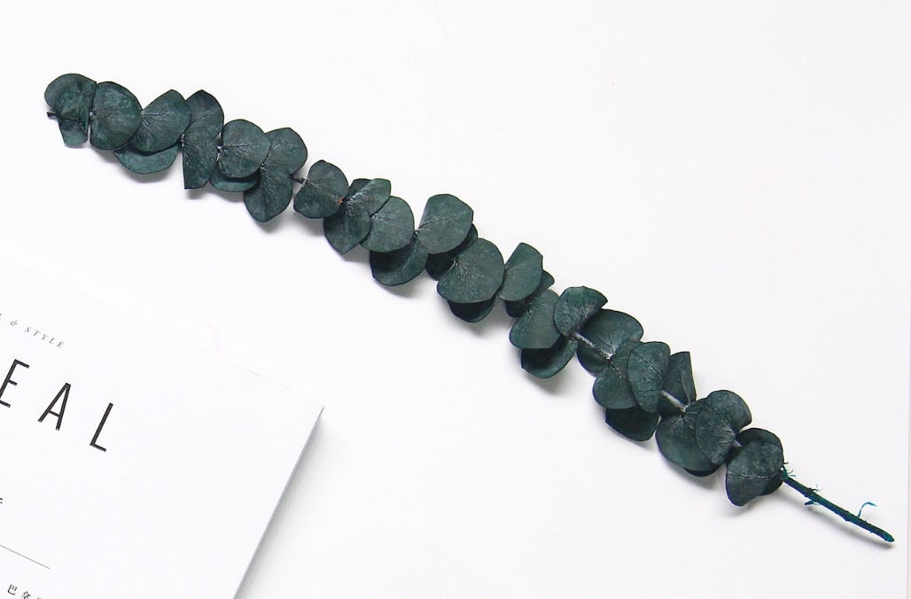
THANK YOU

