Slide 1

感恩遇见，相互成就，本课件资料仅供您个人参考、教学使用，严禁自行在网络传播，违者依知识产权法追究法律责任。
更多教学资源请关注
公众号：溯恩高中英语
知识产权声明

Slide 2
第四部分:写作(共两节，满分40分)
第一节:应用文写作(满分15分)
假定你是李华，上周六澳大利亚学生代表团访问你校，请你为校英语报写一篇报道，介绍这次活动，内容包括:
1.来访人员;
2.活动安排
3.活动意义。
注意:
1.词数80左右
2.可适当增加细节，使行文连贯;3.参考词汇:代表团 delegation n An Exchange Visit

Slide 3
语篇类型
新媒体语篇
新闻报道
主 题
活动介绍
活动意义
细 节
时间
人称
语气

Slide 4
新闻报道文体特点
时态
一般过去时？
一般现在时？
格式
导语
正文
审
题
结束语

Slide 5
when
why
(目的、意义)
where
who
what
Last Saturday
An exchange
visit
Strengthen friendship
Enhance mutual understanding
Promote cultural exchange
Boost cultural diversity
导语
Australian
students
Our school

Slide 6
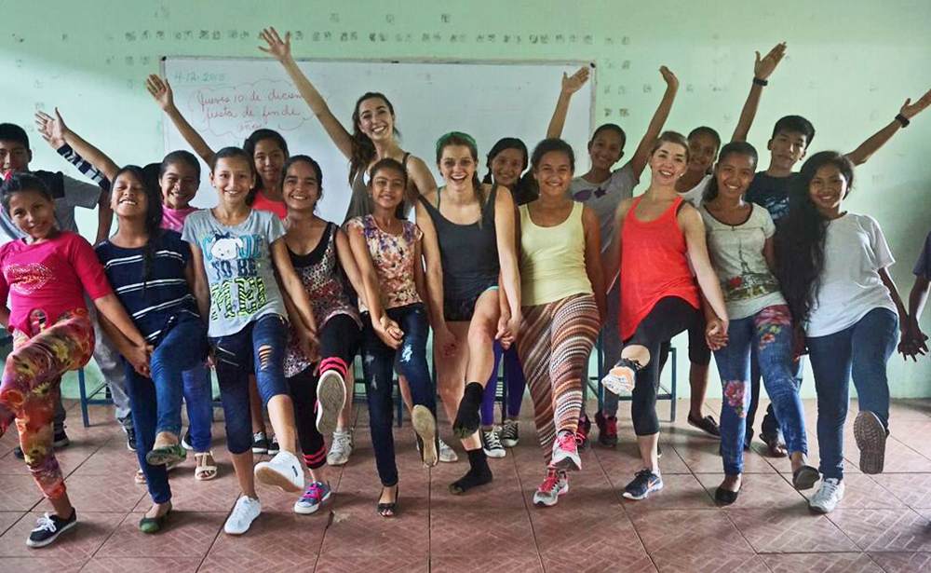
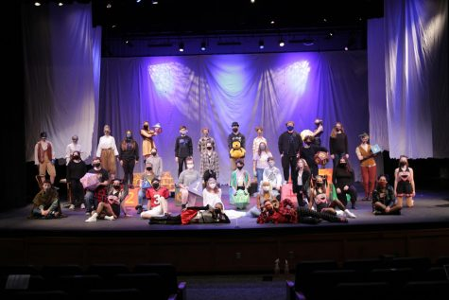
activities
show…around
attend a calligraphy class
enjoy the Beijing Opera
attend an evening gala
experience the local food
give performances about Chinese traditional cultures
visit the temple of Confucius...

Slide 7
活动安排小专题
一、"举行"的表达 主动：start/ take place/ kick off/ last... 被动：be held/ be organized/ be arranged/ be scheduled/be put on...
二、"活动时间"的表达 年：in 2019 月：in January/ February 月日：on Oct. 1 早午晚：in the morning/ afternoon/ evening on Saturday morning/ on the morning of September 1 几点几分：at 8:30 年月日：at half past eight on September 2, 2019 特殊用法(无介词)：this week/next year/ last month/ every day

Slide 8
例：为了丰富校园生活，学生参加了一次由学校组织的登山活动。
In order to enrich sohool life, students participated in a mountain-climbing activity organized by Xin Hua Middle School last Friday Morning.
组织，举办，进行（活动）
organize, launch, hold
参加，参与（活动）
take part in, participate in, get involved in,
be engaged in

Slide 9
活动类
如：目的在于缓解压力，所有的高三师生参加了上周日的一次特殊的远足，并得到好评。
With the purpose of relieving pressure, all the students and teachers in senior 3 got involved in an extraordinary hiking last Sunday, which was well received (highly praised).
Last Sunday witnessed an extraordinary hiking, which successfully drew the attention of every student and teacher in senior 3.

Slide 10
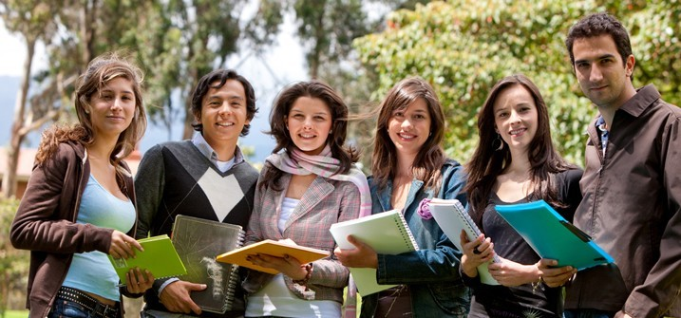
Part 1 本文导语
如：上周六，澳大利亚学生代表团访问了我校。
Last Saturday witnessed a friendly exchange visit to our school from a delegation of Australian students.
Last Saturday, a delegation of Australian students visited our school.

Slide 11
正 文
1. 适当的连接词
Then---Afterwards And---Additionally Later, Next, Finally
2. 适当的从句
We gave various performances. And then we cooked meals by ourselves.
We gave various performances, after which we cooked meals by ourselves.
We walked to the People's Park, where we had a pleasant picnic.

Slide 12
正 文
3. 适当的非谓语
Everyone sat by the lake, eating and sharing the food they brought.
Bathed in the warm sunshine, we managed to arrive in our destination on foot, talking and laughing cheerfully.
A wide range of activities were arranged, including a talent show.
Having been shown around our school, guests were invited to experience Chinese traditional food.

Slide 13
结 语
对活动意义的总结和感悟，如：
By immersing everyone in the charm of nature, this activity definitely offered relaxation to us, which not only strengthened our perseverance, but also enhanced our friendship.
This activity proved to be a success, strengthening our willpower and making us more confident about our future study.
The visit is such a success that our mutual understanding is enhanced and our friendship is strengthened.

Slide 14
It was very tiring and I felt exhausted but it was worth it, because I was proud to have done what I could for this great event.
I was very excited because I was the leading actor/actress in an English short play at the show. Though I was a little nervous at the beginning, later on I felt relaxed and the performance was a great success.
The activity benefited us a lot. Not only did it get us close to nature and give us relaxation from heavy schoolwork, it also promoted the friendship among us. What a wonderful time!

Slide 15
学生习作易错点
on last Saturday
at the playground
It was going to be hold.
We invited the friends experience Chinese traditional food.
We will held an activity to help them have a better understanding of Chinese cultures.
There were three kinds of activities were arranged to greet them.
on/ in
held
to experience
hold
Three
There were three kinds of activities were arranged to greet them.

Slide 16
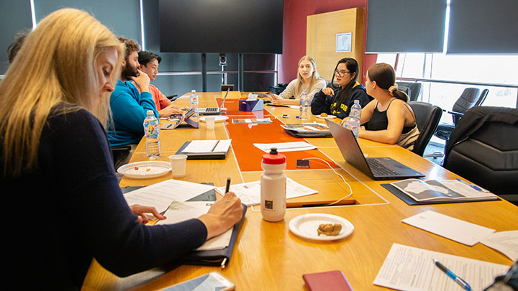
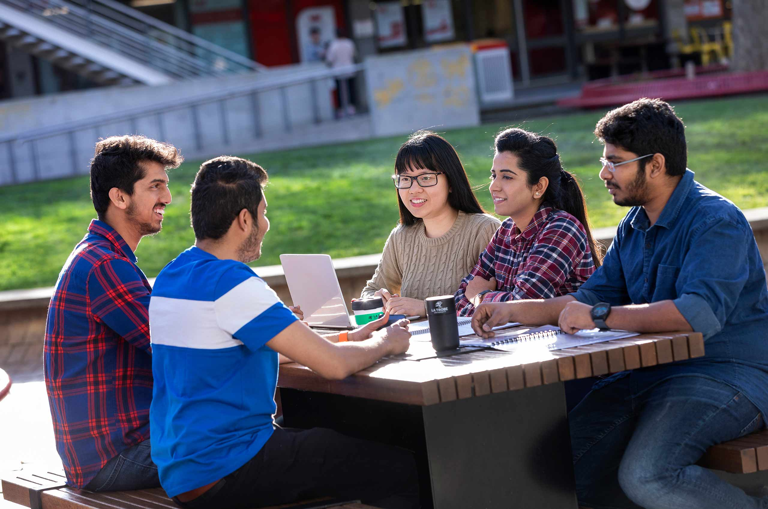
Challenge Yourself

Slide 17
Last Saturday, a delegation of Australian students visited our school.
Upon arrival, the Australian friends received a warm welcome, followed by a campus tour. Next, they were invited to enjoy Beijing Opera in the lecture hall given by our students, whose wonderful performance showcased the Chinese traditional cultures. At noon, all the guests were grouped to make dumplings in the dining hall. After that, they visited the Confucius temple , chatting and laughing all the way.
The visit proves to be a success, which not only has enhanced our friendship but also tightened cultural exchange.

Slide 18


