Slide 1

感恩遇见，相互成就，本课件资料仅供您个人参考、教学使用，严禁自行在网络传播，违者依知识产权法追究法律责任。
更多教学资源请关注
公众号：溯恩高中英语
知识产权声明

Slide 2
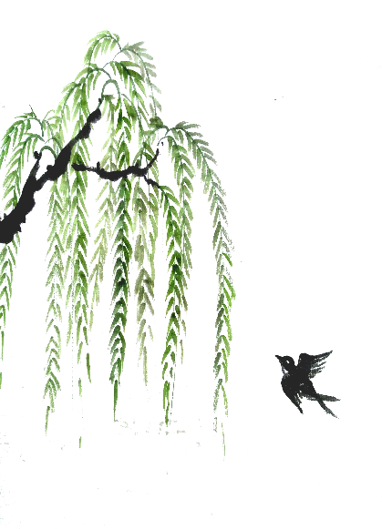
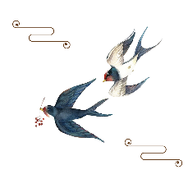
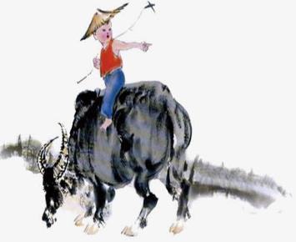
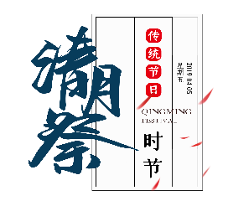
中国传统节日
高考题型开发
Tomb Sweeping Day
余杭区杭州二中树兰高级中学 郭合英

Slide 3
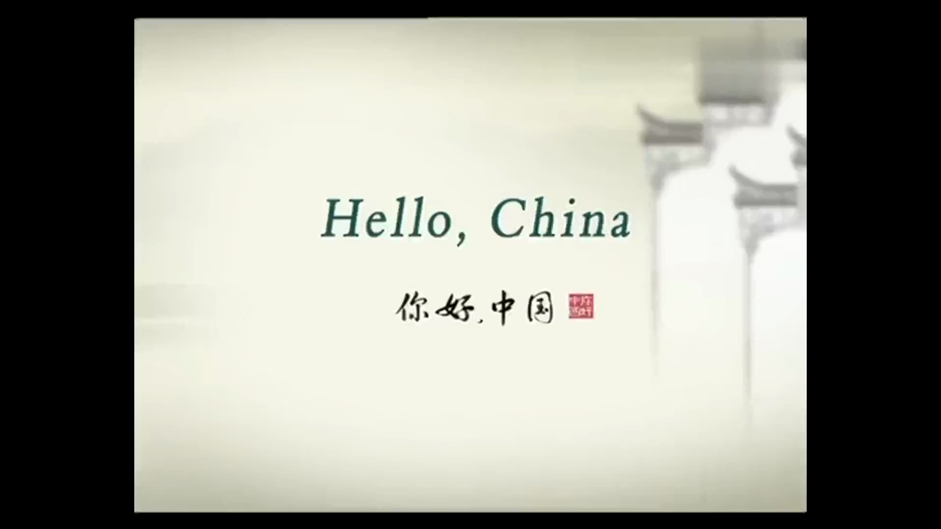

Slide 4
1. The origin of Qingming Festival
2. The legend of Qingming Festival
3. The development of Qingming Festival
contents
4. The customs of Qingming Festival
5. The poems of Qingming Festival
6. Honor the dead, honor the heroes

Slide 5
The introduction of Qingming Festival---高考题型开发：语篇填空
Tomb Sweeping Day is not only one of the traditional Chinese festivals, but also the most important 1 (sacrifice) festival. It falls on either April 4th or 5th of the solar calenda. On that day, sweeping the tombs and 2 (pay) respect to the dead with offerings are the two important practices to remember late relatives. Thousands of Chinese people visit cemeteries 3 (clean) the graves of their loved ones. The Chinese hold great respect for their ancestors and the young 4 (teach) to pray to the family spirits.
The festival is the 5th of the 24 solar terms, 5 marks a change in weather, when temperatures begin to rise nationwide and rainfall 6 (increase). It means it’s __7__ good time for spring ploughing, and it’s during the spring of China, so it is also called “hiking day”. People go to the suburbs for an outing in spring. People love to fly kites during the Qingming festival.
The willow is regarded 8 the symbol of light and enemy of darkness in Chinese culture. On Qingming, willow twigs and 9 (branch) are hung in doorways to ward off the evil spirits. 10 , willow branches are also known as “ghost terror wood”.
sacrificial
paying
to clean
are taught
which
increases
a
as
branches
Therefore

Slide 6
1. The origin of Qingming Festival---高考题型开发：语篇填空
Tomb Sweeping Day also called Qingming Festival is not only a time to remember the dead and the dearly departed, but also a period to honor and to pay respect 1___ their deceased ancestors and family members.
It has a long history, 2 (originate) the funerals of emperors, generals and ministers in ancient times. The rituals(仪式) 3 （perform）at these funerals later became popular among ordinary people. Over time, the tradition of offering sacrifices to the 4 (ancestor) and sweeping tombs 5 (pass) down from generation to generation and evolved into a custom 6 (wide) observed by the Chinese nation. This festival falls in early spring, on the 106th day after the winter solstice (冬至) . Because it carries forward the filial piety（孝顺）, Qing Ming is a major Chinese festival.
Tomb-sweeping day is also 7 happy festival for people to get close to nature,
8 ( go) hiking and enjoy the fun of spring. With the 9 (history) development, the Qingming festival combines a variety of folk customs 10 one, with extremely rich cultural connotation(涵义).
to
originating
performed
ancestors
was passed
widely
a
go
historical
into

Slide 7
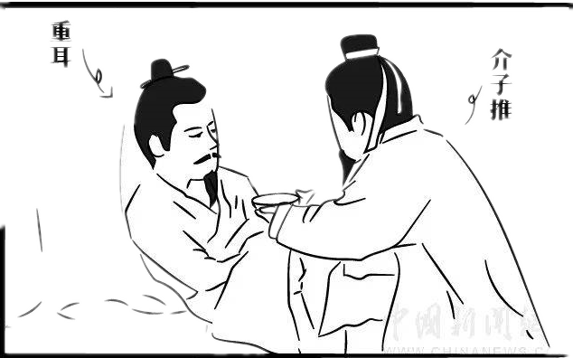
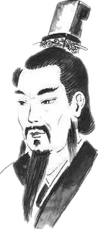
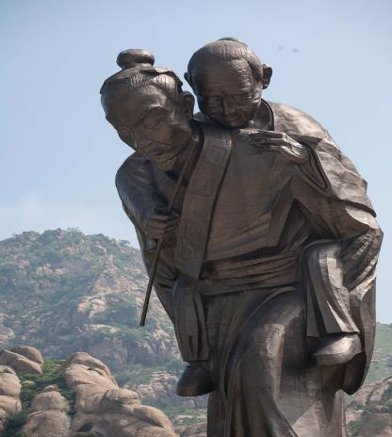
2. The legend of Qingming Festival
介子推和重耳
介子推
介子推背母

Slide 8
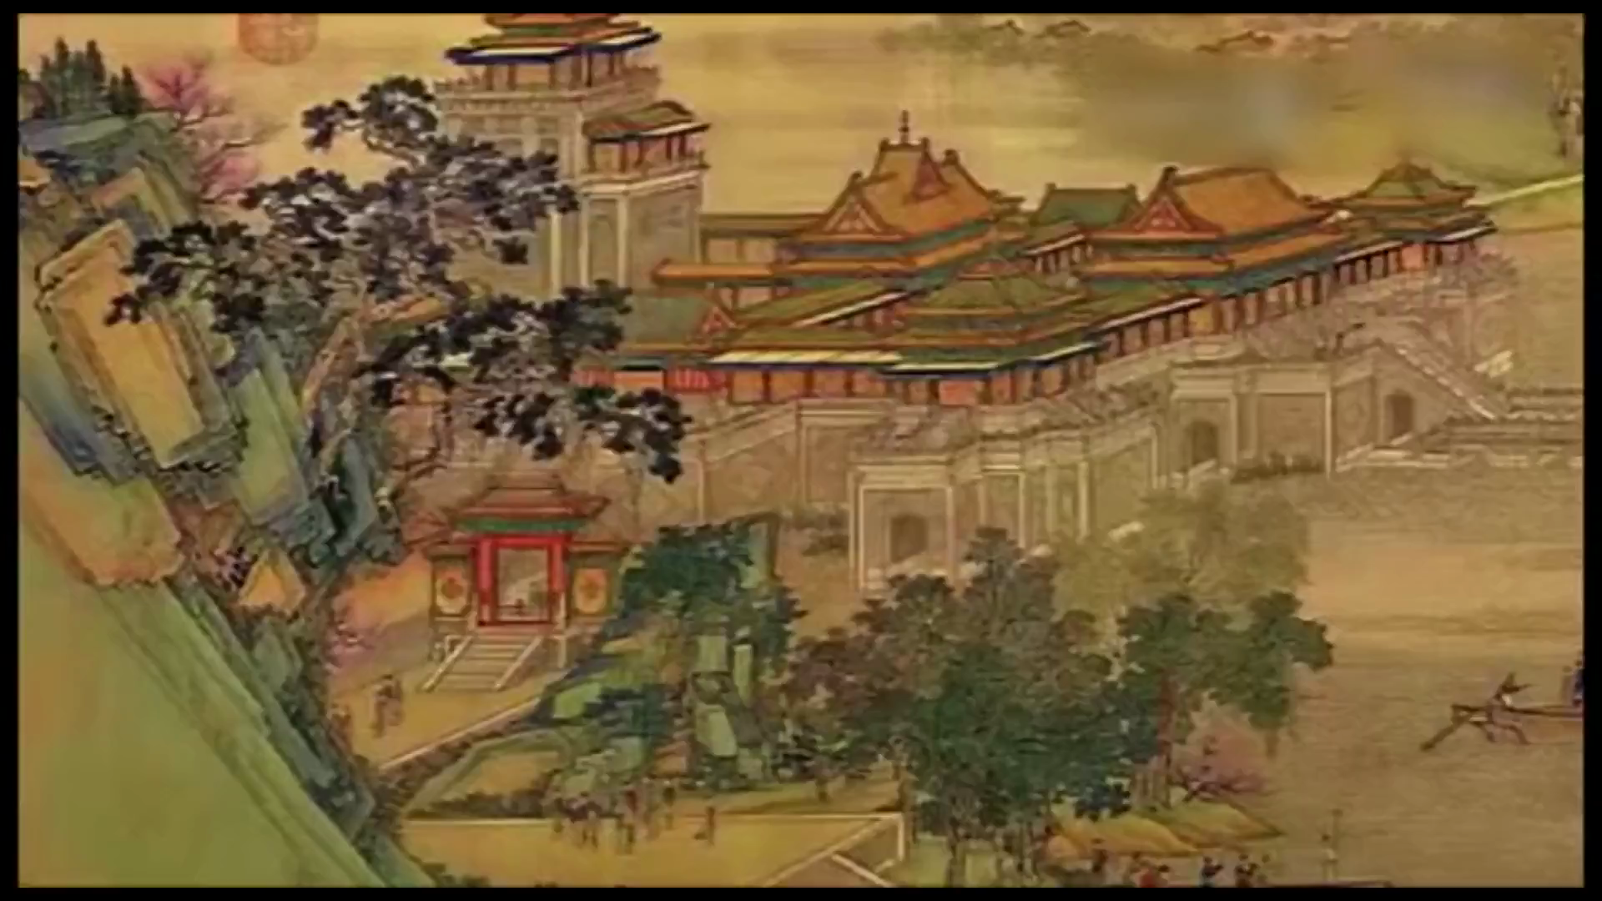

Slide 9
2. The legend of Qingming Festival ---高考题型开发：七选五
Qingming Festival is a time to remember the dead and the dearly departed. 1__
It is an occasion for the whole family to leave the home and to sweep the graves of their forebears (祖先).
2 There’s a legend that Jie saved his starving lord’s life by serving a piece of his own leg. When the lord succeed in becoming the ruler of a small principality, he invited his faithful follower to join him. 3 Believing that he could force Jie out by burning the mountain, the lord ordered his men to set the forest on fire. To his consternation(惊愕), Jie chose to remain where he was and was burnt to death. To commemorate Jie, the lord ordered all fires in every home to be put out on the anniversary of Jie's death. 4___
The “ cold food ” festival occurs on the eve of Qing Ming and is often considered as part of Qing Ming festival. 5 Whatever practice is observed, the basic observation of Qing Ming is to remember one’s elders by making a special effort to
visit their graves, ashes or ancestral tablets. To make the visit even more meaningful, some time should be spent to remind the younger members of the family of the lives
D
G
C
E
B

Slide 10
and contributions of their ancestors, and the story of their ancestors, and the story of Jie Zitui who choose death over capitulation(投降).
A. The young should be taught to pay respect to their forebears.
B. As time passes by, the Qingming Festival replaced the “cold food” festival.
C. However, Jie declined his invitation, preferring to lead a hermit’s life with his
mother in the mountain.
D. More importantly, it is a period to honor and pay respect to one’s deceased ancestors
and family members.
E. Thus began the “cold food feast”, a day when no food could be cooked since no
fire could be lit.
F. With time passing by, the Qingming Festival becomes an anniversary for Jie Zitui.
G. The origin is associated with Jie Zitui, who lived in Shanxi Province in 600 B.C.

Slide 11
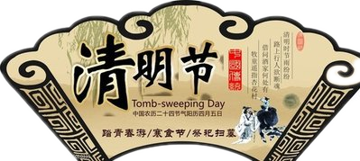
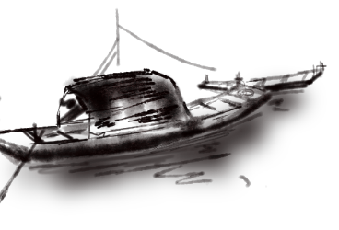
3. The development of Qingming Festival

Slide 12
3. The development of Qingming Festival---高考题型开发：阅读理解
Tomb Sweeping Day Festival occurs around April 5th of the Gregorian calendar. Traditionally, 10 days before and 8 (or 10) days after Tomb Sweeping Day can be counted as the Tomb Sweeping Day Festival.
Tomb Sweeping Day Festival, which is the 5th of the China’s 24 Solar Terms(节气), has its roots in the Shang Dynasty. When spring is in the air, everything, whether plant or human, waves goodbye to the bleak memory of winter and embraces the blooming prospect of spring.
In ancient times the day before Tomb Sweeping Day was Hanwha Day (literally, a day with cold food only), said to be a memorial day for Jie Ziti. Later, Hanwha Day and Tomb Sweeping Day were combined into the one festival. The custom of sweeping tombs was observed on Hanshi Day during the Tang Dynasty period, but following the Song Dynasty the activity was deferred(推迟) to the following Tomb Sweeping Day.
It is said that "Qingming" was used to celebrate the success of flood control and imply the idea of peacefulness after Yu the Great introduced flood control systems. During this beautiful season, flowers blossom and everything brims with vitality,

Slide 13
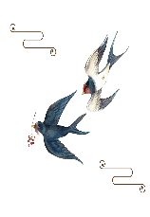

definitely a good time for outings. The tradition of spring outings can be traced back to the Tang Dynasty. Apart from enjoying glorious natural scenery, outings involve many other activities.
Tomb sweeping was originally supposed to be undertaken on Hanwha Day, the day before the Festival. The Tang Emperor ordered people to offer sacrifices to their ancestors and sweep tombs on that day. However, Qingming follows Hanwha Day closely, and so tomb sweeping was then combined into one.
During the Ming and the Qing dynasties the custom of tomb sweeping became increased popular. In ancient times children would fly kites. Some of the kites carried flutes that made sounds that bear a resemblance to those of Chinese Zheng. This is said to be the reason why kites were given the Chinese name "feng zheng".
Many customs have lapsed, such as wearing willow garlands, shooting the willow and playing on swings. According to historical records, Tomb Sweeping Day was the most valued in the Liao Dynasty when everyone from government officials in the royal court to the masses, would play on swings and go on excursions(旅游) in the spring.

Slide 14


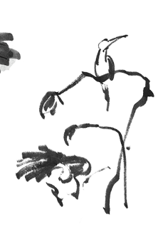

How long does the Tomb Sweeping Day last?
Just one day --- April 5th B. About 10 days
About 20 days D. About 8 days
2. Which of the following is true?
Tomb Sweeping Day is a memorial day for Jie Zitui.
The spring outings originated from the Tang Dynasty.
Hanwha Day and Tomb Sweeping Day was on the same day in ancient times.
All of the kites carried flutes that made sounds during the Ming and the
Qing dynasties .
3. The underlined word “lapsed” in the last paragraph can be replaced by “ ”.
changed B. saved C. continued D. disappeared
4. What can be the best tile for the text?
The contribution of Jie Zitui
The legend of the Tomb Sweeping Day
The evolution of the Tomb Sweeping Day
D. The process of observing the Tomb Sweeping Day

Slide 15
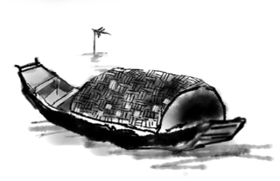
4. The customs of Qingming Festival
清明节的习俗是丰富有趣的，除了讲究禁火、扫草， 还有踏青、荡秋干、蹴鞠、打马球插柳等一系列风俗体育活动。相传这是因为清明节要寒食禁火，为了防止寒食冷餐伤身，所以大家来参加一些体育活动，以锻炼身体。因此，这个节日中既有生别死离的悲酸泪，又有踏青游玩的欢声，是一个很有特色的节日。
The customs of the Qingming festival are richly interesting, in addition to paying attention to the fire, the grave, and outing, swing, a game called cuju, play polo, inserted liu and so on a series of customs sports activities. This is because tomb-sweeping is a day for people from the fire. In order to prevent a cold buffet from injuring body, everyone takes part in some of the sports activities to exercise. Therefore, this festival offers both sacrifices to pay respects to a dead person at his tomb and enjoy the laughter of an outing in spring, which is a very special holiday.

Slide 16
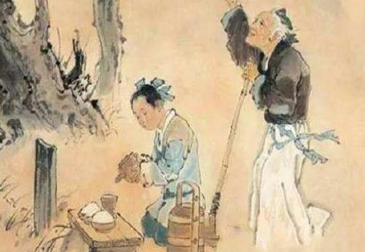
4. The customs of Qingming Festival---题型开发：根据要求，补全句子
扫墓 Tomb Sweeping
The major custom in Qingming Festival is to sweep tombs. (按照)folk religion, the spirits of
deceased ancestors still live underground and look after the family; the tombs (say) to be their houses; thus it is very important to keep the tombs clean.
The Qingming Festival is spent ________ (honor) the dead, which is one of many ways good Confucians（儒家） demonstrate filial piety（孝顺）. On this day, people visit their family graves (remove) any underbrush that has grown， uproot weeds near the gravesites, wipe the tombstones(墓碑) and decorate the tombstones with fresh flowers. And then they will
（摆上） offerings of food and paper money.
清明最主要的习俗是扫墓。根据民间宗教，逝去的祖先依然在地下照顾我们，墓就是他们的家，所以我们需要保持墓的清洁。
清明是为了纪念逝者，这也是儒家所崇尚的孝道。这天，人们上坟去拔掉坟边长出的灌木和杂草，擦干净墓碑并用鲜花点缀，然后摆上供品，烧点纸钱。
According to
are said
honoring
to remove
set out

Slide 17

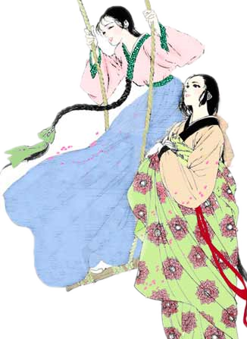
秋千 Swing
荡秋千是我国古代清明节习俗。秋千，意即揪着皮绳而迁移。它的历史很古老，最早叫千秋，后为了避忌讳，改为秋千。打秋千不仅可以增进健康，而且可以培养勇敢精神，至今为人们特别是儿童所喜爱。
To swing is our ancient custom on Qingming Festival in our China . Swing means clenching leather string __________ (migrate). Its history is very old, the earliest (know) “future generation”, the latter in order to avoid taboo(禁忌), replaced by swing. Not only
swing improve the health, but also can cultivate the brave spirit, (love) by people, especially children.
to migrate
known
can
loved

Slide 18
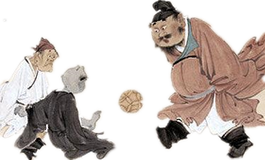
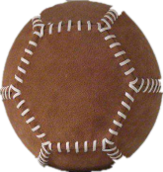
蹴鞠 cuju
鞠是一种皮球, 用皮革做成，球内用毛塞紧。蹴，就是用脚去踢球。“蹴鞠”就是指古人以脚蹴、蹋、踢皮球的活动，类似今日的足球。这是古代清明节时人们喜爱的一种游戏。相传是黄帝发明的，最初的目的是用来训练武士。
“Ju” is a ball with leather skin made, the ball inside with wool （plug）. “Cu” means
(kick) something with foot. Cuju is a game like football. It is ancient favorite game during Tomb Sweeping Days. Legend has it______ the invention of the yellow emperor, original purpose is used (train)warrior.
plugged
kicking
that
to train

Slide 19
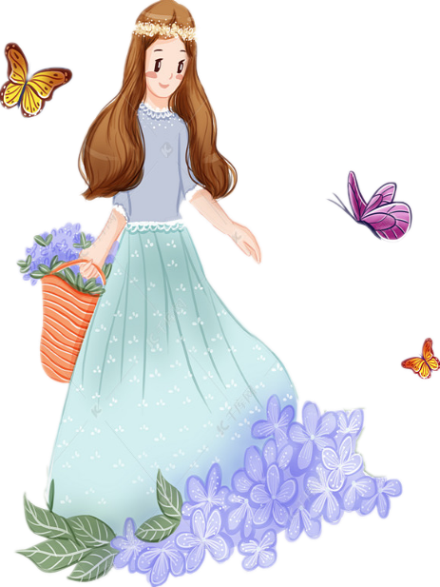

踏青 Outing
踏青又叫春游，古时叫探春、寻春等。 三月清明，春回大地，自然界到处呈现一派生机勃勃的景象，正是郊游的大好时光。我国民间长期保持着清明踏青的习惯。
In ancient times, spring outing (call) TanChun, XunChun, etc. On Tomb Sweeping Day, spring warms the earth, nature a vibrant (有活力的) picture everywhere, it is an excellent time ______ outing. China’s folk society long maintains the hikers habits .
was called
for

Slide 20
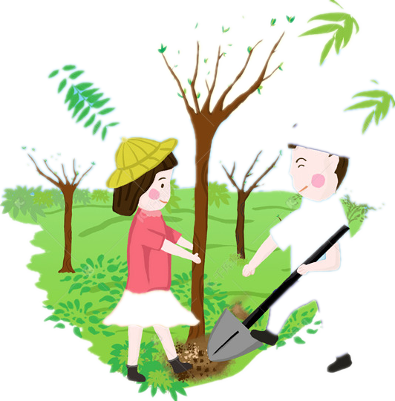
植树 Planting trees
清明前后, 种植树苗成活率高。因此, 自古以来, 我国就有清明植树的习惯。有人还把清明节叫作"植树节”。1979年，人大常委会规定，每年三月十二日为我国植树节。这对动员全国各族人民积极开展绿化祖国活动，有着十分重要的意义。
Around Tomb Sweeping Day, the survival rate of planting seedlings is high. Therefore, our country （develop）the habit of planting trees since the ancient times, some people______ (call) the Qingming Festival ‘Arbor Day’. In 1979, according to the National People’s Congress , March 12 of each year is China’s “Arbor Day”. It is great significance to mobilize(动员) the people of all ethnic（民族的） groups to (active) carry out the activities of greening the motherland.
has developed
calling
of
actively

Slide 21
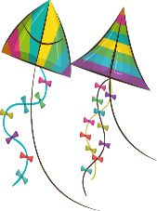
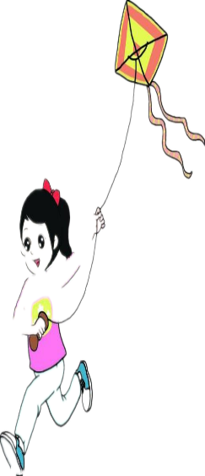
放风筝 Flying a kite
放风筝也是清明时节人们所喜爱的活动。每逢清明时节， 人们不仅白天放，夜间也放。晚上，风筝下一串串彩色的小灯笼，象闪烁的明星， 被称为“神灯”。过去，有的人把风筝放上蓝天后，便剪断牵线，任凭清风把它们送往天涯海角。据说这样能除病消灾，给自己带来好运。
Flying a kite is enjoyed by people. Every Qingming Day, people fly kites not only during the day, at night. The small colorful lanterns (attach) to the kites strings like the twinkling stars are called “the absolute being light”. In the past, some people put a kite on the blue sky, then cut the wire and let the wind send them to the ends of the Earth. is said that this can except disease disaster, (bring) you good luck.
but (also)
attached
It
bringing

Slide 22
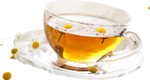
品茶 A Time to Taste Tea
Qingming Festival is also a time to enjoy a cup of tea, because the tea ___1___ (produce) around Qingming Festival is said to be with high- quality.
The plucking of tea usually takes place in spring, summer 2 autumn. Tealeaves 3 different seasons have different appearances and inner quality. Tealeaves plucked in spring, from early March to the Qingming Festival, 4 (call) “pre-ming tea” or “first tea.” ___5___ (it) color is light jade green, and ___6___（taste) pure with a touch of acerbity(苦,涩). Two weeks after Qingming, it is the Guyu solar term on the Chinese lunar calendar. During this time, the Jiangnan area will experience a round of fine precipitation(沉淀物) for the moistening of crops. And this brings forth the __7__ (two) peak season of tea picking. Tealeaves collected __8__ the Qingming but before Guyu are called “pre-rain tea,” and the spring tea picked after that are called “post-rain tea.” Spring tea’ s ____9___ (price) usually vary according to the time the tealeaves were picked, with the prices being higher for ___10___ (early) tea and lower for the later. In most cases, early- spring green tea is the best in quality among all available tea.
produced
and
from
are called
Its
tastes
second
after
prices
earlier

Slide 23
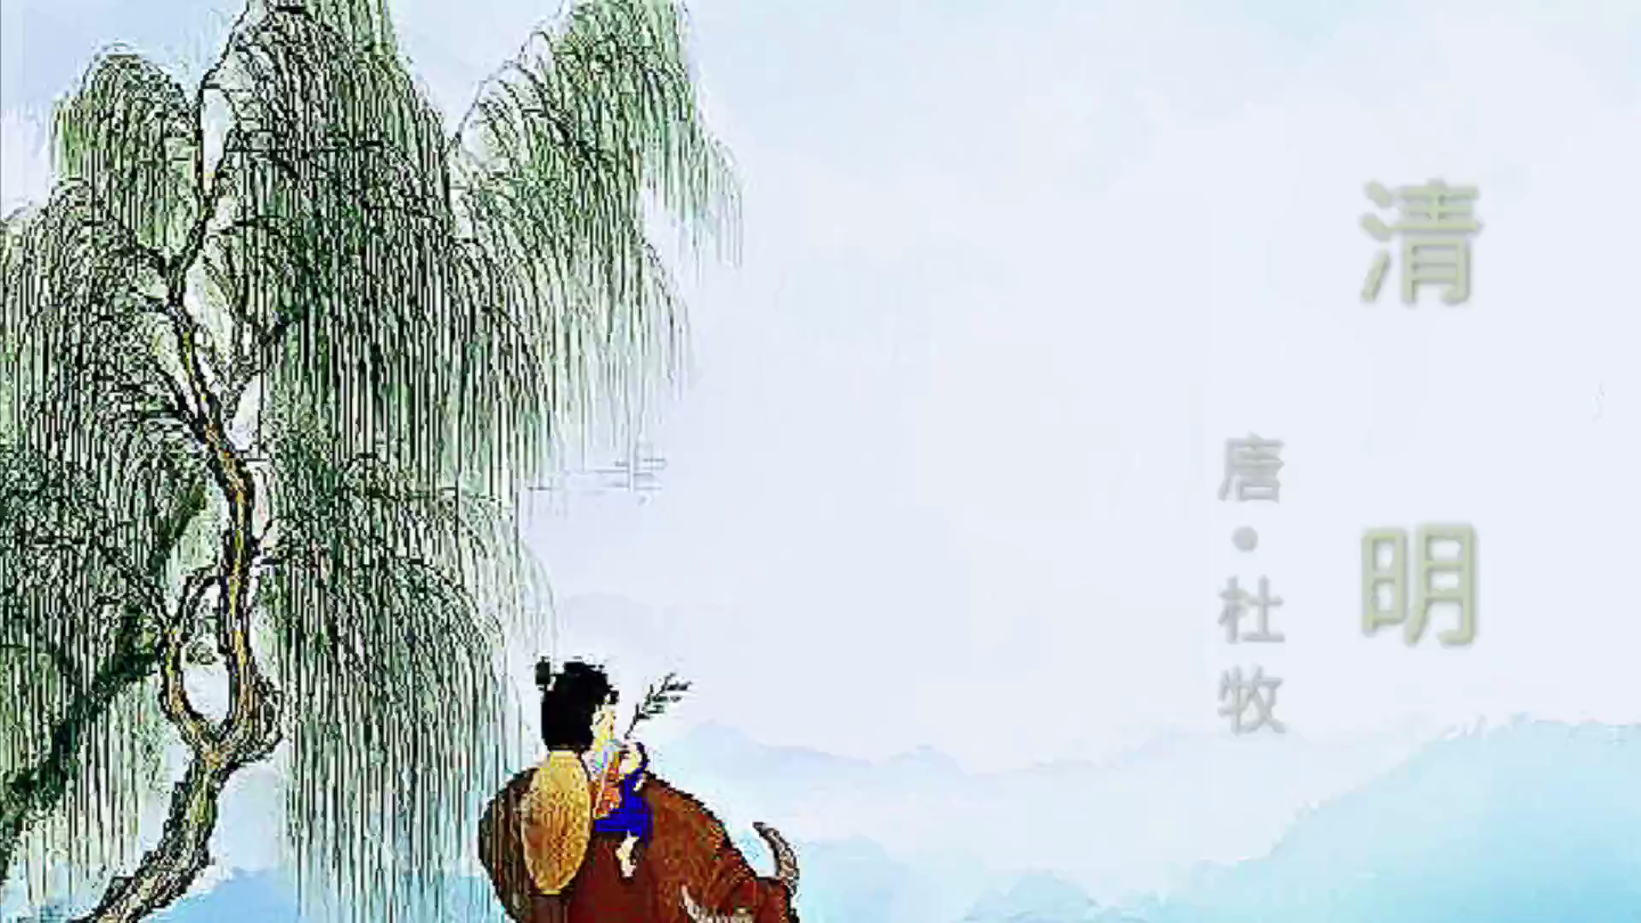

Slide 24
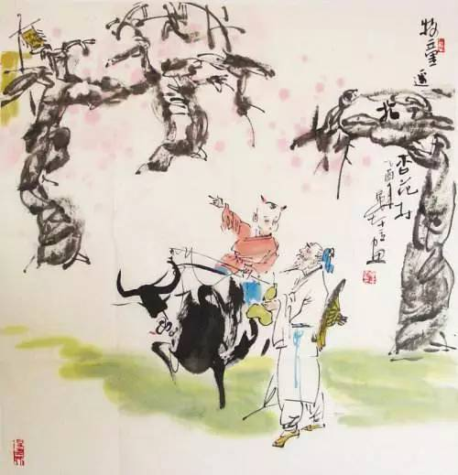
5. The poems of Qingming Festival
清明
杜牧
清明时节雨纷纷，路上行人欲断魂。
借问酒家何处有? 牧童遥指杏花村。
The Mourning Dy
Du Mu
许渊冲译
A drizzling rain falls like tears on the Mourning Day;
The mourner’s heart is breaking on his way.
Where can a winehouse be found to drown his sadness?
A cowherd points to a cot amid apricot flowers.

Slide 25
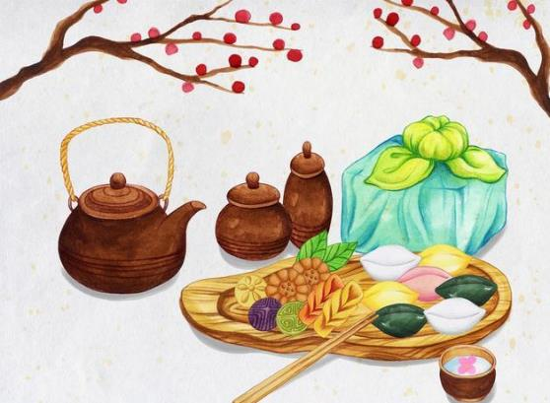
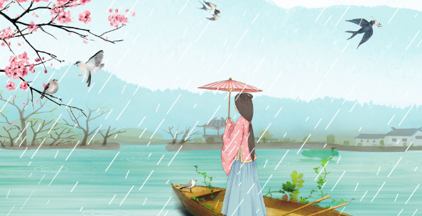
寒食
(唐)韩翃
春城无处不飞花，
寒食东风御柳斜。
日暮汉宫传蜡烛，
轻烟散入五侯家。
After The Day Of No Fire
Translated by Hu Zhuangzi
Petals of spring fly all through the city,
From the wind in the willows of the Imperial River.
And at dusk, from the palace, candles are given out ,
To light first the mansions of the Five Great Lords.

Slide 26
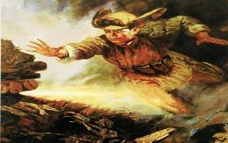
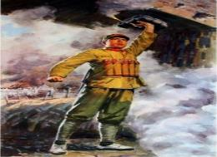
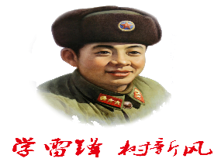
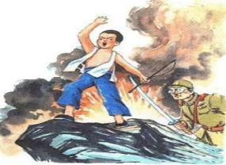
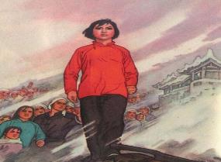
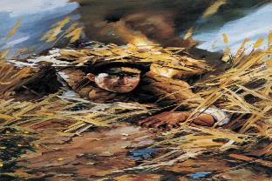
6. Honor the dead, honor the heroes 缅怀先烈，致敬英雄
革命先烈们，为了人民的幸福、民族的解放和国家的富强，英勇战斗，直到流尽最后一滴血，永远长眠于我们脚下的这片热土。他们用殷红的鲜血，书写了爱国主义最壮丽的诗篇！他们是中国的脊梁，是民族的骄傲！他们的名字是黄继光，董存瑞，邱少云，刘胡兰，王二小，雷锋 ┄┄
For the happiness of the people, the liberation of the nation and the prosperity of the country，Martyrs（先烈） of the revolution fought bravely until their last drop of blood was shed, they lying beneath the piece of land. They used the scarlet blood to write down the most magnificent poem of patriotism! They are the ridge beams of China and the pride of the nation! Their names are Huang Jiguang, Dong Cunrui, Qiu Shaoyun, Liu Hulan, Wang Erxiao, Lei Feng ┄┄
黄继光
董存瑞
王二小
刘胡兰
邱少云

Slide 27
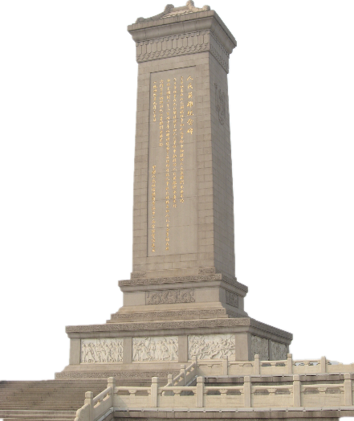
6. Honor the dead, honor the heroes---高考题型开发：应用文
假如你是李华，清明节马上到了，你校组织学生去烈士陵园进行扫墓活动，请你给外教Lucy写封邮件，邀请她一同前往，内容包括：
出发时间；
清明介绍；
活动安排。
参考词汇：烈士陵园 martyrs cemetery
注意：
1.词数80左右；
2.可以适当增加细节，以使行文连贯。

Slide 28
Dear Lucy
I’m Li Hua, one of your students. Tomb Sweeping Day is around the corner. Hearing that you are immersed in our Chinese festival, I’d like to invite you to join us for a visit to martyrs cemetery.
Tomb Sweeping Day, one of traditional festivals in China, falls on either April 4th or 5th every year. It is a time to honor the dead and the dearly departed. On that day, people visit the graves for Tomb Sweeping, known as “shangfen” in our China, offering sacrifices to the dead.
We are scheduled to meet at 8 am at the school gate on April 5th. A variety of activities have been arranged. What comes first is that we will sweep the graves for deceased martyrs, which will make you experience the process of tomb-sweeping in the flesh. In addition, another activity is also arranged----a speech contest in memory of the martyrs , which also offers you a platform where you can gain a deeper insight into our traditional culture.
I sincerely hope that you can accept my invitation. Please keep me informed of your decision at your earliest convenience.
Yours,
Li Hua

Slide 29

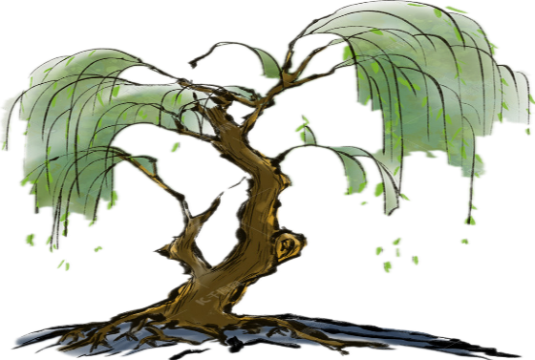
Thank you
spring outing
ancestor worship

