Slide 1


感恩遇见，相互成就，本课件资料仅供您个人参考、教学使用，严禁自行在网络传播，违者依知识产权法追究法律责任。
更多教学资源请关注
公众号：溯恩高中英语
知识产权声明

Slide 2

Words review
穿着传统服饰：
穿着狂欢服：
把自己打扮成明星：
wear traditional costumes
be dressed in carnival costumes
lantern
carnival
costume
dress (sb) up
march
congratulation
riddle
ceremony
samba
make-up
after all
n. 灯笼；提灯
n. 狂欢节；嘉年华
n. (某地或某历史时期的) 服装
穿上盛装；装扮
vi＆n. 行进; 前进; 游行
n. 祝贺；恭喜
n. 谜语；神秘事件
n. 典礼；仪式
n. 桑巴舞；桑巴舞曲
n. 化妆品；性格；构成方式
毕竟；别忘了
dress sb up as stars
游街：
march along the streets
congratulate_{（v)}
收到来自某人的祝贺：
向某人表示祝贺：
因某事祝贺某人：
guess riddles
attend ceremonies

Slide 3
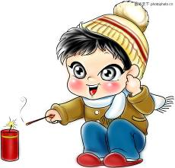
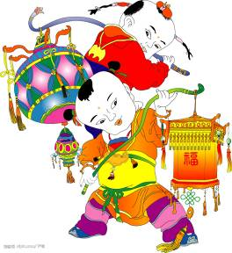


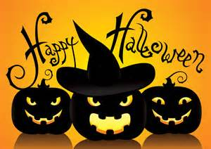
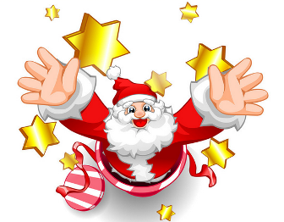
Unit 1
FESTIVALS
AND CELEBRATIONS
Listening
&
Speaking

Slide 4
Learning Objectives
At the end of the class, you will be able to
1. master some phrases that describe the festivals:
2. learn how to identify the relationships between speakers while listening and know some basic features
3. introduce other Chinese feativals to classmates by giving information like time, place, origin, purpose and celebrations

Slide 5
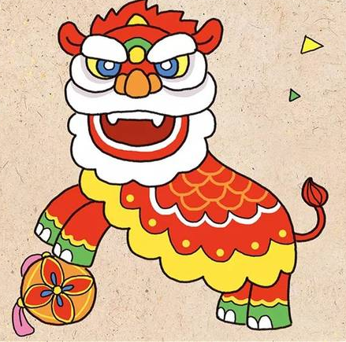
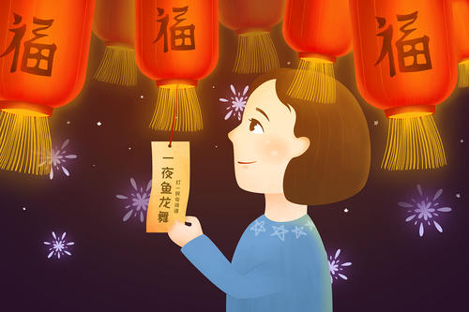
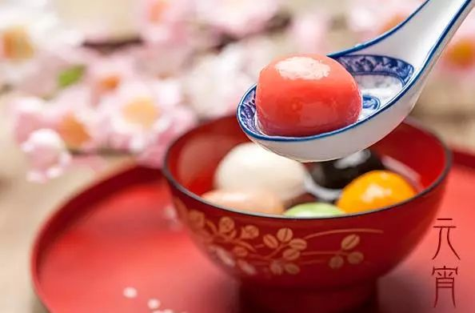
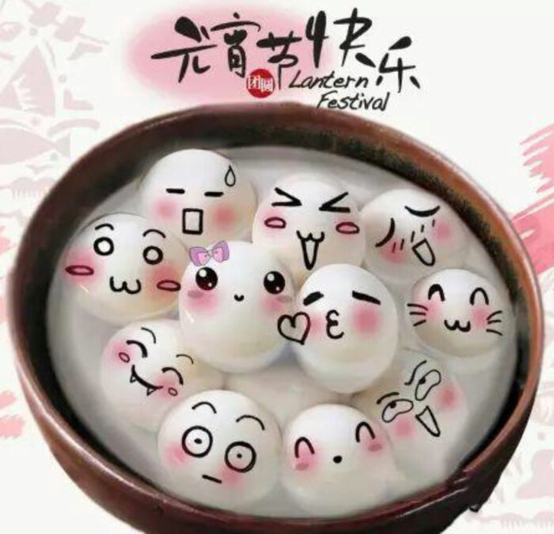
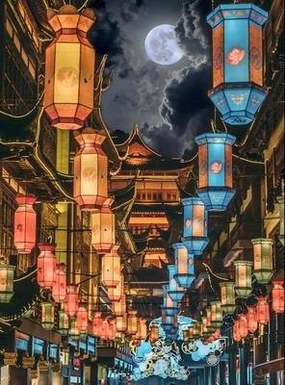
——Guess the festivals
Lead-in
the Chinese Lantern Festival
Clue1：It takes place on the fifteenth day of the lunar year.
Clue2：People will march along the streets on this day.
Clue3：Some places will hold the Lion Dance Show.
Clue4: People can guess riddles.
What else will people do to celebrate this festival?
eat yuanxiao
visit a lantern fair

Slide 6
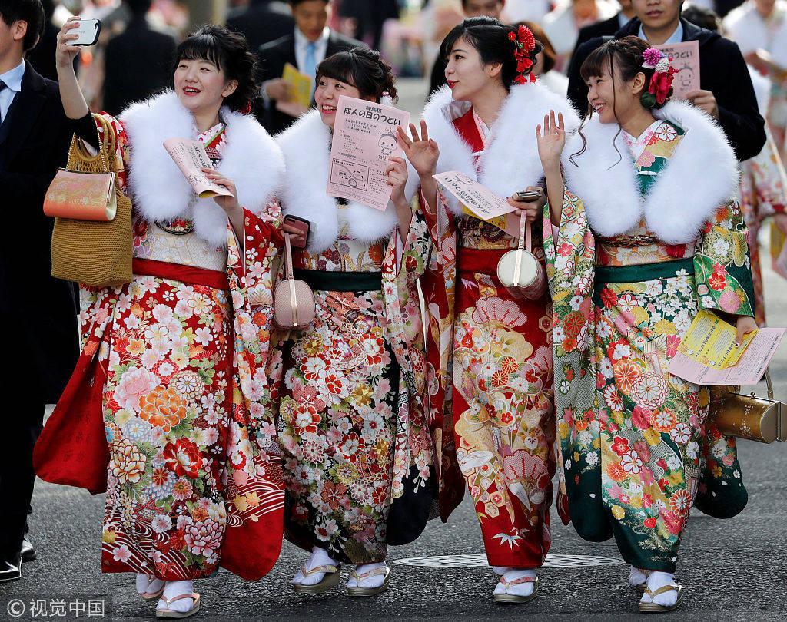
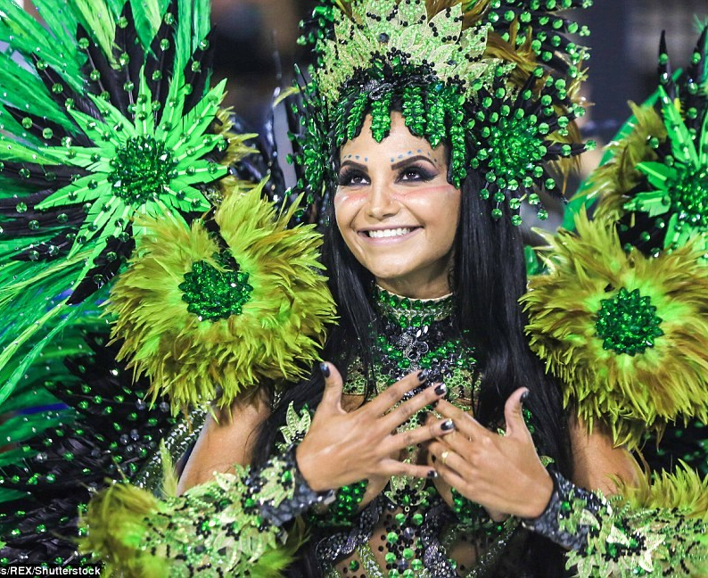
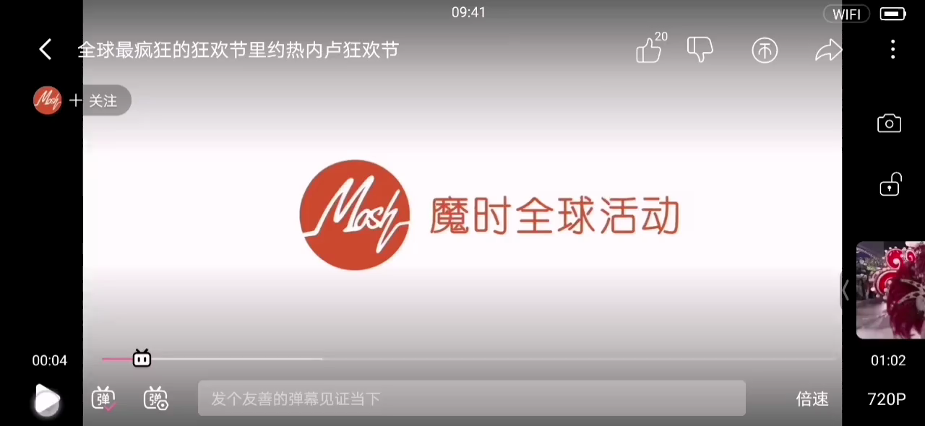
——Know more festivals
Lead-in
the Coming-of-Age Day
Background:
1. take place in Japan
2. originally celebrated on Jan.15, but changed to the second Monday in Jan.
3. to congratulate a person on transitting from
a child to an adult(20)
Celebrations:
1. be dressed in traditional costumes( kimonos/suits)
2. attend the ceremony
3. receive congratulations from...
4.express congratulations to...
Background:
1. take place in Catholic(天主教) countries
2. celebrated in late February or early March(Lent).
3. more than two million people take part in the yearly festivities, it’s a competition
Celebrations:
1. be dressed in carnival costumes
2. give joyful performances
3. watch samba dance on a colorful float
the Rio Carnival

Slide 7

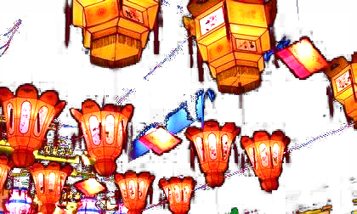

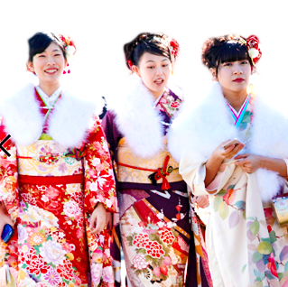
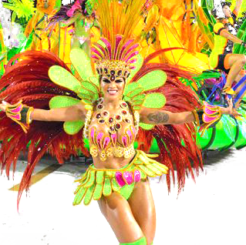
——Listen and match
How?
Listening
relationship between the speakers
Conversition 1
a tour guide and members of a tour group
an interviewer and an interviewee
a reporter and a tourist
two friends
Listening tip:
pay attention to how people talk to each other
specific questions
tone(语气）
Now, everyone
Conversition 2
Miss
Friends: informal, statements
Strangers: polite, questions(could you...please?)
Conversition 3
I’m ready for... Carla

Slide 8
——Listen for details
Listening
It’s ___________on becoming an adult. The girl is wearing ______ colors. It took her a long time to do her ___ and _______, and to get ______ . She is going to meet her _____ soon. “Being an adult” means being ____________, and responsible for ______ and __________.
congratulations
bright
hair
make-up
dressed
family
self-supporting
actions
decisions
Carla advises Limei to change her ______ and ______ . This is because the weather is _____ and they will ____ _____ __ _______ and _____for a long time.
dress
shoes
hot
march along the streets
dance
It’s a ____ for eyes. People can guess______ on the paper to get gifts, watch the ______ and ____dances, as well as eat yuanxiao, a kind of _______ _____________.
treat
riddles
dragon lion
sweet dumplings

Slide 9
Conversation 1
Interviewer: Miss. congratulations on becoming an adult! You look amazing in your
kimono. The bright colours are terrifie!
Girl: Really? That's kind of you to say so. Thank you.
Interviewer: You're welcome. Did it take you much time to get ready today?
Girl: Yes,actually. I spent hours doing my hair and make-up. and getting
dressed. But it was worth it, because I wanted to look my best at the
Coming-of-Age ceremony.
Interviewer: Oh. you look great! Now that the ceremony is over. are you going to
celebrate the day with your family or friends?
Girl: Yes. I 'm going to meet my family soon, and we're having a party tonight.
Interviewer: So what does “being an adult” mean to you?
Girl: Well, I think ii means being self-supporting and responsible for your
actions and decisions, and ...[fade out]
Language feature of an interview
Interviewer:
Interviewee:
Beginning:Excuse me! Can I ask you some questoins?
positive comments + brief questions
The answers to the questions are specific and rich

Slide 10
Conversation 2
Li Mei: I'm ready for Carnival, Carla. Shall we go and join the parade now?
Carla: You must be joking, Li Mei!That dress is too thick. Do you realise
that it's 35℃ out there? Also,－we're going to march along the
streets for hours and dance until midnight. You need to change.
Li Mei :OK. What should I wear?
Carla:Wear somcthing light and cool. I also think you need to wear morc
comfortable shoes. It'll be too tiring to walk or dance for a long time
in those shoes.
Li Mei:Hmm ... You're right. Can you wait for me? I'll change right away.
Carla:Sure.
Li Mei:Carla, how do I look now!
Carla:Fantastic! Now let's go and enjoy this festival! It's going to be so
exciting!
statements, informal, intimate

Slide 11
Conversation 3
Guide: Now, everyone. when we turn this next corner. you'll all have a real treat for
thc eyes.
Man : Wow! These lanterns are amazing!
Woman: Excuse me, Miss Lin. Can you tell me what's written on the pieces of paper？
Are theywishes?
Guide: Not exactly. They're riddles for people to guess. If you guess correctly, you can
get a nice gift.
Woman: Oh. what a nice idea!What else can Chinese people do during this festival?
Guide: Oh, they can do many things. They can watch the dragon and lion dances, and
also eat yuanxiao with their family. Yuanxiao is a kind of sweet dumpling. The
Chinese word “yuan” means “family unity and happiness”
Language feature
A guide usually introduce the place on his own. Sometimes, there is the interaction between the guide and tourists.
Sometimes, there will be sentences like “On your left/right you will see...”, “Turn the corner here, you will...”, “If you look up, you will...”, “Take a look at...”

Slide 12
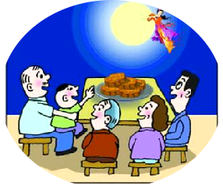
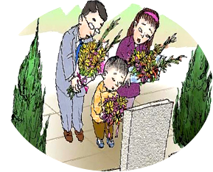
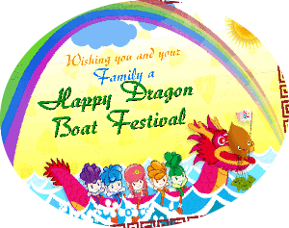
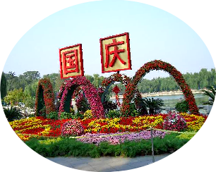
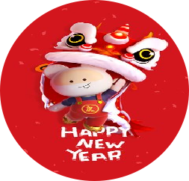
Post-listening
Sample
It’s my great honour to share with you the festival—the Mid-autumn Festival. The Mid-autumn Festival, an ancient festival with a long history in China, is usually celebrated on the fifteenth day in August of the lunar year. It begins with a very interesting story. Long ago... From then on, Chinese people celebrate it on the day to memorize that important event. When the festival approaching, you will find yourself surrounded by various mooncakes in the streets or malls. People will gether together to enjoy the mooncakes at home, admire the moon, visit the lantern fair, fire the firework...
If you have an opportunity to be a guide to introduce Chinese festivals to some foreigners, Which one will you choose to introduce? And how?
Mid-autumn Day
Time, Place, Origin, Purpose, Celebrations
Spring Festival
Tomb-sweeping Day
Dragon Boat Festival
National Day

