Slide 1
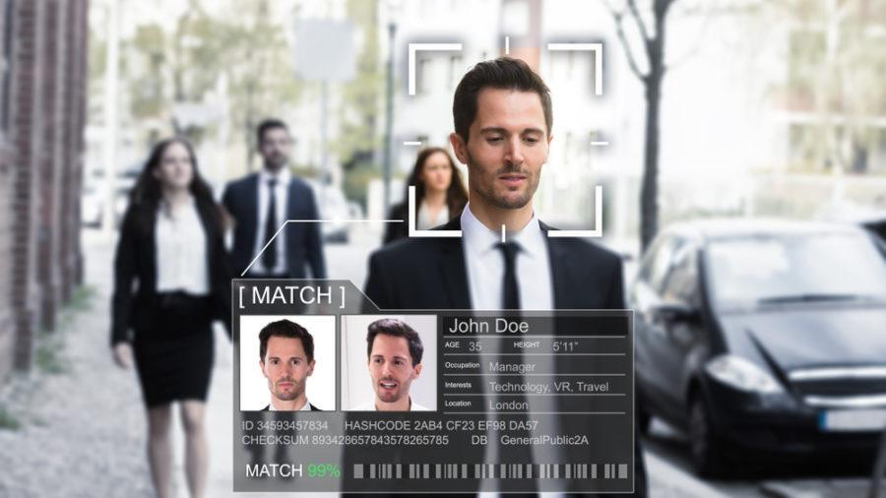
Facial-Recognition Technology

Slide 2
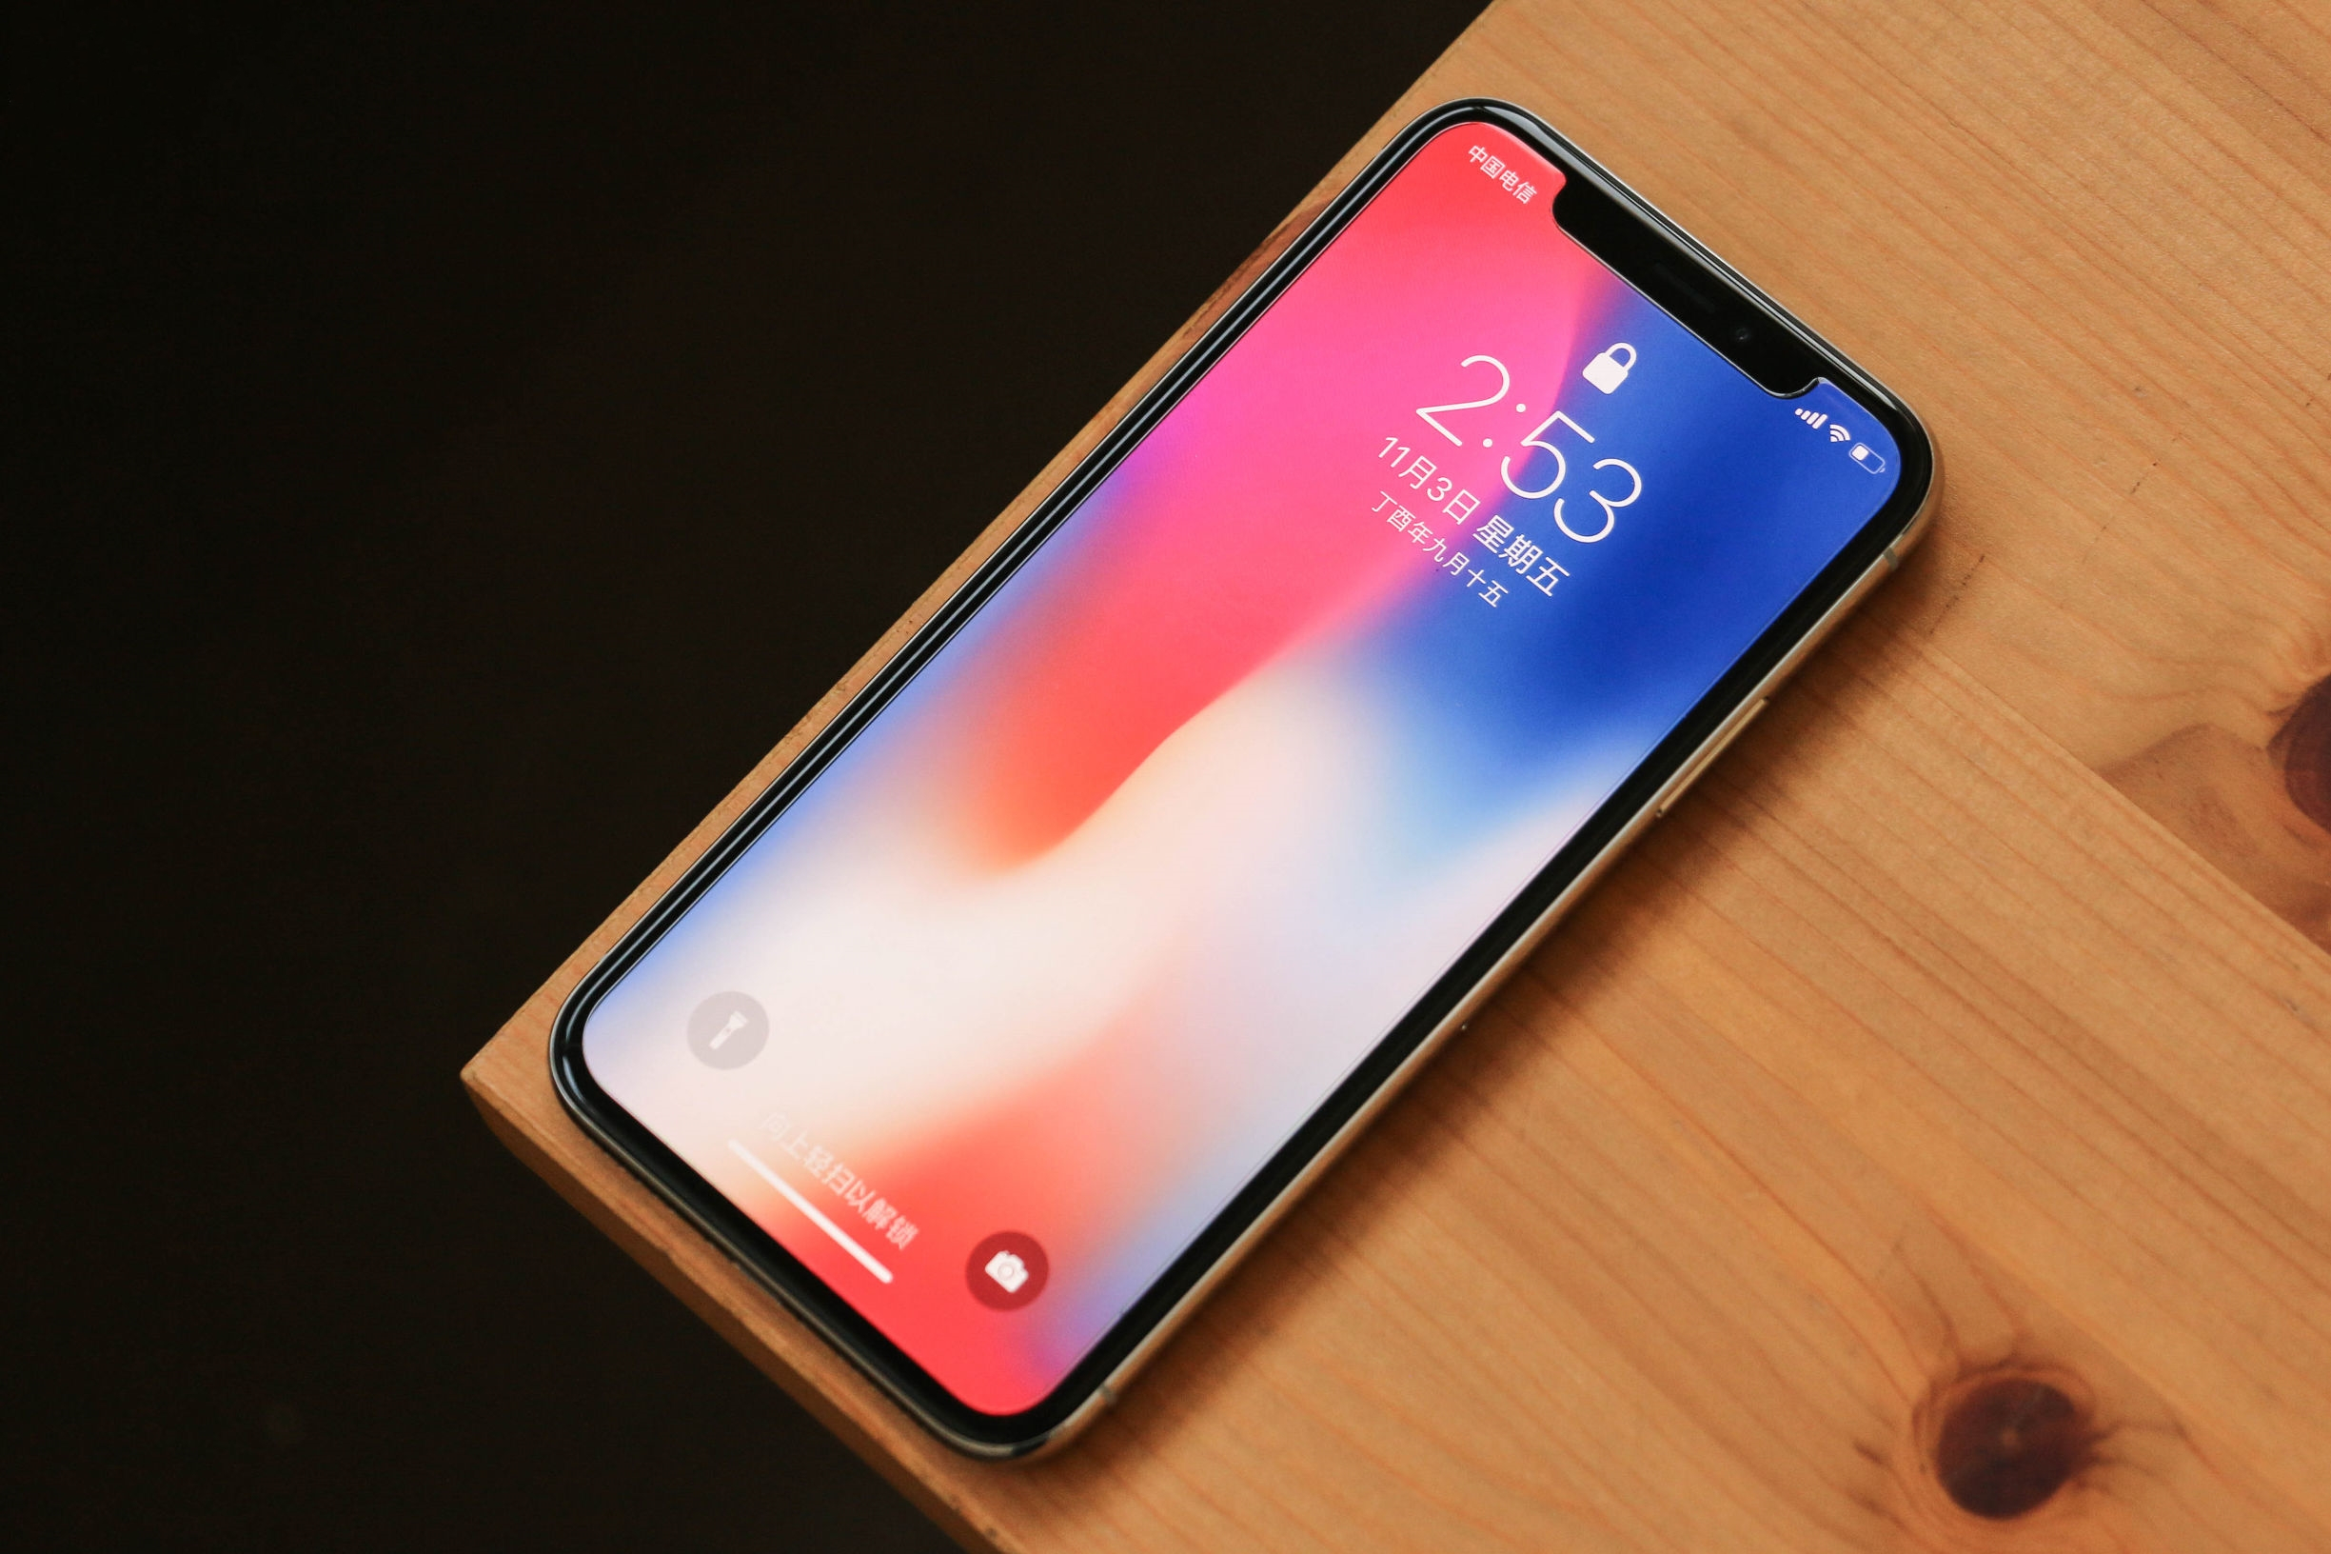

Slide 3

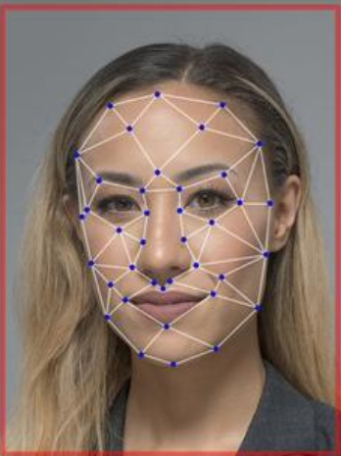
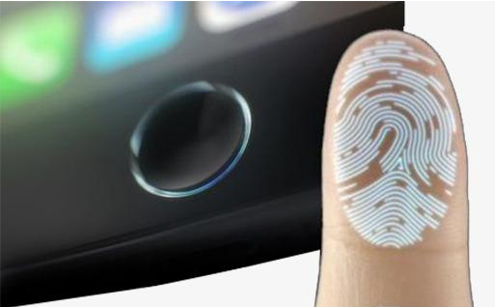
1. How do people usually unlock their smartphones?
fingerprint
password
/passcode
face
fingerprint identification technology
facial-recognition techonology
FRT
Notes:
we can say FRT for short

Slide 4
2. What do you know about FRT (facial-recognition technology)?
It can be used
to confirm our identity in some public places
to track criminal suspects
...
3. What do you expect to know about FRT?
Notes:
we can see FRT is so useful that it has been applied many fields in our daily life. invade our privacy

Slide 5
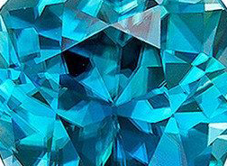
Facial-Recognition Technology
FRT
What did the author write about?
How did he write it?
Why did he write in such a way?
Notes:
let's read the article to see what the atuthor wrote about and how did he wrote.

Slide 6
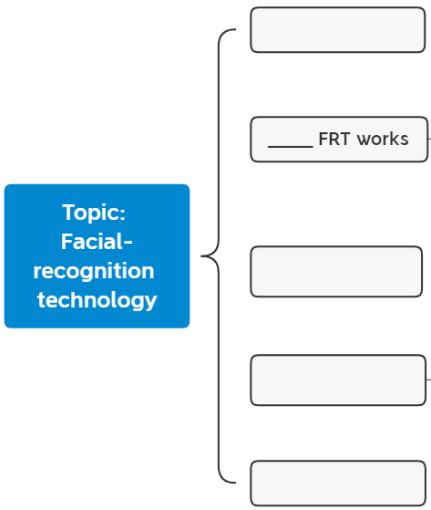

Read for main idea
Para.1
Read the text quickly and summarize the main idea of each paragraph (using a noun or a noun phrase is preferred).
Para.2
You can find main ideas by taking a look at the title, key words and phrases and topic sentences and transitional sentences (过渡句).
Para.3
Para.4
Para.5
Notes:
PLEASE

Slide 7
Para.1
A general introduction to the topic
Faces communicate feelings. They can tell people if we are happy, sad, or confused. Faces have another use, too. Your face can identify you. It is unique, like a fingerprint. Unless you have an identical twin, there is no one else in the world with your face. Now, organizations are using your face for many different purposes. This could be very helpful, but some people have concerns about using faces for identification.
identify
like
purposes.
concerns
para.3
para.2
para.4
What is their relationship to the following three paragraphs?
What information is closely related to the topic in para.1?

Slide 8
Para.1
A general introduction to the topic
Faces communicate feelings. They can tell people if we are happy, sad, or confused. Faces have another use, too. Your face can identify you. It is unique, like a fingerprint. Unless you have an identical twin, there is no one else in the world with your face. Now, organizations are using your face for many different purposes. This could be very helpful, but some people have concerns about using faces for identification.
identify
Topic
purposes.
concerns
para.2
para.4
para.3

Slide 9
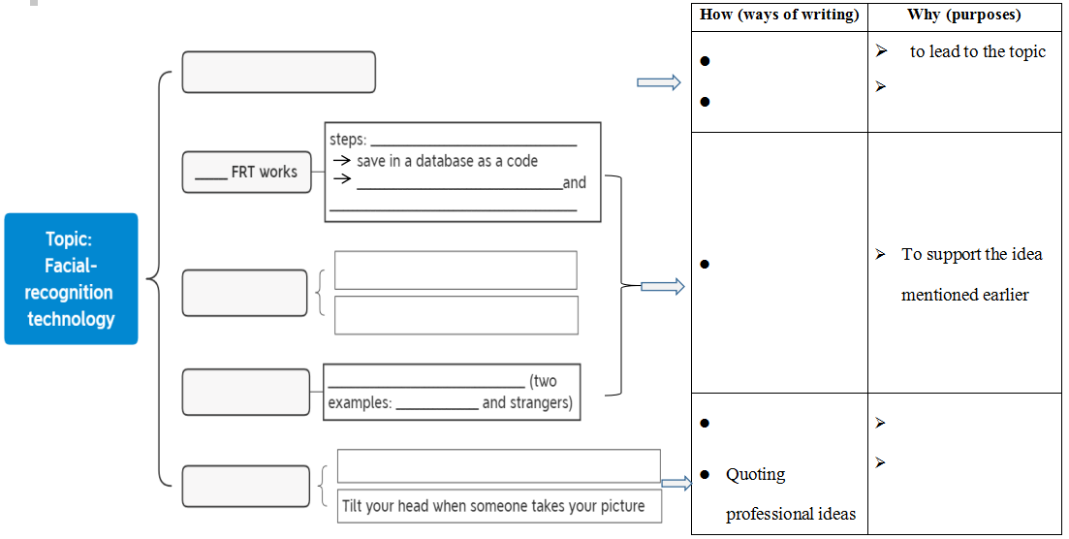
Work in groups and finish both the mindmap and the table on the worksheet.
Group work
Introducing sth familiar
Making a comparison
A general introduction
to explain sth
How
You can find the logical relations between sentences through words like for example, another, in the meantime.
Benefits
Problems
Solutions

Slide 10
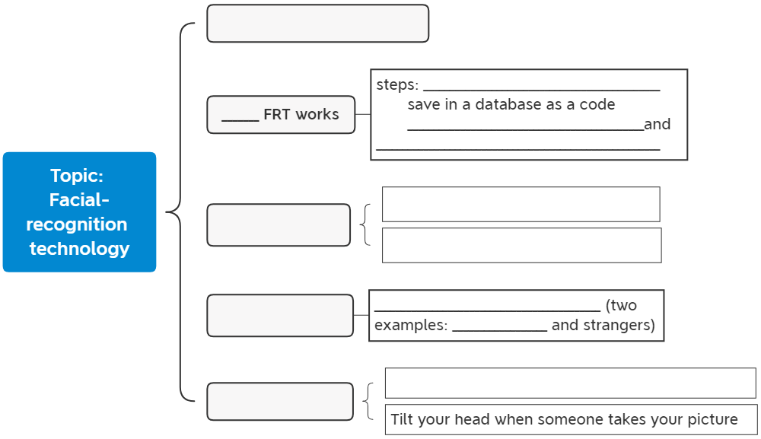
Work in groups and finish both the mindmap and the table on the worksheet.
A general introduction
Group work
How
You can find the logical relations between sentences through words like for example, another, in the meantime.
Benefits
You can find the logical relations between sentences through words like for example, another, in the meantime.
Problems
Solutions
Notes:
move part of your body to the side situation in which someone tries to find out details about another person's private affairs in a way that is upsetting and often illegal affect sth in an unpleasant or annoying way

Slide 11
Work in groups and finish both the mindmap and the table on the worksheet.
How (ways of writing) | Why (purposes)
Introducing sth familiar Making a comparison | to lead to the topic to explain sth new
 | To support the idea mentioned earlier
Quoting professional ideas
Para.1
Giving examples
Para.2-4
Asking an open-ended question
To cause readers to think
Para.5
to make the ideas more convincing

Slide 12
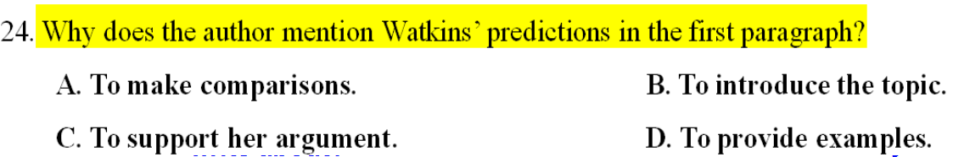
Summary
What
How
Why
Why did he write in such a way?
What did the author write about?
How did he write it?

Slide 13

Group Discussion
In may 2019, a bill was passed in San Francisco that banned all city government agencies and the police from using FRT (facial-recognition technology) in the city, making it the first US city to do so. It was mainly because FRT invades people's privacy and has higher error rates(比率) for people of color and women which could lead to wrongful arrests and racial discrimination(种族歧视).
What do you think of the ban on facial-recognition technology in San Francisco? Please use some of the ways we have learned to illustrate your point.
How
Making a comparison
Giving examples
Asking an open-ended question
Quoting professional ideas

Slide 14
Homework
Write your point down and report to the class in the next class. Be sure to use some of the ways of writing we have learned to illustrate your point.
How (ways of writing) | Why (purpose)
Making a comparison | to explain sth new
Giving examples | To support the idea mentioned earlier
Asking an open-ended question | to cause readers to think
Quoting professional ideas | to make the ideas more convincing

