Slide 1

感恩遇见，相互成就，本课件资料仅供您个人参考、教学使用，严禁自行在网络传播，违者依知识产权法追究法律责任。
更多教学资源请关注
公众号：溯恩高中英语
知识产权声明

Slide 2
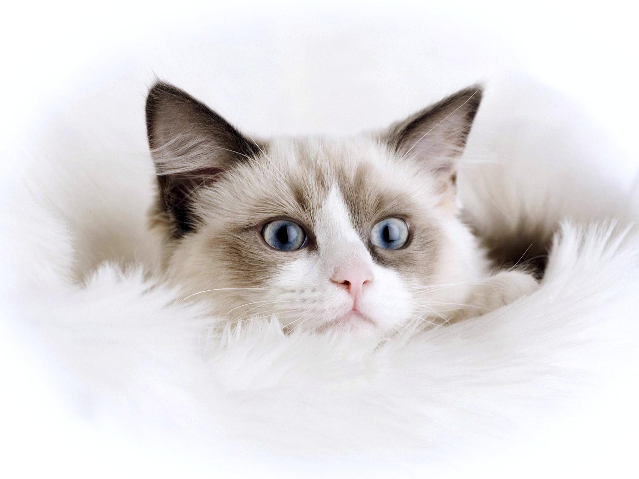
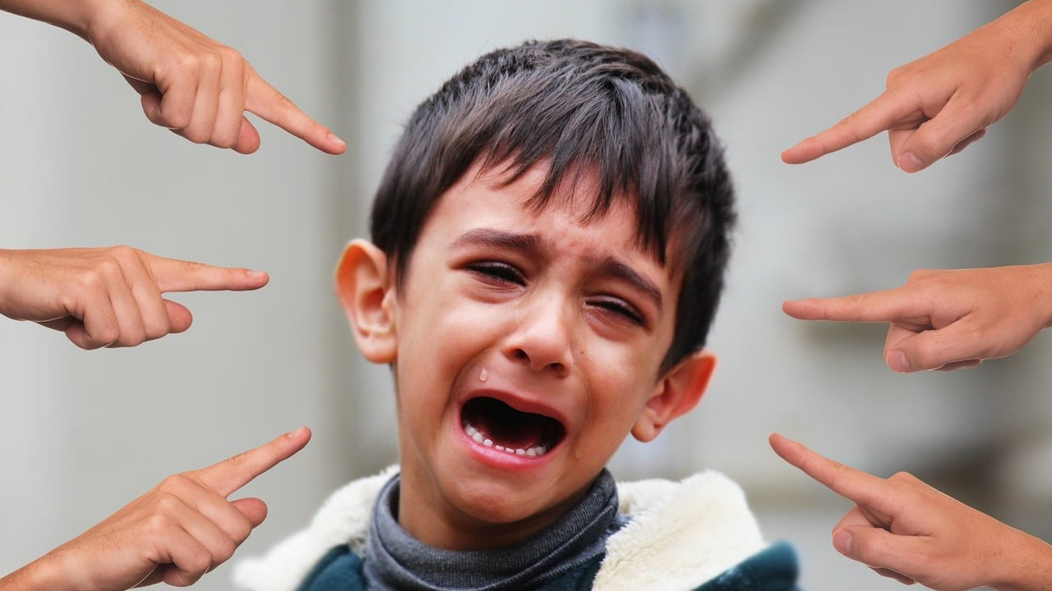
衢州、湖州、丽水三地市联考
读后续写评析
浙江省衢州第一中学 徐荣仙

Slide 3
Carter enjoyed riding the school bus home. The ride home gave him some time to relax after a busy day of fifth grade. He usually sat alone and enjoyed that too. With four siblings (兄妹) he didn’t get much time alone. Sometimes he sat with his younger brother, Jackson, but Jackson was sick at home today. The bus stopped and the tallest boy in his class, Dexter, stepped off followed by his younger brother, Billy. As the bus pulled away, Carter looked back over his shoulder to watch the boys. Dexter was yelling and waving his hands at his little brother. Billy said something Carter could not hear. Dexter yelled, gave his younger brother a hard shove and knocked him to the ground. Billy was on the ground wiping at his eyes, but Dexter walked away. Carter turned in his seat, feeling disgusted. He hated seeing little kids get picked on (欺负). The sight of Billy on the ground crying was burned into his memory. He tried to think of something else.
He thought of the model car he was working on at home, a 1967 Corvette. He started building it over a week ago and just finished putting it together last night. Tonight, as soon as he finished his homework, he could start painting the car. That was his favorite part. He already had the perfect color of blue picked out.

Slide 4
He hurried off the bus, ran through his yard, and breezed through the kitchen with a quick hello to his mom. She was making spaghetti, which smelled delicious. He ran up the stairs two at a time and rushed into his room. “Surprise!” his brother Jackson said, throwing his arms into the air. “What are you doing in my room? I thought you were sick!” “I feel better!” “What’s on your face? Are you bleeding?” “No! I’m not bleeding.” Jackson wiped at his face. “It’s probably just paint. Look! Look what I did!” He pointed at the desk in the corner of Carter’ s room.
Paragraph 1:
Carter looked down at his desk in horror. _____________________
______________________________________________________
Paragraph2:
Carter took a deep breath and then unfolded his fist. ____________
______________________________________________________

Slide 5
读 后 续 写
主题语境：人与社会
语篇类型：记叙文
语篇背景介绍：
本文讲述的兄弟之间冲突如何处理的故事。放学路上，Carter 看到他的同学Dexter欺负他的弟弟Billy。Carter对这种兄弟之间欺凌现象比较反感。他迫使自己转移注意力，去关注他的模型车，一周前他已经拼好了，今天晚上回去就可以完成他最喜欢的部分－上色。当他匆忙到家后，发现他生病的弟弟Jackson在他的房间里，脸上都是像血一样的东西。弟弟指着桌子上的作品，得意地和哥哥炫耀自己的成果。

Slide 6
Analyze the material
⑴. Type of writing ___________
⑵. In what order is the material developed?
⑶. Three elements (要素) for a narrative:
Character
Setting
Plot
Narrative 记叙文
happy, relaxed
Emotion
sequence
disgusted, anger, eager, expectant
shocked, annoyed, tangled, relieved,
Carter, Dexter, Billy, Jackson
In Carter’s room
how to deal with the relation between siblings

Slide 7
Read for General Idea
What's the main idea of the given passage?
Carter went home after school and saw Billy knocked down on the ground by his brother, Dexter.
He felt disgusted and turned his attention to his model car.
Carter hurried home and found that his brother, Jackson, was in his room and that his model car was nearly ruined by his brother.

Slide 8
Analyze the Plots in the given Passage
climax
before arriving at home
after arriving at home
eager to see his model car
ran through his yard
said a quick hello to
ran up the stairs
on his way home
How would he react
to the ruined model car?
relaxed
happy
on seeing Billy bullied
angry
disgusted
unbearable
on thinking of his model car
ignore delicious spaghetti
eager
expectant

Slide 9

Work Out Possible Plots in Paragraph1?
Paragraph 1:
Carter looked down at his desk in horror. _______
________________________________________
What did he see?
What made his room horrible?
How did he feel?
What would he do? Would he knock his brother down to the ground?

Slide 10
Work Out Possible Plots in Paragraph2?
Paragraph2:
Carter took a deep breath and then unfolded his fist. ______________________________________
Why did he unfold his fist?
Did he forgive his brother?
What did he learn from the conflict?
Thinking: What social value does the author want to convey in the story?

Slide 11
How to express annoyed or angry?
He was seized by anger.
His anger boiled over.
He could hardly contain his rage.
He was breathing fire and fury.
His voice trembled with anger.
His face clouded with anger.
He flared（燃烧，突然发怒）up at the world.
Carter, his eyes wide with terror, felt he was on fire.
Color was rising on his face. He bit his lips tightly and held his fist high.
How to express alarmed or terrified?
He stared at Jackson as if he were a ghost.
Carter’s face froze into a dreadful stillness.
Jackson stood still in horror, frozen with fear.
Astonished at Carter’s extreme anger, Jackson were frozen to the spot, body trembling violently and tears rolling down helplessly.

Slide 12
Learn some writing skills
To make one’s story touching, the writer often use rhetoric to let their articles more powerful.
Rhetorical device
Simile（明喻）
She hung her head like a dying flower.
A simile compares two things by using words such as “like” or “as”.
Metaphor（隐喻）
The curtain of night fell upon us.
A metaphor compares two things that are unrelated, but which are similar in some way.

Slide 13
Rhetorical device
Hyperbole 夸张法
I was so hungry that I could eat a horse.
Hyperbole is a way of describing something by saying it is much bigger, smaller, worse etc than it actually is
Personification（拟人）
The leaves are daning in the tree.
Personification is when a thing, idea, or animal is given human attributes.

Slide 14
Rhetorical device
Quote（引用）
...as Longfellow says, “Music is the universal language of mankind.”
To quote is to repeat a short passage, word, phrase, or sentence that came from somewhere or someone else.
Repetition
（重复）
I came, I saw, I conquered.
Repetition is the use of the same word or phrase in a poem, speech, ete. It can be used for different purposes, such as to heighten tension or to give emphasis.

Slide 15
Some examples about rhetoric
He was as cunning as a fox.
When she heard the bad news, a river of tears poured out.
My hopes were all dead, and my future was empty. I lay on my bed, faint and wishing for death, while darkness swam around me.
Mr Rochester’s face was like colorless marble.
Anger was boiling up inside me.
He breathed deeply and his chest rose, as if his heart wanted to fly out of its cage, but he said nothing.
The early sun warmed the bench and the birds were singing.
I could not stop looking at him rather like a thirsty man who knows the water is poisoned but can’t resist drinking.

Slide 16
One possible version:
Carter looked down at his desk in horror. His Corvette! What an awful dull shade of red! “Why did you do that?” Carter yelled loudly. “I just wanted to surprise you!” Jackson pouted his lips and grinned at me proudly. “Isn’t it cool?” he continued. Color was rising on Carter’s face. He bit his lips tightly and held his fist high. Astonished at Carter’s extreme anger, Jackson were frozen to the spot, innocent tears rolling down. “I thought you would like it...!” he drooped his head and murmured. Carter took a deep breath and then unfolded his fist. Jackson’s sad and hopeless expression is somewhat familiar to him. The sight of Billy’s getting picked on was burned into his memory again. “Of course it’s cool!” Carter took a breath of relief and walked towards the table where the car was still drying. He stroked Jackson on the clown-like face and comforted him , “A sweet surprise!” Suddenly, a big and bright smile spread across Jackson’s little face.

Slide 17
One possible version:
Carter looked down at his desk in horror. His Corvette! Jackson had painted it red. An awful dull shade of red! “Why would you do that?” Carter shouted. “I wanted to surprise you!” Jackson grinned,with his eyes gleaming. Carter could feel the anger growing, bubbling up inside him, his hands curling into fists. Jackson kept saying something, but so angry was Carter that he couldn’t even hear a word. “Do you like it? I tried so hard. Look!” asked Jackson. Red paint was smeared across his face, forehead, even hair. Looking at Jackson, Carter couldn’t help imagining his little brother spending the whole day carefully painting the car. Carter took a deep breath and then unfolded his fist. Picturing the scene that Billy sit on the ground wiping at his eyes as his big brother Dexter walked away, Carter stepped toward the table where the car was still drying. Carter wasn’t sure what to say. He didn’t want to lie, but he didn’t want to hurt his brother’s feelings either. Jackson was only trying to surprise him. He could see that now. “Do you? Do you like it?” Jackson insisted.“Every time I look at this car, I’m going to think of you,” Carter responded, a smile stretching across his face. And that was the truth. “Now, we’d better get that paint off your face before dinner.”

Slide 18


