Slide 1

感恩遇见，相互成就，本课件资料仅供您个人参考、教学使用，严禁自行在网络传播，违者依知识产权法追究法律责任。
更多教学资源请关注
公众号：溯恩高中英语
知识产权声明

Slide 2
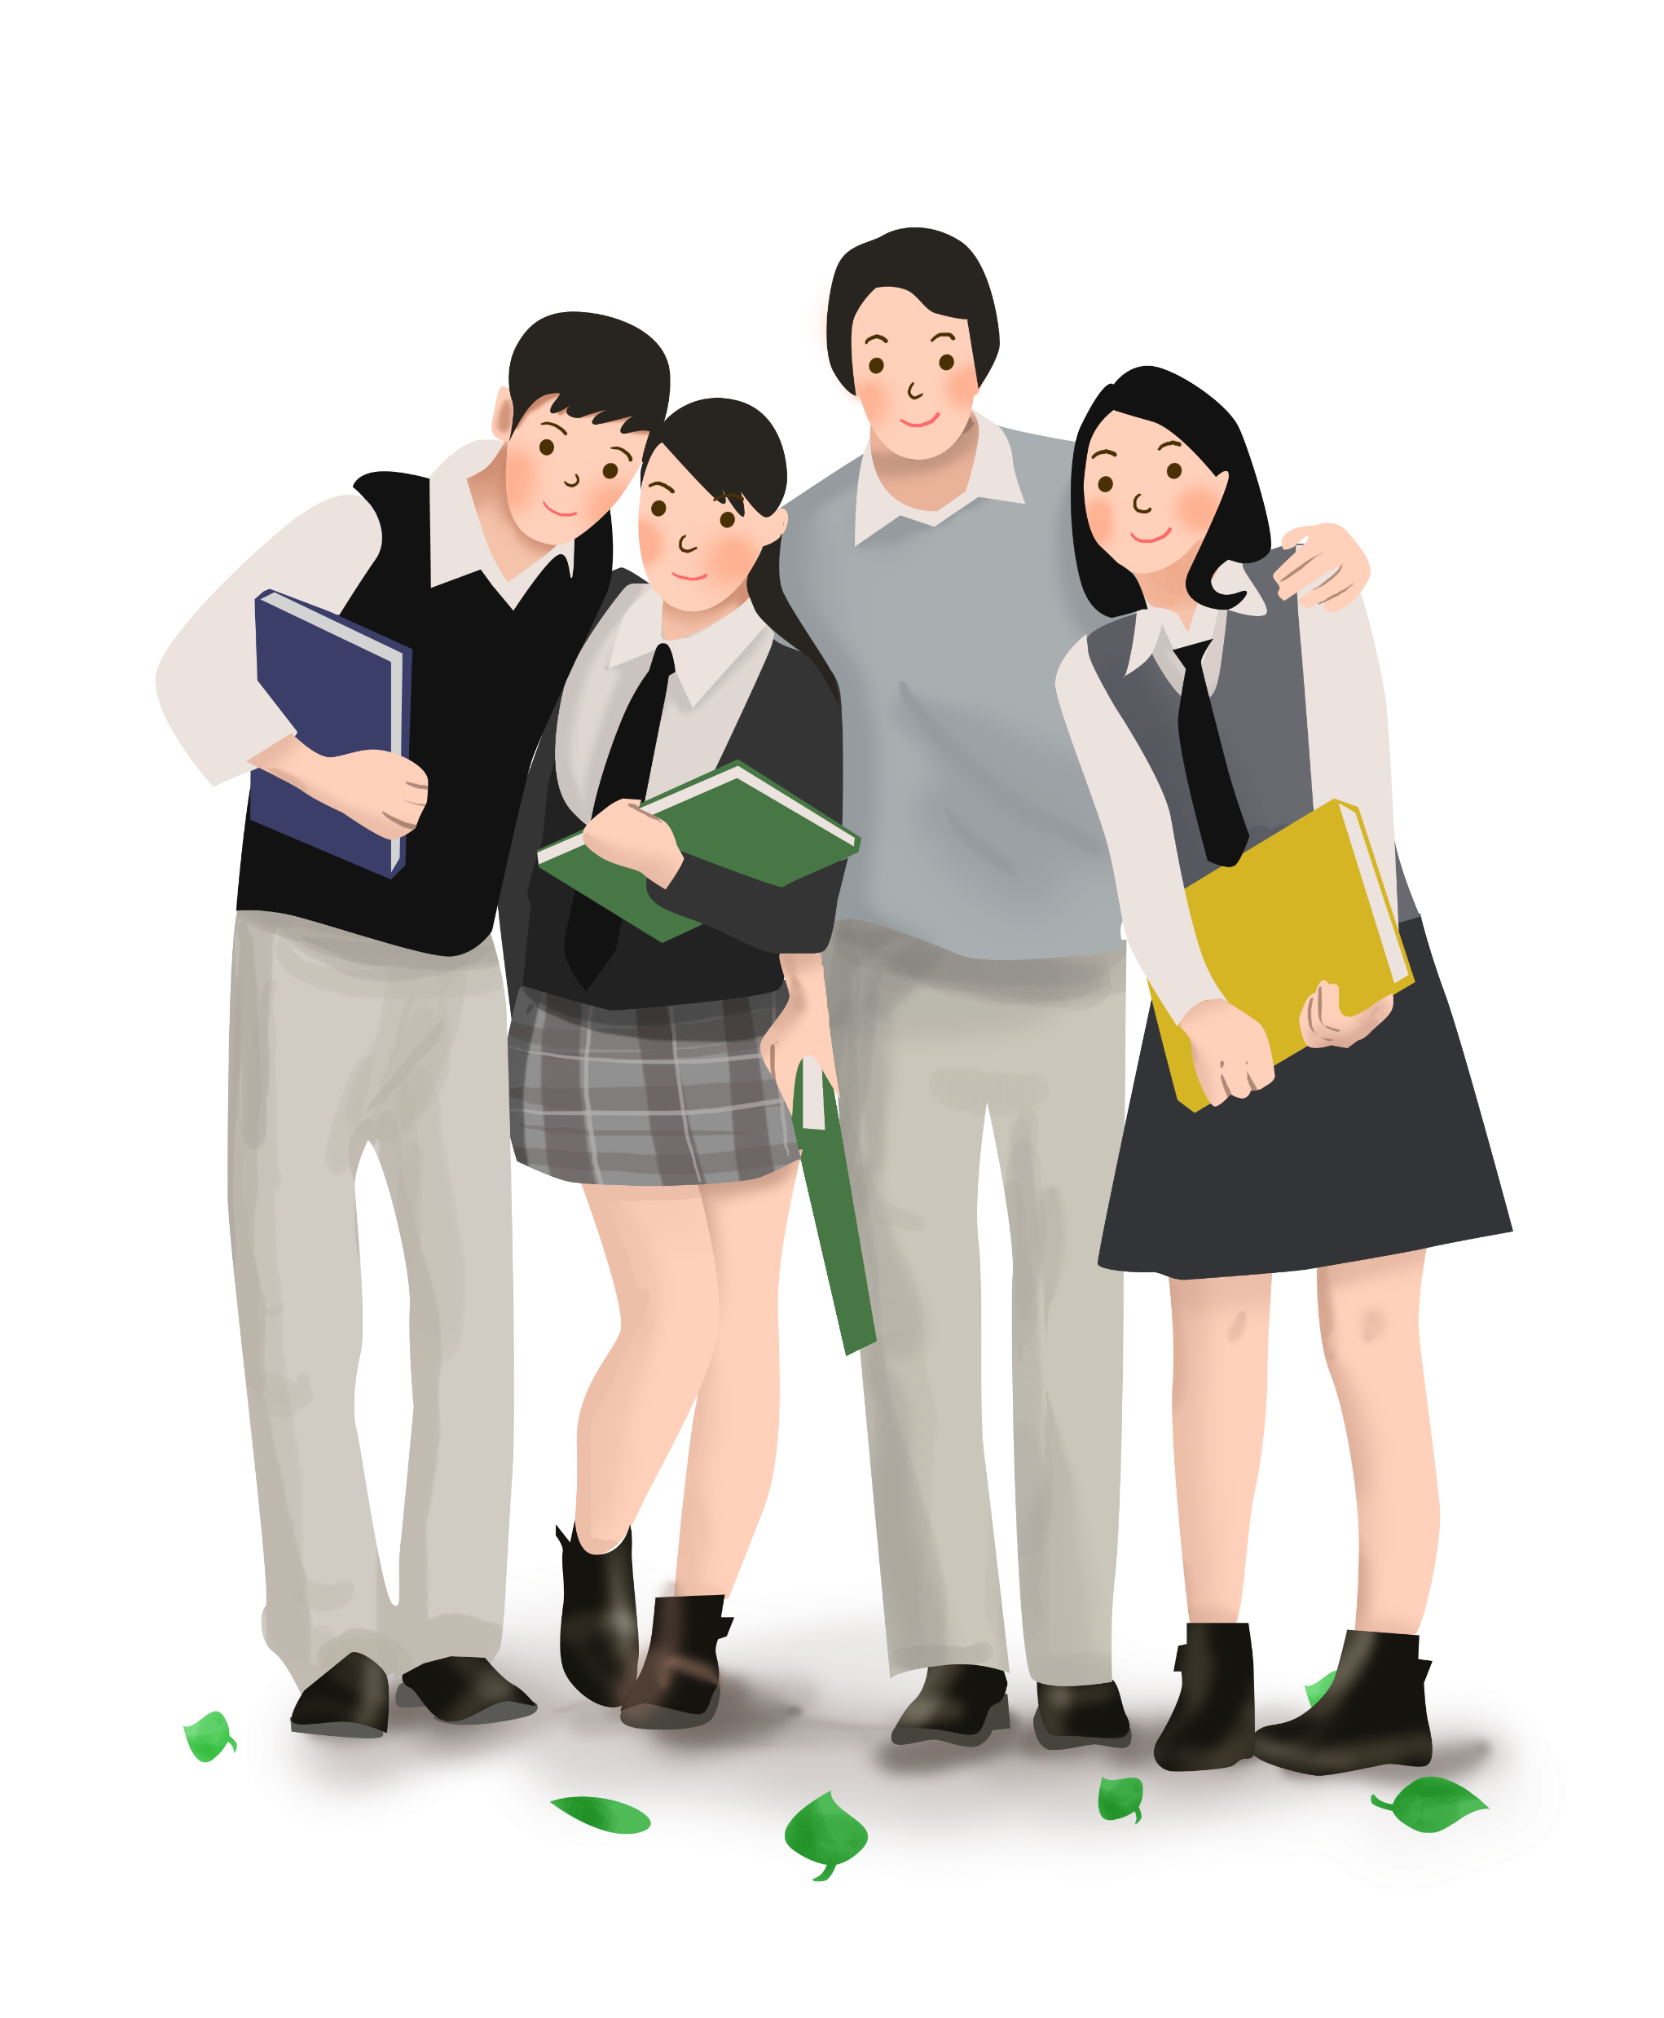

2021.4 绍兴二模 The Valentine Trick
continuation writing
—— How to reveal a character's real traits through observations and realization
浙江省春晖中学 龚金萍

Slide 3


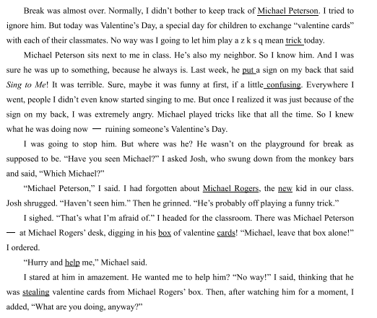

Slide 4
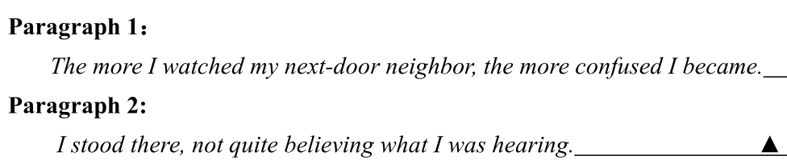

Slide 5
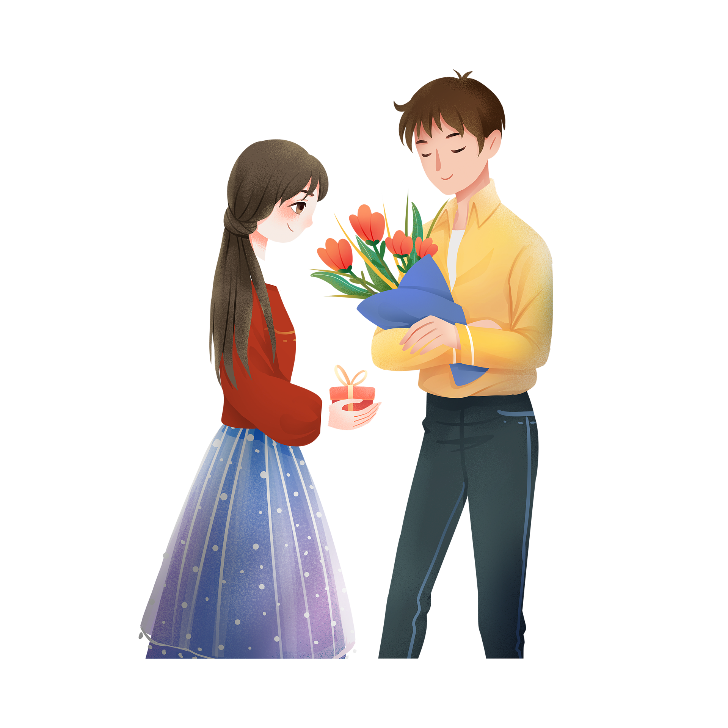
Guessing game
Valentine's day
falls on February 14th
Lovers celebrate it by giving flowers, candy and cards to those they love.
It's also an occasion for family members, friends or students to express their love for each other.

Slide 6
plot
Story
characters
setting

Slide 7
Read for setting
Today was ______________, a special day for ______________________________________
______________________________________
Valentine's Day
children to exchange “valentine cards” with each of their classmates.

Slide 8
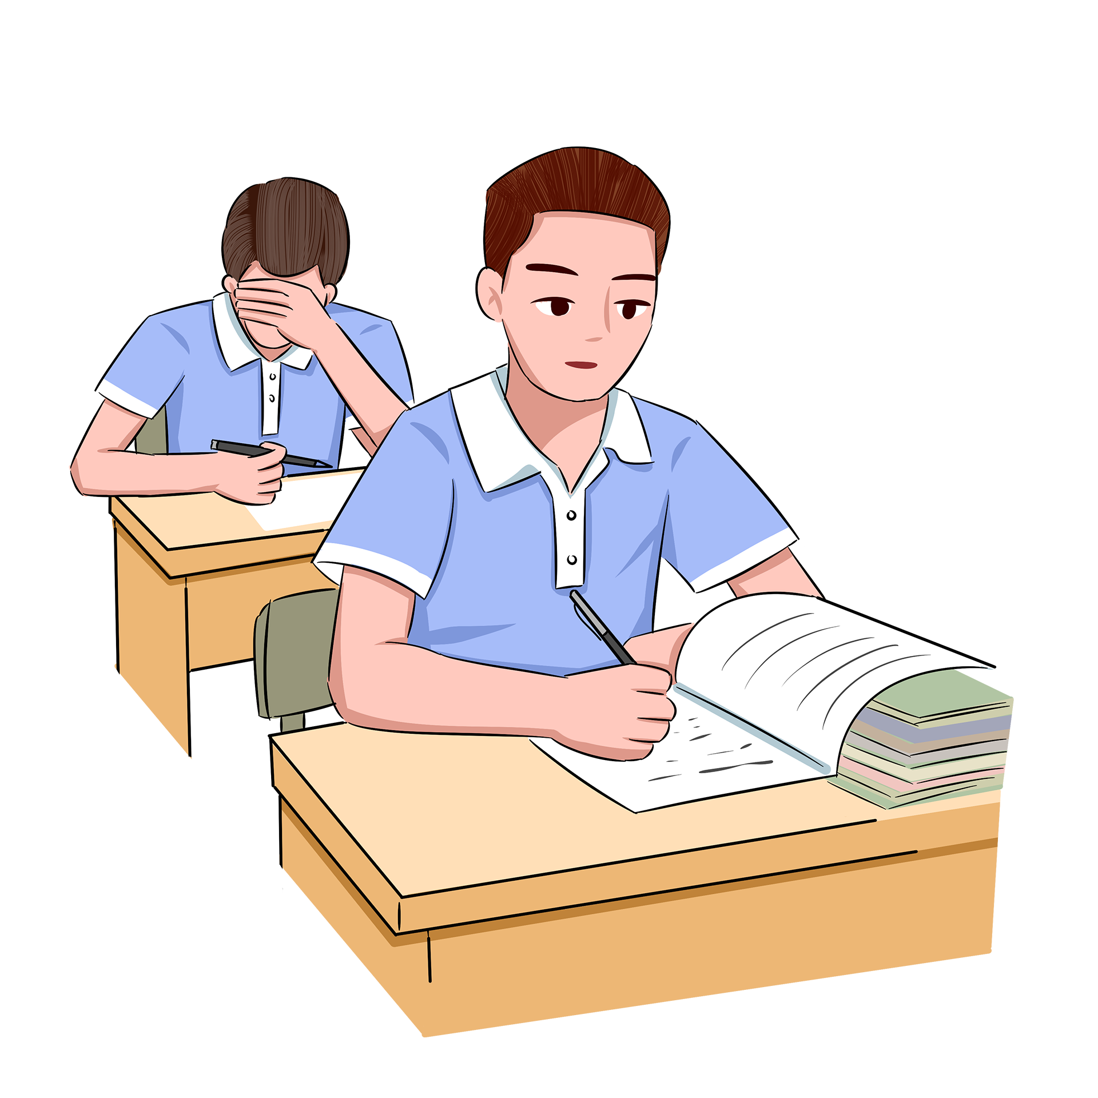
Read for characters
What are our relationships?
characters
description
character's trait
I
Michael Peterson
Josh
Michael
Rogers
No way was I going to let him play a mean trick today.
have a sense of justice
classmates
&neighbors
He played tricks all the time
naughty and annoying
classmates
the new kid in our class

Slide 9

Read for plot
I saw Peterson ____________
Climax
“stealing” cards!
There was Michael Peterson--at Michael Roger's desk, digging in...
prevent
him from ruining Valentine's Day
I searched for Peterson to ____________
No way was I going to let him play a mean trick today.
I held _______________ of Peterson
a bad impression
He played tricks like that all the time.

Slide 10
Was he really stealing cards from Rogers?
He played tricks like that all the time.(experienced)
“He's probably off playing a funny trick.”(heard)
There was Michael Peterson--at Michael Rogers' desk, digging in his box of valentine cards! (saw)
Is it possible that one's first impression, direct observation , or others’ opinion may be deceiving?

Slide 11

Read for theme
What does the author want to convey through the story?
my _____________ __ of Peterson:
he was ____________
misunderstanding
considerate
Scars will remain.
The school bully should be stopped.
Never judge a person too early.
...
my ____________ about Peterson:
he was ______________
new discovery
kind and friendly
my bad impression on Peterson：
he was naughty and annoying
正向结局

Slide 12


plot the ending
Para.1:
The more I watched my next-door neighbor, the more confused I become. __________________________________
Para.2:
I stood there, not quite believing what I was hearing.
___________________________________________
observation
realization

Slide 13
observation (a boy full of tricks)
见他继续在那里掏和拿卡片，我很怀疑地看着他, 质问他究竟在干吗。
As I was watching, he continued to dig, and fished cards out of the box. I cast him a suspicious look/ eyed him suspiciously, questioning him what on earth was he doing.
想起以前他对我的捉弄，我不相信地盯着他,
Memories of his mean tricks played on me _________ (rush) over me, I stared at him in __________.
rushing
disbelief

Slide 14
我很怀疑地上下打量他，一想到罗杰斯会被众人嘲笑我就非常生气。
I studied him __________________in___________, the thought of Rogers would _________________ by everyone making me feel _________.
from head to toe
suspicion
be laughed at
furious
我直勾勾地盯着他，只见他头也不抬地专注地在笨手笨脚摸找卡片。
I stared _________ at him： there he was, devoted to ______ cards in the box, without _______________ .
straight
fumbling
lifting his eyes

Slide 15
observation (a boy full of consideration)
__________________ of it, I strode forward, took hold of his arm, and dragged him back out of rage. But to my surprise, he explained he was _________________
____________________________________________
At the sight
sending cards to Rogers
instead of playing tricks on him

Slide 16

realization (a boy full of kindness)
我瞪大眼睛 吃惊地看着他写的一堆卡片, 突然觉得自己可能弄错了。
My eyes _________, and looked at the cards he wrote in _________. The thought that I might be wrong ________________ to me.
widened
wonder
occurred
我心里咯噔一下, 想到自己可能错怪他了。
With a jolt， I ________ that I ________________
a mistake.
realized
might have made

Slide 17
我往盒子里面 仔细看，果然有很多卡片。我就像被泼了一桶冷水，一下子就明白了。
I________inside and found loads of cards there as he
told.Understanding hit me like ___________________.
peered
a bucket of cold water
我逐渐才意识到他是在往里面放卡片而不是“偷”卡片。
Only gradually ___________ become ______ that
he was putting cards into it instead of stealing them!
did I aware

Slide 18
看到他真诚的眼神，我突然想到自己可能忽视他的善意。
It ________________that I might ______ to see his kindness.
struck/hit me
fail
我目不转睛地盯着他，内心涌起一股对他的欣赏。疑云消除，我赶紧跑过去帮助他。
I _______ my eyes _____ him steadily, a wave of sudden __________ rising inside. With my confusion ________, I rushed forward to help him.
fixed on
appreciation
dissolved

Slide 19
One Possible Version:
The more I watched my next-door neighbor, the more confused I became. Instead of taking valentine cards out of the box, he was putting them in. But whatever he did, I was sure it was wrong. I scolded him for picking on(欺负) the poor kid. Michael just kept working and denied playing a trick. He explained that he was the last person to pass out his valentines before break. When he got to Michael Rogers' box, he noticed it was empty. No one remembered to make the new kid a card. So actually he was giving him his cards. After all, the cards he received from classmates all said “Michael” on them.
I stood there, not quite believing what I was hearing. "You mean you're doing something nice?” I asked. “Of course. When haven't I been nice?" he teased. I blinked but gave no reply. I helped Michael to shake out his cards through the slot (扁口)in his valentine box. Then we stuffed(填满) the cards into Michael Rogers' box. I felt a mixture of embarrassment and satisfaction striking into my heart. Maybe I had misunderstood him and maybe he's even kind of sweet...in a hidden sort of way.

Slide 20
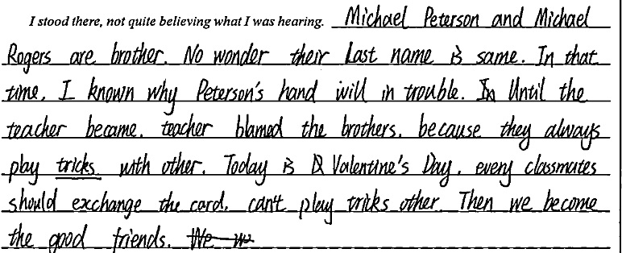

出现问题
关系搞混

Slide 21
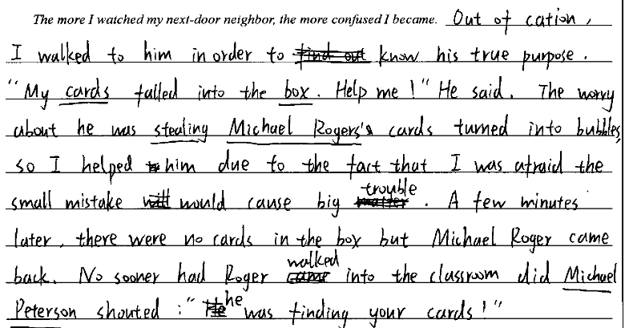
主要人物负面形象

Slide 22
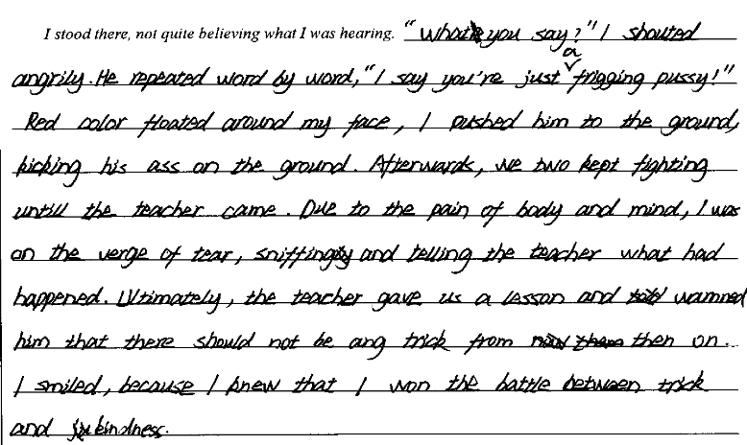
增加人物

Slide 23
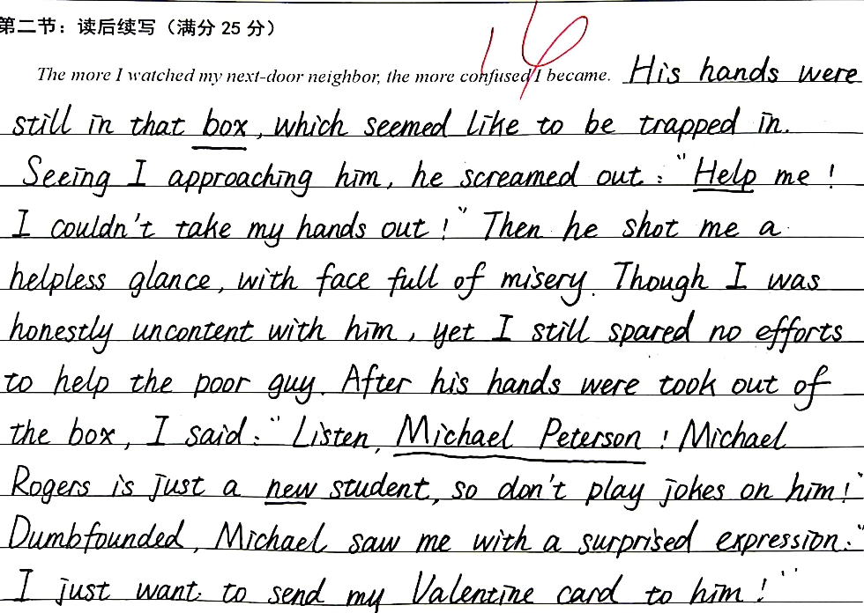
情节离奇

Slide 24
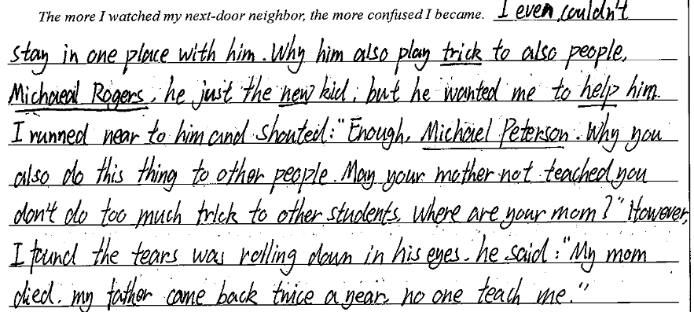
中式表达

Slide 25
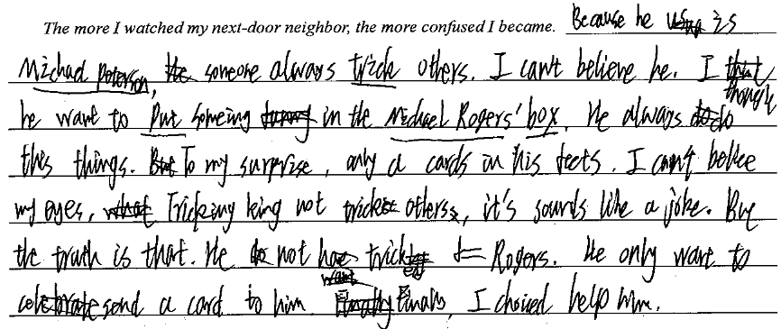
字迹不清

Slide 26
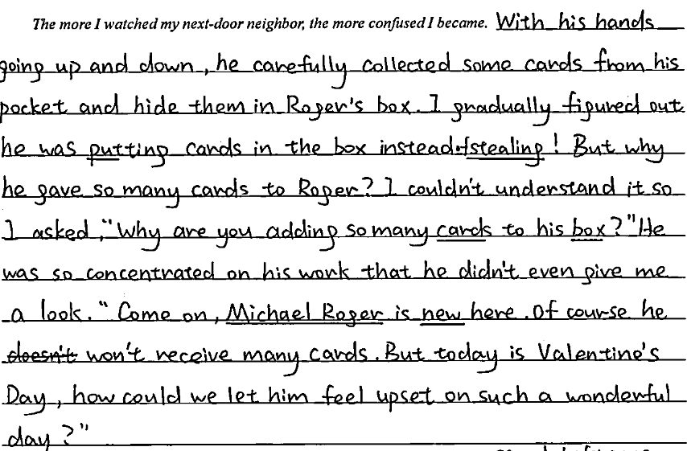
好文欣赏
hid

Slide 27
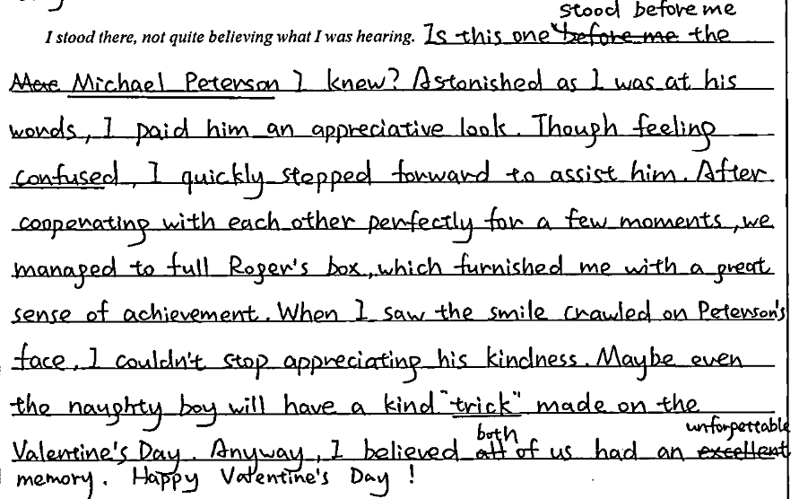
逻辑清楚
表达流畅
主题积极
fill
crawl

Slide 28
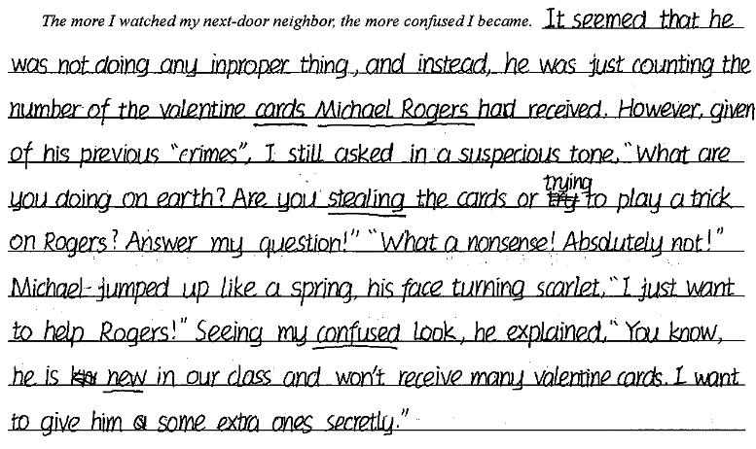
improper

Slide 29
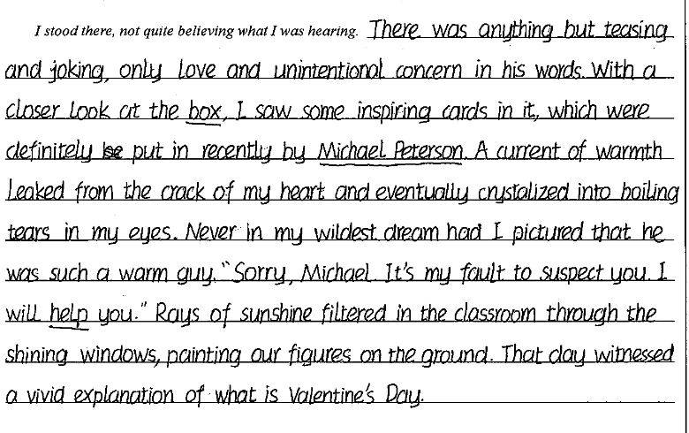
deep
使形成
表达自然
首尾呼应
（光等）透入

Slide 30
The end!

