Slide 1

感恩遇见，相互成就，本课件资料仅供您个人参考、教学使用，严禁自行在网络传播，违者依知识产权法追究法律责任。
更多教学资源请关注
公众号：溯恩高中英语
知识产权声明

Slide 2
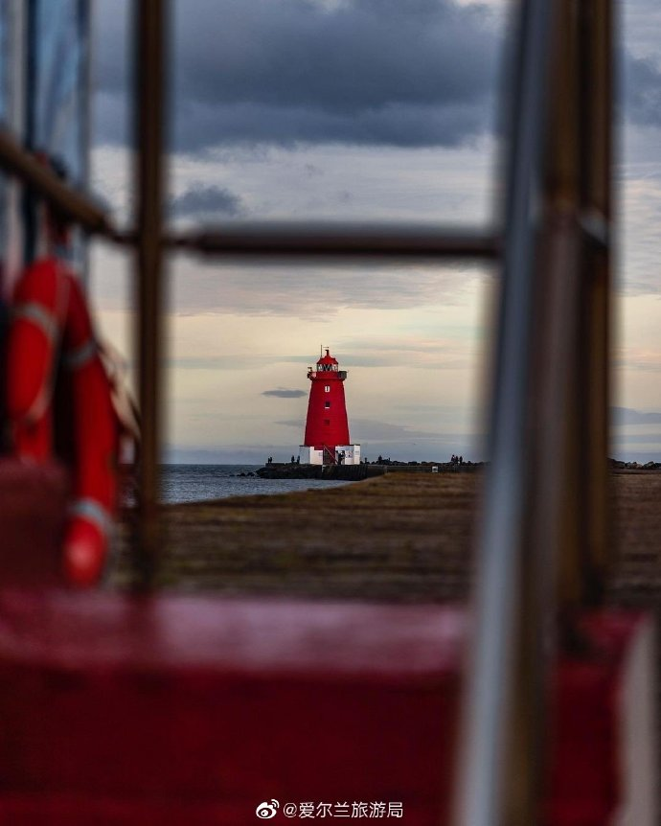

Describe a place
I like
-By Lily

Slide 3
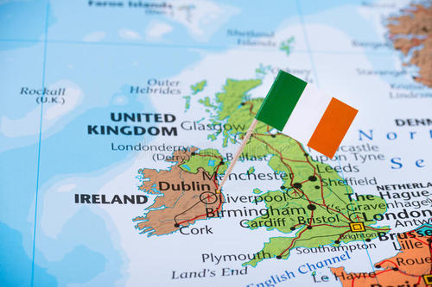
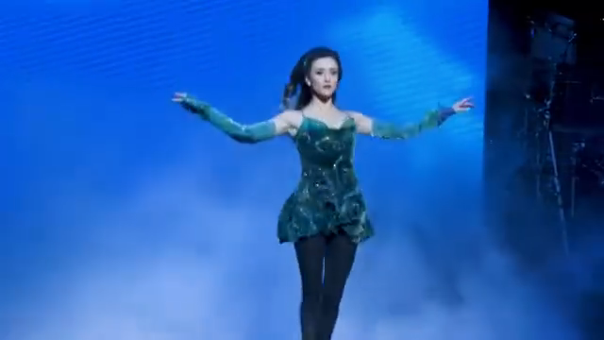
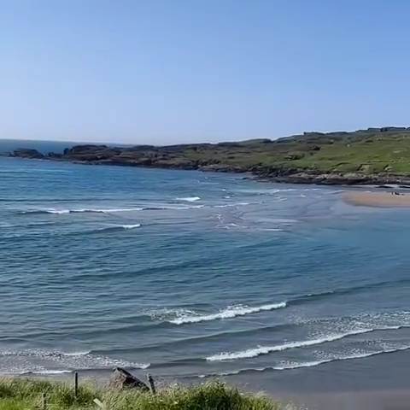
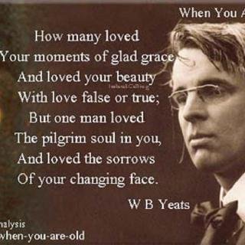
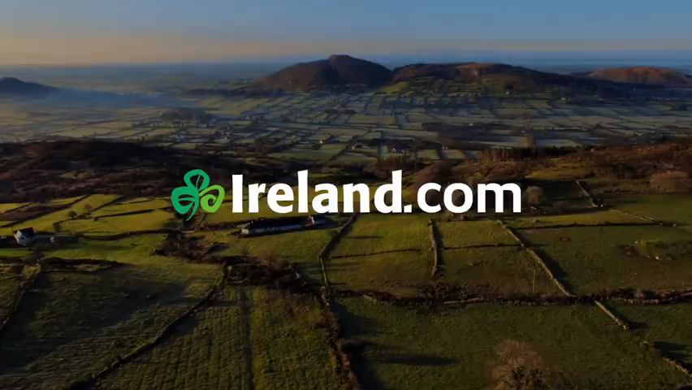
Guess: what’s the place I like?
Ireland
A Poet
the sound of waves;
green hills and grass land
traditional music and dancing
(tap dance)
W.B. Yeats

Slide 4
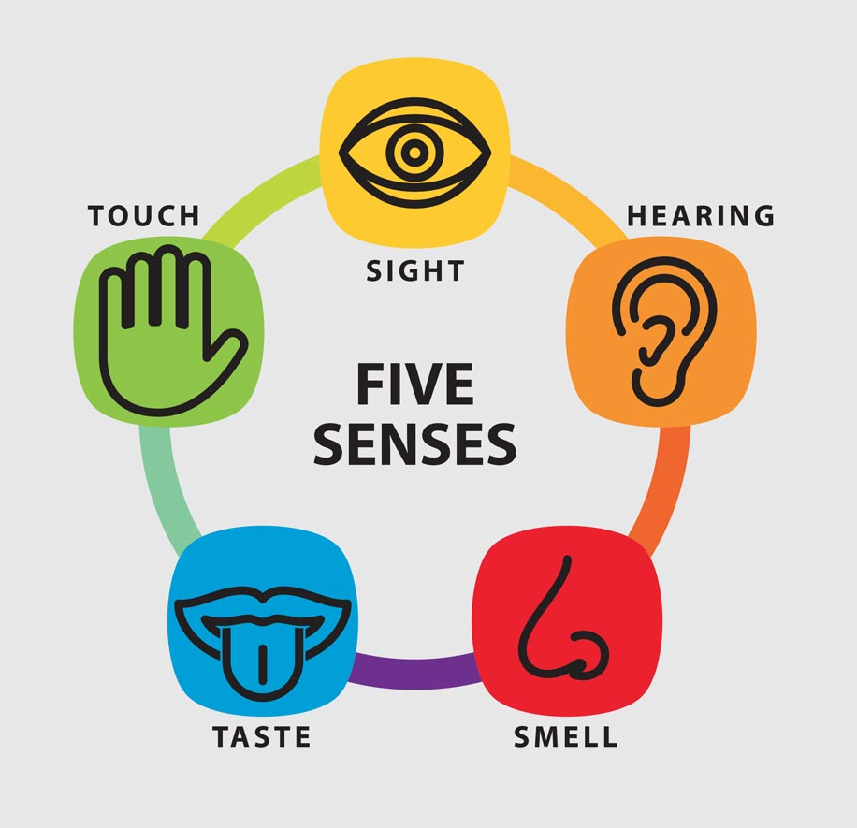
What’s the connection?
and
Beautiful Ireland and Its Traditions
Ireland’s beautiful countryside has always had a great influence on its people
and traditions. The country has a long history of producing great writers and poets. Its beautiful countryside excites and inspires all, offering something for each of the senses. The peaceful landscape of the “Emerald Isle” and its many green counties is a true feast for the eyes, with its rolling green hills dotted with sheep and cattle. And down by the sea, the roar of the ocean waves and cries of the seabirds make up the music of the coast. On a quiet morning in the mountains, feel the sun on your skin, and breathe in the sweet scent of fresh flowers while birds greet the new day with their morning song. With all this beauty, it is not surprising that Ireland has developed strong traditions that include music, dancing, and dining. To have a chance of experiencing this, stop by a village pub and relax with a glass of wine or a local beer. Better yet, enjoy a delicious traditional Irish Beef Stew. If you are lucky, you might be able to enjoy some traditional music and the dancing, too. And if you introduce yourself to a friendly face, you are more than likely to experience local culture and customs first-hand.
The country has a long history of producing great writers and poets.
Its beautiful countryside excites and inspires all, offering something for each of the senses. The peaceful landscape of the “Emerald Isle” and its many green counties
【
Beautiful Ireland
】
transitional sentence
flowers while birds greet the new day with their morning songWith all this beauty, it is not surprising that Ireland has developed strong traditions that include music, dancing, and dining. have a chance of experiencing this, stop by a village
【
】
Its Traditions

Slide 5
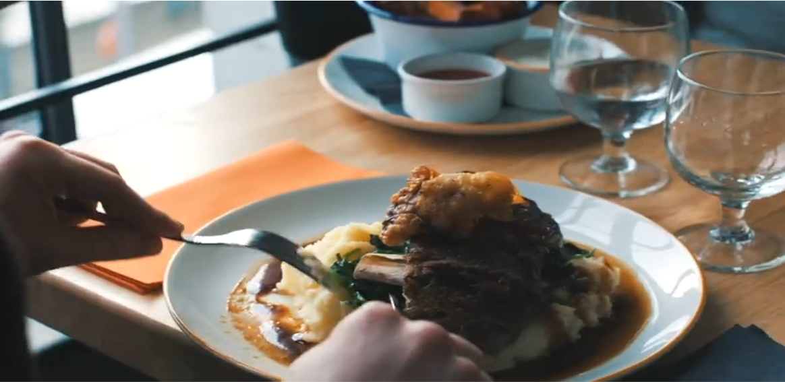
What can you get for five senses? In which place?
Taste& hearing
relax with a glass of wine or a local beer;
enjoy traditional Irish Beef Stew,
music and dancing
relax with a glass of wine or a local beer;
enjoy traditional Irish Beef Stew,
music and dancing
touch &smell
feel the sun on your skin, and breathe in the sweet scent of fresh flowers while birds greet the new day with their morning song
feel the sun on your skin, and breathe in the sweet scent of fresh flowers while birds greet the new day with their morning song
sight
hearing
the roar of the ocean waves and cries of the seabirds make up the music of the coast
a true feast for the eyes, with its rolling green hills dotted with sheep and cattle
the roar of the ocean waves and cries of the seabirds make up the music of the coast
a true feast for the eyes, with its rolling green hills dotted with sheep and cattle
place
green counties
down by the sea
in the mountains
a village pub
metaphor（暗喻）;
specific words
metaphor& personification（拟人）
personification;
specific words
specific examples
Which description impress you most? Why？

Slide 6

East or West, Home is the best.
Beautiful and Slow-pace Changshan

Slide 7
Changshan is a beautiful and slow-pace city.
general
How to make the description more detailed and vivid?
-add sensory details
-use specific words
-use figure of speech(修辞)
-add specific examples
How to organize the description?
-time order or spatial order
detailed
-transitional sentence and words

Slide 8
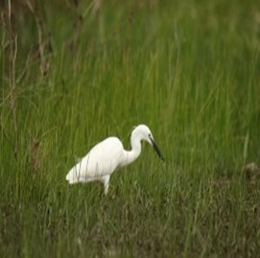
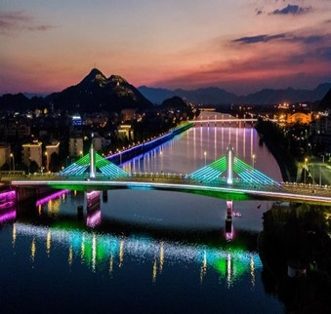
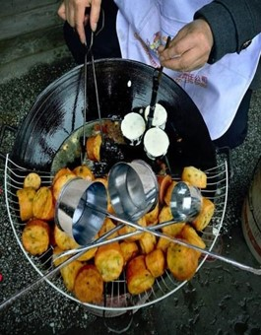
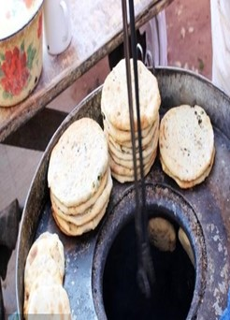
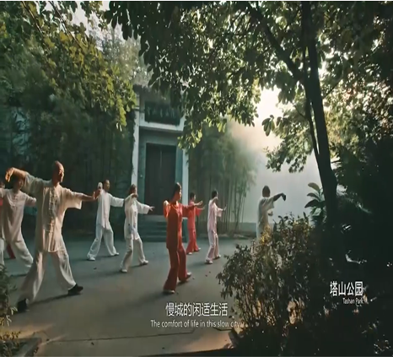
What can we experience in Chanshan?
sight &hearing
taste &smell
Sight
sight &touch
countryside
street food stand
In the Tower Park
At night by the Changshan river,
specific words
the green field
dotted white egrets
spicy but tasty fried buns and roast buns of local flavor（风味）
People who are doing Taiji down Wenfeng Tower
People ；
Wenfeng Tower
the blinking colourful light;
breeze (微风);
the purling sound of stream;潺潺溪水声
Metaphor(比喻)& personification（拟人）

Slide 9
Writing and Sharing
Is the writing well-organized and what order does the writer use?
2. Is the description detailed and vivid?
What words or sentences impress you most and why?
3. Can you find any grammar mistakes?

Slide 10
One Sample
Changshan, located in the western Zhejiang province, is a beautiful and slow-pace city. The beautiful and peaceful landscape offers something for different senses. In the morning of the countryside, the green field is dotted with white egrets. The tweets of the birds and the purling sound of the clean stream make up the song of nature. On the street of downtown, you will be stopped by a street food stalls（摊子） for its scent of local fried buns and roast buns. Not far away is the tower park. Down of it, you will find people who are doing Taiji. If you are interested, you can join them and experience the mix of history and tradition. At night by the Changshan river, the blinking colorful lights are scattered(散落) on the surface of the river. With the breeze from the river touching your cheek, you can enjoy the view and feel the slow-pace life .
Notes:
1.第一句话后面少个名词。2.这三处的衔接关系可以再考虑一下。

Slide 11
Homework
To finish and polish the description of Changshan by adding proper ending.
You can describe a place you like.

Slide 12
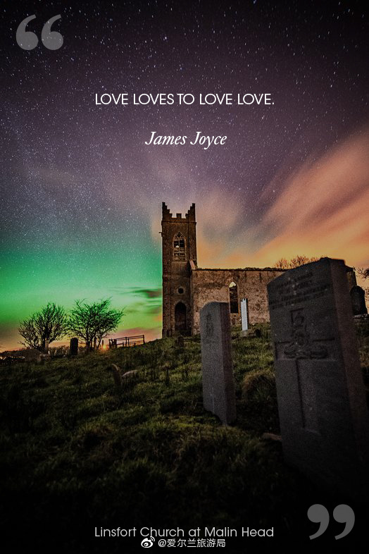
Slow down, take a deep breath and find the beauty around you!
Thank You!

