Slide 1


感恩遇见，相互成就，本课件资料仅供您个人参考、教学使用，严禁自行在网络传播，违者依知识产权法追究法律责任。
更多教学资源请关注
公众号：溯恩高中英语
知识产权声明

Slide 2
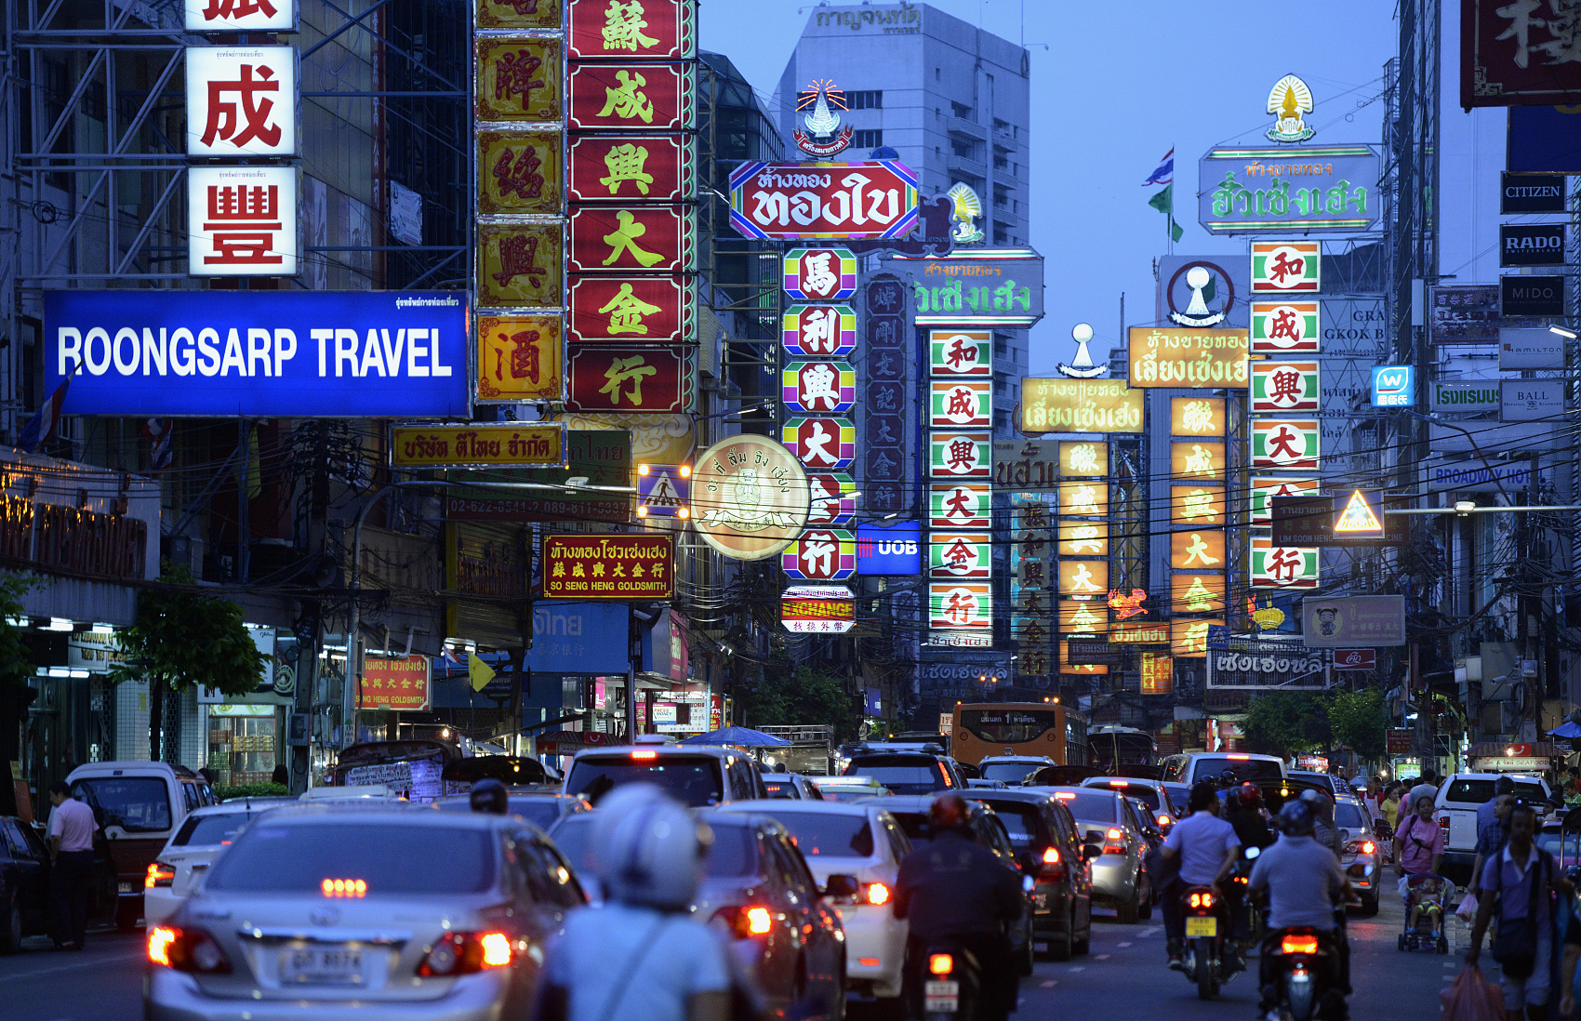
B3U3 Diverse Culture
Listening and Speaking
-By Lily

Slide 3

What is American food?

Slide 4
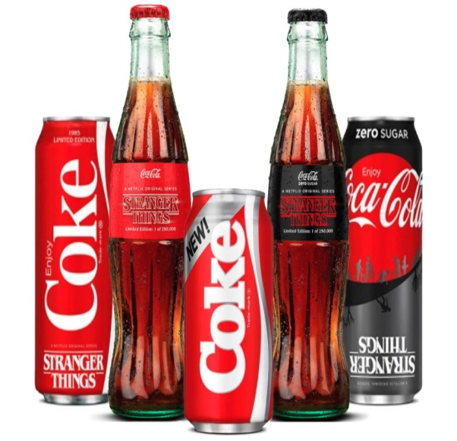
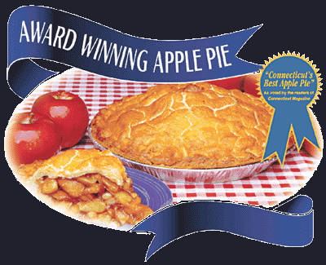
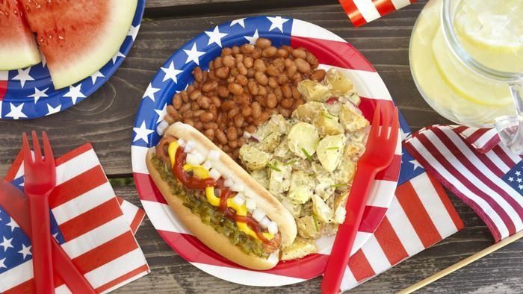
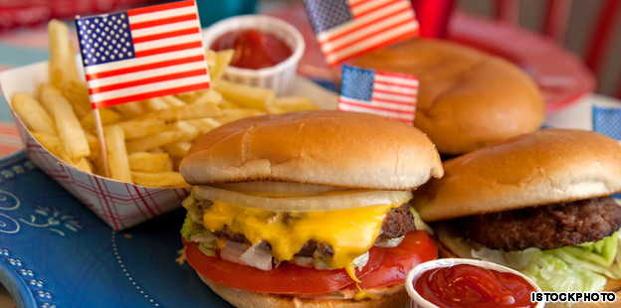
Lead in
What kind of American food have you ever eaten?

Slide 5
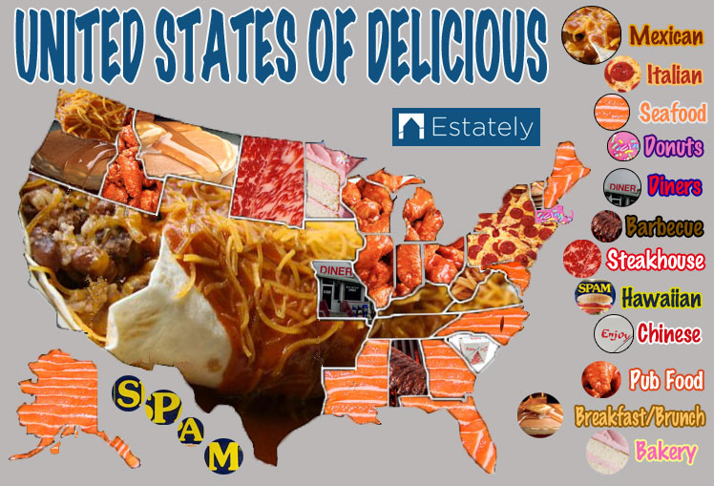
Q: What can you find in the map?
Lead-in
various and mixed food

Slide 6
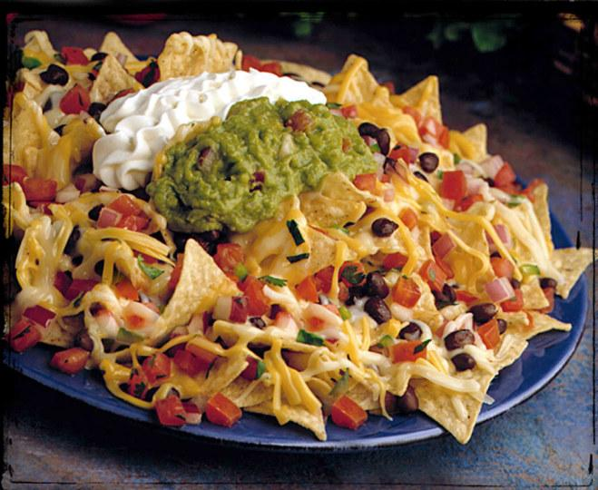
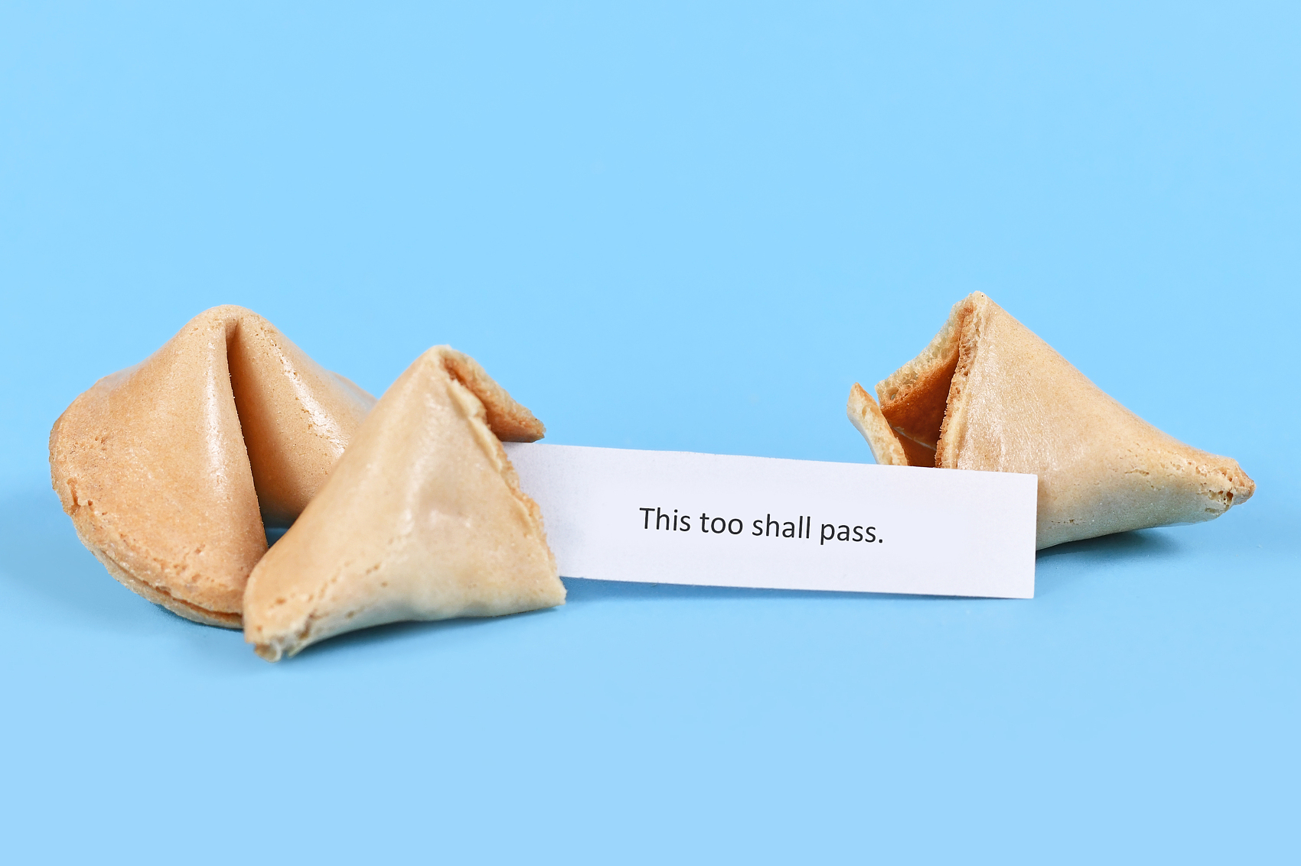
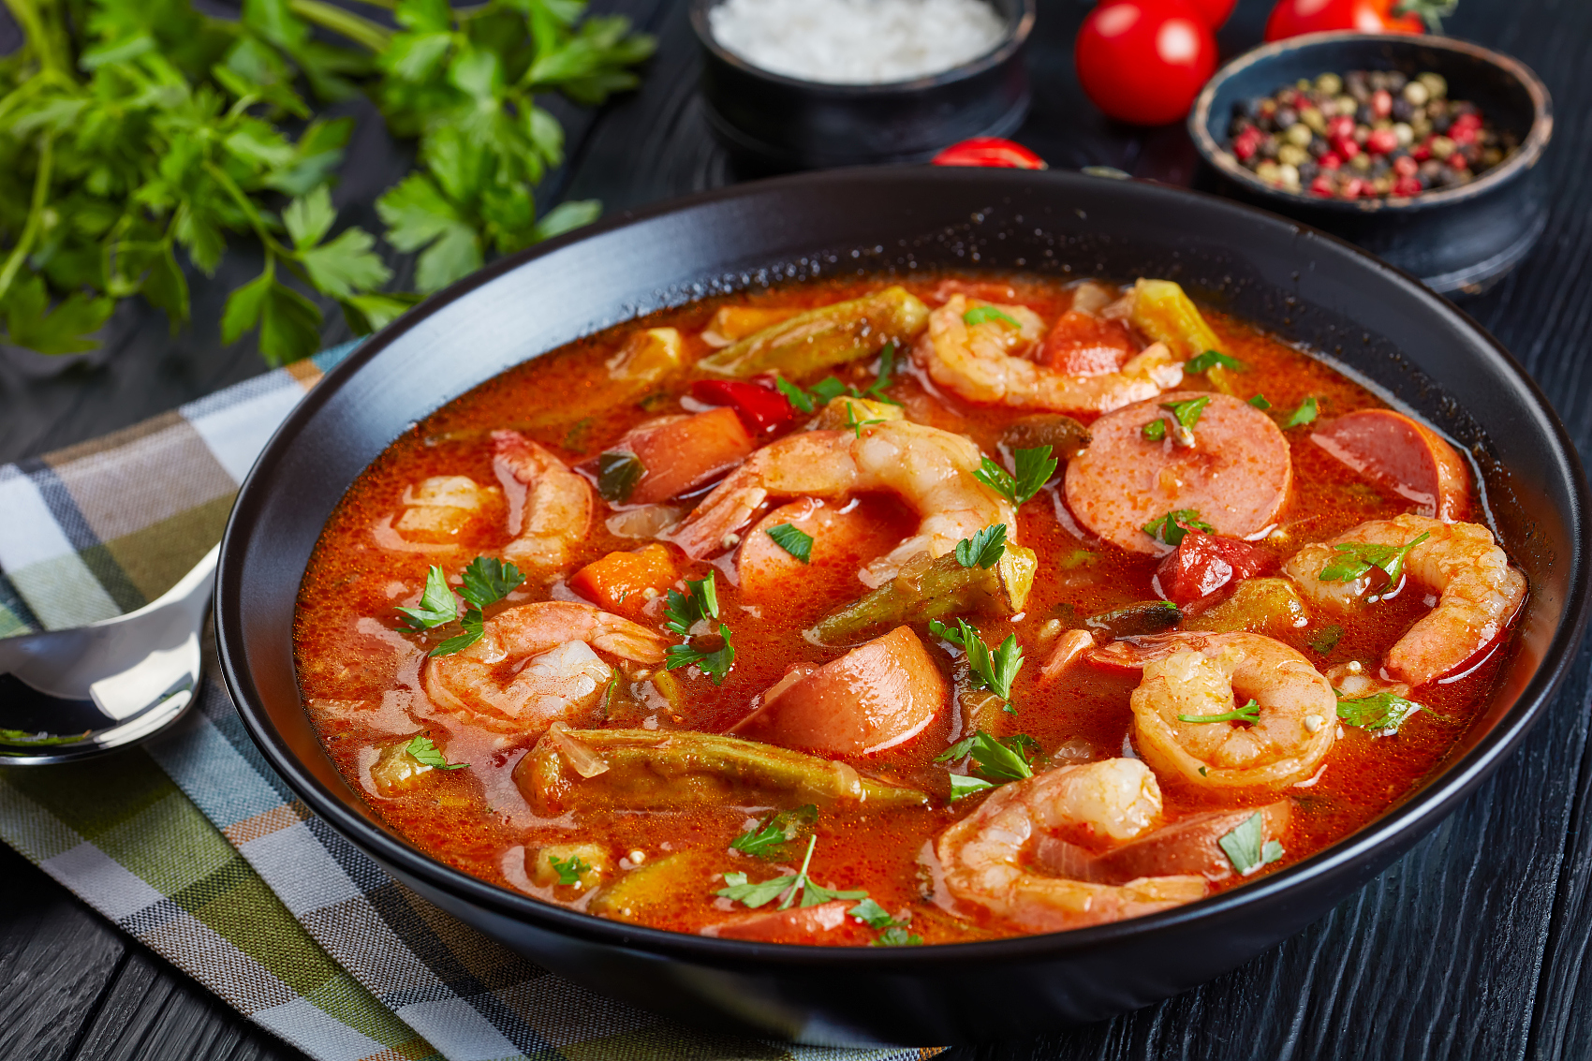
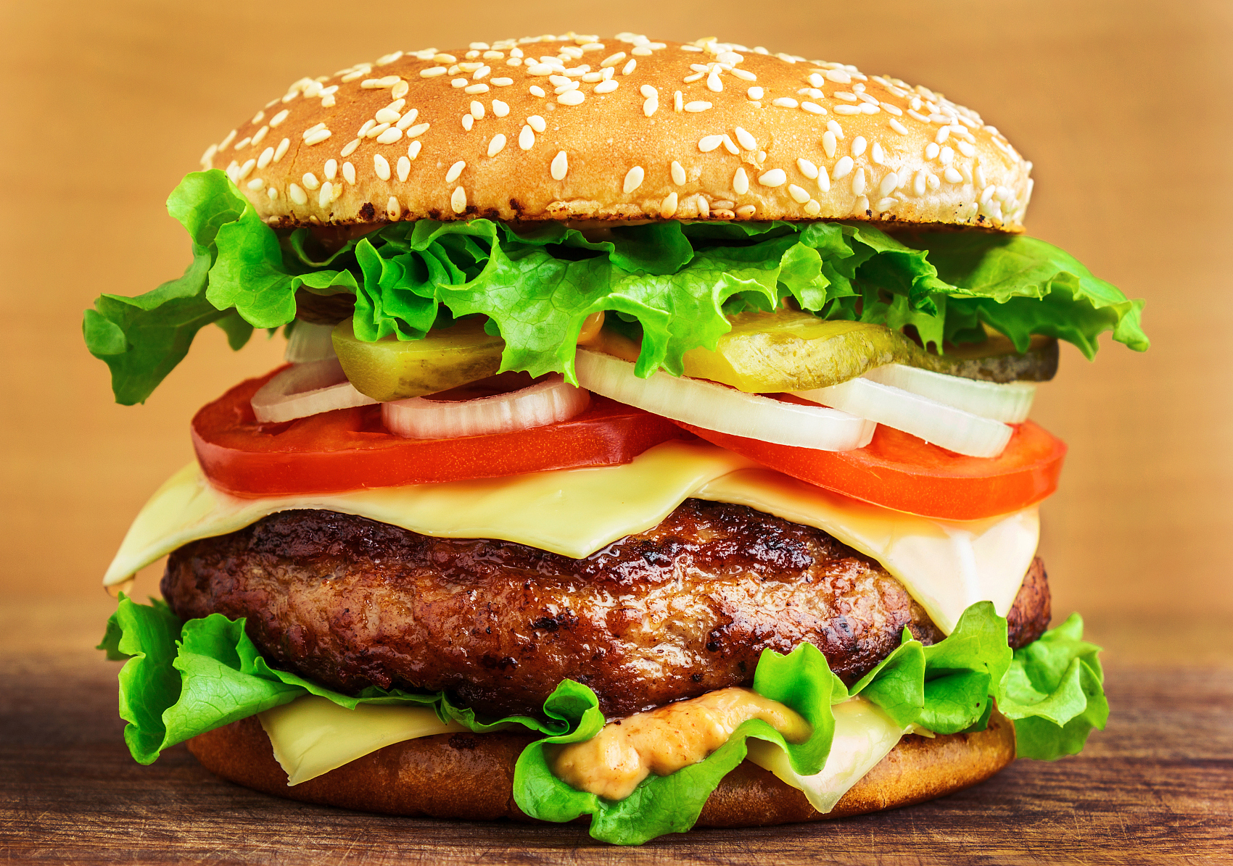
Pre-listening
Match the photos with the descriptions of these food.
A
1. small pieces of thin crisp chips served with beans.
B
2. a crisp hollow cookie containing a piece of paper with a short message on it.
C
3. a thick seafood soup, a spicy stew.
D
4. a sandwich containing cooked meat and some vegetables in a bread roll.
nachos
A
fortune cookie
B
gumbo
C
hamburger
D

Slide 7

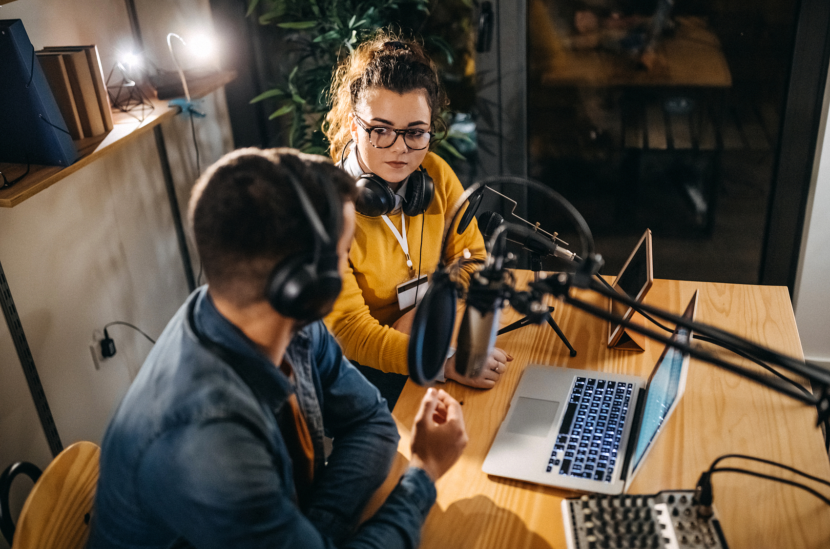
Listening for main idea
The ___________ takes place in________________(where)
between ________and __________(what relation) ,Steve Fox, and they are talking about _______________________________________(what)by giving
examples :___________，_______, _____________and _______.
interview
a radio studio
the host
the guest
the cultural influences of American food
hamburger
nachos
fortune cookie
gumbo

Slide 8

Listening for details
Decide whether the statements are true (T) or false(F).
1. No food was ever invented in America.
2. Hamburgers were invented in Germany.
3. Nachos were invented for Americans by a foreigner.
4. Every Chinese restaurant in America has fortune cookies.
5. American cooking often mixes things from around the world to make something completely new.
F
F
T
T
T

Slide 9

Listening while taking notes
How to take notes: Just write down the key words, such as names, dates, and numbers.
Omit all articles(a, an, the) and use abbreviations. For example, use “N.O.”for New Orleans, “bc” for because, “yrs” for years, “+” for and, and so on.
Names of food | notes
Hamburger | Mix of________ + __________ cultures
Nachos | ____________ chips covered in cheese Made by _________ cook for_________________
Fortune cookie | Invented in_________ about ______ yrs ago A piece of _____ with ______ on it inside cookie
Gumbo | Spicy stew Invented in N.O about _____ yrs ago Mixes ______ , _______ , ______________ , + Spanish cooking
German
American
Mexican corn
Mexican
American customers
San Francisco
100
paper
fortune
200
French
African
Native American

Slide 10
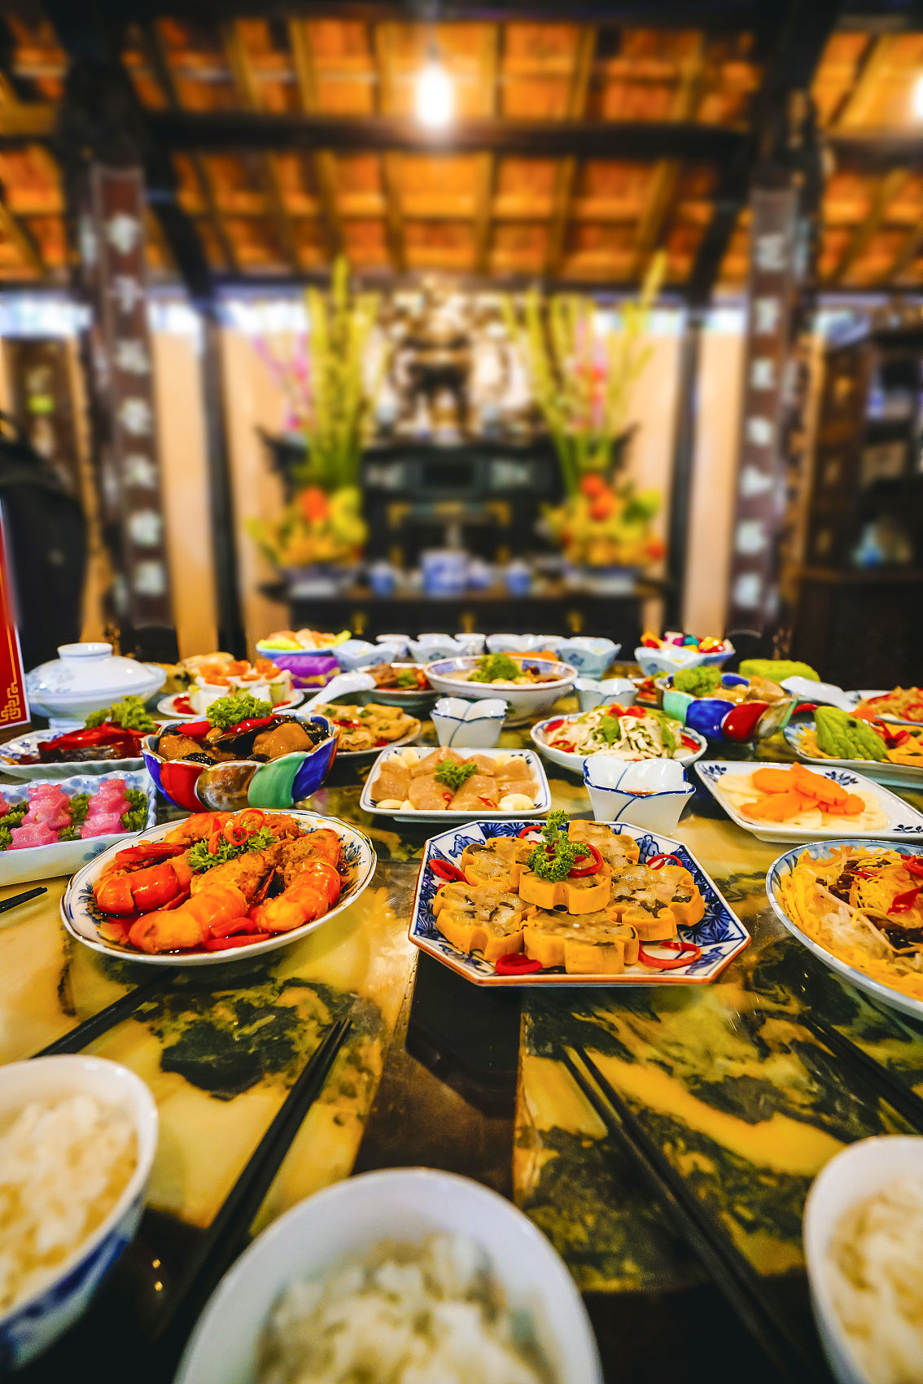
Critical thinking
What does American food show?
mixed cultures
What does food show?
diverse origins
diverse people
diverse cultures
the beauty of the world

Slide 11

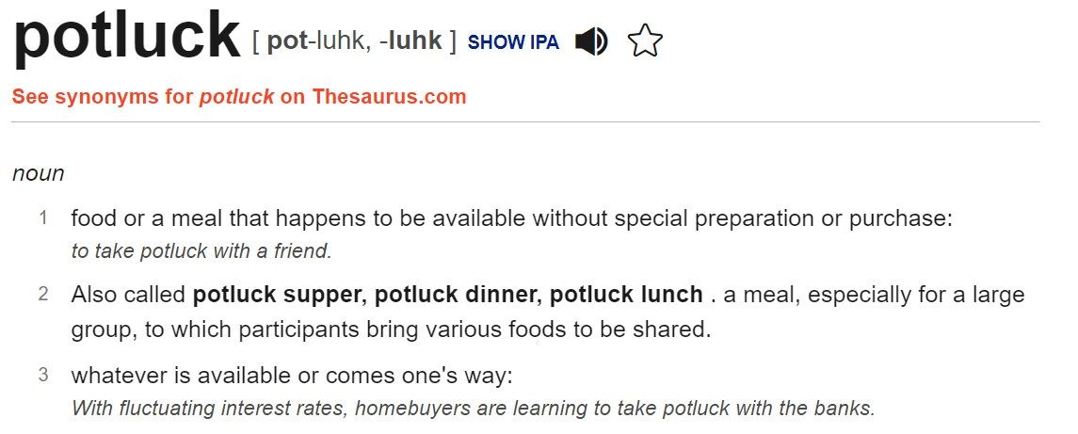
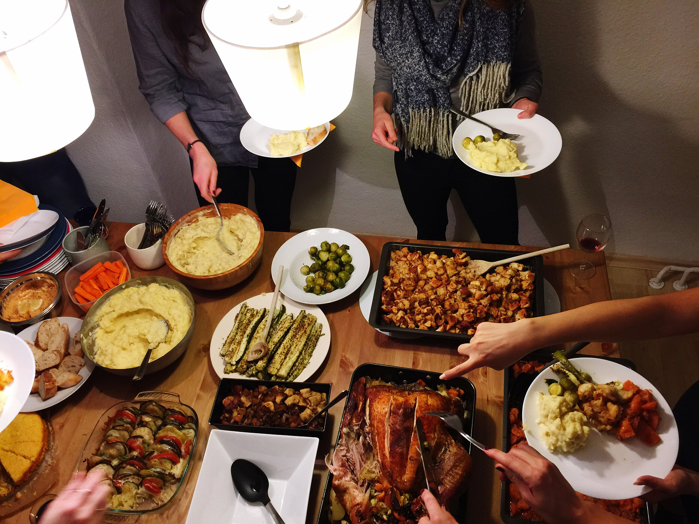
Post-Listening
Join in a Potluck Dinner
IMAGINE you are invited to a potluck dinner at an American friend’s house.
Work in pairs to role-play a dialogue about what special dishes you will take.
(One student plays the role of the guest invited, and the other plays a friend who gives suggestions.)
The following questions may help you.
1. What food or snack from which area/ethnic group will you bring?
2. How is the food prepared and what is it made of?
3. How is the food special?

Slide 12
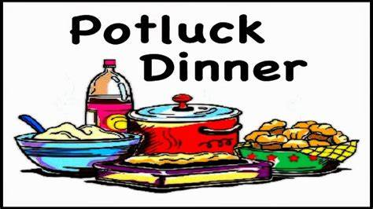
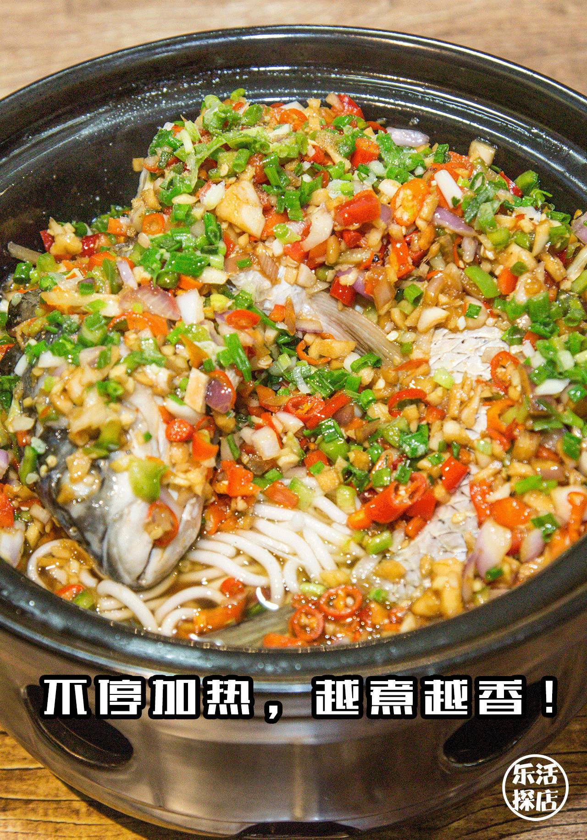
Sample conversation
A: What should I bring to the potluck dinner this weekend?
B: Why don’t you make a dish from your hometown?
A: You mean a Quzhou dish?
B: Yeah, why not? I bet they’d love it!
A: Well, I guess I could make Quzhou Fish Head with Diced Peppers and Quzhou Fengan,a kind of local noodles made of rice. It’s delicious and really unique.
B: Sounds interesting. Can you make that dish?
A: Of course! You just need a fish head, peppers and noodles. Then, spoil it.
B: Sounds so easy! You could make it at your friend’s house. That way it will be fresh.
A: Great idea! I’ll ask my friend.

Slide 13
Thank you
The beauty of the world lies in the diversity of its people.

