Slide 1

感恩遇见，相互成就，本课件资料仅供您个人参考、教学使用，严禁自行在网络传播，违者依知识产权法追究法律责任。
更多教学资源请关注
公众号：溯恩高中英语
知识产权声明

Slide 2
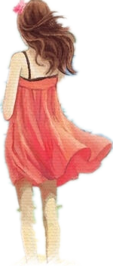
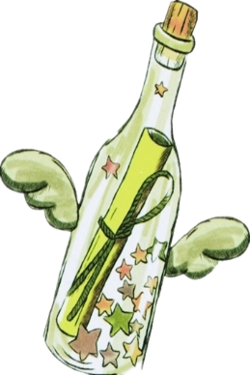
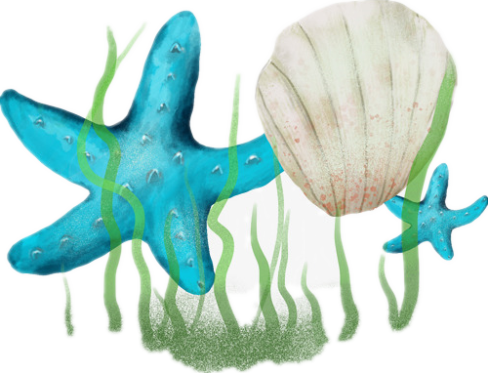


2021.4 杭州二模英语读后续写: 偶遇漂流瓶
临平区杭州二中树兰高级中学 郭合英

Slide 3
第二节读后续写(满分25分)
阅读下面短文，根据所给情节进行续写,使之构成一个完整的故事。
It was on September 5th, my birthday, that we left Cambridge and moved away. We went to the seaside, to our holiday house, which was now to be our permanent home.
I remember the day was cold and grey, with a light rain falling slowly but constantly. My father drove in silence. No one spoke and all we could hear was the sound of the tyres on the wet road.
When we got to the small house near the sea, my mother quietly started to unpack the few things we had brought with us. Carol, Julie and I went down to the beach. We said we were going to look for crabs in the rockpools but actually , we just wanted to get away from our father and his silence.
We climbed along the rocks by the side of the beach. Julie and Carol became interested in some shells they found in one of the pools. I wandered away, lost in my private thoughts. It was my birthday, but no one had said " Happy Birthday" to me. I had not received any cards or presents.

Slide 4
I walked down to the seashore, where the waves were breaking lazily against the muddy sand. Suddenly, I saw something green sticking out of the water. I looked at it more carefully. The green thing moved closer and closer to the shore, and when it was almost near enough for me to touch, I realized what it was.
It was a bottle. I went over and picked it up, all the time looking at it. It seemed old, and had no label on it. Then 1 realized there was something inside. Slowly, I pulled out the wet cork from the top of the bottle. Inside was a piece of paper. With great care, I took out the folded paper and opened it.
Written on it were these words:
“To whomsoever finds this bottle, I promise you a new friend.
Paragraph 1
I stared at the paper and then looked around. ________________________________
Paragraph 2
As I opened my eyes, I found my father standing right beside me. _______________

Slide 5
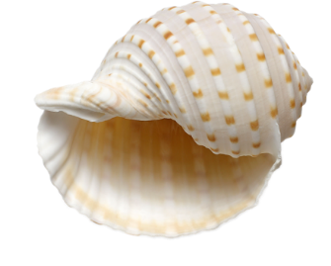
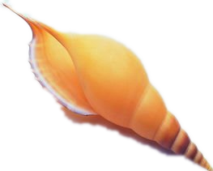
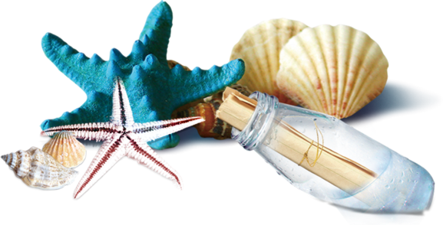
Text interpretation:
Filling the blanks with grammatical knowledge
On my birthday, that’s was September 5th, we family left Cambridge __1__ our holiday house near the seaside, 2 was now to be our permanent home. With a light rain falling slowly but 3 (constant), my father drove in silence, none 4 (speak). When we got there, with the aim of avoiding the father and his cold silence, Carol, Julie and I went down to the beach. They were immersed in some shells 5 (find) in one of the pools while I wandered away, 6 (lose) in my private thoughts with the feeling of a little lose due to no birthday blessings or gifts. In a sudden, I saw something green 7 (stick) out of the water. Not until it was near enough for me to touch 8 I know it was a bottle. 9 (realize) there was something inside, I pulled out the wet cork from the top of the bottle with care. Inside 10 (be) a piece of paper, reading
“To whomsoever finds this bottle, I promise you a new friend”. I stared
at the paper, looking around┄┄
for
which
constantly
speaking
found
lost
sticking
did
Realizing
was

Slide 6

In the fourth paragraph, “I wandered away, lost in my private thoughts.” , here private thoughts means _____ .
A. Julie and Carol didn’t play with me together.
B. I wanted to pick a bottle.
C. Not receiving any cards and birthday gifts, I was a little unhappy.
D. I wanted to make a new friend.
2. Which of the following is true?
A. The mother was wrapped up in making a cake in the house.
B. I saw the bottle the moment I reached the seashore.
C. We talked and laughed when my father drove due to our holiday.
D. To keep away from father’s silence, Julie and Carol went to the seaside, searching
for crabs.
3. After I picked up the bottle, ______ .
A. I pulled out the wet cork quickly. B. I just found it was very new.
C. I found there was label on the bottle. D. I found there was something in the bottle.
4. According to the article, what was the father like?
A. kind B. serious C. out-going D. humorous

Slide 7
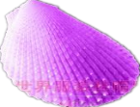
I picked up a bottle near the seashore accidently, saying┄
2. Clarify the context of the article
mother, father, Carol, Julie and I
how
who
I was unhappy because I haven’t received any cards and gifts for my birthday.
Elements of
the story
in our holiday house near the seaside
why
where
on September 5th, my birthday
It was my birthday, but my father and mother kept silent.
when
what

Slide 8
3 Personality analysis
The development of the story should be in line with the persona, which can pave the way for the subsequent development of the story. Therefore，it is important for you to analyze the traits of each person.
We can learn about the traits of each character according to what he/she says and does, using some adjectives to describe.
persons | traits
Dad
Mom
I
Carol, Julie
My father drove in silence. No one spoke; We said we were going to look for crabs in the rockpools but actually , we just wanted to get away from our father and his silence.
strict, be serious in speech and manner (不苟言笑)
Mother quietly started to unpack the few things we had brought with us.
reticent（沉默寡言的）, hardworking
gloomy(悲观的;郁闷的),cautious
I wandered away, lost in my private thoughts.
With great care, I took out the folded paper and opened it.
light-hearted (无忧无虑的)
Julie and Carol became interested in some shells they found in one of the pools.

Slide 9
4. Sentiment analysis
It was on September 5th, my birthday.
My father drove in silence.
My mother quietly started to unpack the few things we had brought with us.
disappointed
expected
Could she find a new friend?
I wandered away, lost in my private thoughts.
sad
surprised + expected
It was a bottle. I went over and picked it up, all the time looking at it.
Written on it were these words: “To whomsoever finds this bottle, I promise you a new friend.
curious

Slide 10
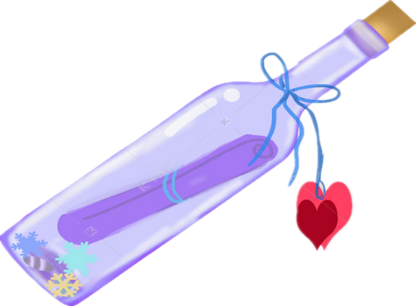

5 Story Mountain
Events
A. We three children searched for
crabs with the aim of avoiding
facing my father and his silence.
B. On September 5th, we left
Cambridge for our home near the
seaside.
C. I stared at the paper and then looked
around. ┅
D. As I opened my eyes, I found my
father standing right beside me. ┅
E. I wandered away when I found a
bottle with a piece of paper, reading
it will promise me a new friend.
Climax
E
This is when the problem reaches a high point.
Rising Action
Falling Action
c
This includes the events leading up to the main problem or conflict.
This is when the characters work to solve the problem or conflict.
A
D
B
Background
This is how things end up in the story.
This includes the introduction of characters and setting.
Resolution

Slide 11
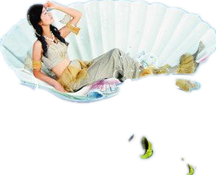
6 To infer the story with backstepping method
①根据原文已知情节和第二段开头的给出句，找出里面的关
键词（关键信息），合理推出第一段发生的故事情节；
② 利用第一段的给出句，找出里面的关键词（关键信息），
提出问题和假设，使故事情节合理发展。
Can this drifting bottle make the promise come true?
逆推情节，圈定合理故事
Paragraph 1
I stared at the paper and then looked around.
Paragraph 2
As I opened my eyes, I found my father standing right beside me.
1. What did I see?/ Did I find a new friend?
2. What would be the emotion if I found a new friend? If not ?
3. Why did I close my eyes?
1. What did my father do and say? (including the family)
2. What was my reaction ?
3. Ultimately, what about the birthday in the opinion of me?

Slide 12
7 vocabulary accumulation：happy
1. gratify v.使高兴；使满意
翻译：收到他们的祝福我非常高兴。
2. beam 笑容满面，眉开眼笑
翻译：他笑容满面，他的灿烂的微笑点亮了房间。
3. 他欢呼雀跃。（用动作描写高兴）
4. 开心的无灵表达
5. 开心的俚语表达
It is gratifying that I have received their blessings.
I’m gratified to receive their blessings.
His face beamed and his bright smile lit up the room.
He danced with joy and sweetness.
A ripple of happiness took possession of me.
（1）have a whale of a time : have a very good time, have an exciting or fun time
玩得非常痛快
（2）be tickled pink : very much pleased or entertained 非常愉悦

Slide 13
7 vocabulary accumulation：excited
1. sweep off one’s feet: 美国习惯用语：使兴奋；使某人大为激动；使某人倾心。
翻译：听说我收到了他们的贝壳项链，他们非常激动。
They were swept off their feet to hear the news that I had received the gift--- the shell necklace.
2. be on cloud nine 异常兴奋；
翻译：得知爸爸给我买了生日礼物，我兴奋极了。
Hearing that my father bought me a birthday gift, I was on cloud nine.
3. be buzzing for: excited for something that’s going to happen 对┄激动不已
翻译：听说我们要去海边度假我激动不已。
Hearing that we’re going to seaside for holiday, I’m buzzing for it.
4. mingle v. 与┄结合；使混合。mingled adj.混合的
悲喜交加：mingled feelings of happiness and sorrow
翻译：看到爸爸手上拿着的蛋糕，我悲喜交加。
Seeing the cake in father’s hands, I have mingled feelings of happiness and grife.

Slide 14
7 vocabulary accumulation：heartbroken
1. be in a bad mood 心情不好
2. be down in the dumps 心情很难受
3. get a face like a wet weekend 表示某人很难过，而且情绪全写在脸上。
4. a lump in one’s throat 哽咽，如鲠在喉
5. feel blue 情绪低落
Don’t talk to me when I’m in a bad mood.
翻译：别在我心情很差的时候跟我讲话。
Not having received the birthday gift, I’m down in the dumps.
翻译：没有收到礼物，我心里很难受。
Not finding new friends, I got a face like a wet weekend.
翻译：我没有找到新朋友心里很难过。
When seeing the birthday cake, I have a lump in my throat.
翻译：当看到生日蛋糕的时候我哽咽地说不出话来。
I suddenly feel blue, but I just don’t know why.
翻译：我突然觉得情绪很低落，可是我不知道为什么会这样。

Slide 15
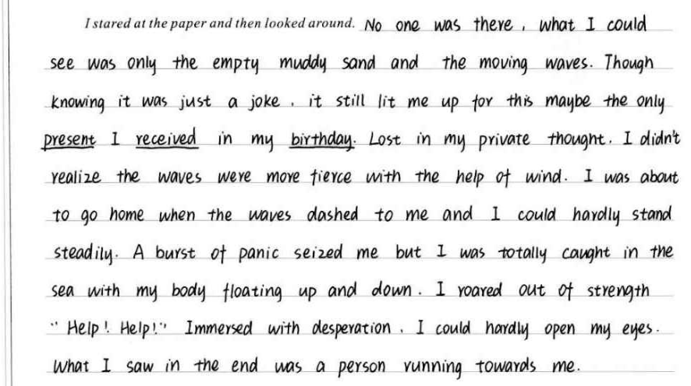
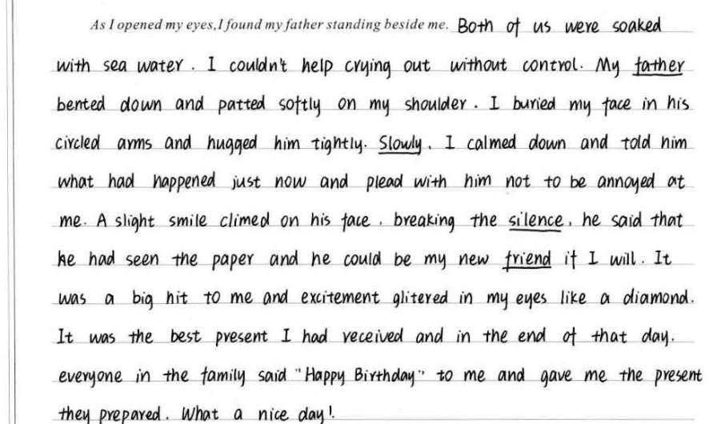
8 Student’s composition 1
衔接
自然
此处加and
主语
从句
衔接自然
点评
语法方面：
学生的语言表达还好，虽有错误，但不多；语言的丰富性，多样性也还行，但是语言的地道性和贴切性有待提高。
内容方面：
从故事情节上来说，该生的续写很好地融入了原文的风格和基调，非常不错。
语言方面：
该生的句式表达丰富多样，修辞的运用让语言充满画面感。但是词汇运用比较简单。
心里活动可以再丰富些。
结构方面：
关联词的运用较少，可适当增加。
非谓语
情节无痕衔接
无灵
表达
非谓语
无灵表达+比喻
无灵
表达
立意不是特别突出。倘若能把看到礼物后的心里活动加上去，就能让主题更突出。
with的复合结构
定语从句
主语
从句
非谓语

Slide 16
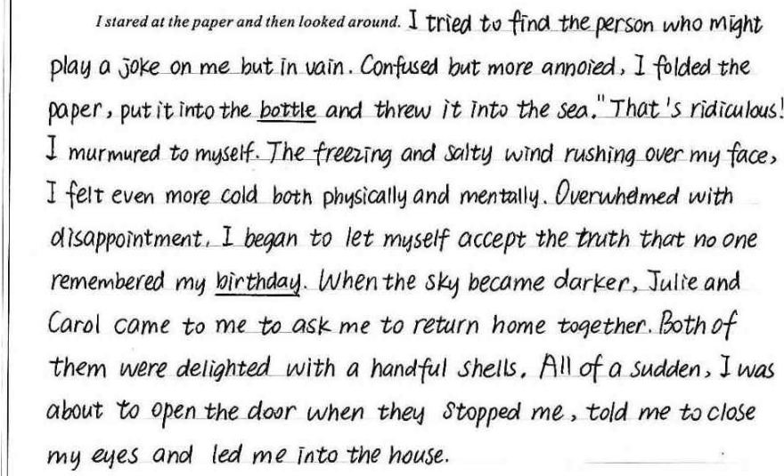
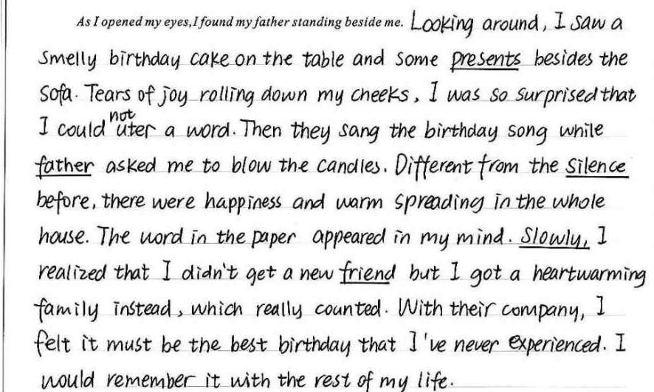
衔接欠佳：前面提到了父亲就站在我身后，如果后面接着父亲往下写会更好。建议此句改成：with a cake held in his hands, he grinned rather than kept silent, blurting out “Happy Birthday!”
无痕
衔接
定语
从句
8 学生习作2
点评
语法方面：
学生的语言表达比较不错，也兼顾了句式的丰富性和多样性，可见学生的英语功底比较好。
内容方面：
从内容上来说，该生的故事曲折有趣，能较好地根据已知情节有序进行。
语言方面：
1. 该生的句式表达丰富多样，但是词汇应用一般，词的丰富性、地道性和贴
切性有待进一步提升。
2. 结尾立意不够突出。
3. 该生的感情线比较丰富。
结构方面：
第二段的给出句和续写句衔接不够自然。
非谓语
独立
主格
独立
主格
blow out 吹灭
非谓语
情节无痕衔接
结尾比较圆满，但是可以进一步升华，建议改为：The special gift made me realize the family love was everywhere， which would company me forever.
定语
从句
强调句

Slide 17
无灵
表达
9 A possible version
独立主格结构
look around no one standing here, 衔接巧妙无痕。
with 的复合结构
I stared at the paper and then looked around. However, no one standing here, a wave of disappointment took possession of me deeply. I wandered around with my head drooping and tear blurring my eyes. Suddenly, something strange, shining under the sun, came into my sight. Approaching it with curiosity, I found it was a necklace made by shells, attached to a piece of paper, reading“Happy Birthday!”I grasped it swiftly like a rabbit running away. A flush of exhilaration overwhelmed me, my eyes twinkling like a glittering diamond. Gripped by an unexpected burst of happiness, I closed my eyes expectantly with my hands crossed before my chest, praying a new friend would suddenly turn up.
As I opened my eyes, I found my father standing right beside me. Instead of cold silence, he grinned, saying “Happy Birthday!” with a cake in his hands, which enabled me to have mingled feelings of startle and excitement. At this time, Carol, Julie and mom also moved here mysteriously, Carol and Julie shouting loudly, “ Is the shell necklace beautiful?” . Everything they prepared looked as if a ray of sunshine shone my heart. I was swept off my foot with tear blurring my eyes. I reckoned it was the best present I received, which make me be on cloud nine. We embraced one another tightly, singing and dancing. What an unforgettable birthday! I’m firmly convinced all the unhappiness would disappear and a brand new chapter of life would unfold before us.
现分作定
非谓语
过分作定
非谓语
非谓语
比喻
无灵主语
独立主格+ 比喻
非谓语
故事情节衔接吻合度高
I found My father standing right beside me , he grinned, saying ┈衔接巧妙无痕。
with 的复合结构
结尾立意升华：开头提到了家从剑桥搬到了海边的小屋，父亲一路上闷闷不乐，也许是工作遭遇到了某种不幸，结尾写到了展开生活的新篇章，立意升华做到了首尾呼应，突显了正能量，是个非常不错的结尾。
非谓语
非谓语
with 的复合结构
定语从句
独立主格结构
俚语表达“激动兴奋”+with的复合结构
定语从句
比喻
定语从句
定语从句+俚语表达
非谓语
感叹句
定语从句

Slide 18

