Slide 1


感恩遇见，相互成就，本课件资料仅供您个人参考、教学使用，严禁自行在网络传播，违者依知识产权法追究法律责任。
更多教学资源请关注
公众号：溯恩高中英语
知识产权声明

Slide 2
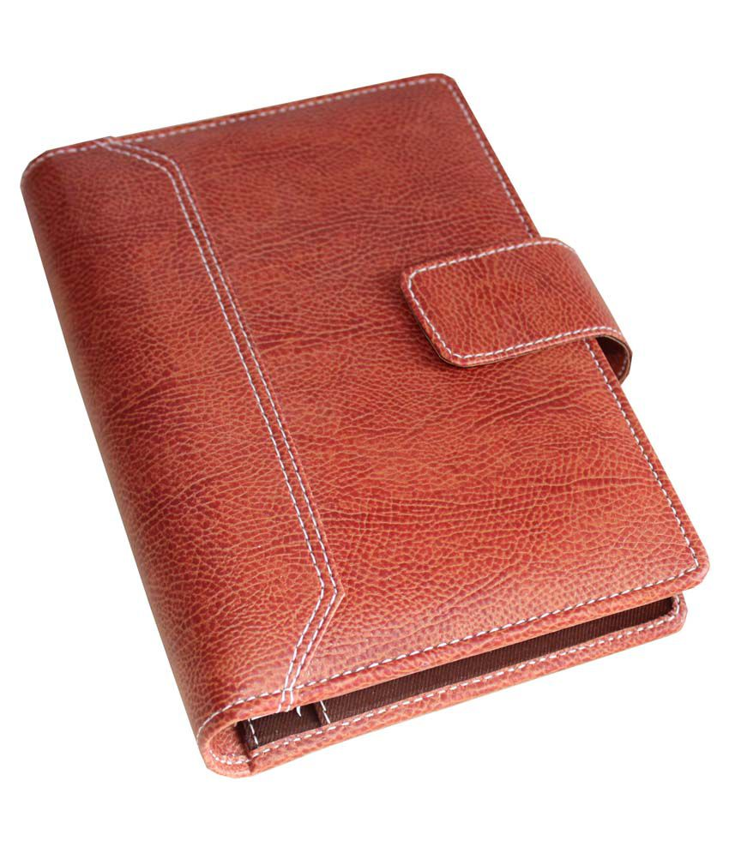
Unit1 Festivals and Celebrations
－Reading for Writing
浙江省衢州第一中学 徐荣仙

Slide 3
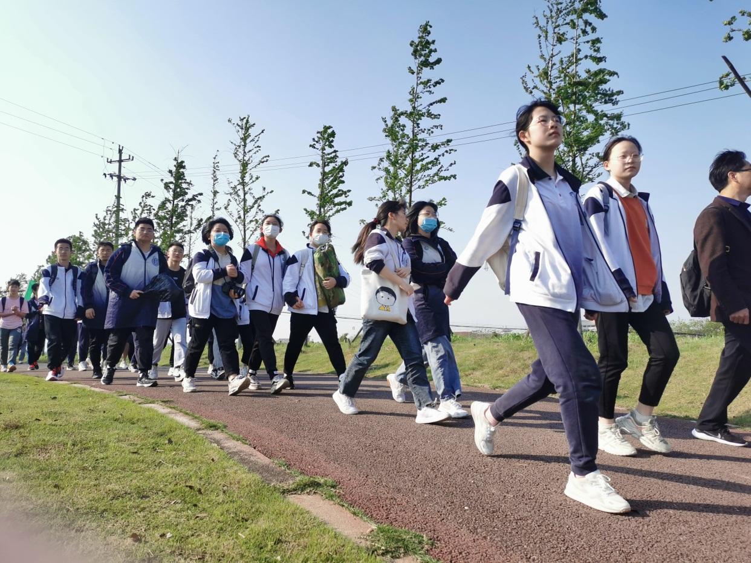
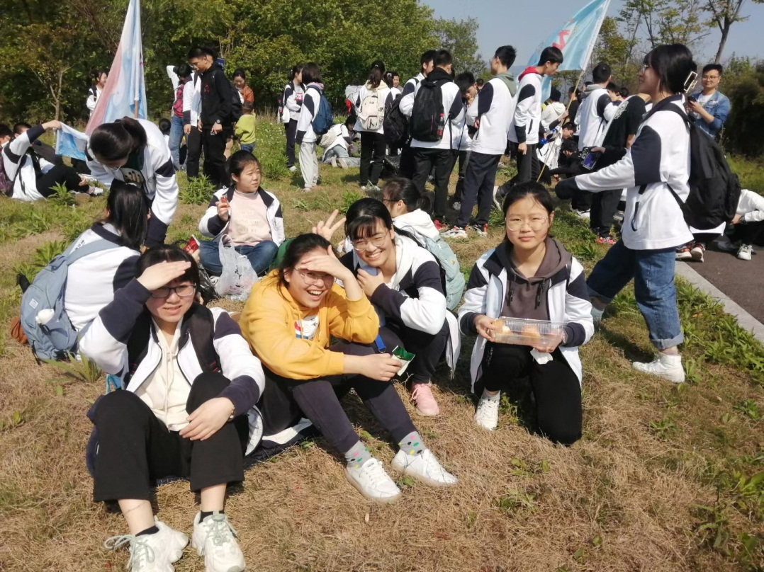
Hiking
How did you feel about the hiking?
Is there any related homework from your teachers about the hiking ?

Slide 4





Related homework

Slide 5
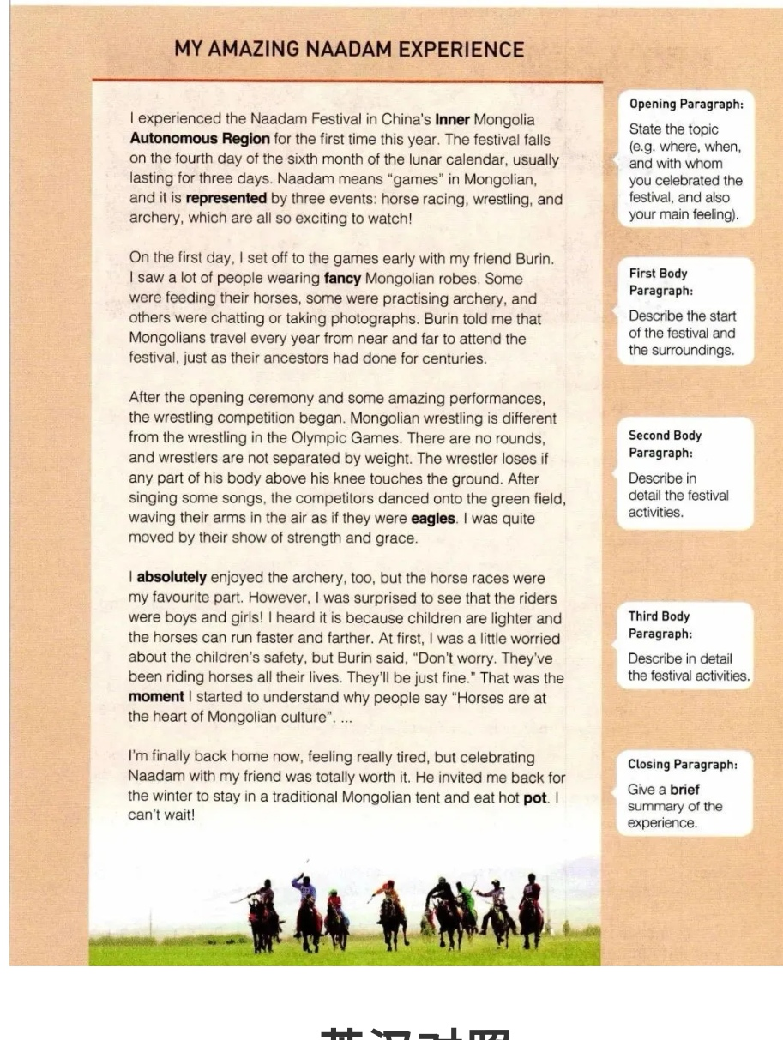
What do you want to know according to the title?
What activities did the author experience?
Why are these experiences amazing?
What is “Naadam”?
...
What is the text’s writing style ?
√
narration
argumentation
exposition
Diary

Slide 6
A general idea about a diary
time order
first person
past tense
the present tense
the future tense

Slide 7
A general idea about a diary
when
what
where
who
first body
the start of the festival
second body
wrestling
third body
horse races
summary
topic
activities
closing
opening
Body
different rules
unique show of strength and show
feeling
what I saw
differences
feeling
excited
tiring but rewarding
people wearing fancy Mongolian robes
feeding horses
practising archey
chatting
taking photos
different
amazing participants-too young
amazing bravery-devotion

Slide 8
Amazing?
competitors
feelings
activities
Experiences

Slide 9
How did the writer describe his/ her feelings/ emotions during the event? Please find out the sentences.
Tip1: using -ing/-ed
to express emotions
...and it is represented by three events: horse racing, wrestling, and archery, which are all so exciting to watch.(Para1)
After the opening ceremony and some amazing performances, the wrestling competition began. (Para2 )
However, I was surprised to see that the riders were boys and girls! (Para4)
At first, I was a little worried about the children’s safety. (Para4)
I’m finally back home now, feeling really tired, but celebrating with Naadam with my friend was totally worth it. (Para5)

Slide 10
How did the writer describe his/ her feelings/ emotions during the event? Please find out the sentences.
Tip2: using adj./adv. or other ways to express emotions
I absolutely enjoyed the archery, too (Para5)
I’m finally back home now, feeling really tired, but celebrating with Naadan with my friend was totally worth it. (Para5)
He invited me back for the winter to stay in a traditional Mongolian tent and eat hot pot. I can’t wait!(Para5)

Slide 11
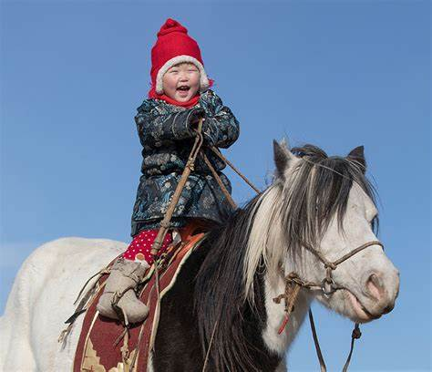
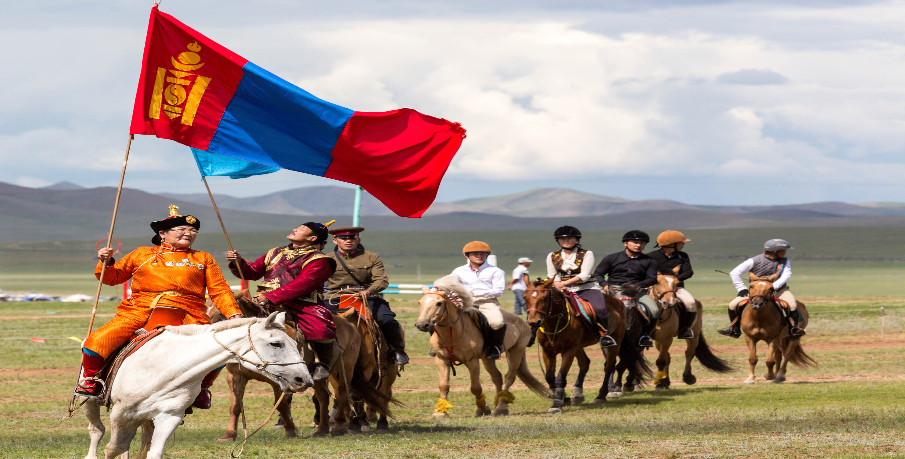
Further reading
What does the sentence “Horses are at the heart of Mongolian culture...” imply?

Slide 12
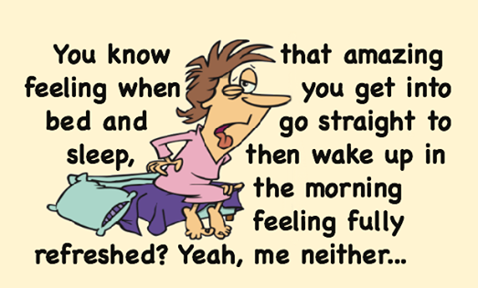
Further reading
What is the most amazing thing to you about the festival?
It’s amazing that...
To my amazement, ...
What amazes me most is that...
..., which makes me amazed.
..., making me feel amazed.

Slide 13
Conlusion
What should be included in wrting a diary?
opening
topic
feelings
body
activities
feelings
closing
summary
feelings
title
first person
first person
when
where
who
what
how
feelings
past tense
the present tense
the future tense

Slide 14
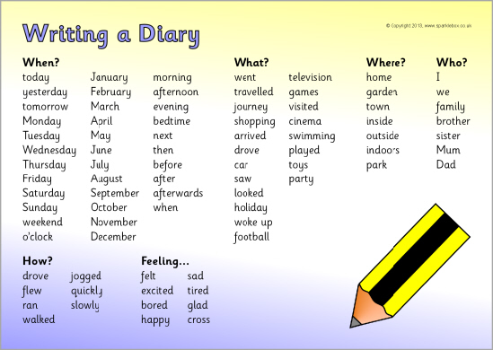
Conlusion
What should be included in a diary?

Slide 15
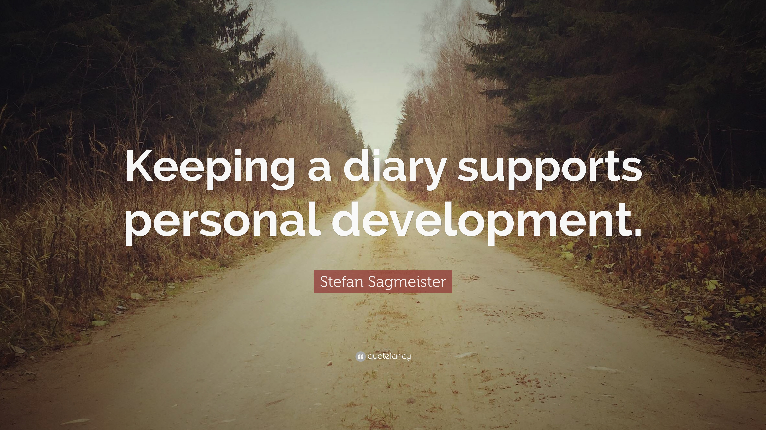
quote

Slide 16
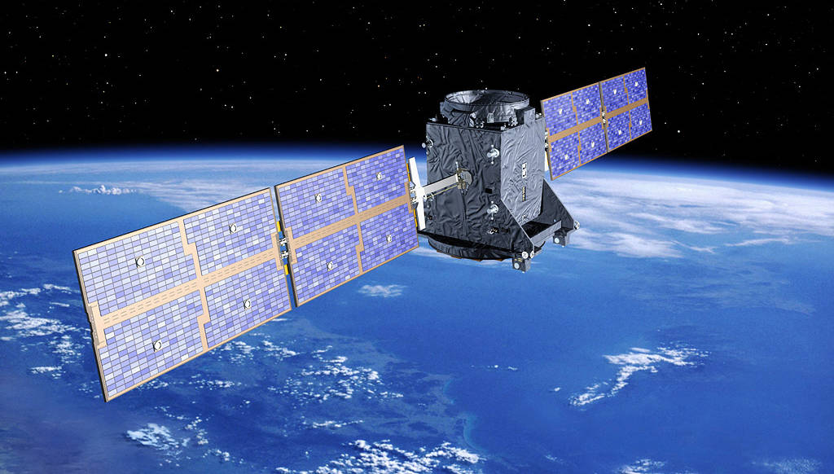

Assignment
Look back to one festival that you have experienced recently and write a diary
Further reading:Amazon.com: Anna's Diary eBook: Ireland, Anna, Books, Blushing: Kindle Store https://www.amazon.com/Annas-Diary-Anna-Ireland-ebook/dp/B01MXGZJHD

Slide 17

Exchange drafts with a partner. Use the checklist to give feedback on your partner’s draft.
Is the writing well organized?
Is there an opening sentence in the first paragraph?
Does each paragraph include necessary details?
Does the writer use his/her feelings and emotions?
Does the writer use the -ing form correctly in the writing?
Are there any grammar, spelling, or punctuation errors?

Slide 18
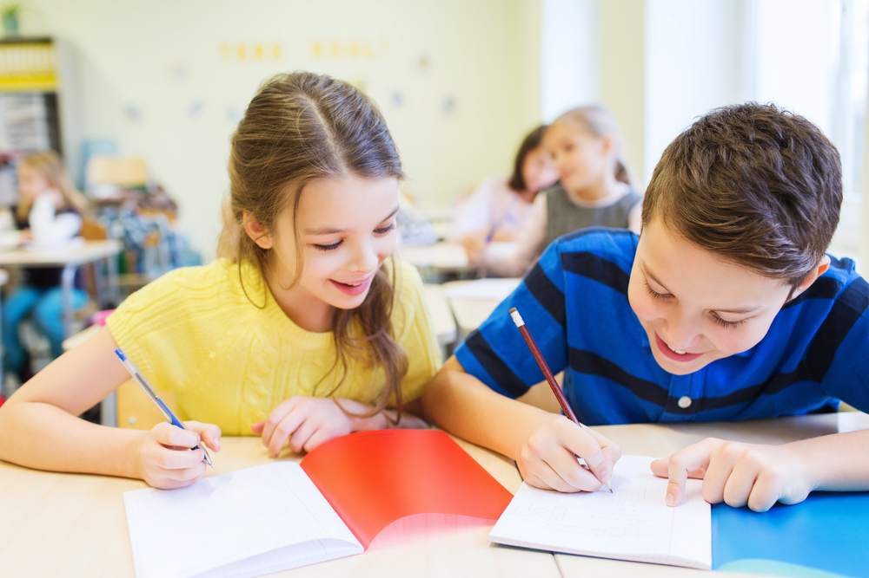
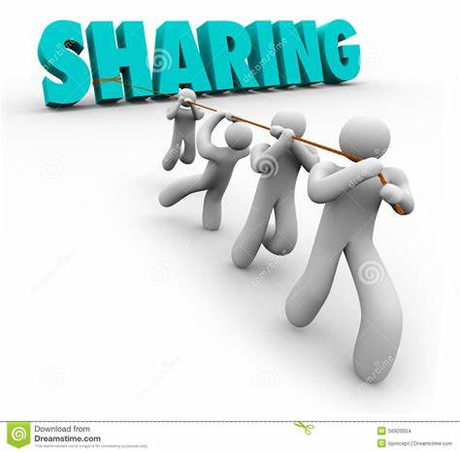
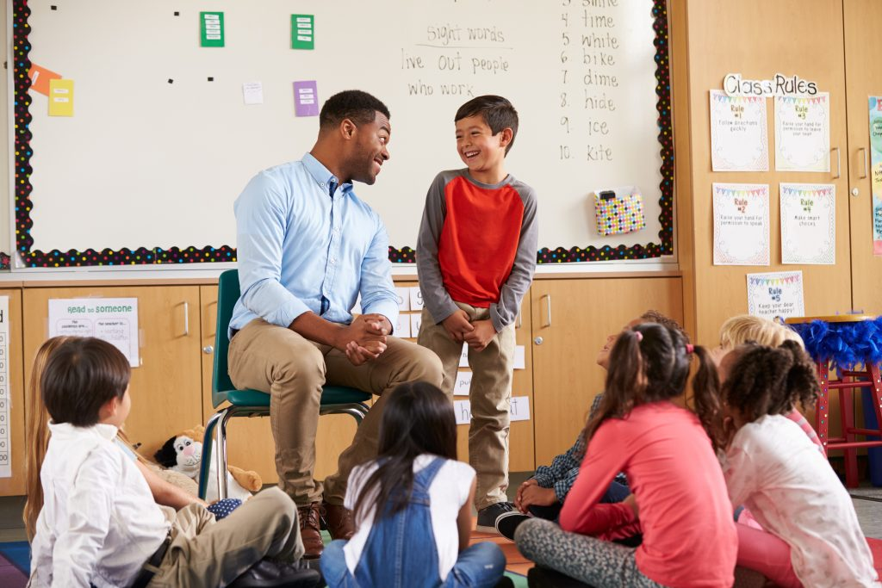
samples from two students

Slide 19
An Unforgettable Dragon Boat Festival Experience
I’ll never forget the Dragon Boat Festival that I experienced last year , which left me a deep impression. The Dragon Boat Festival falls on the fifth day of the fifth month of lunar calendar and is celebrated in honor of the great ancient poet, Qu Yuan.
In the morning, my family and I brought some zongzi made of glutinous rice and meat to one river and threw them into it with our best wishes to Qu Yuan. After that, a dragon boat race was followed. It was my first time that I had experienced it in the flesh. To my amazement, some competitors were even younger than me. I was greatly impressed by their wonderful performances and bravery.
Despite some tiredness, I felt excited and relaxed. Frankly speaking, I can’t wait for next Dragon Boat Festival. (Yirou Ding)

Slide 20
My Amazing Spring Festival Experience
The Spring Festival that I experienced this year in my hometown has unique meanings to every Chinese. It is represented by many interesting activities: lighting firecrackers, making dumplings and a big meal.
On the eve, I was woken up by the early noise of firecrackers, which drew me to the street. I saw people in new clothes laughing and chatting happily. It seemed that everyone was bathed in the joyful atmosphere. After the breakfast, I went to visit my grandma to express our best wishes and heartfelt gratitude to them for their devotion and company. At night, the sky in the countryside was dotted with various firecrackers in order to drive away the evil spirits and welcome the promising new year.
Tired but excited, I stayed wide awake that night. How I wish I could experience the Spring Festival every day! (Sichen Wu)

Slide 21
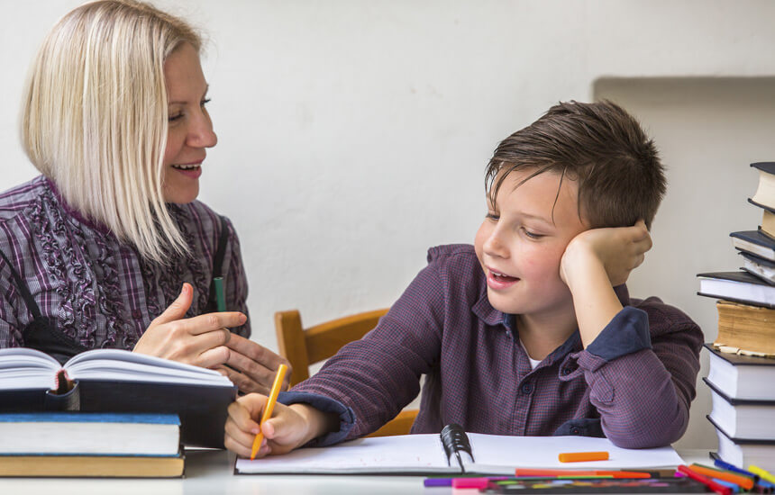
教师点评：根据checklist, 这两位同学的作文基本符合节日日记的写作要求，语言措辞都比较好。从opening, body, closing 三个方面，把作者对于节日的感受、经历和最终的感想和期盼淋漓尽致的描写了出来。在第二段的节日活动中细节描写到位，并能恰当使用-ing 和定语从句，能准确的向读者清晰的传达作者的写作意图。

Slide 22
高考链接
应用文
假定你是李华，你的外国朋友Bruce想来中国体验春节，向你询问一些有关春节的信息。请给他回一封信，内容如下：
1. 表示欢迎；
2. 介绍春节；
3. 表达祝福。
注意：
1. 词数80左右；
2. 可以适当增加细节，以使行文连贯。

Slide 23


