Slide 1

感恩遇见，相互成就，本课件资料仅供您个人参考、教学使用，严禁自行在网络传播，违者依知识产权法追究法律责任。
更多教学资源请关注
公众号：溯恩高中英语
知识产权声明

Slide 2
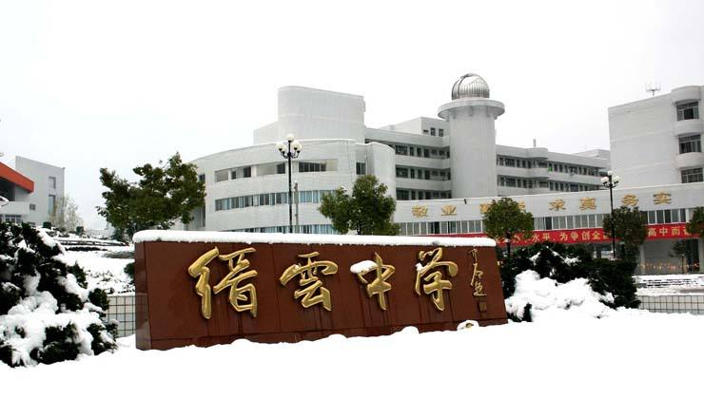
Letter of Congratulations+Thanks
浙江省缙云中学 李晓慧

Slide 3
（2021年4月暨阳联考卷）假定你是李华，你的新西兰外教Jon因为对学校所做的贡献而获得了嘉奖，请你用英语给他写一封祝贺信，内容包括：
1.祝贺获奖；
2.感谢付出；
3.表达祝愿。
注意：
1.词数80词左右；
2.可以适当增加细节，以使行文连贯。注意：
Type:
Letter of Congratulations + Thanks
Tense:
the present perfect+ the present
Person:
second person+ first person

Slide 4
Vocabulary building
作贡献/投入/奉献：
make contributions to/commitment
devotion
获得了嘉奖:
win the award
/ be recognized with the award
/ gain recognition for one’s work
表示祝贺:
congratulate sb on sth
/ Congratulations!
/ express (convey/ extend/offer )sincere congratulations on...
表示感谢：
express/convey one's heartfelt gratitude for…
express one's sincere/cordial/earnest thanks for…

Slide 5


1
写信目的

Slide 6
Para 1: background + purpose
1.表示祝贺
2.对学校所做的贡献
我写信来是因为你对学校所做的贡献而获得了嘉奖表示祝贺。
① Delighted/Pleased/Elated/Excited to hear/know that you’re
_______________________ your contribution to our school,
I’m writing to _________________________.
②I’m writing to __________________________ your winning
the award _____________ your contribution to our school.
③ I’d like to __________________ your achievements in the
work to our school.
④ _______ that you’ve won the award for your contribution to our school, we’re proud of your __________________. ___________!
recognized with the award for
express/convey my congratulations
express my sincere congratulations on
in recognition of
congratulate you on
Knowing
remarkable achievements
Congratulations

Slide 7
2
感谢付出

Slide 8
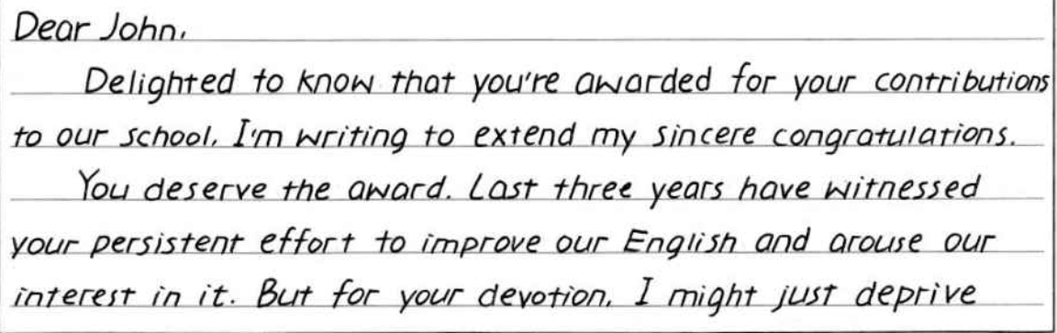
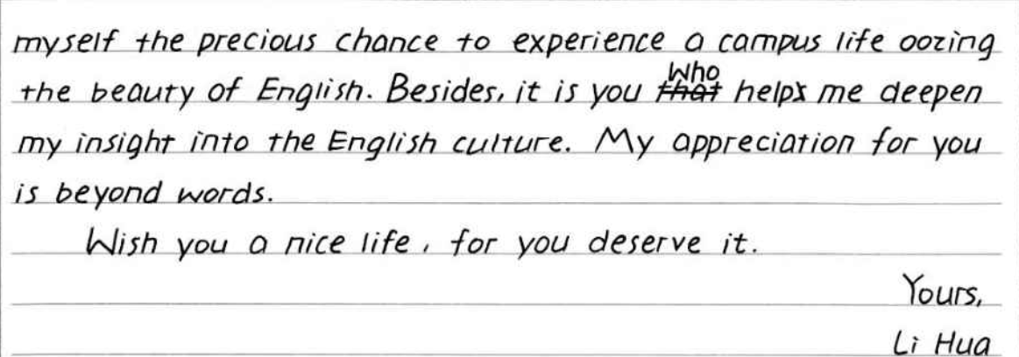
Para 2: 感谢付出
全体学生层面的感谢还是个人层面?
感谢John对学校的付出devotion/
作出的贡献contributions;
？

Slide 9
Para 2: 感谢付出
【写作思路】
基于John是一名外教，对学校所作出的贡献可以联想到英语和英语文化这两个角度。一方面，John提升了我们对学习英语的兴趣和热情。另一方面，他帮助促进了文化交流，提升了对于跨文化的相互理解和交流。
【句式结构】
1.强调结构: It is you who have...
2.虚拟语气：Without your..., We couldn’t have...
But for your..., we wouldn’t have...
3. 排比句式：The past year has witnessed...The past year has witnessed ... And most importantly, the past year has witnessed...

Slide 10
Para 2: 感谢付出
☯These years, we have _______ a lot ____ your _______.（因
为你的付出而获益很多) __________ (强调句式) have
made every effort to guide us in English learning, _________(发
展) our interest in the language and _________(提高）our oral
English.
☯It is you who have helped to __________________(架起两种
文化的桥梁), ______ the way for our ________ _________
and further development.(铺平了相互了解和......发展的道路)
benefited from
devotion
It’s you who
developing
improving
bridge the two cultures
paving
mutual understanding

Slide 11
Para 2: 感谢付出
The past year has witnessed
☯ _____________________ our improvement in spoken English
and better acdemic performances with your guidance. _________
________ your effort to bridge the two cultures, paving the way
for further exploration. And most importantly, _____________
__________ our friendship and bond __________! (见证了)
(过去的一年，我们的友谊和纽带更加紧密。)
☯It is your devotion to the work that _____________(区别) you
from other teachers. ______________ (要不是) your patient
guidance and constant encouragement, we ________________
_______________(不可能取得那么大的进步), which
undoubtedly reveals your professional skills in teaching.
The past year has
witnessed
the past year has
witnessed
strengthened
distinguishes
But for/ Without
couldn’t have made
such great progress

Slide 12
Para 2: 感谢付出---其它层面
☯过去的几年见证你
1.生动(有趣，幽默)的课堂
vivid (lively, humorous) lessons
2.无私(真诚)的奉献；耐心(专业)的引导；
selfless devotion and professional guidance
☯正是你让这成为可能
It’s you that make it possible...
1.英语(成绩，能力，水平)的提高
improve our ability in English learning
2.接触(探索，体验)外国文化的魅力
explore the charm of foreign culture

Slide 13
Para 2: 感谢付出---其它层面
3.视野的拓宽(培养国际视野)
broaden our horizons/ cultivate our international vision
☯没有你就没有
Without (But for ) your help, we couldn’t have enjoyed...
多彩的活动(英语角，演讲)
various(diverse) impressive after-class activities, like the English corner and speech contests
☯此外品格的培养(勇敢面对困难，坚持/绝不半途而废的重要性)
Additionally, you tell us to brave the challenges and insist the significance of persistence/ never to quit halfway.

Slide 14
3
祝贺信的结尾

Slide 15
常用于祝贺信结尾的句子：
☯____________ again, and I wish you ______ _____./and
I’m looking forward to your _______ ________.
再次表示祝贺，并祝/期待你取得更大的成功/成就。
☯Please accept our sincere congratulations and ____ ____ for
all the _____ _____ in the world.请接受我们最真诚的祝
贺和最美好的祝愿，愿你在世界上拥有美好的未来。
☯All my best wishes for a ___________ _______.
我衷心祝愿你有一个更美好/更成功的未来。
☯Congratulations again and wish your stay here ___________
_________. 再次祝贺并希望你在这里过得愉快，难忘。
Congratulations
further success
further achievements
best wishes
good future
better/successful future
enjoyable and
memorable

Slide 16
4
学生习作

Slide 17
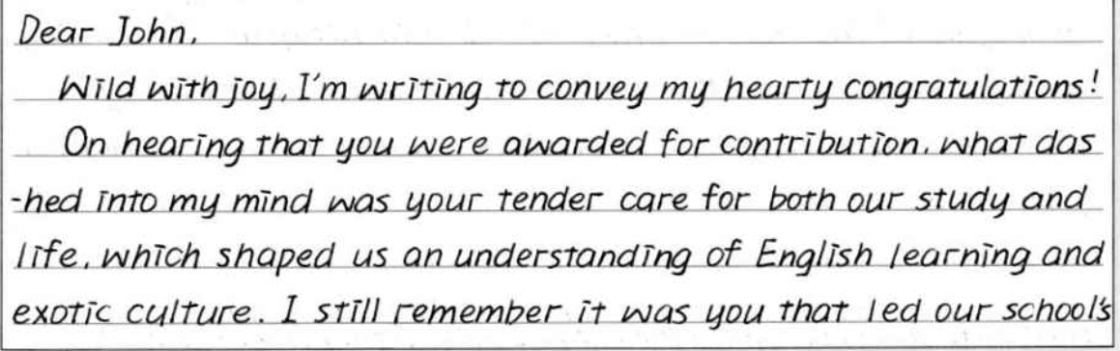
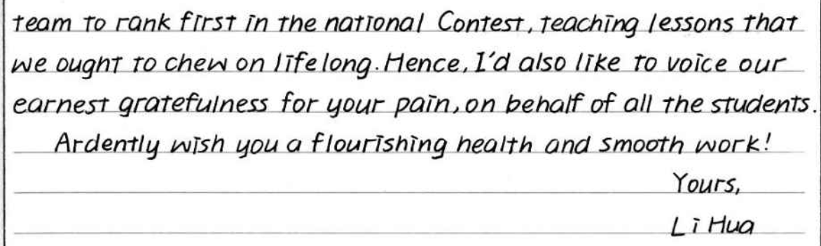
教师点评：
①书写清楚漂亮；
②全篇行文较为流畅；
③首段清楚地表达了写作目的(背景最好在首段呈现）；
④”teaching lessons that we ought to chew on lifelong”这句与前半句内容上感觉逻辑上不太通顺。

Slide 18
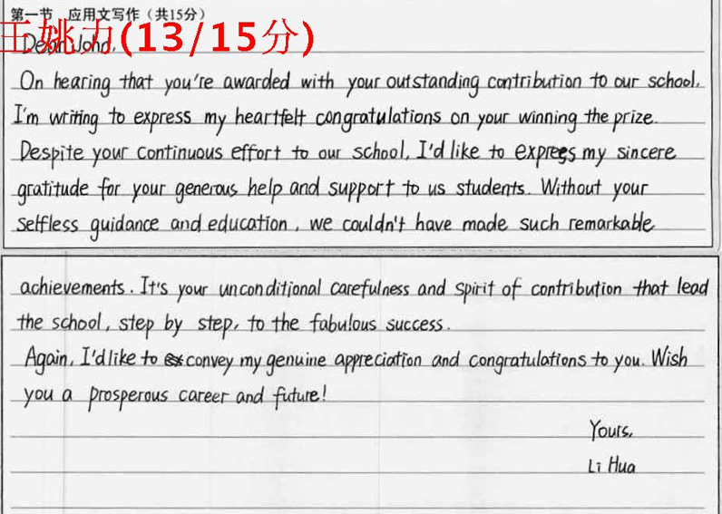
教师点评：
①书写清楚但还需提升；
②全篇行文较为流畅；
③首段清楚地表达了写作
的背景以及目的；
④句式结构较为丰富，使用了虚拟语气与强调句式；
⑤末段祝愿的表达较好。

Slide 19
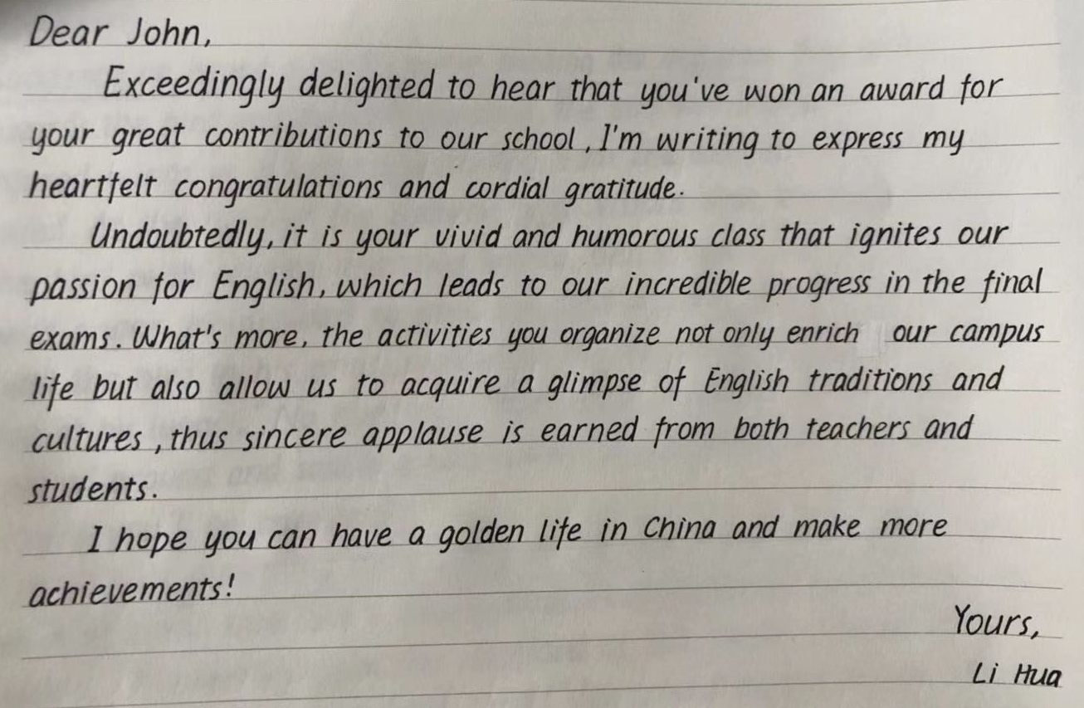
教师点评：
①书写清楚漂亮；
②全篇行文较为流畅；
③首段清楚地表达了写作背景与目的；
④感谢付出从英语到活动再到传统文化，比较有层次感。
⑤“thus”是一个副词，不能引导句子。
and

Slide 20
5
参考范文

Slide 21
Dear John,
I am writing to offer my sincere congratulations to you
on your winning the award. As your student, I just want
you to know how glad I am at your achievement.
For these years, you’ve shown great passion in teaching
and kept on improving our English ability. It is your
humorous and instructive teaching that makes English
learning an entertaining and eye-opening experience for
us.Without your selfless devotion, we couldn’t have made
such great progress. Thank you for your company.
I really hope that you can enjoy your stay here and
make more achievements.
Yours,
Li Hua

Slide 22
Dear John,
I’m writing to express my sincere congratulations on your winning the award in recognition of your contribution to our school. We are lucky to have you with us.
These years, we have benefited a lot from your devotion. It is you who have made every effort to guide us in English learning, developing our interest in the language and improving our oral English. It is you who have helped to bridge the two cultures, paving the way for our mutual understanding and further development.
Congratulations again and wish your stay here enjoyable and memorable.
Yours,
Li Hua

Slide 23
6
同类祝贺信

Slide 24
假定你是李华，你的美籍好友Tom在他所在学校组织的汉字听写大赛中获得了一等奖。请你写一封英文邮件，内容包括：
1. 向他表示祝贺；
2. 你认为他获奖的原因；
3. 请教参赛经验。
注意：1.词数80左右；
2.可适当增加细节，已使行文连贯。

Slide 25
Dear Tom,
Delighted to learn that you have won first prize in the Chinese Characters Dictation Competition held by your school. I am writing to offer my congratulations to you.(祝贺事由)
It comes as no surprise to me that you have won first prize because you have been practicing Chinese characers since you were a child. As I know, you have been interested in Chinese traditional culture, particularly Chinese characters. Besides, you often take part in various competitions. I’ll take part in an English competition next week. Would you like to give me some advice?（获奖原因，请教经验）
Congratulations again on your success.(再次表示祝贺)
Yours,
Li Hua

Slide 26
假如你是韩梅梅，你的朋友李磊被北大录取，请你写一封祝贺信，内容包括：
1. 表示祝贺；
2. 肯定他的努力和付出；
3. 表达祝愿。
注意：1.词数80左右；
2.可适当增加细节，已使行文连贯。

Slide 27
Dear Li Lei,
I’m writing to convey my heartfelt congratulations on your receiving the offer from Peking University. I feel more than delighted for you as it’s a golden chance to learn from the great minds.
But indeed no one could have been more deserving of it than you, because I know you have been studying Chinese for years. It is your diligence and persistence that stand you out in the crowd. It is a real encouragement to see your efforts paid off and I do hope you can understand China and its splendid culture better.
Wish you still further success in Chinese study and make preparations for the coming challenge.
Sincerely yours
Han Meimei

Slide 28
THANKS

