Slide 1


感恩遇见，相互成就，本课件资料仅供您个人参考、教学使用，严禁自行在网络传播，违者依知识产权法追究法律责任。
更多教学资源请关注
公众号：溯恩高中英语
知识产权声明

Slide 2
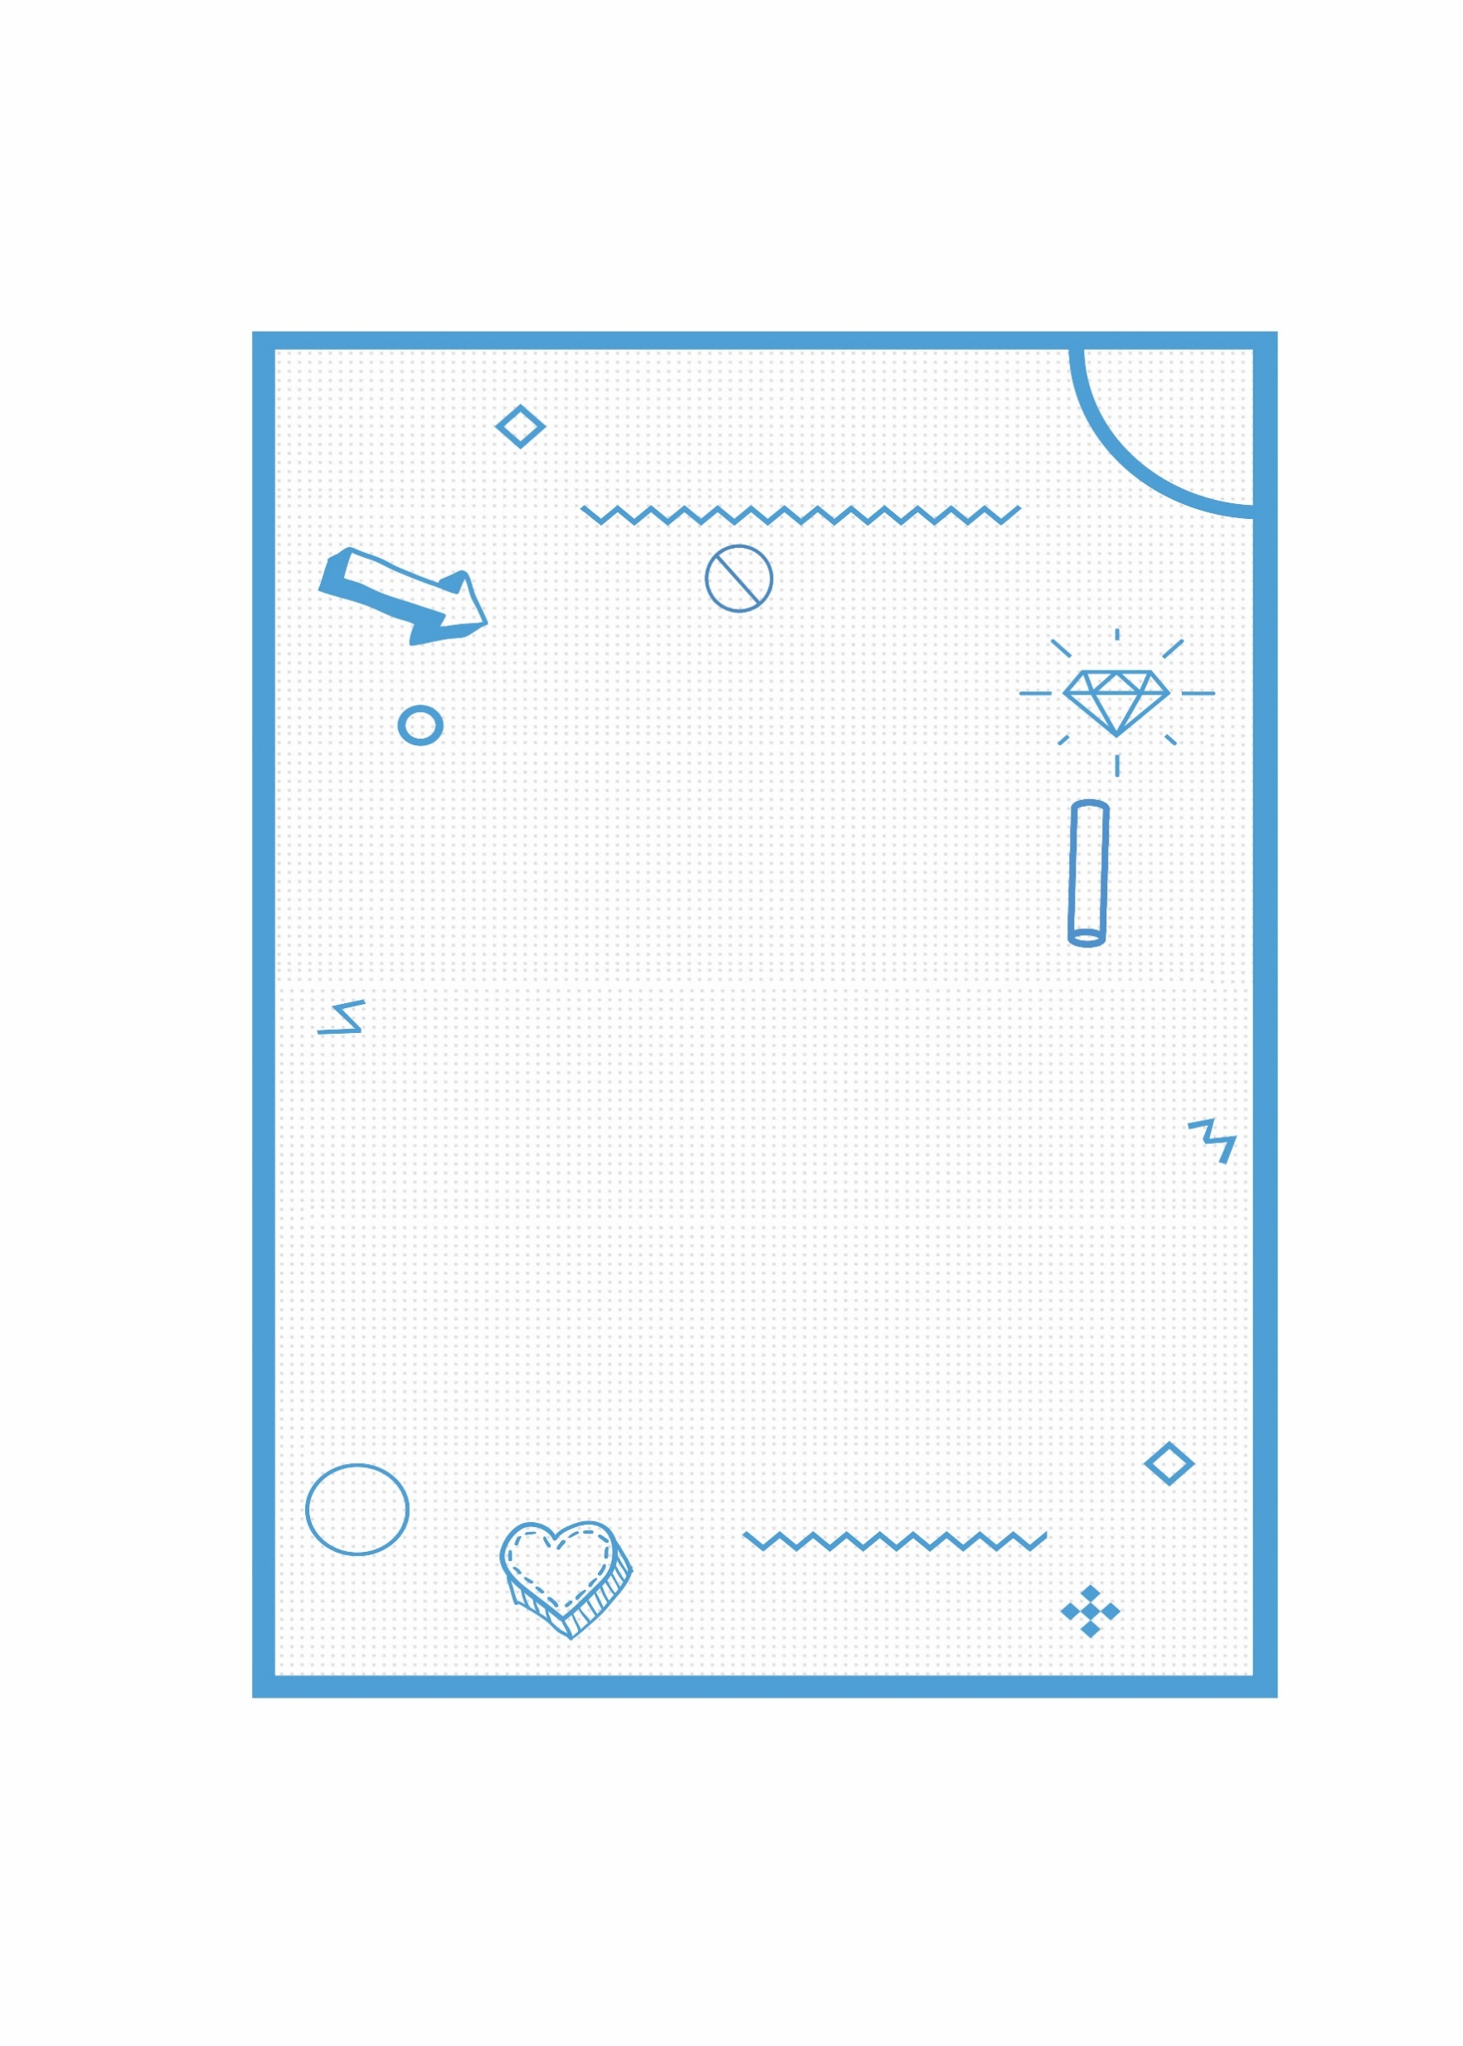
Guidance and drills to improve listening competence
Guidance and drills to improve listening competence
Anna Wei
浙江省浦江中学

Slide 3
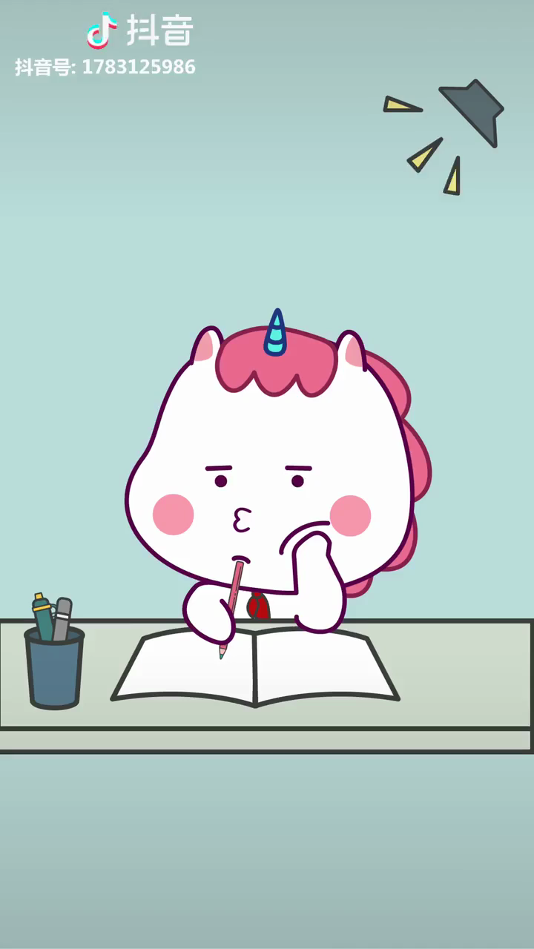
While listening.......
Are you......
学霸？学神? or 学渣？

Slide 4
学霸、学神没有说的
高分秘籍!
本堂课(例题)来自：
历年（新高考）浙江卷
2021八省联考
2020(新高考)山东卷

Slide 5
01
A handy tool makes a handy man!
Some listening guidance before listening
Notes:
工欲善其事必先利其器

Slide 6
What should we do before listening?
Read the questions and options!
How?
The AA principle.
Questions
Analyze
A
Options
Answer
Anticipate(预判)
A
Situation
Relationship

Slide 7
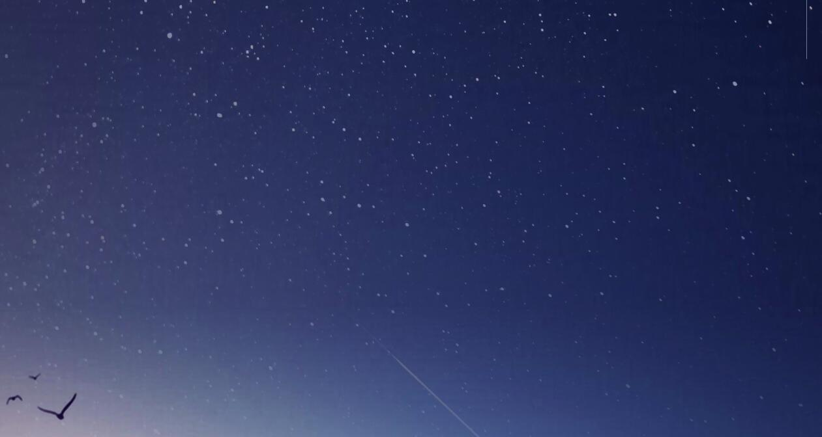
What should we do before listening?
Read the questions and options!
How?
The AA principle.
Questions
Analyze
A
Options
Anticipate(预判)
Answer
A
Situation

Slide 8
1. Analyze the key words in the questions.
a)What will the weather be like tomorrow evening?（2021.1浙江卷）
b)What's Kate's attitude toward her mother's decision?(2019.6浙江卷)
c)What is the probable relationship between the speakers?（2021.1浙江卷）
d)What is banned in Florence?（2021.1浙江卷）
e)What will the students do at 1:15?（2020山东卷）
f)How many candidates are the speakers going to meet?（2021.1浙江卷）
题干关键词可以是：地名、时间、天气、人、事物、情感态度、人物关系、度量单位等…

Slide 9
2. Analyze the differences between the options.
Underline the keywords, focus on the differences
change the English words(词汇) into specific figures(数字).
听第7段材料，回答第8至10题。(2021八省联考)
8. When does the man plan to check in?
A. Three days later. B. Four days later. C. Seven days later.
9. What kind of room does the man take?
A. One with one bed and a kitchen.
B. One with two beds and a kitchen.
C. One with two beds and no kitchen.
3
4
7
选项太长看差异；
数字转换更明晰。

Slide 10
What should we do before listening?
Read the questions and options!
How?
The AA principle.
Questions
Analyze
A
Options
Answer
Anticipate(预判)
A
Situation
Relationship

Slide 11


3. Anticipate the answer.
a.常识判断
听第9段材料，回答第13至16题。（2020山东卷）
13. What's the relationship between the speakers?
A. Good friends. B. Fellow students. C. Roommates.
14. When did Sarah start college?
A. A year ago. B. Three months ago. C. A week ago.
15. Why does Ricky want to move?
A. He wants younger company . B. He wants to be nearer college.
C. He doesn't get along with the host family.
16. What will Ricky probably do next?
A. Visit a teacher. B. Hang out with friends. C. Give John a phone call.
排除

Slide 12
3. Anticipate the answer.
b.呼应原则
听第8段材料，回答第11至13题。（2017.11浙江卷）
11. What does Maria think of the soup?
A. Tasteless B. Just fine C. Thick
12. What does Karl say can be added to the soup?
A. Salt B. Onions C. Pepper
..........
Which is most likely to be the answer for Q11?
长对话中一般设计2~3个问题，这些问题往往形成了一个信息链，考生可以从中预测听力测试内容，有时甚至问题本身就泄露了答案。

Slide 13
What should we do before listening?
Read the questions and options!
How?
The AA principle.
Questions
Analyze
A
Options
Answer
Anticipate(预判)
A
Situation
Relationship

Slide 14

4. Anticipate the situation.
Brainstorm:
Which words or expressions can be used in the following scenes?
restaurant
library
hospital
weather
scenes

Slide 15
4. Anticipate the situation.
Brainstorm:
Which words or expressions can be used in the following scenes?
restaurant | make a reservation, menu,meal, bill,order, tip, soup, dish,beer... A. Would you like something to eat / drink?/Help yourself to some fish./Which do you prefer......? B. ①Yes, I'd like a drink/some rice/chicken. /Just a little, please. Can I have somemore soup?/ It's so delicious. ②No, thank you. I've had enough. / I'm full, thank you. /It's very delicious, but I can't eat any more.
scenes
Notes:
different situations, different words and expressions, if you are familiar with these words, ........can quickly focus on your answers

Slide 16
4. Anticipate the situation.
Brainstorm:
Which words or expressions can be used in the following scenes?
library | library card, borrow, lend, keep, due date, bookshelf, novel, science fiction, magazine, academic paper(学术的论文), reference book(参考书), periodical(期刊), librarian(图书管理员)......
scenes
Notes:
different situations, different words and expressions, if you are familiar with these words, ........can quickly focus on your answers

Slide 17
4. Anticipate the situation.
Brainstorm:
Which words or expressions can be used in the following scenes?
hospital | ICU(=intensive care unit重症监护室), emergency department (急诊室) treatment, take one's temperature/blood pressure, medicine/pills/tablets(药片)...... A: What's the matter/trouble? How long have you felt like this?/It's nothing serious. /Take this medicine three times a day. /Give up smoking and keep on taking more exercise. B. I have a headache/cough/ fever. /I feel terrible/bad /horrible/awful. /I don't feel well. /I've gota pain here. /It hurts here. (注意听语气：语调上扬，身体好转； 降调，身体不好)
scenes

Slide 18
4. Anticipate the situation.
Brainstorm:
Which words or expressions can be used in the following scenes?
weather | cloudy, sunny, thunder, strong/high wind, tornado, typhoon, storm, weather in London/Seattle(常指不好的天气), weather in California(常指好天气)； vacation and flight (be delayed/cancelled )... A. What's the weather like today? /How's the weather in Beijing? /What a cold / hot day today!/ B. It's a nice/fine /beautiful/horrible day. /It's getting cool/cold/warm/hot.
scenes

Slide 19

Practice makes perfect!
1. Where does the conversation take place?(2020山东卷)
A. At a store. B. At a gym. C. At home.
1. Where does the conversation probably take place?(2020.1浙江卷)
A. At a zoo. B. In a library. C. In a drugstore.
4. What are the speakers talking about?(2020.1浙江卷)
A. The weather. B. The scenery. C. The traffic.

Slide 20
What should we do before listening?
Read the questions and options!
How?
The AA principle.
Questions
Analyze
A
Options
Answer
Anticipate(预判)
A
Situation
Relationship

Slide 21
5. Anticipate the relationship.
听第8段材料，回答第11至13题。(2021.1浙江卷)
11. Why does Ms. McDaniel talk to Frank?
A. He missed a speech. B. He failed to pass a test. C. He wanted to drop a class.
12. How would Ms. McDaniel’s students react if a speaker made a mistake?
A. laugh at the speaker. B. Sympathize with the speaker.
C. Persuade the speaker to try again.
13. How does Ms. McDaniel sound?
A. Optimistic. B. Humorous. C. Encouraging.
Probable relationship?
What will a teacher do to such a student?
Guess the answer for No.13?

Slide 22

5. Anticipate the relationship.
Tips: The keywords in the conversation help you predict the relationship between the speakers.
What is the probable relationship between the two speakers?
Relationship | Expressions
mother/father and son;
husband and wife
Darling, My dear, sweetheart,
dinner, sleep...
Dear teacher, Mr./Mrs. .....
course, assignment,term, paper,grade...
teacher/professor and student
What's wrong with you?
Nothing serious. cold/fever/ headache
Take this medicine...
Tip：注意说话人的语气：强硬、甜蜜、亲切、尊敬
正式...
doctor and patient

Slide 23
Practice makes perfect!
听第6段材料，回答第6、7题。（2021.1浙江卷）
6. What is the probable relationship between the speakers?
A. Husband and wife. B. Hostess and guest.
C. Chef and customer.
4. What's the relationship between the speakers? （2019.6浙江卷）
A. Colleagues. B. Classmates. C. Strangers.

Slide 24
02
Know the enemy and know yourself!
Better know the tips while listening

Slide 25
What should we do while listening?
If you are the question designer, what will you do to make the questions difficult/confusing?
命题技巧早知晓；
解题指南请收好！

Slide 26
Tip 1
Tip 1：前句误导，后句正解。
命题特点：
解题方法：
句中有转折连词but, however, though, while…
听到连词后，集中精力听后面的内容
5. What does the man think of the movie?（2021八省联考）
A. Top quality. B. Above average. C. Surprisingly bad.
听力材料
第五节 5:55
W: Hey, Thomas. How was the movie last night?
M: It was OK, not exactly a top quality one but still a welcome surprise. I’ll give it three stars out of four.

Slide 27
Tip 2
Tip 2：一人做多事，时间要重视。
命题特点：
解题方法：
同一人物做多件事
看清题干的时间，听力内容细心识别
3. What will Jack do this weekend?（2021.1浙江卷）
A. Go on a school trip.
B. Have a family picnic.
C. Prepare for an exam.
听力材料
Text 3
M: Kate, let’s go for a picnic somewhere this weekend.
W: Good idea. Can Jack go with us? He studied hard for his exam
in the past two weeks.
M: I don’t think so. He’s going on a trip this weekend with his school.

Slide 28
Tip 2
Tip 2：一人做多事，时间要重视。
命题特点：
解题方法：
同一人物做多件事
看清题干的时间，听力内容细心识别
8. Where will George go after the business trip?（2021.1浙江卷）
A. Milan. B. Rome. C. Florence.
听力材料
Text 7
W: Hello, George. I’ve heard that you’re going to Milan for a business trip next week.
M: Yes, Susan. I’m also planning a trip to Rome for sightseeing after that.
W: Oh, I’m just back from Rome. The city has made some new rules.
M: Really? What rules?
..........

Slide 29
Tip 3
Tip 3：不同人物不同事，人名/性别要重视。
命题特点：
解题方法：
句子中会出现多个人物，分别涉及不同事项
看清题干的人物(人名，性别等)，小心识别
2. How will David get to the club? （2020山东卷）
A. By car. B. By train. C. By bike.
听力材料
Text 2
W: David's going to meet us at the club around six.
M: Good. How will he get there? I don't think driving is a good choice in the rush hour.
W: David said he'll take the underground. What about us?
M: Let's go by bike.

Slide 30
Tip 3
Tip 3：不同人物不同事，人名/性别要重视。
命题特点：
解题方法：
句子中会出现多个人物，分别涉及不同事项
看清题干的人物(人名，性别等)，小心识别
3. What is Jane studying?（2020山东卷）
A. Biology. B. Chemistry. C. Calligraphy.
听力材料
Text 3
M: Jane, wait a second. I'm going with you.
W: Okay. I'm going to Professor Wang's calligraphy class.
M: I know. It's in the chemistry building, right? My biology class is in the same building.

Slide 31
Tip 4
Tip 4：答案全部读一遍，断章取义难过关。
命题特点：
解题方法：
选项内容在听力材料中均有涉及
辩题听意，抓全局，重理解
听第7段材料，回答第8至10题。（2021八省联考）
8. When does the man plan to check in?
A. Three days later. B. Four days later. C. Seven days later.
9. What kind of room does the man take?
A. One with one bed and a kitchen.
B. One with two beds and a kitchen.
C. One with two beds and no kitchen.

Slide 32
Tip 4
Tip 4：答案全部读一遍，断章取义难过关。
听下面一段对话，回答第8至第10三个小题。 9:35
W: Good evening. What can I do for you?
M: Hi, I’d like to make a reservation.
W: All right. Is it just for you?
M: No. I need a room for three.
W: Will two beds be OK?
M: Yes, that would be fine.
W: How long will you be staying with us?
M: We’ll be staying for four nights, starting one week from today.
W: OK, we have a room with two queen size beds and a kitchen.
M: How much will it cost?
W: Three hundred dollars per night.
M: Wow. That’s expensive. Do you have any rooms that cost less?
W: Well, we have another room with no kitchen, 200 dollars per night.
M: That’s OK. I’ll take this one. .........
8. When does the man plan to check in?
9. What kind of room does the man take?

Slide 33
Tip 5
Tip 5：数字有增减，有序速记不慌乱。
命题特点：
解题方法：
句中出现两个（或多个）数字，需加减。
审题干听句子记数字，眼、耳、心、笔合一，所向披靡
3. When does the train leave?（2018.6浙江卷）
A. At 6:30. B. At 8:30. C. At 10:30.
听力材料
W: We'd better be going now. Or we will be late for the train.
M: No rush. It's 8:30 now. We still have two hours.

Slide 34
❥(^_-)~~Tips：
a.Read the numbers：13,30,15,50,34,35
要注意区分-teen和-ty及four和five的发音；辨别多位数，如电
话号码，门牌等。
b.做好简要的笔记。
c.数字形式多样，例如年代、日期、价格、数量等，并且会以基
数词、序数词、分数、小数、百分比等形式出现。
d. 日常注意积累：各类数字读音规则。Read the numbers:
2008年
2001年4月2日 （April 2nd, 2001）
10：55
2/3
11.3％
15℃
two thousand and eight
（or twenty O eight）
April the second, two thousand and one
ten fifty five ( five to eleven)
two thirds
eleven point three percent
fifteen degrees

Slide 35
Tip 6
Tip 6：换词不换句，关注同义词。
命题特点：
解题方法：
选项和原文部分结构一致，关键信息偷换
认真听题，大脑快速搜索
听第9段材料，回答第14至16题。（2021八省联考）
14. What did the woman do last night?
A. She went to school. B. She listened to a talk. C. She decorated her home.
听力材料
W: Sam, I listened to a lecture last night at the art gallery and the artist told
us that we don't need to be professional to give our home a new look?
M: So, did the artist say how to do it exactly? I'm about to decorate my
house.

Slide 36
Tip7
Tip 7：斩获满分不容易，关键词句勤累积。
Text 2 （2021.1浙江卷）
...... M: No. There would be __________ in the morning and ____________ in the afternoon and evening.
Text 4 （2021.1浙江卷）
......
M: It’s this visit by Mr. Johnson. I’m afraid he’s _________________ and won’t be able to ________ this time.
Text 8 （2021.1浙江卷）
W: Hi, Frank. I heard you are going to ______________ speech class. Can you tell me why?
M: Well, Ms. McDaniel. I don’t think I could make it. Public speaking scares me. I just can’t get in front of a group and talk.
......
W: Well, Frank. Your fear is really not ______________. I once asked my students what they would do if someone in class forgot a word or made a mistake. They said they would ________________ the speaker, for they knew they would ______________________ someday. Does that make you feel better?
high clouds
heavy showers
had an emergency
make it
withdraw from
based on fact
feel bad for
be in the speaker’s shoes

Slide 37
03
What if you are the designer?
The only limitation is your imagination!

Slide 38

Work together!
If you are the questions designer, how will you set the questions? Form a group of four~six and design 3 questions(including options) for the following conversation.
M: Shall we sit here?
W: Sure!
M: Why didn’t you have anything on your plate?
W: Well, I am not even a bit hungry.
M: Is there anything wrong? Do you feel well?
W: I’ve been really worried. It’s my computer. It’s in the shop again.
M: Really? What’s wrong this time?
W: I don’t know, exactly. There seems to be something wrong with the system. It restarts several times within an hour, and I can’t save what I have typed.
M: That’s too bad.
W: Yeah. I need to hand in a sales report next Monday, and it’s already Wednesday today. Besides, I was only halfway through my report, and everything is in the computer.
M: I see. Perhaps you should ask them to get it fixed in just one or two days. Then at least you still have the weekend to work on the report.
W: Yes, I guess you’re right. Thanks.

Slide 39

Show time!
Share your work!

Slide 40

References:
1. Where does the conversation probably take place?
A. In a shop. B. In a canteen. C. In an office.
2. What bothers the woman?
A. Her computer is down.
B. Her paper is missing.
C. Her hand is aching.
3. When is the woman’s report due?
A. Wednesday. B. Friday. C. Next Monday.

Slide 41
Thanks for listening!

