Slide 1


感恩遇见，相互成就，本课件资料仅供您个人参考、教学使用，严禁自行在网络传播，违者依知识产权法追究法律责任。
更多教学资源请关注
公众号：溯恩高中英语
知识产权声明

Slide 2


高中英语应用文写作
道歉信
Letters of Apologies
冲刺2021年
6月高考
杭州二中许丽君

Slide 3
学习目标： Learning Goals
After learning this lesson, you will
learn about the structure and contents of apology letters;
6. know what a good letter of Apologies is like.
1
6
5. use some advanced expressions and sentence patterns to write a letter.
2. write the points completely and clearly.
2
5
3. make your writing more coherent.
3
4
4. use appropriate expressions in your writing and mind your tone.

Slide 4

Lead in：道歉信使用场合—Occasions that call for Apologies
When do you need to write letters of Apologies?
Someone’s failure to keep a promise
Forgetting to invite someone
Rude behavior
Inappropriate behavior

Slide 5
Lead in：把握道歉信的特点
The Characteristics of Letters of Apologies
道歉信应该反映自己具体的过失或疏忽，解释的理由要真实而详细，态度要诚恳，语言要诚挚，取得收信人的谅解。

Slide 6
Lead in：道歉信写作基本步骤---4步走
4. 再次致歉，希望得到理解
3. 提出补救办法
04
2. 说明具体原因
03
表示歉意
02
01

Slide 7
Lead in：Framework/structure道歉信写作框架
Letters of Apologies ---Readers-based
Part 1: Beginning --- Lead/Introduction- (Greetings) + background + Purpose of writing the letter【开头段-表明写信目的➔开门见山+表示歉意】
Part 2: Body Arrangements --- General-Part-General
【中间段-解释原因➔取得对方原谅➔重新约定】
Part 3: Ending --- hope/wishes
【结尾段-提出弥补措施➔再次表示道歉，➔希望对方谅解】

Slide 8
Writing preparations
Part 1: Beginning - Lead/Introduction (Greetings) + background + Purpose of writing the letter【开头段-表明写信目的➔开门见山+表示歉意】
I regret to inform you that I am unable to …
我很遗憾的告诉你，我不能…
2. I am very sorry for my rudeness/thoughtlessness / bad manners.
我为我的粗暴/考虑不周/不礼貌道歉。
3. I express my regret at being unable to help you.
我对不能帮助你表示遗憾。

Slide 9
Writing preparations
Part 1: Beginning - Lead/Introduction (Greetings) + background + Purpose of writing the letter【开头段-表明写信目的➔开门见山+表示歉意】
4. I apologize most sincerely for what I said that day. I didn’t mean to hurt you.
我诚挚地为那天我说的话向你道歉。我不是有意伤害你。
5. I am indeed sorry for what I said, but believe I had no intention to…
对于我说的话，我确实感到很抱歉。但请相信， 我并非故意要…
6. I have no choice but to cancel the appointment.
我别无选择只好取消约定。

Slide 10




Writing preparations
Part 2: Body Arrangements --- General-Part-General
【中间段-解释原因➔取得对方原谅➔重新约定】
1. 要点2个原则：Complete; concrete
2. 语言3个 原则：conciseness; sincere; accurate
Suitable Details? apologize sincerely, accurately(语言要诚挚，态度要诚恳) state your reasons in a persuasive way

Slide 11
Writing preparations
Part 2: Body Arrangements --- General-Part-General
【中间段-解释原因➔取得对方原谅➔重新约定】
I did not mean to hurt your feelings. 我不想伤害你的感情。
Just now I was informed to attend an important voluntary activity to be held on the very day. 刚才我得到通知那天要参加一个重要的志愿者活动。
I do beg your pardon for the mess I have made.
为我造成的混乱，我真心请求你的原谅。
4. We assure you that such a matter will never happen again.
我向你保证这样的事情不会再发生。

Slide 12
Writing preparations
Part 2: Body Arrangements --- General-Part-General
【中间段-解释原因➔取得对方原谅➔重新约定】
5. Much to my regret, I cannot join you and your family, because I will be fully occupied then with an important exam coming the day after tomorrow.
让我遗憾的是，我不能和你及家人在一起，因我忙于准备后天即将到来的重要考试。
6. I feel awfully sorry about it and want you to know what happened.
为此我感到非常内疚，所以想告诉你实情。
7. I fear you are displeased at my failing to keep my promise, but I hope you will forgive me. 恐怕你会因为我的失约而不高兴，但是希望你能原谅我。

Slide 13
Writing preparations
Part 3: Ending --- hope/wishes
【结尾段-提出弥补措施➔再次表示道歉，➔希望对方谅解】
Please allow me to say sorry again.
请允许我 再说一次抱歉。
2. I hope you will accept my apology.
希望您能接受我的道歉。
3. I hope the settlement of this matter can meet your wishes.
我希望这件事情的解决能满足你的愿望。

Slide 14
Writing preparations
Part 3: Ending --- hope/wishes
【结尾段-提出弥补措施➔再次表示道歉，➔希望对方谅解】
4. To compensate for your loss, I decide to ...
为了弥补你的损失，我决定…
5. I am sorry that I can’t keep my promise that I’ll pay a visit to Beijing with you next weekend.
我很抱歉我不能遵守下周末和你一起去北京参观的诺言。
6. I sincerely hope you can understand my situation/think in my position and accept my apologies.
我真诚地希望你能理解我的处境，并接受我的道歉。

Slide 15



irresponsible
overlooked
pardon
regrettable
repair
thoughtless
unaware
unfortunate
Writing help: Useful words and expressions：
unintentional
unsatisfactory
unwise

Slide 16
Writing help: Useful phrases
♥ I am sorry you were dissatisfied with
♥ it was embarrassing to discover that
♥ it was most understanding of you to
♥ discover/learn that
♥ avoid this in the future
♥ correct the situation
♥ express my regret
♥ feel sorry/terrible/bad about
♥ how can I apologize for

Slide 17
Writing help: Useful phrases
♥ I am most upset about
♥ sincerely regret/apologize
♥ sorely regret
♥ sorry for the inconvenience /confusion
♥ mix-up/misunderstanding
♥ my apologies for any inconvenience
♥ please accept my apology/apologies for
♥ until you are completely satisfied
♥ we regret to inform you that

Slide 18
Writing help: sentences
1. This will not, of course, happen again.
2. We apologize for the delay-it is unfortunately unavoidable.
3. We are sorry/apologize for any embarrassment this has caused you.
4. We look forward to continuing to serve you.
5. We owe you an apology.

Slide 19
道歉信写作模板
Dear______,
①Thank you for your letter of _______ （收信日期）. I’m writing to tell you that I cannot ­­_____ （道歉的原因）I am feeling terribly sorry for______.
② Here is the reason why I can’t _______. （过失的原因）Since ______ (具体某件事)is around the corner, I decide to do______ . I hope you can understand my situation and forgive me.
③ What about doing _____? (提出弥补方法) If you are free, we will have a wonderful time together. It’s much to my regret that I missed the chance of ______. Once again, please accept my sincere apology. （再次道歉）
Yours sincerely,
_________

Slide 20
Evaluation
Work in groups. Every student read the article and others remark on others’ article. Then choose the best one to present before the class. When you are discussing, you can note the following hints.
Goal | Have you made the purpose clear?
Frame | Does the structure conform to the requirements?
Language | Are the sentences brief and accurate? Is the language smooth and fluent？
Main points | Have you contained all the points of view?
Proper details | Are the details suitable?
Clear Logic | Is the logic clear and well-organized?

Slide 21
应用文写作
道歉信 题型训练

Slide 22
道歉信题型训练-1 （2016·全国卷三：因故不能和Bob一起去书店致歉）
第一节：应用文写作（满分15分）
假定你是李华，与留学生朋友Bob约好一起去书店，因故不能赴约。请给他写封邮件，内容包括：
1.表示歉意；
2.说明原因；
3.另约时间。
注意：
1.词数80左右；
2.可以适当增加细节，以使行文连贯。

Slide 23
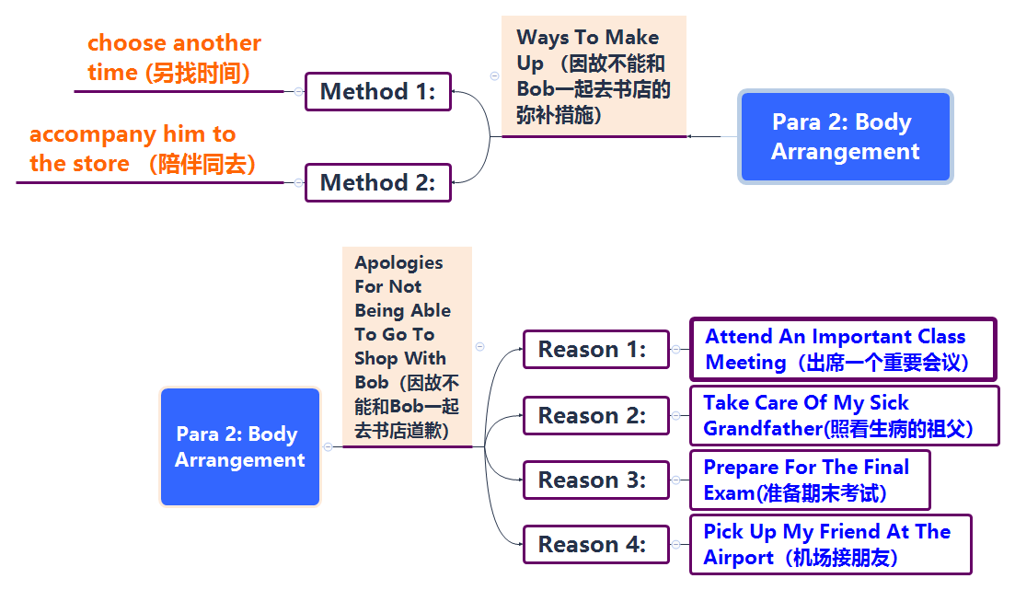
道歉信 思维导图

Slide 24
道歉信范文 （2016·全国卷三：因故不能和Bob一起去书店致歉）
【参考范文Possible Version 1:】
Dear Bob,
I’m sorry to say that I cannot go to the bookstore with you on Friday afternoon. I have just found that I have to attend an important class meeting that afternoon. I hope the change will not cause you too much trouble.
Shall we go on Saturday morning? We can set out early so that we’ll have more time to read and select books. If it’s convenient for you, let’s meet at 8:30 outside the school gate. If not, let me know what time suits you best. I should be available any time after school next week.
Yours,
Li Hua

Slide 25
道歉信范文 （2016·全国卷三：因故不能和Bob一起去书店致歉）
【参考范文Possible Version 2:】
Dear Bob,
① I’m writing to tell you that I cannot go to the bookstore with you at our appointed time. I am feeling terribly sorry for that and I hope you can understand me.
② The reason why I won’t be availabele at that time is that my grandfather felt ill suddenly yesterday and now he is in hospital. My family are taking turns to take care of him in the hospital. So I have to stay with him that day.
③ What about going to the bookstore next Sunday? If you are free, we will have a wonderful time together.
Yours,
Li Hua

Slide 26
道歉信范文 （2016·全国卷三：因故不能和Bob一起去书店致歉）
【参考范文Possible Version 3: 】
Dear Bob,
(表示歉意) I’m sorry to say that I might have no choice but to break my promise of going to the book store with you. （说明原因）I have just been informed that our class is going to hold an important meeting on Saturday afternoon---exactly the time we shall meet. What an awful coincidence! I feel so sorry about it.
（另约时间）Now that I’m not able to be present on time, shall we choose another time? I’ll be available any time after the meeting. Will Sunday morning suits your convenience? If so, we can meet then and I’m sure we will have a good time together.
（再次致歉）I make an apology again for not going to the book store with you as promised. I sincerely wish we can have fun next time.
Yours,
Li Hua

Slide 27
道歉信范文 （2016·全国卷三：因故不能和Bob一起去书店致歉）
【参考范文Possible Version 4:】
Dear Bob,
(表示歉意) I am sorry to tell you that I cannot go to the bookstore with you on Friday afternoon. I am upset about breaking my promise. （说明原因）Now I should make an apology to you because they told me there would be an important meeting for me on Friday afternoon. I hope the change will not bring you too much trouble.
To have more time to read and select books, I suggest that we set out early. （另约时间）Let’s meet at 8:30 am outside the school gate. Is it convenient for you if we go next Saturday morning? If not, let me know what time suits you best. I promise to come on time next week.
Yours,
Li Hua

Slide 28
道歉信范文 （2016·全国卷三：因故不能和Bob一起去书店致歉）
【参考范文Possible Version 5: 】
Dear Bob,
(表示歉意)I’m writing this letter to express my regret to you. I am extremely sorry to tell you that I cannot go to the bookstore with you on Friday afternoon.
（说明原因）The reason why I can’t accompany you to buy books is that I have to attend an important class meeting that afternoon. I sincerely hope that you can understand me and forgive me. （另约时间）I will be very grateful if you are kind that we will go on Saturday morning next week.
I will try to make up for my fault. （再次致歉） I apologize for any inconvenience I have caused.
Yours,
Li Hua

Slide 29
道歉信范文 （2016·全国卷三：因故不能和Bob一起去书店致歉）
【参考范文Possible Version 6: 】
Dear Bob,
I am sorry to tell you that I can’t go to the bookshop with you on Sunday morning as we planned last week. I am writing to apologize for breaking my promise.
Here is the reason why I can’t go to the bookstore with you. Since the final exam is just around the corner, I decide to stay at home to go over my lessons. You know, I didn’t do well in the last exam. So I want to devote all my spare time to working on my lessons in order to get good scores in the final exam. I am wondering if we can go to the bookstore on the second Sunday in January. Sorry again for the inconvenience caused to you. I promise to come on time next time.
Look forward to your early reply.
Yours,
Li Hua

Slide 30
道歉信题型训练-2 （浙江五校联考：因故不能应约共进晚餐表歉意）
第一节：应用文写作（满分15分）
假如你是李华,你的好友Tom想约你明晚和他家人共进晚餐,但你因故不能应约。请根据以下要点用英语给他写一封电子邮件:
1.表示歉意;
2.解释原因;
3.弥补方法。
注意:1.词数80左右;
2.可以适当增加细节,以使行文连贯。

Slide 31
道歉信范文 （浙江五校联考：因故不能应约共进晚餐表歉意）
【Writing Sample：Possible Version 1(浙江五校联考)】
Dear Tom,
Thank you for your invitation to have dinner at your home tomorrow evening. Unfortunately, it is much to my regret that I cannot join you and your family, because I will be fully occupied then for an important exam coming the day after tomorrow.
I feel terribly sorry for missing the chance of such a happy get-together, and I hope that all of you enjoy a good time. Is it possible for you and me to have a private meeting afterward? If so, please don’t hesitate to drop me a line about your preferable date. I do long for a pleasant chat with you.
Please allow me to say sorry again.
Yours,
Li Hua

Slide 32
道歉信范文 （浙江五校联考：因故不能应约共进晚餐表歉意）
【Writing Sample：Possible Version 2(浙江五校联考)】
Dear Tom,
I’m grateful and honored to be invited to have dinner at your home tomorrow evening.
However, it’s regretful that I’m so engaged in my study to prepare for the important approaching final examination that I can’t spare time to join you and your family. I am extremely sorry that I won’t have such a good chance to have a get-together with you, hoping all of you enjoy a pleasant time. Are you available to have a personal meeting afterward? If you are free, please let me know the specific time for the appointment. I really hope to have a great time with you.
I sincerely hope you can understand my situation. Please accept my most cordial apology again.
Yours,
Li Hua

Slide 33
道歉信题型训练-3 （不能参加“中国传统文化日”活动表歉意）
第一节：应用文写作（满分15分）
假如你是李华,你和外教Christina原定于本周六上午一起参加“中国传统文化日”活动。但因故你不能履约，请根据以下要点用英语给她写一封电子邮件，内容包括:
告诉她不能履约；
解释爽约的原因；
希望她谅解。
注意: 1.词数80左右;
2.可以适当增加细节,以使行文连贯

Slide 34
道歉信范文 （不能参加“中国传统文化日”活动表歉意）
【参考范文Writing Sample】
Dear Christina，
I’m writing to apologize to you for not being able to participate in the Chinese Traditional Cultural Day activity to be held on the Saturday morning with you as we planned last week.
To be honest, I wish I could join in the activity, but I am afraid I will not be available because I was informed yesterday that I would have to go to Naijing for a contest on the morning of Saturday. That is why I can’t go with you. I am awfully sorry for breaking my promise and I apologize for any inconvenience it brings to you. I hope you can understand me.
Wish you a good time there.
Yours,
Li Hua

Slide 35
道歉信题型训练-4 （2014北京卷：由于腿部受伤不能和朋友一起去云南旅游表歉意）
第一节：应用文写作（满分15分）
（2014北京卷）假如你是李华, 你给英国朋友Chris写封信，内容包括：
你们原计划7月份一同去云南旅游；
由于脚步受伤，你无法按原计划前往；
表达你的歉意并建议将旅行推迟到8月份。
注意: 1.词数80左右;
2.可以适当增加细节,以使行文连贯

Slide 36
道歉信题型训练-4 （2014北京卷：由于腿部受伤不能和朋友一起去云南旅游表歉意）
写作提示：
写作步骤：按照命题中汉语提示先后顺序，开门见山，表明写信目的，说明原因，表示歉意，提出修改原计划的建议；
注意使用客套用语；
3. 时态：以一般现在时为主。

Slide 37
道歉信范文 （2014北京卷：由于腿部受伤不能和朋友一起去云南旅游表歉意）
【参考范文Possible Version 】
Dear Chris，
（开头句）How is everything going? （说明不能履行原计划的原因）I remember I planned to accompany you to visit Yunnan in July, but I’m sorry that I can’t keep my promise that I’ll pay a visit to Yunnan with you, because my left foot was injured, I cannot go with you as planned/scheduled.
(表示歉意并提出建议) I’m sorry about it. Can I suggest that we put it off until early August? I wish you could understand.
I’m looking forward to hearing from you soon.
Yours,
Li Hua

Slide 38
Thanks

