Slide 1

感恩遇见，相互成就，本课件资料仅供您个人参考、教学使用，严禁自行在网络传播，违者依知识产权法追究法律责任。
更多教学资源请关注
公众号：溯恩高中英语
知识产权声明

Slide 2


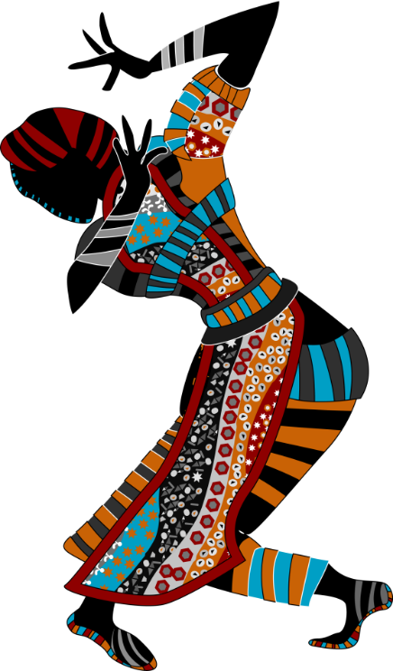

Unit 3 Diverse Cultures
Listening & Talking

Slide 3
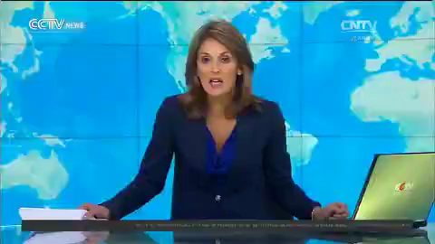

Slide 4

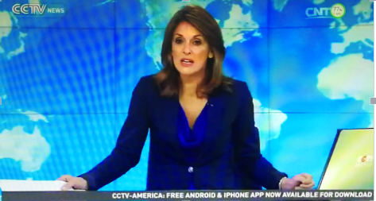
Talk about ethnic minority cultures in China
Watch and answer
What is the news about?
Miao
The ______, one of the 55 ethnic minority groups in China, celebrate new year with _________________ in __________.
songs and dances
Guizhou
Notes:
带着学生读一遍大意 ethnic minority: a group of people of a different race from the main group in a country

Slide 5
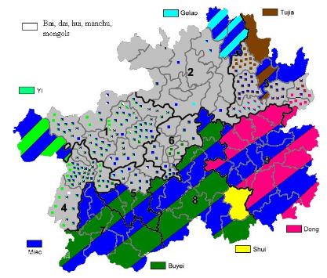

The population distribution(分布) of ethnic minority groups in Guizhou
Gelao
Tujia
Which three ethnic minority groups have the largest population?
Yi
the Miao
the Buyi
the Dong
Dong
Shui
Miao
Buyi

Slide 6
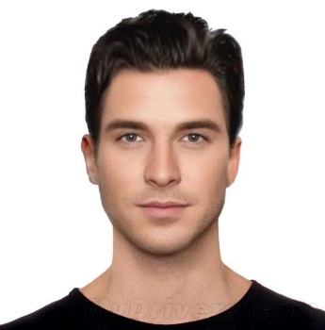

Talk about ethnic minority cultures in China
Hi, I'm Justin. I'm crazy about Chinese ethnic minority cultures. I plan to travel to China in the approaching summer holiday.
Notes:
how many ethnic minories do we have/ are there in China? So China with traditional ethnic minority cultures attracts foreigners to visit every year.

Slide 7
Before the travel
Can you recommend a place to me?
Look and Describe
Guizhou is home to diverse ethnic minority groups, so I recommended Guizhou to Justin by sharing a webpage.
Notes:
underline them with the curiosity, Justin fly to

Slide 8

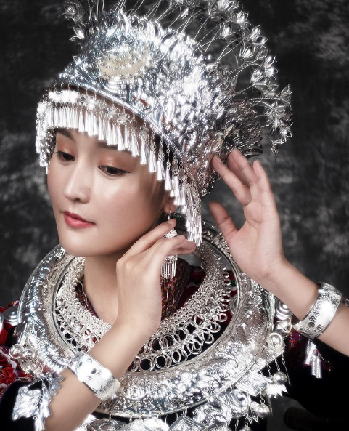

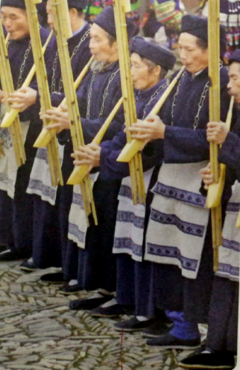
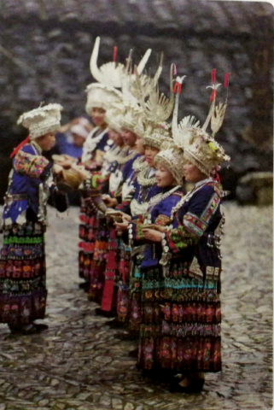
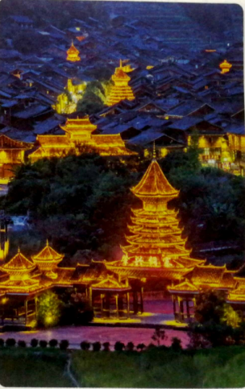
Before the travel
silver accessories
Describe the pictures with the help of the following sentence patterns.
Miao villagers dressed in ________________ are______________.
Miao women wearing _______________ are _____________.
Zhaoxing Dong village with_____________ is_______________.
Notes:
生词：silver accessory: a thing that you can wear or carry that matches your clothes, for example a belt or a bag； musical instrument; perform embroidery silver jewelry/ jewels
an object that you buy or keep to remind yourself of a special occasion or a place you have visited

Slide 9
Before the travel
Can you recommend a place to me?
Read and Think
Read the webpage on the worksheet.
Underline what might interest Justin about the Miao and the Dong.
Notes:
underline them with the curiosity, Justin fly to

Slide 10
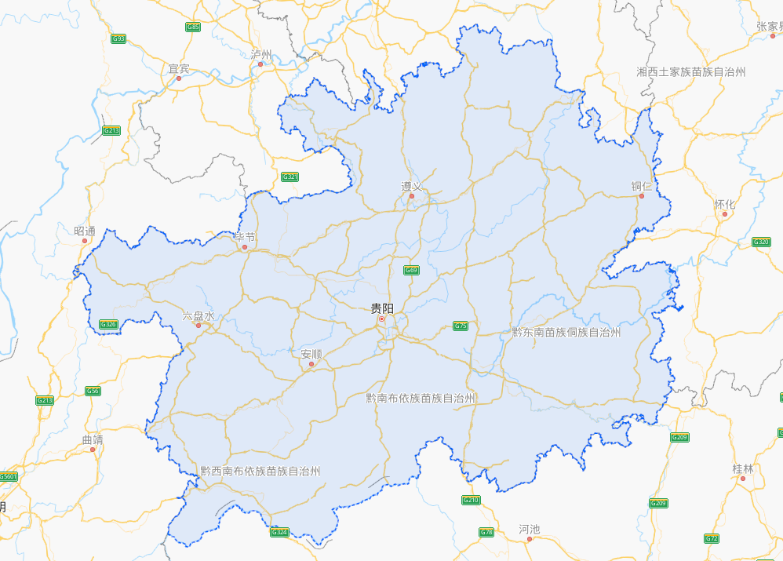
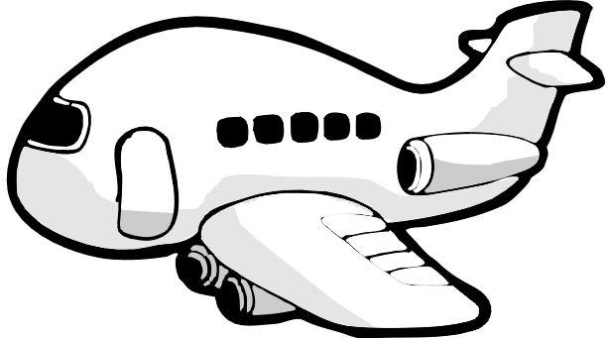
I'm traveling to Guizhou.
Guiyang
Qiandongnan Miao and Dong Autonomous Prefecture
Qiannan Buyi and Miao Autonomous Prefecture
Qianxinan Buyi and Miao Autonomous Prefecture

Slide 11


While traveling
I'm in Guizhou now.
Listening
Task 1: Listen for basic information:
What information did Justin learn about the Miao and the Dong?
Notes:
While traveling, Juatin met a new friend. listen to their conversation and complete the summaries below.

Slide 12
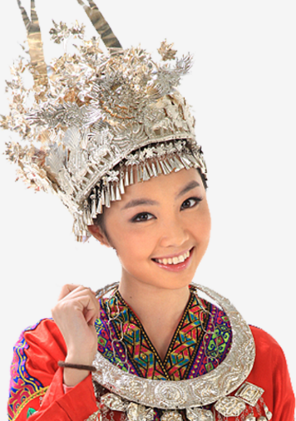
While traveling
I'm in Guizhou now.
Task 2: Listen for summaries:
Wu Yue
lusheng
Part 1 Justin and _______ watched some ______ people play the ________. The instrument has a history of over _____years and it is even mentioned in the oldest collection of Chinese poetry. Then they watched the ____________. Justin wanted to buy some hand-made ______________ accessories as souvenirs. He was told that the price will depend on the percentage of _____.
Miao
3000
lusheng dance
traditional/ silver
silver
I'm Wu Yue.
Notes:
collection: several stories, poems, pieces of music etc that are in one book or on one record first go through the two passages to get yourself prepared 提问巩固听力内容，为说做准备 according to part 1, what do you know about Miao people?

Slide 13
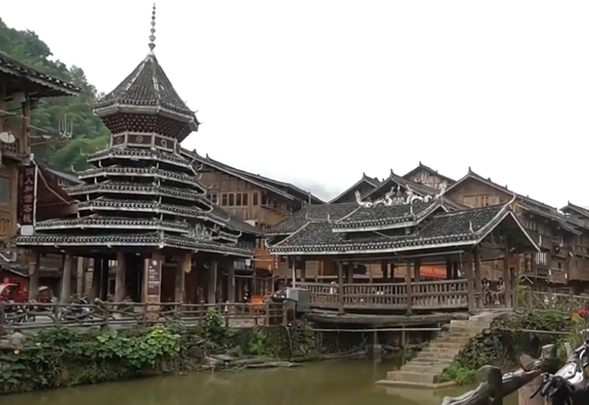
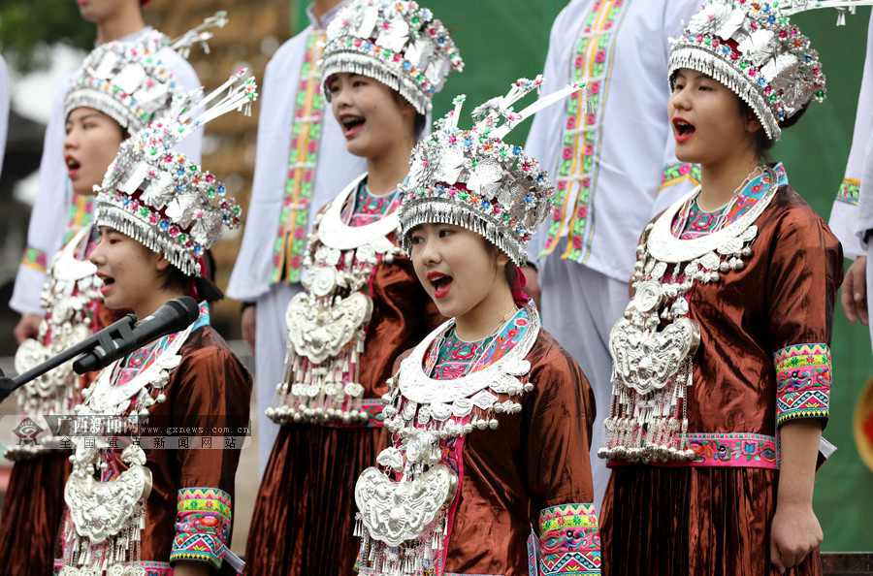
While traveling
Part 2
They will go to a pretty ______ village called _______. They will see the __________ and the _________________. They may also see a performance of the _____________of the Dong people.
Dong
Zhaoxing
drum towers
wind and rain bridge
the Grand song

Slide 14
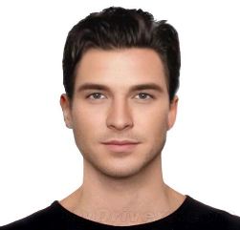
Summarizing
I'm in Guizhou now.
Summarize what Justin learnt about the Miao and the Dong according to the listening.
the Miao
the Dong
(Zhaoxing Village)
...

Slide 15
Summarizing
I'm in Guizhou now.
Summarize what Justin learnt about the Miao and the Dong according to the listening.
playing the lusheng
performing the lusheng dance
the Miao
wearing hand-made silver accessories
drum towers
the Dong
(Zhaoxing Village)
wind and rain bridges/ flower bridges
a performance of the Grand song
...
Notes:
which etnnic group do you belong to ? From the listening, we know they had a deep converstaion. They both show interest in the topic and they are listening to each other carefully.

Slide 16
Task 3: Read and Think
What expressions does Justin use to show his feelings about the Miao and Dong cultures?
Justin: Hey, Wu Yue, do you know ...
Wu Yue: Yes, it's called a lusheng...
Justin: It sounds beautiful. Is it made of bamboo？
Wu Yue: Yes. Can you guess when it was invented?
Justin: Um... five hundred years ago? I can't tell...
Wu Yue : That's a good guess, but the Lusheng ...
Justin : Wow, such a long time ago ...
Wu Yue : Yes, indeed, and they all make me proud...
Justin: This is great! And I really like the silver accessories ...
Wu Yue: Oh, they're traditional hand-made accessories. I can help you buy...
Justin:Great, thanks! I hope they're not expensive.
Wu Yue: Oh, well, it'll depend on the percentage of silver.
Justin: Great, now I have my souvenirs. ...
Wu Yue: I'm taking you to Zhao Xing, ...
Justin: Great, I can't wait. ....
Wu Yue: There is. Frist, I'll take you to see the beautiful ...
Justin: Wow, I'm really looking forward to it now.

Slide 17

Task 3: Read and Think
What expressions does Justin use to show his feelings about the Miao and Dong cultures?
Showing you are interested and you are listening
It sounds beautiful!
Wow, such a long time ago.
This is great!
Great, I can't wait.
Wow, I'm really looking forward to it.
Notes:
are you proud of our culture from the conversation, we know Jusin has known a lot more about the Miao and Dong people

Slide 18
Guiyang
Qiandongnan Miao and Dong Autonomous Prefecture
黔东南苗族侗族自治州
Qiannan Buyi and Miao Autonomous Prefecture
Qianxinan Buyi and Miao Autonomous Prefecture

Slide 19
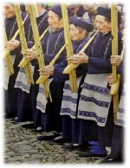

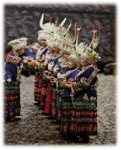
After the travel
I'm back in school now.
Talking: A Sharing Meeting
Justin went back home and met his friends. He was going to share his travel experience and send souvenirs.
As a friend, what do you want to know about his trip?
Notes:
most importantly, speak with emotion。 make sure everyone is involved. speak loud enough to make yourslef heard and speak with emotion.

Slide 20

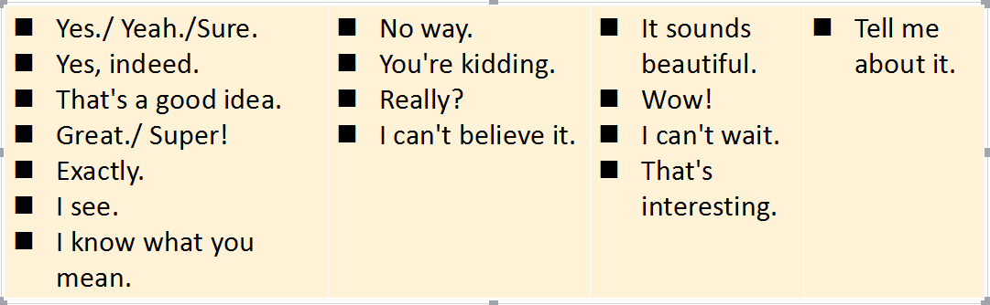
After the travel
Talking: A Sharing Meeting
Group work: suppose one of you is Justin and the rest of you are his friends. Make a conversation to talk about Justin's trip.
Use the following expressions to show you are listening.
Ask questions to cover as much as Justin’s travel experience.
Present a complete conversation with everyone involved.
Showing you are interested and listening
Using proper body language, like eye contact and nodding also works.
Notes:
most importantly, speak with emotion。 make sure everyone is involved. speak loud enough to make yourslef heard and speak with emotion.

Slide 21
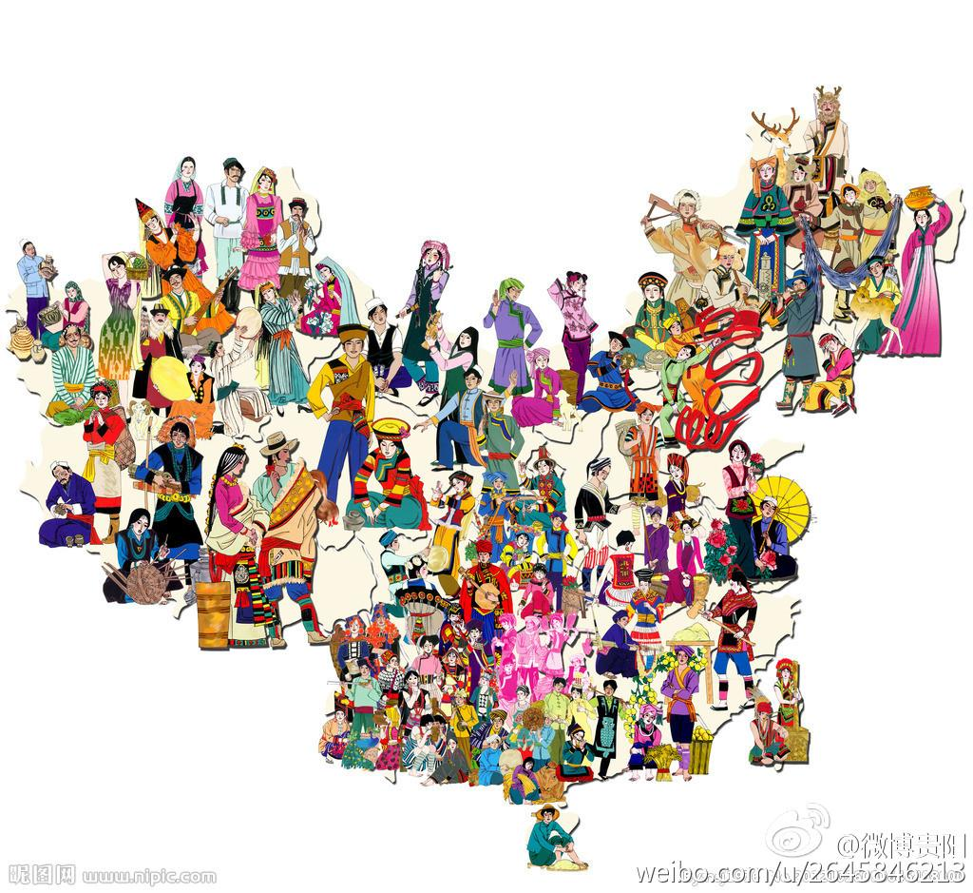
Embrace and respect diverse cultures!
Seize every opportunity to spread our fascinating culture!
The beauty of the world lies in the diversity of its people.
We are family!
Notes:
What i want to say is as a country of 56 peoples, we are a family let's.... shal we?

Slide 22
Homework: Sharing traditional customs
The Tomb-sweeping Day is approaching.
Work in groups and talk about the different customs in your hometown.
Showing you are interested and listening
Yes./ Yeah./Sure. Yes, indeed. That's a good idea. Great./ Super! Exactly. I see. I know what you mean. | No way. You're kidding. Really? I can't believe it. | It sounds beautiful. Wow! I can't wait. That's interesting. | Tell me about it.

Slide 23
