Slide 1

感恩遇见，相互成就，本课件资料仅供您个人参考、教学使用，严禁自行在网络传播，违者依知识产权法追究法律责任。
更多教学资源请关注
公众号：溯恩高中英语
知识产权声明

Slide 2
B3U3 Diverse Cultures

Slide 3
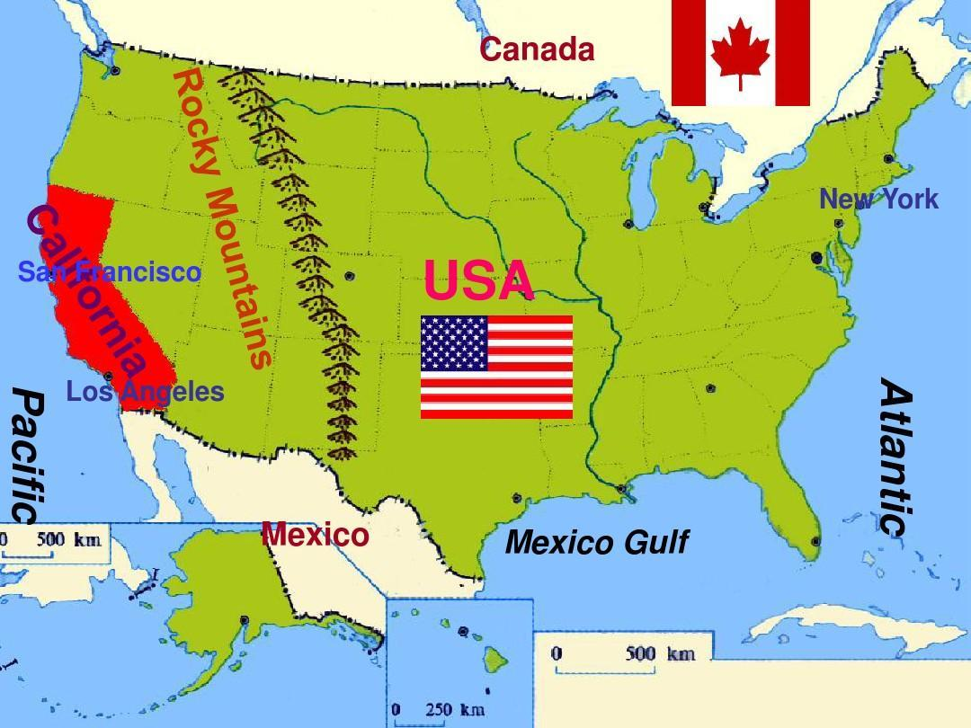
Pre-reading
Q: What do you know about this city?
San Francisco
Notes:
图片导出，使学生在地理位置上对旧金山有所认知

Slide 4
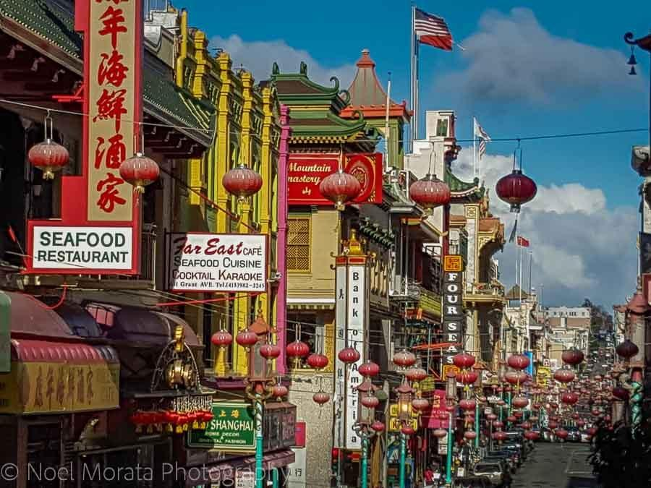
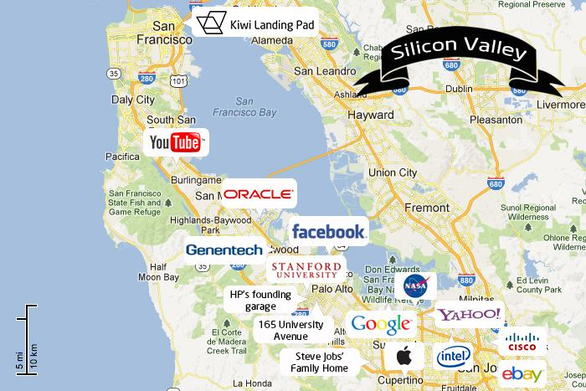
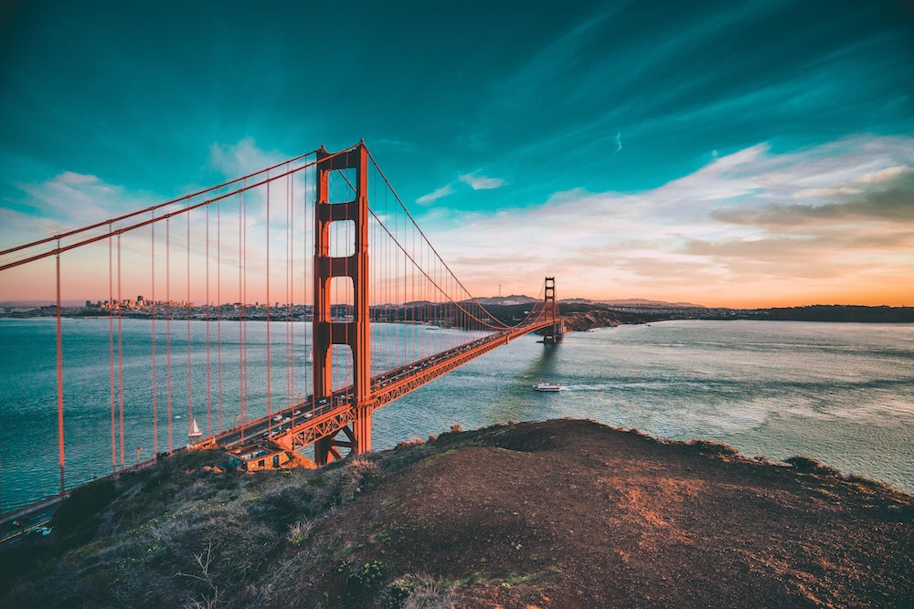
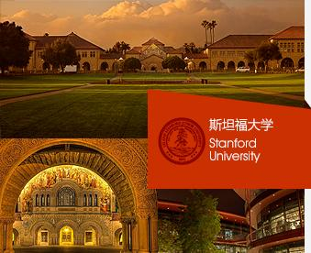
China Town
Silicon Valley
Golden Gate Bridge
Stanford University
Notes:
激发学生已有经验

Slide 5
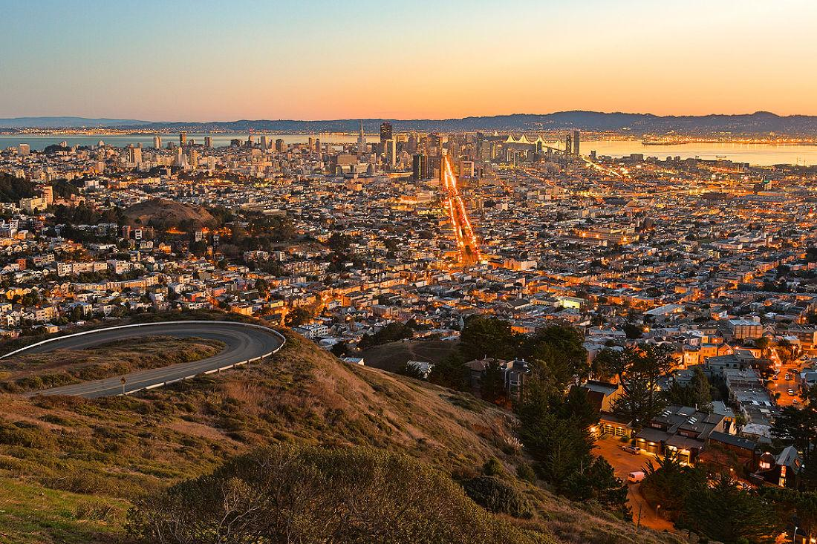
Pre-reading
If you have a chance to visit the city, what do you want to know about this city?
Group Work:
to list what you want to know about this city.
possible questions:
Which place to visit?
What can we see there?
What can we eat there?
the history of the city
the people of the city
the culture of the city
Notes:
创设情境，激发学生阅读兴趣，通过围绕话题头脑风暴，引发读前思考，拓展学生思维。让学生带着阅读问题，开启阅读

Slide 6

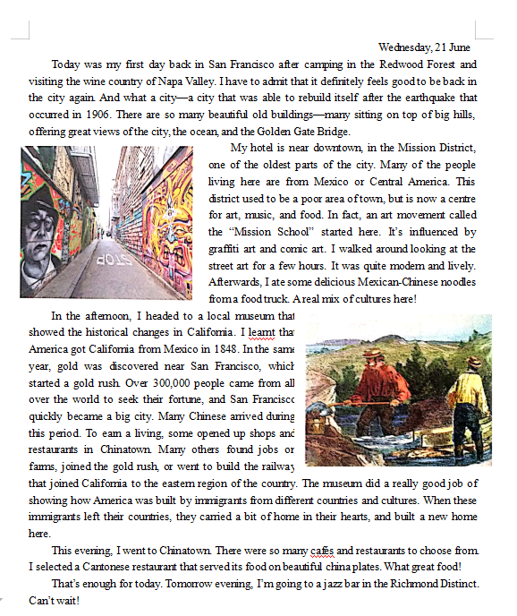
date
first person of speech
Q: What is the style of the text?
A. a news report
B. a letter
C. a travel guide
D. a travel journal
pictures
a travel journal
Notes:
立足语篇，关注体裁特征，训练快读策略，迅速把握关键信息

Slide 7
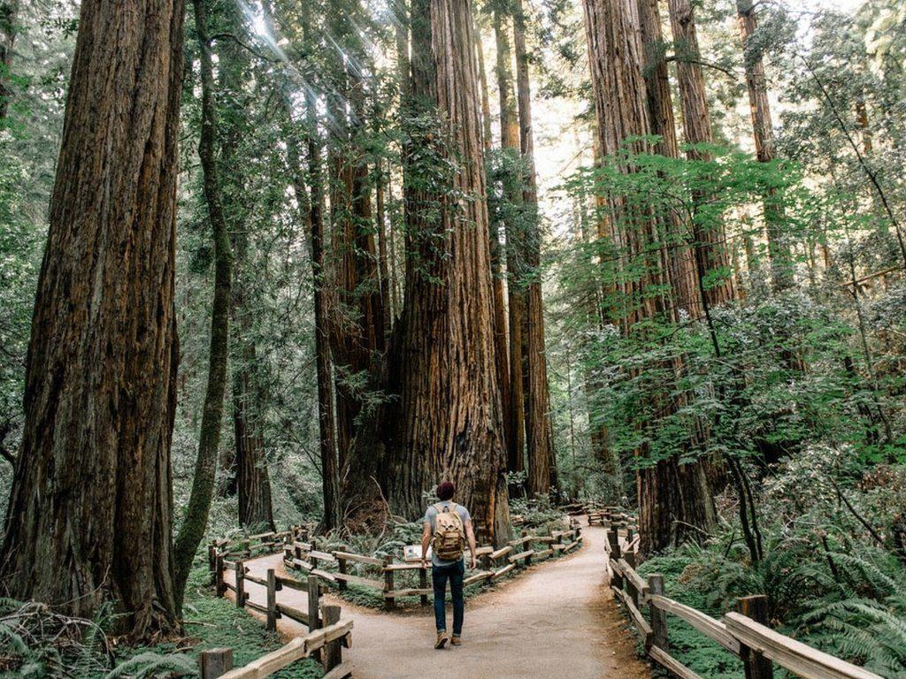
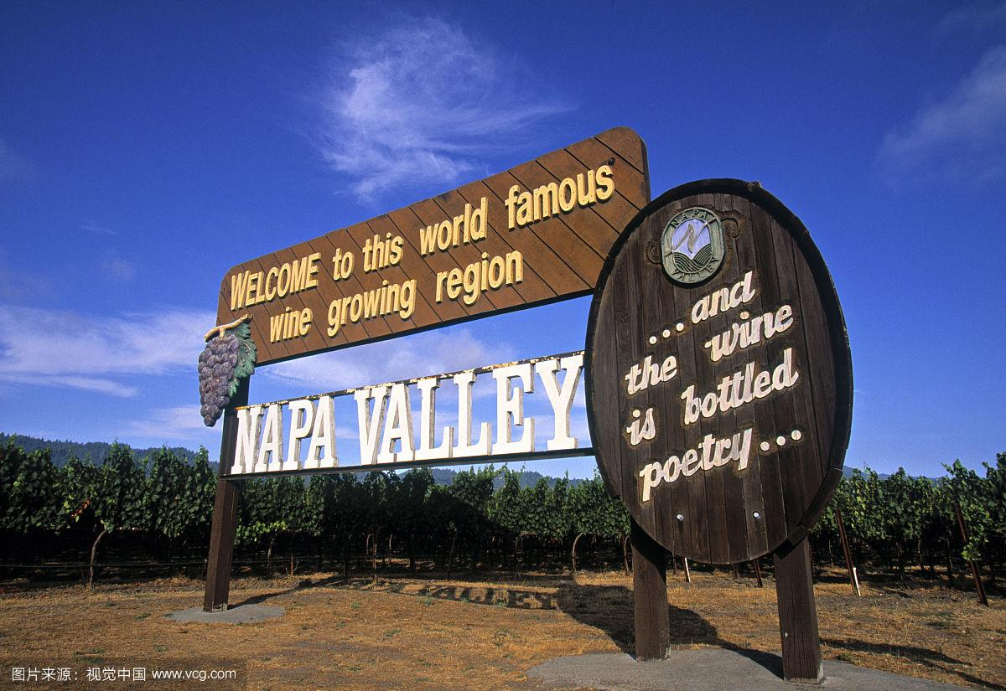
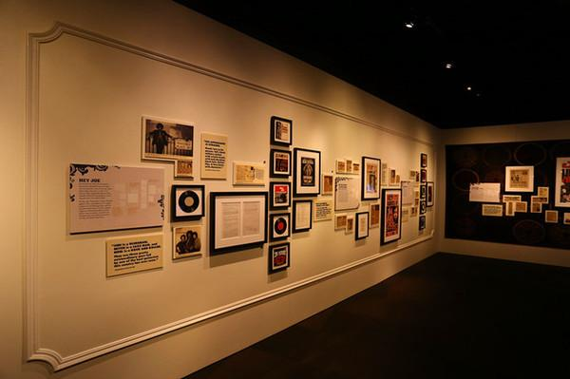
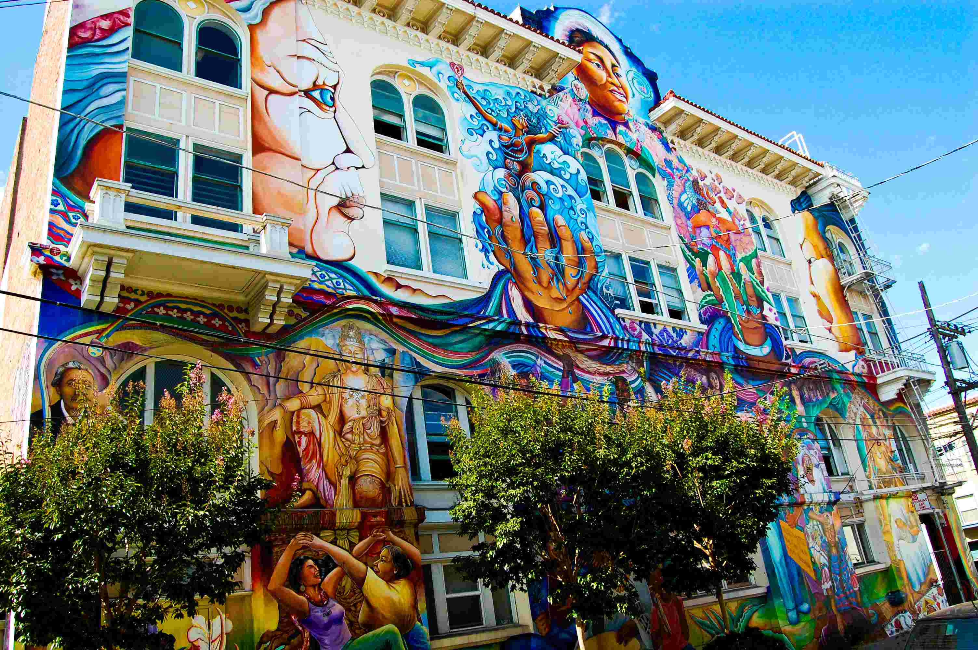
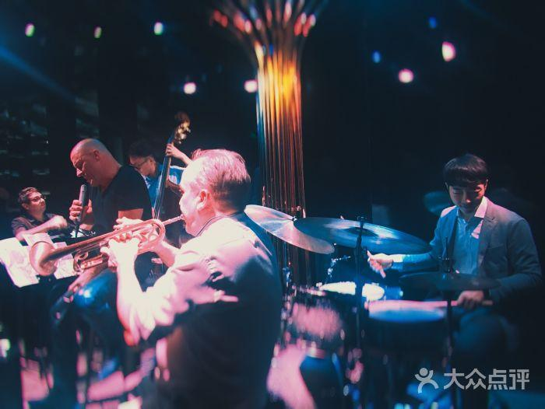
time&place
Today was my first day back to San Francisco
Redwood Forest
Napa Valley
a travel journal
the Mission District
In the afternoon,
a local museum
This evening,
Chinatown
Tomorrow evening,
a jazz bar
Notes:
依据体裁特征，快速定位信息，训练找读策略

Slide 8
time&place
Today was my first day back to San Francisco
Redwood Forest
Napa Valley
a travel journal
the Mission District
In the afternoon,
a local museum
This evening,
Chinatown
Tomorrow evening,
a jazz bar
Notes:
依据体裁特征，快速定位信息，训练找读策略

Slide 9


Tomorrow
Scanning
I’m going to a jazz bar.
Evening
What did I do?
I selected a Cantonese restaurant to enjoy dinner.
a travel journal
eager
Afternoon
Morning
I learnt the history of this city.
happy
look at the street art for a few hours…
ate delicious food
Before coming to San Francisco
inspired; touched
And what a city...
many beautiful old buildings
offering great view…
How did I feel ?
amazed
amazed and impressed
Notes:
通过导图处理加工文章信息，训练阅读加工策略；通过问题而How ｄｉｄ Ｉ ｆｅｅｌ 进行逻辑推断，训练逻辑推理能力

Slide 10
Scanning
Can this travel journal solve some of your questions?
possible answers:
Which place to visit?
What can we see there?
What can we eat there?
the history of the city
the people of the city
the culture of the city
Notes:
让学生通过解决读前问题，评估问题，训练批判性思维

Slide 11
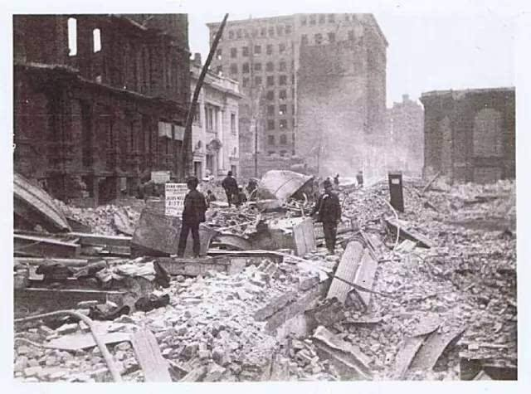
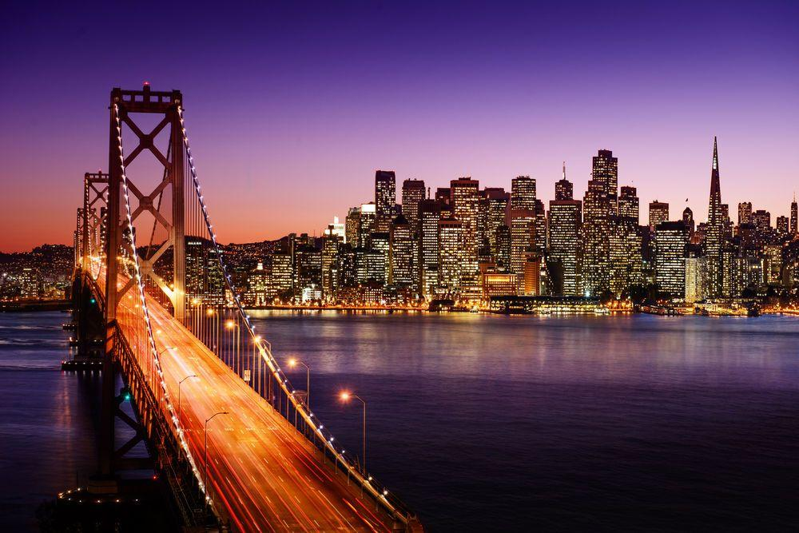
Thinking
What kind of city is San Francisco?
...I have to admit that it definitely feels good to be back in the city again. And what a city—a city that was able to rebuild itself after the earthquake that occurred in 1906. There are so many beautiful old buildings—many sitting on top of big hills, offering great views of the city, the ocean, and the Golden Gate Bridge.
newly-born, tough and wonderful
Notes:
通过分析原文信息，概括旧金山城市特点，深度理解文章信息；训练逻辑思维与批判性思维；
补充文章中的信息ｇａｐ

Slide 12
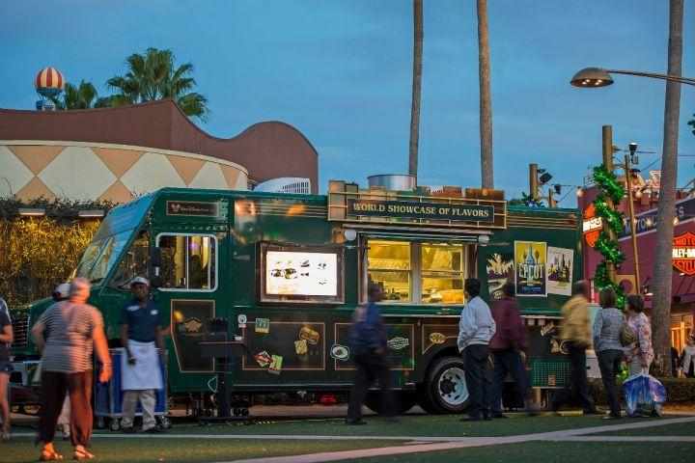
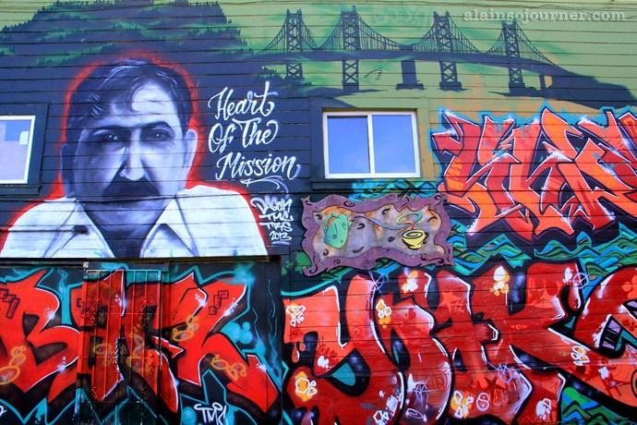
a vibrant city of art, mixed culture and ethnic diversity
My hotel is near downtown, in the Mission District, one of the oldest parts of the city. Many of the people living here are from Mexico or Central America. This district used to be a poor area of town, but is now a centre for art, music, and food. In fact, an art movement called the “Mission School” started here. It’s influenced by graffiti art and comic art. I walked around looking at the street art for a few hours. It was quite modern and lively. Afterwards, I ate some delicious Mexican-Chinese noodles from a food truck. A real mix of cultures here!
Many of the people living here are from Mexico or Central America.
graffiti art and comic art
the street art
quite modern and lively
Mexican-Chinese noodles
A real mix of cultures here!
More examples of ethnic diversity:
This evening, I went to Chinatown. There were so many cafés and restaurants to choose from. I selected a Cantonese restaurant that served its food on beautiful china plates. What great food!
That’s enough for today. Tomorrow evening, I’m going to a jazz bar in the Richmond Distinct. Can’t wait!

Slide 13
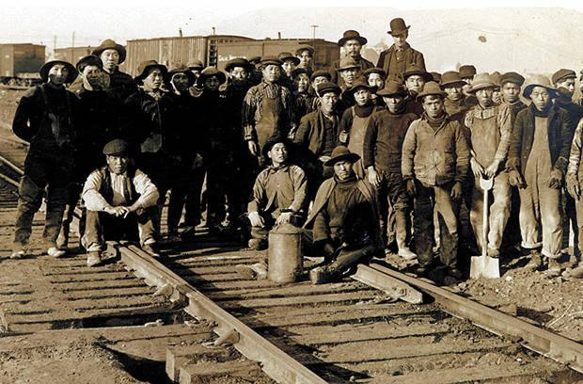
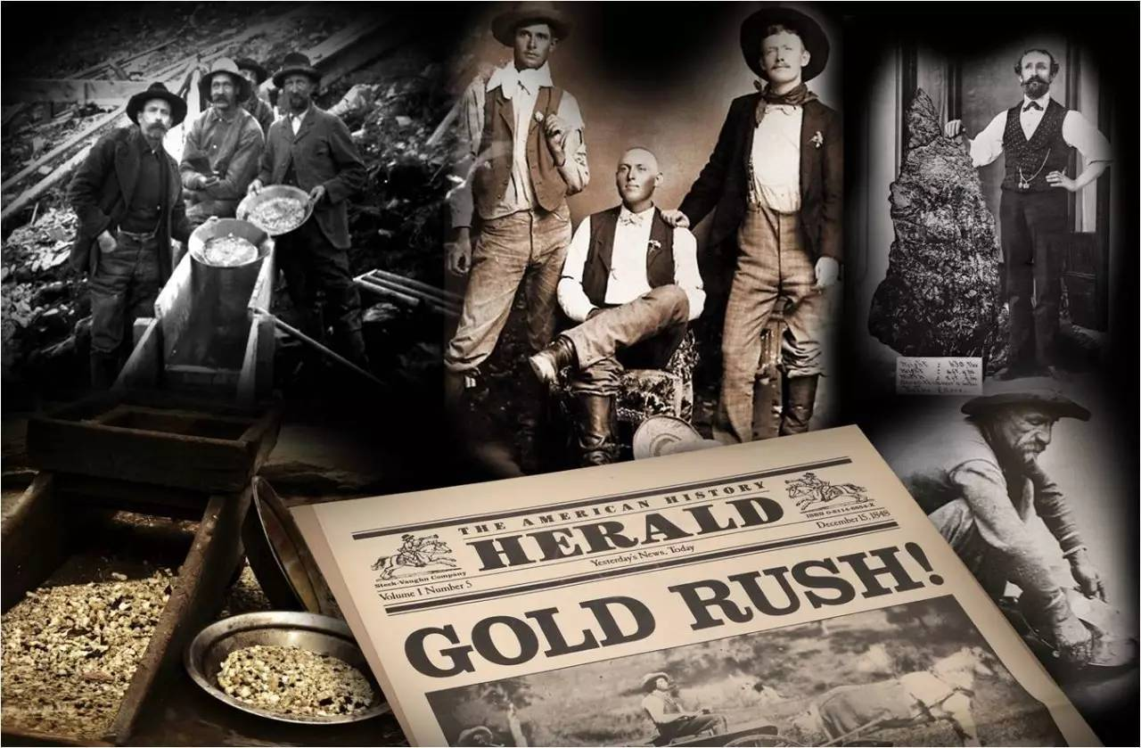
Further Thinking
What makes San Francisco such a city ?
a pioneering city with many immigrants
In the afternoon, I headed to a local museum that showed the historical changes in California. I learnt that America got California from Mexico in 1848. In the same year, gold was discovered near San Francisco, which started a gold rush. Over 300,000 people came from all over the world to seek their fortune, and San Francisco quickly became a big city. Many Chinese arrived during this period. To earn a living, some opened up shops and restaurants in Chinatown. Many others found jobs on farms, joined the gold rush, or went to build the railway that joined California to the eastern region of the country. The museum did a really good job of showing how America was built by immigrants from different countries and cultures. When these immigrants left their countries, they carried a bit of home in their hearts, and built a new home here.
historical
changes
America got California from Mexico
in 1848.
a gold rush
Chinese arrived during this period.
When these immigrants left their countries, they carried a bit of home in their hearts, and built a new home here.
These immigrants left their countries, but they brought their culture to the new city.
Notes:
进一步分析背后原因；更好理解主题；为主题探讨cultural diversity做铺垫

Slide 14
Summary:
What can we learn about San Francisco through this journal?
a city to explore cultural diversity
newly-born; tough and wonderful
vibrant ;with atmosphere of art
with ethnic diversity
with cultural diversity

Slide 15
Discussion:
What are the benefits and challenges of cultural diversity?
opportunities to experience different cultures and customs;
misunderstanding across languages and cultures
benefits
Challenges
Personal growth (culture awareness, intercultural communication, cooperation)
conflicting values and lifestyles;
unconscious cultural biases;
race conflicts;
more open-minded society;
exchange of innovative ideas;
Notes:
进行主题探讨；通过批判性问题，通过评估评价活动；让学生辩证看待文化多样性；

Slide 16

The challenges
Notes:
补充最新信息，与生活联系，为拓展性活动创设真实情境

Slide 17


extensive activity
Can you record a vlog to speak for cultural diversity?
1. You can mention the benefits of cultural diversity with your own experience of cultural diversity or some examples.
2. You can talk about how to
treat cultural diversity.
3. To voice for Asians who are
biased
...
Notes:
通过录短视频，结合自身经历或其他例子，讲述文化多样性的好处，并且讲述如何对待文化多样性，为被歧视的亚裔发声

Slide 19
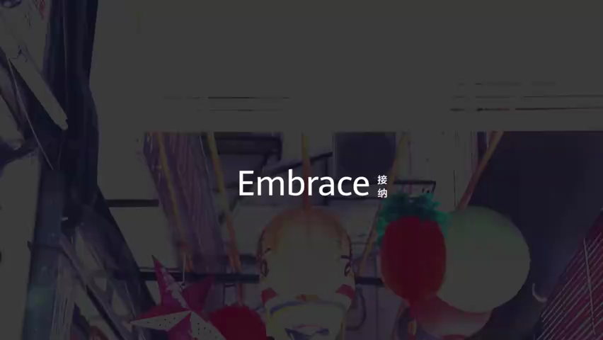
One Possible example:

Slide 20
Embrace the diversity!
Notes:
激发学生文化多元意识，培养学生文化多元的包容力与理解力；素养指向

