Slide 1


感恩遇见，相互成就，本课件资料仅供您个人参考、教学使用，严禁自行在网络传播，违者依知识产权法追究法律责任。
更多教学资源请关注
公众号：溯恩高中英语
知识产权声明

Slide 2
老外朋友要来中国参加活动系列，告知信？
Lilly

Slide 3
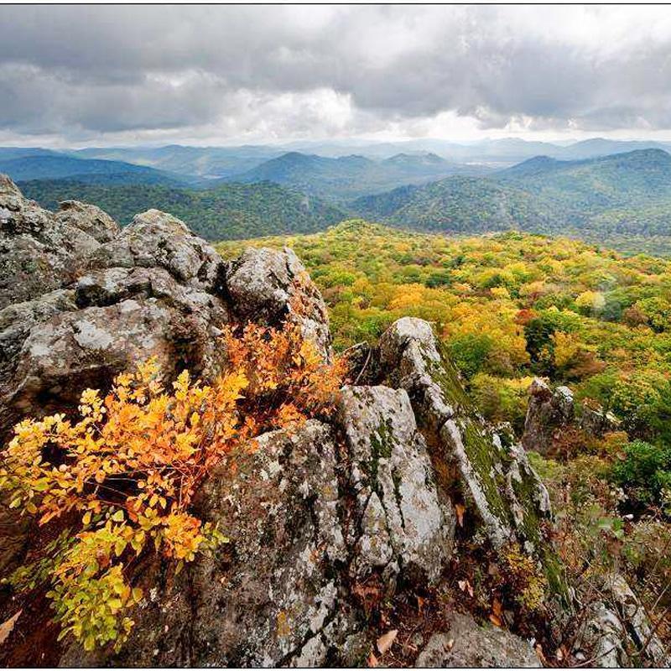
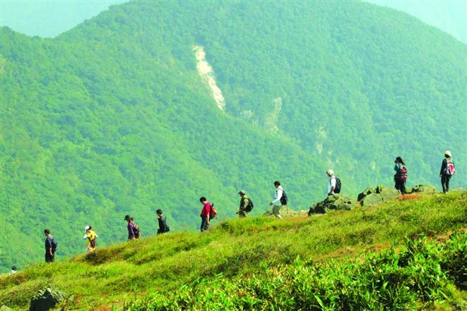
Review
假定你是李华，你校交换生James听说五一节将组织一次短途旅行，他来信告知你想参加此次旅行。请你给他回一封邮件，内容包括：
1.出发时间及目的地
2.具体活动：爬山、野餐等。
注意：1.词数80词左右
2. 可以适当增加细节，以使行文连贯

Slide 4
审题
Objection(对象):
Occasion（场合）:
Objective（目的）:
an exchange student in my school who wants to take part in the short trip on May Day.
tone
There will be a short trip on May day.
tense
To tell James something about the trip.
Key points: 1.时间与地点 2. 具体活动

Slide 5
Layout
What should be included in a letter of informing?
Dear ______,
Beginning --- Purpose of writing the letter【写信意图-说明自己的计划或目的➔告知对方什么信息】
➢Why are you writing the letter?
Body Arrangements---【告知具体信息➔（活动的时间地点与活动内容）➔注意增加细节，如活动安排目的或其他温馨提示】
When, where, and what?
Why and How?
Ending --- 【期待参加并表示祝福➔表达期许
Yours faithfully
***

Slide 6
Part1:Purpose
得知你想要参加五一的短途旅行，我写信来告知你一些讯息。
I‘m delighted to know that you want to join in the short trip on May Day. I’m writing to help you.
复杂句：
I’m delighted to know that you want to…so I’m writing to introduce something to you.
非谓语作状语：
Delighted to know that you want to join in the short trip on May Day, I’m writing to tell you some detailed information about it.
Knowing that you intend to join in the trip on May Day, I’m delighted to share some relevant information with you.
be accurate (精准) in words choice
be concise(精炼) in sentence patterns

Slide 7
Part 2 Body Part
be complete (完整) in information
1.介绍出发时间及目的地
2. 介绍具体活动：爬山野餐
The destination is…
We will set off on foot for Yellow Mountain at our school gate at 8:00 am this Sunday.
We will depart from our school on foot to Yellow Mountain at our school gate at 8:00 am this Sunday.
The trip is scheduled to start at 8:00 am this Sunday. And all the students will gather at our school gate.
After arriving there/On arrival, we will climb up the mountain. At the top of it, we will have a picnic as lunch.
be coherent(连贯) in text

Slide 8
3.适当添加细节（how to add details?）-the hidden point
丰富要点2的描述：
After arriving there/On arrival, we will climb up the mountain. At the top of it, we will have a picnic as lunch.
where we can also enjoy a feast for the eyes.
, enjoying/appreciating the beautiful scenery of the nature
增加要点：
Climbing mountain will take us about two hours so remember to wear a comfortable sneakers/ to remember to take some snacks with you.
extra sweet tips
be practical in adding details

Slide 9
Part 3 Ending Part
期待参加➔表达期许
Looking forward to your joining.
Anticipating your participation.
Expecting your joining.
Hope you have a nice trip.
Wish you an unforgettable experience.
be sincere(真诚) in wishes

Slide 10
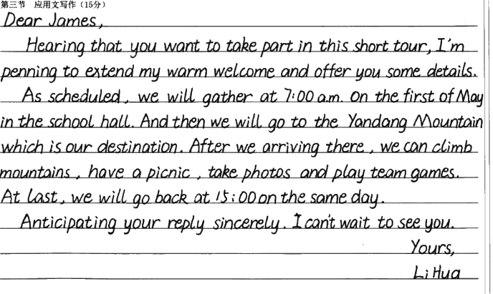
Appreciating Students’ Writing
complete and coherent

Slide 11
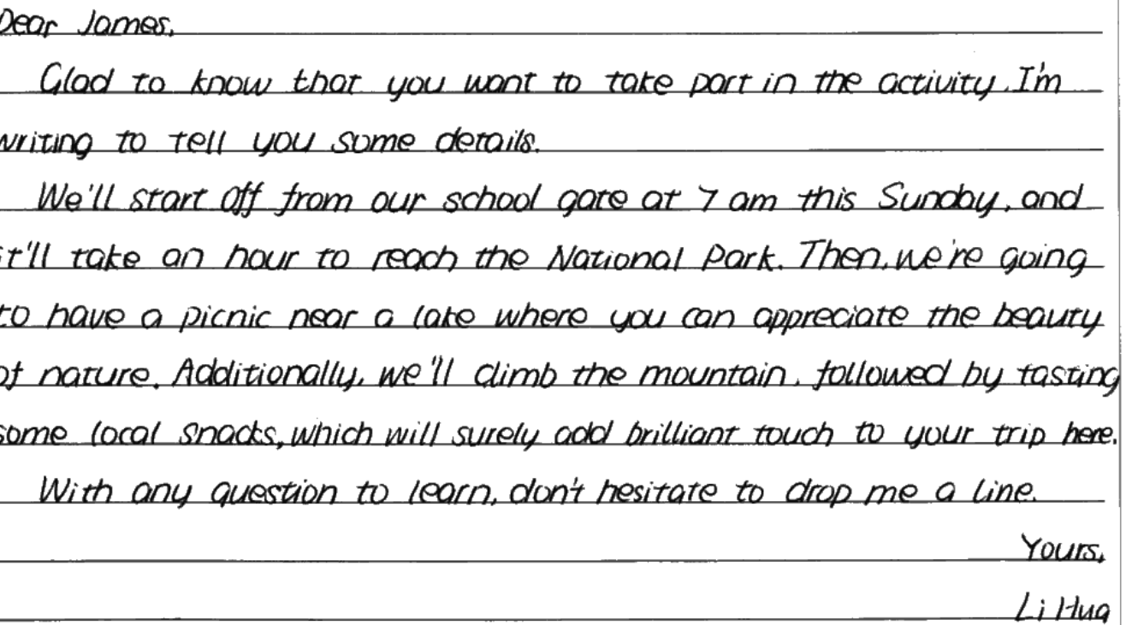
concise, complete and coherent

Slide 12
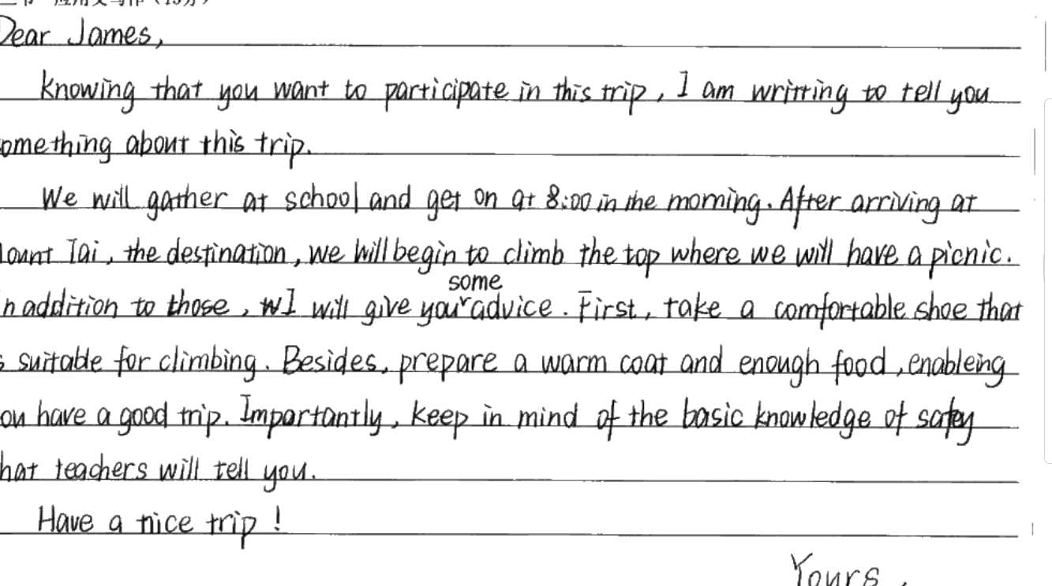
rich in details

Slide 13

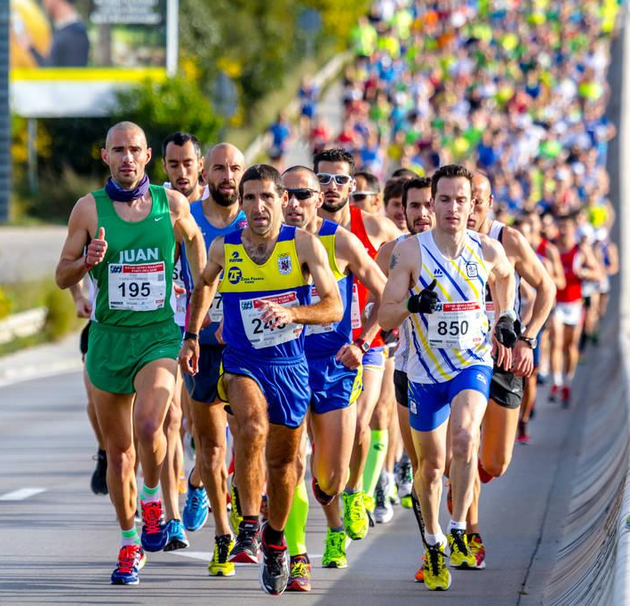
2021.04三地市联考
Practice
你是李华，外国友人Tony 写信告诉你他要来参加你所在城市举办的马拉松比赛，请你写封邮件回复他，内容包括：
1.马拉松的出发点、时间。
2.其他提示

Slide 14
One Possible version：
Dear Tony，
Knowing you intend to run the marathon in my city, I am delighted to share with you some relevant information.
The event is scheduled to start at 7:30 a.m. on April 25th. Runners will gather at the gate of Zhaoyang Park. Before the event, regular training is necessary, which will guarantee you a good performance. What’s more, with a long distance to cover, you’d better wear comfortable sneakers and suitable clothes.
Wish you an unforgettable experience.
Yours,
Li Hua

Slide 15
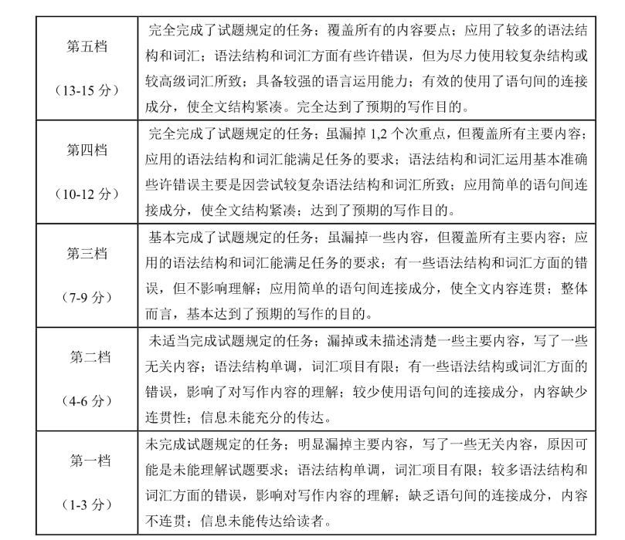

Slide 16

The way to start something is to stop talking but start doing it .
-Walt. Disney

