Slide 1

感恩遇见，相互成就，本课件资料仅供您个人参考、教学使用，严禁自行在网络传播，违者依知识产权法追究法律责任。
更多教学资源请关注
公众号：溯恩高中英语
知识产权声明

Slide 2
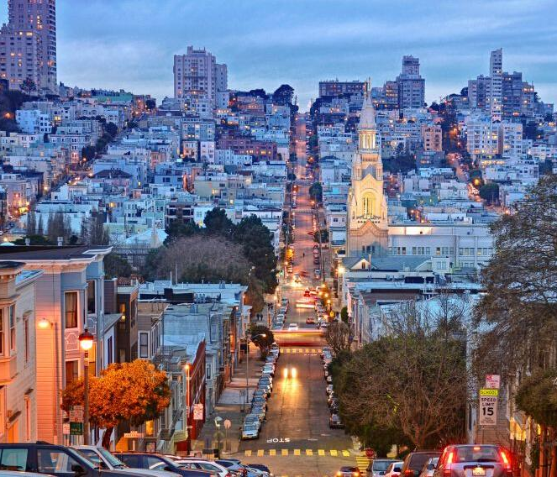
Unit 3 Diverse Cultures
Reading for writing

Slide 3
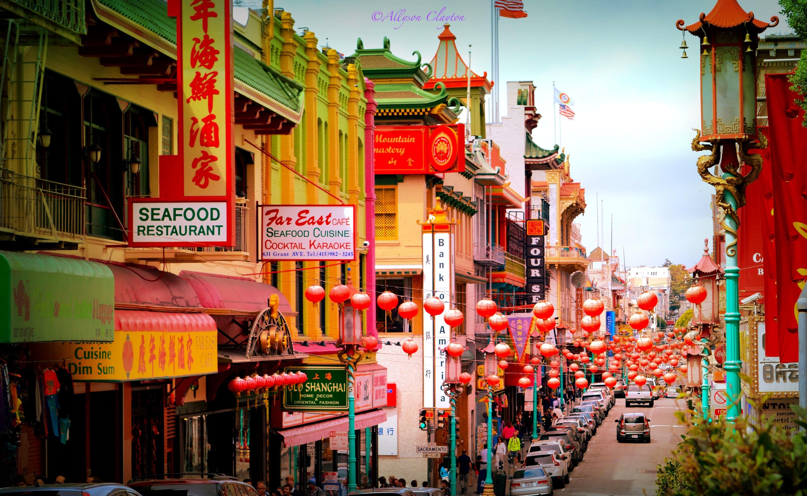

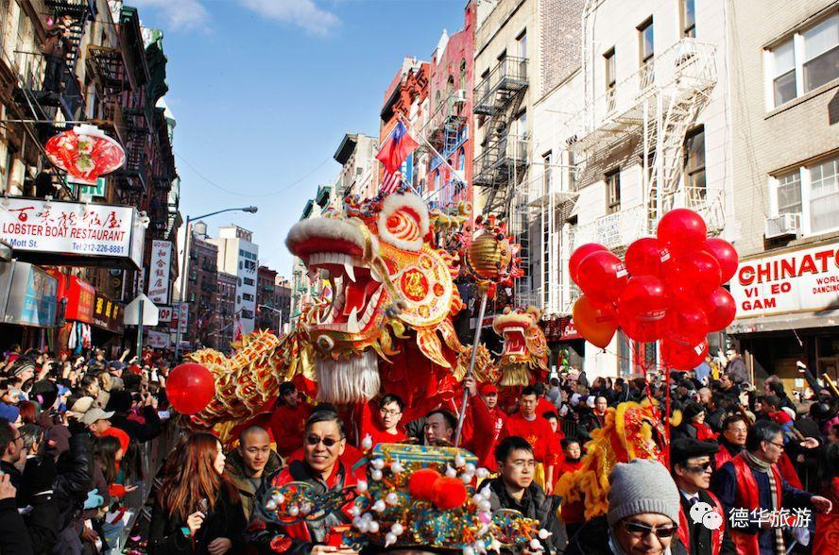
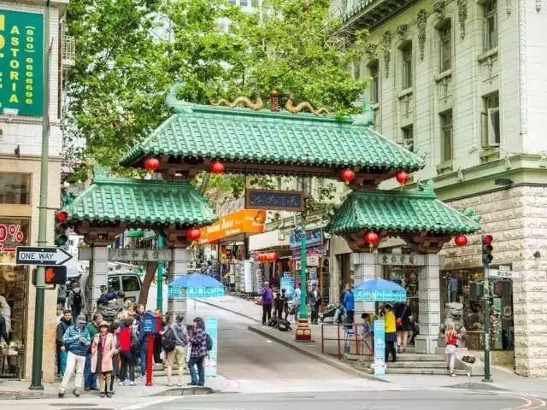
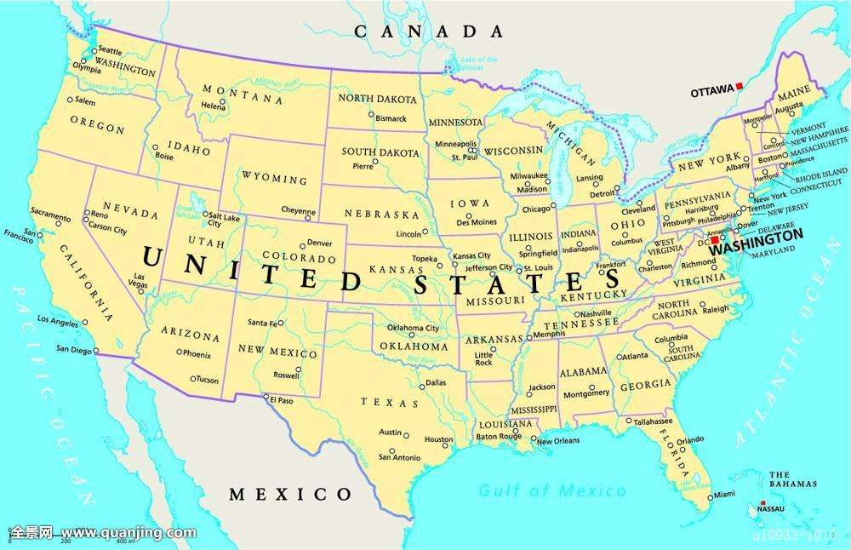
Chinatown
Revision
Location:
Feature:
located/situated in San
It is a popular tourist draw that receives...
Dragon Gate

Slide 4



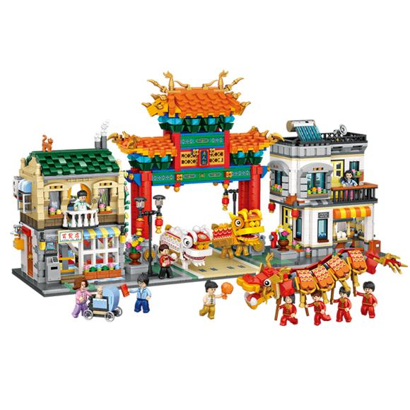
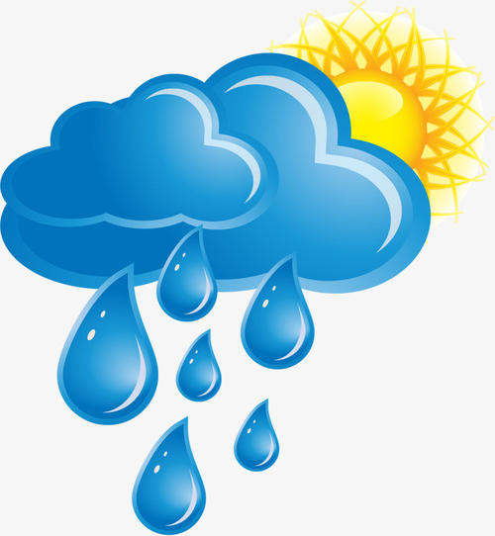

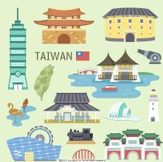
Chinatown
Lead-in——Brochure
The brochure should contain the introduction of:
location
population
Welcome To Chinatown
climate
tourist attractions
What should be included in the brochure to introduce it?
history, souvenirs, food...

Slide 5
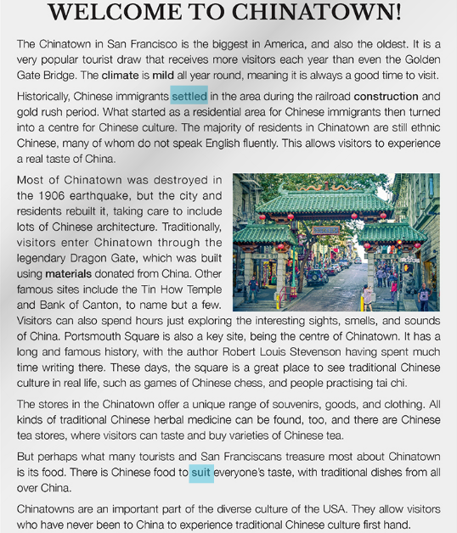
Reading
Brief Introduction
(Short introduction to Chinatown)
Can you divide the passage into several parts? And tell the reasons.
Detailed Introduction
(What you can learn and do)
(Stress the importance of Chinatown)
Summary

Slide 6
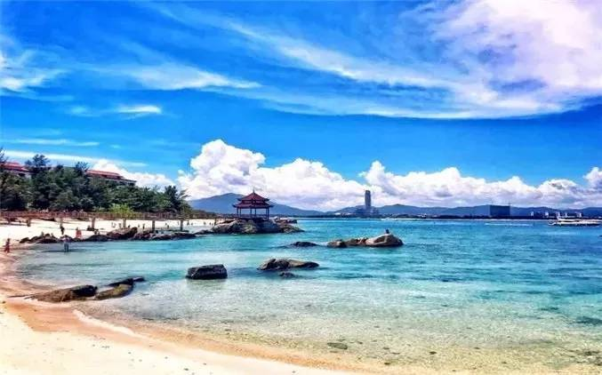
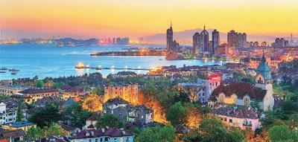
Reading
海南
1. What is mentioned in the first part? And How？
青岛
Location
The climate in Hainan is mild all year round, meaning that it is always a good time to visit.
  Qingdao is a city with four distinct seasons, cold in winter and hot in summer.
  Located in Shangdong Province, Qingdao is a city with four distinct seasons, cold in winter and hot in summer.
  Hainan, where the climate is mild all year round, is situated in South China.
Feature
Climate
Hainan, is situated in South China.
  Qingdao is located in Shangdong Province.
the weather in some location averaged over a long period of time
Do you know any other climates in different regions?

Slide 7

Reading
If you are the guide, what information about Chinatown will you introduce to your tourists? How will you make your introduction (language) vivid? (Combine your own thinking, make it your own expressions)
a. tourist attractions
b. population
c. history
d. food
e. business
f. other names
g. legends
h. ethnic groups
My version of the introduction to the history
Historically, Chinatown began as a residential district for Chinese immigrants then turned into a center for Chinese culture, meaning the majority of residents there were ethnic Chinese. And this is why people say you can experience a real taste of China.

Slide 8
Revision of the language in
Para | Introduction (location...P33) | Vivid Expressions
location, feature, climate
1.It is a popular tourist draw that receives...
Part1
(Para1)
2.The climate is mild all year round, meaning...
1. history
Historically,... What started as...then turned into...
2. ethnic groups
The majority of residents in... are..., many of whom...
Part2
(2-5)
1. famous sites include... to name but a few.
2. visitors can also spend hours exploring...
3. attractions
3. ...is a key site as well/a good place to visit, with结构
4. ...is a good place to visit, where...
4. business
...offer a unique range/diversity of ...;all kinds of...can be found
1. What is treasured most in...is...
5. food
2. There is food to suit everyone’s taste, with 结构
Part3
(para6)
...allow(s) people who...to...to experience... first hand
diverse culture

Slide 9

Thinking
Who are the intended readers?
Those who are intersted in traveling
What does the writer want to express in the passage?
What’s the theme of the passage?
To introduce a place with distinct cultural identity
—— Chinese culture
1. To show the combination of Chinese-American cultures
2. To show the unique position of Chinese culture in America
3. To show that Chinatown is the spiritual hometown of overseas Chinese and the way to spread Chinese culture

Slide 10

Writing
simple present tense the third person
海南基本情况介绍：
1. 气候、地理位置，基本特征（先不写）
2. 居民构成：来自三十多个少数民族，大多数普通话带口音(accent)
3. 旅游景点：天涯海角、三亚湾(Sanya Bay)、民族村、阳光滩等
4. 商业：纪念品、民族服装
5. 食品：椰子(coconut)、椰子产品
6. 历史：一开始作为少数民族居住地(minority residence)，慢慢发展成休闲度假胜地(leisure resort)
7. 别称：东方夏威夷（oriental Hawaii)
Sample
a. Is the city introduction clear?
b. Is the information specific and are the facts coreect?
c. Is the information arranged in a good order?
d. Does the passage have a proper beginning and conclusion?
e. Are there any grammar, spelling, or punctuation errors?
Hainan, which started as a minority residence then turned into a leisure resort, is a great place waiting for people to explore. Firstly, known as Oriental Hawaii, it allows people who have never been to Hawaii to experience the beauty and leisure life of Hawaii first hand. Besides, all kinds of traditional coconuts and products made of coconuts can be found here, so people will have the opportunity to experience the real taste of coconut. Most importantly, visitors can spend days exploring the striking tourist attractions, such as Tianya Haijiao, Sanya Bay, Ethnic Village and Shunshine Beach.
Try to write a short passage with at least 3 points, using various expressions

