Slide 1


感恩遇见，相互成就，本课件资料仅供您个人参考、教学使用，严禁自行在网络传播，违者依知识产权法追究法律责任。
更多教学资源请关注
公众号：溯恩高中英语
知识产权声明

Slide 2
Diverse Cultures
Welcome to My Class
嵊州市高级中学
尹 娟
Diverse Cultures

Slide 3
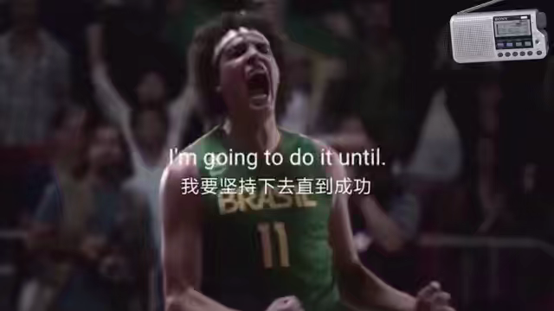
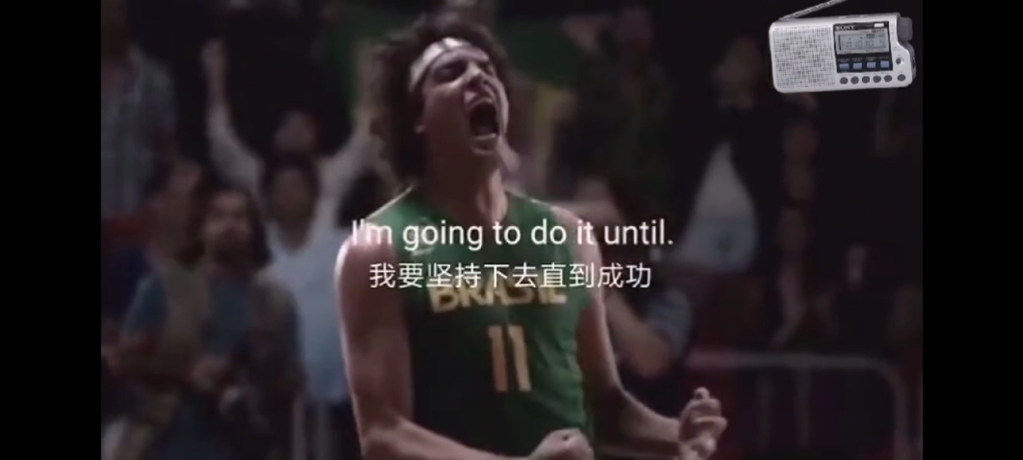
Appreciating & Guessing
Hints
1. When you feel like giving up, don’t.
2. When you’re thinking about giving up, don’t.
3. When it look like you ain’t gonna make it, keep going.
4.No matter what, you don’t give up.
6. If there’s something that you want ..., you’ve got to do whatever is necessary until.
7. I’m going to do it until.
Ellipsis

Slide 4
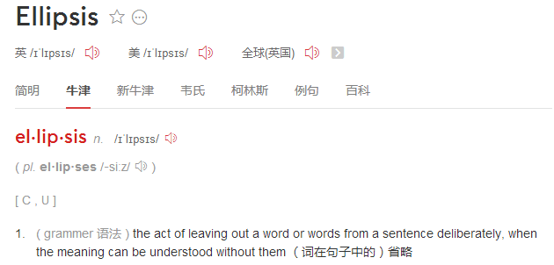

Ellipsis
Functions
avoid repetition
Less is more.
be concise/brief
少即是多。
be powerful
——Ludwig Mies Van der Rohe
link closely
Brevity is the soul of wit.
emphasize the importance
言以简为贵。
——William Shakespeare

Slide 5
Ellipsis
Explore the Ellipsis
1
Simple sentence 简单句
2
Imperative sentence 祈使句
Ellipsis
3
Exclamatory sentence 感叹句
...
4
Compound sentence 并列句
5
Adverbial clause 状语从句
6
Attributive clause 定语从句
7
Object clause 宾语从句

Slide 6

Ellipsis
Cases of ellipsis in the speech video
1. When you feel like giving up, don’t.
2. When you’re thinking about giving up,
don’t.
3. When it look like you ain’t gonna make
it, keep going.
Sentence Pattern
What has been left out？
subject
主语
Imperative sentences
祈使句
predicate
谓语
4. No matter how rough the sea, you
keep standing.
5. No matter what, you don’t give up.
Adverbial clauses
状语从句
predicate
谓语
subject
6. If there’s something that you want ...,
you’ve got to do whatever is necessary
until.
7. I’m going to do it until.
Adverbial clauses
状语从句
predicate
object 宾语
subject 主语
predicate 谓语/be
object 宾语

Slide 7
Ellipsis
Practice of Ellipsis
Imperative sentences 祈使句
Adverbial clauses 状语从句
1. 如果你想要体验古城的魅力，来绍兴吧。
2. 当你想要了解更多关于绍兴文化的时候，别犹豫，尽管问我。
3. 无论多累，你都不会后悔来过绍兴。
If you want to experience the charm of ancient city, come to Shao Xing.
When you feel like knowing more about culture of Shao Xing, don’t hesitate to ask me.
No matter how tired, you will never regret having come to Shao Xing.

Slide 8
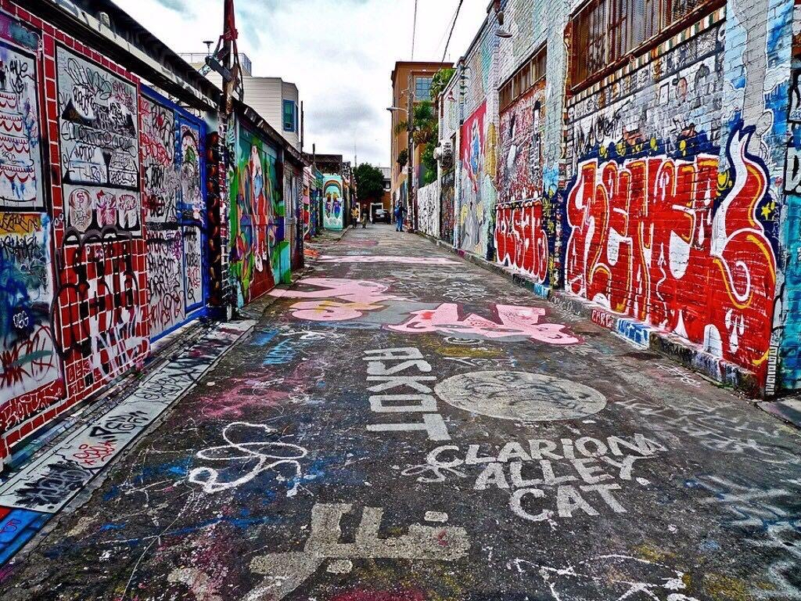
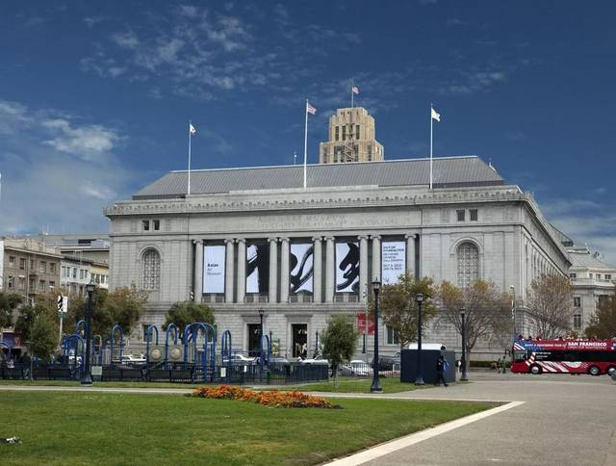
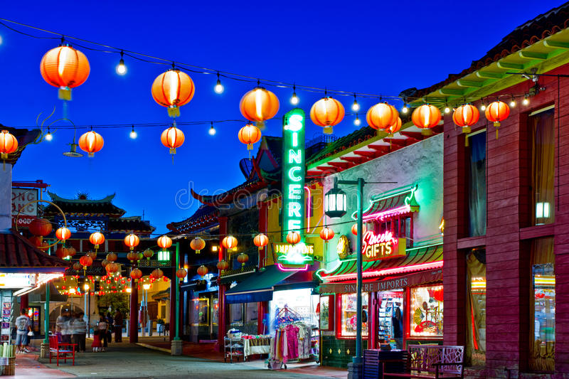
A day in San Francisco
Ellipsis
Cases of ellipsis in the travel journal
The Mission District
A local museum
Chinatown
Sentence Pattern
What has been left out？
1. What a city—a city that was able to rebuild itself after the earthquake.
2. What great food!
Exclamatory sentence
感叹句
subject 主语
predicate谓语/be
3.This district used to be a poor
area of town, but is now a centre
for art, music, and food.
4. When these immigrants ..., they
carried a bit of home in their hearts,
and built a new home here.
Compound sentence
并列句
subject

Slide 9
A day in San Francisco
Ellipsis
Cases of ellipsis in the travel journal
The Mission District
A local museum
Chinatown
Sentence Pattern
What has been left out？
5. A real mix of cultures
here!
Simple sentence 简单句
There be 句型
subject
6. Can’t wait!
Simple sentence 简单句
object 宾语

Slide 10
Practice of Ellipsis
Ellipsis
Practice of Ellipsis
Exclamatory sentence 感叹句
Compound sentence 并列句
Simple sentence 简单句
1. 多么令人难忘的一次旅途——一次体验和探索绍兴之旅。
2. 我强烈推荐你来绍兴游玩，并且来尝尝绍兴的美食。
3. 这儿有古代与现代文明的完美融合。
What an unforgettable journey—a journey to experience and explore Shao Xing.
I strongly recommend that you should visit Shao Xing, and taste the delicious food here.
A perfect mix of ancient and modern civilization here!

Slide 11
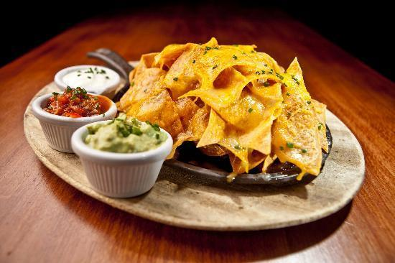
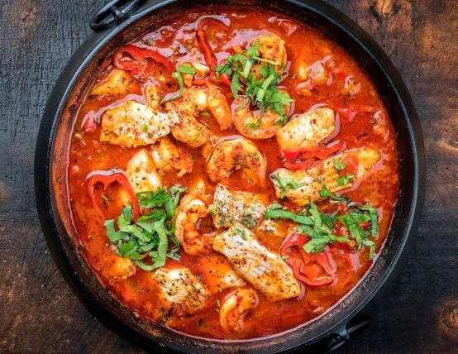
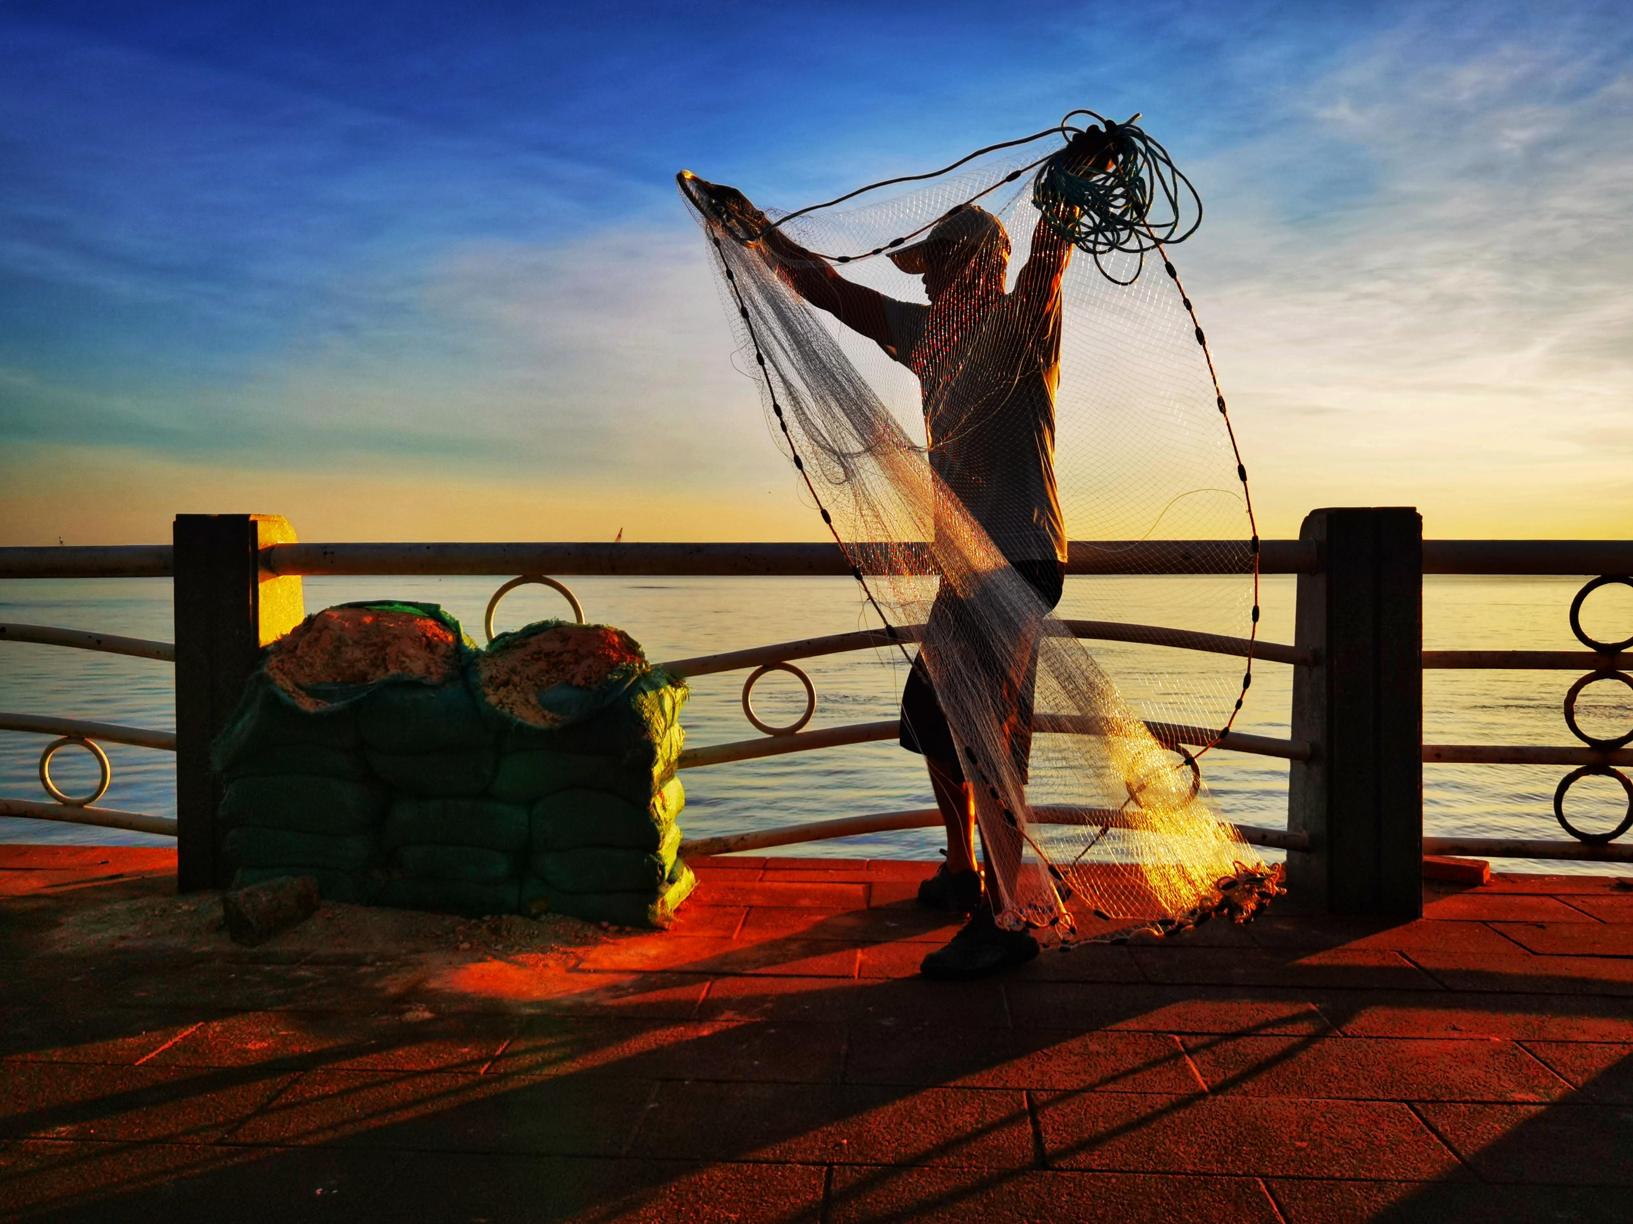
Ellipsis
Cases of ellipsis in the dialogues
1. A: Oh, I just love nachos! Mexican corn chips covered in cheese! B: Me, too. 2. A: We have gumbo, the spicy stew. It was invented in New
Orleans over 200 years ago, and mixes French, African, Native
American, and Spanish cooking.
B: So it’s the food of many different cultures, all in one dish? A: Exactly.
subject/predicate/object
Simple sentence 简单句
the repetitive part
Here is a conversation between Mr Green and his good friend Mr Smith, a fisherman. Can you understand what they are talking about?
Mr Green: Going? Mr Smith: Been.
Mr Green: Any? Mr Smith: Some.
Mr Green: Big? Mr Smith: Small.

Slide 12


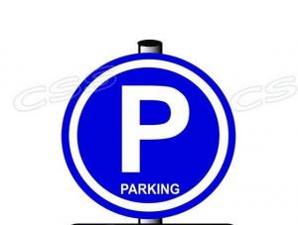

Ellipsis
Cases of ellipsis in the public signs
You cannot smoke here.
You cannot take photos here.
subject 主语
Simple sentence 简单句
modal verb 情态动词
You can park your car here.
You should cross here with care on your bike.

Slide 13
Ellipsis
Cases of ellipsis in the diary
Saturday, May 15, 2021 Sunny
After enjoy the travel journal about San Francisco, I feel fascinated by the attractive city that LiLan visited. If it is possible, I would like to pay a visit to it myself. I can imagine that when I am wandering around the Chinatown , I will try a lot of delicious food. What an amazing experience it is! If it is necessary, I’ll write my own travel journal on San Francisco as soon as it is possible to record my fantastic journey.
Sentence Pattern
What can be left out？
Attributive clause
定语从句
that, which, who
object 宾语
Object clause
宾语从句
that+clause
the first “that”
subject（it）
when, while, if, as if, though, although, as, until, once, whether, unless, whenever
Adverbial clause
状语从句
be

Slide 14
Ellipsis
Practice of Ellipsis
Attributive clause 定语从句
Object clause 宾语从句
Adverbial clause 状语从句
1. 当你漫步在绍兴时，你会感受到深刻而持久的多元文化。
2. 这个城市是我参观过的最优雅的城市。
3. 我相信你的绍兴之旅会不虚此行。
While wandering around Shao Xing, you can appreicate the profound, lasting and diverse cultures.
This city is the most elegant one I have ever visited.
I believe your trip to Shaoxing will be worthwhile.

Slide 15

Ellipsis
Cases of ellipsis in the famous sayings
1. Reading makes a full man, conference a ready man, and writing an exact man.
2. Histories make men wise; poets, witty; the mathematics, subtle; natural philosophy, deep; moral, grave; logic and rhetoric, able to contend.
读书使人渊博，辩论使人机敏，写作使人精细。
读史使人明智，读诗使人聪颖，算数使人缜密，自然哲学使人深刻，伦理使人庄重，逻辑与修辞使人善辩。
Simple sentence 简单句
predicate 谓语
Practice of Ellipsis
学习使人聪慧，音乐使人优雅，旅游使人博学。
Learning makes a wise man, music an elegant man, travel a knowledgeable man!

Slide 16
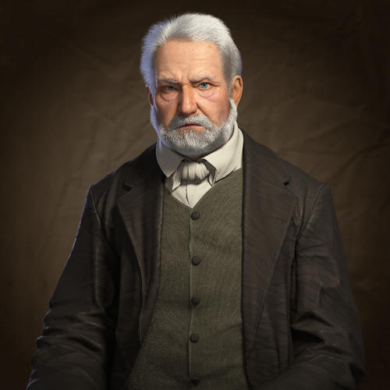


Ellipsis
Cases of ellipsis in the letters
There is a famous anecdote that the world's shortest correspondence took place between Victor Hugo and his publisher. After LES MISÉRABLES was published for the first time, Hugo, inquiring about the status of sales, sent a telegram to his publisher.
Victor Hugo's telegram: ?
Publisher's telegram: !
Can you understand what they meant?
Victor Hugo

Slide 17
Ellipsis
Assignment of ellipsis
你的美国朋友Alex对中国文化很感兴趣，想要了解你所在城市的文化元素，请你用课堂所学的含有省略的句子向他介绍绍兴古城，并邀请他来绍兴游玩，感受古城的魅力。
1. 学习使人聪慧，音乐使人优雅，旅游使人博学。
2. 如果你想要体验古城的魅力，来绍兴吧。/如果你想要领略中国文化，
我强烈推荐你来绍兴游玩，并且来尝尝绍兴的美食。
3. 这儿有古代与现代文明的完美融合。
4. 当你漫游在绍兴时，你会感受到深刻而持久的多元文化。
5. 这个城市是我参观过的最优雅的城市。
6. 如果你想要了解更多关于绍兴古城的文化，别犹豫，尽管问我。
7. 相信你会拥有一次难忘的旅行——一次体验和探索绍兴之旅。/相信
你的绍兴之旅会不虚此行。/无论多累，你都不会后悔来过绍兴。

Slide 18
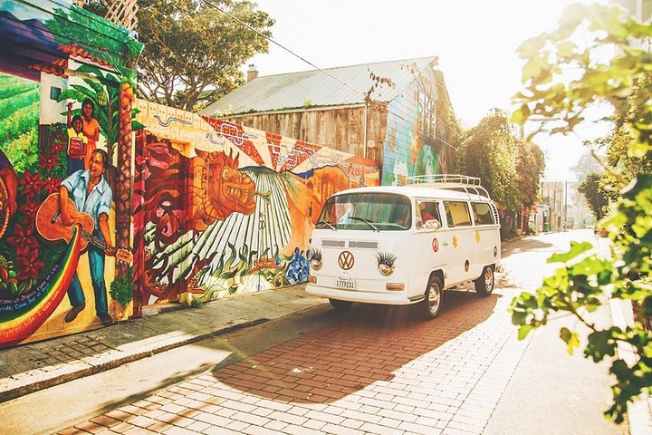
Thank you!

