Slide 1


感恩遇见，相互成就，本课件资料仅供您个人参考、教学使用，严禁自行在网络传播，违者依知识产权法追究法律责任。
更多教学资源请关注
公众号：溯恩高中英语
知识产权声明

Slide 2
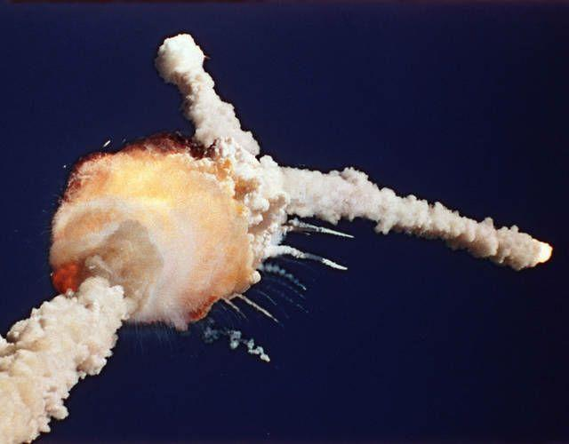
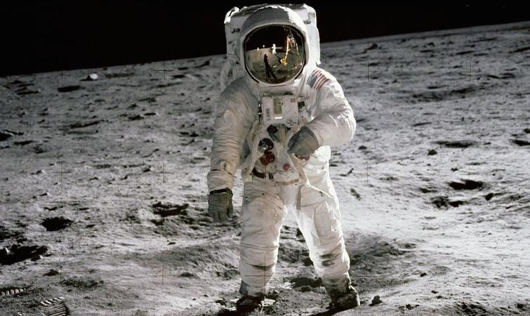
B3U4
Space Exploration
Reading for Writing
All the astronauts on the America’s Challenger died.
Welcome to Iris’ class!
“That's one small step for a man,
one giant leap for mankind.”

Slide 3
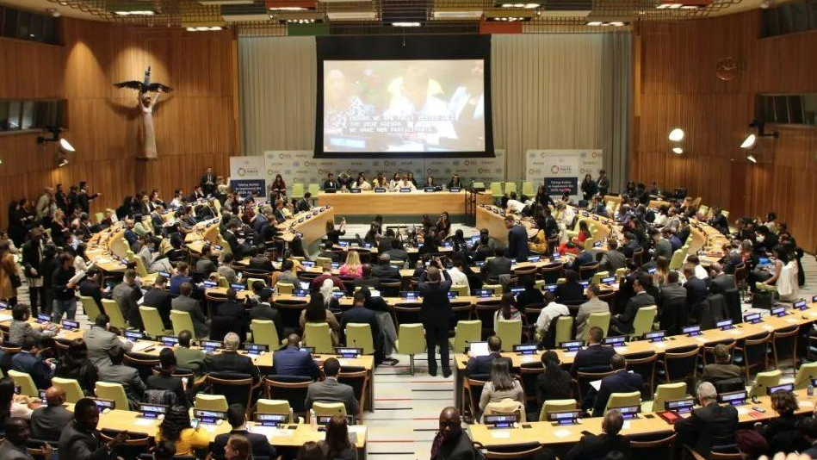
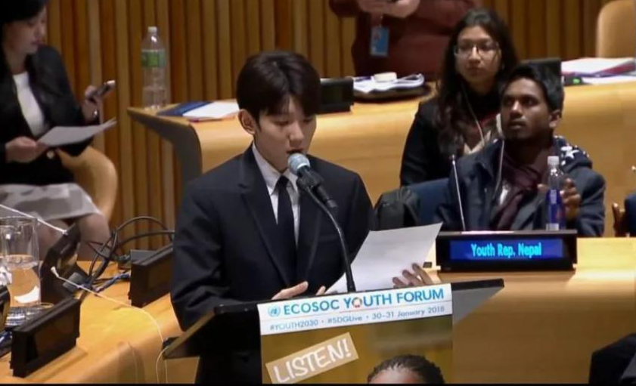
ECOSOC Youth Forum 2021
Countries around the globe are spending billions of dollars and lots o f time on various space missions.
During space explaration, there are hugh risks which may cause deaths or disasters.
Nowadays, the main threats to our well-being are the damaged environment, hunger, fatal diseases and so on.
Should we spend so much time, money and even lives to explore space?
Is exploring space a waste of time and money?

Slide 4

Is exploring space a waste of time and money?
Your point | Yes | No
Your Reasons (Arguments)

Slide 5
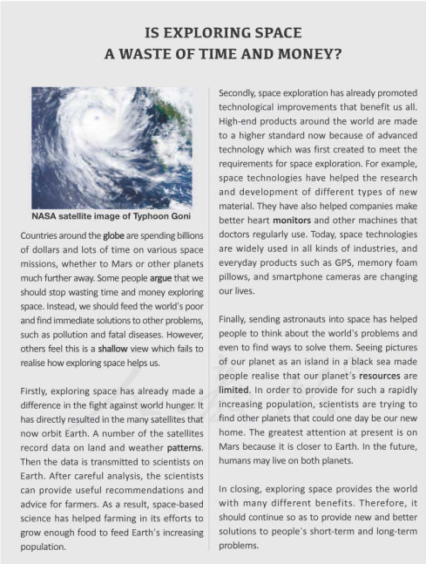
Skim the passage quickly and
work out the structure.
1
1
2
3
2
3
4
4
5
5

Slide 6
Read the passage carefully and
answer the questions.
1.What is the author’s point?
2.How does the author develop his point?
3.Do you think it is a good and persuasive argumentative essay? Why?
Introduction
Body
Conclusion

Slide 7
1.What is the author’s point?
2.How does the author develop his point?
3.Do you think it is a good and persuasive argumentative essay? Why?
The author argues that exploring space has benefitted us a lot thus it should continue.
Introduction
some
others
Body
Conclusion

Slide 8
1.What is the author’s point?
2.How does the author develop his point?
3.Do you think it is a good and persuasive argumentative essay? Why?
Argument2
...has already promoted technological improvements that benefit us all.
The author develops his point by giving arguments in 3 different aspects.
Argument3
Argument1
...has helped people to think about the world’s problems and even to find ways to solve them.
...has already made a difference in the fight against world hunger.
Body

Slide 9
3.Do you think it is a good and persuasive argumentative essay? Why?
Secondly
...has already promoted technological improvements that benefit us all.
For example
Advantage1
also
clear structure
Today
some
Advantage2
Finally
parallel sentences
others
Advantage3
Firstly
In order to
proper conjunctions
(logical words)
...has helped people to think about the world’s problems and even to find ways to solve them.
In closing
In the future
Then
...has already made a difference in the fight against world hunger.
After
As a result

Slide 10
Writing Techniques
3.Do you think it is a good and persuasive argumentative essay? Why?
A.giving examples
B.making comparisons or contrasts
C.making graphs
D.using quotos
E.listing data or numbers
F.giving explanations
A
Advantage1
clear structure
Advantage2
B
parallel sentences
Advantage3
proper conjunctions
(logical words)
F
F
Advantage4
proper writing techniques

Slide 11
ECOSOC Youth Forum 2021
Is exploring space a waste of time and money?

Slide 12
Are the statements FOR or AGAINST space exploration?
A.There are a lot of unsolved mysteries on Earth. So why are we going into space to explore?
B.It is necessary to find a new home for people in space, as the resources on Earth will run out.
C.I cannot understand spending all this money on expensive research and experiments when so many people need food.
D.Exploring space encourages scientists to improve technology that can help people in other ways, too.

Slide 13
Is exploring space a waste of time and money?
Your Title:
—————————————————————————————————————————————————————————————————————————————————————————————————————————————————————————————————————————————————————————————————————————————————————————————————————————————————————————————————————————————————————————————————————
Your opinion + supporting details

Slide 14

Checklist
 |  | Partner’s feedback
About the opinion | Is there a topic sentence which clearly states the opinion? | 1-3 stars
About the content | Does the paragraph give arguments with suitable supporting information? | 1-3 stars
Abou the language | Are there any grammar, spelling, or punctuation（标点） errors? | 1-3 stars

Slide 15
possible version1
I cannot understand spending all this money on expensive research and experiments when so many people need food. Around the world, millions of people are hungry and dying of starvation. On the other hand, we hear on TV that for as little as a dollar a day, a child in Africa can be saved. Considering the billions spent on space travel, it just seems a better investment to feed he hungry.

Slide 16
possible version2
Ever since space research began, it has been criticized as a huge waste of money and other resources. Despite the disadvantages and potential dangers, the advantages are far greater. We have already succeeded in using satellites for communications, weather forecast and oil exploration and with further space research, more problems we are having now can be solved. Space exploration contributes not only to the improvement of the quality of human life, but also to our understanding of all the creatures.

Slide 17
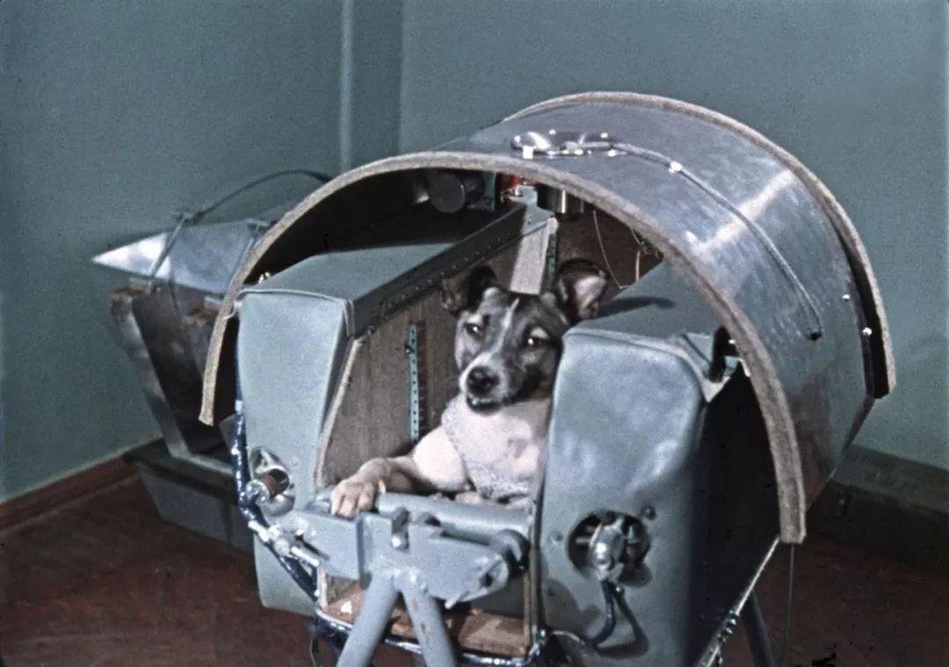
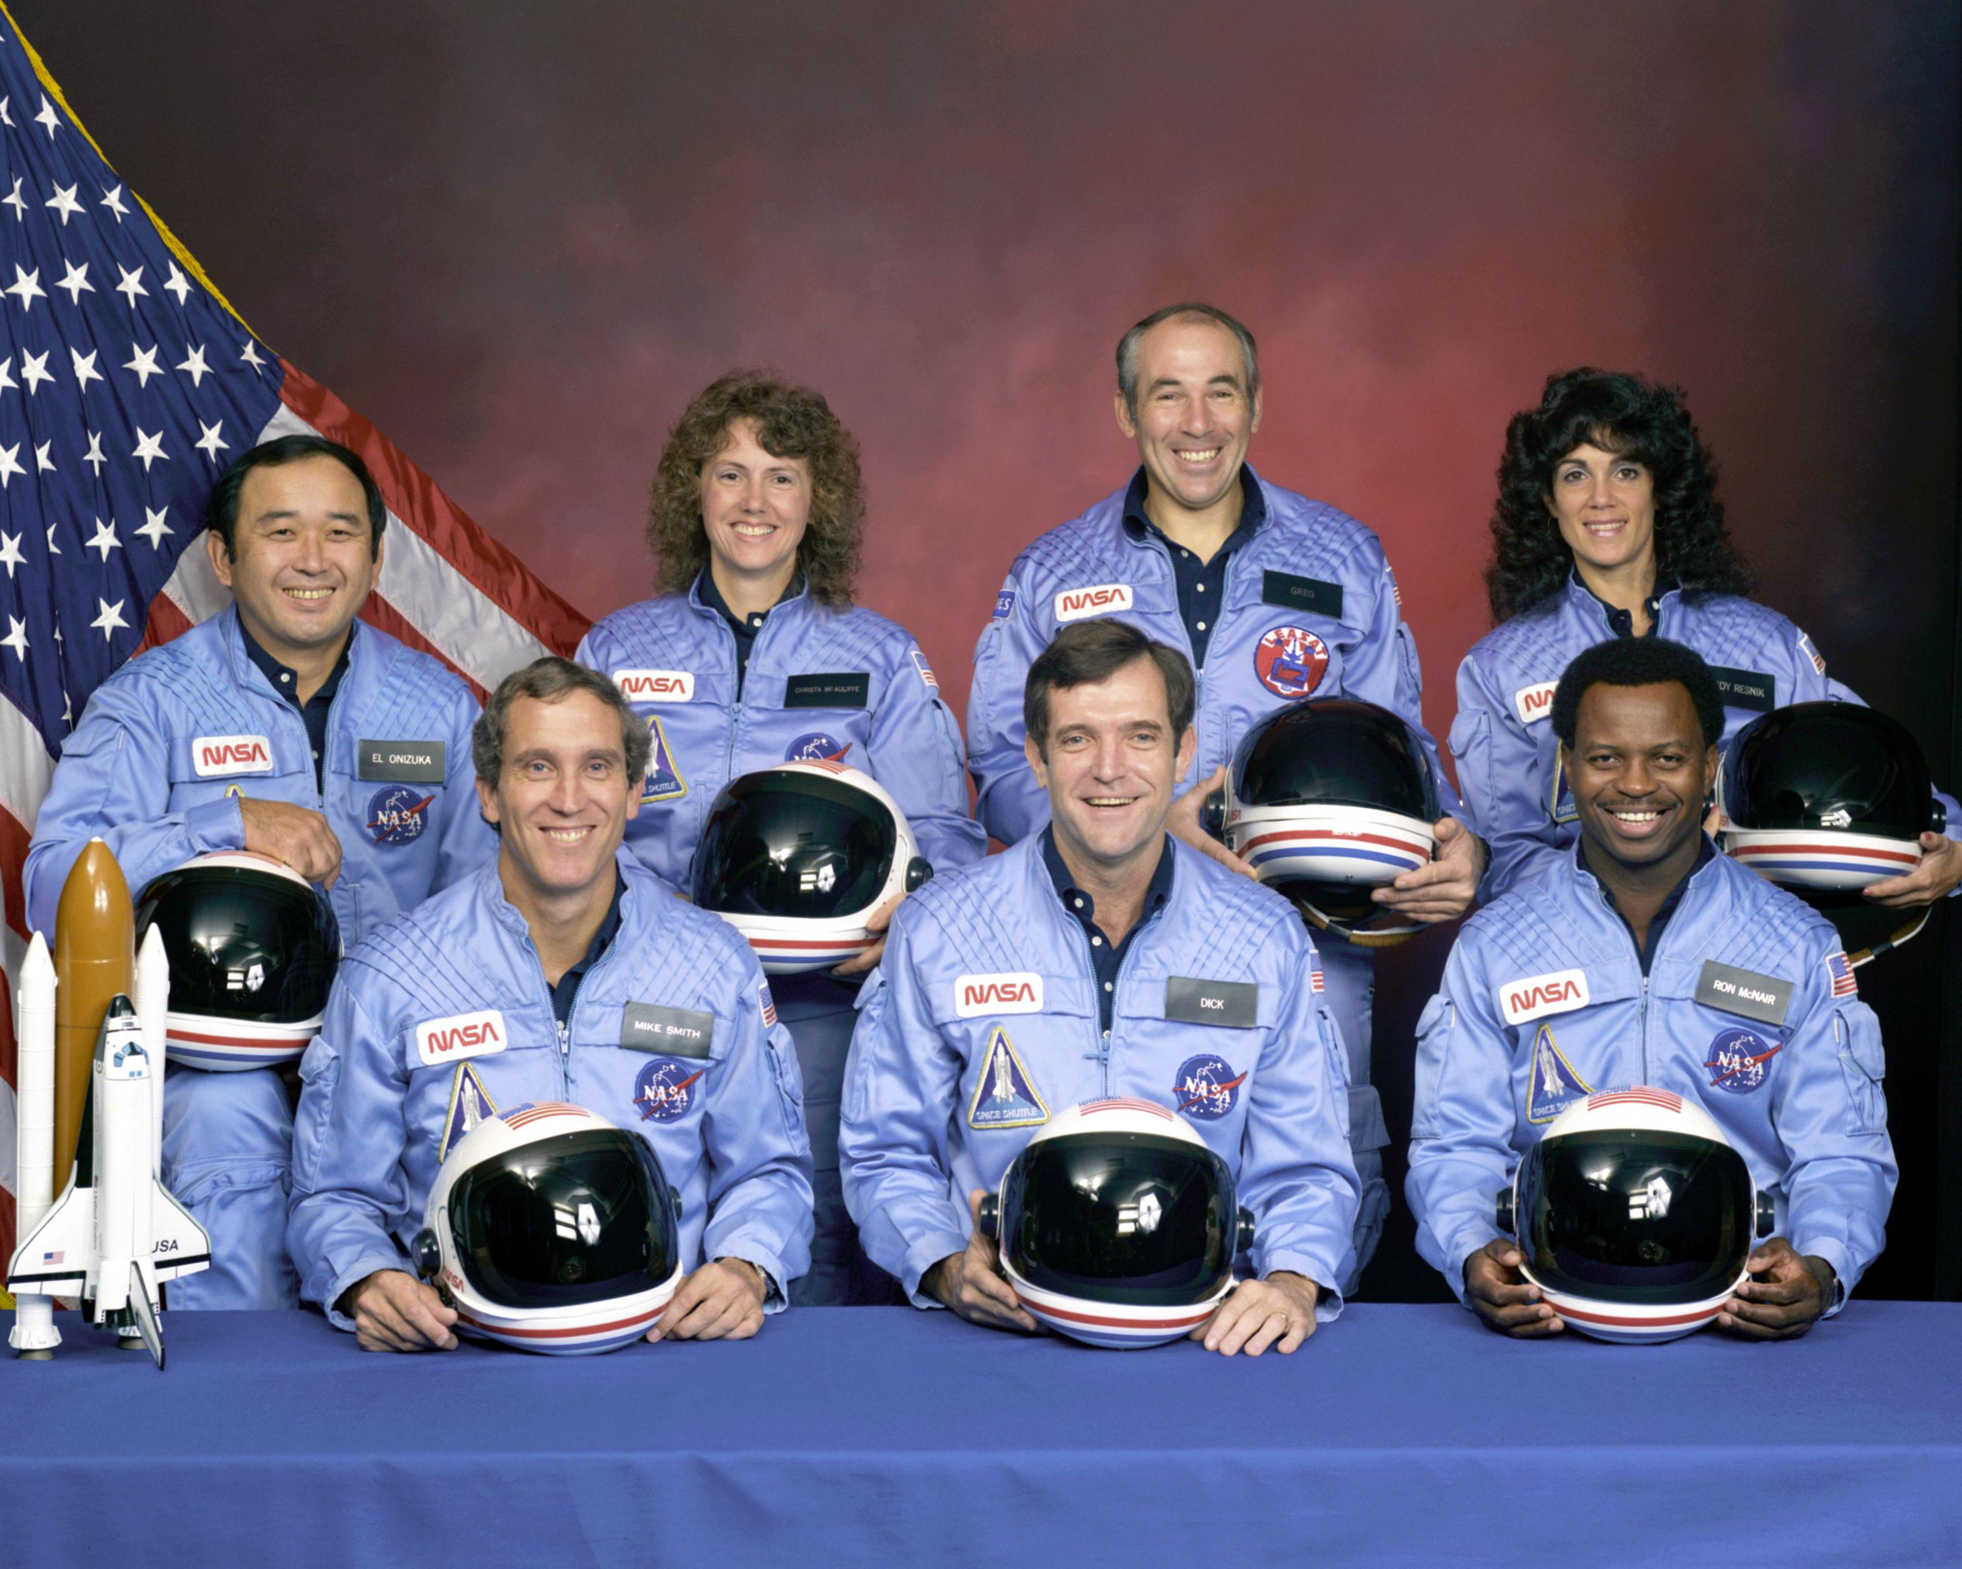
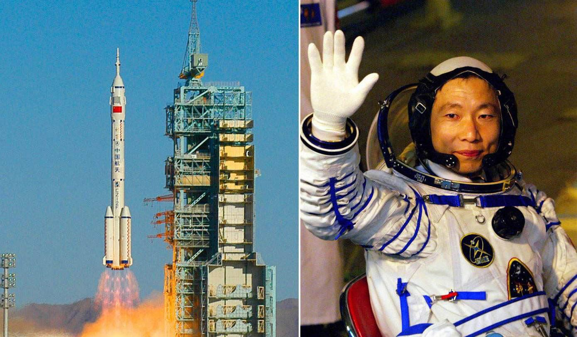
Assignment
1.Polish your draft and exchange it with your classmates.
2.Find stories about space exploration from the Internet.

