Slide 1


感恩遇见，相互成就，本课件资料仅供您个人参考、教学使用，严禁自行在网络传播，违者依知识产权法追究法律责任。
更多教学资源请关注
公众号：溯恩高中英语
知识产权声明

Slide 2
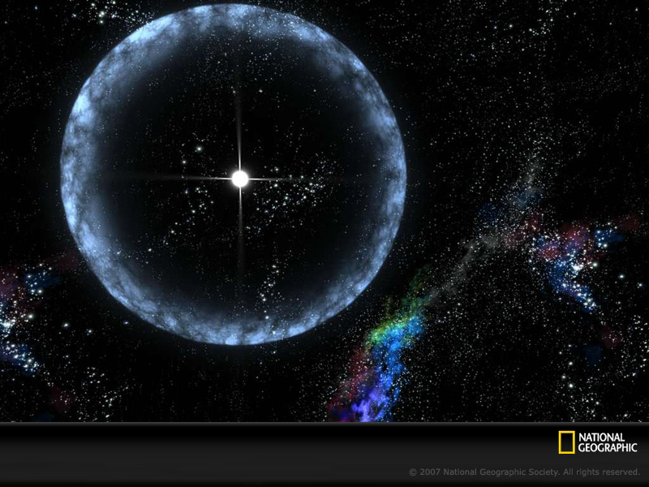
UNIT 4
SPACE EXPLORATION

Slide 3
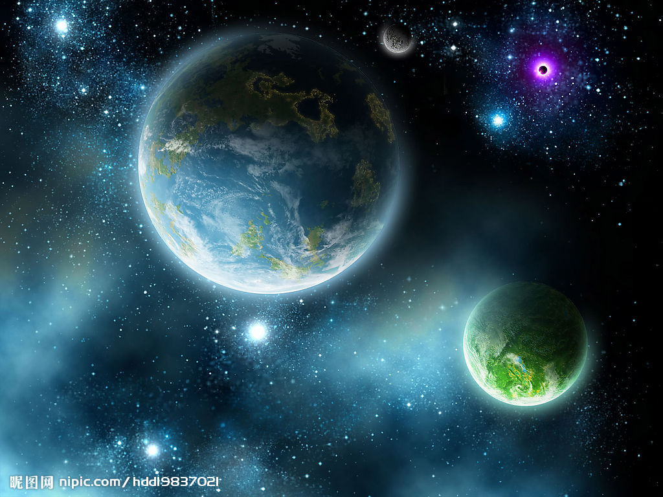
Teaching objectives:
By the end of this period, you will be able to…
1. learn about the development and significant historical events of space exploration.
2. analyze the structure of the article and summarize the main idea of the text.
3. express your opinions on space exploration.

Slide 4
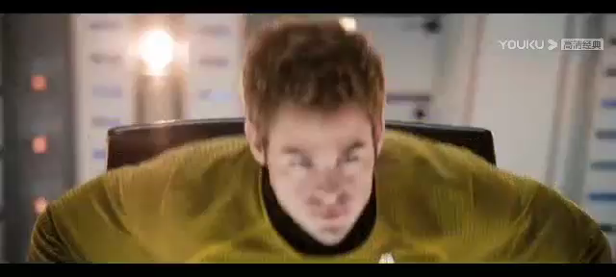

Slide 5
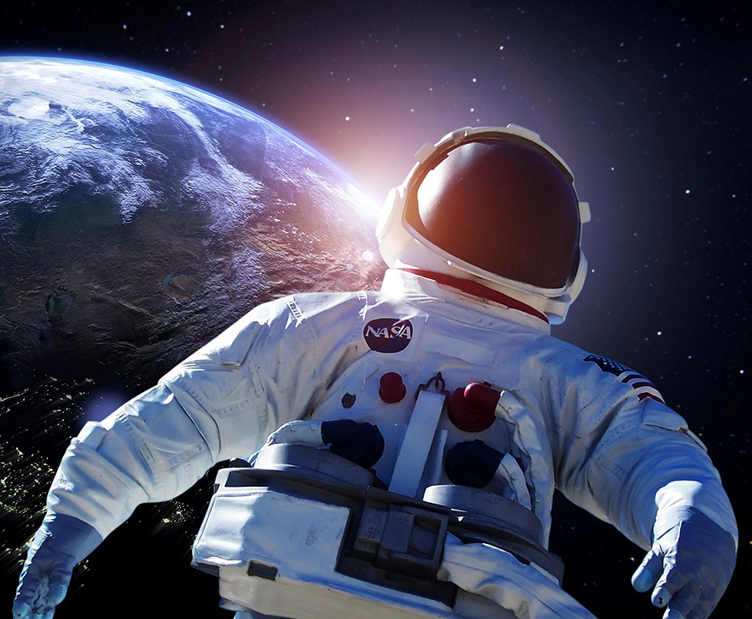
“Space, the final frontier. These are the voyages of starship Enterprise(进取号星舰），its continuing mission:
to explore strange new worlds,
to seek out new life forms and civilsations,
to boldly（勇敢地） go where no man has gone before.”
——James Kirk
Star Trek星际迷航
What do you think are the main reasons for space exploration?

Slide 6

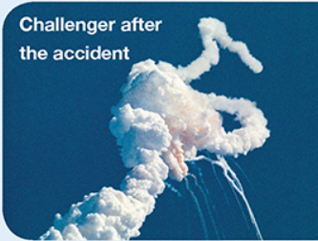
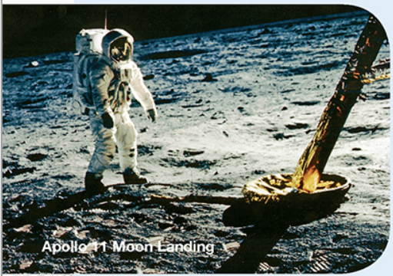
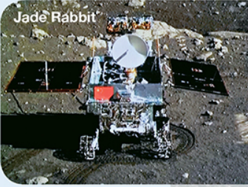
Pre-reading:
What do you expect to read about in this text?

Slide 7
While-reading:
Choose the correct sentence A-D to fill each gap in groups.
A. Although scientists try to make sure nothing goes wrong, accidents can still happen. B. They also really wish to discover other planets that are suitable enough to support life. C. The future of space exploration remains bright. D. After many experiments, they succeeded in making rockets that could escape Earth’s gravity.
BDAC

Slide 8
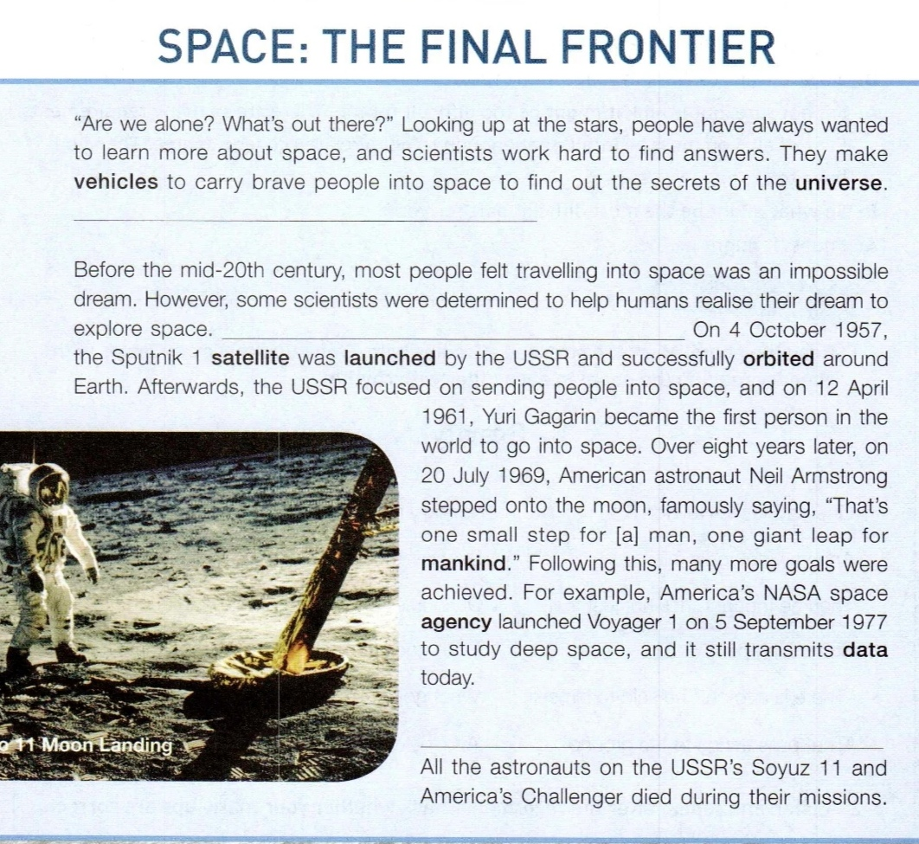
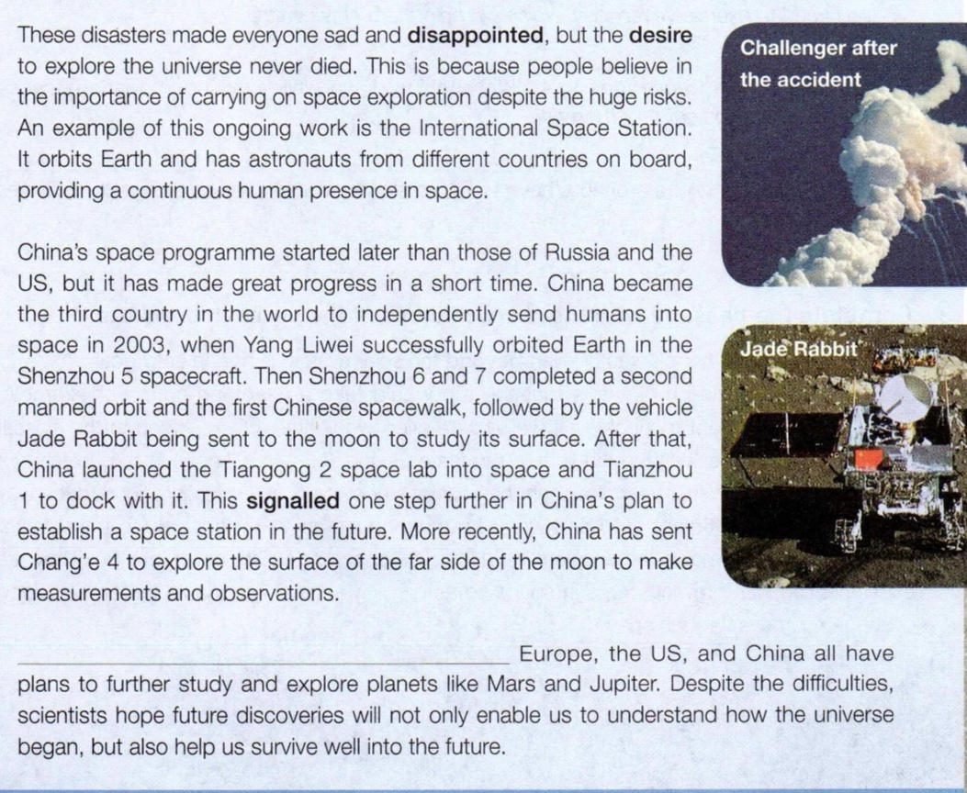
Para1
Para2
topic sentence/
main idea for each paragraph:
Para 1: _______
Para 2: _______
Para 3: _______
Para 4: _______
Para 5: _______
Para3
Para4
Para5

Slide 9
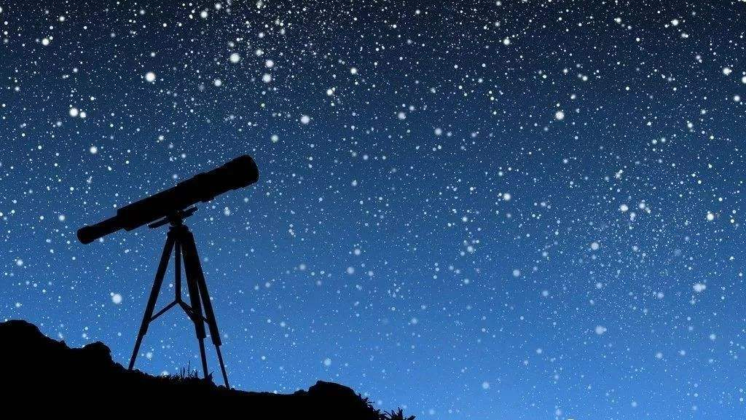
Main idea:
People are always curious about space and scientists
work hard to find answers.
Para1
“Are we alone? What’s out there?” Looking up at the stars, people have always wanted to learn more about space, and scientists work hard to find answers. They make vehicles to carry brave people into space to find out the secrets of the universe. They also really wish to discover other planets that are suitable enough to support life.
_____________

Slide 10
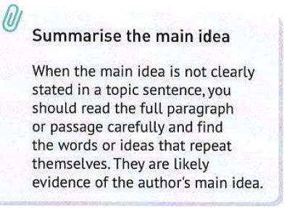
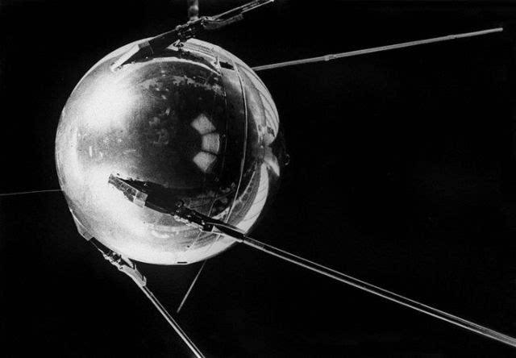
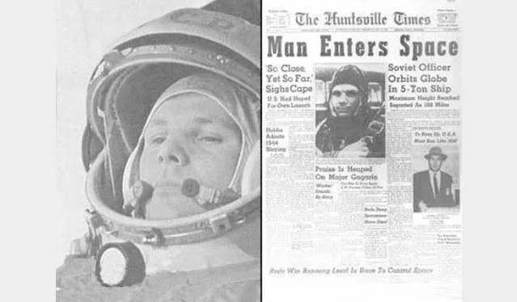
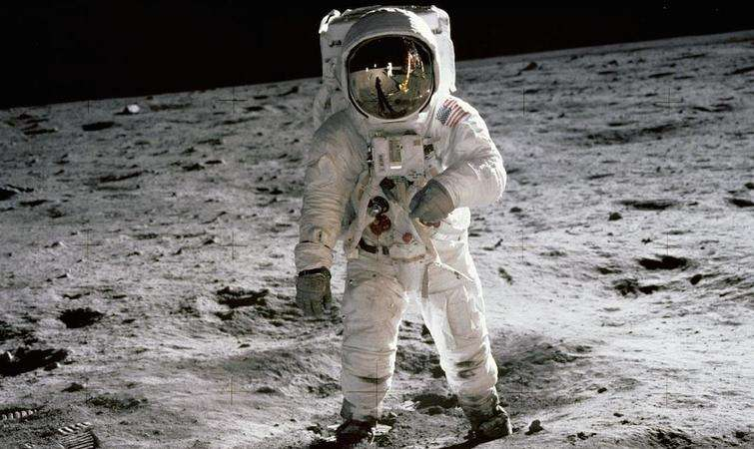
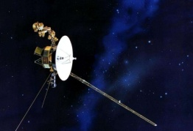
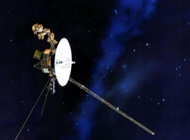
Main idea:
People’s dream of space exploration came true in the 20th century.
Para2
Before the mid-20th century, most people felt travelling into space was an impossible dream. However, some scientists were determined to help humans realise their dream to explore space. ___________ On 4 October 1957, the Sputnik 1 satellite was lunched by the USSR and successfully orbited around Earth. Afterwards, the USSR focused on sending people into space, and on 12 April 1961, Yuri Gagarin became the first person in the world to go into space. Over eight years later, on 20 July 1969, American astronaut Neil Armstrong stepped onto the moon, famously saying, “That’s one small step for [a] man, one giant leap for mankind.” Following this, many more goals were achieved. For example, America’s NASA space agency launched Voyager 1 on 5 September 1977 to study deep space, and it still transmits data today.

Slide 11
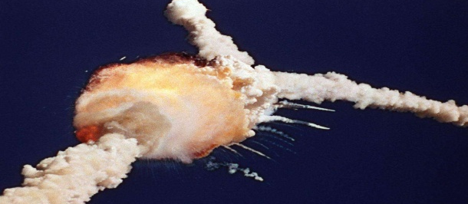
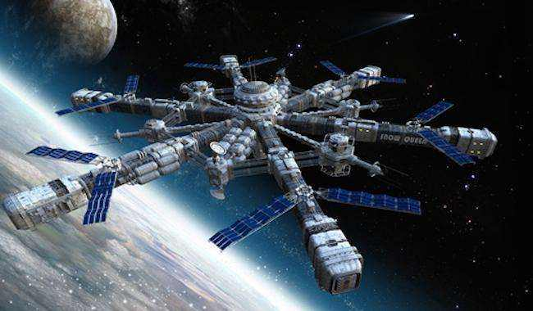
Despite the huge risks, humans still desire to explore space.
Main idea:
Para3
Although scientists try to make sure nothing goes wrong, accidents can still happen. All the astronauts on the USSR’s Soyuz 11 and America’s Challenger died during their missions. These disasters made everyone sad and disappointed , but the desire to explore the universe never died. This is because people believe in the importance of carrying on space exploration despite the huge risks. An example of this ongoing work is the International Space Station. It orbits Earth and has astronauts from different countries on board, providing a continuous human presence in space.

Slide 12
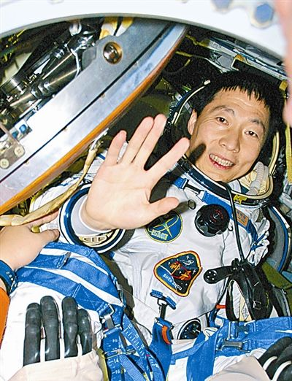
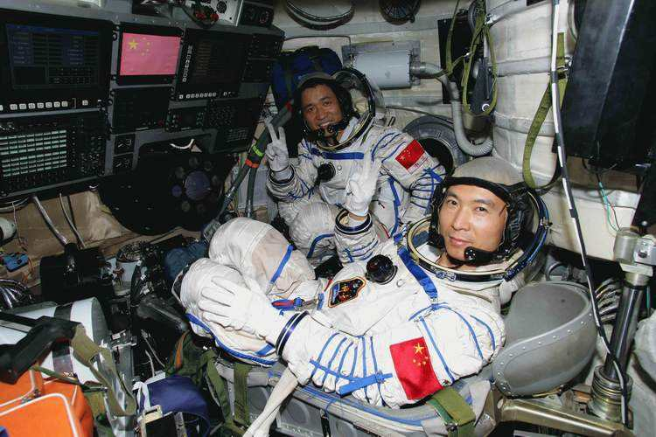
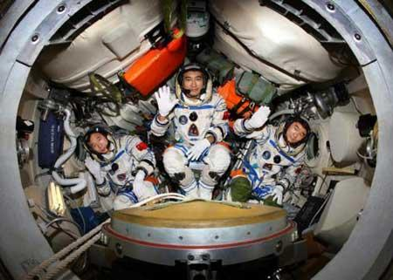
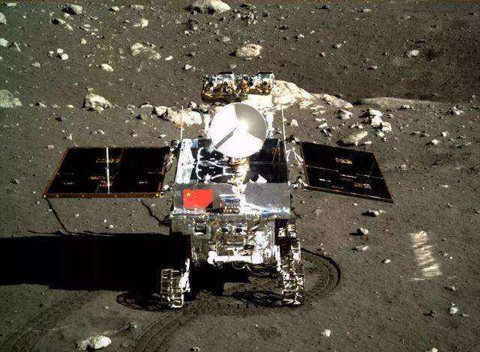
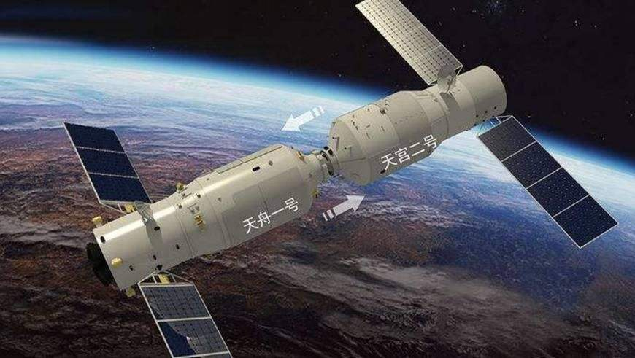
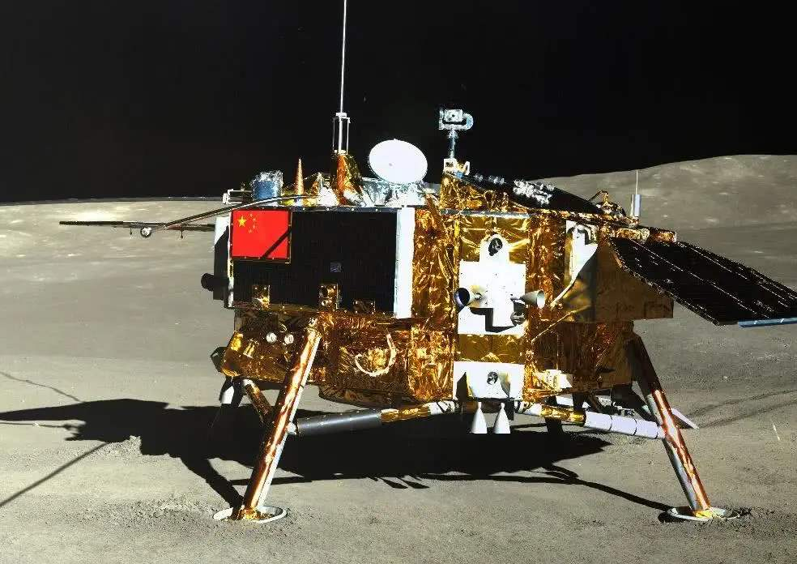
Para4
China’s space programme started later than those of Russia and the US, but it has made great progress in a short time. China became the third country in the world to independently send humans into space in 2003, when Yang Liwei successfully orbited Earth in the Shenzhou 5 spacecraft. Then Shenzhou 6 and 7 completed a second manned orbit and the first Chinese spacewalk, followed by the vehicle Jade Rabbit being sent to the moon to study its surface. After that, China launched the Tiangong 2 space lab into space and Tianzhou1 to dock with it. This signalled one step further in China’s plan to establish a space station in the future. More recently, China has sent Chang’e 4 to explore the surface of the far side of the moon to make measurements and observations.

Slide 13
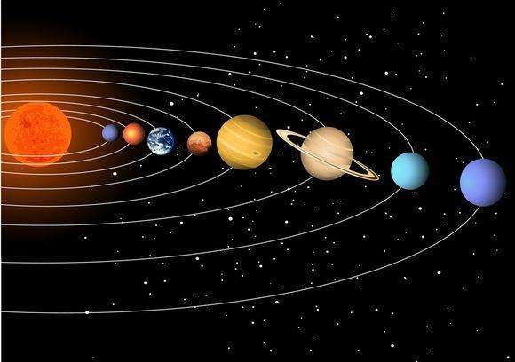
Para5
The future of space exploration remains bright. Europe, the US, and China all have plans to further study and explore planets like Mars and Jupiter. Despite the difficulties, scientists hope future discoveries will not only enable us to understand how the universe began, but also help us survive well into the future.

Slide 14
While-reading: Read para 2 and 4 to find out the main events home and abroad.
foreign
countries
1957
1961
1969
1977
The Sputnik 1 satellite was launched
Yuri Gagarin went into space
Neil Armstrong stepped onto the moon.
Voyager 1 was launched
Why was space exploration mainly carried out by the USSR and the US in the 20th century?

Slide 15

Para4
Jade Rabbit Studied the surface of the moon
Shenzhou 5 Independently sent humans into space
Chang'e 4 Explored the surface of the far side of the moon.
Shenzhou6&7
Completed a second manned orbi and the first Chinese spacewalk
Tiangong 2
Tianzhou1
Furthered the establishment of a space station.
2003
then
(2005&2008)
followed by
(2013)
after that
(2016&2017)
more recently
(2018)

Slide 17
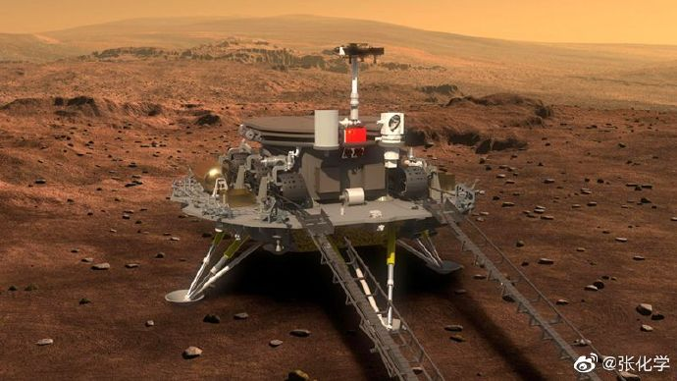

Slide 18
Were the space missions always successful ?
If not, what might happen to space missions ?

Slide 19
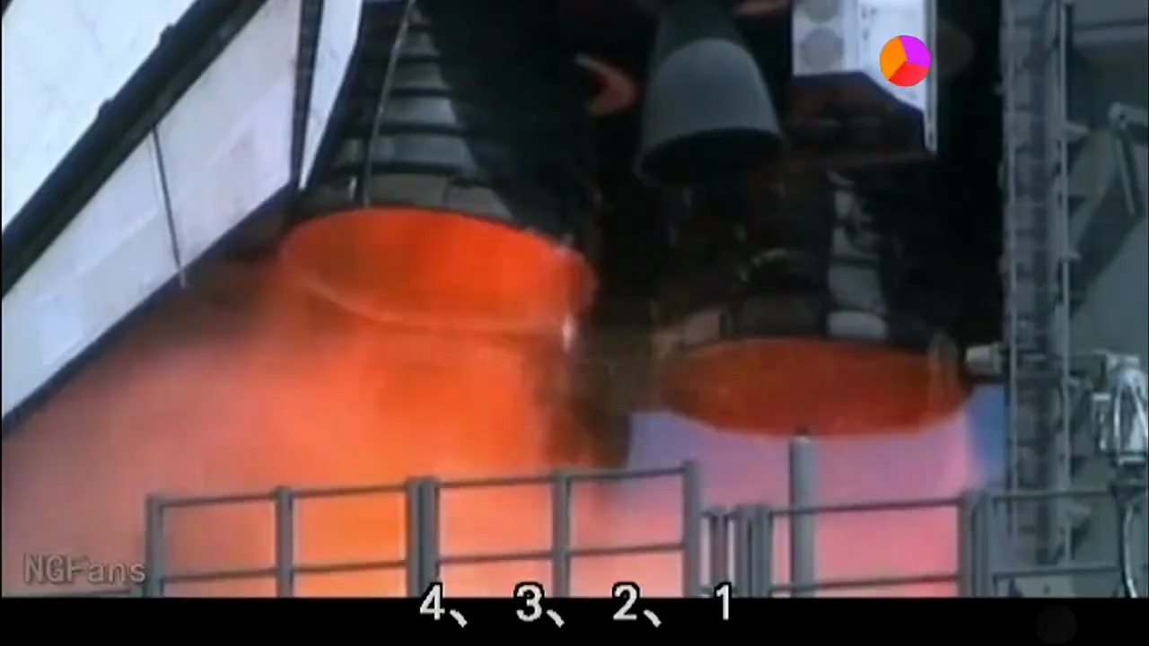

Slide 20
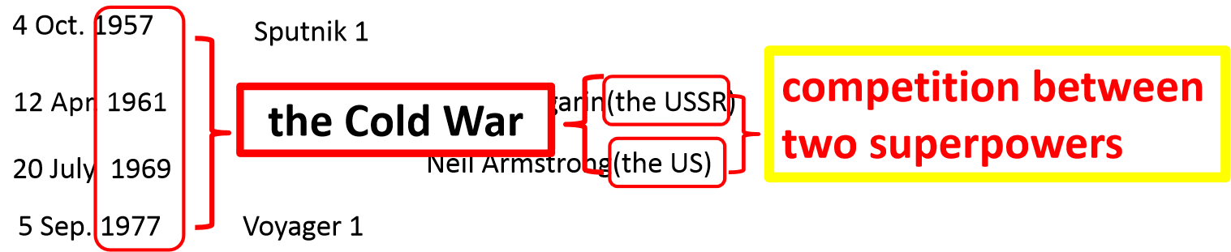
An example of this ongoing work is the International Space Station. It orbits Earth and has astronauts from different countries on board, providing a continuous human presence in space.
cooperation
The future of space exploration remains bright.

Slide 21
Para5
The future of space exploration remains bright. Europe, the US, and China all have plans to further study and explore planets like Mars and Jupiter. Despite the difficulties, scientists hope future discoveries will not only enable us to understand how the universe began, but also help us survive well into the future.
Further thinking ：What does the title mean to you?

Slide 22


Slide 23
SPACE SPIRIT
What do you think are the main reasons for space exploration?

Slide 24
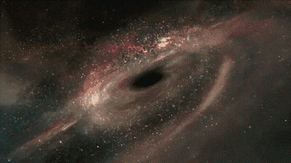
Thank you!

