Slide 1

感恩遇见，相互成就，本课件资料仅供您个人参考、教学使用，严禁自行在网络传播，违者依知识产权法追究法律责任。
更多教学资源请关注
公众号：溯恩高中英语
知识产权声明

Slide 2

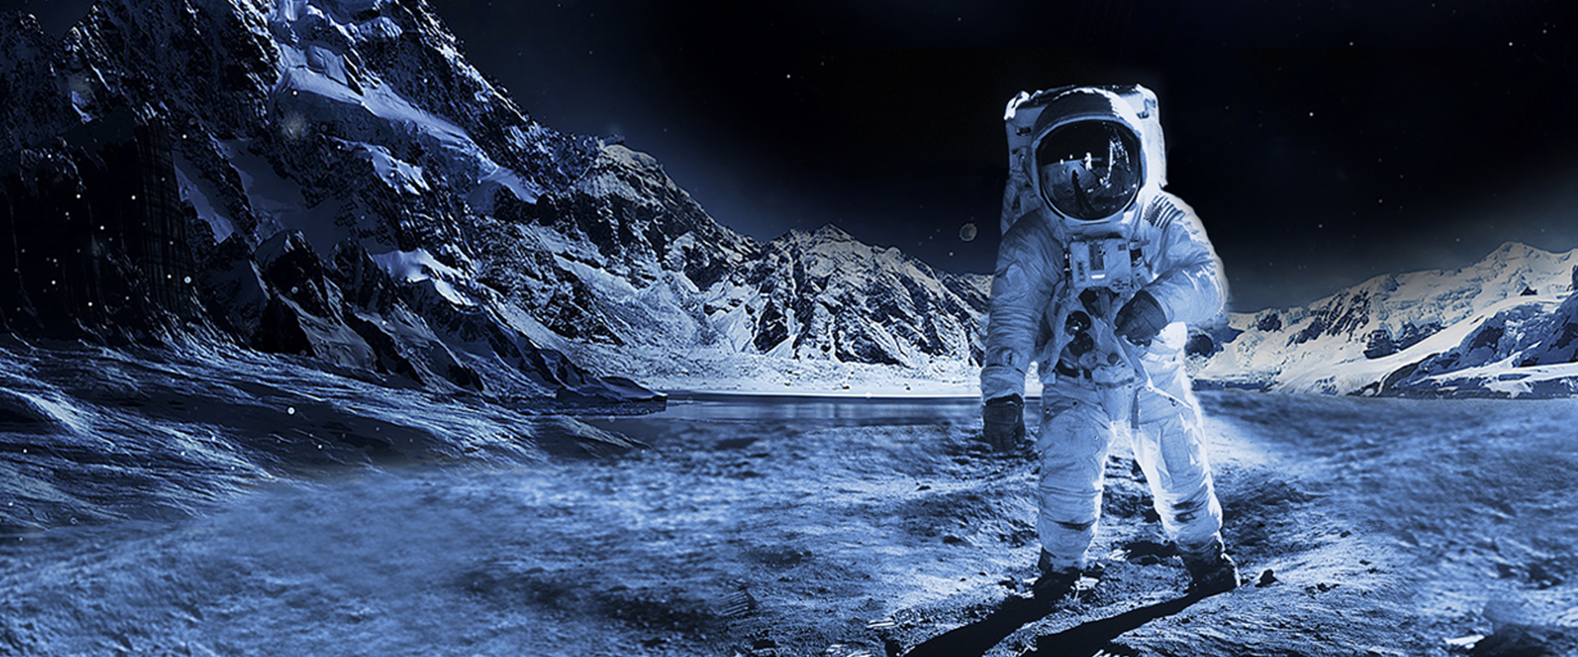
M4U4 Space Exploration
Space:
The Final Frontier

Slide 3
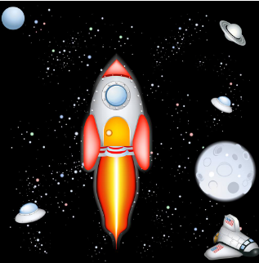
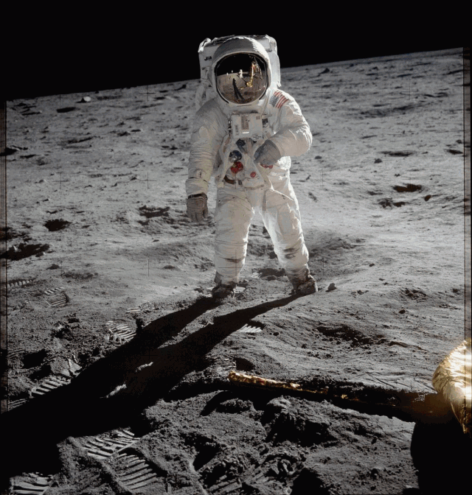
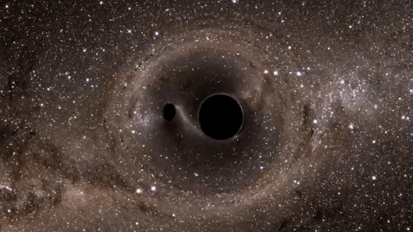
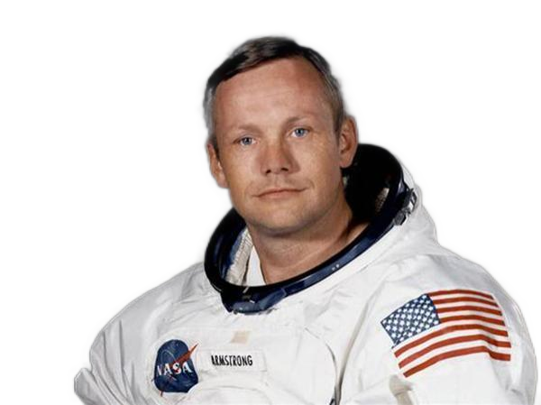
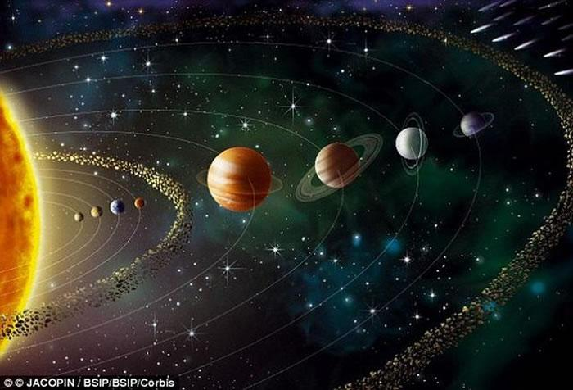
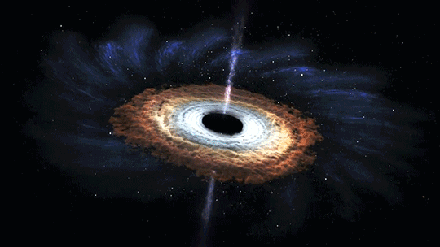
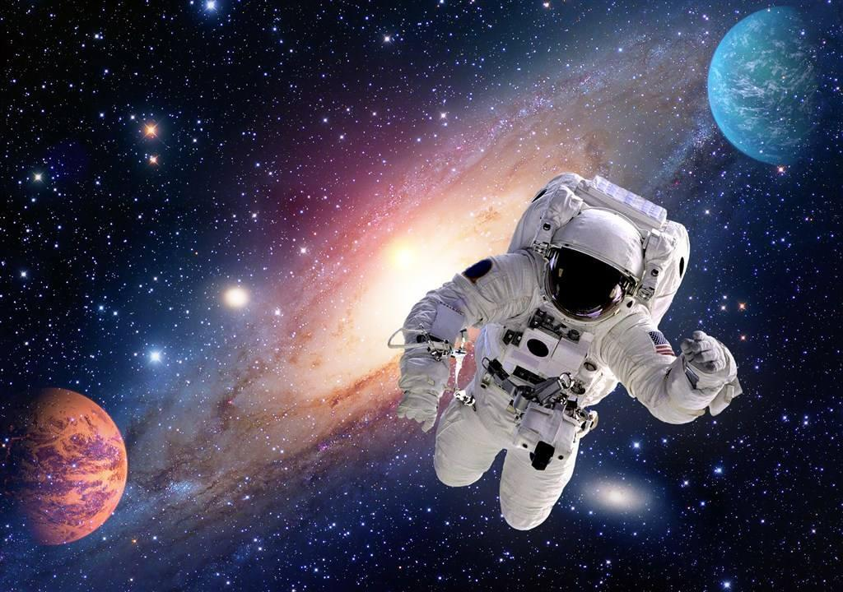
Lead-in
“That is one small step for a man, one gaint leap for mankind.”
What achievements has the world made so far?
1. What achievements has the world made so far?
The discovery of the black hole
2. What benefits has the space exploration brought to us?
Mankind stepped onto the moon
The exploration of solar system
The theory of the origin of Big Bang Universe

Slide 4
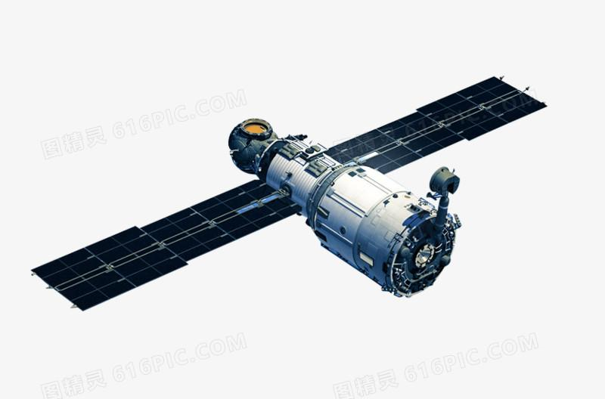
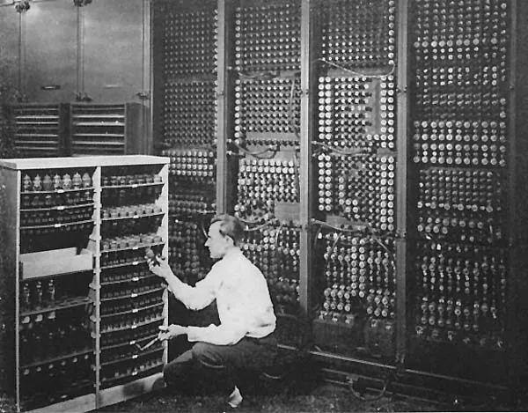

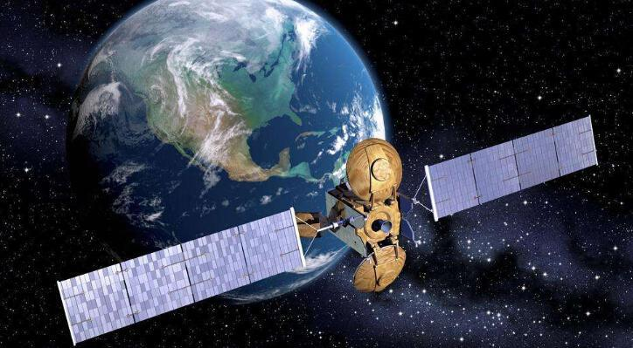
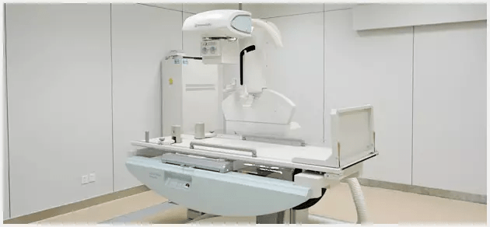
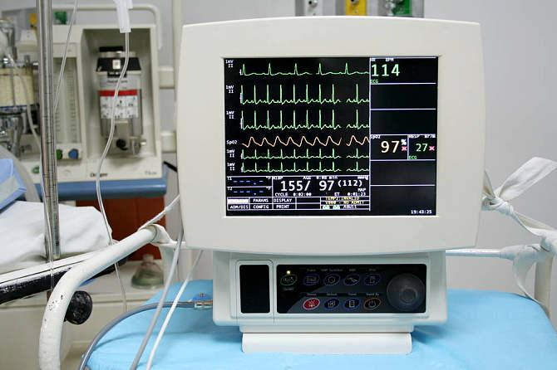
Lead-in
What benefits has the space exploration brought to us?
1. improve the development of new technology
Are you curious about the development of the space exploration of human beings?
2. improve the accuracy of the weather forcast
3. help develop the medical system
4. help widen mankind’s knowledge
satellites
...
Original computer
weather satellite
heart monitor
Medical scanner

Slide 5
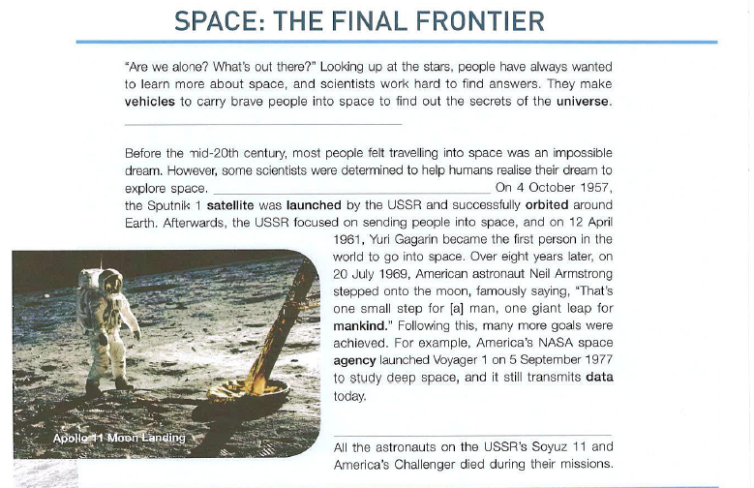
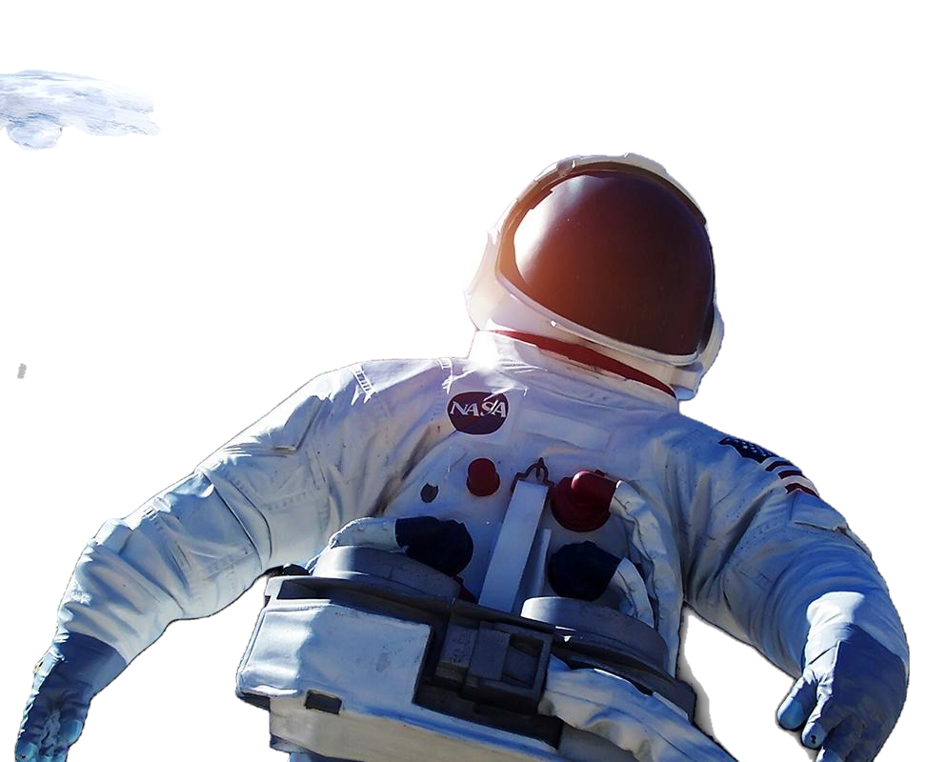
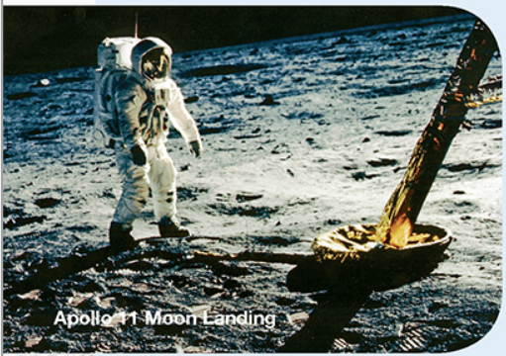
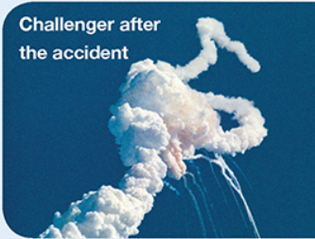
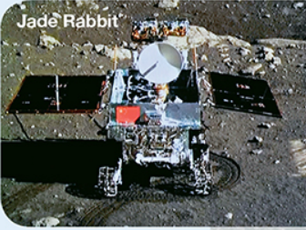
Prediction
A popular science article should contain the following features, except?
A. a brief and eye-catching title
B. related pictures
C. difficult language
D. the presentation of the results
E. the analysis of the procedure
F. the backgroud information at the beginning
Where can we find the passage?
A. magazine B. travel journal
C. news report D. science book
a popular science article
(科普文)

Slide 6
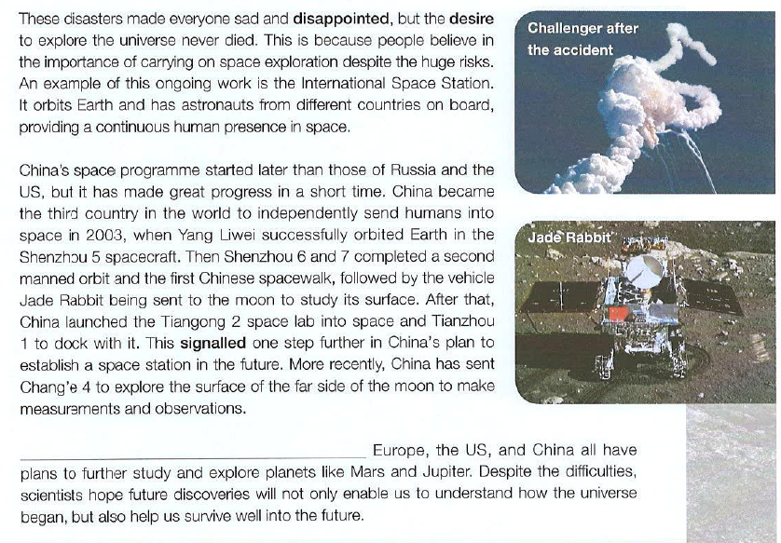
Reading
1. Choose the correct sentence (A-D) to fill each gap.
2. Find the topic sentence or summarize main idea.
Although scientists try to make sure nothing goes wrong, accidents can still happen.
They also really wish to discover other planets that are suitable enough to support life.
The future of space exploration remains bright.
After many experiments, they succeeded in making rockets that could escape Earth’s gravity.
1.Which sentences are general statements that could serve as topic sentences for paragraphs?
2.Which sentence contains a linking word which indicates that it is a part of a list of details?
3.Which sentence begins with a sequence word showing that it is probably a detail from the middle of a narrative?
A and C
B also
D After

Slide 7
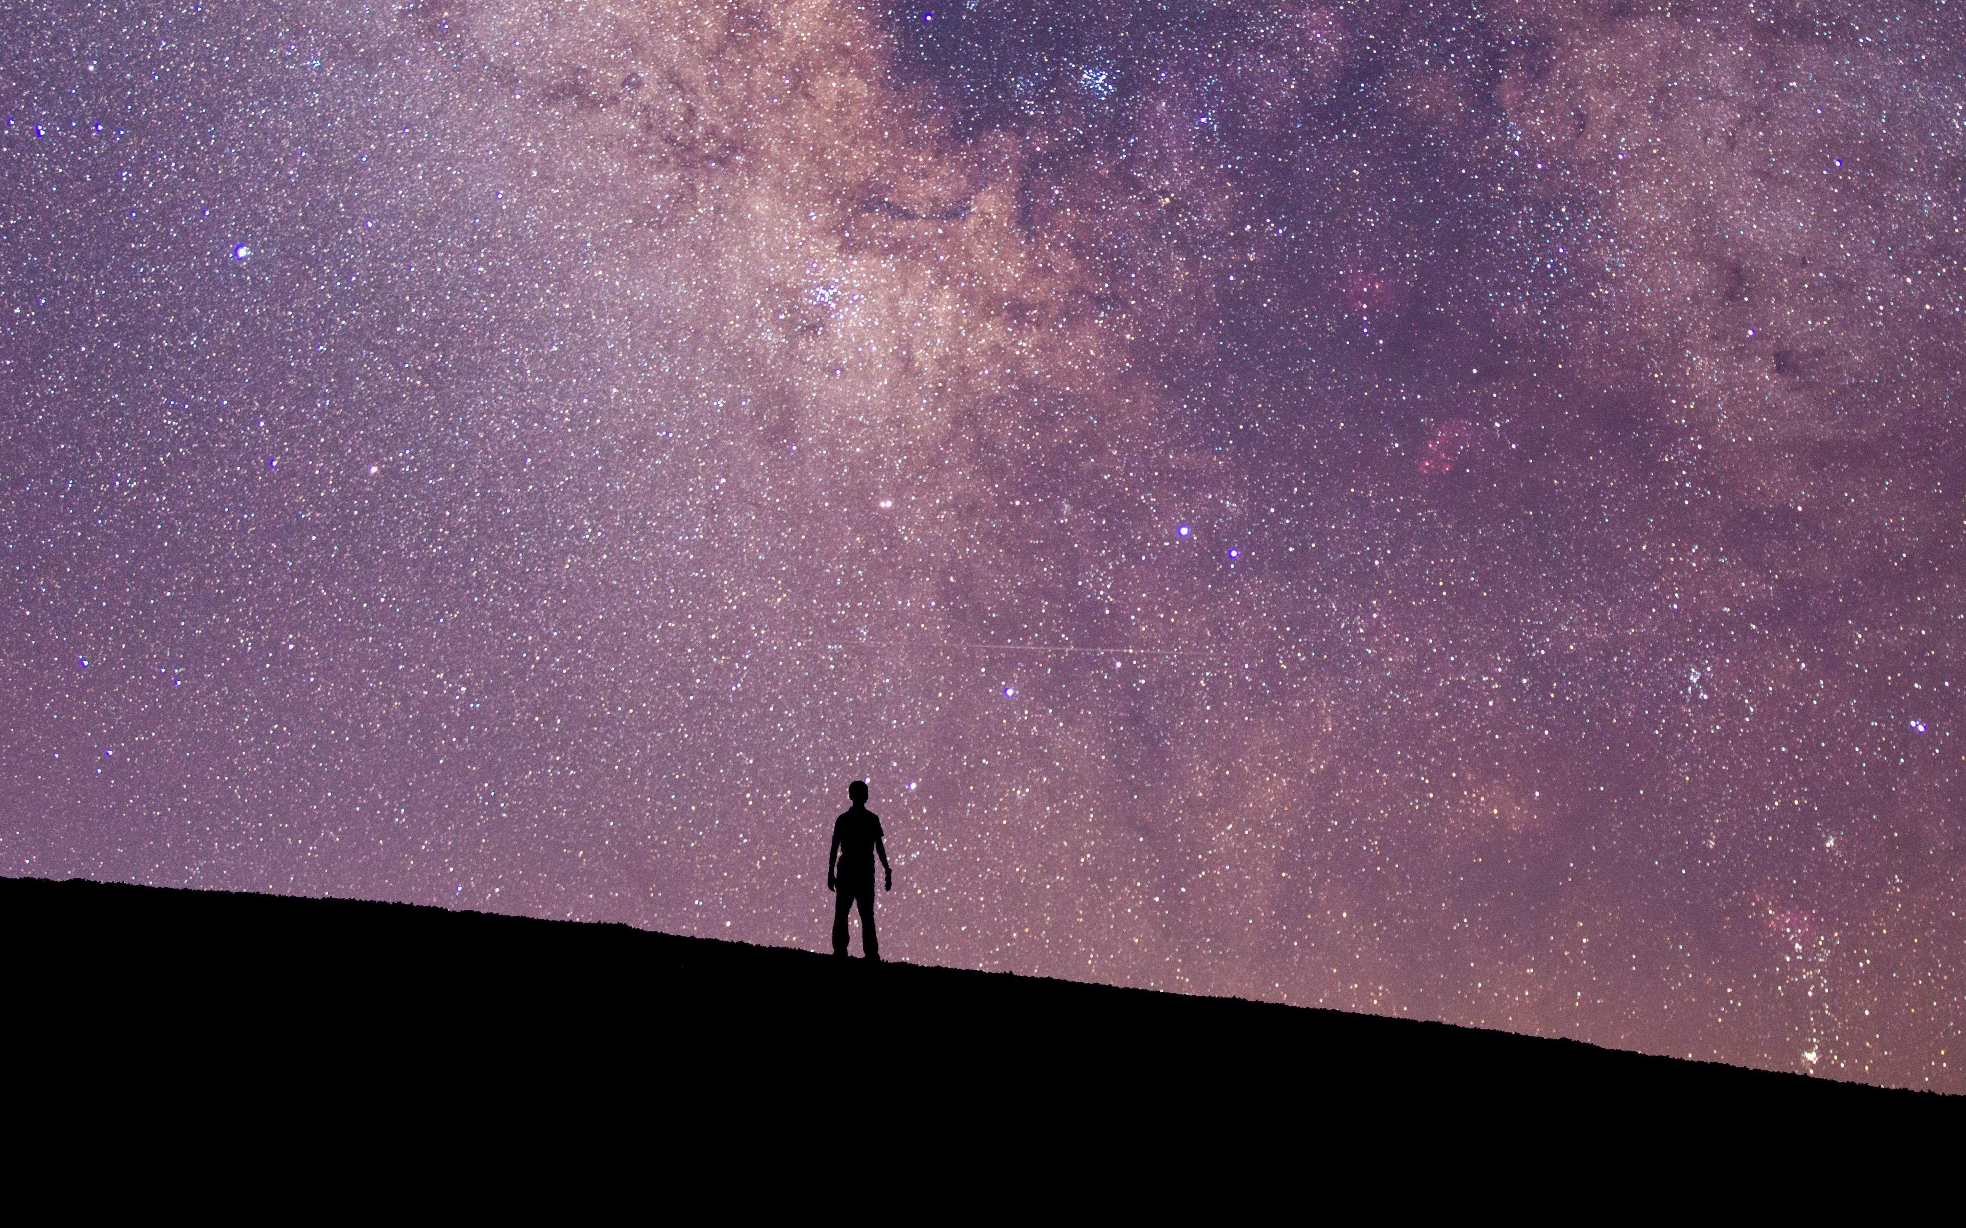
Reading
“Are we alone? What's out there?” Looking up at the stars, people have always wanted to learn more about space, and scientists work hard to find answers. They make vehicles to carry brave people into space and find out the secrets of the universe. _____________________________
__________________________________________________________.
(
Details to support the topic sentence
B
They also really wish to discover other planets that are suitable enough to support life.
Mystery creates wonder and wonder is the basis of man’s desire to understand
)
逻辑上，递进also；同义词they复现
A. Although scientists try to make sure nothing goes wrong, accidents can still happen.
B. They also really wish to discover other planets that are suitable enough to support life.
What's the main idea of this para?
关键词复现：近义词
What's the relationship between the topic sentence and the following sentences?
People are ____________the space and make ________ to ________ the universe, like making _________.
curious about
efforts
explore
C. The future of space exploration remains bright.
vehicles
D. After many experiments, they succeeded in making rockets that could escape Earth's
gravity.

Slide 8
Reading
Can you rearrange the order of mankind’s achievements?
Before the mid-20th century, most people felt travelling into space was an impossible dream. However, some scientists were determined to help humans realise their dream to explore space. ______________________________ ___________________________________________________. On 4 October 1957,... and on 12 April 1961, ... Over eight years later, on 20 July 1969,...
After many experiments, they succeeded in making rockets that could escape Earth's gravity
( ) many goals were achieved.
( ) Sputnik 1 satellite was launched and successfully orbited around Earth.
( ) American astronaut Neil stepped onto the moon in 1969.
( ) America’s NASA space agency launched Voyager 1, which still transmits data today.
( ) USSR focused on sending people into space, like Yuri Gagarin.
d
To the achievements, are you desired to say something to the scientists in your nation?
Sometimes, there is no topic sentence in a para, then you should pay attention to the key words(ideas).
a
逻辑上：时间先后
c
What's the main idea of this para?
A. Although scientists try to make sure nothing goes wrong, accidents can still happen.
B. They also really wish to discover other planets that are suitable enough to support life.
e
Mankind made ________________ a reality in mid-20th century, with their ___________ to help _____humans’ dream. They succeeded ______________, like Sputnik 1 ___________________.
travelling into space
determination
realise
C. The future of space exploration remains bright.
同义词复现: realise , succeed in doing sth.
b
in making rockets
satellite was launched
D. After many experiments, they succeeded in making rockets that could escape Earth's
gravity.

Slide 9
Reading
+ some unknown accidents/risks
Although scientists try to make sure nothing goes wrong, accidents can still happen.
________________________________________________________________All the astronauts on the USSR's Soyuz11 and America's Challenger died during their missions. These disasters made everyone san and disappointed, but the desire to explore universe never died. This is because people believe in the importance of carrying on space exploration despite the huge risks…
What do you want to say to those astronauts in the space at this moment?
Why were people so determined to explore the universe?
关键词复现：died，disaster, accident
What's the main idea of this para?
A. Although scientists try to make sure nothing goes wrong, accidents can still happen.
B. They also really wish to discover other planets that are suitable enough to support life.
_______the fact that space exploration involved great ______, mankind would ____________ their exploration.
Despite
risks
carry on with
= Mankind would risk their lives exploring the universe.
C. The future of space exploration remains bright.
D. After many experiments, they succeeded in making rockets that could escape Earth's
gravity.

Slide 10
Reading
Thanks to scientists’ and astronauts’ efforts, mankind has made great achievements at home and abroad.
What was writer’s comment on China’s achievements of space exploration?
surprised B. admired
C. passive D. both A and B
Which statement of China’s achievements is not true?
China was the third country to explore the universe independently.
After Jade Rabbit was sent to moon, one Chinese spacewalked on the moon.
The docking of Tianzhou 1 with Tiangong 2 space lab signalled one step further in China’s plan to establish a space station.
The most recent achievement China has made was the launch of Chang’e 4 to explore the surface of the far side of the moon.
China’s space programme started later than those of Russia and the US, but it has made great progress in a short time.
Main idea

Slide 11
Reading
Writer’s attitude
The future of space exploration remains bright.
________________________________________________. Europe, the US, and China all have plans to further study and explores planets like Mars and Jupiter. Despite the difficulties, scientists hope future dicoveries will not only enables us to understand how the universe began, but also help us survive well into the future.
相同词高频复现
What's the main idea of this para?
A. Although scientists try to make sure nothing goes wrong, accidents can still happen.
B. They also really wish to discover other planets that are suitable enough to support life.
同一语义词复现
C. The future of space exploration remains bright.
D. After many experiments, they succeeded in making rockets that could escape Earth's
gravity.

Slide 12
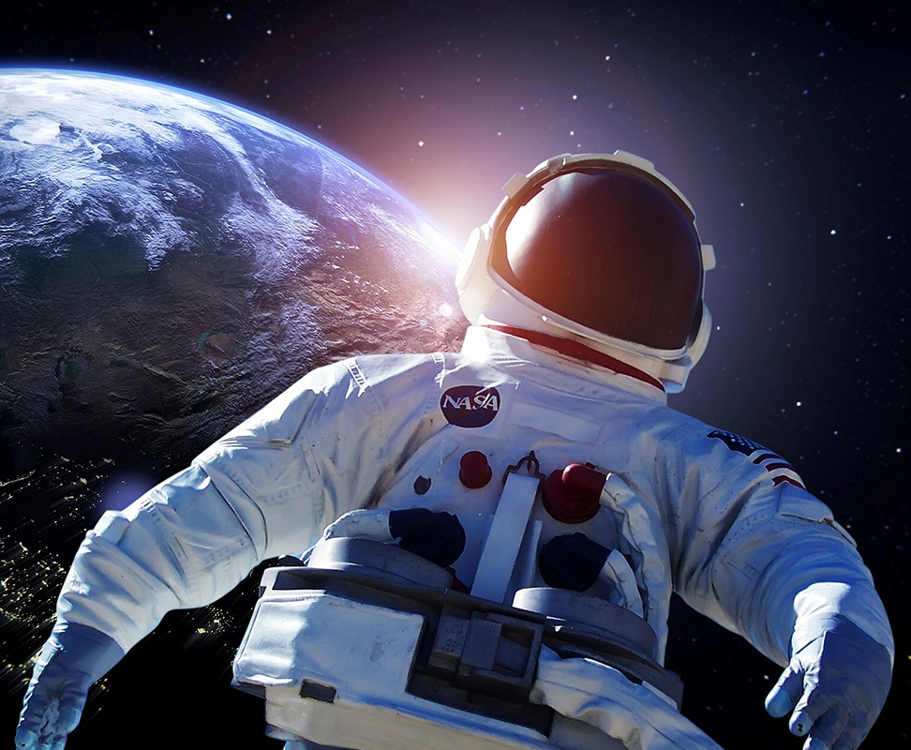
Further Thinking
frontier: a border between two countries;
a wilderness at the edge of a settled area or a country;
an undeveloped field of study
final: implying there were other human frontiers before space, such as physical
frontiers( the discovery of America, the Arctic and the deep sea); and scientific
frontiers( advances in medicine and technology)…
Space: the final frontier: Space is the last field that remains mysterious and unknown to
mankind.
While I support space exploration, I don’t think space is the final frontier just yet. There is still much to learn about the earth, and we are only at the very beginning of new technological breakthroughs involving information technology and AI. There are many scientific and technological frontiers all around us.
“Space, the final frontier. These are the voyages of starship Enterprise(进取号星舰), its continuing mission:
to explore strange new worlds,
to seek out new life forms and civilsations,
to boldly（勇敢地） go where no man has gone before.”
——James Kirk (Star Trek星际迷航）
1. Where is the title “Space: The Final Frontier” adapted from?
2. What does the title “Space: The Final Frontier” mean to you?

Slide 13
Revision
What’s the main idea of each para? How to get the main idea?
What is the main idea of the whole passage?
Can you divide the passage into several parts according to the main ideas?
How to choose proper answers of the missing sentences in a passage?

Slide 14


