Slide 1


感恩遇见，相互成就，本课件资料仅供您个人参考、教学使用，严禁自行在网络传播，违者依知识产权法追究法律责任。
更多教学资源请关注
公众号：溯恩高中英语
知识产权声明

Slide 2


中国传统节日高考题型开发
The Dragon Boat Festival
杭州二中树兰高级中学 郭合英

Slide 3
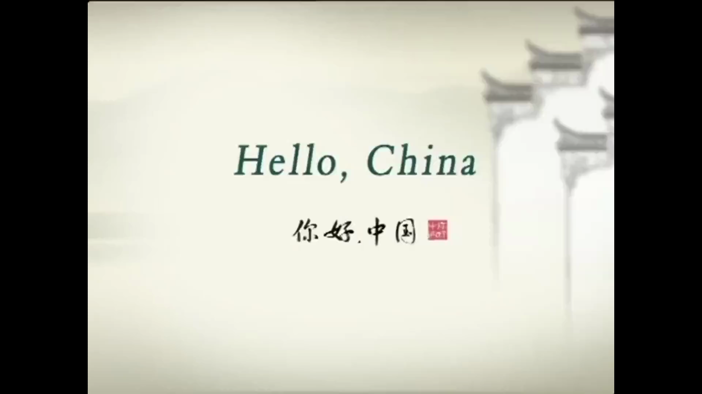

Slide 4
The introduction to the Dragon Boat Festival 高考题型开发---语篇填空
on
The Dragon Boat Festival, also called Double Fifth Festival, falls 1 the fifth day of the fifth month of the lunar calendar and usually in June in the Solar calendar with a history of more than 2000 years. It is one of the most important Chinese 2 (festival).
The Dragon Boat Festival 3 （celebrate）for thousands of years to commemorate(纪念) Qu Yuan, a great patriotic (爱国的) poet 4 lived in the state of Chu during the Warring States period (475 B.C. to 221 B. C.). He drowned 5 in the Miluo River in today‘s Hunan Province in 278 B.C. on the fifth day of the fifth month of the Chinese lunar calendar, 6 (hope )his death would encourage the king ____7___ (revitalize) the kingdom. The tradition arose that on the day of his death，the dragon boat races would be held and people should eat "zongzi" (glutinous rice dumplings 8 (wrap) in bamboo or reed leaves).
Today, Dragon Boat Festival in the Chinese people is still 9 very popular grand festival. Country attaches great 10 (important) to the protection of intangible cultural heritage(非物质文化遗产), May 20, 2006, the State Council approved the inclusion of the folk first batch of national intangible cultural heritage.
festivals
has been celebrated
who
himself
hoping
to revitalize
wrapped
a
importance

Slide 5
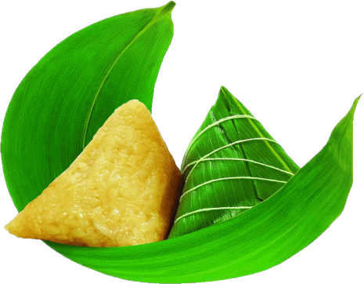
1. The origin of the Dragon Boat Festival
2. The legend of of the Dragon Boat Festival
contents
3. The customs of of the Dragon Boat Festival
4. The poems concerning the Dragon Boat Festival
5. The composition

Slide 6
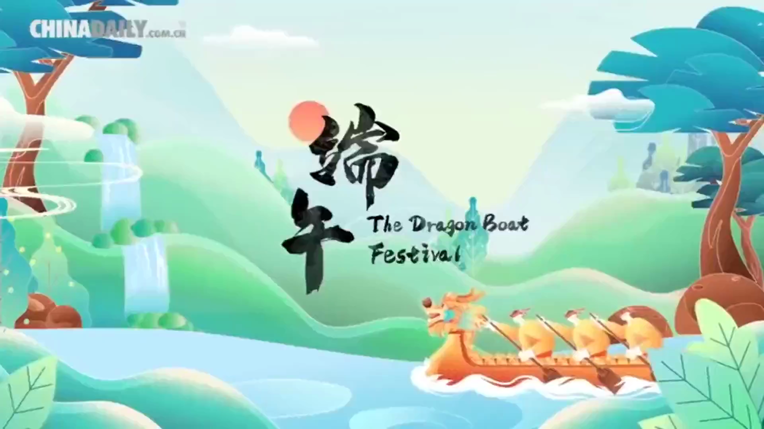
1. The origin of the Dragon Boat Festival

Slide 7
1. The origin of the Dragon Boat Festival (1)--- 高考题型开发: 阅读理解
The Dragon Boat Festival, a traditional Chinese festival, has a history of more than 2,000 years. The fifth day of the fifth lunar month is the Dragon Boat Festival, also known as ruiyang festival and the fifth festival. It is said that the Dragon Boat Festival is related to Qu Yuan.
Qu Yuan was a minister of the state of chu during the spring and autumn period. He was deeply trusted. However, he was set up by a villain. He was driven out of the capital by the king of chu and exiled to a distant land. Later, the qin army broke into Kyoto. Qu Yuan saw that his motherland was invaded, heartbroken. On the fifth day of the lunar calendar, he picked up a stone and jumped into the Miluo river.
After Qu Yuan died, the people of chu were devastated. They came to the Miluo river to salvage the body of Qu Yuan, rowing the boat back and forth in the river. A fisherman took out prepared rice balls, eggs and other food and throw them into the river, saying the fish, lobster, crab would not go to the bite the body of Qu Yuan. People followed suit. It is said that an old doctor also brought a realgar wine and poured it into the river, hoping that the dragon water beast would faint after drinking it and would not harm the body of Qu Yuan. Later, people were afraid that the dragon would eat the rice balls, and then they would cover the rice with leaves, and then they would be wrapped in colorful strings and turned into dumplings and thrown into the river.
From then on, every year on May 5, there was the custom of racing dragon boat, eating zongzi and drinking realgar wine.

Slide 8

1. How many years can we infer about the origin of the Dragon Boat Festival?
A. only 2000 years. B. 2000 years or so.
C. over 2000 years. D. less than 2000 years.
2. What does the underlined word “set up” in Paragraph 2 probably mean?
A. formed B. criticized C. praised D. framed
3. Why did the local people throw rice balls, eggs and other food into the river?
A. Because they wanted to raise the fishes to make them grow fatter.
B. Because they didn’t want the body of Qu Yuan eaten by the fish, lobster, crab and so on.
C. Because the dragon water beast fainted after eating the food.
D. Because it was a custom to throw them into the river.
4. The sentence in Paragraph 3 “ they would cover the rice with leaves, and then they would be
wrapped in colorful strings”, the second word “they” refers to _______.
A. the local people B. the rice balls covered with leaves
C. the ministers of Chu D. the rice balls

Slide 9
1. The origin of the Dragon Boat Festival（2）--- 高考题型开发: 完形填空
The Dragon Boat Festival, the 5th day of the 5th month in the Chinese lunar calendar, has had a history of more than 2,000 years. It is usually in June in the 1 calendar. You only know the Dragon Boat Festival, but do you know how it 2 ? And if you say it's going to be a long, long time ago.
During the spring and autumn period and the warring states period, there was a minister
named Qu Yuan in the state of chu. He was not only a 3 man to govern the country, but also a great 4 . At that time, the state of qin 5 the king of chu, Qu Yuan 6 that Chu qing wang, the son of the king of chu, should save the king, but Chu qing wang was
7 to fight the state of qin and manifested（表明）the indecision in it. There was a villain
who didn’t want Qu Yuan 8 . He spoke 9 of Qu Yuan before Chu qing wang, and Chu believed in him, got the fief (封地) of Qu Yuan confiscated and exiled Qu Yuan. Finally, the state of chu was 10 by the state of qin. Because Qu Yuan is a 11 poet, his heart ached. He wrote a 12 ‘Tian Wen’ , expressing his 13 that he would be determined to live and die with the country. He jumped into the Miluo river 14 the 5th day of the 5th month with a stone held in his arms to put an end to his 15 life.

Slide 10
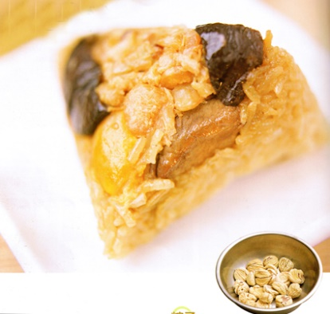
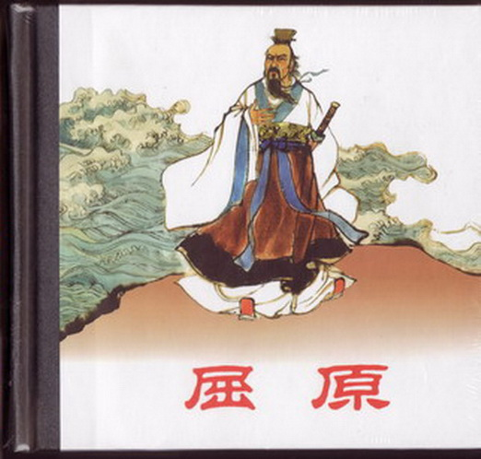
At that time, many people, in order to save Qu Yuan, __16__ the boat, threw rice balls and meatballs into the river, and poured realgar wine into the river to 17 the fish and shrimp from biting Qu Yuan's body. Later, in memory of the great poet, Qu Yuan, people refer to the fifth day of the fifth lunar month 18 the Dragon Boat Festival. On that day, The local people held 19 activities,
including racing the Dragon boat , making dumplings and drinking realgar wine.
Today, Dragon Boat Festival in Chinese is still a very popular grand festival. Country 20 great importance to the protection of intangible cultural heritage, May 20, 2006, the State Council approved the inclusion of the folk first batch of national intangible cultural heritage.

Slide 11
1. A. universal B. traditional C. solar D. lunar
2. A. come off B. came about C. came around D. came over
3. A. honest B. capable C. strange D. timid
4. A. poem B. singer C. poet D. painter
5. A. returned B. invited C. killed D. seized
6. A. ordered B. suggested C. adopted D. employed
7. A. glad B. kind C. afraid D. friendly
8. A. favored B. blamed C. attended D. suspected
9. A. badly B. highly C. good D. ill
10. A. exchanged B. destroyed C. banned D. conveyed
11. A. patriotic B. severe C. strange D. efficient
12. A. song B. draw C. poem D. picture
13. A. determination B. kindness C. bravery D. sadness
14. A. for B. at C. in D. on
15. A. tragic B. happy C. satisfying D. illegal
16. A. polished B. squeezed C. paddled D. decorated
17. A. protect B. prevent C. defend D. harm
18. A. for B. toward C. in D. as
19. A. a variety of B. a amount of C. a plenty of D. a great deal of
20. A. obeyed B. conveyed C. attaches D. won

Slide 12
1. The origin of the Dragon Boat Festival（3）--- 高考题型开发：七选五
The Dragon Boat Festival is traditionally celebrated on the fifth day of the fifth month on the lunar calendar, 1 In Chinese, the holiday is called Duan Wu Jie.
The Dragon Boat Festival commemorates the life and death of the famous Chinese scholar-statesman Qu Yuan, who was a loyal minister that served the King of Chu during the Warring States Period. Initially, Qu Yuan was highly respected and trusted, 2 Eventually, the intrigues of his rivals exerted enough ill influence on the King. Not long after, the King banished Qu Yuan from Chu. While in exile（流放), Qu Yuan composed many poems expressing his sorrows and concerns for his country and people. 3
In the year 295 B.C., at the age of 37, Qu Yuan drowned himself in the Milo River with a heavy stone to his chest. The people rushed to the river to save him, desperately searching the waters in their boats for Qu Yuan. When it was known that Qu Yuan had been lost forever, the local people began the tradition of throwing sacrificial cooked rice into the river. However, a local fisherman had a dream that Qu Yuan did not get any of the cooked rice thrown into the river in his honor. 4 So, the following year, the tradition of wrapping the cooked rice in bamboo leaves begun. The cooked rice wrapped in bamboo leaves later came to be known as zong zi.
F
B
D
A

Slide 13
5 When it was known that Qu Yuan had been lost to the river, the local fisherman had a dream that the fishes in the river were eating Qu Yuan's body. The local people came up with the idea that if the fishes in the river were not hungry, then they would not eat Qu Yuan's body. So the local people began the tradition of throwing zong zi into the river to feed the fishes in hope that Qu Yuan's body would be spared.
G
A. Instead, it was the fishes that had eaten the rice.
B. but over time, his wisdom and erudite ways antagonized the other court officials.
C. He was favored by local people.
D. Amongst his most famous poems is “Encountering Sorrow“(离骚) .
E. however, he came to become proud of himself.
F. and it is therefore often called ‘Double Fifth Festival’.
G. There is also another version of the story.

Slide 14
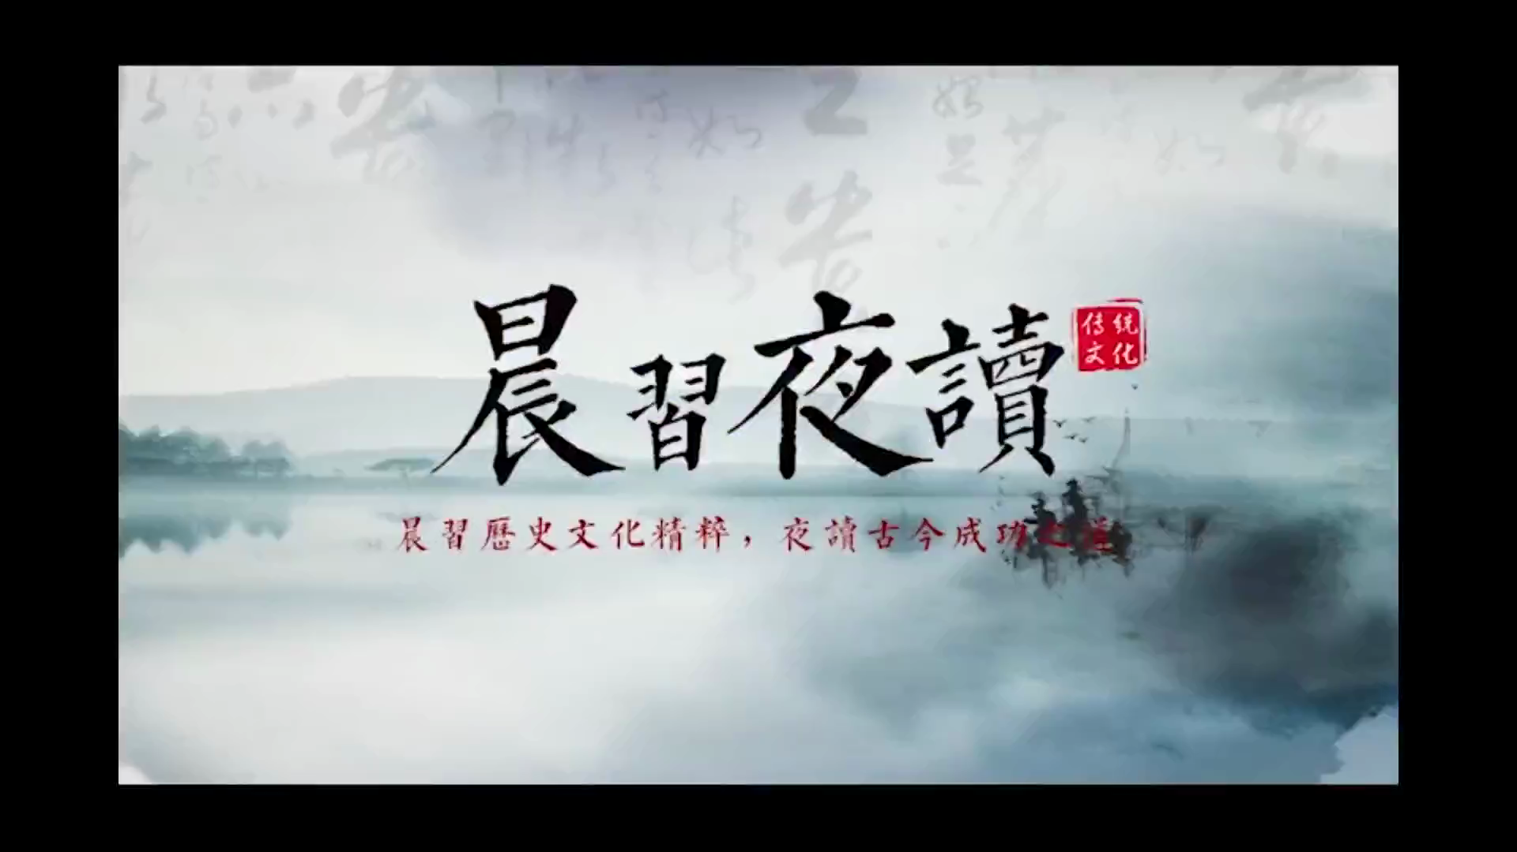
2. The legend of of the Dragon Boat Festival

Slide 15
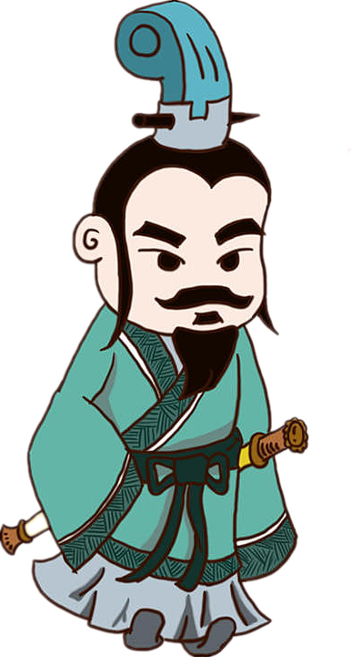
2. The legend of of the Dragon Boat Festival---补全句子
1. Qu Yuan jumped off river
屈原投江
In order to memorialize patriotic poet Qu Yuan
1 jumped into the Miluo river, and avoid his body 2 (eat) by fish and shrimp, so people cast much bamboo rice (rice dumplings) in the river and compete 3 (row), 4 (hope) to find the body of Qu yuan.
为了纪念爱国诗人屈原，为了不让跳下汨罗江的屈原尸体被鱼虾吃掉，人们在江里投下许多用竹叶包裹的米食(粽子)，并且竞相划船(赛龙船)希望找到屈原的尸体。
who
being eaten
to row
hoping

Slide 16
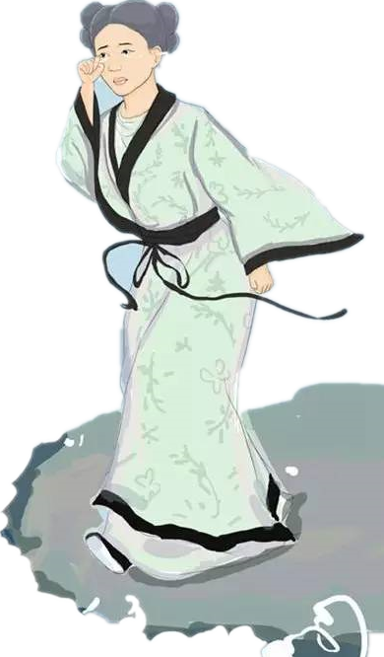
2. Cao E looked for her father’s corpse
曹娥寻父尸
Cao E, dutiful girl of the Eastern Han Dynasty, ___1___
father drowned in the river when she was 14-year old. She cried along the river，and still didn’t see his father’s corpse after 17 days, and then the she jumped into the river on May 1st
2 （也,又,和), after five days the two corpses folded together and 3 （float). That was a 4 (move) story, so people in the township worshipped her.
东汉孝女曹娥，因曹父溺江而亡，年仅十四岁的她沿江豪哭，经十七日仍不见曹父尸首，乃在五月一日投江，五日后两尸合抱而浮起的感人事迹， 乡人群而祭之。
whose
as well
floated
moving

Slide 17
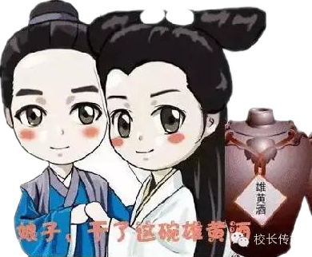
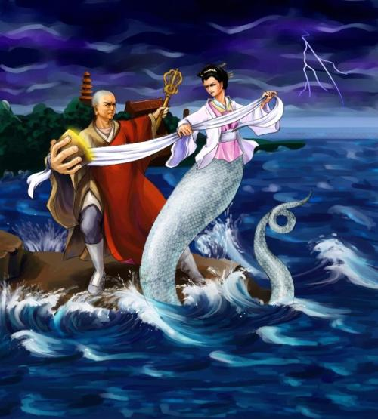
3. Madam White Snake
白蛇传
There is a legend of white snake Bai Suzhen.____1___ (repay) Xu Xian ，she fell in love with him and finally got
2 (marry). On the day of the Dragon Boat Festival, white snake drank realgar wine and revealed ____3____ (her) snakelike. The white snake, Fa Hai and water logging Jinshan temple, 4 （be） popular folk opera repertoire.
传说白蛇白素贞，为了报答许仙的恩惠，与许仙结为夫妻的凄美的爱情故事。端午节当天白蛇喝了雄黄酒，然自己现出蛇形，加上法海白蛇及水淹金山寺的情节，都是脍炙人口的民间戏曲的曲目。
To repay
married
herself
are

Slide 18
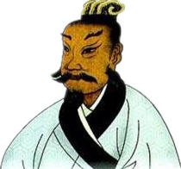
4. Wu Zixu’s death anniversary
伍子胥的忌日
It’s a legend 1 after He Lu, the king of Wu died, the prince Fuchai ascended(v.上升；攀登) the throne, 2 (send) armed forces to suppress (镇压) Yue and won. Goujian, the king of Yue please reconciliation(调和;和好). Fuchai didn’t listen but agreed treacherous(不忠的;不可靠的) official and judged Wu Zixu commit suicide and threw his body
3 river on May 5, since then people ___4___ (commemorate) him on Dragon Boat Festival.
传说伍子胥助吴伐楚后，吴王阖闾逝世，皇子夫差继位，伐越大胜，越王勾践请和，伍子胥主张和，夫差不听，却听信奸臣言，赐伍子胥自杀，并于五月五日将尸体投入江中，此后人们于端午节祭祀伍子胥。
that
sent
into
have comemorated

Slide 19

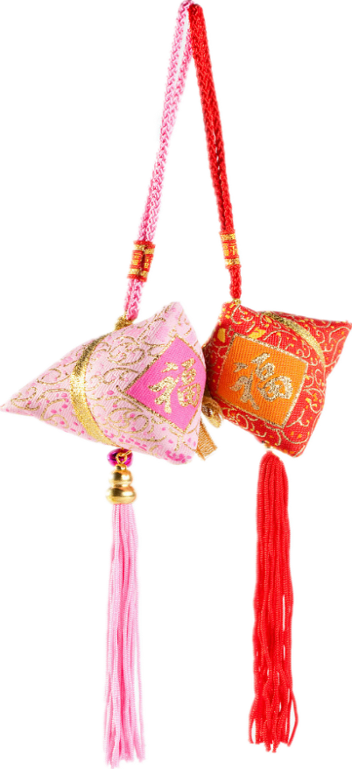
3. The customs of of the Dragon Boat Festival
端午节特色词汇：
端午节 the Dragon Boat Festival
粽子 zongzi/tsung-tse/rice dumpling
糯米 glutinous rice
赛龙舟 Dragon boat racing
雄黄酒 realgar wine
香包 perfumed medicine bag/sachet
驱邪 ward off evil
祛病 ward off disease

Slide 20

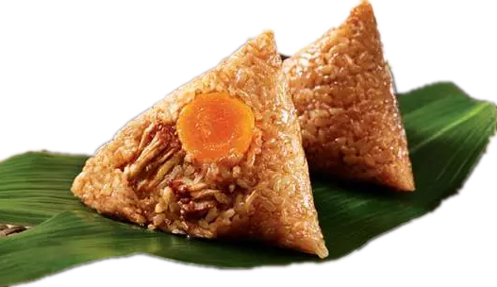
端午吃什么？
“粽包分两髻，艾束著危冠。旧俗方储药，羸躯亦点丹。”端午节不可不吃的美味食物就是tsung-tse（粽子），这种传统源于汨罗江边的渔夫，将米丢入江中平息江中的蛟龙，希望它们不要伤害屈原。
粽子 tsung- tse
A very popular dish during the Dragon Boat festival is tsung-tse. This tasty dish 1 (consist) of rice dumplings with meat, peanut, egg yolk, or other fillings 2 (wrap) in bamboo leaves. Eating tsung-tse is meant to remind us 3 (remember) the practice that the village fishermen scattered rice into the Mi Luo river to appease the river dragons so that they would not devour Qu Yuan. The custom of eating tsung-tse is also ____4___(popularity ) in North and South Korea, Japan and Southeast Asian nations.
consists
wrapped
to remember
popular

Slide 21
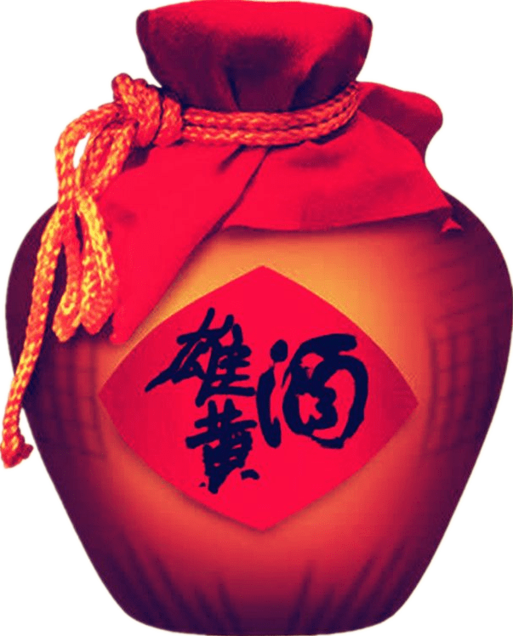
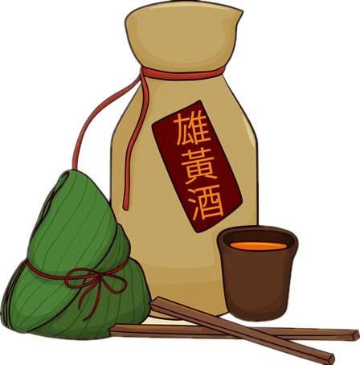
端午喝什么？
“樱桃桑椹与菖蒲，更买雄黄酒一壶。”端午节尝试一下雄黄酒吧。端午节这天，人们把雄黄倒入酒中饮用，并把雄黄酒涂在小孩儿的耳、鼻、额头、手、足等处，希望这样可以使孩子们不受蛇虫的伤害。
It is a very popular practice 1 (drink) this kind of Chinese liquor 2 (season) with realgar at the Dragon Boat Festival. This is for protection 3 evil and disease for the rest of the year.
to drink
seasoned
from

Slide 22

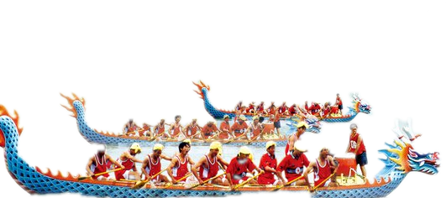
端午玩什么？
“鼓声三下红旗开，两龙跃出浮水来。棹影斡波飞万剑，鼓声劈浪鸣千雷。”端午节最应景的节目就是赛龙舟。
Dragon boat racing is 1 indispensable(不可或缺的) part of the festival, ___2___ （hold） all over the country. As the gun 3 (fire), people will see racers in dragon-shaped canoes pulling the oars harmoniously and 4 (hurry), accompanied by rapid drums, speeding toward their destination.
an
held
is fired
hurriedly

Slide 23
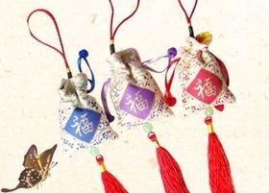
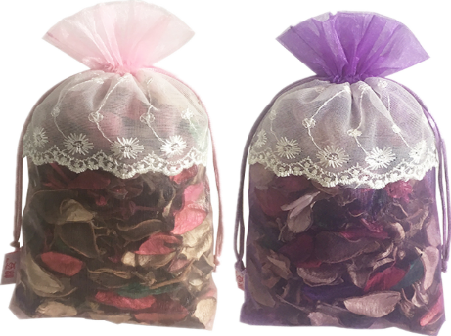
端午戴什么？
端午节最有特色的饰物就是香包（sachet）。小孩佩戴香包，传说有避邪驱瘟之意。用含有多种香味的药用植物做成的香包也可以预防疾病。
On Dragon Boat Festival, parents also need to dress their children up with a sachet. They first sew little bags with 1 (color) silk cloth, then fill the bags ____2____ perfumes or herbal medicines（草药）, and finally string them with silk threads. The sachet will be hung around the neck or 3 (tie) to the front of a garment as an ornament. They 4 (said) to be able to ward off evil.
colorful
with
tied
are said

Slide 24
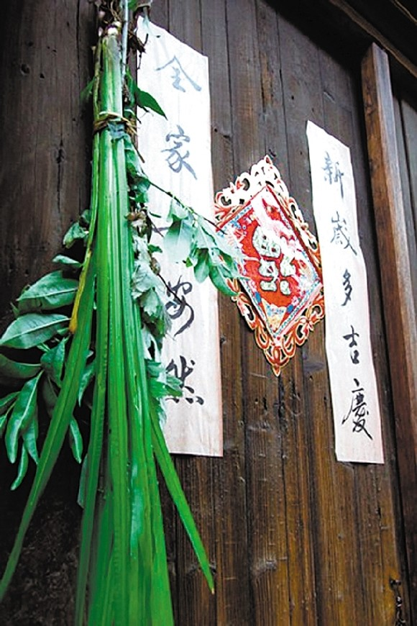
端午挂什么？
“不效艾符趋习俗，但祈蒲酒话升平。”
许多人相信五月是一年中容易引发疾病的危险时节，因此必须有许多防备家人生病的措施。端午节时，人们会将一种特别的植物-艾草挂在门口，作为保护之用。
It is believed 1 May is a dangerous time of the year for diseases. Therefore, it is necessary for us ____2___
（take） measures to prevent family 3 illness. On Dragon Boat Festival, people hang branches of moxa(艾草) and calamus （菖蒲）around the doors of their homes ____4____ a protection.
that
to take
from
as/for

Slide 25
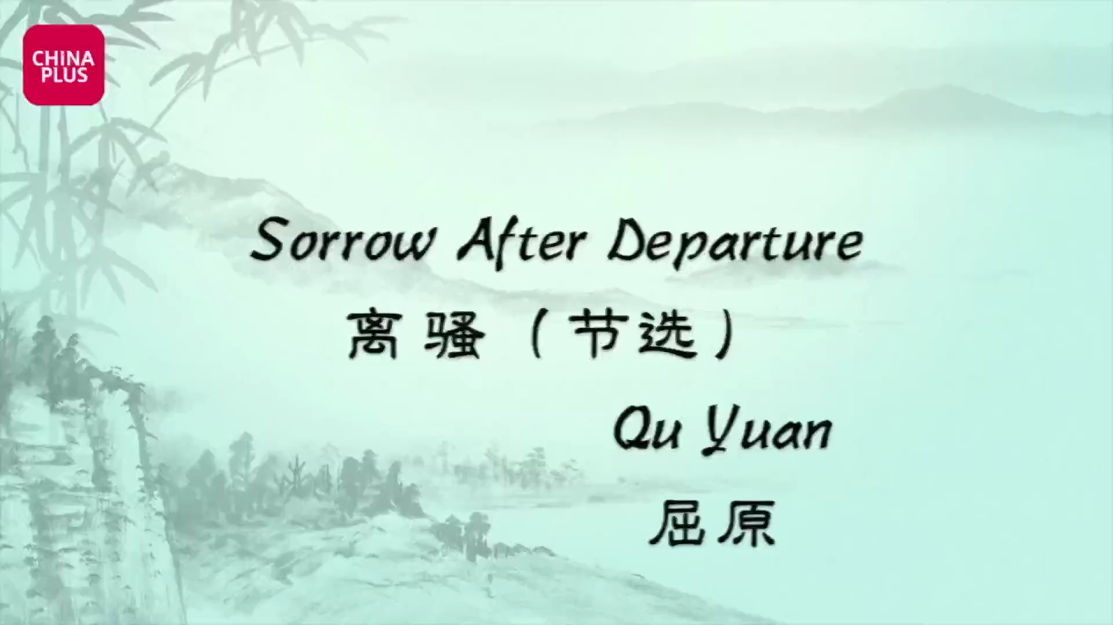
4. The poem of Sorrow After Departure

Slide 26
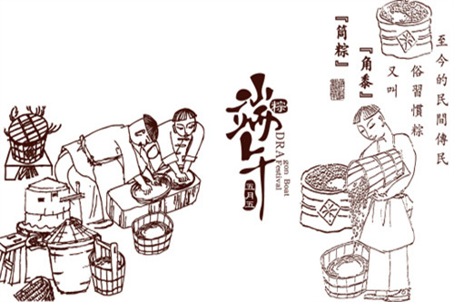
4. The poem about the Dragon Boat Festival
《端午日赐衣》
唐 杜甫
官衣亦有名，端午被恩荣。
细葛含风软，香罗叠雪轻。
自天题处湿，当暑著来清。
意内称长短，终生荷圣情。
A Presentation of Clothes on the Duanwu Festival
Du Fu
For palace robes even my name was there，on Duanwu I received the glory of his grace.
Fine threaded linen, so soft that the breeze gets in, fragrant gossamer, light as layered snow.
Coming from the emperor, still wet where the writing is, wearing these in hot weather one is cool.
He took consideration to measure the length, all my life I will be obligated to His Majesty’s feelings.
(Stephen Owen 译)
译文欣赏
_{端午佳节，皇上赐予名贵的宫衣，恩宠有加。}
_{香罗衣是细葛纺成，柔软得风一吹就飘起，洁白的颜色宛如新雪。}
_{来自皇天，雨露滋润，正当酷暑，穿上它清凉无比。}
_{宫衣的长短均合心意，终身一世承载皇上的盛情。}

Slide 27
5. The composition
假如你是李华，你的美国笔友Jim对中国的传统节日端午节很感兴趣，来信询问相关情况，请你给他写封e-mail回复，主要内容如下：
1. 节日时间；
2. 历史起源；
3. 庆祝活动。
注意：
1. 词数80词左右；
2. 首句已给出，不计入总词数。
Dear Jim,
I am glad to tell you something about the Chinese Dragon Festival.
____________________________________________________________________________________________________________________________________________________________________________________________________________
Yours,
Li Hua

Slide 28
One possible version
Dear Jim,
I am glad to tell you something about the Chinese Dragon Festival. Originating from more than 2000 years, Dragon Boat Festival is said to commemorate the Chinese patriotic poet Qu Yuan, who drowned himself into the Miluo River on the 5th day of the 5th month for losing his country. Chinese people refer to the day as Dragon Boat Festival in honor of the poet.
As one of the four major Chinese traditional festivals, Dragon Boat Festival has a public vacation when people will have a three-day off to observe it throughout the country. Nowadays, eating Zongzi and racing dragon boats are the most widespread activities . It’s also a time when family or friends brighten up the day together.
Hope that you’ll experience it in the flesh some day .
Yours,
Li Hua

Slide 29
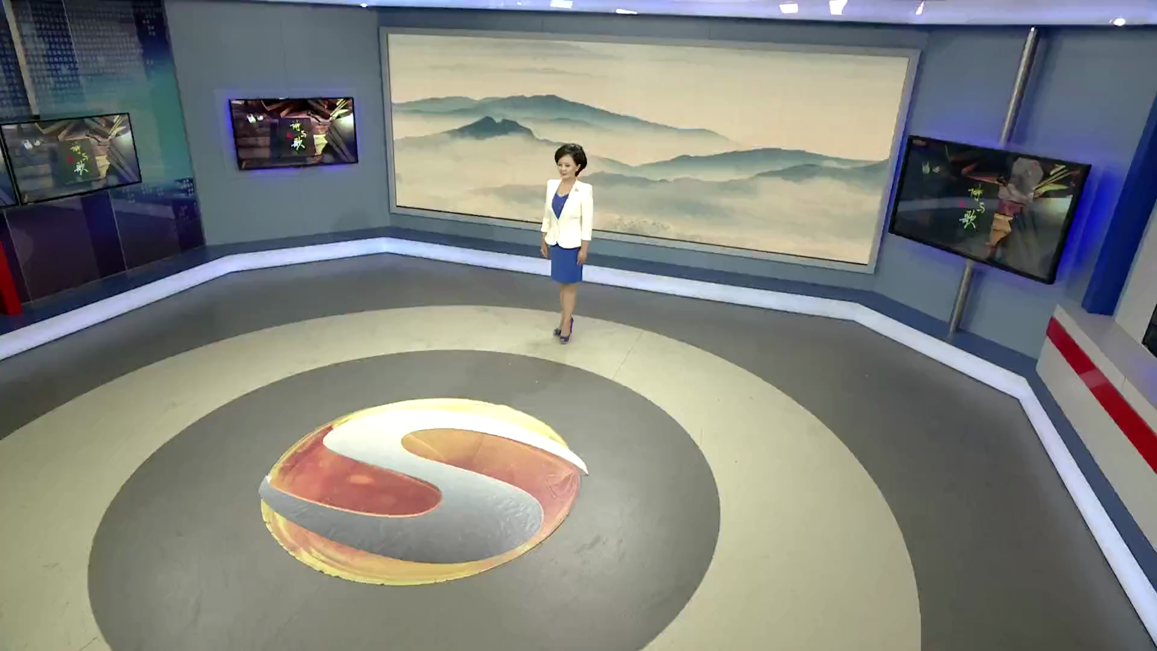

Slide 30


