Slide 1


感恩遇见，相互成就，本课件资料仅供您个人参考、教学使用，严禁自行在网络传播，违者依知识产权法追究法律责任。
更多教学资源请关注
公众号：溯恩高中英语
知识产权声明

Slide 2

M3U5 The Value Of Money

Slide 3



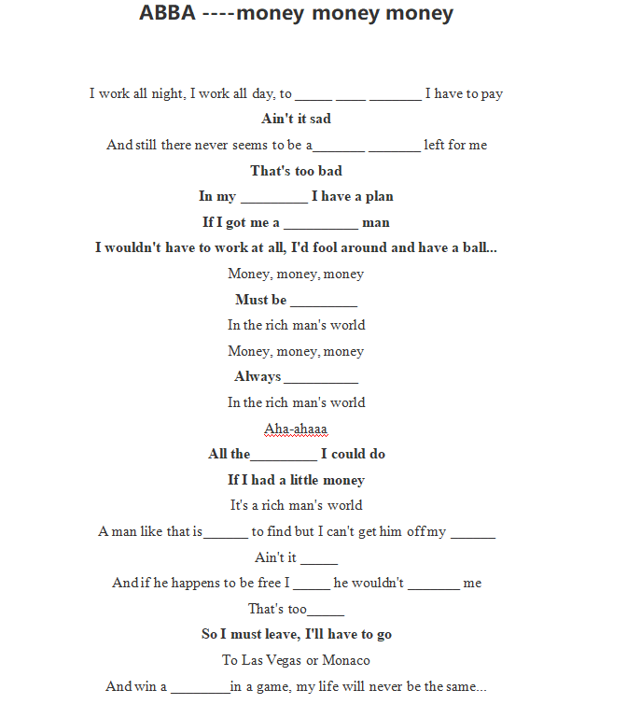
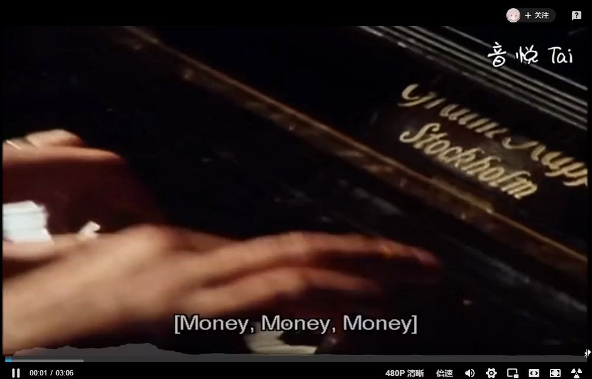
Lead-in
Enjoy and fill in blanks

Slide 4
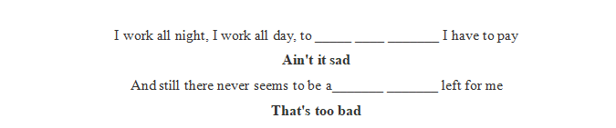
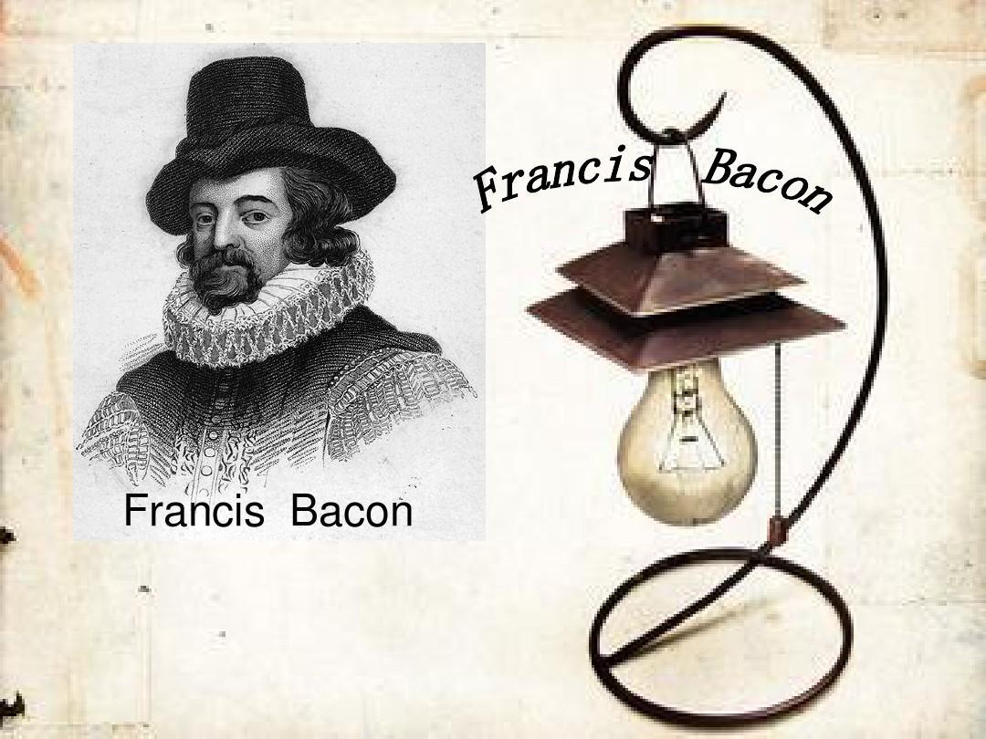
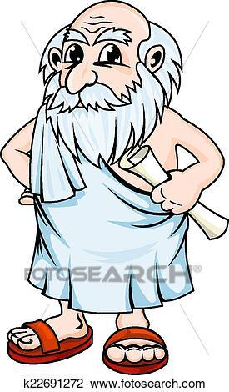
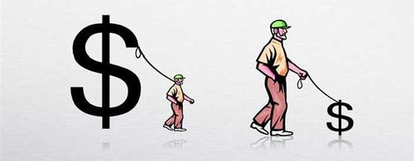
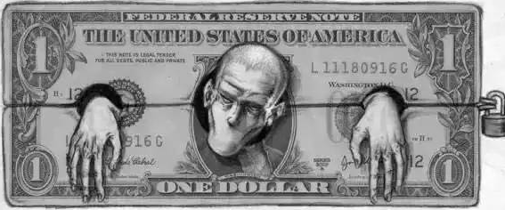
Lead-in
Have a look into the lyrics
pay the bills
single penny
How do you figure out these lyrics?
Money is a good servent and bad master.
We should
make good use of
prisoner
money

Slide 5
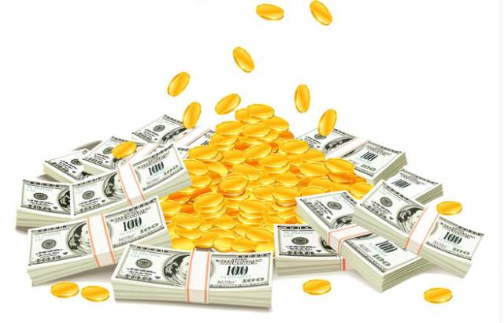


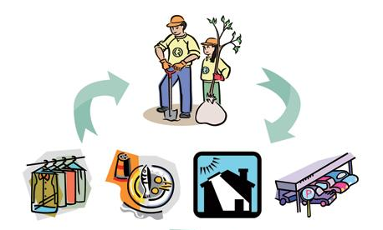
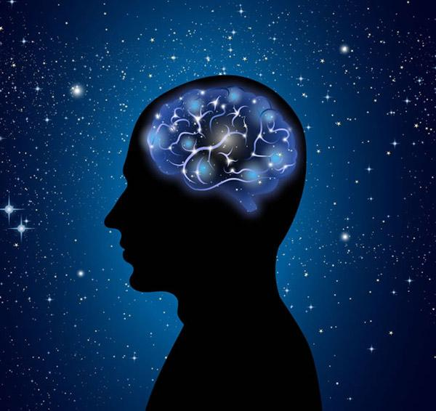

Lead-in
Have a look into the lyrics
With enough money, what will you buy?
What can people not buy with money?
meet/satisfy
“ I don’t care too much for money, for money can’t buy me love.” --- The Beatles
material needs
spiritual needs
things

Slide 6

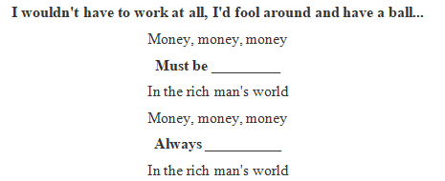


Lead-in
Have a look into the lyrics
dreams
attitude 1
wealthy
funny
hard
mind
sad
bet
fancy
sunny
attitude 2
Do you agree with this opinion?
fortune
Is money the basis of a happy life? Why or why not?
What should be our attitudes to money?
“ Don’t let money direct you”
There are two attitudes mentioned in the lyrics, what are they?
Is happy life _____ ____ money?
Is money the _______element of happy life?
basic
based on

Slide 7


Listening
Listen for general information
job,character, relationship...
How
Who
Chen found a plastic bag with 100000 yuan and returned it to the owner.
Chen Liyan
Ma Dongbao
Wang Zheng
Liu Xia
Why
When
because of her generous and honest act
recently
last Tuesday moring
What
Where
made the headline
Taiyuan Railway Station
,police station, hospital

Slide 8
Listening
Listen for general information
job,character, relationship...
How
Who
Chen Liyan
(took out a loan for her)
(a cleaner)
(neighbour)
Liu Xia
Why
(returned his money)
When
(Chen’s daughter)
Ma Dongbao
(set a funderraising website for her)
(police officer)
(informer)
Wang Zheng
What
Where
(the owner of lost money)

Slide 9
Listening
Listen for the details, rearrange.
____ Chen Liyan found Wang Zheng’s money and returned it to him.
____ Chen gave an interview to the local newspaper.
____ Wang built a website to help raise funds for Liu Xia.
____ Ma Dongbao shared Chen’s story with Wang.
____ Chen spent all her savings and took out a large loan.
____ Wang offered Chen 5,000 yuan.
2
6
5
4
borrow money from the bank
1
3
Listening tip:
The events in the news are usually arranged in time order, pay attention to the linking words of time.

Slide 10
Listening
Listen and decide T or F
1. It was the first time Chen Liyan’s story was reported.
2. Chen found 10,000 yuan in a small plastic bag in Taiyuan railway station.
3. Wang Zheng apologised to Chen because he couldn’t offer her more money.
4. Chen took out a large loan to cure her daughter.
5. Wang set up a fundraising website for Chen’s daughter after Chen told him about her situation.
F
reported in the newspaper.
made the headline
interviewed by the local paper
F
What is Chen’s view of money?
100,000
for the incovenience
F
Return money found
T
Ma
F

Slide 11
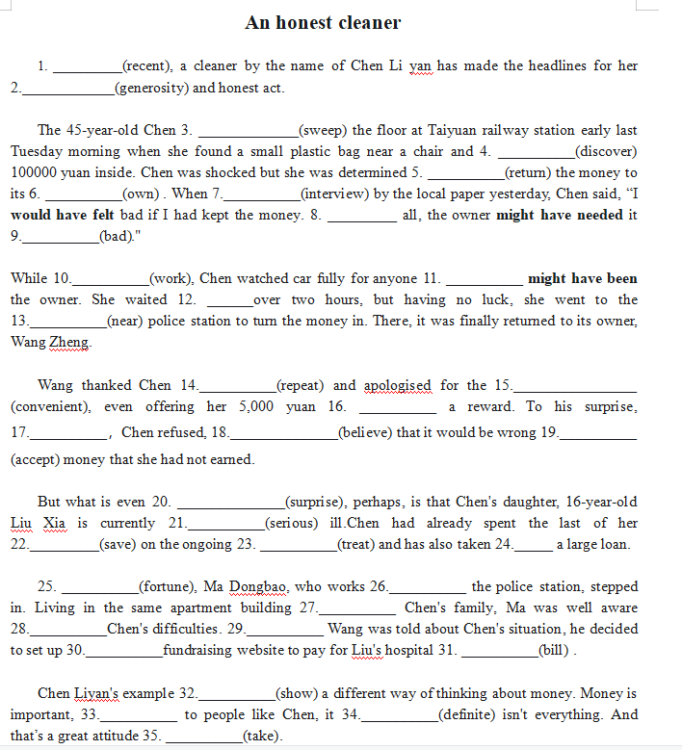
Post-listening
Analyze the structure
Lead paragraph
(导语）
5W+H
content：wide
Main body
(主体）
language：concise
detailed information
timeliness：strong
in time order
writer's attitude
Conclusion
(总结）

