Slide 1

感恩遇见，相互成就，本课件资料仅供您个人参考、教学使用，严禁自行在网络传播，违者依知识产权法追究法律责任。
更多教学资源请关注
公众号：溯恩高中英语
知识产权声明

Slide 2

Space Exploration
Reading for writing

Slide 3

learning objectives
1. Read the argumentative essay about space exploration
2. Study the features of the argumentative essay
3. Try to write an argumentative essay about space exploration

Slide 4
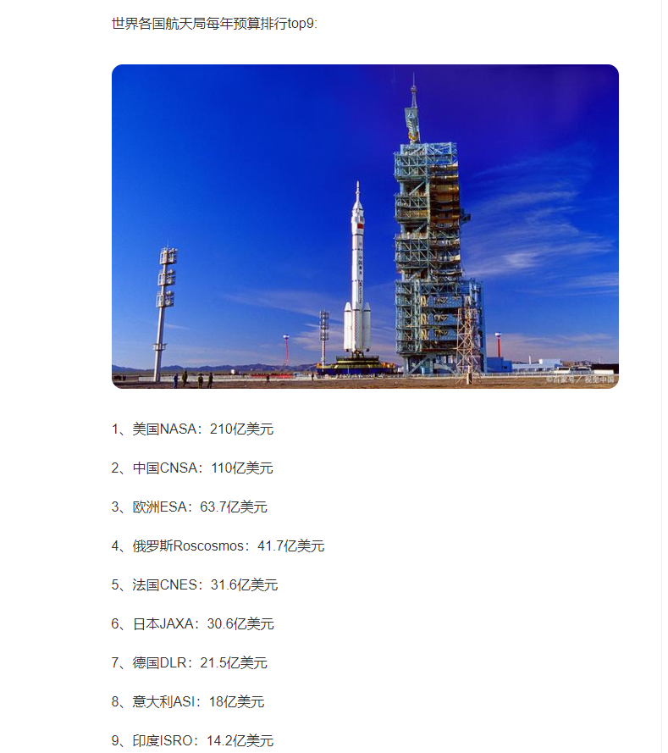
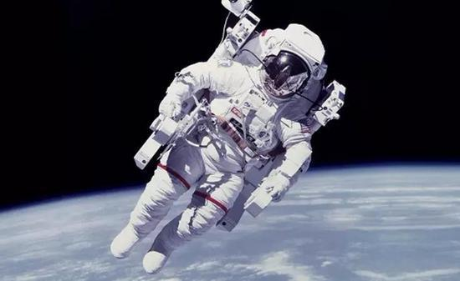


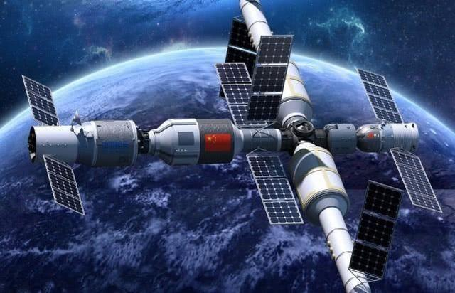
lead-in
Space exploration is really a waste of time!
Do you agree?

Slide 5

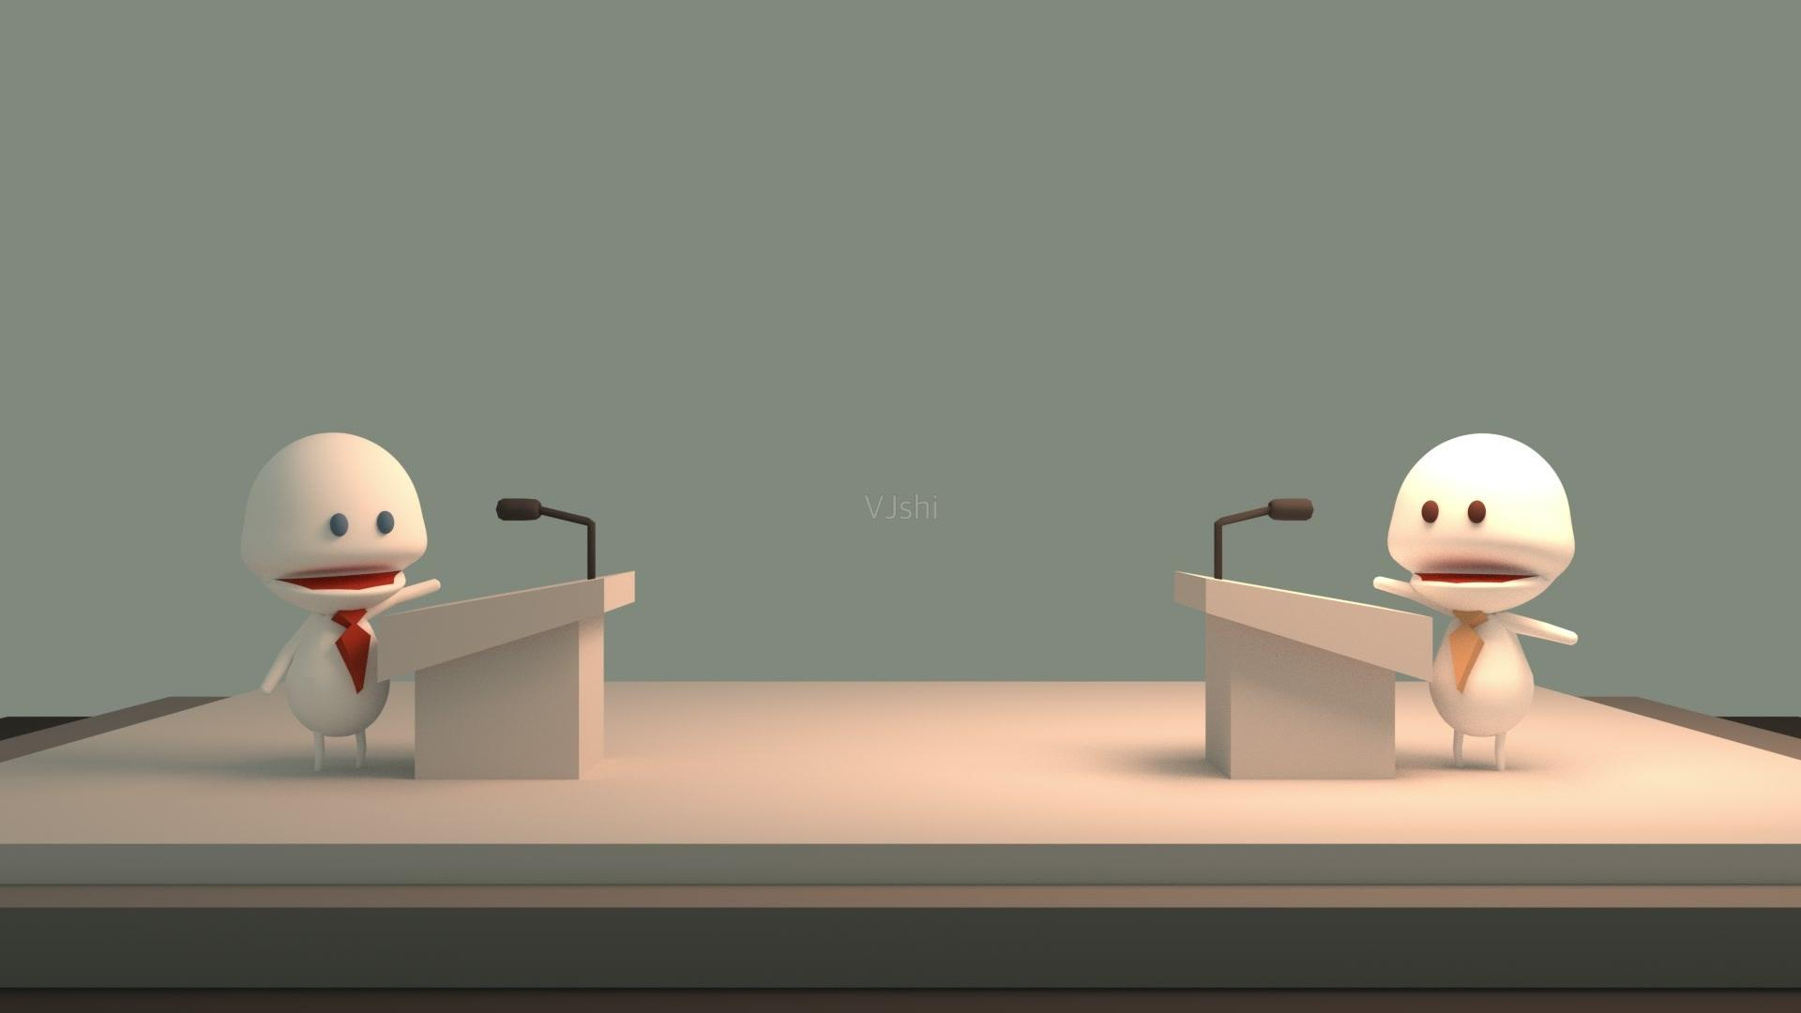

Have A Debate
The counterclaim
Different people, however, think quite differently on this issue.
Opinions are divided on this issue.
The claim
Can you combine the two sides’ opinions together?
1. Some people argue that…, while others disagree, they...
2. Some people argue that … Others , in contrast , believe that …
3. Although more and more people come to believe … there are still others who insist that …
Is exploring space a waste of time and money? Why?

Slide 6
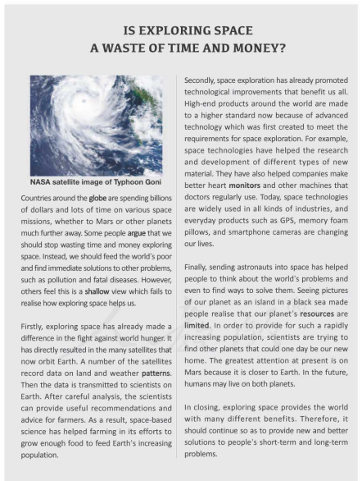
Prediction
Title
1. What kind of passage is it? And the feature of this kind?
an argumentative essay
list
the proofs
state the topic
argument(论点), proof(论据), reasoning(论证), conclusion.
2. Can you divide it into several parts? and why?
echo the topic
conclusion

Slide 7
Reading
Is the topic clear and attractive?
Countries around the globe are spending bllions of dollars and lots of time on various space missions, whether to Mars or other planets much further away. Some people argue that we should stop wasting time and money exploring space. Instead, we should feed the world’s poor and find immediate solutions to other problems, such as pollution and fatal diseases, However, others feel this is a shallow view which fails to realise how exploring space help us
The opinion of the counterclaim
1. Nowadays, there is an increasingly hot topic about whether to…or not.
2. There is a drastic discussion about whether it is necessary to … or not. (rewrite)
3. Nowadays there is a growing concern for…
4. Recently , …has become the focus of the society.
The opinion of the claim
What’s the topic of the argumentative writing?
What are the opinions of the two sides? Why?
What’s the writer’s argument?
the claim

Slide 8
Reading
1. What were the proofs to support writer’s argument?
3, the topic sentences
How does the writer support his argument?(reasoning)
analyzing the data B. contrasting
C. listing examples D. presenting results
2. How did the space exploration help improve food production?
4 steps:
sent satellites
——record data
——transmitted it to
Firstly, then, besides (moreover, in addition (to that), apart from that, more importantly), last but not least (the most importantly)
analysis & recommendation
3. What did the picture of Earth from space make people realise?
It made people realise that our planet's resources are limited.
…may help us find a suitable planet to live on.
What’s the function of last para? How?
To echo(呼应）the argument (writer’s opinion)
4. How did space exploration benefit the products that people use nowadays?
High-end products around the world are made to a higher standard now because of the advanced technology.
In closing, exploring…different benefits.

Slide 9
Argumentative writing
topic, opinions of the claim, counter claim and the author
1
Structure
2
proofs (supporting details)
Repeat writer’s opinion to echo ...
3

Slide 10
Writing
假设你是李华，最近你班就“垃圾是否要分类回收”进行了讨论。请根据讨论结果，写一封80词左右的信给某英文报社的编辑来报道此事。
注意：开头和结尾已给出，不计入总词数。
严峻形势 | 每天产生大量的垃圾，己成为令每个城市头疼的问题
垃圾分类的意义 | 1.减少垃圾量和垃圾对环境的污染；2．是对垃圾进行有效处置的一种科学管理方法；3．回收资源，有利于改善生存环境质量和环境保护。
呼吁 | 政府采取有效措施并即刻行动，在公共场所放置不同的垃圾箱供居民投放分类垃圾

Slide 11
Sample
Recently, garbage sorting recycle has become a focus of the society. Some people argue that it’s not necessary to do this. Others, in the contrast, think we should take actions right away, for society produces a large amount of rubbish every day. And I agree with the latter.
Firstly, rubbish classification can reduce the amount of rubbish and the rubbish pollution to the environment. Secondly, it is a scientific and effective way to manage rubbish. Apart from that, by classifying rubbish it allows us to recycle resources, which will improve the quality of our living conditions and help the environment.
In closing, I definitely think we should start the activity--- garbage sorting recycle immediately. It will surely be beneficial to both our mankind, but also the environment.

