Slide 1


感恩遇见，相互成就，本课件资料仅供您个人参考、教学使用，严禁自行在网络传播，违者依知识产权法追究法律责任。
更多教学资源请关注
公众号：溯恩高中英语
知识产权声明

Slide 2
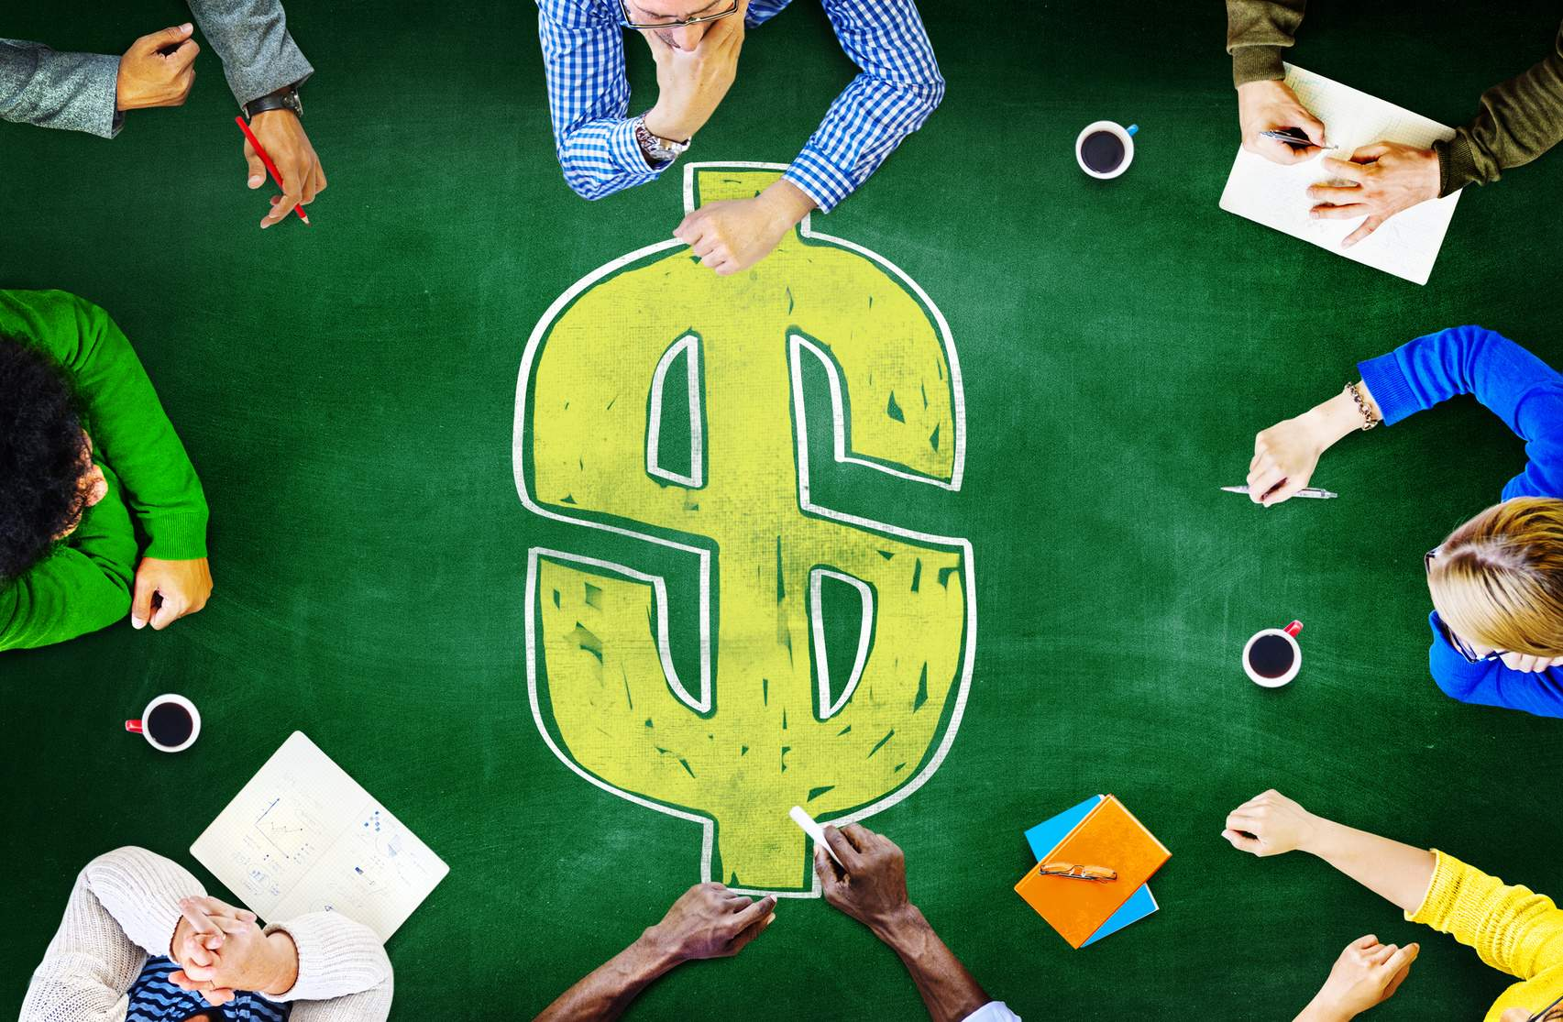
Listening and speaking
M3U5 THE VALUE OF MONEY
-- Yu Yue,
Shengzhou Senior High School

Slide 3


M3U5 THE VALUE OF MONEY
What’s the value of money?
satisfy material needs
satisfy spiritual needs
buy a dream house
Stay at home without worry about money
trip around the world
do anything you like
learn anything you like
lead a good life
lead a happy life
Although money is necessary, money is not everything!

Slide 4

How should we treat money correctly?
Money is a good servant and a bad master.
-- Francis Bacon

Slide 5

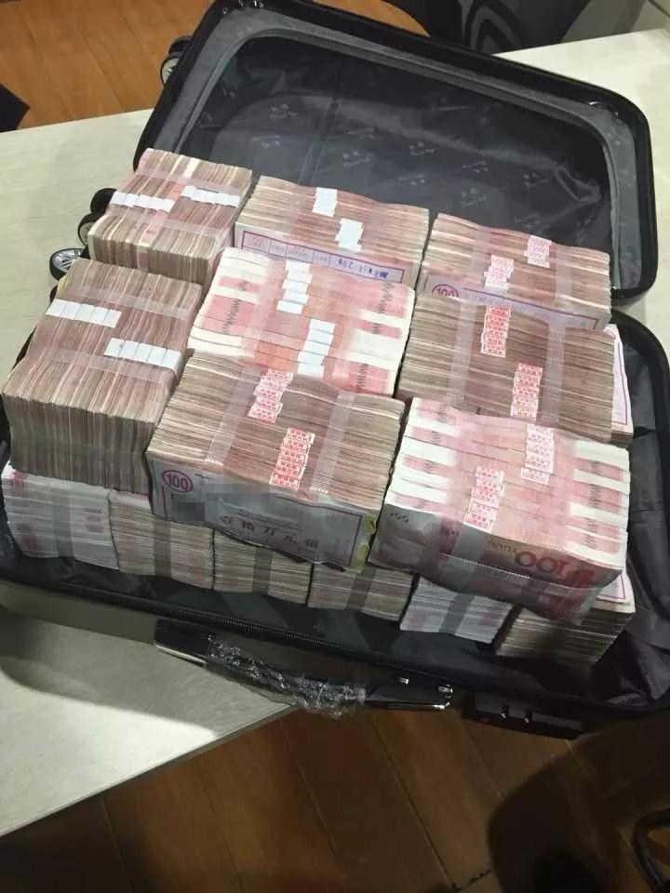
One day, if you find a box full of money on the road unexpectedly and no one knows it,
you will….
Why?
keep it at home?
find the owner and return it?
Why?

Slide 6

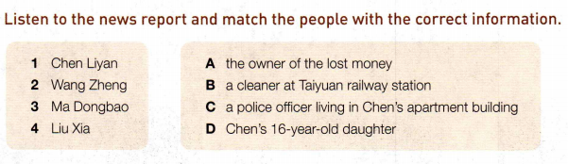

Activity 1：

Slide 7
2
2
Activity 2：
2
_______Chen Liyan found Wang Zheng’s money and returned it to him.
_______Chen gave an interview to the local newspaper.
_______Wang built a website to help raise founds for Liu Xia.
_______Ma Dongbao shared Chen’s story with Wang.
_______Chen spent all her savings and took out a large loan.
______Wang offered Chen 5000 yuan.
6
5
4
1
3

Slide 8
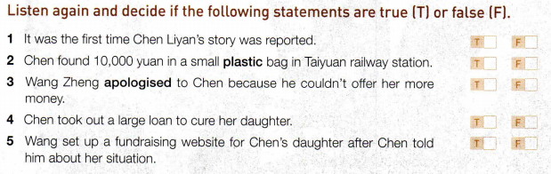
Activity 3：

Slide 9

Activity 4：
According to what you have heard, please try to summarize its main idea.
Chen,_________, found a bag within 100,000 yuan. She was determined to _______ it and finally found its _______ , Wangzheng. Wang offered her 5000yuan for her______________________, but she ________
Wang’s money. While Chen’s daughter, Liu, was ____________ and she had spent all _______ and even ________________ to treat Liu. Ma Dongbao, a
_____________, knew Chen’s _________ and shared them with Wang. Later, Wang set up ____________________ to pay for Liu’s bill.
Chen was __________ for her _________ and _________ act. Besides, as an old saying goes: “___________________________”, Chen was helped by others, too.
a cleaner
return
owner
kindness and honesty
refused
seriously ill
savings
taken out a loan
police officer
difficulties
a fundraising website
rewarded
generous
honest
one good turn deserves another

Slide 10
cleaner
cleaner
cleaner
Activity 5：
Please finish the mind map about the news.
Chen Liyan
( _________)
cleaner
took out a loan for her
neighbour
Ma Dongbao
( ________________)
Liu Xia
(________________)
returned his money
police officer
Chen’s daughter
Set up a fundraising website for her
told him about Chen’s situation
Wang Zheng
(_____________________)
owner of lost money

Slide 11
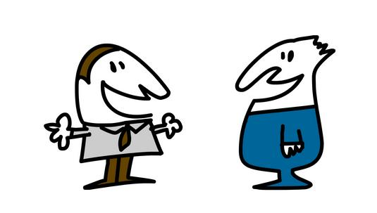
Activity 5：
Answer following questions according to the news.
Is it common for people to do what Chen did?
How did the news reporter feel about Chen’s action?
Do you agree or disagree with Chen’s actions and why?
It depends on the culture. In some countries it is quite common to return money that has been found. In other countries, people believe “Finders are keepers.”
The news reporter speaks highly of Chen’s action.
debate

Slide 12
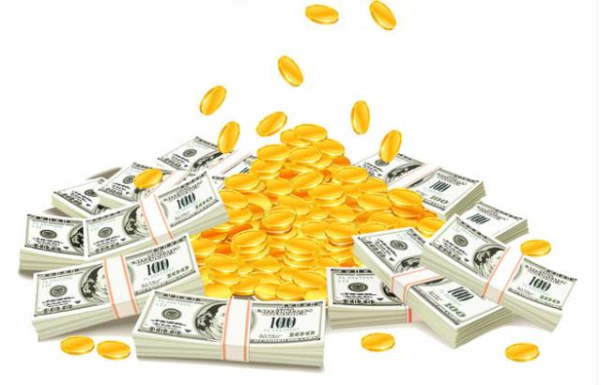
Thank you!

