Slide 1


感恩遇见，相互成就，本课件资料仅供您个人参考、教学使用，严禁自行在网络传播，违者依知识产权法追究法律责任。
更多教学资源请关注
公众号：溯恩高中英语
知识产权声明

Slide 2

2020年全国新高考卷---读后续写公开课
A Good Idea to Help the Neighbor

Slide 3
The Meredith family lived in a small community. As the economy was in decline, some people in the town had lost their jobs. Many of their families were struggling to make ends meet. People were trying to help each other meet the challenges.
Mrs. Meredith was a most kind and thoughtful woman. She spent a great deal of time visiting the poor. She knew they had problems, and they needed all kinds of help. When she had time, she would bring food and medicine to them.
One morning she told her children about a family she had visited the day before. There was a man sick in bed, his wife, who took care of him and could not go out to work, and their

Slide 4
little boy. The little boy — his name was Bernard — had interested her very much.
“I wish you could see him,” she said to her own children, John, Harry, and Clara. “He is such a help to his mother. He wants very much to earn some money, but I don’t see what he can do.”
After their mother left the room, the children sat thinking about Bernard. “I wish we could help him to earn money,” said Clara. “His family is suffering so much.”
“So do I,” said Harry. “We really should do something to assist them.”

Slide 5
For some moments, John said nothing, but, suddenly, he sprang to his feet and cried, “I have a great idea! I have a solution that we can all help accomplish（完成）.”
The other children also jumped up all attention. When John had an idea, it was sure to be a good one. I’ll tell you what we can do,” said John. “You know that big box of corn Uncle John sent us ?Well, we can make popcorn（爆米花），and put it into paper bags, and Bernard can take it around to the houses and sell it.”
Paragraph 1: When Mrs. Meredith heard of John’s idea, she thought it was a good one, too.
Paragraph 2: With everything ready, Bernard started out on his new business.

Slide 6
不可再分段
第二节（满分25分）
阅读下面材料, 根据其内容和所给段落开头语续写两段, 使之构成
一篇完整的短文。
注意：
1. 续写词数应为150左右：
2. 请按如下格式在答题卡的相应位置作答。
When Mrs. Meredith heard of John's idea, she thought it was a good one, too.__________
With everything ready, Bernard started out on his new business._____________________
不留悬念
两段字数均分

Slide 7
STEP
1
STEP
2
STEP
3
STEP
4
写作步骤
read -- think -- draft -- polish
读懂大意
理清脉络
细读首句
构思框架
增加细节
开始写作
修改润色
整洁誊写
------------------------------
Pre-writing
While-writing
Post-writing

Slide 8
Pre-writing（ W and T )
what
when
who
beginning
theme
ending
where
how
why
STEP
1
tense
place
characters
events/plots
positive

Slide 9
Pre-writing
Pre-writing
Tense(s)
Place(s)
Characters
plots
the simple past/the simple present
in a small community/ Mrs. Meredith’s home
major characters:
Mrs. Meredith:
John, Harry, and Clara:
Bernard:
major characters & personalities & relationship
major characters: personalities:
relationship:
kind, thoughtful
mum &children
sympathetic, clever
helper &
help receiver
tough, strong-willed
......

Slide 10

Pre-writing
PET
plots
明 线
Climax
plots
discuss how to help
emotions
暗 线
excited
+
Para.5-8
(children who wanted to help)
emotions
Continuation
para.1
help
&
love
+
sad
Para.2-4
(a boy in need & a mother who wanted to help)
Resolution
theme
Main development
Para.1
(background)
Continuation
para.2
the beginning
the ending

Slide 11
From the given sentences
---to predict the plot properly
Para. 1
When Mrs. Meredith heard of John's idea, she thought it was a good one, too.
Para. 2
With everything ready, Bernard started out on his new business.
STEP
2
Think

Slide 12
While-writing
From the given sentences
---to predict the plot properly
Para. 1
When Mrs. Meredith heard of John's idea, she thought it was a good one, too.
What would Mrs. Meredith say or do?
How to make popcorn and when to tell the plan to Bernard?
para1:
兼顾两段的首句
70-80字左右
Did they succeed?
Para. 2
With everything ready, Bernard started out on his new business.
STEP
2
How was the business?
How did Bernard family and the Meredith family feel?
para2:
衔接自然；故事完整；升华主题
70-80字左右
Echo the theme.
Think

Slide 13

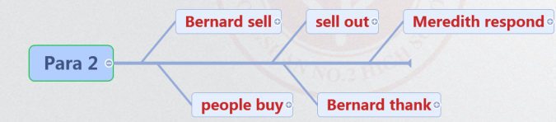
While-writing—constructing the plot further
When Mrs. Meredith heard of John's idea, she thought it was a good one,too.
With everything ready, Bernard started out on his new business.

Slide 14
5-7 details（sentences） in each paragraph
While-writing
details in each paragraph
say
do
Actions
plots
Surroundings
+
emotions
STEP
3
Feelings
grateful/appreciative/moved..,
eyes shining with/burst into ...
Draft

Slide 15
Finding writing style and clues in the given passage
The Meredith family lived in a small community. As the economy was in decline, some people in the town had lost their jobs. Many of their families were struggling to make ends meet. People were trying to help each other meet the challenges.
Mrs. Meredith was a most kind and thoughtful woman. She spent a great deal of time visiting the poor. She knew they had problems, and they needed all kinds of help. When she had time, she would bring food and medicine to them.
One morning she told her children about a family she had visited the day before. There was a man sick in bed, his wife, who took care of him and could not go out to work, and their
环境
动作

Slide 16
For some moments, John said nothing, but, suddenly, he sprang to his feet and cried, “I have a great idea! I have a solution that we can all help accomplish（完成）.”
The other children also jumped up all attention. When John had an idea, it was sure to be a good one. I’ll tell you what we can do,” said John. “You know that big box of corn Uncle John sent us ?Well, we can make popcorn（爆米花），and put it into paper bags, and Bernard can take it around to the houses and sell it.”
动作

Slide 17
Post-writing
1. change simple words to advanced expressions
2. use some sentence patterns
3. pay attention to the linking words
4. copy carefully
STEP
4
Polish

Slide 18
Conclusion
Prewriting
reading: 4W1T: who/where/when/what/theme
plot
linking words
While-writing
who
theme
emotion
linking words
para1: 兼顾两段的首句 ； 70-80字左右
para2: 衔接自然；故事完整；升华主题；70-80字左右
总字数：130-180
Polish: advanced words; various sentence structures;linking words
Post-writing

Slide 19
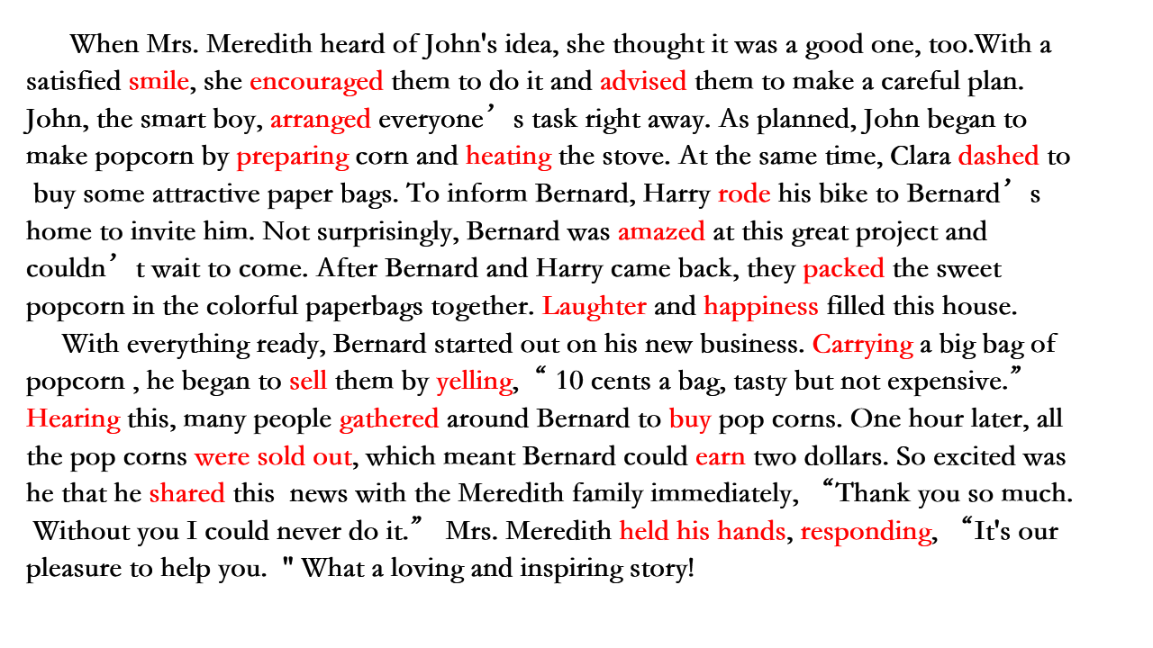
Possible version

Slide 20
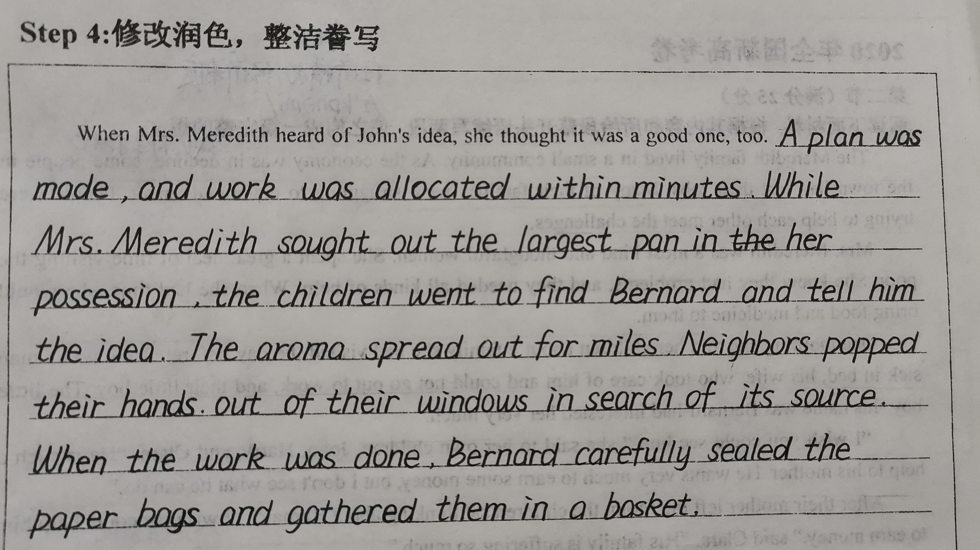
讲评
书写范例
---From 张晏宁

Slide 21
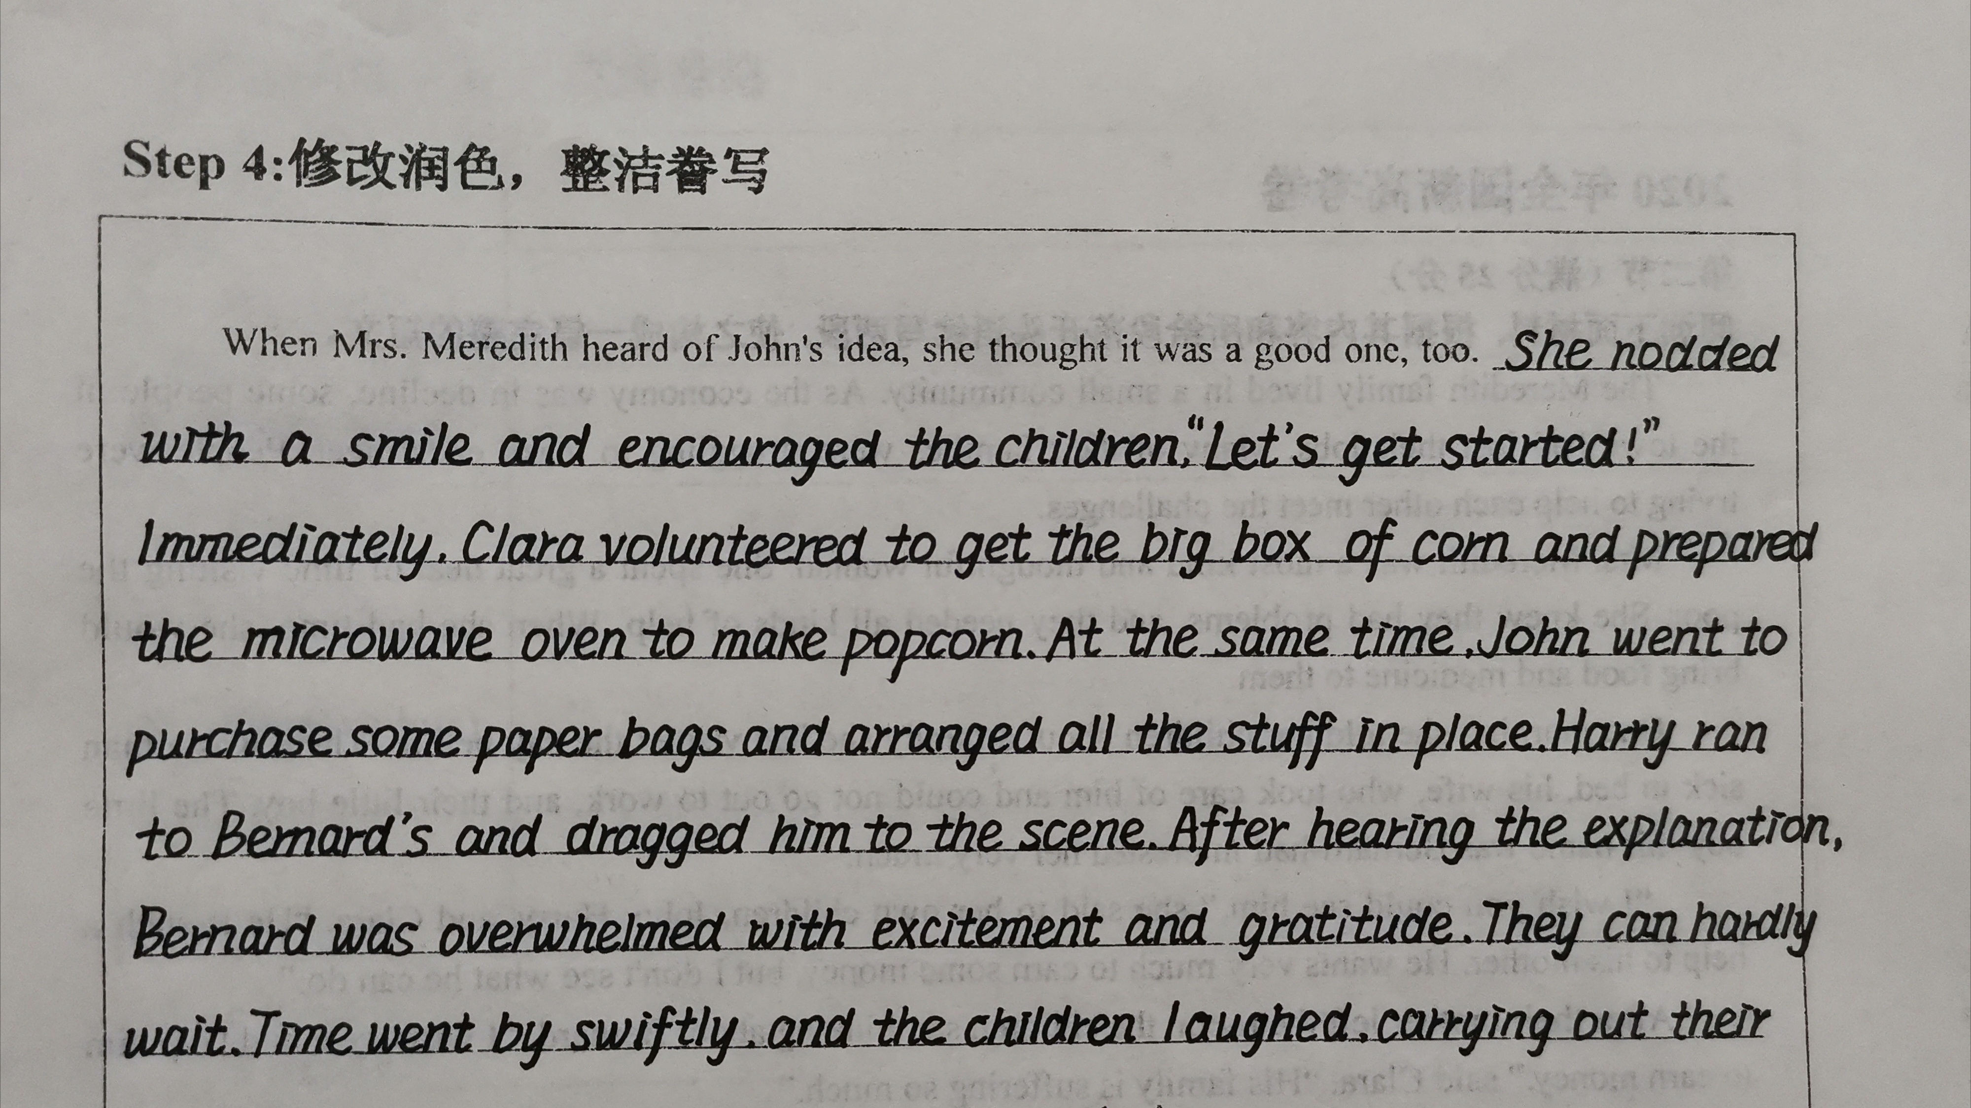
---From 田承尚

Slide 22
学生佳作展示 (para1)
When Mrs. Meredith heard of the idea, she thought it was a good one, too. She nodded with a smile and encouraged the children, “Let's get started!” Immediately, Clara volunteered to get the big box of corn and prepared the microwave oven to make popcorn. At the same time, John went to purchase some paper bags and arranged all the stuff in place. Harry ran to Bernard's and dragged him to the scene. After hearing the explanation, Bernard was overwhelmed with excitement and gratitude. They can hardly wait. Time went by swiftly, and the children laughed, carrying out their great “project”. Joy filled the yard and everyone's heart.

Slide 23
学生佳作展示 (Para2)
With everything ready, Bernard started out on his business. He took the popcorn around his community to sell it. But at first, he was too shy to talk about what he was doing. Luckily, he came across many people who were as kind as the Meredith family. With their understanding and encouragement, Bernard finally sold out all of his popcorn. Joy and love was deeply rooted in his heart. Under no circumstances would Bernard forget the kindness he received. It was this experience that contributed to a great man who devoted all his life to charity.

Slide 24
Appreciation
Read one possible version and make sure you know how the plot develops.
Paragraph 1: When Mrs. Meredith heard of John’s idea, she thought it was a good one, too. A plan was made, and work was allocated within minutes. While Mrs. Meredith sought out the largest pan in her possession, the children went to find Bernard and tell him the idea. The little boy was so thankful that he was lost for words. Soon the Meredith household was filled with laughter. The aroma spread out for miles. Neighbors popped their heads out of their windows in search of its source. When the work was done, Bernard carefully sealed the paper bags and gathered them in a basket.
动作
环境
夸张
动作

Slide 25
品评
Read one possible version and make sure you know how the plot develops.
Paragraph 2: With everything ready, Bernard started out on his new business. The shy boy hesitated upon reaching the first door, but the Meredith kids encouraged him with a “go for it” gesture. After a short gentle knock, the door opened and a friendly face emerged. The neighbor asked if she could buy a bag of the tempting snack. As they went down the street, more doors opened. Even the less privileged households offered to make fair trades with their extra food. The basket grew heavier with coins, foods, and other necessities, while Bernard’s steps became lighter with joy and relief.
动作
动作
替代
对比

Slide 26
Accumulation
Useful Expressions
allocate v. 分配……（给） to give something officially to somebody or something for a particular purpose
aroma n. 芳香；香味 a pleasant, noticeable smell
pop v. （让人意外地）突然出现 to suddenly appear, especially when not expected
seal v. 密封（容器） to close a container tightly or fill a crack, etc., especially so that air, liquid, etc. cannot get in or out
gesture n. 手势；姿势；示意动作 a movement that you make with your hands, your head or your face to show a particular meaning

Slide 27
Useful Expressions
tempting adj.吸引人的；诱人的 something that is tempting is attractive, and makes people want to have it, do it, etc.
seek out 找寻到；找到
lost for words 说不出话来

Slide 28
Review and Practice
allocated
A plan was made, and work was _____________ (allocate) within minutes.
2. Neighbors _____________ （pop） their heads out of their windows in search of its source.
3. The neighbor asked if she could buy a bag of the _____________ (tempt) snack.
4. Even the less _____________ (privilege) households offered to make fair trades with their extra food.
popped
tempting
privileged

Slide 29
sought out
5. While Mrs. Meredith __________ （找出）the largest pan in her possession, the children went to find Bernard and tell him the idea.
6. The little boy was so thankful that he was lost for words. Soon the Meredith household was _______________ （充满）laughter.
7. After a short ________________ （轻轻的敲门声）, the door opened and a friendly face emerged.
8. Even the less privileged households offered to _________________ (与……公平交易) their extra food.
filled with
gentle knock
make fair trades with

Slide 30
Review and Practice
9. After a short gentle knock, the door opened and a friendly face emerged.
（仿写）当玛丽那张友好的脸出现时，理查德正等候在门外。
Richard was waiting outside the door as Mary’s ______________________.
friendly face emerged

Slide 31
Review and Practice
10. Neighbors popped their heads out of their windows in search of its source.
（仿写）听到一阵噪音响起，汤姆好奇地把头探出了窗外。
Tom __________________________________________ on hearing a burst of noise.
popped his head out of the window with curiosity

