Slide 1


感恩遇见，相互成就，本课件资料仅供您个人参考、教学使用，严禁自行在网络传播，违者依知识产权法追究法律责任。
更多教学资源请关注
公众号：溯恩高中英语
知识产权声明

Slide 2
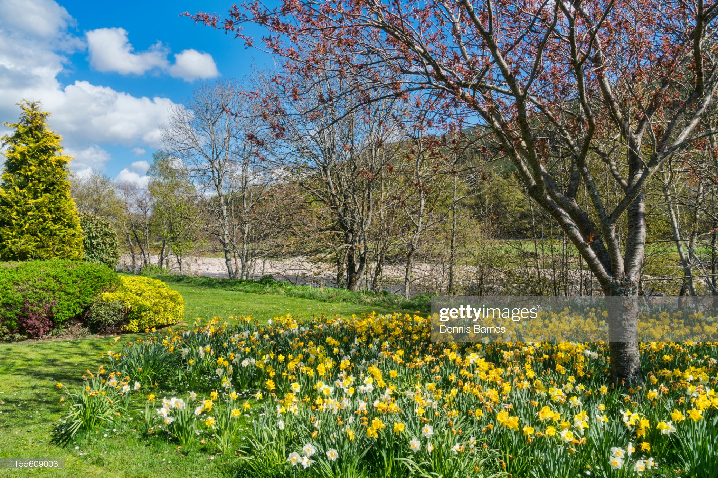
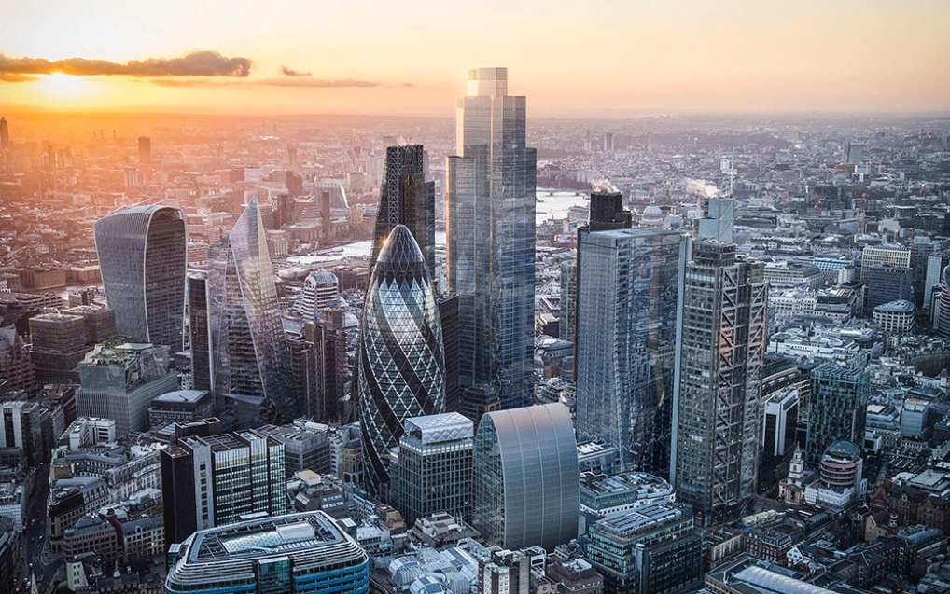

Nature
Civilisation

Slide 3
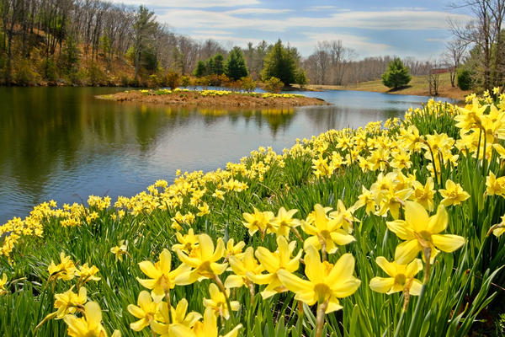
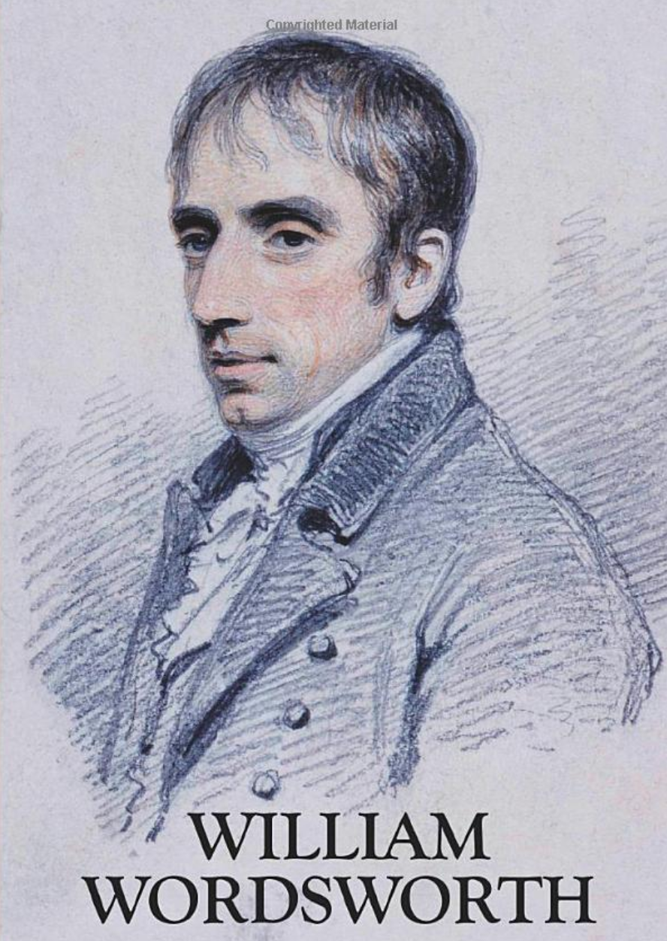
I wandered lonely as a cloud
Helped to launch
the Romantic Movement

Slide 4
Preview
valley
vale:
a host of:
flutter:
margin:
toss:
sprightly:
out-did:
glee:
jocund:
vacant:
pensive:
bliss
solitude:
a great number
to move lightly and quickly
the outside limit of something
to move sth/sb from side to side or up and down
full of life and energy
to go beyond in action or performance
a feeling of happiness and excitement
cheerful and light-hearted
loneliness:
the unhappiness that is felt by someone because they do not have any friends
showing no sign that the person is thinking of anything
thinking deeply about sth, especially you are sad or worried
extreme happiness
pleasant
the state of being alone, especially when this is pleasant

Slide 5
as
A
I wandered lonely as a cloud
That floats on high o’er(over) vales and hills,
When all at once I saw a crowd,
A host, of golden daffodils;
Beside the lake, beneath the trees,
Fluttering and dancing in the breeze.
Simile: using “like” or “as” to compare seemingly unlike things
B
crowd
A
Personification: giving human characteristics to non-human objects
B
C
dancing
C

Slide 6
Summarise
Stanza 1
The speaker describes the experience of feeling ________ and decided to ________ in nature. He came ________ some daffodils which moved as if they were ________.
lonely
wander
across
dancing

Slide 7
Analyse
as
Continuous as the stars that shine L7
And twinkle on the milky way,
They stretched in never-ending line
Along the margin of a bay:
Ten thousand saw I at a glance,
Tossing their heads in sprightly dance. L12
never-ending
Hyperbole: a way of writing to make things sound better, more exciting, etc. than it really is
Tossing their heads
dance

Slide 8
Summarise
Stanza 2
The speaker describes in a __________ manner the way he saw the __________ and how __________ he was by them.
hyperbolic
daffodils
impressed

Slide 9
Analyse
danced
The waves beside them danced; but they L13
Out-did the sparkling waves in glee:
A poet could not but be gay,
In such a jocund company:
I gazed—and gazed—but little thought
What wealth the show to me had brought: L18
in glee

Slide 10
Summarise
Stanza 3
The speaker declares the daffodils were the ________ and best ________ in nature and that he felt ________ in seeing them dance.
happiest
dancers
joy

Slide 11
Analyse
For oft, when on my couch I lie L19
In vacant or in pensive mood,
They flash upon that inward eye
Which is the bliss of solitude;
And then my heart with pleasure fills,
And dances with the daffodils. L24
dances

Slide 12
Summarise
Stanza 4
The speaker __________ the experience and was __________ after he returned ________.
recalled
happy
home

Slide 13
Analyse
Stanza 1
I wandered lonely as a cloud
That floats on high o’er vales and hills
Stanza 4
They flash upon that inward eye
Which is the bliss of solitude.
lonely
solitude
Contrast: a thing or person having qualities noticeably different from another

Slide 14
Paraphrase the poem in about 150 words using simile, personification and hyperbole learnt in class and at least the following 5 words.
Paraphrase
daffodils, dance, cloud, lonely, solitude,
flutter, stretch, couch, jocund, sparkle
P1. Feeling lonely, I decided to take a walk in the forest.
_________________________________________
P2. Accompanied by such a joyful friend, I was floating on the air.
_________________________________________

Slide 15
Paraphrase
Feeling lonely, I decided to take a walk in the forest. I was wandering alone as a cloud floating high over valleys and hills when suddenly I caught sight of a crowd of daffodils beside the lake and beneath the trees. They were like angels in the heaven, fluttering and dancing in the breeze. There were so many of daffodils that they were like the twinkling stars in the milky way. Stretching in a never-ending line along the lakeshore, the daffodils shook their heads in a lively dance, even outperforming the sparkling waves.

Slide 16
Paraphrase
Accompanied by such a joyful friend, I was floating on the air. Gazing at this amazing scene, I sank into deep thought. Lying on the couch after returning home, I couldn’t help recalling the beautiful scene which was so overwhelming and fulfilling to me earlier today in the forest. The daffodils flashed in my mind, taking away the loneliness and bringing a sense of solitude to me. So contented did my heart feel that my mind started to dance with the daffodils.

Slide 17
Homework:
Imitation reading and reciting the poem

