Slide 1


感恩遇见，相互成就，本课件资料仅供您个人参考、教学使用，严禁自行在网络传播，违者依知识产权法追究法律责任。
更多教学资源请关注
公众号：溯恩高中英语
知识产权声明

Slide 2

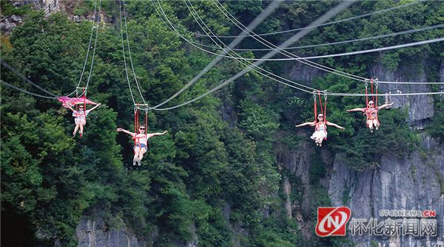
2021学年杭州市高二期末教学质量检测读后续写解析
高空滑索zip lining
杭州二中 许丽君
常山一中 吴俊峰

Slide 3
一、continuation阅读理解能力
读文体 （narration）
读内容（5W+H）
浅层的信息定位能力：
读语言（vivid，specific，concise）
对语篇结构的把控能力
读关键词（10 underlined key words）
理清故事的发展线索（read for the clue）
深层的文本分析能力：
明确文本的主要矛盾( read for the conflict)
关注故事的语言风格 (read for the style)

Slide 4
二、读后续写策略（Strategy of continuation）
起始部分：情节基调
核心矛盾
情节走向
情节内容
中间部分：顺延故事发展
框架结构
遣词用句
不着痕迹
语篇段落
语言文体
框架完整
Ending：合情合理的创意

Slide 5
2021学年杭州市高二教学质量检测读后续写（高空滑索zip lining）典题例析：
第二节：读后续写（满分25分） 阅读下面短文，根据所给情节进行续写，使之构成一个完整的故事。
Zipping Out of Fear
“Breakfast time!” I quickly put on my clothes and rushed down the stairs.
“ Come on, we don’t want to be late！”My mom said. The aroma （香味）of pancakes filled the kitchen, making the room warm. I looked out of the window. The sun was out, making a warm and bright morning.
“Today’s the day, zip lining （高空滑索）！” My dad said, sounding very enthusiastic early this morning.
Today we would go zip lining. The excitement built up inside of me as breakfast went on. After breakfast, we set out in my dad’s car. Half way through the ride, the sun grew hot, and the leather on the seats burned my legs. I thought about the trip, how my parents went but not me. It was my first time experiencing something like this. I also thought about my fear of heights, one thing I tried to get rid of multiple times. It got in the way of so many fun activities, like roller coasters at Kings Island.
We were basically there by now, the sun still blazing hot. We pulled up to big sign where our instructor waited for us.

Slide 6
2021学年杭州市高二教学质量检测读后续写（高空滑索zip lining）典题例析：
“Hi y’all！”said our instructor cheerfully.
“So, have y’all done this before?”
My parents nodded but I shook my head. Our instructor went over safety instructions while we each put on a safety harness （安全带）. I started to get nervous. A never ending roller coaster of excitement and anxiousness built inside of me. I looked down the cliff. My heart skipped a beat when the wind howled, blowing leaves and twigs in the trees. My legs started to shake.
注意：
1.所续写短文的词数应为150左右；
2.至少使用5个短文中标有下划线的关键词语；
3.续写部分分为两段，每段的开头语已为你写好；
4.续写完成后，请用下划线标出你所使用的关键词语。
Paragraph 1:
“Alright y’all, time to hit the trails!” said the instructor with too much enthusiasm.
Paragraph 2:
My turn finally came.

Slide 7
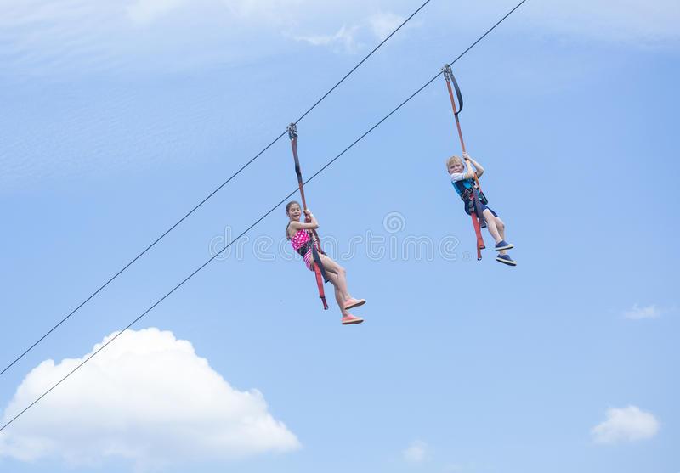
Step 1:Read for the plot
整体阅读，确定故事基本情节(read for the plot)
who, when, where,
what happed,
how would the story continue

Slide 8
Step 1:Read for the plot
who | The author, Mom and Dad; the instructor
when | Breakfast time，A warm and bright morning, the day I first experienced zip lining
where | At home, a big sign where the instructor waited for us, the place where we take ziplining
what happened | My parents and I were going to take our zip line tour. Mom and Dad made the zip lining excitedly and successfully. This was my first time to experience zip lining, I was in anxiety whether I could make it. I overcame my fear of heights inspired by my parents and instructor.
summarize the story | It was the first time for the author to experience zip lining. Fearful of heights as “I” was, “I” saw what good example my parents set for me, “I” was encouraged and inspired by my parents. With the help of my instructor, I succeeded overcoming my fear of heights and made it in zip lining.

Slide 9
Step 2:Read for the character
人物性格分析(read for the character)
1. 从人物的动作中
2. 从人物的言语中
3. 从他人的评价中

Slide 10
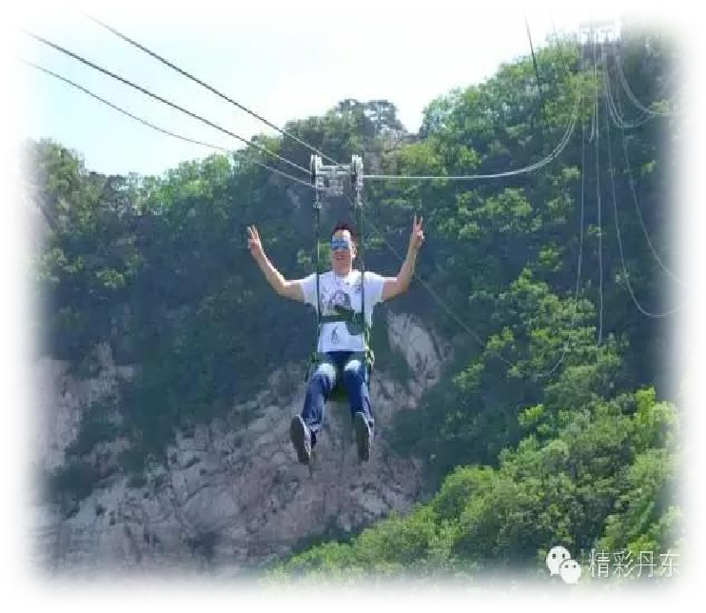
Step 2:Read for the character
who | character/traits
author | shy/timid, worried, but stay calm in difficulty
Mom and dad | enthusiastic, inspiring
the instructor | Warm-hearted, reliable in the eyes of the author, patient

Slide 11

Step 3:Read for the clues
1. One sunny, warm bright morning my parents and I got ready for a zip lining tour.
2. Eager for zip lining as I was, my fear of heights prevented me from many fun activities.
3. I was not brave enough to experience zip lining, my parents did it successfully.
4. ?
?
3
Ending
2
Climax
(conflict)
1
Process
( Developing)
Beginning
(Introduction)
List the plots

Slide 12
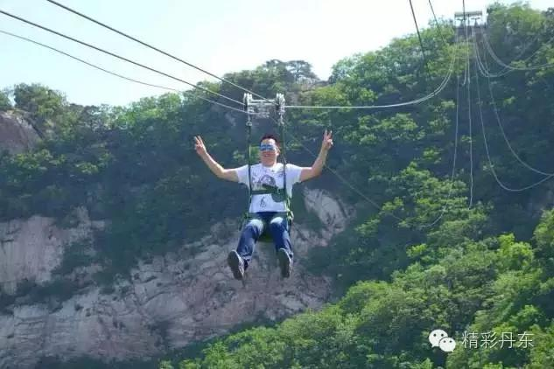
Step 4:Read for the information – Classify 10 key words into different groups.
parents，instructor, morning, excitement , fear, zip lining, hot, safety harness, cliff, wind
_________________: parents，instructor
_________________: morning
_________________: excitement , fear
_________________: zip lining, hot, safety harness, cliff, wind
characters
time
feelings
setting

Slide 13
Step 4:Read for the information – try to answer the following questions
1
Q1: when did the author zip with her parents?
2
Q2: Who will take part in the zip lining?
3
Q3: What did “my” parents ask “me” to do?
4
Q4: How did “my Dad” feel when he told me to zip that day?
5
Q5: How did the author feel when asked to zip in the beginning?
6
Q6: Why didn’t I get involved in the zip lining?
7
Q7: What prevented “me” taking part in the fun activities?

Slide 14
Step 5： Read for the emotion of main character(读主人公的情感)
Climax
When the author first experienced zip-lining
fearful
frightened
frustrated
nervous
Inspired, encouraged
upset
When the author was encouraged by parents and the instructor
uneasy
anxious
alive/refreshed/overwhelmed?
excited
Glad/satisfied?
delighted?
feelings?
Beginning
Ending
…

Slide 15
Step 5：Read for the emotion 情感表达的多样性-表达的方式和途径
Excitement built up, tried to get rid of fear of heights, get nervous
Started to shake
actions
My fear of heights
legs
author's
feelings
thoughts
surroundings
Heart
Warm and bright sun, the sun blazing hot
Skipped a beat

Slide 16

Step 6： Read for the theme (读主旨大意)
I; Mom; Dad; our instructor
At home, a big sign where the instructor waited for us, the place where we take ziplining
Who (character)
Where (place)
Main idea: the first time for the author to experience zip lining. Fearful of heights as “I” was, “I” saw good example my parents set for me, “I” was inspired by my parents. With the help of my instructor, I succeeded overcoming my fear of heights and made it in zip lining.
Mom and Dad encouraged me, the instructor inspired and helped me.
Breakfast time，A warm and bright morning, the day I first experienced zip lining
How (solution)
When (time)
My parents and I were going to take our zip line tour.
Mom and Dad made the zip lining excitedly and successfully.
This was my first time to experience zip lining, I was in anxiety whether I could make it.
I overcame my fear of heights inspired by my parents and instructor.
My first time experiencing zip lining, and my fear of heights.
Why (reason)
What (event)

Slide 17
Step 7：Predicting the ending(预测故事结尾）
Make predictions with the help of given detailed information
三条线 | 时空线（明线） Time & Place (setting) | 情节线 (Plot明线) | 情感线 (Mood暗线)Mom and dad | 情感线 (Mood暗线) (the author)
 | Breakfast time, A warm and bright morning The day “I” first experienced zip lining | Opening (起） inciting incident(引发事件） | enthusiastic | excited Anxious/uneasy/upset nervous
 | At home, a big sign where the instructor waited for us, the place where we take ziplining | Foreshadowing (伏笔） | excited | fearful/frightened/frustrated
 | Zip lining, hot, safety harness, cliff, wind | Developing ( 承）Up | inspiring/ encouraging | inspired/ encouraged
 |  | Changing （转） | cheerful | alive/refreshed
 |  | Concluding （合） | delighted/satisfied | Satisfied/delighted /overwhelmed/

Slide 18
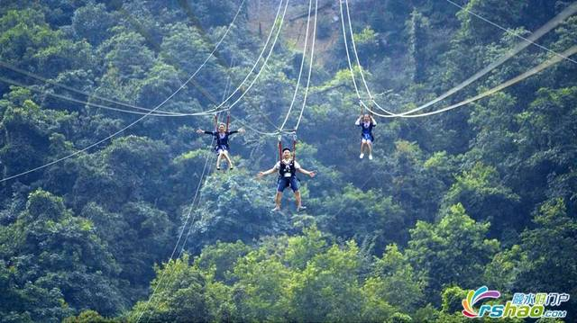
二、由读到写的思维能力
细读两段续写的开头语，理顺续写段落的逻辑关系；
围绕划定的10个关键词，合理创新故事情节。
Para.1:
“Alright y’all, time to hit the trails”. Said the instructor with too much enthusiasm.
Para.2:
My turn finally came.

Slide 19

Step8： Read for writing
Para.1:
“Alright y’all, time to hit the trails”. Said the instructor with too much enthusiasm.
Para.2:
My turn finally came.
Event: Mom and Dad did their zip lining successfully
Parents’ Feelings: enthusiastic excited delighted
Event: “ I” overcame my fear of heights and succeeded in zip lining.
Author’s Feeling: nervous/upset fearful encouraged still nervous brave enough refreshed overwhelmed

Slide 20

Step 9：Draft a continuation(起草续篇) Questions to generate ideas:
Para.1:
“Alright y’all, time to hit the trails”. Said the instructor with too much enthusiasm.
Q1: Will the author zip across the line?
Q2: Will the author be encouraged by father, mother or the instructor?
Q3: How did the author feel after seeing parents succeeded zip lining?
Para.2:
My turn finally came.
Q1：Will the author succeed in zip lining?
Q2: How did the author overcome her fear of heights, by herself or with the help of family?
Q3: How did “father” encourage “me” to zip?
Q4: What about families’ reaction after “I” succeeded in zip lining?

Slide 21
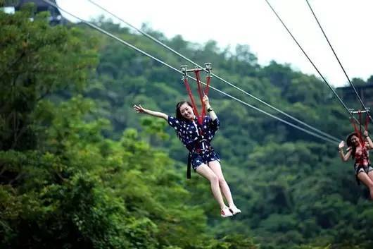
Step 9：Draft a continuation(起草续篇)
Para.1:
“Alright y’all, time to hit the trails”. Said the instructor with too much enthusiasm.
Mom首当其冲 Mum 把自己挂在金属线上
爸爸紧随其后 Dad 滑索前鼓励了我一番
Dad and Mum 都滑索成功 接着该轮到我了

Slide 22
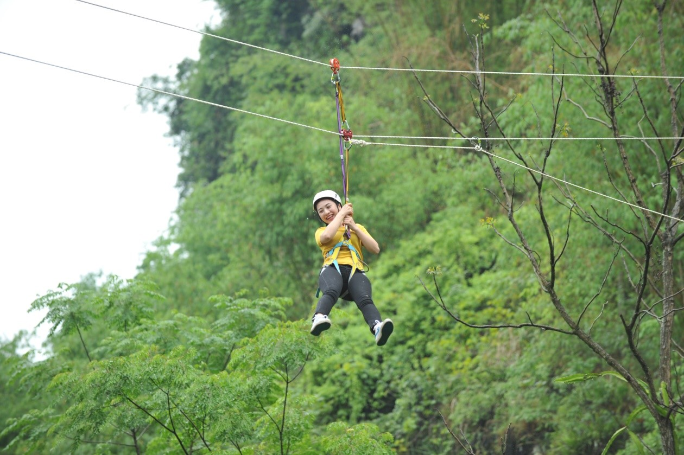
Step 9：Draft a continuation(起草续篇)
Para.2:
My turn finally came.
我手心直冒汗 我开始跳跃 我闭上眼睛 我很紧张 我往我身下看 我听到了家人的欢呼 我感到精神倍增，神清气爽 我克服了恐高

Slide 23
Predict the plot -1
Trace the hidden clues in the given sentences
Paragraph 1:
“Alright y’all, time to hit the trails. Said the instructor with too much enthusiasm.
Paragraph 2:
My turn finally came.
problem
author’s reflection:
Still nervous
inspired
parents’ reflection
Cheered me up
Appreciative/delighted
further problem

Slide 24
Predict the plot -2
Trace the hidden clues in the given sentences
Paragraph 2:
My turn finally came.
My parents and instructor encouraged me to overcome my fear of heights.
I received lots of encouragement.
My first zip lining gained great success.
Resolution
result?
I learned how to zip line, and experienced the first zip-lining successfully.

Slide 25
Writing sample -1
Paragraph 1:
“Alright y’all, time to hit the trails. Said the instructor with too much enthusiasm.
My mom stepped up first, she got hooked up to the metal wire, ready to get pushed off the cliff. She jumped off the stool and zipped across the metal line, the wind blowing on her face. My dad gave me an encouraging smile before he followed suit. I got woozy. What if the zip failed me? The sun kept beating down on me and I had to brace myself up. Since my parents had made it, why couldn’t I?
…

Slide 26
Writing sample -1
Paragraph 2:
My turn finally came.
My hands grew clammy, and I started to sweat. The smell of metal came upon my hands from holding my harness. I jumped and closed my eyes, my legs folding up in unison. All the nervousness went away as soon as I jumped. I flew across that wire. I looked down to see the river below my feet while still hearing my family’s faint cheers. The wind blew against my face and I felt alive and refreshed from it. When I reached the end, my family greeted me with a huge embrace. I realized how far I had come, conquring my fear of heights.
…

Slide 27
Writing sample -2
Paragraph 1:
“Alright y’all, time to hit the trails. Said the instructor with too much enthusiasm.
Everyone lined up with excitement in front of the cliff. They were chattering briskly(happily) and everyone except me, seemed to wear a confident look on their faces. The hot sun was baking the ground, sweat streamed down my burning face, fear and unwillingness filled every inch of my heart. I was on the point to escape, when a cute pet laid on my shoulders. It was the instructor, “Hi, little girl! Don’t be afraid, this is a very fun game, of course, it’s very safe. Be brave and enjoy it!” He ruffled my hair and encouraged me. I squeezed a flicker of smile and said “thank you” to him in a deep voice. Still, I’m afraid but ready to give a try.
…

Slide 28
Writing sample -2
Paragraph 2:
My turn finally came.
I firmed my lip into a line and paced slowly to the cliff. My parents were behind me. “You can do it!” they said in a determined voice. Gathering up all my courage, I bounced off the cliff and dived into the sky. Wind ran through my body, I felt like I was a bird. The feeling of the zip lining was so amazing, fear and nervousness vanished, my heart was filled with joy and gratitude. Thanks to all those people who encourage me to challenge the difficulties, and always be brave to try new things. Therefore, roller coaster, I’m coming!
…

Slide 29
Writing sample -3
Paragraph 1:
“Alright y’all, time to hit the trails. Said the instructor with too much enthusiasm.
“I’ll be the first.” Dad cocked his head, took a deep breath, and directly sprang off the edge. Like a swooping hawk（像一只猛扑的鹰）, he stretched his arms and swooshed （嗖嗖地迅速移动）along the trail toward the other side. The exhilarated (愉快的，振奋的) yelling echoed in the valley, and the next moment I glanced beyond the cliff. Dad had already reached the end, waving at us. Full of excitement as it seemed, I couldn’t help wriggling （扭动） my toes nervously. When Mom gestured to the instructor to let her go next. Before jumping, she cast me an encouraging grin （咧嘴笑，露齿笑）and comforted, “Just do as I do.” Then she gripped / grasped the belt and stamped the ground. Like Dad, she rapidly became a small dot and hit the terminal-another cliff that was nearly a hundred meters across from me.
…

Slide 30
Writing sample -3
Paragraph 2:
My turn finally came.
My eyes were fixed on the safety harness. “Is this truly firm enough?”On the other side were my parents waving at me, and down the cliff was endless darkness. Just when my stomach began to churn（搅动）, Mom’s words flashed across my mind, “Do as I do.” I gritted my teeth, clenched my fist, and leapt out（跳跃）. No sooner had I squeezed my eyes shut, a gust of wind lashed at my face. My feet were dangling （悬挂，摇摆）casually in the air, as if stepping on invisible stairs. Eventually, I plucked up my courage to open my eyes a bit, and a view of breathtaking scenery instantly leapt into my sight. “Wow—” Hardly could I resist the desire to yell at the top of my voice. Several seconds later, I was again on the ground. But unlike a few moments ago, I was beaming （喜气洋洋）wholeheartedly this time.
…

Slide 31
Writing sample -4
Paragraph 1:
“Alright y’all, time to hit the trails. Said the instructor with too much enthusiasm.
I stood rooted to the spot, motionlessly, with my hands trembling violently. A flood of fear crept in my mind, I couldn’t even utter a word or make a movement. “Oh, my poor boy.” The instructor patted me smoothly on the shoulder. “Then your parents go first, and they’ll wait for you at the destination.” I nodded, paced back and hid myself behind the instructor. My mom and dad waved at me and soon set off without a second thought. I caught my safety harness tightly, hoping the moment would never come. I felt the line above me was shaking, and I closed my eyes, waiting for the time.
…

Slide 32
Writing sample -4
Paragraph 2:
My turn finally came.
Breathing a sigh of relief, I seized the safety harness and felt my heart beating violently. I screamed and exclaimed. But I didn’t regret. It’s fantastic. The ray of sunlight darted （投射）towards me, as if saying “You are a brave boy.” Ultimately, catching sight of my parents’ faint smile cracking on them tightly. A dust of breeze, cool and soft, crafted （吹拂）our face with a sense of fulfillment welling up from the bottom of my heart. I realized I not only succeeded in zip lining, but also cured my fear of heights.
…

Slide 33
Writing sample -5
Paragraph 1:
“Alright y’all, time to hit the trails. Said the instructor with too much enthusiasm.
My father volunteered to be the first. With a scream of excitement, he went off. So fast was he that he almost immediately turned into a black spot, the scream echoing in the cliff. Looking at the land under my feet and glancing at the bottom of the cliff, fear overwhelmed my mind and I was nearly unable to move. “Don’t be so afraid,” Mom patted me on the shoulder, “Just enjoy the feast of the scenery!” Then she set off. “I had to muster up/gather my courage,” I thought, “Just enjoy this chance of flying.”
…

Slide 34
Writing sample -5
Paragraph 2:
My turn finally came.
“Relax, relax.” The instructor said when attaching my safety harness to the rope, “You are going to love it!” Sweat drowned my face, and I had no idea whether it was because of the hot weather or my fear. My parents were cheering up in excitement. I took a deep breath and then went into the air. Wind howled by my ears. I managed to open my eyes. Looking at the blue sky, soft cloud and green mountains，I felt like a bird! Surprise took the place of fear. “Woo-hoo!” I cheered when landing on the ground safely. What an amazing experience!”
…

Slide 35
Writing sample -6
Paragraph 1:
“Alright y’all, time to hit the trails. Said the instructor with too much enthusiasm.
My father patted me on the shoulder and whispered the inspiring words to me, “You can do it, I will be the first, just follow me.” Then he was ready to start zip lining. Exactly at that moment, he began to zip. Shortly afterwards, he was standing on the other side of the cliff, waving to us happily. My father looked so relaxed but I was still frightened, with my palms sweating and my legs shivering. My mom stroked my head and said, “Don’t be scared. I’ll wait for you on the other side.” Then she also started her zip lining. On the other side, my parents yelled at me. “Come on!”
…

Slide 36
Writing sample -6
Paragraph 2:
My turn finally came.
Still hesitant, I stood far away from the cliff. The instructor walked towards me, then gave me a pat on the shoulder, saying, “Just keep your head up, and you won’t be afraid.” I took a deep breath and stepped forward. With a push on my back, I set out, keeping my head up. I could feel the wind howling beside me, blowing away all my fear. When I reached the other side, I knew I not only completed one zip lining ride, but also rid myself of fear of height.
…

Slide 37
Writing sample -7
Paragraph 1:
“Alright y’all, time to hit the trails. Said the instructor with too much enthusiasm.
Before my parents’ turn, they encouraged me, patting me on the shoulder. “Come on! Don’t be afraid.” Father said with excitement. Having tightened the safety harness again, my parents were ready to go. Right at that moment, I heard my heart beating heavily and the sun hovering （盘旋）my head nearly swallowed me. Full of fear, I was quivering （颤抖）from head to toe, with my palms sweating.
…

Slide 38
Writing sample -7
Paragraph 2:
My turn finally came.
I checked my safety harness over and over again. Then I was ready. Clenching/Holding the string tightly, I jumped. The wind dashed onto my face. With the sun blazing, I attempted to open my eyes. Just green all around, I felt like I was just a bird kissing the sky. The hotness was gone with the fear. Suddenly, the destination came into my sight. Looking back at the zip lining left behind and the green waves below, I beamed/smiled at the terrifying cliff. Don’t give in to the fear. The fantastic world is waiting for us to try.
…

Slide 39
Writing sample -8
Paragraph 1:
“Alright y’all, time to hit the trails. Said the instructor with too much enthusiasm.
Mom was the first and I would follow her after she finished. “Ready to go!” she yelled to the instructor gladly. After a quick waving back, she took off. Screaming with excitement, she quickly disappeared in the morning sunlight and soon became a black dot faraway like a bird flying through the valley. Seeing this, I covered my mouth with a hand to conceal my panic and couldn’t feel excited at all. How could I do that?
…

Slide 40
Writing sample -8
Paragraph 2:
My turn finally came.
The wind and the scenery quickly passed me. I plucked up my courage to open my eyes and looked down, I couldn’t help letting out a cry, startled(surprised). But gradually, after yelling constantly, I began to enjoy the zip lining. Seeing the breathtaking view, a surge of current of joy welled up inside me. After landing on the ground, my parents wrapped me into their arms and we were exultant（狂喜的，欢跃的）, with smiles spreading on our faces. When I was bathed in the sunshine, it felt like the amber-like sunshine was kissing every inch of skins. It eventually dawned on me that what truly frightens me is the fear itself.
…

Slide 41
Writing sample -9
Paragraph 1:
“Alright y’all, time to hit the trails. Said the instructor with too much enthusiasm.
My parents hit the trails with full of confidence, but my palm was sweating and I couldn’t do that. “Don’t worry, boy, just look at how your Dad do!” Dad clenched （紧握）the trail, slipping down without a second thought. As he attached to the ground, he waved to me at the opposite side. A chill of fear went down my spine the instant I stepped on the edge of the cliff. I closed my eyes, not caring about my quivering/trembling body and the peak. At the moment, the instructor pushed me down, my mind was blank and every part of me was plunged into（陷入） fear.
…

Slide 42
Writing sample -9
Paragraph 2:
My turn finally came.
A mixture feeling of fear and excitement seized me. Closing my eyes, I determined to start. Just at that moment, all of my fear vanished and I feel like that I was flying like a bird. After some seconds, I was on the ground. I was enveloped with overwhelming delight and I threw a bone-crushing （紧紧的）hug to my parents. I yelled at the top of my lung, “I made it! I made it!” My parents face broad into a smile. The chirping birds （叽叽喳喳的鸟）and blooming flowers did witness my success of line zipping out of fear of heights.
…

Slide 43


Tip 1. Use rhetorical devices to show anxiety
How to describe
a person's anxiety?
1. Full of anxiety, I felt like sitting on pins and needles.
Simile
如坐针毡
2. The thought of what might have happened to sb. sent shivers down my spine.
Personification
让我脊背发凉
3. A deep sense of anxiety arose in my heart and quickly overwhelmed me.
Exaggeration
我的心底涌现出深深的焦虑,迅速将我淹没
4. The sense of anxiety got increasingly stronger with each passing minute.
Exaggeration
焦虑感渐增
5. A deep sense of anxiety flooded over me.
Exaggeration
焦虑感淹没了我
6. I felt too anxious that my heart almost jumped out of my throat.
Exaggeration
7. My brain was like a scribble.
Simile
脑子乱作一团

Slide 44
Tip 2. Use inner speech to show anxiety
How to describe
a person's anxiety?
1. “What will happen? Where will I land?” my mind was in chaos.
我的大脑一片混乱
2. “What if I was injured? What if I fell on the big rock?” worry crept into my mind. 担忧爬上我的心头
3. “What if the dream was true?” the thought hit me like a bucket of cold water.(像被泼了一盆冷水) I dared not think about it any longer.
4. “What should I do—oh! I shouldn't have done zip lining with my parents.” I was filled with regret.
5. “God, please bring me to the ground safely.” I prayed.

Slide 45


Thank you for your attention!
。

