Slide 1


感恩遇见，相互成就，本课件资料仅供您个人参考、教学使用，严禁自行在网络传播，违者依知识产权法追究法律责任。
更多教学资源请关注
公众号：溯恩高中英语
知识产权声明

Slide 2

2021年6月杭州二中高二英语月考
---新闻报道
News Report
杭州二中 许丽君

Slide 3
教学目标： Teaching Goals
After Teaching this lesson, students will
2. Pay attention to the timelines of news reports;
1. learn the accuracy of news reports;
Addressess
（写作对象）
4. know what good news report is like.
3. Pay attention to the truthfulness of news reports;

Slide 4
一、把握新闻报道的特点：The Characteristics of News Reports
01
立场：观点鲜明，主题突出
02
内容：真实具体，简明扼要
03
反应：迅速及时，适度议论
04
语言：简洁准确，文字精炼
05
结构：层次分明，详略得当

Slide 5
二、Requirements for News reports【新闻报道的要求】
  内容正确correct content
  主题突出Highlight the theme
  条理分明Logic well-organized
  叙述清楚 State clear
  语句通顺 smooth and fluent language
  行文生动Writing vivid
  标点准确 Accurate Punctuation

Slide 6
 三、【新闻报道写作常识】Common Sense of Writing
【新闻报道写作手法】：Writing Techniques
倒叙：（内容要点：When，where，who,
what, why  how ）
人称：第三人称(Third Person)
时态：以一般过去时为主(Past Tense)

Slide 7
Writing preparations
➢ Part 1: Headline/Title --- Reveal the theme and bring out the subject
【(揭示主题+引出正题) 第一段：简明准确地概括消息内容】
1. 2020年10月 10日，上周日, 为了让青少年更了解和学会欣赏诗歌, 第一中学举行了诗歌大赛。
A poetry contest was held at No. 1 Middle School on Sunday, Oct 10th , 2020, in order to let teenagers know more about and learn to appreciate poetry.
2. 200多个来自全市不同学校的高中生齐聚一堂, 背诵自己的作品, 交流经验。
More than 200 high school students from different schools around the city gathered to recite their works and exchange experiences.
3. 为了鼓励学生参加户外活动，我们学校在4月10日组织了一次爬山活动。
In order to encourage the students to take outdoor activities, our school organized a mountain-climbing on April 10.

Slide 8
Part 2:
Lead/Introduction---【简洁的文字➔（最重要、最精彩的事实）➔提纲挈领+牵引全文+吸引读者】
Tell the reader the basic core of the story【集中呈现， 提示要旨，告诉读者故事报道的核心内容】
1. 我们聚集在大青山脚下，兴高采烈地朝山顶出发。
we gathered at the foot of Daqing Mountain and set out for the top in high spirits.
2. 我们一路上尽情畅谈，唱啊笑啊，呼吸着新鲜空气，享受着美丽的风景。
All the way we were chatting, singing and laughing, enjoying the fresh air and the beautiful scenery.
3. 当有人落在后面时，其他人都过来帮忙。
When some fell behind, others would come and offer help.
4. 下午两点，来自不同年级的老师和同学们积极参加，一些挖土，一些种树，另一些浇水。
At 2:00 P.M, the students and teachers from different grades actively participated in it, some digging, some planting and others watering.

Slide 9
Part 2:
Lead/Introduction---【简洁的文字➔（最重要、最精彩的事实）➔提纲挈领+牵引全文+吸引读者】
Tell the reader the basic core of the story【集中呈现， 提示要旨，告诉读者故事报道的核心内容】
Natural transitions衔接词： first of all, first and foremore, as for, In addition, above all, initially, likewise, Therefore, as well, to be frank, what’s more, additionally, meanwhile, moreover, furthermore, undoubtedly, eventually, on the whole,…

Slide 10
Part 3:
Subject/Main part ---【正文部分---新闻报道的主要部分➔繁简适度+结构严密+层次分明+详略得当】
Highlight the main body, enrich the content. 【突出主干+充实内容，承接导语， 揭示主题】
1. 我们意识到我们能够使我们自己在需要帮助和照顾的人面前很有用。
We realize that we can make ourselves useful to those who need help and care.
2. 众所周知，帮助别人就是帮助自己。/爱对于人来说就像水对于鱼一样重要！
As we all know/As is known to all, to help others is to help ourselves.
It is well known that love is to human what water is to fish.
3. 在活动期间，按计划沿学校主干道种了一千颗树。
During the activity, 1000 new trees were planted along the main road in our school as planned.

Slide 11
Part 4:  Ending---【交代事件的结果, 阐明意义，加深感受】
Account for/explain the outcome of the event.【给读者完整的印象】
1. 这次活动不仅让我们亲近大自然，让我们从繁重的学业中得到释放，也促进了同学们之间的友谊。
Not only did it get us close to nature and give us relaxation from heavy schoolwork, it also promoted the friendship among us.
2. 我们度过了美好的时光！
What a wonderful time!
3. 这项活动对我们意义重大。
The activity benefited us a lot.
4. 这项活动给我们提供了老师和学生交流的平台。
This activity provided us a good platform for communication between teachers and students.

Slide 12
Useful words and expressions
01
02
03
estimate
evaluate
exhibit
explanation
exposition
forecast预见，深谋远虑
inspect
instruction
introduce
how-to
investigation
issue
judge
method
offer
opinion
outline

Slide 13
Headline（标题）
On National Day ________ went to________(导语：揭示核心内容)．Upon their arrival ______．Then they ________, When _________________________(正文：对事件或人物进行详细描写)．
What they did has___________________________________________ (结束语：概括、总结或预测)．
【新闻报道写作模板】：

Slide 14

2021年6月杭州二中高二月考
应用文写作— 新闻报道
典题例析参考范文

Slide 15

典题例析【新闻报道: 报道一次校园文化节活动】
假设你是李华，你们学校组织了一次校园文化节活动。请你就本次活动给校园英语报写一篇报道。谈谈你对此次活动的印象、感受和评价。
内容包括:
1.活动时间、地点、参与者;
2.活动内容;
3.活动的意义。
注意: 1.词数80左右;
2.可适当增加细节,以使行文连贯。
3. 文章标题已给出，不计入总词数。

Slide 16

【新闻报道: 报道一次校园文化节活动】
【Possible Version 1】
A Successful Campus Cultural Festival
Campus Cultural Festival, which proved to be a huge success, was held in our school gym on the afternoon of last Friday.
Aimed to enable students to learn about the cultural diversity, The festival covers a variety of activities, ranging from Chinese calligraphy, tea show to pop music. A great number of students showed much interest and got actively involved in it. Not only did it offer us a platform to show our talents, but also it got us immersed in the charm of diverse cultural shows and enriched our campus life a lot.

Slide 17

【新闻报道: 报道一次校园文化节活动】
【Possible Version 2】
A Campus Cultural Festival
Last Friday, our school held a Campus Cultural Festival，attracting hundreds of students took an active part in it. There were varieties of activities in the splendid Festival.
First of all, we watched a film concerning school history. Additionally, some students and teachers gave us their marvelous performances, making us burst a cry of laughter. Finally, various delicious foods were provided to us, containing a symbol of our school culture. Not only did we enrich our campus life but it allowed us to broaden our horizon, creating a prosperous atmosphere where we cultivated our sense of loving our school.
Both participants and organizers hoped that such meaningful and colorful activities would be held in the future.

Slide 18

【新闻报道: 报道一次校园文化节活动】
【Possible Version 3】
Last week，a school culture festival was held on our campus. All the teachers and students were having a marvelous time participating in diverse activities.
Aimed at arousing students’ interest in learning knowledge and cultivating love for school, activities ranging from Knowledge Contest to My Campus Life Demonstration won popularity from all the students. Not only could these extra-curriculum activities provide us a platform to have a break from our stressful school work, but also they added colors to our dull campus life, which was significantly beneficial.

Slide 19

【新闻报道: 报道一次校园文化节活动】
【Possible Version 4】
The school Cultural Festival was held by the Students Union in the school stadium on the afternoon of Last Friday.
There were various activities, such as singing English songs, History speeches, Math competition and so on. Hundreds of students took an active part it. The activity made a huge success. Not only did it bring us great pleasure and promoted friendship, but also gave us relaxation and relieved stress from school work.
Both of participants and organizers hoped that such meaningful and colorful activity would be held in the future.

Slide 20

【新闻报道: 报道一次校园文化节活动】
【Possible Version 5】
The School Cultural Festival
In order to make students have a better understanding of our school, a school cultural festival was held in our school, from 8:00 to 10:00 p.m. last Friday.
The festival presents what school was, is and will be like. All of the students showed great interest in and got actively in it. We had a nice time to know more about school culture.
The festival also featured other activities, such as fitness classes, martial arts and dancing performances. Not only did it provide a golden chance for us to deepen our insight into our school history, but also promote our sense of loving school.

Slide 21

【新闻报道: 报道一次校园文化节活动】
【Possible Version 6】
The School Cultural Festival
Aiming to arouse students’ interest in taking various activities, last week witnessed an extraordinary school cultural festival held in our school.
Diverse programs were displayed and hundreds of students and teachers took an active part in it. Bathed in the warm sunshine, some had pretty pictures taken and others enjoyed themselves visiting the school history museum. So appealing was the feast that all our stress was relieved, which was of great significance.
This activity inevitably offered relaxation to us and reward us with a marvelous memory.

Slide 22

【新闻报道: 报道一次校园文化节活动】
【Possible Version 7】
The School Cultural Festival
Last week, our school organized the school cultural festival in the gym. The festival was made up of Spoken Show, handwriting competition and many other activities, which have successfully melted away students’ uneasiness towards culture. As everyone could hear, ripples of laughter lingered in the gym almost every day.
During the festival, not only did we have fun playing subtle and splendid games, but we enjoyed a feast of culture. Hoping that the school cultural festival could be held every year! In this way, we firmly believe that students’ passion for study will increase.

Slide 23

【新闻报道: 报道一次校园文化节活动】
【Possible Version 8】
Last week our school witnessed an extraordinary cultural festival, which nearly drew every student’s attention.
The festival was held in school’s theater. Aiming to celebrate the 100 years anniversary, various programs were displayed by students and teachers. The impressive behaviors won the thunderous claps from the audience. Additionally, students marvelous performances made everyone burst into laughter.
By immersing us in the charm of the festival. It definitely offered relaxation to us. Not only did we enrich our life, but it strengthen our perspective, creating an atmosphere, where we can cultivate the sense of loving school.

Slide 24

【新闻报道: 报道一次校园文化节活动】
【Possible Version 9】
Aiming to celebrate and enrich our school life, we organized a school cultural festival on our campus last Monday.
The festival featured a series of activities, ranging from reading poems to singing and dancing. Various performances were displayed by students on the stage. Not only did we broaden our horizon, but also enhance our friendship, creating an atmosphere where we cultivated the sense of loving school.
What a visual feast! So unforgettable and thrilling was the experience that everyone enjoyed themselves greatly! All the students hoped such fruitful and joyful activity will be held in the future.

Slide 25

新闻报道题型训练：【新闻报道2: 新年迎新活动报道】
新华中学(Xinhua High School)近期举行了一次新年迎新活动。假定你是学校英语报记者,请写一篇短文, 报道此次新年迎新活动。内容包括:
1. 时间与地点;
2. 新年迎新活动的过程;
3. 你对这次新年迎新活动的印象和感受。
注意:1.词数80左右;
2. 可适当增加细节,以使行文连贯。

Slide 26
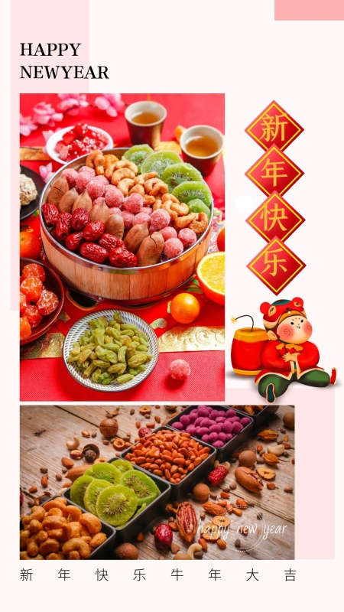
Writing Sample【新闻报道2:新年迎新活动报道Possible version 1：】
A New Year celebration was held by the Students’ Union in our school stadium on the afternoon of December 30th. A great number of students showed much interest and got actively involved in it. The major activities consisted of a New Year’s Gala and a charity sale. The former provided students with a platform to show their talents, on which the amazing performances in the form of dancing and singing gained great popularity with everyone present. The latter proved to be meaningful because the raised money would be donated to people in need. All of us enjoyed the great time.

Slide 27

Writing Sample【新闻报道2:新年迎新活动报道Possible version 2】：
As we all know, New Year represents a completely new beginning, so teachers and students shared their New Year resolutions, which served as a strong motivation in the following year. Additionally, some traditional shows were performed during New Year’s Gala, a charity sale was also held on the afternoon of December 30th on the playground to spread our kindness. The New Year celebration was a brilliant success, during which we all enjoyed ourselves greatly.

Slide 28

Writing Sample【新闻报道2:新年迎新活动报道Possible version 3】：
During our New Year celebration, varieties of performances such as dancing and singing were put on in the school stadium, showing the happiness that we enjoyed and creating an atmosphere of harmony. What’s more, our students and teachers wrote their expectations of the New Year on paper which not only conveyed our emotions but also motivated ourselves to achieve goals. Not only did the activity reduce our mental pressure but also gave some good wishes to us, through which we all had a great time.

Slide 29

Writing Sample【新闻报道2:新年迎新活动报道Possible version 4】：
On the afternoon of December 30th, all the students gathered in the gym, our president delivered an inspiring speech to praise our achievements in the past term. After the lecture, we organized students to sing in chorus to promote the spirit of teamwork and offer/arouse a warm atmosphere for the New Year. Moreover, we decorated a wall for students to write down their wishes and targets for the coming New Year, which was meaningful to encourage them to perform better next year.

Slide 30
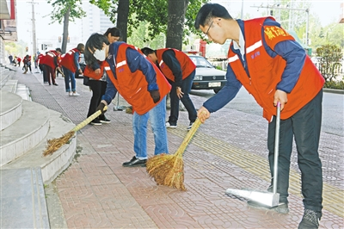
【新闻报道3: 报道一次义务劳动】
假设你是李明，上周末学生会组织部分学生去附近社区进行了一次义务劳动，受到居民的欢迎。请你就此给校英文报写一篇报道。活动内容包括：
1. 打扫卫生；
2. 浇灌花木；
3. 帮老人做家务。
注意: 1.词数80左右;
2.可适当增加细节,以使行文连贯。
3. 文章标题已给出，不计入总词数。
Students’ voluntary work in a neighborhood
_____________________________________________________________________________________

Slide 31
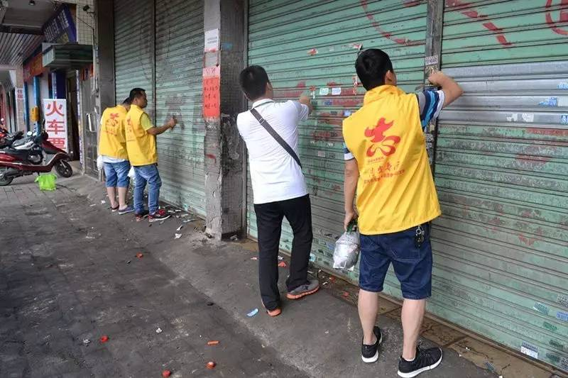
【新闻报道3: 报道一次义务劳动】
【Possible Version】
Students’ voluntary work in a neighborhood
Last weekend, some students took part in an activity organized by the Students’ Union. They did some voluntary work in a nearby neighborhood. Once they got there they dividied themselves into small groups to do different jobs. Some cleaned the street corners, some watered the plants, others helped the elderly with their housework.
The activity was highly praised by the neighborhood, and the students also enjoyed it. They got to know society better and learned how to help people around.

Slide 32

Thank you for listening!

