Slide 1

感恩遇见，相互成就，本课件资料仅供您个人参考、教学使用，严禁自行在网络传播，违者依知识产权法追究法律责任。
更多教学资源请关注
公众号：溯恩高中英语
知识产权声明

Slide 2
高中英语应用文写作
倡议信 an advocate letter
杭州二中许丽君

Slide 3
教学目标： Teaching Goals
➢After Teaching this lesson, students will
1. learn about the layout and contents of an advocate letter;
2. write the advocate letter correctly;
3. Polish your advocate letter;
4. know what an advocate letter is like.

Slide 4
倡议信之题型解读
倡议信是个人或集体提议某种做法、倡议某种活动的开展，并希望能够得到广泛响应，有更多的人来参与和支持的应用文。
倡议书必须将语言建立在客观事实的基础上，讲究可信性和劝说性。
倡议书的格式较为固定，依次为标题、称呼、正文、结尾、署名和日期。

Slide 5
篇首句：夺人眼球开头句--发出倡议的原因和目的
I'm appealing to you to pay attention to proper and frequent hand washing.
我呼吁大家正确而且经常洗手。
2. Our handwriting is not as good as it was in the past. To solve the problem, we should do as follow. 我们的书写不如过去好。为解决这个问题,我们应采取如下做法。
3. In order to ease the present serious situation, all students had better do as follows
为缓解目前的严重情况,所有学生最好做以下事情。
4. It develops rapidly and now has become one of the hottest topics. But still, problems cannot be overlooked. 它发展迅速,现在已成为最热门的话题之一。但问题仍然不容忽视。
5. Recently, there exists(=is) a problem that…(问题内容), leading to(=causing) many bad effects. Therefore, we call on(号召) people to do…
最近，存在一个关于……的问题，导致了不良后果，因此，我们号召人们……
6. We are now faced with(=facing) the problem that…(问题内容), so on behalf of …, I call on you to do… 目前，我们面临……问题，代表…, 我号召大家…..
7. Due to (=because of) sth, … is/are now under threat.
=句子，leaving(使得)… under threat/in danger.
因为…原因， …正受到威胁/处在危险中。

Slide 6
篇中句：亮点出彩篇中句---所倡议的具体内容和要求
Never does it produce pollution, contributing to a low- carbon lifestyle.
它从不产生污染,有助于低碳的生活方式。
2. It's everyone's responsibility to protect the environment. If we can change our way of life, we can make a big difference to the earth.
保护环境是每个人的责任。如果我们能改变我们的生活方式,我们就能使地球大为改观。
3. Our environment can benefit from such a sport, which can make our world a better place to live in.这样的运动有益环境,它能使世界成为一个更宜居住的地方。
4. Everyone ought to have a positive attitude to the campaign against the disease.
人人都应对抗击疫情持积极的态度。
5. In order to do…, we are encouraged/supposed/required/expected to…
为了达成…….目的，我们被鼓励做……。
6. It is suggested that we do… 倡议我们做……
7. It would be better if we could do… 如果我们做…, 结果会更好。
8. It is highly recommended that …, which aims to do(旨在)/enables us to do(使我们能)…
强烈推荐……, 目的是为了让我们能够……。

Slide 7
篇尾句：韵味无穷结尾句---再次呼吁, 表达信念
1. Let's work hand in hand to overcome anxiety and do our bits.
让我们一起努力克服焦虑,尽好我们的一份力。
2. Hoping to see you participate in the activity! Take action now and you won't regret it!
希望看到你参加活动!现在就采取行动,你不会后悔的!
3. Let's take action right now! I'm convinced our efforts will eventually pay off.
让我们现在就采取行动吧!我相信我们的努力最终会有回报的。
4. Please keep in mind that a small action can make a huge difference.
请记住,一个小小的行动可以产生巨大的影响。
5. Let's make joint efforts to create a green and harmonious environment.
让我们共同努力,创造一个绿色和谐的环境。

Slide 8
篇尾句：韵味无穷结尾句---再次呼吁, 表达信念
6. Immediate measures should be taken to do… 要立即采取措施来……。
7. Let’s work together to do … 让我们共同努力来……。
8. If everyone spares no efforts to do sth/With joint efforts, we will …
假如人人努力去做……/ 在共同努力下，我们会…….
9. We have faith in sth 我们对……有信心
10. We are bound to succeed (in…) 我们一定会成功(……)
11. I strongly believe that a better world owes to (归功于)the commitment (=devotion) and dedication(=devotion) of everyone. 我坚信美好的世界归功于每个人的付出与奉献。

Slide 9
倡议信模板-1
① Dear , （被呼吁的对象）
②（写信目的）I am writing this letter to call on .③（描述目前现状）As some of you may know, . In fact, .④（呼吁大家行动起来的必要性）It is necessary for us to . On the one hand, . On the other hand, . ⑤（具体采取的行动）Hence, it is high time . Firstly, we should . Secondly, . ⑥（再次呼吁大家）Please contact us via . Please join us in the effort to . ⑦（表示感谢）Thank you for your participation!
Yours,

Slide 10

应用文习作----倡议信
题型训练&语篇鉴赏

Slide 11

倡议信题型训练-1【倡议全校同学阅读英语文学作品】
应用文写作：
假如你是李华, 你注意到你校学生很少进行英语文学阅读。请你用英语给全校同学写一封倡议信，倡导大家多阅读英语文学作品。内容包括：
介绍现状；
你对英语文学阅读的看法；
发出倡议。
注意:
1.词数 80 左右;
2.可以适当增加细节,以使行文连贯。

Slide 12
倡议信题型训练-1【倡议全校同学阅读英语文学作品】写作思路
1. 首段---介绍现状：你校学生很少进行英语文学阅读。
Nowadays, students in our school read little English literature.
Nowadays, students in our school are not willing to spend time reading little English literature.
Currently, students don’t attach great importance to reading English literature.

Slide 13
倡议信题型训练-1【倡议全校同学阅读英语文学作品】写作思路
2. 中间段---谈你对英语文学阅读的看法。
--- play an important role in English study,-
--- be of great help to English study.
( detailed benefits: --- enlarge our vocabulary
--- appreciate the beauty of English
--- have a taste of a different culture
--- communicate with those great minds
--- develop our interest in ……）
English literature plays an important role in English study, because it offers us a chance to appreciate the beauty of English and have a taste of a different culture.

Slide 14
倡议信题型训练-1【倡议全校同学阅读英语文学作品】写作思路
3. 结尾段---发出倡议
I appeal to every one of you to do ---
I call on every one of you to do ---
( I’m strongly for the activity because it is very meaningful and helpful.)
Let’s start right now and spare no effort to do ---.
Therefore, let’s take responsibility to do ---
As high schools students, it’s our duty to do ---

Slide 15
倡议信题型训练-1【倡议全校同学阅读英语文学作品】参考范文
Writing Sample：
My fellow students,
Currently/Nowadays, most students in our school read little English literature, not only because they consider it too difficult, but because they don’t think it necessary. In my view, however, English literature is what we can’t afford to miss. It offers us an opportunity to appreciate the beauty of English and have a taste of a different culture. Better yet/More importantly, it allows us to communicate with those great minds.
I hereby appeal to every one of you to read more English literature and you won’t regret it!
Li Hua

Slide 16

倡议信题型训练-2【倡议珍惜水资源,节约用水】
Writing 3 (浙江宁波九校)
浙江虽然是水资源大省,但对水资源的保护也刻不容缓。假如你是李华,请代表学生会向全校发起“珍惜水资源,节约用水”的倡议。内容提示:
1.珍惜水资源的重要性;
2.如何从身边小事做起。
注意:
1.词数 80 左右;
2.可以适当增加细节,以使行文连贯。

Slide 17
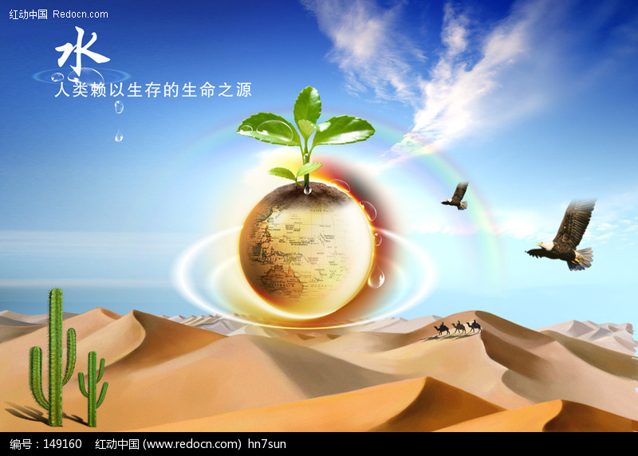
倡议信题型训练-2【倡议珍惜水资源,节约用水】写作提示
1.本文是倡议书,注意语言要书面化。
2.列举事件时要注意句子之间的合理衔接,不可太突兀。

Slide 18
倡议信题型训练-2【倡议珍惜水资源,节约用水】参考范文
【Possible version 1: 】
My dear fellow students,
As the concept of environmental protection draws increasing concern, water conservation, which is of great importance for the survival of humans and other species, has engaged/attracted/gained growing public attention.
Therefore, on behalf of the Students’ Union, I advocate you to save water. To begin with the little things around, turn off the tap when not in use; reduce daily water consumption by recycling water like watering flowers and plants with used rice-washing water. Moreover, water-saving devices should be adopted by more families.
I’m in belief that a wonderful world will present in front of us.
Li Hua

Slide 19
倡议信题型训练-2【倡议珍惜水资源,节约用水】参考范文
【Possible version 2: 】
My dear fellow students,
Due to serious pollution and global warming, water protection, which is vital(至关重要) for the survival of humans as well as other species, has drawn growing(日益增加的) public attention. Hence(因此), on behalf of the Students’ Union, I call on you to save water.
To start with the little things around, switch off the tap(水龙头) when it is not in use; minimize (使最小化) daily water consumption(消耗) by reusing water like flushing(冲洗) the toilet with fish-tank(鱼缸) water. Besides, water-saving devices(装置) should be encouraged in more families.
I strongly believe that a better world owes to the commitment and dedication of everyone.
Li Hua

Slide 20
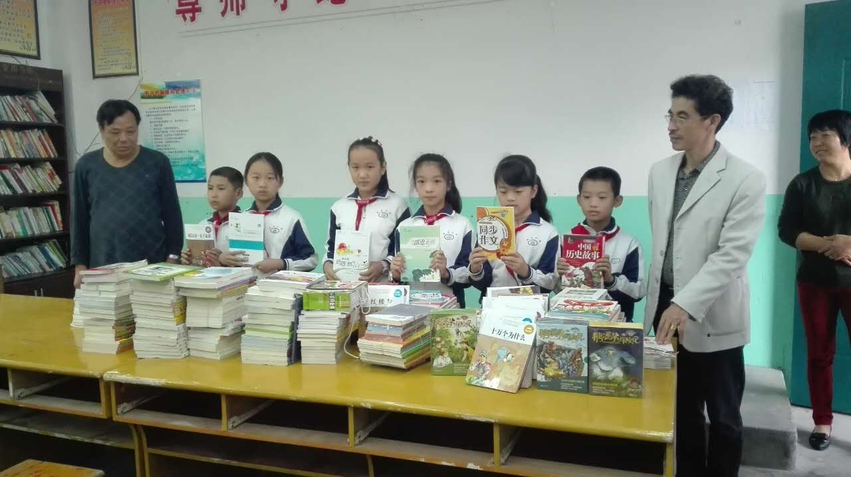
倡议信题型训练-3【倡议高考结束后捐书】
Writing 4 (浙江十校联盟高三期中)
假设你是高三学生李华, 请你写一封倡议书, 号召同学们在高考结束后捐出旧书, 送给需要的同学。内容包括:
1.捐书的种类:参考书、课本等;
2.捐书的意义。
注意:1.词数80左右;
2.可适当增加细节,以使行文连贯。

Slide 21

倡议信3【倡议高考结束后捐书】 【写作提示】
1.注意倡议书的格式和用语。
2.通常时态用一般现在时。
3.注意不要遗漏要点。
4.注意使用高级词汇和高级句型使文章更精彩。

Slide 22
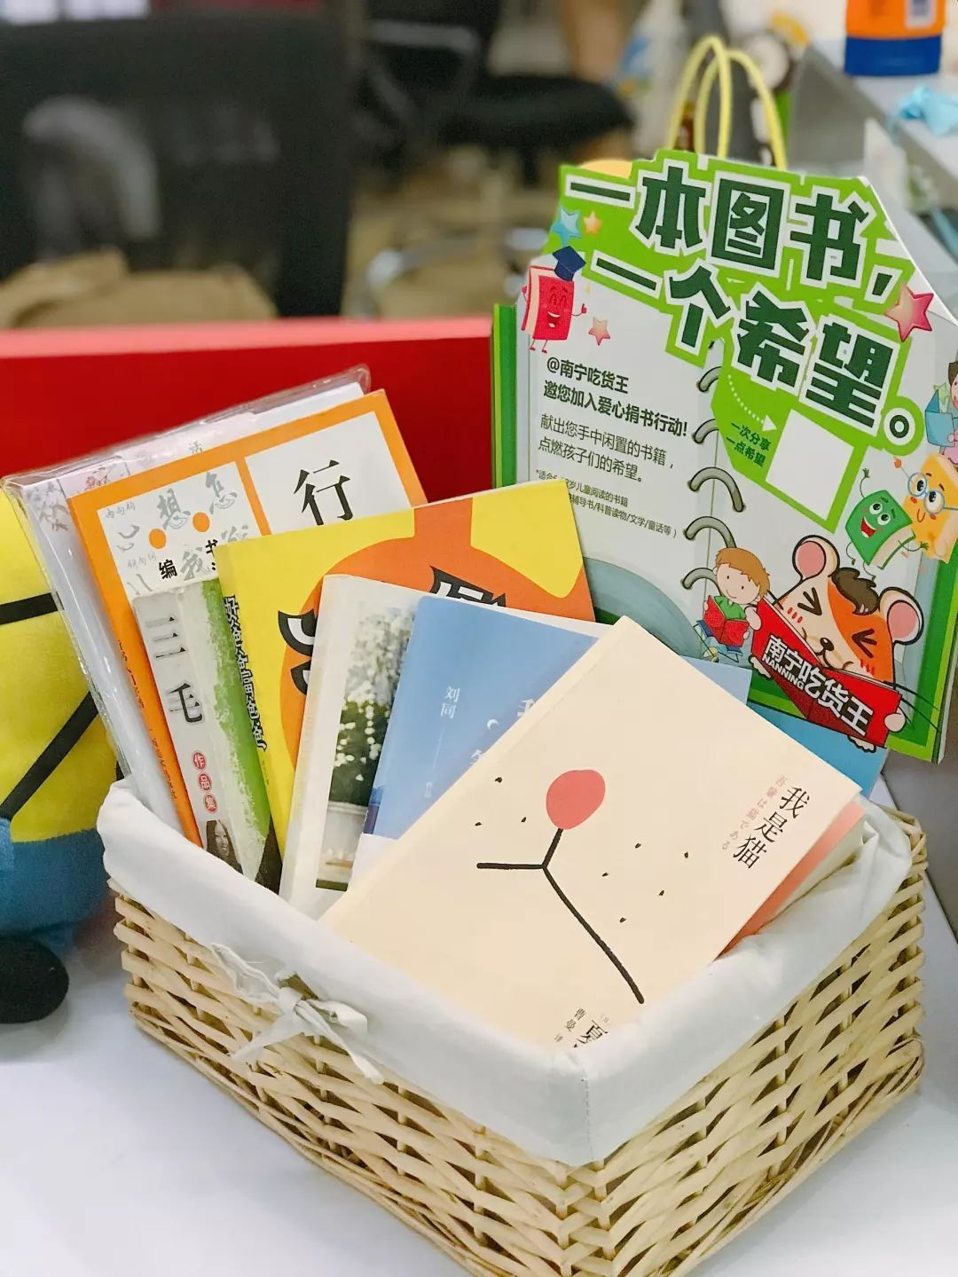
倡议信题型训练-3【倡议高考结束后捐书】参考范文
【One possible version】
Dear fellow students,
Soon we are going to say farewell to middle school and become freshmen in universities. How to deal with loads of used reference books and textbooks? I urge/call on that after the college entrance examination, we collect/gather the books and donate them to those who need them. By doing so, we can not only bring warmth to those in need, but also give the second-hand books a new life, which is far more environmentally-friendly than throwing them into the dustbins. Let’s act hand in hand!
Li Hua

Slide 23
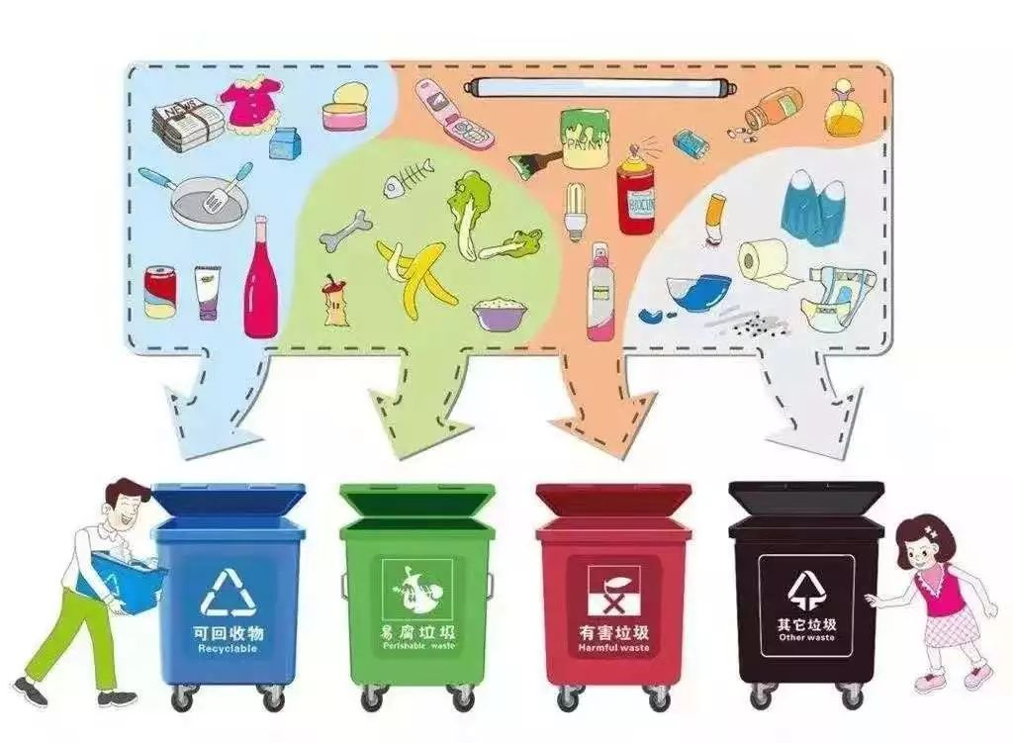
倡议信题型训练-4【倡议垃圾分类,从我做起】
Writing 5 (浙江金华外国语月考)
为配合学校开展的垃圾分类工作,学生会向全校学生发出了“垃圾分类,从我做起”的倡议。请你代表学生会, 用英语写一封倡议书, 内容包括:
1.垃圾分类的做法;
2.垃圾分类的益处;
3.呼吁全体学生一起参加。
注意:1.词数在80左右;
2.开头已给出,不计入总词数。
参考词汇:垃圾分类: garbage classification;厨余垃圾: leftovers废旧电池:used batteries

Slide 24

倡议信题型训练-4【倡议垃圾分类,从我做起】写作提示
1.本文是一份倡议书,注意时态要用现在时和将来时。并特别注意祈使句的使用。
2.要多用被动语态。
3.写作要点:做法、益处、号召。

Slide 25
倡议信题型训练-4【倡议垃圾分类,从我做起】参考范文
【Possible version 1】
Dear fellow students,
Our school has started a program of garbage classification. Different kinds of garbage are required to be sorted out and placed in different dustbins. Paper can be recycled, while leftovers can be collected as food for pigs or processed as fertilizer for plants. Above all, harmful things such as plastics and used batteries should not be mixed with other wastes. ①垃圾分类的做法。
The program is of great benefit. We will be able to save resources by making use of recyclable garbage and harmful things which will not pollute our environment after special treatment. ② 垃圾分类的益处。
Let’s work together for a better campus! ③呼吁全体学生一起参加。

Slide 26
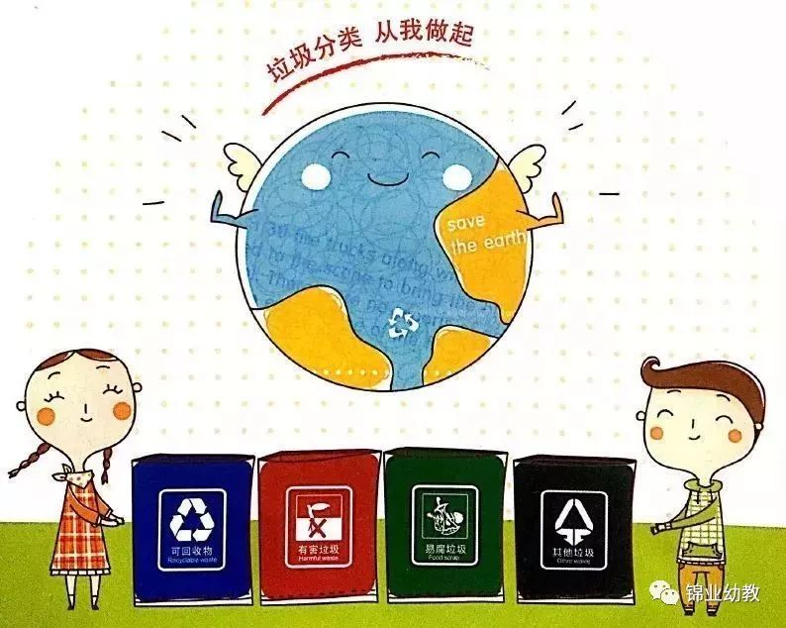
倡议信题型训练-4【倡议垃圾分类,从我做起】参考范文
【Possible version 2】
Dear fellow students,
Our school has started a program of garbage classification. Therefore, we are supposed to learn the ways about the garbage classification. As we know, we produce a lot of garbage every day. However，some garbage can be used again but some garbage can do harm to our environment and body health. So we should recycle the used batteries and make the leftovers together. It’s obvious that our world will be more comfortable! In order to help with school’s work, let’s do this from now on.
Students club

Slide 27
倡议信题型训练-4【倡议垃圾分类,从我做起】参考范文
【Possible version 3】
Dear fellow students,
Our school has started a program of garbage classification. Since it does help to create a neat environment. I hope that everyone could join it. What you could do daily is greatly simple. Take out the trash of your kitchen and throw it into the dustbin that is prepared for leftovers every day. What’s more, place used batteries in special areas, which you could all do it with ease.
If everyone takes the responsibility, the city will surely be a more beautiful one.
Students club

Slide 28
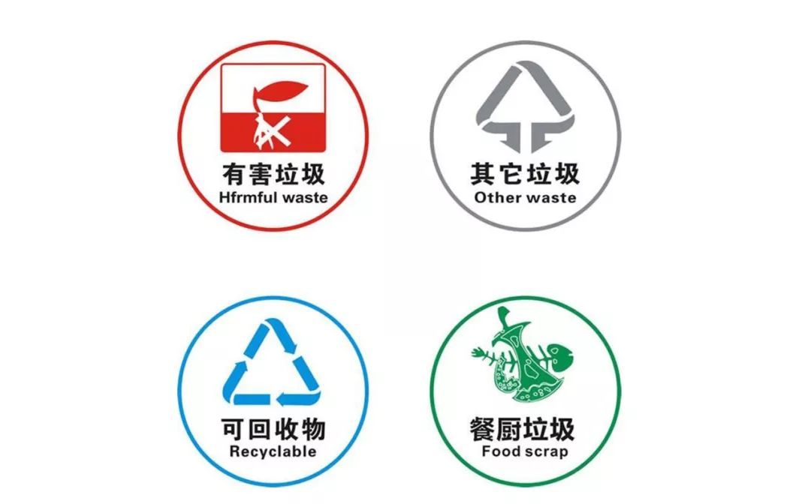
倡议信题型训练-4【倡议垃圾分类,从我做起】参考范文
【Possible version 4】
Dear fellow students,
Our school has started a program of garbage classification. As is known to all, saving resources is of vital importance. Garbage classification would help protect the environment and solve the resources shortage in some ways. So we have some proposals as follows.
First and foremost, learn to sort out the garbage. You must know whether leftovers or used batteries can be recycled or not. Secondly, you may ask your friends to join us. Please take actions from now on!
Students club

Slide 29
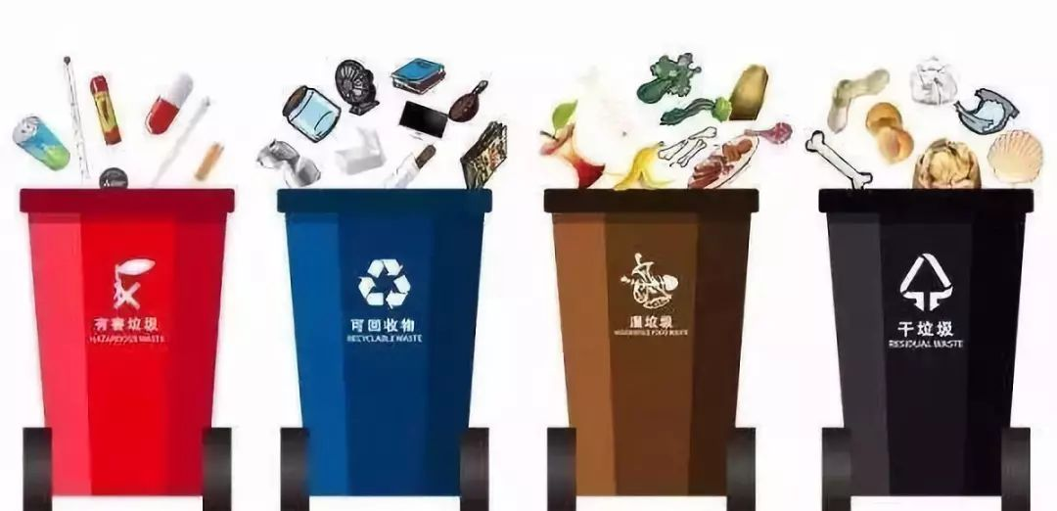
倡议信题型训练-4【倡议垃圾分类,从我做起】参考范文
【Possible version 5】
Dear fellow students,
Our school has started a program of garbage classification. It’s generally acknowledged that sorting out the waste can definitely contribute to recycling and energy-saving. Thus, what we are supposed to do is dividing the garbage into diverse kinds. For instance, leftovers should be put into “other garbage” apart from used batteries, which undoubtedly have a bad effect on the earth. Come on, dear schoolmates! Let’s all bathe in the environmental protection and dedicate ourselves to it.
Students club

Slide 30
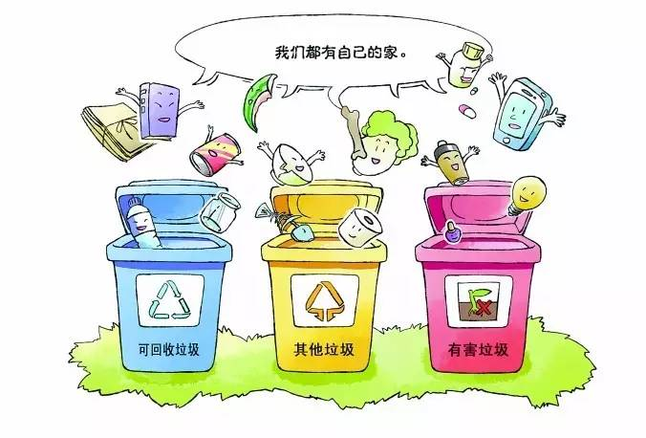
倡议信题型训练-4【倡议垃圾分类,从我做起】参考范文
【Possible version 6】
Dear fellow students,
Our school has started a program of garbage classification. On behalf of the Students’Union of our school. I hope that everyone can take an active part in it. Now let me tell you how to do it. First of all, you are supposed to distinguish different garbage, in which case you can know which garbage can be reused, which can’t. You need to put used batteries into a special bin.
It has come to our notice that the environmental pollution is serious. Garbage classification does good to environment.
Come and join us!
Students club

Slide 31
倡议信题型训练-4【倡议垃圾分类,从我做起】参考范文
【Possible version 7】
Dear fellow students,
Our school has started a program of garbage classification. As our environment has been polluted seriously, garbage classification has been acknowledged to be an important method to keep the environment from further pollution. Here are some ways of it. First, garbage like used paper should be recycled and reused. Second, leftovers should be collected. Last but not least, used batteries shouldn’t be thrown casually. By these ways, we can make our own effort to rescue our environment and save energy.
Let’s try our best to make our earth more and more beautiful.
Students club

Slide 32
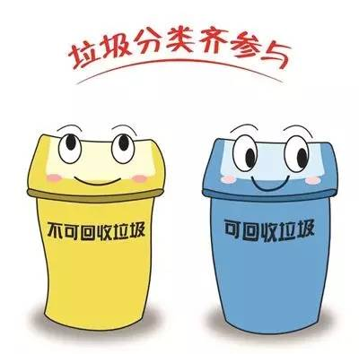
倡议信题型训练-4【倡议垃圾分类,从我做起】参考范文
【Possible version 8】
Dear fellow students,
Our school has started a program of garbage classification. If you are interested in it, come to join us right now. Here are the tips on how to classificate the garbage. Leftovers will be dealt with in canteen. And used batteries should be recycled. By doing these, not only can we beautify our campus, but it can also raise our awareness of protecting the environment.
Dear fellow students, let us actively participate in the program to beautify our campus.
Students club

Slide 33
倡议信题型训练-4【倡议垃圾分类,从我做起】参考范文
【Possible version 9】
Dear fellow students,
Our school has started a program of garbage classification. It’s important to do the following things. Firstly, we should sort out the garbage. They should be gathered as three kinds-leftovers, used batteries and other garbage. Next, you need to put them into where they should be. Garbage classification is good for our environment and we can reuse things instead of wasting them. By the way, our country can save money and energy. Come on, boys and girls, let’s do it together to protect our environment.
Students club

Slide 34

Thanks for attention!

