Slide 1


感恩遇见，相互成就，本课件资料仅供您个人参考、教学使用，严禁自行在网络传播，违者依知识产权法追究法律责任。
更多教学资源请关注
公众号：溯恩高中英语
知识产权声明

Slide 2

Inundation knows no feelings,
but the worst of times reveals the best in people.
洪水无情，人间有爱
Hang in there, Zhengzhou!
郑州加油！
杭州二中树兰高级中学 郭合英

Slide 3
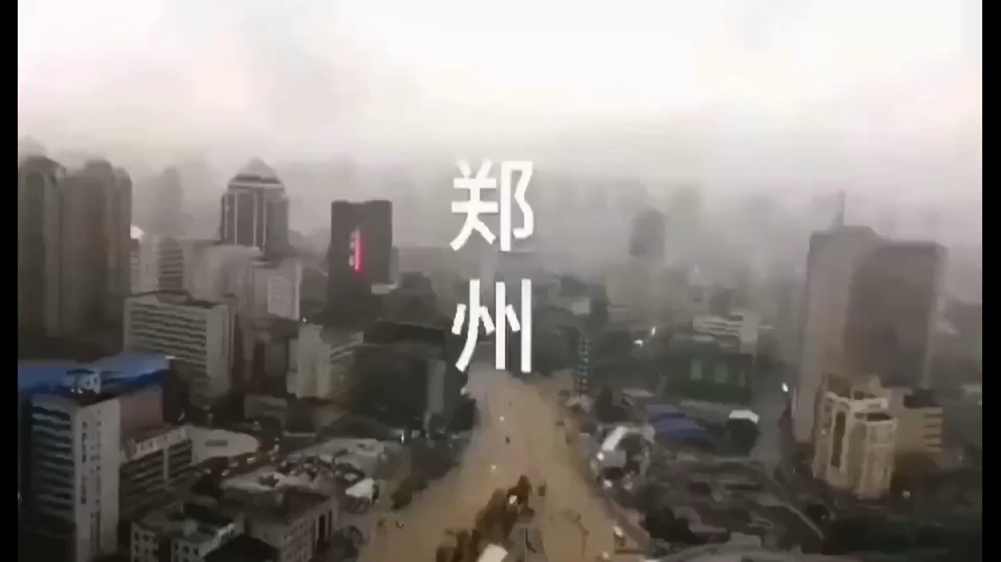

Slide 4
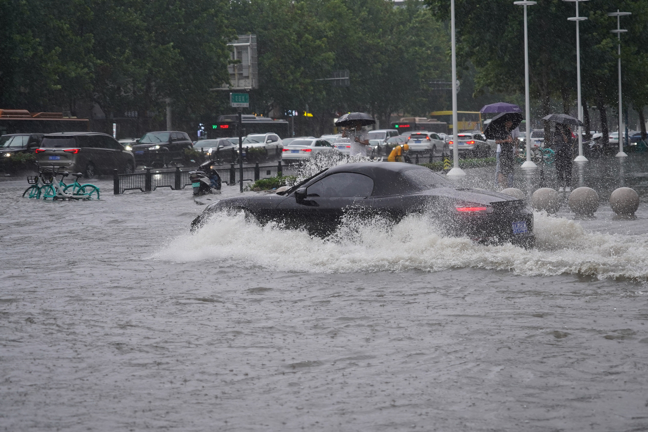
Henan Province has experienced heavy precipitation on end.
Since July 17, there has been continuous heavy rainfall in central China's Henan Province, with the precipitation concentrated in the province's western, northern and central regions.
According to the National Meteorological Center, the accumulated rainfall reached 622.7 millimeters in the provincial capital Zhengzhou between 2 a.m. Tuesday and 2 a.m. Wednesday, more than double the 24-hour threshold of 250 millimeters for extremely heavy rainfall.
1. precipitation [prɪˌsɪpɪˈteɪʃən] n.降水;降水;
降水量;沉淀;
2.provincial [prəˈvɪnʃəl] adj.省的；行政区的;
外省的；
3. threshold n.门槛；开端；界限；
阈限（指外界引起有机体感觉的最小刺激量）

Slide 5
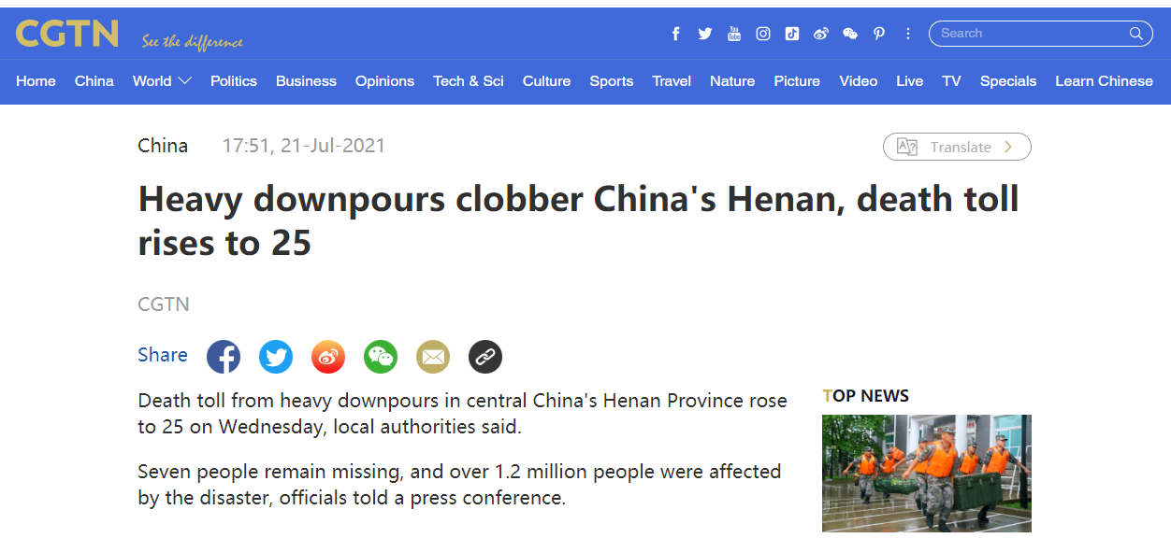
【知识点】
A total of 25 persons have been killed by the 21st- July-2021 in the torrential rains in the downtown area
of Zhengzhou, the provincial capital
of central China's Henan province, the local government said. About 100,000 people have been relocated to safe places, it added. The accumulated rainfall reached 449 mm on average in Zhengzhou from 6 pm Sunday to midnight Tuesday.
1. 从气象上来说，24小时降水量（24-hour
precipitation）达到50毫米或以上的雨称为“暴
雨”（rainstorm/ downpour/ torrential rain）。
2. 特大暴雨是一种灾害性天气（disastrous
weather），往往造成“洪涝灾害”（flood），
在山区还会引发“山体滑坡”（landslide）和
“泥石流”（debris flow）。
3. landslide（山体滑坡）是指暴雨使山体不堪重负，由
山体薄弱地带断开整体下滑形成。
4. debris flow（泥石流）是暴雨使沙土石达到水饱和，在
重力的作用下液化的泥沙石向低洼处流动。
河南省政府表示，截至目前，暴雨已造成郑州市区25人死亡，当地已转移避险约10万人。7月18日18时至21日0时，郑州累积平均降水量达449毫米

Slide 6
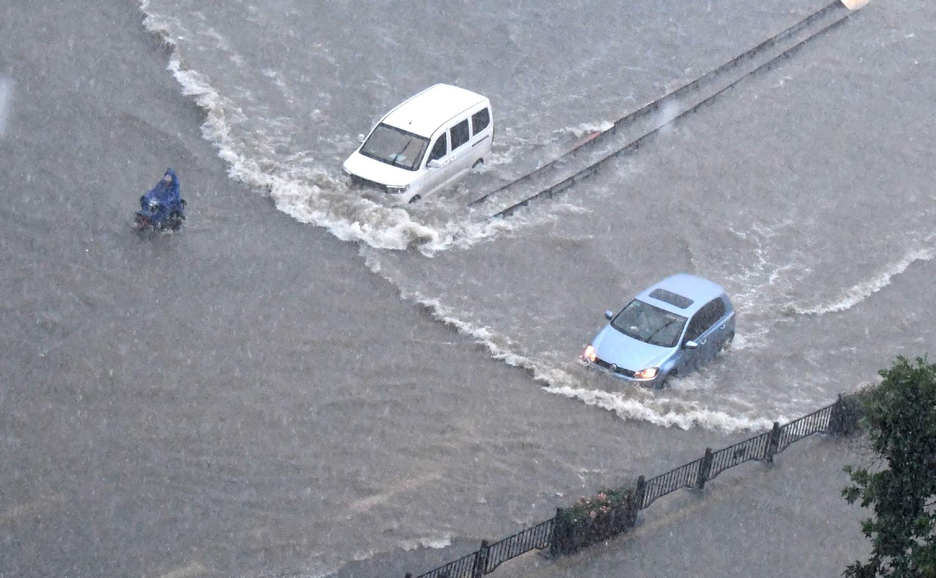
【词汇讲解】
Rainstorms caused severe waterlogging, traffic disruptions, and power outages in Zhengzhou.
暴雨导致郑州市区出现严重内涝，交通受到严重影响，电力中断。
Waterlog在词典中的解释是to cause (a boat, ship, etc.) to become uncontrollable as a result of flooding（船只等被水淹后失控）或者to become saturated with water（被水浸透）。
waterlogged 形容词，指在暴雨中被淹的车辆。waterlogged vehicles 即“涉水车辆,进水的车辆”。
如：保险公司会对涉水车辆进行理赔。
The claim on the waterlogged vehicles are supposed to be settled by the insurance company.

Slide 7
Both Henan provincial and Zhengzhou municipal flood control and drought relief headquarters have raised the emergency response for meteorological disasters to level I.
China’s central government has upgraded the nationwide flood control emergency response level from Level III to Level II at 3:00 am Wednesday local time, according to the relevant provisions of the State Emergency Plan for Flood Control and Drought Relief.
【知识点】
气象部门发布的暴雨预警一共有四个级别，由低到高分别是：蓝色、黄色、橙色和红色。
蓝色预警（blue alert）
标准：12小时内降雨量将达50毫米以上，或者已达50毫米以上且降雨可能持续。
黄色预警（yellow alert）
标准：6小时内降雨量将达50毫米以上，或者已达50毫米以上且降雨可能持续。
橙色预警（orange alert）
标准：3小时内降雨量将达50毫米以上，或者已达50毫米以上且降雨可能持续。
红色预警（red alert）
标准：3小时内降雨量将达100毫米以上，或者已达到100毫米以上且降雨可能持续。

Slide 8
暴雨相关词汇
torrential rain | 倾盆大雨
downpour | 倾盆大雨
rain cats and dogs | 倾盆大雨
the bluster of the wind and rain | 狂风暴雨
the fury of a storm | 狂风暴雨
pour down | 下暴雨
the violent storm | 暴风
a heavy rainfall | 大雨，暴雨
pouring rain | 瓢泼大雨
cloudburst | （突然的）大暴雨
heavy rain | 暴雨
storm/tempest/rainstorms | 暴风雨
red/orange/yellow/blue rainstorm alert | 红色/ 橙色/ 黄色/ 蓝色暴雨预警
the violent thunderstorms | 强烈的雷暴

Slide 9
抗洪抢险相关词汇
floods/floodwater/ inundation | 洪水
relief | 救灾
freshet | 河水猛涨/涨水
water levels | 水位
to burst their banks/breaching of the dyke | 决堤/溃堤
watercourses | 河道/水道
the flood level | 洪水水位
warning level | 警戒水位
flash floods | 山洪暴发
water discharge | 水流量/排水
water reservoirs | 水库
Office of State Flood Control and Drought Relief Headquarters | 国家防汛抗旱总指挥部
disaster areas | 受灾地区
evacuate | 疏散
rescue boats | 救生艇
life vests | 救生衣
rubber boats | 橡皮艇
emergency materials | 紧急援助物资
burst the banks | 决堤
exceed warning levels | 超出警戒线
plug the breach | 封堵决堤口

Slide 10
语法填空
Zhengzhou has received average precipitation of 457.5 mm within 24 hours to 5 pm Tuesday, the 1 (high) daily rainfall since the weather record began. The city also reported record-high 2 （hour) precipitation of 201.9 mm between 4 pm and 5 pm on Tuesday, the Henan provincial meteorological center said.
More than 160 trains stopped services at Zhengzhoudong Railway Station, ___3___ (strand) a large number of passengers. The severe waterlogging led to the virtual
4 (paralyze) of the city's road traffic. Over 80 bus lines 5 (suspend), more than 100 temporarily detoured (绕道), and the subway service was temporarily suspended.
Chinese President Xi Jinping on Wednesday stressed 6 (save) people's lives as the top priority in flood prevention and rescue. He described the flood control situation
7 "grim" and having "entered a crucial period." He added serious 8 (effort) must be made 9 (assist) the disaster-affected poor residents so that they
10 (not fall) back into poverty because of the disasters. Xi also emphasized the importance of sanitation and anti-epidemic work, warning of the possibility of major disease outbreaks in the aftermath(善后) of natural disasters.
highest
hourly
stranding
paralysis
were suspended
saving
as
efforts
to assist
wouldn’t fall

Slide 11
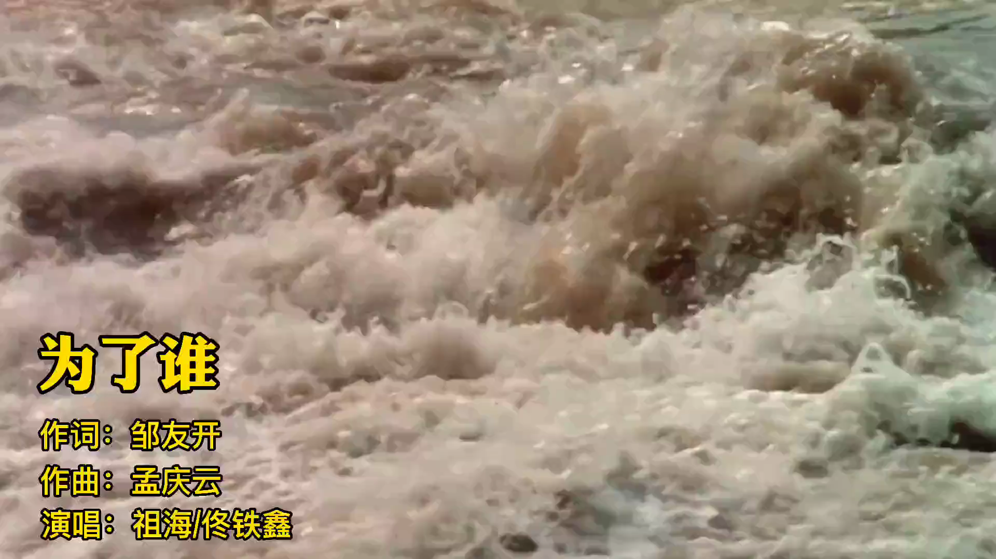

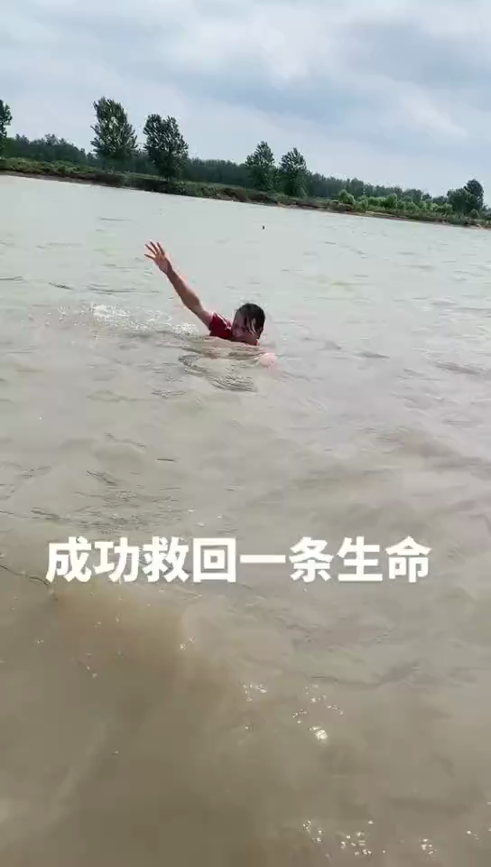

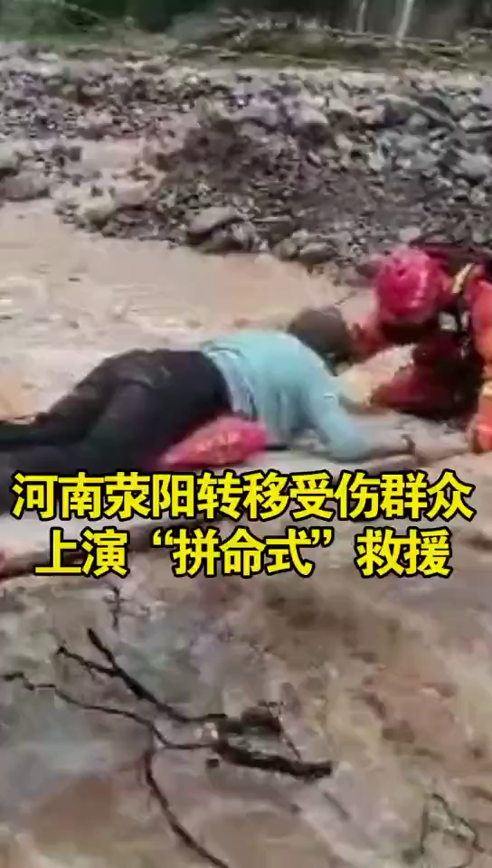
I don't know who you are,
but I know who you're fighting for
我不知道你是谁，但我知道你为了谁

Slide 12
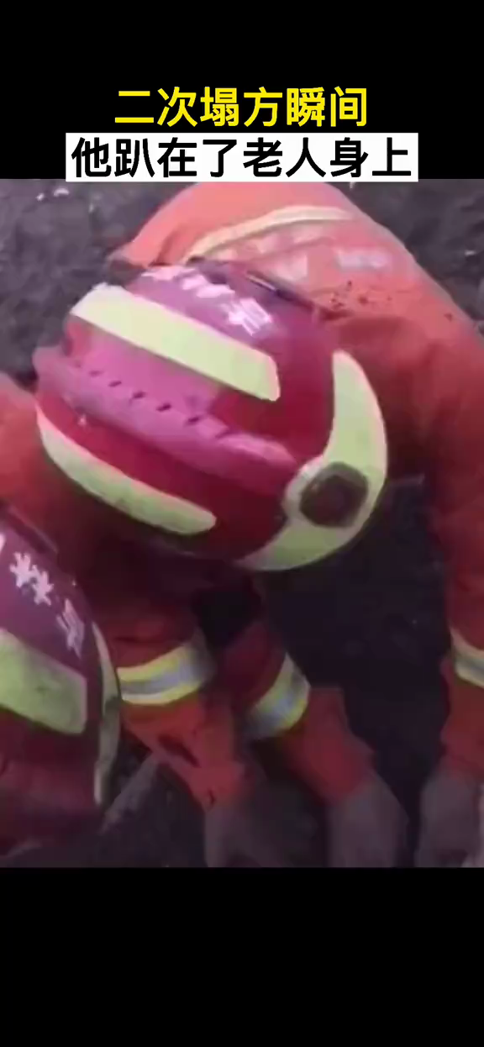

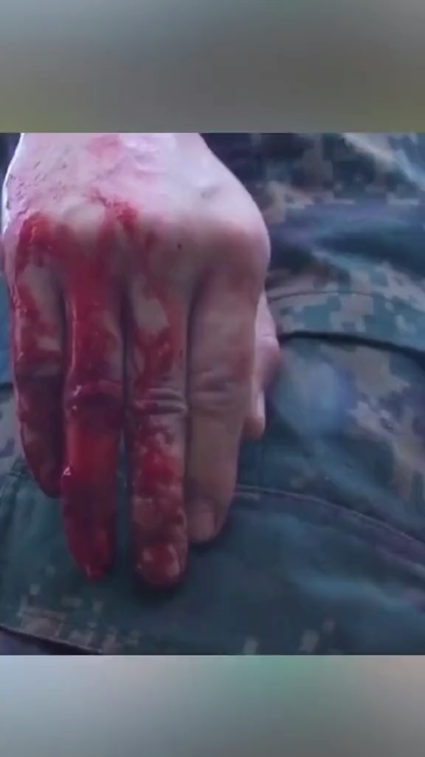

Slide 13
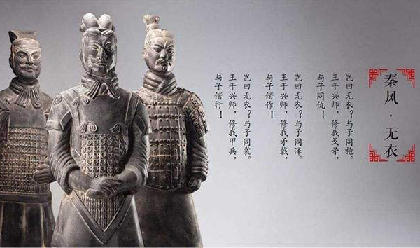

Fear not the want of armor, for mine is also yours to wear.
岂曰无衣，与子同裳。
岂曰无衣？与子同袍。王于兴师，修我戈矛。与子同仇！
Are you not battle-dressed?
Let's share the coat and vest!
We shall go up the line.
Let's make our halberds shine!
Your job is mine.
岂曰无衣？与子同泽。王于兴师，修我矛戟。与子偕作！
Are you not battle-dressed?
Let's share the plate for breast!
We shall go up the line.
Let's make your lances shine!
Your foe is mine.
烈火炼真金&患难见真情
True gold can stand the test of fire.
Adversity reveals true friendship.
Persons from all walks of life have extended a helping hand to Zhengzhou.
岂曰无衣？与子同裳。王于兴师，修我甲兵。与子偕行！
Are you not battle-dressed?
Let's share kilt and the rest!
We shall go up the line.
Let's make our armor shine!
And march your hand in mine!

Slide 14


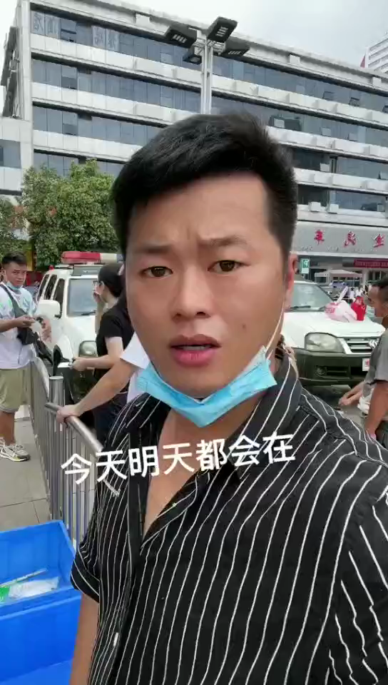
以马云为代表
的成功人士
以韩红为代表
的明星
以普通人为代表
的爱心人士

Slide 15
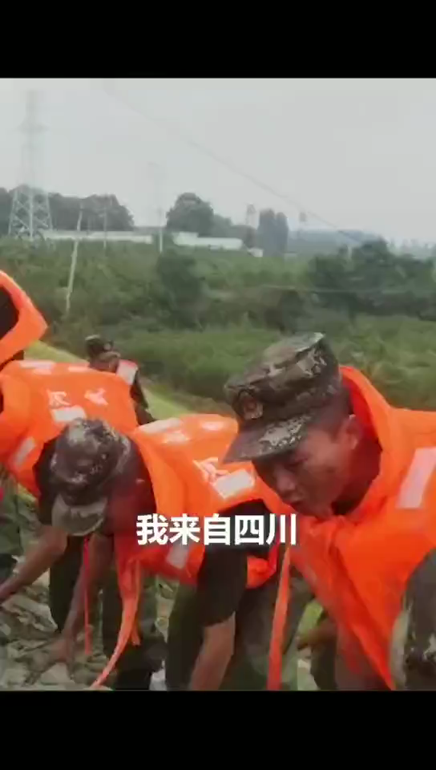

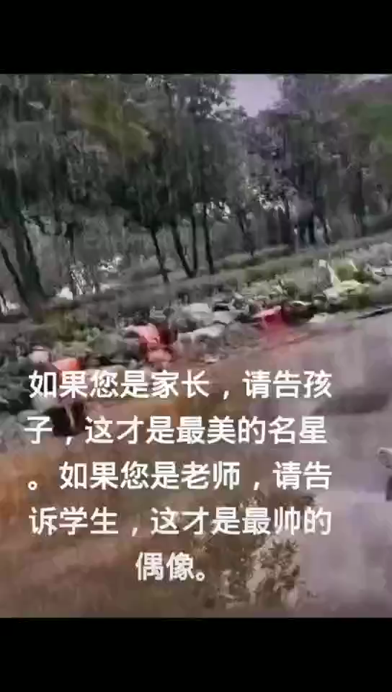

以兵哥哥为代表的
来自五湖四海的同胞
代表祖国未来的小朋友
来自社会的呼吁
Patriotism is
cultivated
at an early
age, and there is no lack of successors to carry on the cause!
爱国后继有人！

Slide 16
Discuss?
1. Who are they ? What should we learn from them ?
2. Who is the real hero in your opinion?
They are the heroes in harm’s way .
他们是最美逆行者
They are the most lovable people in this world.
他们是世界上最可爱的人。
They are our idols in our heart.
他们是我们心中的偶像。
As a student, you should ……

Slide 17
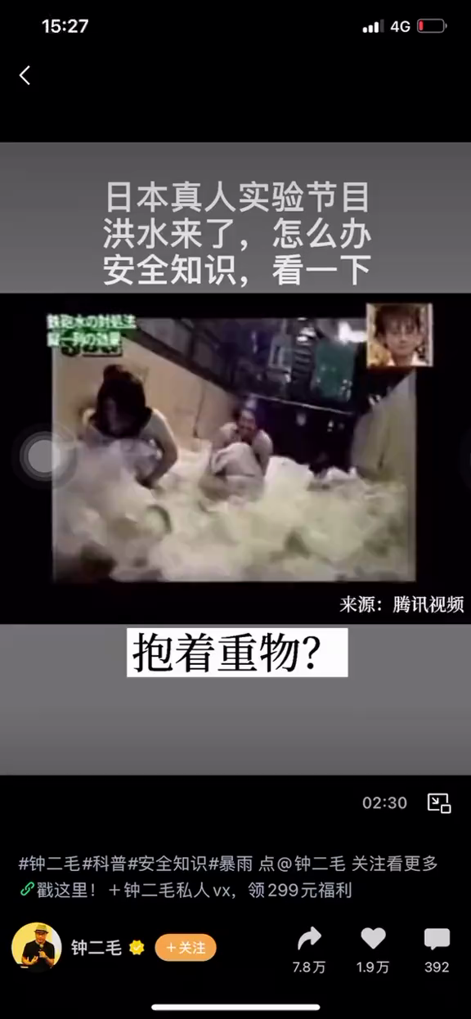
How to save ourselves when we face a sudden flood?
面对突如其来的洪水
如何自救？

Slide 18
How to save ourselves when we face the sudden flood?
面对突如其来的洪水如何自救？
七选五
Like many other natural disasters, floods can occur with little to no warning. Flash floods move quickly and have strong currents.
Of course, drowning is a threat during a flood, not only because there is so much water and it’s moving quickly, 1 . Debris caught in the current can injure anyone in the floodwater.
Additionally, floods can cause power outages, communication disruptions, traffic jams and widespread destruction. 2 . The aftermath can be also just as deadly, as it may not be possible to deliver essential supplies such as water and food to the area.
3 . Never attempt to walk, swim or drive through floodwaters. It only takes six inches of moving water to knock a person off their feet. Additionally, as little as one foot of flood water can sweep cars away.
A guide to survival in the flood.
1. Avoid bridges that cross rapidly-moving water, as floodwaters can cause bridges to collapse.
F
C
A

Slide 19
2. Listen to emergency broadcasts for further instructions. If told to evacuate, do so.
3. Stay inside a car trapped by fast-moving water. Only get out if the water begins to flood the car itself, then move to the roof of the vehicle.
4. If trapped within a flooding building, move to the highest floor. Do not go into the attic (阁楼), as it is possible to become trapped there without a way to escape. 4 .
5. Avoid power lines, as they are often damaged or knocked down during strong storms and flooding. A downed power line can cause surrounding water to become charged, leading to electrocution.
___5___
Do not drink flood water, or use it to wash dishes, brush teeth, or wash/prepare food. Drink clean, safe water. If you evacuated, return to your home only after local authorities have said it is safe to do so. Use only bottled, boiled, or treated water for drinking, cooking, bathing, etc. Avoid driving through flooded areas and standing water. As little as six inches of water can cause you to lose control of your vehicle.
D
G

Slide 20
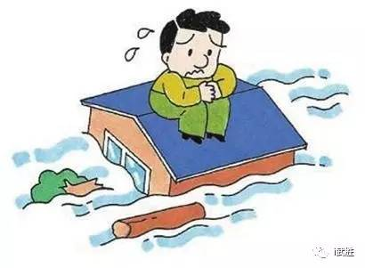
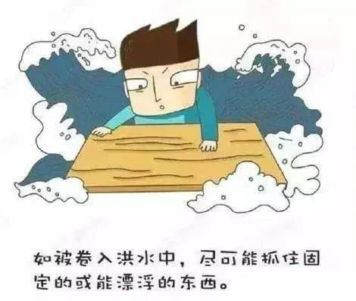
A. If a flood warning has been issued, seek shelter immediately
B. but also the water is salty.
C. And the flood itself isn’t the only issue to contend with
D. Once there, signal for help，such as drawing SOS on the roof
E. Being caught in a flood is incredibly dangerous
F. but also because of what the water is carrying
G. Some dos and don’ts after the flood.

Slide 21
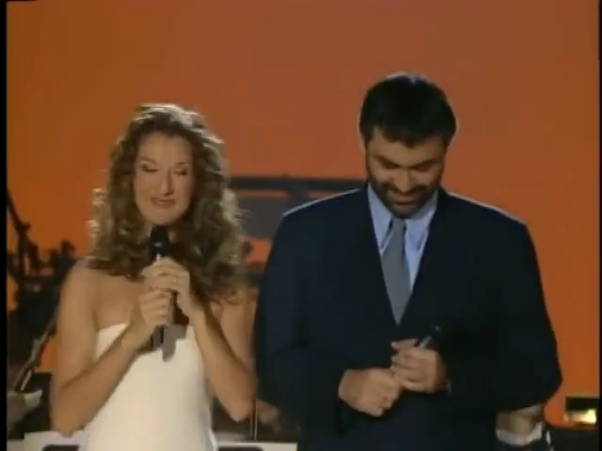
席琳的《祈祷》，天佑郑州！

Slide 22

Winter will eventually pass, and spring is sure to come.
没有一个冬天不可逾越， 没有一个春天不会到来。

