Slide 1


感恩遇见，相互成就，本课件资料仅供您个人参考、教学使用，严禁自行在网络传播，违者依知识产权法追究法律责任。
更多教学资源请关注
公众号：溯恩高中英语
知识产权声明

Slide 2

Unit 1
People
of
Achievement
Songxia Middle School
Zhang Fengbao

Slide 3
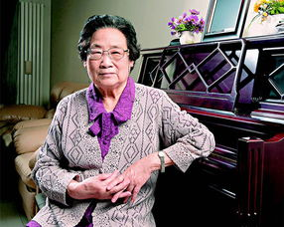
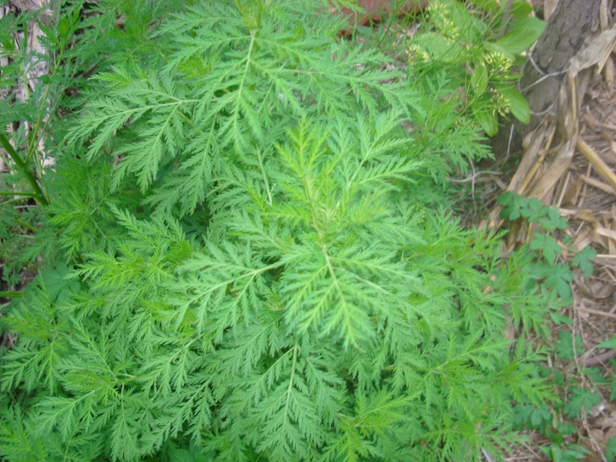
Pre-reading
TU YOUYOU
from: Ningbo,China
Nobel Prize winner
the discovery of artemisinin

Slide 4
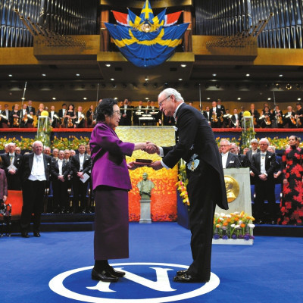
While-reading---Prediction
TU YOUYOU AWARDED NOBEL PRIZE
6 October 2015
From the title and the pictures, we can predict that the passage might include ________________________________
A. A quote from Tu Youyou
B. The details of how artemisinin was discovered
C. Tu Youyou's important contributions other
than the discovery of artemisinin.
D. Tu Youyou's personal life.
E. Tu Youyou's road to discovering artemisinin
F. What Tu Youyou was awarded.
G. Why artemisinin is an important discovery.

Slide 5

Where would you most likely find this passage?
A. In a blog B. In a book C. In a letter D. In a newspaper
news story
The passage may be a ____________.
TU YOUYOU AWARDED NOBEL PRIZE
6 October 2015
title: simple, general
but attractive
Passage like this are most often written in _____ and _______?
A. the active voice/ offer many opinions
B. the first person/ talk about feelings
C. both active and passive voices / mostly contain facts
content: more objective, accurate and convincing

Slide 6
While -reading : main thread of the text
Paragraph1:
Paragraph2-3:
Paragraph4:
The news about Tu Youyou winning the award and the significance of discovering artemisinin.
Tu’ s life experience and the research process of discovering artemisinin.
Tu’s comment on hearing the news.
NEWS
STORY

Slide 7
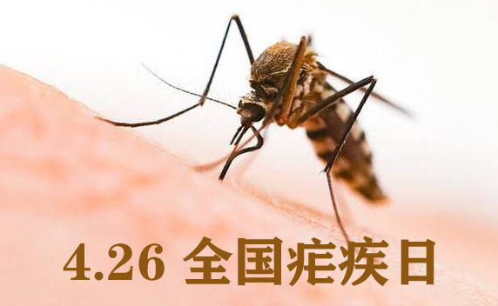
Careful-reading: Part1
when
who
what
Why
This year's Nobel Prize for Physiology or Medicine has been awarded to TU Youyou(Co-winner), whose research led to the discovery of artemisinin, a crucial new treatment for malaria. Artemisinin has saved hundreds of thousands of lives, and has led to improved health for millions of people. Over 200 million people around the world get malaria each year, and about 600,000 die from it. Artemisinin has become a vital part of the treatment for malaria, and is thought to save 100,000 lives a year in Africa alone.
Introduction: main idea of the news
background information: use descriptive words
and numbers to
impress readers
background
information
fact1:
fact3:
effects of artemisinin
fact2:
severe situation because of malaria

Slide 8
Life experience of Tu
Careful-reading: Part2
Read the passages carefully and draw a mind map according to the time
born on 30 Dec. 1930. Ningbo, China.
became a researcher to fight malaria
succeeded in discovering artemisinin
1930
1955
1967
1969
1971
2015
graduated from Peking University
appointed head of the project
awarded the Nobel Prize

Slide 9

The details of how artemisinin was discovered
Careful-reading: Part2
The road to discovering artemisinin
They discovered and tested _______________________________
___________________
Tu’s team examined __________________________, and evaluated ____________________
380 distinct ancient Chinese
medical treatments
over 2,000 old medical texts
280,000 plants for properties
The medicine became ____________ for malaria.
a standard treatment
They found one medical text
suggesting _______________________
___________________________________
using the extract from
sweet wormwood to treat a fever.
malaria patients
They tested the medicine on ________.
They tested ________________________
_____________________________________
dried wormwood leaves
They tested the medicine ____________ to see if safe.
but found no effect
on themselves
They tried _______________________
but_____________________________
They used a ________________________
the sweet wormwood extract
boiling fresh wormwood
lower temperature to draw out
this didn’t work either

Slide 10
Further Exploring 1
1. What was the key to getting a good extract from the wormwood?
2. What do the numbers suggest?
3. What qualities of Tu Youyou are reflected on the road to discovering artemisinin?

Slide 11
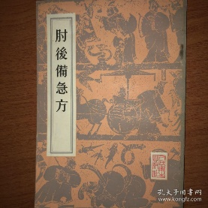
2. What do the numbers suggest?
1. What was the key to getting a good extract from the wormwood?
They discovered and tested _______________________________
___________________
Tu’s team examined __________________________, and evaluated ____________________
380 distinct ancient Chinese
medical treatments
over 2,000 old medical texts
280,000 plants for properties
a
tough
task
The medicine became ____________ for malaria.
a standard treatment
They found one medical text
suggesting _______________________
___________________________________
using the extract from
sweet wormwood to treat a fever.
malaria patients
They tested the medicine on ________.
They tested ________________________
_____________________________________
dried wormwood leaves
They tested the medicine ____________ to see if safe.
but found no effect
on themselves
She found one sentence suggesting a different way to …
A lower temperature is the key to getting a good extract
They tried _______________________
but_____________________________
They used a ________________________
the sweet wormwood extract
boiling fresh wormwood
lower temperature to draw out
this didn’t work either

Slide 12
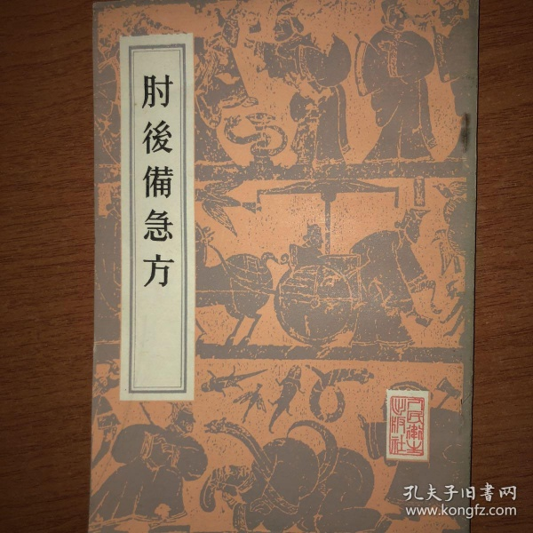
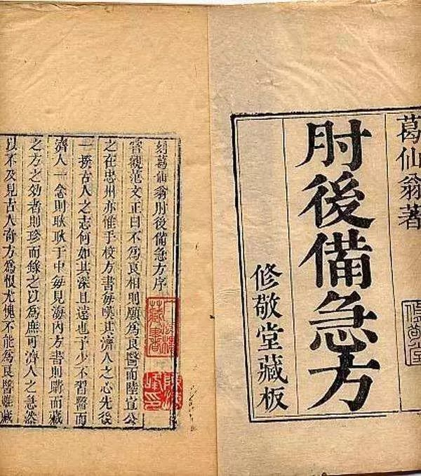
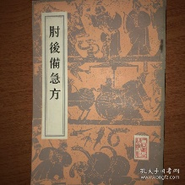
Ge Hong（284-364） the Eastern Jin Dynasty
With a collection of treatments for emergency

Slide 13
3. What qualities of Tu Youyou are reflected on the road to discovering artemisinin?
Descriptive words in the story:
committed
patient
do research
in person
at the frontline
refer to a large
number of
ancient Chinese
medical texts
do experiments;
analyse;
fail more than
190 times
test first
on themselves
then on patients
repeatedly

Slide 14
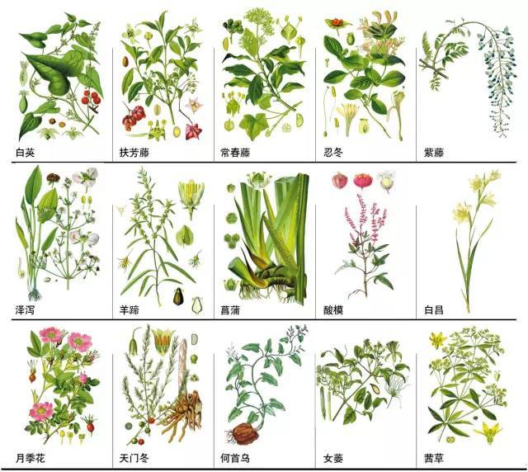
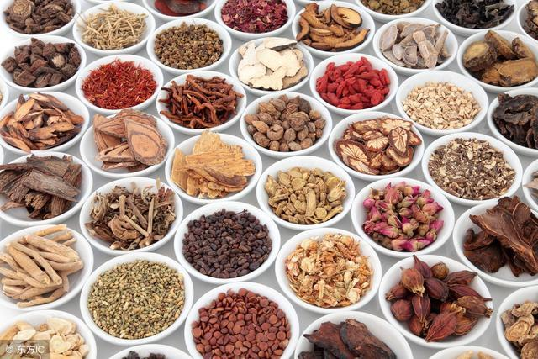
Careful-reading: Part3
Read the last paragraph carefully and find out what Tu Youyou owes her success to. And what quality of Tu does it reflect?
Team effort and the great value of traditional Chinese medicine.
modest
leadership

Slide 15
Further Exploring 2
1. Talk about the factors contributing to the discovering of artemisinin.
talent
effort: committed patient …
01
02
03
04
team effort
great value of traditional
Chinese medicine
Which do you think is the most important for
making a great discovery?

Slide 16

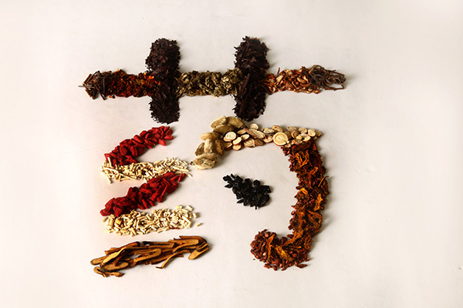
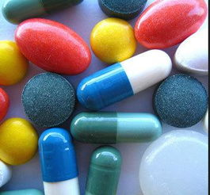
2. Which is more important, Chinese medicine or western medicine?
 | Chinese Medicine | Western Medicine
Theoretical Basis (理论基础)
Source
Time to take effect
Side Effects
dialectical therapy
(辩证治疗)
modern medicine
chemical synthetic
(化学合成物)
natural animals and plants
slow
quick
few
more

Slide 17
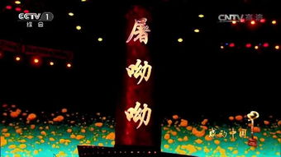
Homework:
On Feb.14th, 2016, the "Touching China" 2015 Award Ceremony went on the air on CCTV-1, and TuYouyou was conferred the honorary title "person of the year".
As one of the crew members,
write an English introduction
about Tuyouyou for the TV
programme as an award speech
to make others have a general
understanding of her.

Slide 18
THANKS

