Slide 1


感恩遇见，相互成就，本课件资料仅供您个人参考、教学使用，严禁自行在网络传播，违者依知识产权法追究法律责任。
更多教学资源请关注
公众号：溯恩高中英语
知识产权声明

Slide 2
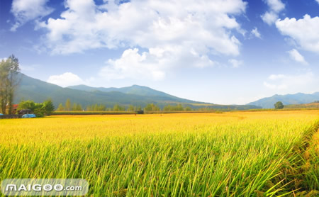
Welcome to my English Class
Songxia Middle School
Zhang Fengbao

Slide 3
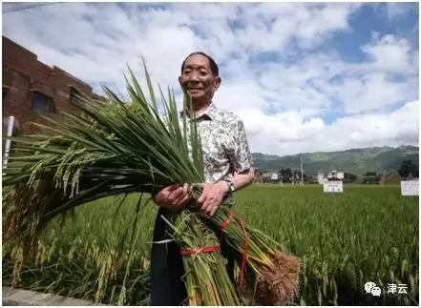
Free talk
1.Who is the man in the photo? What crop is he holding in his hands?
2.What do you know about the man? What else do you want to know about him?
The photo is of Yuan Longping, holding sheaves of his hybrid rice.

Slide 4
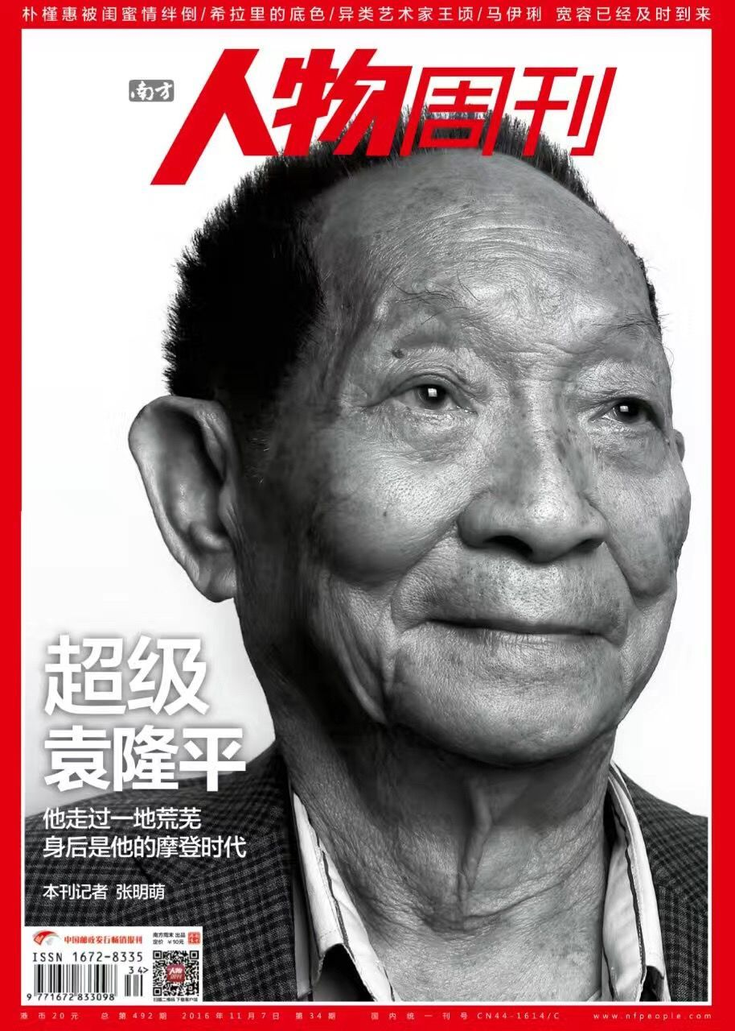
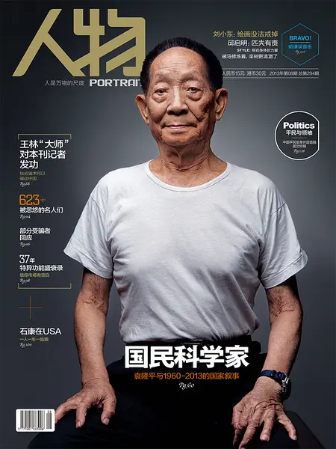
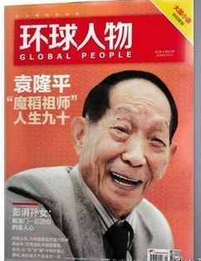
Fast reading
A PIONEER FOR ALL PEOPLE
Task1 Read the title and the first sentence of each paragraph. What kind of writing do you think this is? Where can you find such a piece of writing?
A brief biography
In a journal
(A story of a person's life written by someone else)

Slide 5
Task 2 Read the text. Match the main idea with each paragraph.
Para.1 A. Yuan conducted research and developed hybrid rice.
Para.2 B. Yuan is old but still working hard to fulfil his dreams.
Para.3 C. Yuan considers himself a farmer.
Para.4 D. Yuan decided to study agriculture.
Para.5 E. Yuan’s innovation has helped to feed more people.
Para.6 F. Yuan cares little for fame or wealth.
A tip for reading: pay attention to
the transitional words.

Slide 6
Careful reading
Read the biography carefully and try to fill in the
following table.
paragraphs | What (content) | How (writing technique ） | Why (moral features)
1
2
3
4 |  | / | /
5
6 |  | /

Slide 7
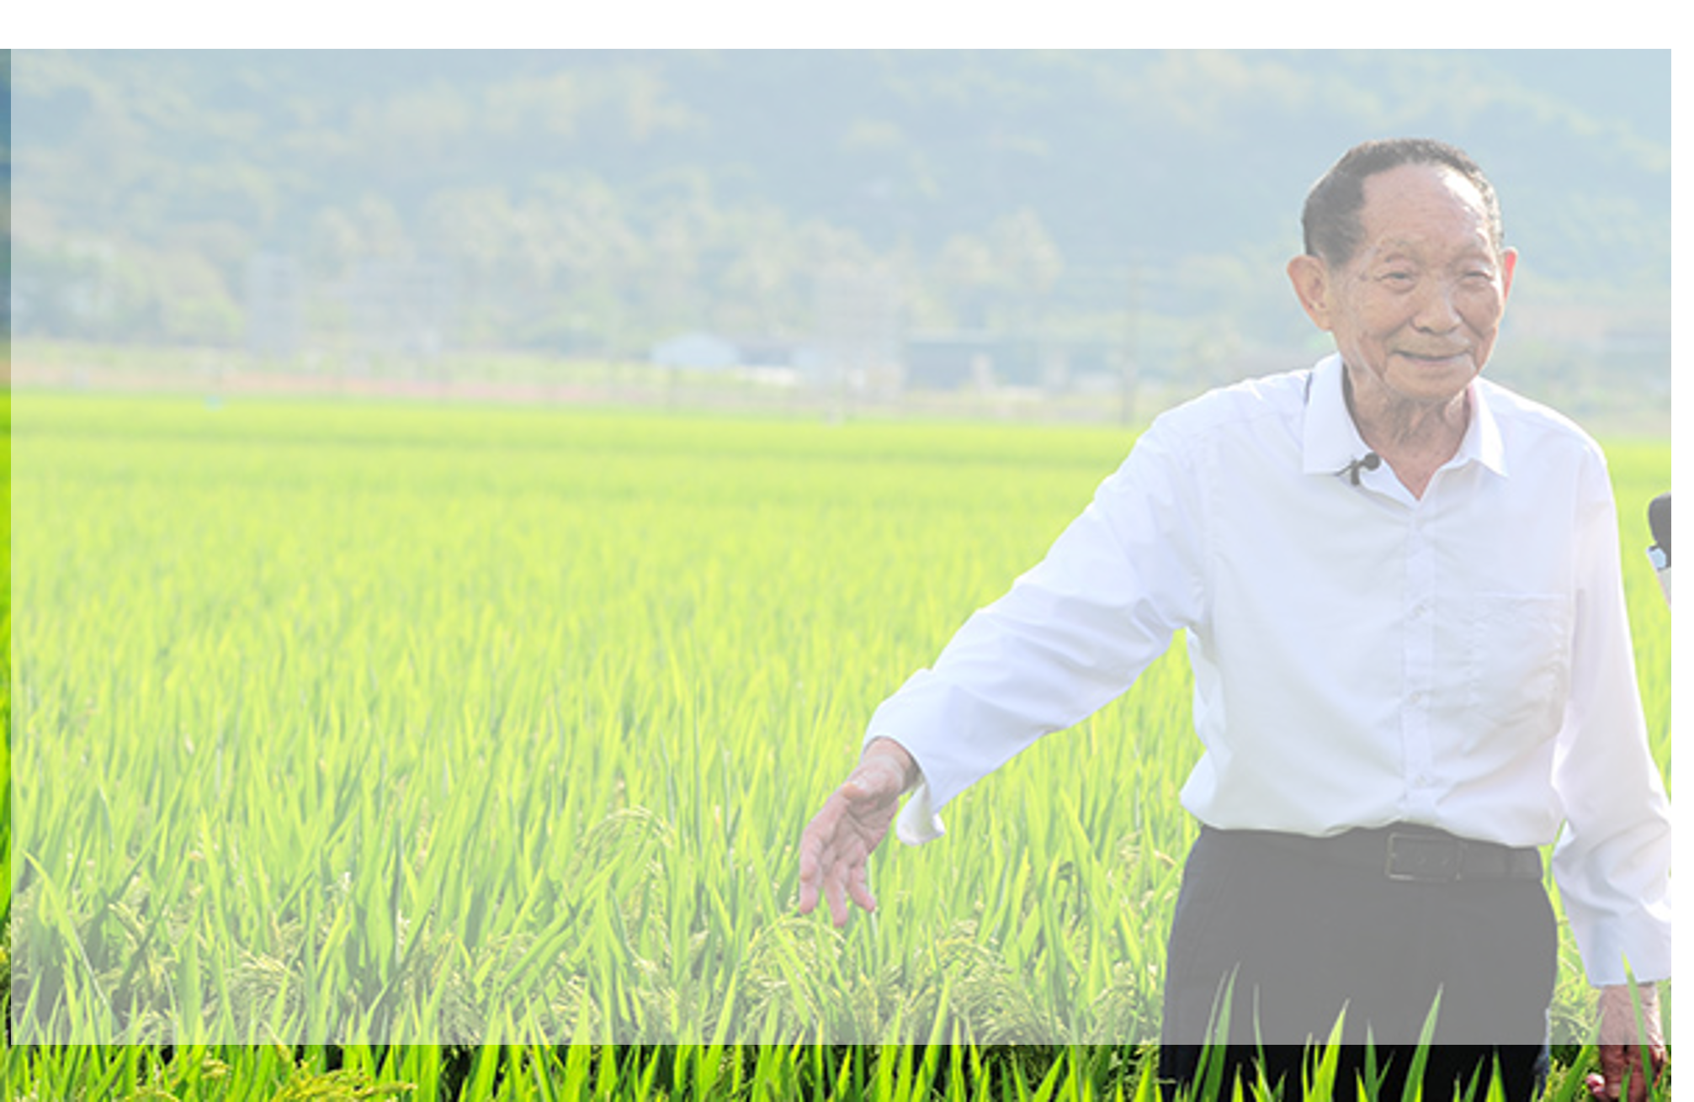

Analysis
a typical way to start a biography
1
Yuan Longping, known as the"father of hybrid rice", is one of China's most famous scientists. Yet, he considers himself a farmer because he continually works the land in his research. Indeed, his slim but strong body is just like that of millions of Chinese farmers, to whom he has devoted his life.
introduction
Yuan considers himself a farmer.
Father of hybrid rice VS farmer
His great
contribution
his research field
and his appearance
modest/devoted
use the writing technique: contrast to highlight Yuan’s moral qualities

Slide 8
A biography is usually written in time order from birth.
2
Yuan Longping was born in 1930 in Beijing. His parents wanted him to pursue a career in science or medicine. However, what concerned him most was that farmers often had poor harvests and sometimes even had a serious shortage of food to eat. To tackle this crisis, he chose to study agriculture and received an education at Southwest Agricultural College in Chongqing.
motivation
Yuan decided to study agriculture.
Yuan wanted to help get rid of the shortage of food.
Contrast: his parents’ wish vs his own decision
caring/sympathetic/determined

Slide 9
After graduating in 1953, he worked as a researcher. Yuan Longping realised that larger fields were not the solution.Instead, farmers needed to boost yields in the fields they had. How this could be done was a challenging question at the time. Yuan was convinced that the answer could be found in the creation of hybrid rice. A hybrid is a cross between two or more varieties of a species. One characteristic of hybrids is that they usually attain a higher yield than conventional crops. However,whether it was possible to develop a hybrid of self-polinating plants such as rice was a matter of great debate. The common assumption then was that it could not be done. Through intense effort, Yuan overcame enormous technical difficulties to develop the first hybrid rice that could be used for farming in 1974. This hybrid enabled farmers to expand their output greatly.
unique thinking of the problem
3
creative solution to the problem
process
devoted to overcoming difficulties
succeed finally
Q1: What is hybrid rice?
Q2: What’s the main advantage of hybrid rice?
Q3:How did Dr. Yuan develop hybrid rice? Is it an easy or tough task?
Hybrid rice is rice produced by crossbreeding different kinds of rice.
It attains a higher yield than conventional rice.
brave creative innovative confident devoted compassionate
an unprecedented task
Contrast: the general assumption about hybrid rice vs his belief

Slide 10
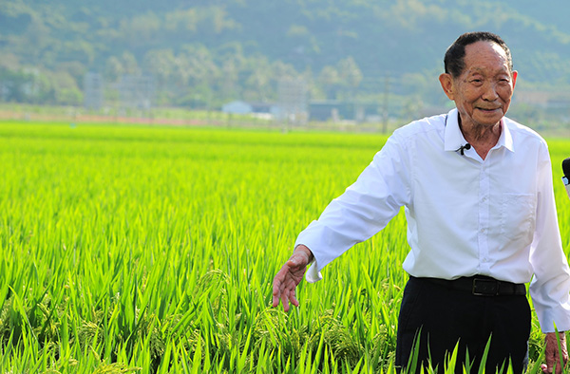
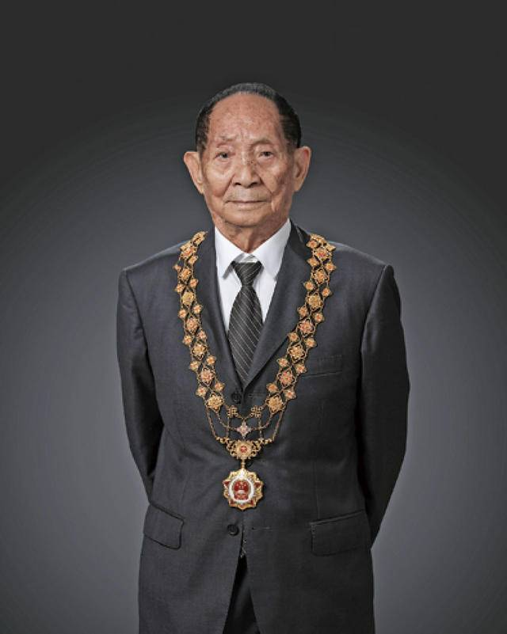
Today, it is estimated that about 60 percent of domestic rice consumption in China is comprised of crops generated from Yuan‘s hybrid strains, and his strains have allowed China’s farmers to produce around 200 million tons of rice per year. Yuan‘s innovation has helped feed not just China, but many other countries that depend on rice as well, such as India and Vietnam. Because of his invaluable contributions, Yuan Longping has received numerous awards both in China and abroad.
4
tackle the crisis of food shortage
achievement
receive numerous awards
Q1: What’s the main idea of the passage?
Q2: How has Yuan’s work helped China and other countries?
The hybrid rice he was devoted to developing enables farmers to
boost yields in the situation when the fields are limited.

Slide 11
Given that Yuan's hybrids have made him quite wealthy, one might think he would retire to a life of leisure. However, this is far from the case. Deep down, Yuan is still very much a farmer at heart. As a man of the soil, he cares little for celebrity or money. Instead, he makes large donations to support agricultural research.
5
view of life
Contrast: retire to a life of leisure vs continue to work the land
Contrast: care for fame and wealth vs donate money to support …
plain simple caring generous

Slide 12
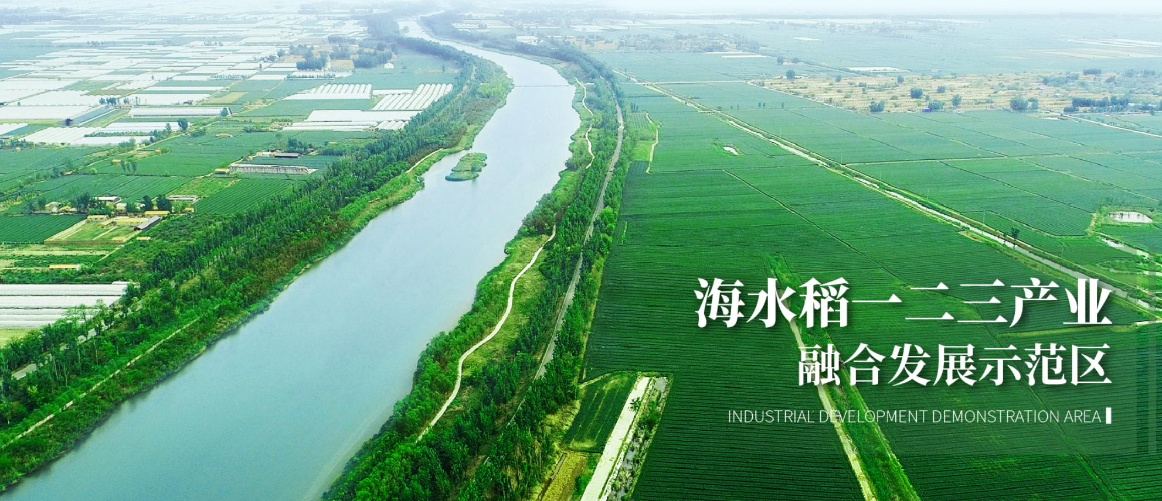
①What impresses people most about Yuan Longping is his ongoing ability to fulfil his dreams.
② Long ago, he envisioned rice plants as tall as sorghum, with each ear of rice as big as a broom,and each grain of rice as huge as a peanut.③ He succeeded in producing a kind of rice that could feed more people at home and abroad. ④His latest vision for “seawater rice” has also become a reality, and potentially opened up nearly one million square kilometres of salty land in China for rice production. ⑤Despite his advanced years, Yuan Longping is still young at heart and full of vision, and everyone is waiting to see what he will dream up next.
6
vision
①
Q1: Draw out the structure chart of the passage.
Q2: Use a sentence to summarize Yuan’s dream.
②
③
④
… make the impossible to possible
… make dream to reality
…make people get rid of hunger and live a wealthy life
⑤
visionary, optimistic and perseverant.
A person with dreams is ___________________________________

Slide 13
Check
paragraphs | What (content) | How (contrast ） | Why (moral features)
1 | introduction | Father of hybrid rice vs farmer | modest/devoted
2 | motivation | his parents’ wish vs his own decision | caring/sympathetic/ determined
3 | process | the general assumption about hybrid rice vs his belief | brave / creative / innovative / confident / devoted/compassionate
4 | achievement | / | /
5 | view of life | retire to a life of leisure vs continue to work the land care for fame and wealth vs donate money | plain / simple / caring / generous
6 | vision | / | visionary / optimistic/ perseverant

Slide 14
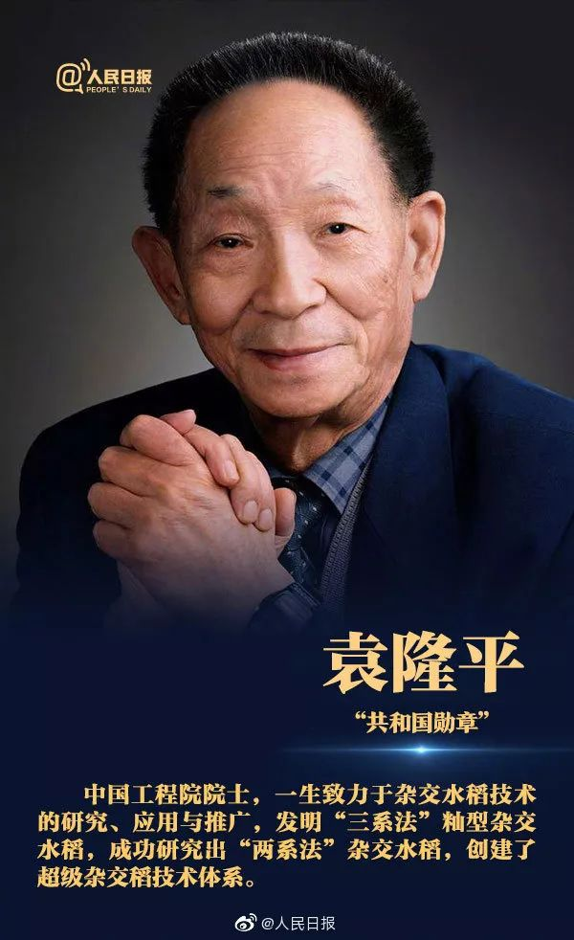
Theme Analysis
How can we understand the title of the passage “A Pioneer for All People”?
A Pioneer For All People
Though old, Yuan is still dreaming and fulfilling his dreams.
Yuan is willing to consider himself as a farmer.
1
2
4
5
6
3
Yuan cares little for celebrity and wealth.
Concerned about the farmers, Yuan decided to study agriculture.
Pioneer
My lifelong pursuit is to keep all the people away from hunger.
---Yuan Longping
Yuan's innovation has helped people get rid of hunger.
Faced with the challenges, Yuan was devoted to his hybrid rice research and succeeded.

Slide 15
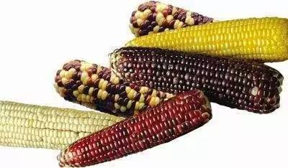
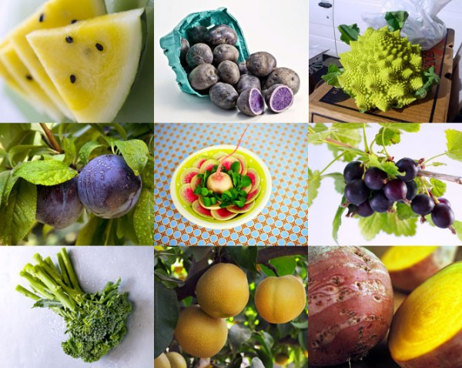
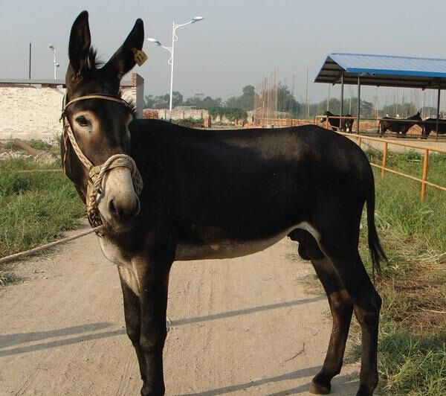
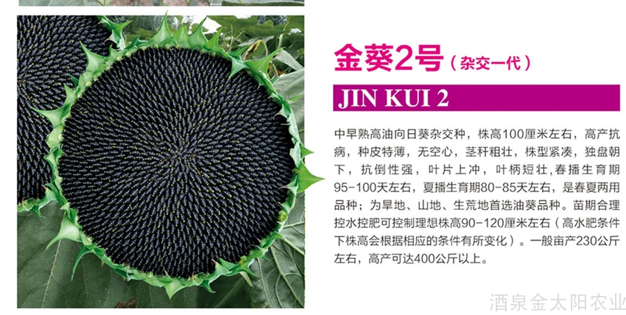
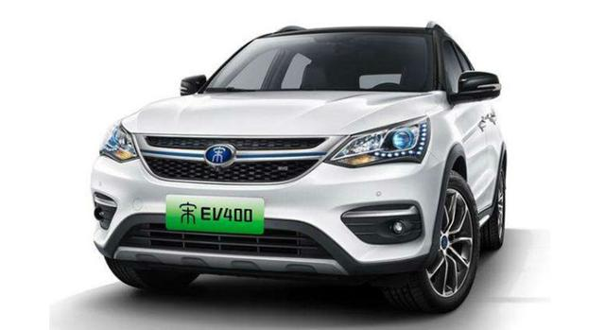
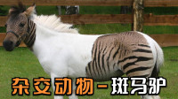
Further Information
Other than hybrid rice, what other hybrid products do you know? Can you think of new hybrid ideas?
The concept of a hybrid is not restricted to plants and animals,
but every aspect you can imagine.

Slide 16


Critical Thinking
Do you want to make great contributions to others like Yuan Longping,Tu Youyou, LinQiaozhi? If so, what preparations are you supposed to make?
Have dreams and strive for them.
Be devoted, and don't let the precious time leak away from you.
Be interested and have a wide range of knowledge.
Have the bravery to question, challenge and take up responsibility.
…
First of all, study hard to be admitted into a top university.

Slide 17
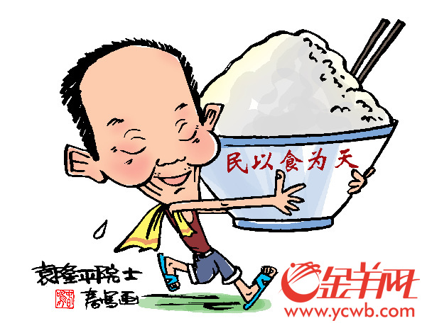
Assignment
Read the text twice and try to write expressions to replace the
following:
shortage, tackle this crisis, boost yields, be convinced, attain,
conventional, intense effort , be comprised of, generated,
a life of leisure, envision, vision.
2. Write a passage titled “Yuan Longping’s Devotion to Hybrid Rice”
within 100 words from these aspects:
motivation, process, achievement, view of life and vision.
If possible, try to use the expressions above.

Slide 18


